Slide 1


GISC CASABLANCA
OPENWIS TRANING MATERIAL
OpenWIS: AcCESSING PRODUCTS
AKNOWLEDGMENT: For the purpose of this training session, we choose to use available OPENWIS training material that is a part from the OPENWIS user manual. Many thanks to Rémy Gibaut from MFI and Leon Mika from the ABOM

Slide 2
Timeline
The OpenWIS Catalogue
  Searching and viewing metadata.
Accessing Products From OpenWIS
  Requesting and subscribing to products in OpenWIS.
Creating Metadata Within OpenWIS
  Creating and uploading metadata in OpenWIS.

Slide 3
Accessing Products From OpenWIS
Overview of Product Delivery
Requesting A Product
  Requesting A Product
  Specifying A Dissemination Method
Creating A Subscription
Managing Request And Subscriptions
  Viewing Previous Requests
  Managing Subscriptions
Managing Favorites
Questions

Slide 4
Overview Of Product Delivery (1/2)
GISC
Along with the metadata of GTS bulletins, OpenWIS provides access to the GTS data itself.
The catalogue search is used to find the type of data you are looking for.
  Search for the metadata item you are interested in.
  Access the products of interest from the search results.
Access to products of the global dataset (24h cache of data).

Slide 5
Overview Of Product Delivery (2/2)
DCPC
OpenWIS provides access to the data stored/ archived in the underlying data centers.
The catalogue search is used to find the type of data you are looking for.
  Search for the metadata item you are interested in.
  Access the products of interest from the search results.
Access to products of the local dataset through dedicated interfaces (called ‘harnesses’).

Slide 6
What Type Of Products Can Be Retrieved (1/2)?
GISC
Products that are part of the WMO Essential or Additional dataset.
  Products from other datasets will be available soon as part of the setup of DCPCs.
Products that are associated to a metadata item within the catalogue; either a proper metadata item, or a Draft metadata item.
Products belonging to metadata items with a data policy of public or additional-default.

Slide 7
What Type Of Products Can Be Retrieved (2/2)?
DCPC
Products that are locally stored.
Products that are associated to a metadata item within the catalogue.
Products belonging to metadata items with a locally defined data policy.

Slide 8
When Can A User Retrieve Products?
When the user has an account and is currently logged in.
When the user has not exceeded the daily delivery quota of 100,000 products or 100 Mbytes in total.
  Product delivery will be disabled for that user when this quota has been exceeded.
  A warning will be sent when 90,000 products or 50 Mbytes in total have been sent to that user.
  If this has happened, please contact us.

Slide 9
Accessing Products
Request
  Access any number of products for a particular metadata item currently available in OpenWIS.
  Immediate retrieval of products.
  One time delivery of products.
  Also called Ad Hock requests.

Slide 10
Accessing Products
Subscription
  Regular delivery of products of a specific metadata item.
  Products can be sent as soon as they become available, OR can be queued to be delivered at a regular time interval.
  Subscriptions are active until they are paused or removed.

Slide 11
Product Delivery Methods
Staging Post
Email
FTP
Product can be access through the browser.
Product is sent as an attachment in an email.
Product is transferred to a remote host via FTP.
Potentially more to come…
HTTP, WebDAV, SFTP, direct socket connection…

Slide 12



Product Delivery Methods
Staging Post
download
OpenWIS
email
ftp
Dissemination
Harness

Slide 13
Product Delivery Failure
Each delivery mechanism has a different level of assurance in whether or not your product has been delivered without error.
  Products sent via the Staging Post or Email have no assurance of successful delivery from OpenWIS.
  Products sent via FTP have full assurance of successful delivery.
When the application has detected that a product was not received successfully, it will perform a product redelivery operation (shown in next slide).

Slide 14
Product Delivery Failure
Staging Post
OpenWIS
ftp
Dissemination
Harness

Slide 15
Product Delivery Failure
Staging Post
download
OpenWIS
notification
of error
Dissemination
Harness

Slide 16
Product Delivery Failure
Staging Post
download
OpenWIS
Resend failed
messages
ftp
One Minute Later…
Dissemination
Harness

Slide 17
Delivery Method Summary
 | Staging Post | Email | FTP
Setup | Easy | Moderate | Moderate
Product sent via | Download using web browser | Attachment in email | File transfer
Consumable by | Humans | Humans | Automated systems
Suitable for | Small products consumed occasionally | Moderately sized products consumed regularly | Large products consumed frequently
Successful product delivery assurance | None | None | Ensures each file has been transmitted
Product delivery validation assurance | None | None | Ensures file sizes of source and transferred files are equal
Retry on failure | No | No | Up to 3 times

Slide 18
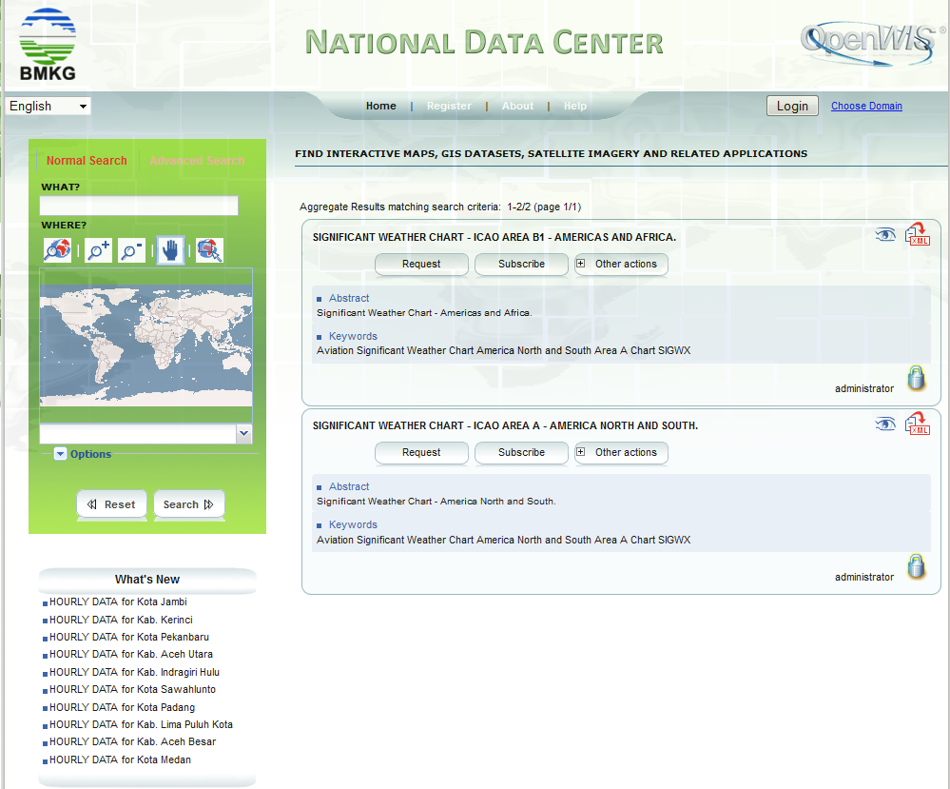
Requesting A Product
Request Product

Slide 19
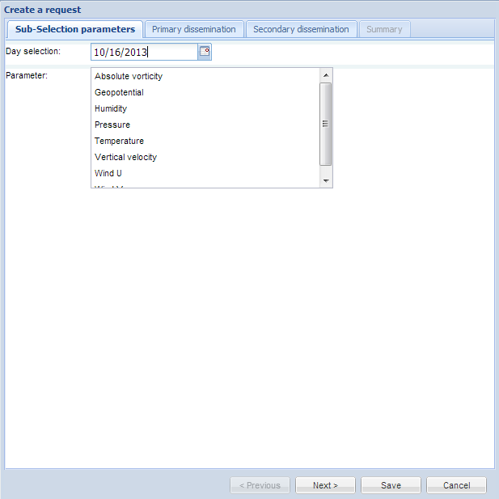
Requesting A Product
Refine your search
Go to next screen

Slide 20
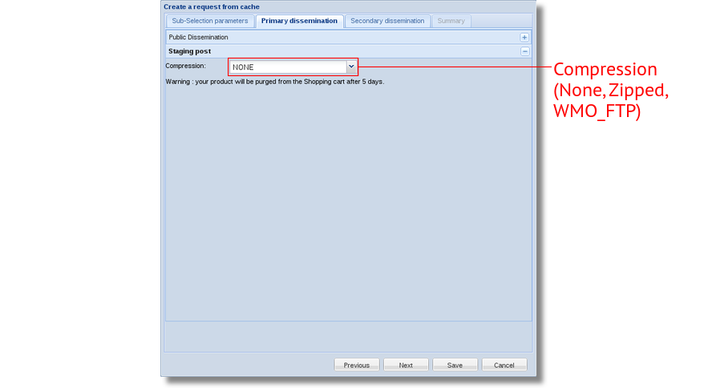
Configuring Product Delivery

Slide 21
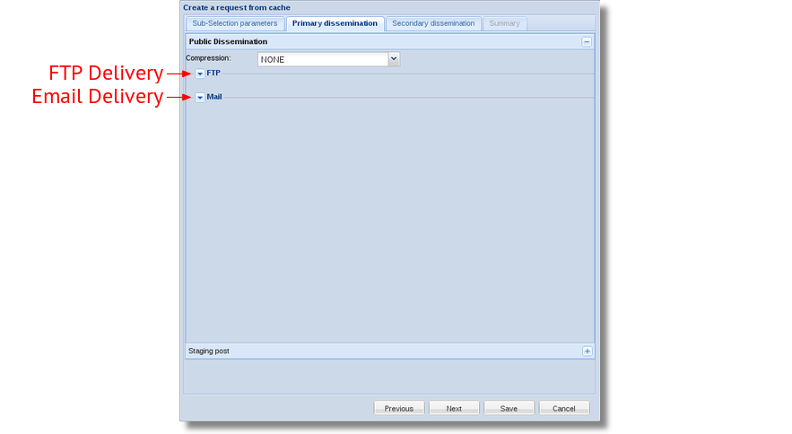
Configuring Product Delivery

Slide 22
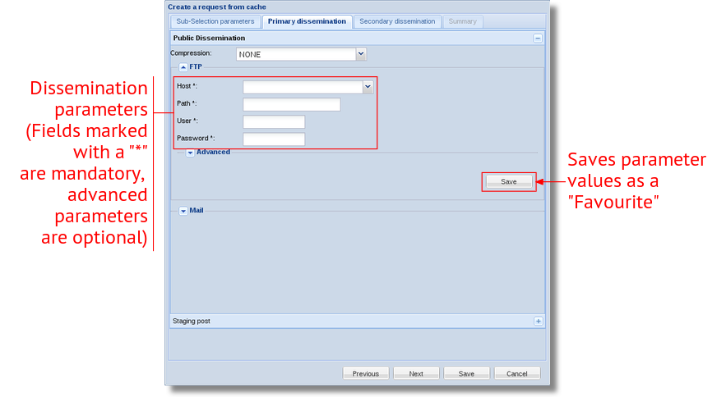
Configuring Product Delivery

Slide 23
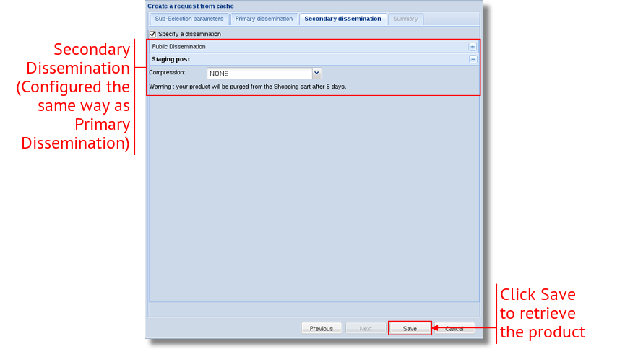
Configuring Product Delivery

Slide 24
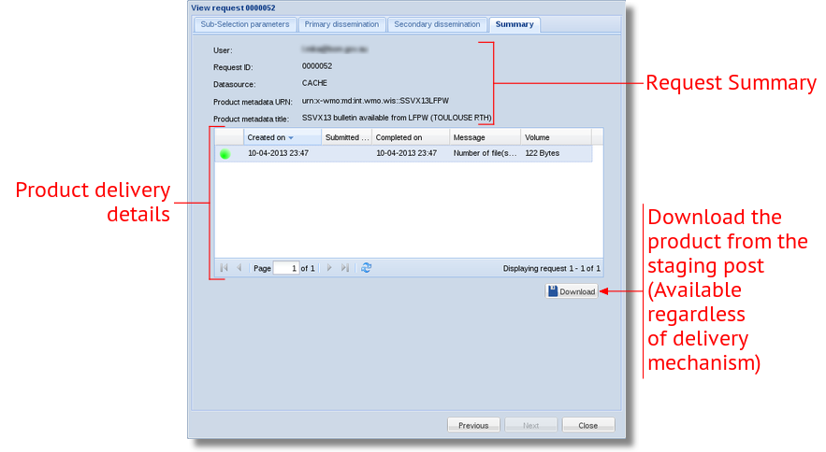
Dissemination Summary

Slide 25
Live Demo
Requesting A Product

Slide 26
FTP Options
Field | Description | Default Value
Host | The host to transfer the files to. | (required)
Path | The target directory on the host. | (required)
User | The FTP username | (required)
Password | The FTP password | (required)
Port | The FTP port | 22
Passive | Enable FTP passive mode | Off (recommended if clients are behind firewalls)
Check File Size | Check file size after transfer. | Off
Encrypted | Encryption through SSL | Off
File Name  | Target file name of the (first) file. | (use product filename)

Slide 27
Email Options
Field | Description | Default Value
Email Address | The address to send the email to | (required)
Header Line | Sets an email header (must be in the form "Name: Value") | (none)
Email TO/CC… | Which address to use | To
Subject  | The email subject | (none)
Attachment Mode | The attachment disposition of the products | As Attachment
File Name  | The filename of each of the attachments. | (use product filename)
Notes:
Subject lines will have "[SEC=UNCLASSIFIED]" appended to it.
"Inline" attachment mode is actually a MIME attachment with the content disposition set to "inline". Single text products will appear within the emails body.

Slide 28

Field Date Expansion
Some dissemination fields support date expansion.
  Fields in the previous two slides marked with a  symbol.
  Any text surrounded by "#" will be interpreted as a date pattern.
    Example: Date is #yyyy-MM-dd#
When the product is delivered, the date pattern will be replaced with the date.
  Example: Date is 2013-04-14
  More information: Date Expansion Supplement

Slide 29
Exercise 1
Request a product from the catalogue via the Staging Post. Some metadata items you can try:
  Buoy reports available from LFVW (SSVX13LFVW)
  Synop reports available from YRBK (SMRO01YRBK)
  Synop reports available from LTAA (SNRH81LDZM)
  Temp reports available from LTAA (SNRO41YRBK)
Request a collection of products as a zip file from a metadata item via Email.
(If possible) Request a collection of metadata products via FTP.

Slide 30
Creating A Subscription
Period Selection: Which products are of interest.
  Specifies the time of day products associated with that metadata item should be collected for dissemination.
  Can choose individual hours or a continuous time range.
Schedule: When should the products be delivered.
  Specifies when OpenWIS should deliver products once they have been collected.
    Deliver products as soon as they are ingested.
    Collect products in the staging post and deliver them in batches.
Dissemination Parameters identical to Requests

Slide 31
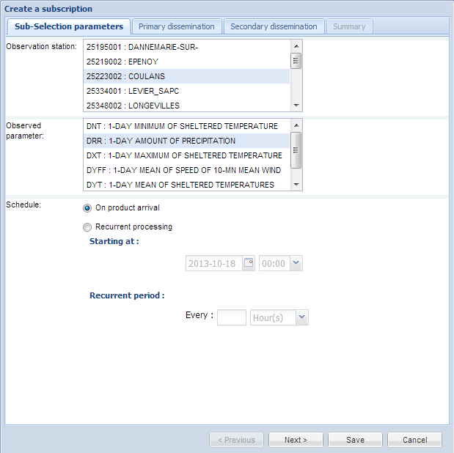
Subscriptions
Refine your subscription

Slide 32
Subscriptions
Send the product as soon as it is available
Collect the products and send them as routine batches

Slide 33
Live Demo
Subscribing To A Product

Slide 34
Exercise 2
Create the following subscriptions for products from a metadata item. Use any delivery mechanism you like. Some metadata items you can try:
  Buoy reports available from LFVW (SSVX13LFVW)
  Synop reports available from YRBK (SMRO01YRBK)
  Synop reports available from LTAA (SNRH81LDZM)
    Temp reports available from LTAA (SNRO41YRBK)
    Select products in the morning GMT (from 00:00 to 12:00) and have them delivered when they are ingested.
    Select products in the afternoon GMT (from 12:00 to 24:00) and have them delivered every hour from today.
    Select products 09:30 GMT to 16:30 GMT and have them delivered daily at 02:00 GMT.

Slide 35
Viewing Previous Requests
Can be found at:
  My Account → Track my requests → Requests
Shows a history of the most recent requests made.
  This will include deliveries made as part of subscriptions.
From here, it is possible to:
  View the summary of the request.
  View the metadata item associated with the request.
  Download the requested product from the staging post.

Slide 36
Managing Subscriptions
Can be found at:
  My Account → Track my requests → Subscriptions
Shows the list of current subscriptions.
From here it is possible to:
  Suspend (or resume) subscriptions.
  Modify the subscription parameters.
  View the metadata item the subscription was made against.
  Remove (unsubscribe from) the subscription.

Slide 37
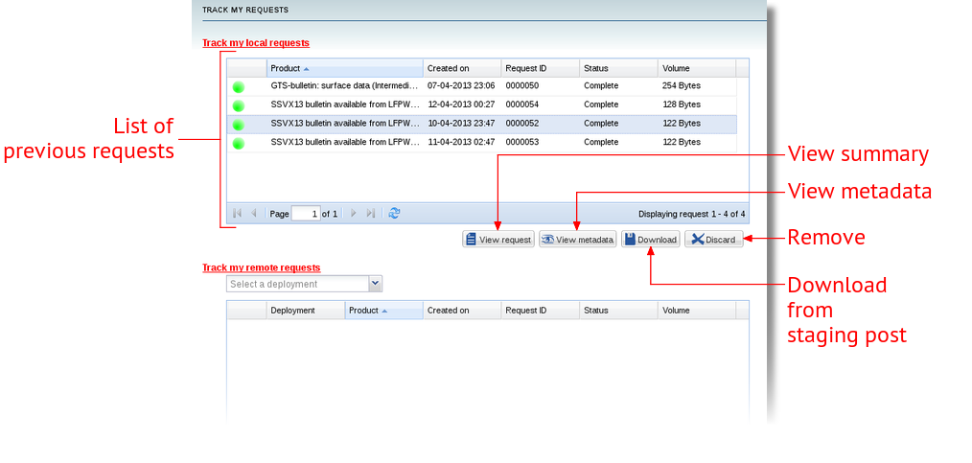
Viewing Previous Requests

Slide 38
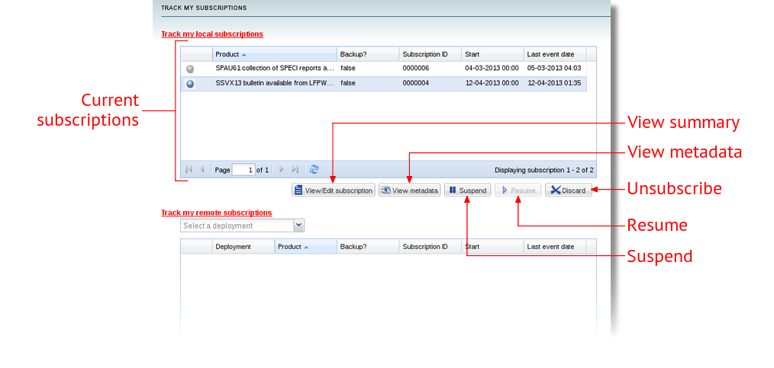
Managing Subscriptions

Slide 39
Managing Favorites
Can be found at:
  My Account → Personal Information →
  User information → Favorites
Allows for adding, modifying and removing commonly used dissemination parameters.
Favorites can be created for either a collection of FTP or Email dissemination values.
Favorites can be added here, or while filling in the dissemination parameters for a delivery (by clicking the top "Save" button).

Slide 40
Recalling Favorites
Favorites can be recalled while filling in the dissemination options for a request or subscription.
A favorite is recalled by either:
  Selecting the email address for Email dissemination options.
  Selecting the hostname for FTP dissemination options.
When recalled, a favorite will automatically fill out the remaining dissemination options using the saved set of values (including advanced options).

Slide 41
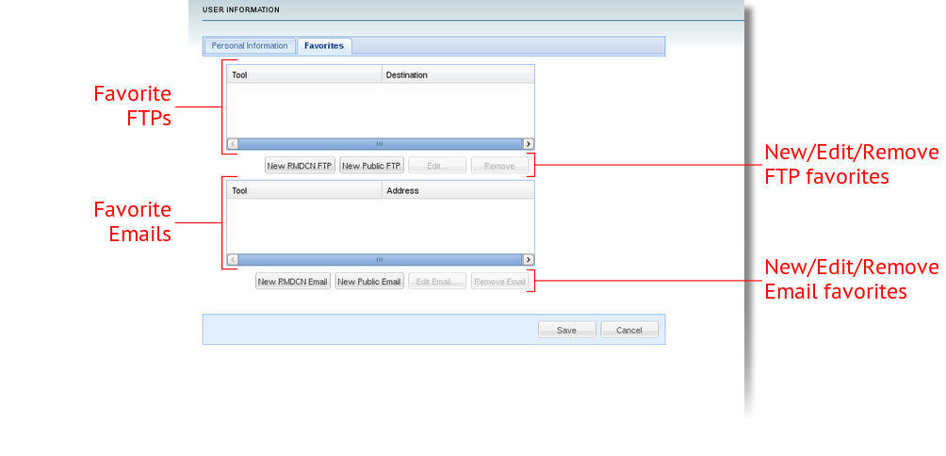
Managing Favorites

Slide 42
Live Demo
Viewing Previous Requests
Managing Subscriptions
Managing Favorites

Slide 43
Exercise 3
Review the status of the request made in Exercise 1. Download the requested product from the staging post.
Check the status of the subscription made in Exercise 2. Attempt to suspend and resume the subscription and also try to change the dissemination options.
Create a new Email favorite while requesting a product (i.e. from within the dissemination options window).
Create a new FTP favorite from the Favorites page.

Slide 44
Summary
Products from metadata items can either be requested on demand, or by subscribing to receive them periodically.
Products can be delivered via the Staging Post, or by being disseminated via Email or FTP.
The status of recent requests and subscription deliveries can be checked in the My Account → Track My Requests section.
Favorites can be created while setting dissemination options for a delivery and can be managed with the My Account section.

Slide 45
Accessing products from OpenWIS

Slide 46
Questions?

