Slide 1


GISC CASABLANCA
OPENWIS TRANING MATERIAL
The OpenWIS Catalogue
AKNOWLEDGMENT: For the purpose of this training session, we choose to use available OPENWIS training material that is a part from the OPENWIS user manual. Many thanks to Rémy Gibaut from MFI and Leon Mika from the ABOM

Slide 2
GISC CASABLANCA
OPENWIS TRANING MATERIAL
The OpenWIS Catalogue
  Searching and viewing metadata.
Accessing Products From OpenWIS
  Requesting and subscribing to products in OpenWIS.
Creating Metadata Within OpenWIS
  Creating and uploading metadata in OpenWIS.

Slide 3
The OpenWIS Catalogue
Accessing OpenWIS
  Creating Accounts and Logging In
Searching The Catalogue
  Normal Search
  Advanced Search
Viewing Metadata
My Account
  Updating Personal Information
  Changing Your Password

Slide 4
What Is OpenWIS?
Implementation of the WIS specification as defined by the WMO.
Web-portal developed by AKKA on behalf of the OpenWIS Association (UKMO, MF, BoM, KMA and MFI).
Adopted from GeoNetwork and using technologies such as Java, Apache Solr, HTML + JavaScript + CSS.
But for the user…

Slide 5
What Is OpenWIS?
A product metadata catalogue
  Complete repository of metadata for products of the global dataset (which will grow to include other datasets like the national products).
A product delivery and subscription gateway
  Provides access to the products themselves either on demand, or through a subscription.
Metadata authoring and management workspace
  Provides the tools to create, upload and manage metadata items.

Slide 6
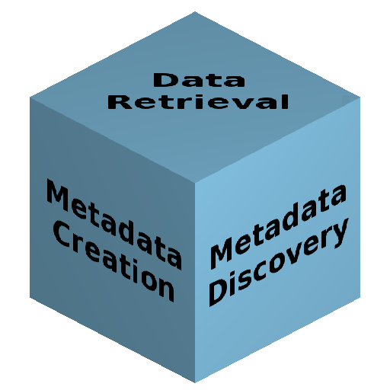
The Three Façades Of OpenWIS
Retrieving and subscribing to products.
Embedded metadata authoring tools & management screens.
Metadata search and viewing.

Slide 7
Accessing OpenWIS
Public website:
  http://gisc.marocmeteo.ma
All major desktop browsers supported.
  Standard compliant HTML + JavaScript + CSS.
  No HTTPS.

Slide 8
OpenWIS Access Control
Anonymous access to the catalogue search.
Accounts are required to access products or to create/upload metadata.
Accounts are created upon request.
  Done so by filling out the Account Request form.
  Email will be sent with username and password.
Lost accounts can be recovered by filling out the Account Recovery form.

Slide 9
Live Demo
Requesting An Account
Recovering An Account
Logging In

Slide 10
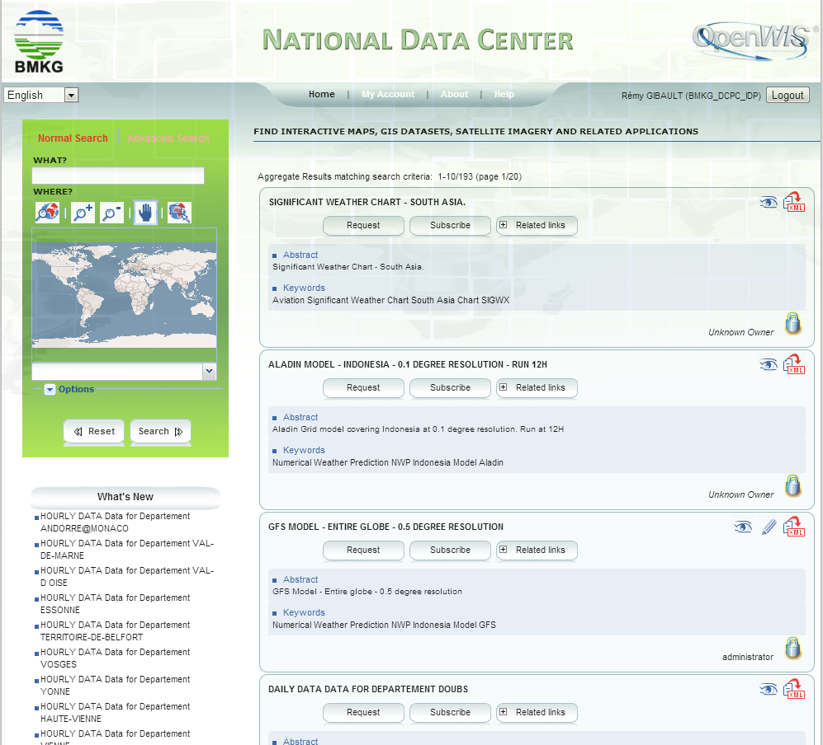
OpenWIS Home Page
Sections
Username
Logout button

Slide 11
Sections
Home:
  Access to the metadata catalogue search facilities. Also access point for retrieving and subscribing to products.
My Account:
  Management tools for past product requests, subscriptions and authored metadata. Also management of user details.
About:
  Page describing a bit of history of OpenWIS and the WIS project. Also, displays the current OpenWIS version.
Help:
  Reference guide for common operations in the OpenWIS portal.

Slide 12
The Home Screen
The Catalogue Search
  Search criteria and list of matching metadata items.
The What's New List
  Displays the latest metadata items that have been added to the catalogue.
The Last Products List
  Displays the most recently delivered product made for the logged in user (more on product delivery in the next presentation).

Slide 13
OpenWIS Search Page
Search criteria
Search results

Slide 14
Searching The Catalogue
Primary method of accessing metadata in the catalogue.
Two search modes:
  Normal Search: Provides a simple text based and geographic based search for metadata items.
  Advanced Search: Provides the complete set of search criteria that can be performed on the metadata.
A metadata item must satisfy all non-empty search fields to be included in the list of results.

Slide 15
Text Based Search (What?)
Performs a text search over all the elements of a metadata item: title, abstract, URN, publisher name, addresses, etc.
Search is conducted by splitting the field value into terms.
  Words separated by whitespace
    Example: "Weather Forecast" is split up into the terms "Weather" and "Forecast".
  Regardless of where the term is found, a metadata item containing every term entered will be returned.
Terms can be in any order.
No support for phrases.

Slide 16
Geographic Based Search (Where?)
Allows searching for metadata by selecting a geographic region of interest (the search extent).
  All metadata items with a geographic extent overlapping the search extent will be returned.
The search extent is shown on the map as a yellow rectangle.
  Can either be drawn manually, or
  Selected from a predetermine set of regions.

Slide 17
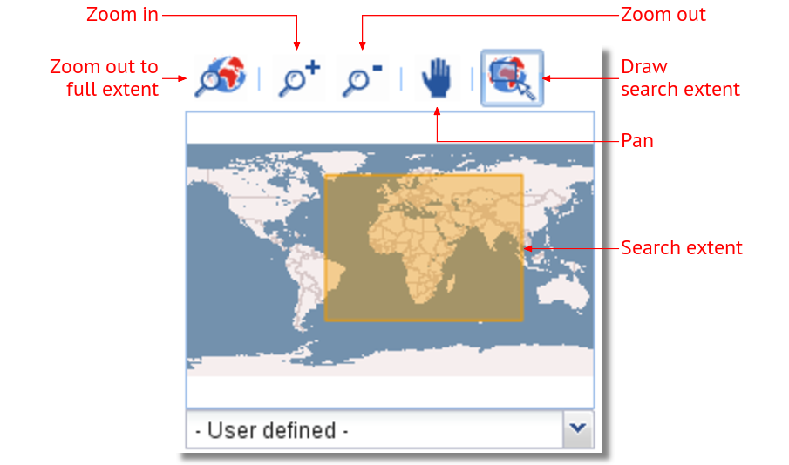
Geographic Based Search (Where?)

Slide 18
Search Options
Used to adjust how the search results will be displayed.
Sort By: Adjusts the ordering of the results:
  Change date: Sort by modification date.
  Popularity: Sort by how often the metadata has been search or modified.
  Relevance: Sort by how close the metadata aligns with the search query.
  Title: Sorts alphabetically by the title.
Hits Per Page: Number of results returned per page.

Slide 19
Live Demo
Searching For Metadata using Normal Search

Slide 20
Exercise 1
Log into the OpenWIS portal: http://gisc.marocmeteo.ma
Try performing these searches using the Normal Search:
    Metadata items for “PILOT".
    Metadata items for “SYNOP" from Morocco.
    Metadata items for “TEMP”

Slide 21
Common Terms
Searches containing common words may produce no results.
This is because common words (or stop words) are not included in the search index.
The list of stop words in the OpenWIS index:
a | an | and | are | as | at | be
but | by | for | if | in | into | is
it | no | not | of | on | or | such
that | the | their | then | there | these | they
this | to | was | will | with

Slide 22
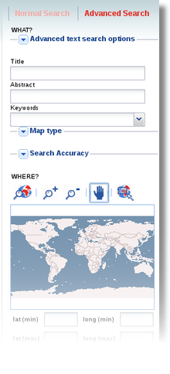
Advanced Search
Provides complete set of searchable fields.
Fields can be loosely broken up into 4 main areas:
  Content text-based search fields
  Geographic search fields
  Temporal search fields
  Miscellaneous search fields
A metadata item must satisfy all non-empty search fields to appear in the results.

Slide 23
Content Text Search Fields
Advanced Text Search Options: Text based search fields which operate over the entire metadata item.
  Either of the words: Search for metadata items which contain any of the terms entered.
  Exact phrase: Search for metadata items which contain the exact value of the field as entered.
  What: Search for metadata items which contain all the terms entered (identical to the What field in Normal Search).
  Without the words: Search for metadata items which do not contain the terms entered.

Slide 24
Content Text Search Fields
Title: Searches for metadata items containing all the entered terms in the title.
Abstract: Searches for metadata items containing all the entered terms in the abstract.
Keywords: Searches for specific keywords in the metadata item.
  Searches for metadata items which contain any of the keywords entered.
  Enter keywords manually, separating them with the "|" character; or select keywords using a dialog.

Slide 25
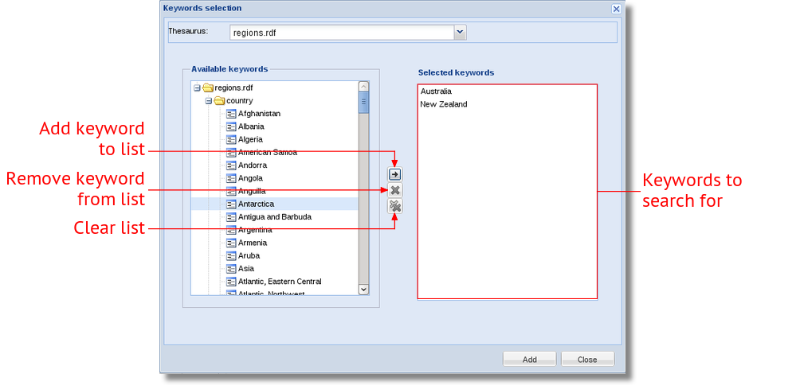
Keyword Selection Dialog

Slide 26
Advanced Geographic Search Options
Search
Extent (S)
Allows for advance geometric tests between the search extent and the geographic extent.
  The search extent and geographic extent are treated as rectangles.
  A relationship between the geographic extent and search extent is selected.
  If a metadata item with a geographic extent has the selected relationship with the search extent, the metadata item will be returned.
Geographic Extent (G)
Overlaps
✗ Encloses

Slide 27
Geographic Search Relationships
Intersects:
  Both the geographic extent and the search extent have at least one point in common.
  This includes points on the boundary of the geographic extent.
✓
✓
✓
S
G

Slide 28
Geographic Search Relationships
Overlaps:
  Both the geographic extent and search extent have some points in common, but not all points in common.
  The search extent must be crossing the boundary of the geographic extent.
✓
✗
✗
S
G

Slide 29
Geographic Search Relationships
Encloses:
  The geographic extent completely encloses the search extent.
✓
✓
✗
S
G

Slide 30
Geographic Search Relationships
Is Fully Outside Of:
  The geographic extent and search extent and have no points in common.
  The opposite of intersect.
S
G
✓
✗
✗

Slide 31
Geographic Search Relationships
Touches:
  The boundary of the geographic extent touches, but does not cross, the boundary of the search extent.
  This includes search extents touching a corner of the geographic extent.
✓
✓
✗
S
G

Slide 32
Geographic Search Relationships
Within:
  The geographic extent is completely contained within the search extent.
✓
✓
✗
S
G

Slide 33
Geographic Search Relationships
Equals:
  The geographic extent is equal to the search extent.
Crosses:
  Not relevant in the WIS context (inherited from GeoNetwork)
✓
✗
✗
S
G

Slide 34
Metadata Change Date
Performs a time based search using the date the metadata item was last changed.
Both the From and To dates are required.
  If the date the metadata item was last changed falls within the From and To dates, it will be returned.
Change Date
t
X
✓
t
X
✗
From
To
From
To

Slide 35
Temporal Extent Date
Performs a time based search using the temporal extent of the dataset described by the metadata item.
  Represented as a time period with a start and end date.
Both the From and To dates are required:
  If the temporal extent of the metadata overlaps the period between the From and To date, it will be returned.
Temporal Extent
t
✓
t
✓
From
To
From
To

Slide 36
Other Advanced Search Fields
Geographic Search Extent Coordinates: The minimum and maximum latitude and longitude boundaries of the search extent can be entered into text boxes.
Map Type: Select metadata items based on the type of associated media.
Restrict To Category: Select metadata based on the internal category.
Restrict To Kind: Select either published metadata items, or templates used as a basis of new metadata items.

Slide 37
Other Advanced Search Options
Search Accuracy: Adjust the accuracy of a search. A less accurate search allows for more error in the matching of terms (e.g. miss-spelt terms).
Inspire: Search options for Inspire metadata items.

Slide 38
Exercise 2
Try performing these searches using the Advanced Search:
    Metadata items for either "Surface", "Ship" or "Buoy" observations with the word "Bulletin" in the title and overlapping Indonesia.
    Metadata items containing the phrase “SIGNIFICANT WEATHER CHART " with the word "america" in the abstract
    Any metadata items that have been updated in the past month sorted by the change date.

Slide 39
Metadata Results
The title, keywords and an extract of the abstract of each metadata item matching the search criteria will be returned.
The metadata can be viewed in the Metadata Viewer. The XML source of the metadata item can also be retrieved from the results window.
Each metadata item may also support the following actions:
  Dissemination: Will be discussed in the next presentation.
  More Actions: Permits access to sites and resources relevant to this metadata.

Slide 40
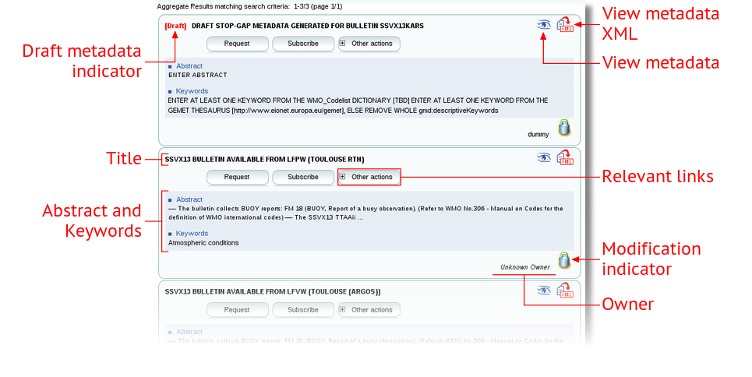
Metadata Results

Slide 41

Draft Metadata Items
(GISC only)
If a product without a metadata item has been ingested into OpenWIS, a draft metadata item will be created and inserted into the catalogue.
  Acts as a placeholder for missing or incomplete metadata.
  Uses information from the product header.
  Uses generic information for remaining metadata elements.
Draft metadata items will be replaced with correct metadata as soon as it has been inserted into the catalogue.

Slide 42
Viewing Metadata
The metadata can be viewed by clicking on the Viewer icon ( ).
  Opens a dialog containing a subset of the metadata elements displayed in a human readable format.
  The set of visible metadata elements can be changed by selecting a different group from the dropdown menu.
The raw metadata XML can be viewed or downloaded by clicking on the XML icon ( ).

Slide 43
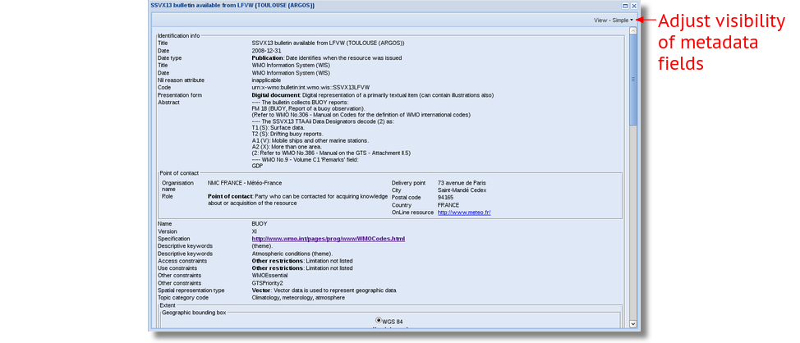
Metadata Viewer

Slide 44
Exercise 3
Perform a search and perform the following steps for a metadata item:
    Open the metadata viewer for a metadata item in the results. Adjust the viewer to show the following:
        The ISO Minimum set
        The Identification information
        The Distribution information
    Browse some of the “Related links“ supplied by that metadata item.
    Download the XML of that metadata item.
Repeat step 1 for a "Draft" metadata item. Note the value of elements within the viewer and the "Other Actions" list.

Slide 45
My Account
The My Account section is used for managing your personal information.
  Updating personal information (Name, Address, Email).
  Updating password.
It is also the gateway to data associated with your account.
  The latest dissemination status.
  The metadata items which are owned by you.
  These sections will be covered in detail in the next two presentations.

Slide 46
Managing Your Account
To change your personal information:
  Go to the User Information section.
  Make any amendments and click Save.
To change your password:
  Go to the Change my password section.
  Enter your new password and click Save.
Changes to your personal information and your password will be performed immediately.

Slide 47
Exercise 4
Go into My Account and change your password to something a bit more memorable. Some hints on a good password:
    Choose a password with a length of at least 8 characters.
    Use a mixture of letters, numbers and symbols.
    Avoid using common words.
    Avoid passwords you use for other services.
Review and (optionally) update your personal information in the User Information section.

