Slide 1


GISC CASABLANCA
OPENWIS TRANING MATERIAL
OpenWIS: METADATA MANAGEMENT
AKNOWLEDGMENT: For the purpose of this training session, we choose to use available OPENWIS training material that is a part from the OPENWIS user manual. Many thanks to Rémy Gibaut from MFI and Leon Mika from the ABOM

Slide 2
Timeline
The OpenWIS Catalogue
  Searching and viewing metadata.
Accessing Products From OpenWIS
  Requesting and subscribing to products in OpenWIS.
Creating Metadata Within OpenWIS
  Creating and uploading metadata in OpenWIS.

Slide 3
Creating Metadata Within OpenWIS
The Basics Of Authoring Metadata
  Accessing The Authoring Services
  The Metadata URN and Category
Creating and Inserting Metadata
  Using The Built-in Editor
  Uploading Metadata
Managing Metadata
Questions

Slide 4
Metadata Authoring Services
New metadata items can be created and modified from within OpenWIS.
The metadata services are available to users designated as editors.
  These editors can create or upload new metadata items into the catalogue.
  They can also modify metadata items that they own.
The metadata services are accessible from the My Account section.

Slide 5
Metadata Authoring Services
Create Metadata: Create new metadata items using the built-in metadata editor.
Insert Metadata: Insert metadata XML documents into the catalogue.
Browse My Metadata: View, edit, remove and export metadata items owned by the current user.

Slide 6
Metadata URNs
Each metadata item within OpenWIS requires a Unique Resource Name or (URN).
This is a globally unique identifier of the form:
  urn:x-wmo:md: authority :: unique identifier
The authority and unique identifier of a URN depends on what the metadata item describes:
  For datasets intended for global exchange, the authority will be "int.wmo.wis" and the identifier will be the GTS «TTAAii» and «CCCC».

Slide 7

Metadata URNs
  For other datasets, the authority will be the reverse-DNS name of the dataset provider and the identifier will be a locally-unique identifier.
  The full specification of URNs is described in WMO Core Metadata Profile v1-2 Guidance Document v0.1. (section A.1.2, page 40)

Slide 8
Metadata Categories
  Along with a URN, each metadata item is associated with a category.
  Categories partition the metadata within the catalogue.
  All metadata items intended to be harvested by Primary GISC should be added to WIS-DCPC in KMS catalogue.
  At this point in time, it is not possible to change the category of a metadata item once it has been saved.

Slide 9
Creating Metadata
  New metadata items can be created from the Create Metadata screen.
  For a new metadata item:
  Specify the authority and locally unique identifier.
  Specify the category.
  Select a template to use. A template is a specially built metadata item designed to be used as a starting point for new metadata items.
  Clicking Create will launch the editor.

Slide 10
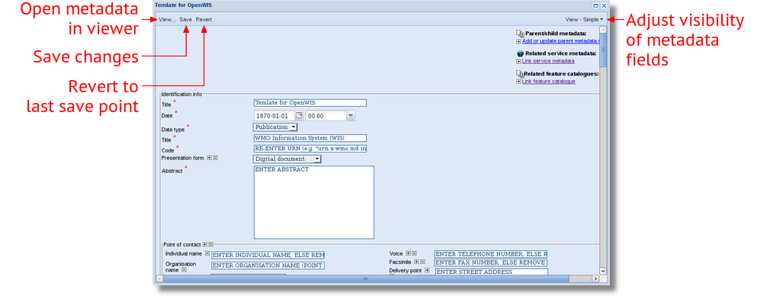
Metadata Editor

Slide 11
Using The Editor
  The metadata item will be created from the template selected.
  A subset of the elements will be displayed for editing.
  Clicking the field label shows a brief description of the element.
  Fields marked with a red asterisk (*) must have a value.
  The set of metadata items displayed can be adjusted by selecting a different configuration from the View menu to the right of the dialog.

Slide 12
Using The Editor
  Changes are saved by clicking the Save button.
  This will publish the metadata item immediately.
  To rollback to the last saved changes, click the Revert button.
  All unsaved changes will be lost.
  To preview the metadata item, click the View… button to the left of the dialog.

Slide 13
Repeatable Elements
  Various metadata elements can appear multiple times in a single metadata item.
  Example: A point of contact entry for the data author, data custodian, data publisher…
  The elements which can appear multiple times have an Add repeat icon next to the label ( ).
  When clicked, a copy of the element appears at the end of the collection.
  It is possible to reorder the repeatable elements by using the Reorder icons beside the labels:



Slide 14
Removable Elements
  Elements that are conditional can be removed from the metadata item.
  Properties of the metadata which are irrelevant or unknown.
  Repeatable fields which are no longer necessary.
  These elements can be removed by clicking the Remove icon next to the element label ().

Slide 15
Live Demo
  Creation of Metadata using the editor
  Authority: ma.marocmeteo
  Identifier: TEST01GMMC
  Name: TEST Weather forecast bulletin for Casablanca.
  Abstract: Example metadata item using the editor.
  Keywords: weather (theme), Casablanca(place)
  Date Published: Published on 2015-10-28 at 10:00
  Data Custodian: your_name
  Geographic Extent: Morocco
  Format: HTML
  Email: email_contact_gisc_casablanca

Slide 16
Editor Tips
  The default element value can give an indication as to what the expected element value is, including any references to code-sets, links, etc.
  You may need to scroll to the end of the field value for the full description.
  Fill in all element values, or remove them if they are unnecessary.
  Consider using element values which work internationally.
  Example: phone numbers with country codes, etc.
  Save changes frequently.

Slide 17
Exercise 1
  We will be conducting this exercise on the OpenWIS server :
http://gisc.marocmeteo.ma/openwis-user-portal
  You should all have accounts with "editor" privileges.
Log into the development server.
Access the metadata services.

Slide 18
Exercise 1
Create the following metadata item using the editor:
  Authority: com.example.your-user-name
  Identifier: exercise1
  Categories: WIS_GISC_CASABLANCA
  Name: Example weather forecast for your home city.
  Abstract: This is an example metadata item referring to the weather forecast for your home city.
  Keywords: weather (theme), Your home country (place)
  Date Published: Todays date
  Data Custodian: Your name and organisation
  Geographic Region: Your home country
  Format: XML
  Email: Your email address

Slide 19
Exercise 1
Once you have saved your metadata item, go to the Normal Search and search for "exercise1 your-user-name".
When you have found it, open the metadata item up in the viewer.

Slide 20
Uploading Metadata
  Existing XML metadata can be uploaded within the Upload section.
  Support for single XML files, or XML files bundled within a MEF file.
  Multiple files can be uploaded simultaneously by clicking the Add… button.
  Basic XML services can be applied to each XML file:
  A stylesheet can be applied to transform the XML file.
  The XML file can be validated using either XSD or Schematron validation (recommended).

Slide 21
Managing Metadata
  The Browse My Metadata section displays the metadata items owned by the user.
  Operations that can be performed on the selected metadata items include:
  Duplicate: creates a complete copy of a metadata item (requires a new URN).
  View: displays the metadata in the viewer.
  Edit: opens the metadata in the editor for editing.
  Remove: removes the metadata item from the catalogue.
  Export: exports the metadata item (as XML or MEF)

Slide 22
Metadata Exchange Format
The metadata exchange format (MEF in short) is a specially designed file format for the purpose of metadata exchange between different platforms
This format has been designed with the following needs in mind:
  Export a metadata record for backup purposes
  Import a metadata record from a previous backup
  Import a metadata record from a different OpenWIS version to allow a smooth migration from one version to another.
  Capture metadata plus thumbnails and any data uploaded with the metadata record.

Slide 23
Metadata Exchange Format
public: this is a directory used to store the metadata thumbnails and other public files. There are no restrictions on the image format but it is strongly recommended to use the portable network graphics (PNG), JPEG or GIF format.
private: this is a directory used to store all data (maps, shape files etc...) uploaded with the metadata in the GeoNetwork editor. Files in this directory are private in the sense that authorisation is required to access them. There are no restrictions on the file types that can be stored into this directory.

Slide 24
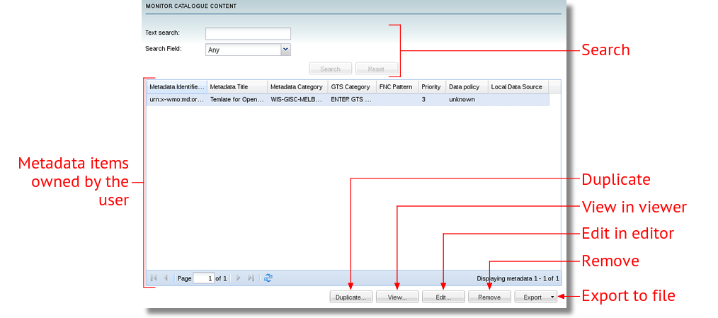
Managing Metadata

Slide 25
Live Demo
  Uploading Metadata
  Managing Metadata

Slide 26
Exercise 2
  Go to the Browse My Metadata section and duplicate the metadata item created in Exercise 1. Give it the URN:
  urn:x-wmo:md:ma.marocmeteo::your-user-name.exercise2
  Export "exercise2" as an XML file onto the desktop.
  Remove the "exercise2" metadata item from the list.
  Go to Insert Metadata and select the exported XML file. Select XSD and schematrons validation and the WIS-NC-CONGO category. Insert the metadata item.
  Go to Browse My Metadata and opening it up for viewing.
  From the metadata viewer, open the metadata item up for editing.

