Slide 1

Ethiopian WIS-GTS Status
WIS Training and Planning Workshop for RAI
INSTITUTE FOR METEOROLOGICAL TRAINING AND RESEARCH (IMTR)/ WMO RTC
NAIROBI, KENYA, 2ND – 6TH NOVEMBER, 2015
Kinfe Hailemariam (kinfe_hm@yahoo.com)
Meteorological Electronic Stations and ICT Director,
National Meteorological Agency of Ethiopia

Slide 2
Introduction
Mission
By collecting analyzing and studying data of atmospheric air, We provide weather forecast and early warnings on the adverse effects of weather and climate of Ethiopia.
Vision
World-class meteorological services in Ethiopia by 2025.
Values
Timely and reliable meteorological services are our mark.
Teamwork and ethical to the profession is our motto.
Forecasting the possible adverse effects of weather and climate is the measuring tool for our success.

Slide 3
Met Service started in 1951
Current autonomous structure since 1980
About 1203 conventional surface stations
50 - 110 years of data
About 150 radio based station for near real time data collection
1- upper air stations, 1- in Nov 2015, Another in 2017
14- satellite receiving station
1- SADIS station
107 Automatic Weather Stations, 250 in 2015, 700 in 2020
11 Regional Branch Offices
More than 887 permanent employees
Mandated as exclusive meteorological services provider in the country

Slide 4
National Meteorological Agency
Director General
Meteorological Data and Climatology Directorate
Meteorological Forecast & Early Warning Decorate
Aviation Meteorology Service Directorate
Development Meteorological Service Directorate
Meteorological Research and Studies Directorate
Meteorological Electronic Stations and ICT Directorate
Deputy Director General
Public Relation & Communication Directorate
Change Management Directorate
Audit Service Directorate
Women Affairs Directorate
Meteorological Education and Training Directorate
Human Resource and General Service Directorate
Procurement, Finance & Property Administration Directorate
Planning and Budget Preparation, Monitoring and Evaluation Directorate
Meteorological Instruments and Building Directorate
Adama Meteorological Branch Directorate
Mekelle Meteorological Branch Directorate
Bahirdar Meteorological Branch Directorate
Kombolcha Meteorological Branch Directorate
Jigjiga Meteorological Branch Directorate
Balerobe Meteorological Branch Directorate
Assosa Meteorological Branch Directorate
Gambella Meteorological Branch Directorate
Semera Meteorological Branch Directorate
Hawassa Meteorological Branch Directorate
Jimma Meteorological Branch Directorate

Slide 5
ICT Organizational Structure
Director General
Meteorological Data and Climatology Directorate
Meteorological Electronic and Stations and ICT Directorate
Meteorological Communication Case Team
Meteorological Electronics Station Case Team
Meteorological Data Management Case Team
ICT and GIS Services Case Team
Climatology Case Team
SSB data collection
GTS data transmission
Database management
Geo-spatial data analysis
Metadata
Clidata is used
Network
Website
E. Stations (AWS, Sat, Upp, Airpol, Radar, etc
Software/hardware support
Programming
GIS support

Slide 6
Data transmission and exchange
Real time transmission
  For air navigation use
  Instantaneous (e.g., AWOS, DWS)
  Wireless based
Near Real time transmission
  For Weather forecast and early warning use
  SSB Radio (> 150 stations)
  GPRS based SMS (107 to grow to 700 stations by 2020)
  Satellite images (13 stations)
  SADIS (1-Vsat stations at Bole International Airport)
Delayed transmission
  From over 1200 conventional stations
  For climatology and research use
  Postal transmission
  Station inspection time collection

Slide 7
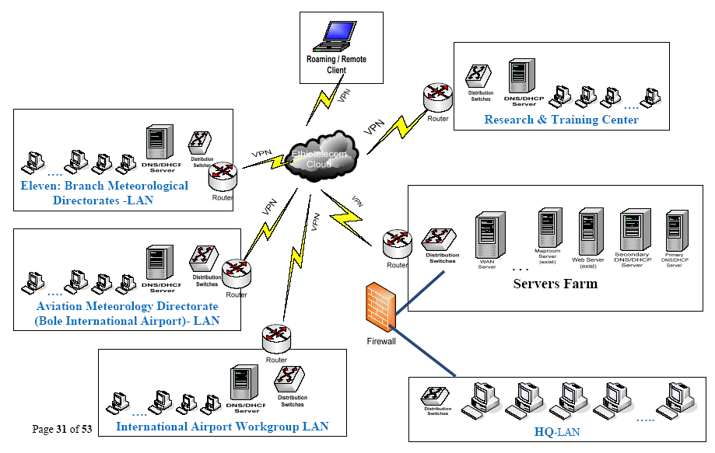
Network and data exchange
WAN/LAN at HQ, 11-BO, 4-Airpot
107AWS GPRS
150 SSB radio
LAN,WAN, Maproom, AWS, DMS, DHCP,
GTS uses Leased line to Nairobi-HUB until 2000
Since 2000 GTS data sent by email (via Meteo-France )

Slide 8
Distribution of Synoptic Stations

Slide 9
GTS
Until 2000 : Leased line to Nairobi-HUB
Initially, in 2000, the line from Ethiopia side changed to digital and became incompatible to the Nairobi side.
MESSIR -COMM was used but server crushed
We use to get GTS data through PUMA
Currently GTS data sent by email to the following address:
  Climat (Monthly)
    Mss.operator@dwd.de
  Synop (every 3hrs) / Upper air-Addis Ababa (Every day)
    transmet@meteo.go.ke (Nairobi)
    Transmet-alpha-reunion@meteo.fr (France)
We check the data on
  http://www.ogimet.com/

Slide 10
We send three data to the following address:
  Climat (Monthly)
    Mss.operator@dwd.de
  Synop (every 3hrs)
    transmet@meteo.go.ke (Nairobi)
    Transmet-alpha-reunion@meteo.fr (France)
  Upper air-Addis Ababa (Every day)
Station that observe hourly and send data to GTS every three hours are
  Addis Ababa Bole and
  Dire Dawa
Station that observe from 03GMT to 18GMT are
  Kombolcha
  Nekemt
  Awassa
  Robe
  Jimma
  Other ten GTS stations observe from 03 GMT to 15 GMT

Slide 11
Area of priority
GTS facility for international data exchanges
  Knowledge gap on the required software and hardware
  Who give proper technical support
Lack of capacity to apply Table Driven Code, training on TDC is needed

Slide 12
Thanks you for listening

Slide 13
Sample SYNOP Report
SMET01 HAAB 281800
AAXX 28181
63333 42580 30000 10190 20126 38161 40172 81530 333 10284 59014 81626 82358=
63340 42580 63602 10156 20153 37941 40162 84530 333 10252 59012 84623 85358=
63402 42580 50000 10182 20164 38348 40020 82101 333 10290 59013 82826 84070=
63450 42580 50704 10188 20107 37730 40086 85500 333 10248 59015 85624=
63460 42580 61802 10222 20160 86800 333 10302 82824 84625=
63471 41960 20802 10264 20135 38846 40089 70500 80001 333 10350 58006 82070=
63474 42580 50000 10128 20117 85800 333 10218 84821 81623=
NNNN
Challenges
  TDC implementation
  GTS communication HW/SW and training both for the national and international communication

Slide 14
Sample Upper Air Report
TTAA 79121 63450 99772 23666 15014 00000 ///// ///// 92717 /////
///// 85477 ///// ///// 70156 13459 09505 50588 06579 07516
40761 13396 09512 30973 29957 03502 25100 40757 33003 20248
52567 30511 15428 67766 27521 10661 81557 07014 88115 80958
25501 77999 31313 48008 81137=
UKET01 HAAB 291200
TTBB 79128 63450 00772 23666 11768 21066 22624 04417 33586 02257
44562 01085 55500 06579 66493 05199 77421 10797 88315 27171
99288 32548 11260 38750 22225 46164 33168 61769 44163 63768
55115 80958 66100 81557 21212 00772 15014 11771 09503 22738
14010 33720 11011 44659 09510 55621 03510 66603 02014 77562
08013 88546 07015 99519 08521 11497 07014 22483 36006 3347
1 01010 44436 04010 55408 09513 66384 08012 77365 11015
88317 00000 99207 31012 11195 30514 22188 28510 33161 30018
44147 27524 55137 29513 66125 29510 77114 00000 88109 03510
99100 07014 31313 48008 81137 41414 58530 51515 77294 23666
14011 60430 03256 02515=
ULET01 HAAB 291200
TTCC 79122 63450 70866 71368 25012 50068 63980 29041 30386 56382
22027 20648 51383 28032 10107 ///// 88999 77999 31313 48008
81137=
UEET01 HAAB 291200 TTDD 7912/ 63450
11869 82757 22739 70164 33658 73569 44601 64979 55502
63780 66450 66379 77407 60381 88366 59181 99318 54782
11287 56382 22256 50984 33225 50984 44220 51583 55195
51184 66174 44186 77136 48184 88133 45585 99118 47385
21212 11964 04512 22887 04020 33851 03017 44840 04015
55798 13014 66778 14010 77748 16004 88716 24510 99672
26513 11649 25012 22632 29014 33620 29014 44614 28014
55599 26022 66568 25534 77528 28041 88513 28540 99424
30529 11390 36016 22373 35510 33351 00000 44345 16511
55322 18529 66298 22526 77276 23533 88256 22039 99240
25531 11227 25031 22187 29027 33176 28021 44162 27042
55143 27048 66122 32527 77118 31529
31313 48008 81137=
NNNN

