Slide 1
Kenya WIS Status
WIS RA1- Training and Planning Workshop
2-6Nov 2015
Nairobi,
Peter Mutai
WIS Focal Point
Kenya Meteorological Department

Slide 2
Introduction
Provision of meteorological services in Kenya started in 1929, following the establishment of the British East African Meteorological Service (BEAMS)
KMD became a Department of the Government of Kenya in 1977 from the previous East African Meteorological Department (EAMD) after the collapse of the East African Community (EAC).
KMD under Government Ministry of Environment, Natural Resources and Regional Development

Slide 3
Vision & Mission
Vision:
A leading world-class Operational Forecasting Centre and Scientific Institution contributing to high quality of life.
Mission
To facilitate access of quality meteorological information and services and infusion of scientific knowledge to spur socio-economic growth and development for quality life.

Slide 4
Mandate of KMD
As stated in the WMO Convention, the purpose of a National Meteorological & Hydrological Service, like KMD, is in observing and understanding weather and climate and in providing meteorological, hydrological and related services in support of relevant national needs, which include the following areas:
Safety of life and protection of property;
Safeguarding the environment;
Contributing to sustainable development;
Promoting long-term observation and collection of meteorological, hydrological and climatological data, including related environmental data;
Meeting international commitments;,
Contributing to international cooperation.

Slide 5
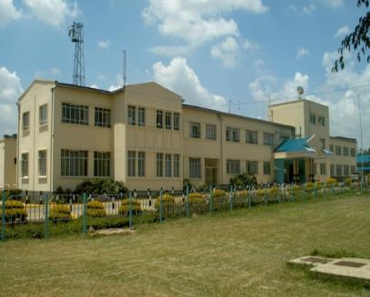
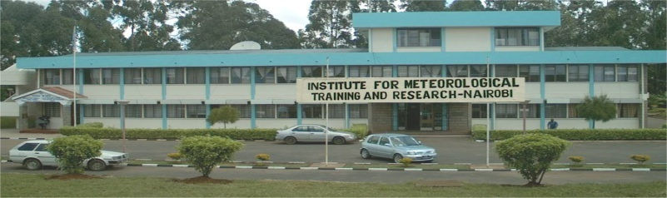
KMD ORGANIZATIONAL STRUCTURE
DIRECTOR
DEPUTY DIRECTOR TECHNICAL & SUPPORT SERVICES
DEPUTY DIRECTOR FORECASTING & COUNTY METEOROLOGICAL SERVICES
DEPUTY DIRECTOR METEOROLOGICAL APPLICATIONS AND SERVICES
DEPUTY DIRECTOR /PRINCIPAL EDUCATION, TRAINING & RESEARCH
5

Slide 6
Meteorological Infrastructure & Services
The infrastructure that is necessary for KMD to achieve its mandate includes:
  Observational Systems and Networks;
  Telecommunication Systems and Networks;
  Data Processing, Analysis and Forecasting System;
  Data-base Management System and Archiving;
  Product and Information Dissemination System; and
  Human Capital.

Slide 7
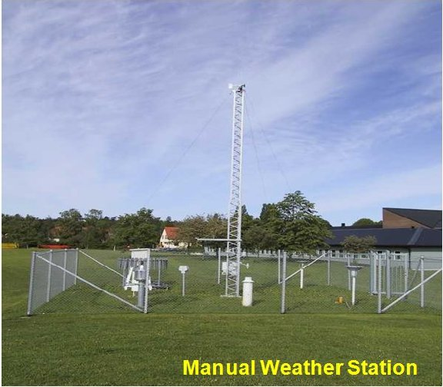
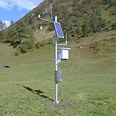
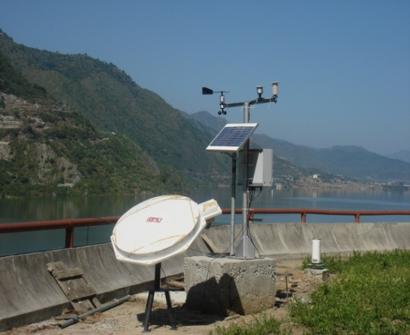
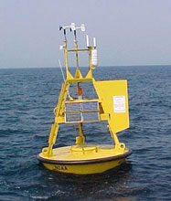
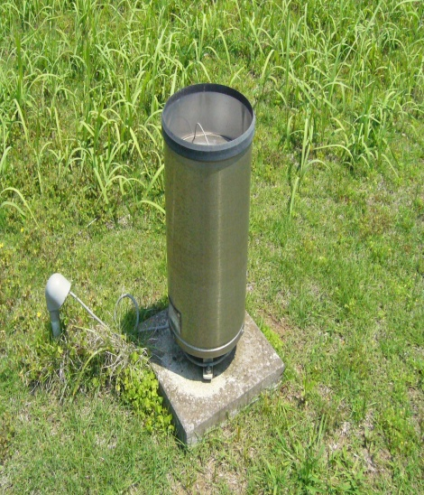
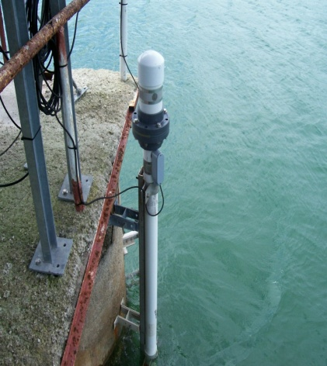
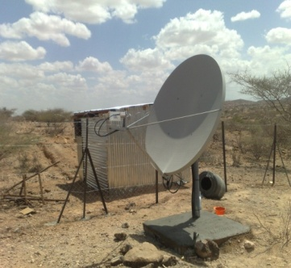
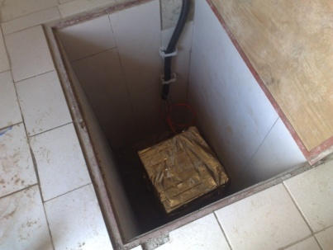
CURRENT OBSERVATIONAL NETWORK
39 manned 24-hr
Synoptic & 14 Agro Met Stations
92 Automatic Weather Stations
17 Hydromet Automatic Weather Stations
3 Airport Weather Observation Systems (AWOSs) at JKIA, Wilson & MIA
4 tidal gauge stations
at Lamu, Mailindi,
Kilifi and Shimoni
  2 fixed buoys at Lake Victoria
Over 1500 rainfall stations
4 Seismic Stations
in Lodwar, Voi, Mombasa and Kibwezi

Slide 8
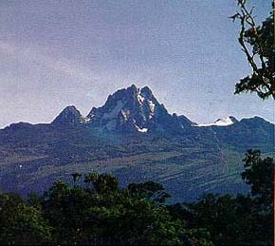
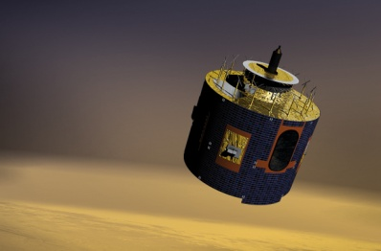
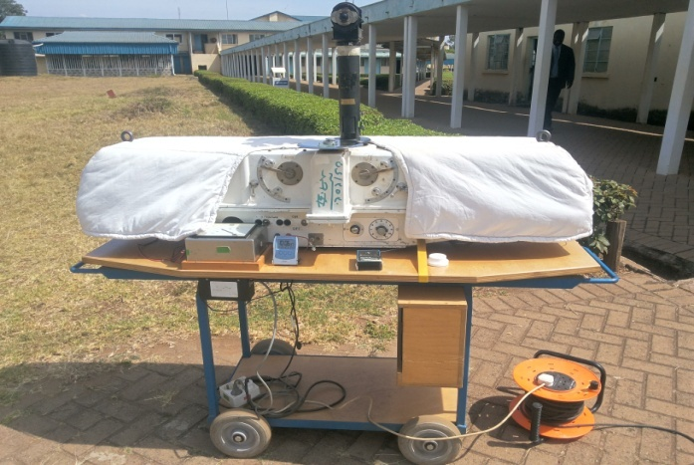
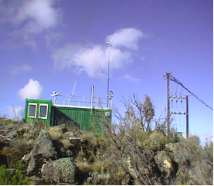

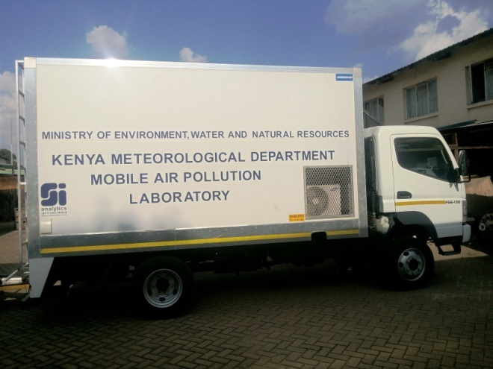
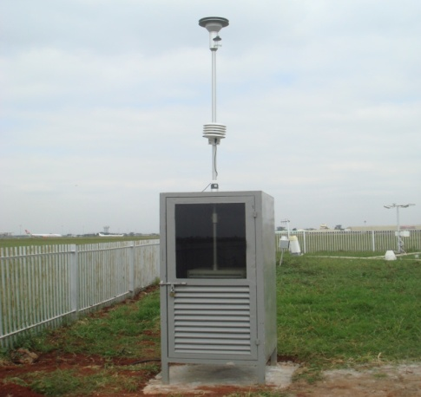
CURRENT OBSERVATIONAL NETWORK II
4 EUMETCAST MSG
Receiving Stations
1 Ozone Profile measuring system in Nairobi
1 Global Atmospheric Watch at Mt Kenya
1 Upper Air Station at Dagoretti, Two have been installed at Mombasa & Kisumu Airports
2 urban pollution stations at Chiromo and JKIA
One Mobile Air Pollution Monitoring Laboratory

Slide 9
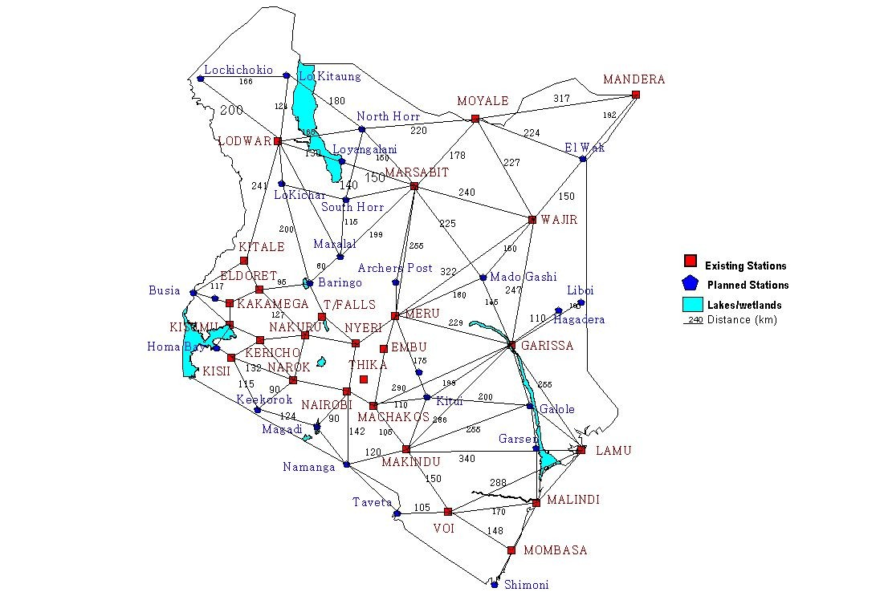
Network of Existing and Planned manned Synoptic Observation Stations
Existing Stations
Planned Stations

Slide 10
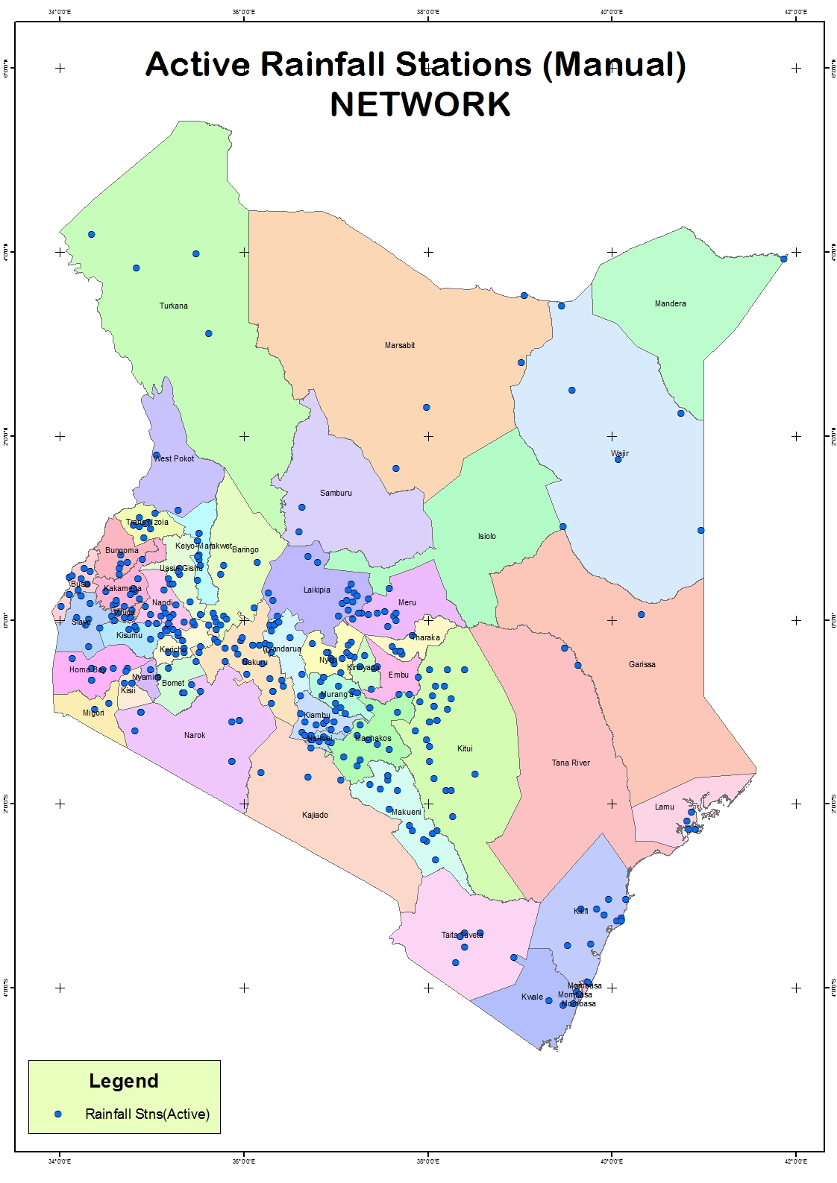

Slide 11


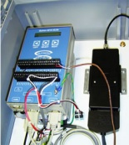



National Data Transmission Techniques
INTERNET
GTS/WIS
VPN
AMSS
AWS
Manual Observations
+ Key Entry
FTP
GSM
GSM
Base Station
Internet Mail Server
Climate Database
CLIMSOFT
Postal Mail
Quality Control Checks
Rainfall Records

Slide 12
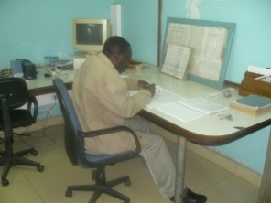
Data Transmission, Archival and Applications
Observations
GTS Circuit
TDCF Encoding
GSM
TAC
Alphanumeric data (SMTP- email)
Internet Mail Server
Internet
VPN
AMSS
CLIMSOFT
BUFR
Binary data (FTP)
GSM
Decoding-Visualization
Synergie
Messir Vision
Applications

Slide 13
Regional Responsibilities
  The World Meteorological Organization (WMO) has designated regional responsibilities to KMD.
  WMO Regional Training Centre (WMO-RTC) for English Speaking Africa;
  RTH
  RSMC – SWFDP
  RIC

Slide 14
Nairobi – RTH Responsibilities
Toulouse
Rome
Moscow
Madrid
Algiers
Casablanca
New Delhi
Western
Sahara
Tunis
Canary
Tripoli
Cairo
Jeddah
Offenbach
Nouakchott
Toulouse
Khartoum
Dakar
Niamey
Asmara
Banjul
Bamako
Djibouti
Bissau
Ouagadougou
N'djamena
Conakry
Addis Ababa
Sal
Bangui
Freetown
Accra
Cotonou
Lagos
Entebbe
Mogadiscio
Monrovia
Nairobi
Abidjan
Lome
Douala
Kigali
Malabo
Bujumbura
Seychelles
Libreville
Dar Es Salaam
Brazzaville
Washington
Lusaka
Sao Tome
Kinshasa
Lilongwe
Mauritius
Luanda
RTH
Harare
NMC
Ascension
Windhoek
Gaberone
Moroni
St Denis
Centre in other region
St. Helena
Pretoria
Maputo
Antananarivo
MTN circuit
Maseru
Manzini
Regional circuit
Kerguelen
New Amsterdam
Interregional circuit

Slide 15
KMD –WIS Activities
(2011 – 2016)
No | Activity | Status
1 | PR Notification of WMO secretariat to register RTH as WIS DCPC | Completed
2 | Identification of Focal Point | Completed
3 | Modernization of infrastructure | On-going
4 | Implementation of the WMO Table Driven Code Format (TDCF) for category 1 data | Updating of WMO Volume C1 done
5 | Development of National Metadata catalogue for Meteorological data held by KMD | Done for GTS data
7 | Enhancing telecommunication capacity- Upgrade of internet bandwidth and connection to RMCDN | Upgraded to 12/12 Mpbs done, RMCDN –budget allocation planned for 2016
 | Upgrade of AMSS – Data collection Centre | completed
 | Implementations of Production Centre | Upgrade in progress-TBC by Mid December 2015
 | Installation of WIS DCPC System- Based on OpenWIS Webiste : wis.meteo.go.ke | Completed in July 2015
 | Audit of WIS DCPC | Planned for Dec 2015
 | Training | -Staff – done for Key personnel - end-users TBD 2016

Slide 16
Human Resource at KMD
CADRE | NO. | QUALIFICATIONS
METEOROLOGICAL TECHNICIANS (Weather Observers) | 240 | Equivalent of National Diploma and Higher National Diploma
METEOROLOGICAL TELECOMMUNICATION TECHNICIANS | 23 | Equivalent of National Diploma and Higher National Diploma
METEOROLOGICAL COMMUNICATION TECHNICIANS | 99 | Equivalent of National Diploma
METEOROLOGICAL OFFICERS (Weather Forecasters) | 19 | BSc in Physics of Mathematics and Post Graduate training in Meteorology
ENGINEERS (Electronics and Mechanical) | 17 | BSc in Engineering (Some with MSc)
METEOROLOGISTS | 147 | 87 BScs in Meteorology, 33 MScs in Meteorology & 2 PhDs
VARIOUS SUPPORT STAFF | 138 | Accountants, Procurement officers, Librarian, Printing officers, Hostel and Kitchen officers, etc.

Slide 17
Challenges & recommendation
Though we have made progress in the implementation of WIS DCPC, there few outstanding tasks that must be completed. This include
  Completion of upgrade and integration of NWP (Production Centre) with the OpenWIS;
  Need to upgrade Telecommunication links- Re-establish dedicated links with some of the NMHSs and Join RMCDN to improve data exchange with GISCs(Primary/Backup, Secondary& Associate Gisc;
  Capacity building to improve competencies in the country and Eastern Africa sub-region;
  Inadequate funding from national treasury to support development & recurrent operation budget – request for additional funds have been made to national treasury;
  Training users- planned for next year (2016/17);

Slide 18
THE KMD PROPOSED FIVE-YEAR (2012 – 2017) DEVELOPMENT PLAN
Priority areas of focus
Global Framework for Climate Services (GFCS);
Implementation of the WMO Information SYSTEM & WMO Integrated Global Observing System (WIGOS);
Disaster Risk Reduction;
Advancing Seamless Weather, Climate, Water and related Environmental services;
Capacity Development- Modernization of infrastructure and enhancing human resource skills

Slide 19
Thank you

