Slide 1

World Meteorological Organization
Working together in weather, climate and water
WMO
Introduction to WIS
WIS Project Office
WMO
Wis-help@wmo.int
WMO
www.wmo.int

Slide 2
WIS Sessions
WIS – WMO Information System
Introduction to WIS
WIS Competencies
Exchanging data using WIS
WIS Discovery Metadata
Managing WIS
Operating WIS
Telecommnications in WIS
2

Slide 3
Introduction to WIS
Why WIS?
What WIS does
WIS Centres
Secretariat support

Slide 4
Why WIS?
WMO Vision
Needs of Programmes
Why not the GTS?

Slide 5
The WMO vision is…
to provide world leadership in expertise and international cooperation in weather, climate, hydrology and water resources and related environmental issues and thereby contribute to the safety and well-being of people throughout the world and to the economic benefit of all nations.

Slide 6
The mission of WMO is to:
• Facilitate worldwide cooperation in the establishment of networks of stations for the making of meteorological observations as well as hydrological and other geophysical observations related to meteorology, and to promote the establishment and maintenance of centres charged with the provision of meteorological and related services;
• Promote the establishment and maintenance of systems for the rapid exchange of meteorological and related information;
• Promote standardization of meteorological and related observations and to ensure the uniform publication of observations and statistics;
• Further the application of meteorology to aviation, shipping, water problems, agriculture and other human activities;
• Promote activities in operational hydrology and to further close cooperation between Meteorological and Hydrological Services;
• Encourage research and training in meteorology and, as appropriate, in related fields, and to assist in coordinating the international aspects of such research and training.

Slide 7






What does this mean for WIS?

Slide 8


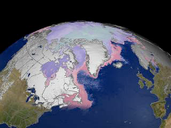
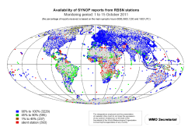
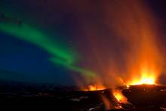
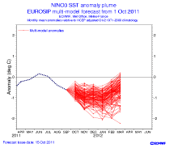
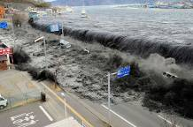
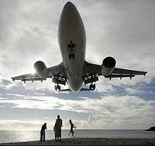

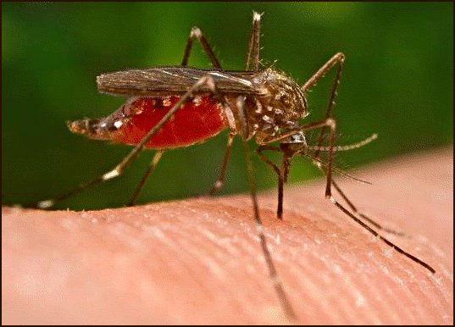
Needs of Programmes
GFCS
GCW
GAW
WWW
Ash
Forecasts
Tsunami
Aviation
Space
Weather
Health

Slide 9
Conflicting priorities
Operations
Predictable
  Deadlines
  Content
  Formats
Infrastructure
  Fixed
  Slow to change
  Limited capability
Research
Flexible
  Deadlines
  Content
  Formats
Peer networks
  Ad hoc
  Rapid change
  Time to adapt to new sources

Slide 10
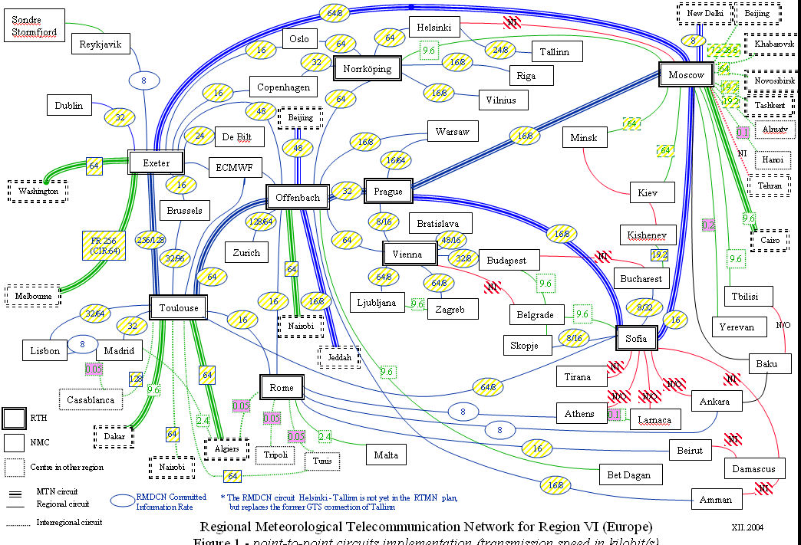
The GTS is…
Reliable
Strongly managed
Effective
Complex
Restricted access
Limited capacity

Slide 11
WIS is..
The WMO Information System
Part A: enhanced GTS
Part B: enhanced flexibility through Discovery, Access and Retrieval
Part C: information management.
  That the scope of the WMO Information System be extended to include setting and auditing standards for centres that hold information in support of WMO Programmes, to be known as Part C of the WMO Information System (Rec.24 CBS Ext .(2104)).

Slide 12
Benefits of WIS
Enhances collection of critical data
Catalogs all WMO data and products
Enhances availability of time-critical data and products at all national centres
Opens up GTS to other types of data
Exploits technology innovation

Slide 13
What WIS does
Describes information
Routinely exchanges information
Brokers ad hoc exchanges

Slide 14

WIS describes information
WIS Discovery Metadata
What datasets contain
Who is responsible
How to get datasets
Image by Tim Parkinson from http://www.flickr.com/photos/timparkinson/320165882/ under the creative commons licence http://creativecommons.org/licenses/by/2.0/

Slide 15
WIS routinely exchanges information
Suppliers can automate sending data
  GTS, Private line, Email, FTP…
Users can ask to be sent data when they are received
  GTS, email, ftp, private lines, satellite…
################################################################################
# SYNOPS from 03772, London / Heathrow Airport (United Kingdom) | 51-29N | 000-27W | 24 m
################################################################################
201209241450 AAXX 24154 03772 45680 /2418 10146 20098 39867 49896 51019 91450 333 55300 20703 84/44 90710 91127=
201209241150 AAXX 24124 03772 17465 /2617 10115 20105 39848 49878 53025 60081 761// 91150 333 55300 20325 84/13 85/44 90710 91127=
201209240850 AAXX 24094 03772 47450 /1009 10150 20145 39823 49852 57020 723// 90850 333 55300 20353 85/11 83/41=
201209240750 AAXX 24084 03772 47234 /0808 10140 20135 39829 49858 56025 761// 90750 333 55300 20069 81/03 87/09=
201209240650 AAXX 24074 03772 47240 /0908 10136 20131 39836 49865 56029 751// 90650 333 55300 20037 83/03 87/09=
201209240550 AAXX 24064 03772 17139 /0808 10131 20126 39842 49872 56039 60092 710// 90550 333 20108 3/010 55000 55300 20000 70218 86/02 84/07=
201209240450 AAXX 24054 03772 47134 /0909 10127 20122 39854 49883 56044 723// 90450 333 55300 20000 88/02=
201209240350 AAXX 24044 03772 47239 /0807 10124 20119 39865 49894 58039 722// 90350 333 55300 20000 85/03 87/08=
201209240250 AAXX 24034 03772 47135 /0807 10120 20114 39881 49911 57037 710// 90250 333 55300 20000 88/02=
201209240150 AAXX 24024 03772 47130 /0807 10119 20113 39898 49927 56032 710// 90150 333 55300 20000 88/02=
201209240050 AAXX 24014 03772 47245 /0806 10119 20112 39904 49934 58034 710// 90050 333 55300 20000 88/04=
201209232350 AAXX 24004 03772 17350 /0807 10119 20110 39919 49949 58015 60091 710// 92350 333 55/// 20204 88/07=

Slide 16

Brokers ad hoc exchanges
Once information found:
Download routine data
Download data
Request data to be sent
  Large datasets
  Paper datasets
  …
Standard formats
  WMO: TDCF
  Research: NetCDF …
  Other: XML …
Image reproduced by courtesy of Arttu Manninen (http://www.flickr.com/photos/adrenalin/4250667/) under the Creative Commons attribution non-commercial no-derivatives licence. http://creativecommons.org/licenses/by-nc-nd/2.0/deed.en

Slide 17
WIS Centres
Global Information System Centres
Data Collection or Production Centres
National Centres

Slide 18
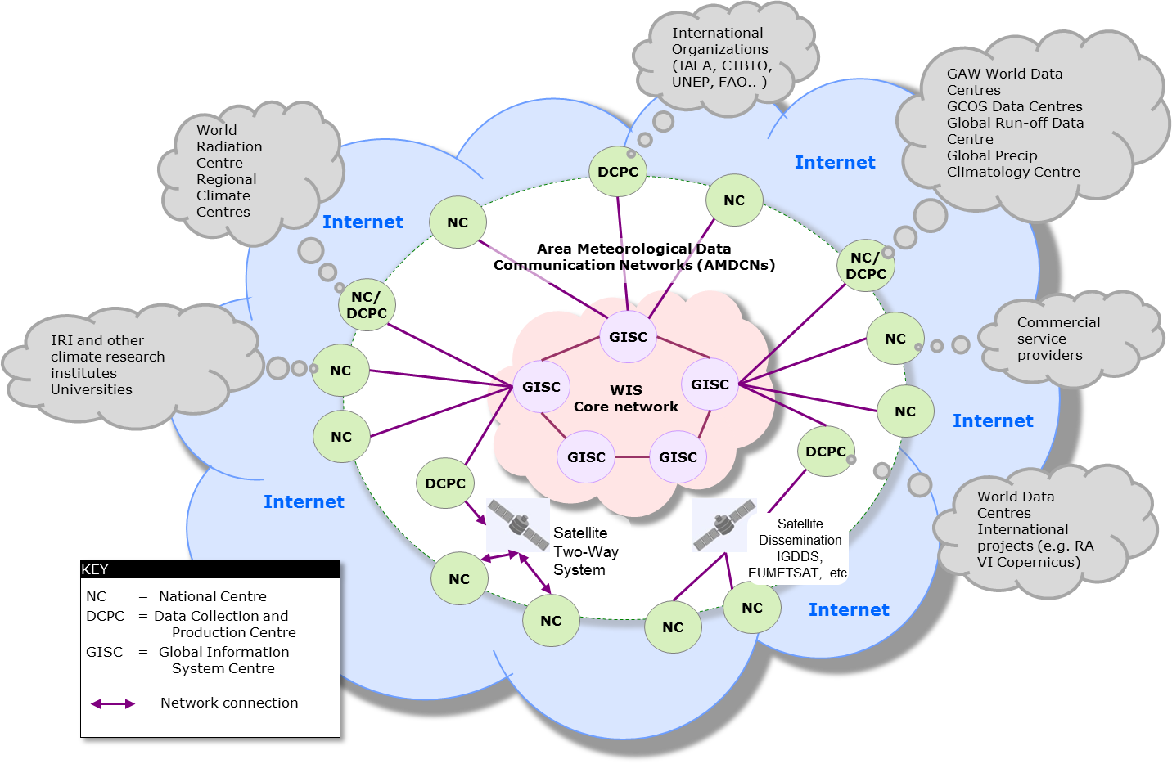
WIS Centres

Slide 19
WIS Centres – GISC (WIS Infrastructure)
Hold global metadata catalogue
Upload metadata for area of responsibility
Distribute (global exchange) data to other GISCs
Provide (global exchange) data to area of responsibility
Ad hoc and subscription data supply
Ensure area of responsibility has effective telecommunications

Slide 20
WIS Centres – DCPC (Information provider/user)
Programme function
    WWW regional telecommunications hub
    RSMC
    World Data Centre
Provide metadata
Provide data

Slide 21
WIS Centres – NC (Information provider/user)
Collect and pass national data to WIS
Receive data from WIS for national users
Provide metadata to WIS
Main source of information for national purposes

Slide 22
Summary
Extend data exchange beyond GTS
Add flexibility to data gathering and distribution
Centres
  GISC
  DCPC
  NC

Slide 23
WIS components (& Secretariat support)
The aim of WIS is to get information from those that make or collect it to those that need it
Base on information management (Steve Foreman)
  Data representation, metadata and monitoring of data flow
Operates on an infrastructure (Dave Thomas)
  Data centres, pipes and performance monitoring
Relies on governance, practices and procedures

Slide 24
Exercise
In 2000, CBS agreed characteristics for WIS.
How well does WIS meet these?

Slide 25
WIS Characteristics – as described in 2000
6.2.62 The Commission agreed that the future WMO information system should provide an integrated approach to meeting the requirements of:
(a) Routine collection of observed data;
(b) Automatic dissemination of scheduled products, both real- and non-real-time;
(c) Ad hoc non-routine applications (e.g. requests for non-routine data and products).
The system should be:
(a) Reliable;
(b) Cost effective and affordable for developing as well as developed Members;
(c) Technologically sustainable and appropriate to local expertise;
(d) Modular and scalable;
(e) Flexible and able to adjust to changing requirements and to allow dissemination of products from diverse data sources.
The system should also support:
(a) Different user groups and access policies;
(b) The integration of diverse datasets;
(c) Data as well as network security;
(d) Ad hoc as well as routine requests for data and products as well as "push");
(e) Timely delivery of data and products (appropriate to requirements).

Slide 26
Secretariat Support

Slide 27
Secretariat support
Peiliang Shi
Dave Thomas
Steve Foreman
Atsushi Shimazaki
Jennifer Best
wis-help@wmo.int

Slide 28
Summay
Why WIS?
What WIS does
WIS Centres
Secretariat support

