Slide 1

World Meteorological Organization
Working together in weather, climate and water
WMO
WMO Information System
RA III WG-ITD
08 Oct 2015
WIS Project Office
Wis-help@wmo.int
WMO – http://wis.wmo.int/page=TrainingAids
www.wmo.int

Slide 2
Overview
WIS – WMO Information System
Introduction to WIS
Exchanging data using WIS
Managing WIS
Operating a WIS centre
2

Slide 3
Why WIS?
WMO Vision
Needs of Programmes
Why not the GTS?

Slide 4
The WMO vision is…
to provide world leadership in expertise and international cooperation in weather, climate, hydrology and water resources and related environmental issues and thereby contribute to the safety and well-being of people throughout the world and to the economic benefit of all nations.

Slide 5
The mission of WMO is to:
• Facilitate worldwide cooperation in the establishment of networks of stations for the making of meteorological observations as well as hydrological and other geophysical observations related to meteorology, and to promote the establishment and maintenance of centres charged with the provision of meteorological and related services;
• Promote the establishment and maintenance of systems for the rapid exchange of meteorological and related information;
• Promote standardization of meteorological and related observations and to ensure the uniform publication of observations and statistics;
• Further the application of meteorology to aviation, shipping, water problems, agriculture and other human activities;
• Promote activities in operational hydrology and to further close cooperation between Meteorological and Hydrological Services;
• Encourage research and training in meteorology and, as appropriate, in related fields, and to assist in coordinating the international aspects of such research and training.

Slide 6






What does this mean for WIS?

Slide 7


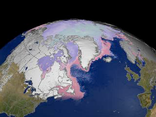
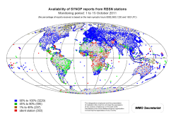
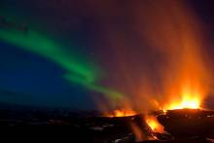
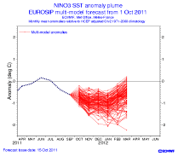
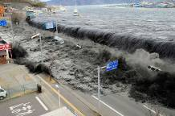


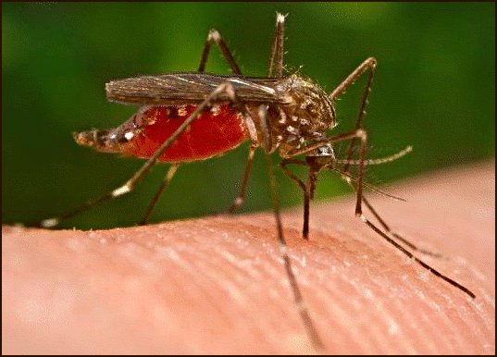
Needs of Programmes
GFCS
GCW
GAW
WWW
Ash
Forecasts
Tsunami
Aviation
Space
Weather
Health

Slide 8
Conflicting priorities
Operations
Predictable
  Deadlines
  Content
  Formats
Infrastructure
  Fixed
  Slow to change
  Limited capability
Research
Flexible
  Deadlines
  Content
  Formats
Peer networks
  Ad hoc
  Rapid change
  Time to adapt to new sources

Slide 9
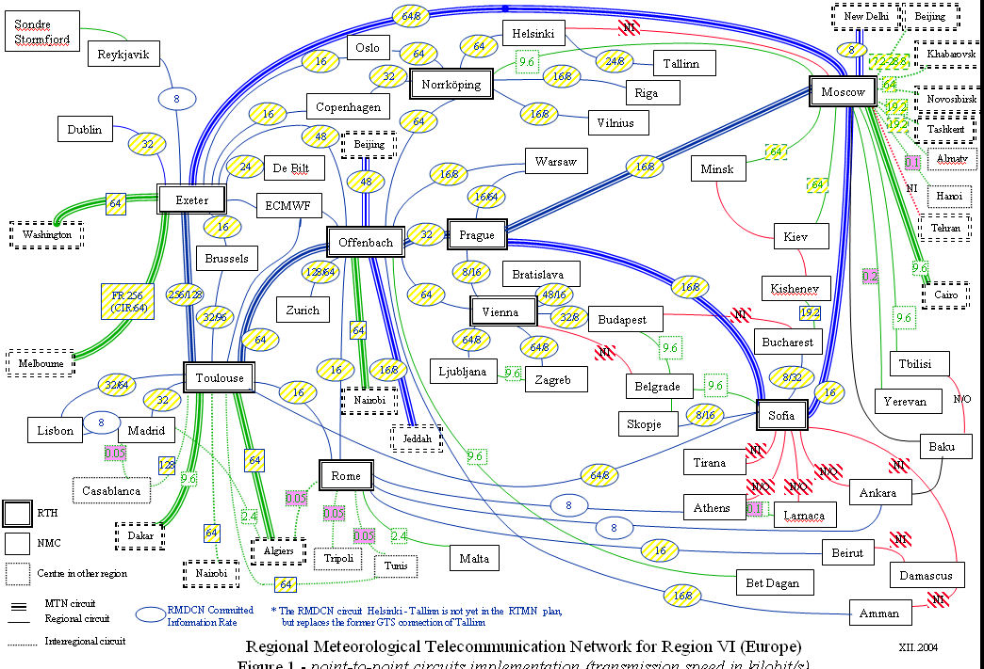
The GTS is…
Reliable
Strongly managed
Effective
Complex
Restricted access
Limited capacity

Slide 10
WIS is..
The WMO Information System
Part A: enhanced GTS
Part B: enhanced flexibility through Discovery, Access and Retrieval
Part C: information management.
That the scope of the WMO Information System be extended to include setting and auditing standards for centres that hold information in support of WMO Programmes, to be known as Part C of the WMO Information System
(Resolution 33 (Cg-17))

Slide 11
Benefits of WIS
Enhances collection of critical data
Catalogs all WMO data and products
Enhances availability of time-critical data and products at all national centres
Opens up GTS to other types of data
Exploits technology innovation

Slide 12
What WIS does
Describes information
Routinely exchanges information
Brokers ad hoc exchanges

Slide 13

WIS describes information
WIS Discovery Metadata
What datasets contain
Who is responsible
How to get datasets
Image by Tim Parkinson from http://www.flickr.com/photos/timparkinson/320165882/ under the creative commons licence http://creativecommons.org/licenses/by/2.0/

Slide 14
WIS routinely exchanges information
Suppliers can automate sending data
  GTS, Private line, Email, FTP…
Users can ask to be sent data when they are received
  GTS, email, ftp, private lines, satellite…
################################################################################
# SYNOPS from 03772, London / Heathrow Airport (United Kingdom) | 51-29N | 000-27W | 24 m
################################################################################
201209241450 AAXX 24154 03772 45680 /2418 10146 20098 39867 49896 51019 91450 333 55300 20703 84/44 90710 91127=
201209241150 AAXX 24124 03772 17465 /2617 10115 20105 39848 49878 53025 60081 761// 91150 333 55300 20325 84/13 85/44 90710 91127=
201209240850 AAXX 24094 03772 47450 /1009 10150 20145 39823 49852 57020 723// 90850 333 55300 20353 85/11 83/41=
201209240750 AAXX 24084 03772 47234 /0808 10140 20135 39829 49858 56025 761// 90750 333 55300 20069 81/03 87/09=
201209240650 AAXX 24074 03772 47240 /0908 10136 20131 39836 49865 56029 751// 90650 333 55300 20037 83/03 87/09=
201209240550 AAXX 24064 03772 17139 /0808 10131 20126 39842 49872 56039 60092 710// 90550 333 20108 3/010 55000 55300 20000 70218 86/02 84/07=
201209240450 AAXX 24054 03772 47134 /0909 10127 20122 39854 49883 56044 723// 90450 333 55300 20000 88/02=
201209240350 AAXX 24044 03772 47239 /0807 10124 20119 39865 49894 58039 722// 90350 333 55300 20000 85/03 87/08=
201209240250 AAXX 24034 03772 47135 /0807 10120 20114 39881 49911 57037 710// 90250 333 55300 20000 88/02=
201209240150 AAXX 24024 03772 47130 /0807 10119 20113 39898 49927 56032 710// 90150 333 55300 20000 88/02=
201209240050 AAXX 24014 03772 47245 /0806 10119 20112 39904 49934 58034 710// 90050 333 55300 20000 88/04=
201209232350 AAXX 24004 03772 17350 /0807 10119 20110 39919 49949 58015 60091 710// 92350 333 55/// 20204 88/07=

Slide 15

Brokers ad hoc exchanges
Once information found:
Download routine data
Download data
Request data to be sent
  Large datasets
  Paper datasets
  …
Standard formats
  WMO: TDCF
  Research: NetCDF …
  Other: XML, AvXML, WaterML2 …
Image reproduced by courtesy of Arttu Manninen (http://www.flickr.com/photos/adrenalin/4250667/) under the Creative Commons attribution non-commercial no-derivatives licence. http://creativecommons.org/licenses/by-nc-nd/2.0/deed.en

Slide 16
WIS Centres
Global Information System Centres
Data Collection or Production Centres
National Centres

Slide 17
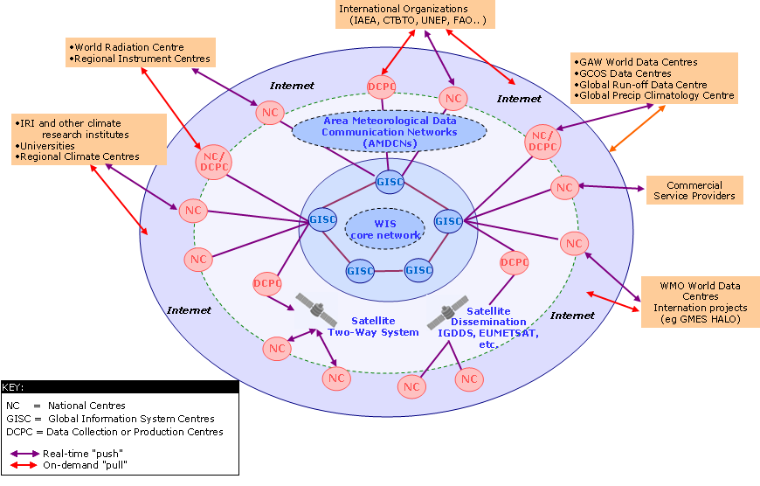
WIS Centres and Networks
WIS Centres
NCs
DCPCs
GISCs
WIS Networks
Core
AMDCN
GTS
  MTN
  RMTN

Slide 18
WIS Centres - GISC
Hold global metadata catalogue
Upload metadata for area of responsibility
Distribute (global exchange) data to other GISCs
Provide (global exchange) data to area of responsibility
Ad hoc and subscription data supply
Ensure area of responsibility has effective telecommunications

Slide 19
WIS Centres - DCPC
Programme function
    WWW regional telecommunications hub
    RSMC
    RCC
    World Data Centre
Provide metadata
Provide data

Slide 20
WIS Centres - NC
Collect and pass national data to WIS
Receive data from WIS for national users
Provide metadata to WIS
Main source of information for national purposes

Slide 21
WIS Data Exchange
Discovery Metadata
Providing data
Receiving data
Standardizing data
21

Slide 22
Discovery Metadata
WIS and discovery metadata
What makes good metadata
Responsibilities for metadata

Slide 23

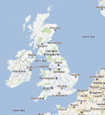

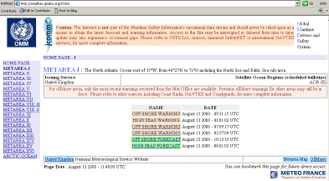

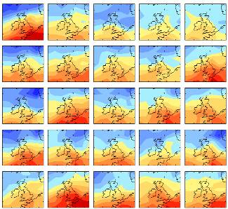
Search: Climate change for 48°N to 60°N and 10°W to 5°E
Search Results
User searches for metadata then retrieves information from data custodian
Information request to custodian
http://www.metoffice.gov.uk/precis/qump
Centre publishes metadata to GISC DAR catalogue
Retrieve information
Security/authentication/authorization and even charging is managed by each service provider
GISC – DAR service
NC/DCPC information access service

Slide 24
What makes good metadata?
Technically compliant
  Or WIS will not work
Useful to users
  Describes data in way users can find
Kept up to date with data it describes
Consistent with other information sources
The “start-up” metadata are technically compliant, but not “good”
  A centre’s first task is to review “start-up” metadata
Need to experiment with searching for their own data

Slide 25
Data restrictions – Resolutions 40 and 25
Resolution 40 (Cg-XII) and Resolution 25 (Cg-XIII)
Essential data (“WMOEssential”)
  “… data and products which are essential to support WMO Programmes … exchange without charge and with no conditions on use….”
Additional data (“WMOAdditional”)
  Data on which the originator has placed restrictions (on commercial use)
Data not covered by these (“WMOOther”)
PR notifies WMO of “additional data”

Slide 26
Providing data
Register metadata
Agree delivery methods
Supply data

Slide 27
Register metadata
Decide how data to be grouped
  GTS bulletin? five day global forecast? 200 year climate simulation? AWS hourly observations
Describe data – in way user will understand
Create metadata record
Publish on your principal GISC (Brasilia)
  Or via DCPC / RTH (Buenos Aires)

Slide 28








Agree delivery methods
WMO Pizza Programme
DCPC
?

Slide 29
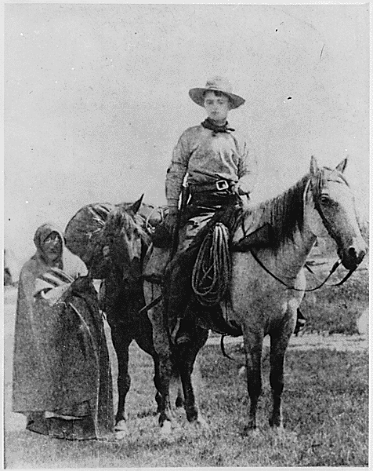
Supply your data to WIS
Implement the procedures you agreed with your GISC or DCPC

Slide 30
Receiving data
One-off requests
Subscriptions

Slide 31
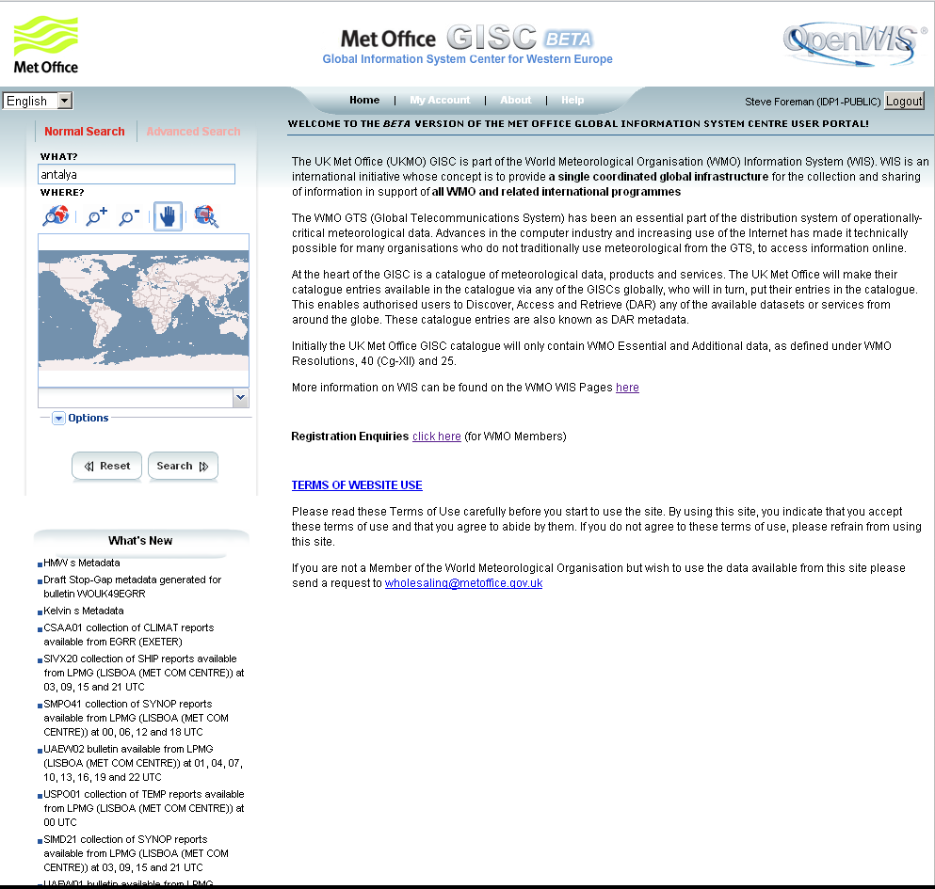
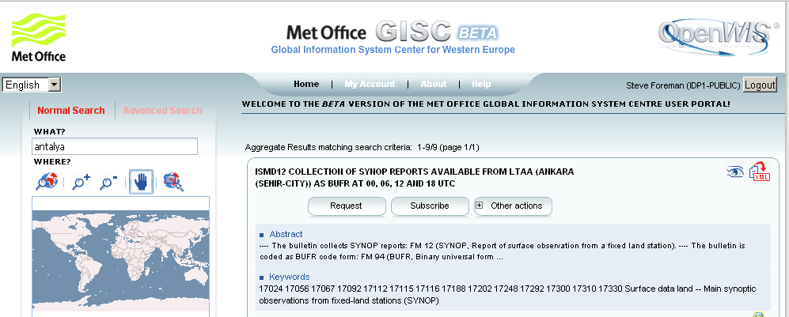
Find information
Look at metadata
… and request it
Search phrase
Links to web sites
Search metadata fields
One-off
Search in area
Search
button
Regular delivery
Download
metadata

Slide 32
Delivery methods
Login needed for “additional” data
Login
needed
Method | Request | Subscribe
Download | ✓ | ✗
Email | ✓ | ✓
FTP | ✓ | ✓
GTS | Not Usually | By arrangement
Post | Perhaps | Perhaps

Slide 33
Standardizing data
Why standardize formats
WMO formats
Candidate “other” formats

Slide 34

Standardizing data
Know
Content
  what values to expect
Format
  how to read the values
File names / headers
  what you are handling

Slide 35
WMO Formats
Table Driven Code Forms
Irregular data (e.g. observation such as synop)
  BUFR
  CREX
    Observations, satellite data, significant weather…
Regular data (e.g. model output fields, coverages)
  GRIB
    Model fields …
Hydrological data
  WaterML 2
  Traditional Alphanumeric Codes (Strongly discouraged)
  Cannot describe modern data

Slide 36
“Other” formats
NetCDF
Widely used in research community
XML
Built into many systems
  OGC Observations and Measurements
    Water ML 2
    Aviation XML

Slide 37
Managing WIS (WMO Information System)
Manuals
Guidance material
Changing the rules for WIS
37

Slide 38
Manuals
Manual on WIS
Manual on GTS
Manual on Codes

Slide 39
Manual on WIS
Organization and responsibilities
Designation procedures
Functions of WIS
Technical Specifications
WIS Discovery Metadata

Slide 40
Manual on WIS
Organization and responsibilities
Designation procedures
Functions of WIS
Technical Specifications
WIS Discovery Metadata
1.1 GISC, DCPC, NC
1.2 Comply with requirements
1.3 WIS Core Network & AMDCNs
1.4 Part A and Part B
1.5 Discovery, Access Retrieval
1.6 Robust and reliable
1.7 Collect and disseminate

Slide 41
Manual on WIS
Organization and responsibilities
Designation procedures
Functions of WIS
Technical Specifications
WIS Discovery Metadata
2.1 General
2.2 Designating GISC
2.3 Designating DCPC
2.4 Designating NC
WIS3 - Managing WIS
41

Slide 42
Manual on WIS
Organization and responsibilities
Designation procedures
Functions of WIS
Technical Specifications
WIS Discovery Metadata
3.1 General
3.2 Procedure for GISC
  formal tests
3.3 Procedure for DCPC
  demonstration
3.4 Procedure for NC
  PR notification
  (Demonstration in Regional WIS IP)
  PR certification

Slide 43
Manual on WIS
Introduction
Organization and responsibilities
Designation procedures
Functions of WIS
Technical Specifications
WIS Discovery Metadata
GISC
Receive information
Exchange with GISCs
24h Cache (global)
Metadata catalogue
Networks (AMDCN)
Recovery
Performance monitoring

Slide 44
Manual on WIS
Introduction
Organization and responsibilities
Designation procedures
Functions of WIS
Technical Specifications
WIS Discovery Metadata
DCPC – for Programme
Collect/produce data
Data - global exchange
Disseminate - Prog
Request/reply
Metadata
Recovery
Performance monitoring

Slide 45
Manual on WIS
Introduction
Organization and responsibilities
Designation procedures
Functions of WIS
Technical Specifications
WIS Discovery Metadata
NC – Programme role
Collect data, Products
Produce information
Provide data, Products
Create Metadata
Performance monitoring

Slide 46
Manual on WIS
Introduction
Organization and responsibilities
Designation procedures
Functions of WIS
Technical Specifications
WIS Discovery Metadata
_________________________________
e.g. WIS-Tech-Spec-12
4.13.1 This specification requires that data
or products downloaded shall be represented
and communicated in a manner appropriate to
the relevant programme.
4.13.2 Data and products should be handled
as specified in the Manual on the Global
Telecommunication System (WMO-No. 386),
Volume I, Part I, 1.3, Design principles of the GTS,
and other WMO manuals, specific to the relevant
programme.
4.13.3 See also 3.5.4 (Disseminate information
to the GISC area) and 3.6.5 (Provide information
intended for global exchange).

Slide 47
Resolution 31 (Cg-17)
Resolution 31 (Cg-17) approved many updates
Manual on WIS (WMO No 1060)
  Recommendation 20 (CBS-Ext.(2014))
Guide to the WIS (WMO No 1061)
  Recommendation 21 (CBS-Ext.(2014))
In addition to the WIS manual and guide, updates were approved for the Manuals on Codes and GTS, including the addition of aviation XML, and the removal of Vol II of the GTS Manual relating to regional practices
Resolution 32 (Cg-17) approved the WIS competencies

Slide 48
Resolution 32 (Cg-17)
“Competences of Meteorological, Hydrological and Climatological Personnel”
Section 5 (WMO-No. 49), VOLUME I
5.4.1 Members operating one or more WMO Information System (WIS) centres should
ensure that the centres have access to people who between them are able to contribute the
required standard Information Technology and management competences together with
competences that are specific to the WMO Information System.
Members should consider the following areas of competence:
Manage the physical infrastructure;
Manage the operational applications;
Manage the data flow;
Manage the data discovery;
Manage WIS centre to centre interactions;
Manage external user interactions;
Manage the operational service.

Slide 49
Manual on Codes
Defines
Traditional Alphanumeric Codes (discouraged)
Table Driven Code Forms
  GRIB
  BUFR
  CREX
    Code tables to support these
In future:
Logical Data Model, XML representations …

Slide 50
GTS as Part A of WIS
GTS - continued consolidation and further improvements for data and products delivery
Time-critical and operation-critical delivery based
on real-time “push” via dedicated telecommunications
Timely delivery based on delayed mode “push”
via combination dedicated + public networks

Slide 51
Relevance of Manual on GTS
Rules for operating WIS Part A
Conventions used in WIS
  File naming
  Abbreviated Header Lines

Slide 52
Guidance material
Formal Guides and WIS wiki
WIS help

Slide 53
Guidance material - http://www.wmo.int/wis
WIS
  http://wis.wmo.int/wis-manaul
  http://wis.wmo.int/wis-guide
GTS
  …/GTS-manual
  …/ GTS-security
  …/ GTS-VPN
Tech Reg 49
  …/ TechReg49

Slide 54
WIS help
GISC Brasilia offers a help desk
Online help GISC Brasilia and and DCPC Buenos Aires, includes:
Introduction
Layout
Registration
Product Search
Destinations
Metadata Editor
Metadata Contacts
Questions on implementing WIS can also be sent to the WMO team using wis-help@wmo.int

Slide 55
Changing the rules for WIS
Operational information
Developing changes to WIS
Approving changes to WIS

Slide 56
Operational Information
Now: WMO No 9, Vol C1 (bulletins)
RTH tells WMO of planned changes
Discovery metadata records must be updated
Planned:
Information in Vol C1 extracted from discovery metadata
Responsibility passes to data originators to notify changes by updating discovery metadata

Slide 57
Developing changes to WIS
Requirements assessed by OPAG-ISS and its expert teams
  Expert Team develop and test solutions
  Proposals recommended by
    ICT-ISS
    CBS-Management Group
    CBS
  Approved by EC (for changes to Manuals)
“Fast track” for codes and metadata changes
  Fast track approved by Cg-17 for all CBS techregs

Slide 58
Operating a WIS Centre
Registering the Centre
Technical Implementation
Running the Centre
Staff competencies (Guide to WIS)
58

Slide 59
Registering the Centre
Applying to register a centre
Assessment of capabilities
Authority to approve a centre

Slide 60
Applying to register a centre
National Centres
PR notifies the Secretariat
  contact details for focal point
  agrees Principal GISC
  confirms centre will meet functional requirements
DCPCs
meet Programme/Regional need
functionality tested by GISC
compliance confirmed by CBS

Slide 61
Applying to register a GISC
Member proposes
  Confirms functional compliance
  Proposed area of responsibility
  Formal PR commitment that services will be provided
Demonstrate
  To CBS – using TT-CAC to confirm technical compliance
Designation by Congress or Executive Council

Slide 62
Assessment of Capabilities
DCPC and GISC – Utilising online form:
Questions about type of centre
Identification Information
General Criteria
Functional Requirements
Technical Requirements
Demonstration Tests
NC – Centre works with Principal GISC to demonstrate capabilities
NC compliance use cases/tests in Regional WIS IP

Slide 63
Technical Implementation
Metadata (all centres)
NC/DCPCs can use tools from GISC
staff training
ICT Infrastructure
NC – may need some ICT development
DCPC – amount of development depends on new services to be offered
GISC – substantial development likely to be needed

Slide 64
Running the centre
Audit Questionnaire discusses many of the issues.
Availability/resilience and how it is achieved
  Infrastructure
  Support & preventative maintenance
  Staffing
Working with other WIS centres
User interaction (eg helpdesk, capacity development)
Monitoring practices and response

Slide 65
National WIS Focal Points
Nominated by the PR to represent them on matters as per the terms of reference approved by CBS Ext(2014)
Listed in the Country Profile Database
  http://www.wmo.int/cpdb
Listed in the RA III WIS implementation plan
Must be kept current
Must complete rotuine survey on WIS implementation

Slide 66
TORs for National WIS Focal Point
National Focal Points for WIS matters are nominated by the Permanent Representatives of Members of WMO. These Focal Points provide the operational channel of communication with the WMO Secretariat, and Centre and National Focal Points for WIS matters.
The responsibilities of the Focal Points are:
(a) Act as a focal point on all WIS activities within the Member State or territory;
(b) Monitor and report on the national status of WIS implementation;
(c) Participate in regional or sub-regional WIS coordination and implementation activities;
(d) Arrange for the authorization of national entities or people for access to WIS;
(e) Ensure issues relating to WIS, including the GTS, and World Weather Watch monitoring are directed to the relevant person and followed-up on;

Slide 67
TORs for National WIS Focal Point
(f) Monitor and participate in the overall maintenance of WIS including CBS expert teams addressing data management and data representation as well as network issues;
(g) Oversee the creation and management of WIS Discovery Metadata for data and products from participation centres;.
(h) Assist centre focal points in matters relating to WIS, including compliance and functional issues;
(i) Identify and follow-up on training and capacity development needs;
(j) Represent the NMHS in WIS contributions and liaison with other initiatives such as WIGOS and GFCS.

Slide 68
TORs for National WIS Focal Point
Resolution 14 (Cg-17), added the following additional tasks:
(k) To receive notifications of amendments to the Manual on WIS (WMO-No. 1060), the Guide to WIS (WMO No. 1061), the Manual on the GTS (WMO No. 386) and associated Guides, and propagate the information within their State or territory;
(l) To comment on amendments to the Manual on WIS (WMO-No. 1060), the Guide to WIS (WMO No. 1061), the Manual on the GTS (WMO No. 386) and associated Guides by the simple procedure, on behalf of the Permanent Representative;
(m) To request amendments to the Manual on WIS (WMO-No. 1060), the Guide to WIS (WMO No. 1061), the Manual on the GTS (WMO No. 386) and associated Guides on behalf of the Permanent Representative.

Slide 69
N° | PAIS | WIGOS | WIS
1 | *ARGENTINA | Mario Jorge GARCIA | Julián DUNAYEVICH
2 | BOLIVIA | Leo Erick Pereyra Rodriguez | Leo Erick Pereyra Rodriguez
3 | *BRASIL | Jose Arimatea SOUZA BRITO | Jose Arimatea SOUZA BRITO
4 | *CHILE | Gastón TORRES ARAVENA | Luis LAZCANO GUERRERO
5 | *COLOMBIA | Hugo Armando SAAVEDRA UMBA | Julio César FRANCO BUITRAGO
6 | ECUADOR | Manuel CARVAJAL | Edison CRUZ
7 | FRANCIA
8 | GUYANA | Ms. Bhaleka Seulall | Ms. Haymawattie Danny
9 | PARAGUAY | Raúl Enrique RODAS FRANCO | Raúl Enrique RODAS FRANCO
10 | *PERU | Jorge CHIRA | Olimpio SOLIS
11 | *SURINAME | Dwight. Samuel | Mrs Truusje. Warsodikromo
12 | URUGUAY | Victor MARABOTTO | Marcelo Chico Espinoza
13 | VENEZUELA | Kleiver José GARCIA | Kleiver José GARCIA

Slide 70
PR specific roles in WIS
PRs have an important role in WIS. They:
Implement WIS nationally under the Regional WIS IP
Authorise participation and/or access to WIS
Ensure WIS compliance of centres
Ensure staff collectively encompass required WIS competencies
Ensure their Country benefits from WIS
Champion use and participation in WIS from partners and potential users/contributors of WIS
Lead in the development of WIS Part C – Information mgt.

Slide 71
Thank you
Questions?

