Slide 1

2014-2015
GISC Seoul
Operation
2015.10.
CHOI Chulwoon / Associate Director, ICT division of KMA

Slide 2

I.
Status of GISC Seoul
Ⅱ.
Interoperability with GEOSS
Ⅲ.
Service of GEOSS Metadata
Ⅳ.
Improvement/Capacity Building

Slide 3
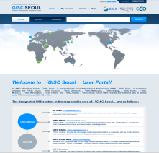


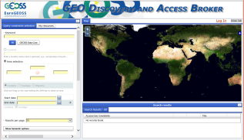



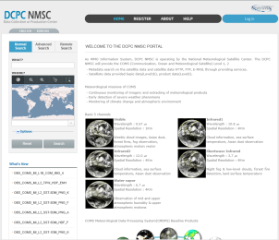
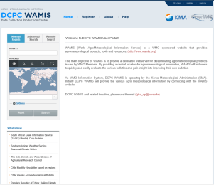
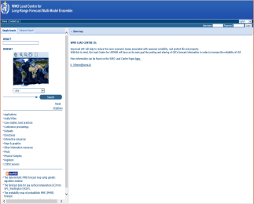
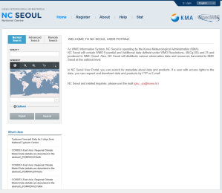
Status of GISC Seoul
Cloud VM
(Pilot Prj)
Cache
Exchange
GISC Seoul
GISC
GEOSS
GISC
GISC
Harvesting
GEOSS Metadata
by OAI-PMH
WIS + GEOSS
Metadata storage
14
GISCs
GISC Seoul
Portal
GISC
GISC
Metadata
Synchronization
GISC
GISC
Cache
Metadata
GISC Seoul Responsibilities
DCPC NMSC
DCPC WAMIS
DCPC LC/LRFMME
NC Seoul
MD/ Cache | 104 25Gb | 69 | 107 | 165 45Mb

Slide 4






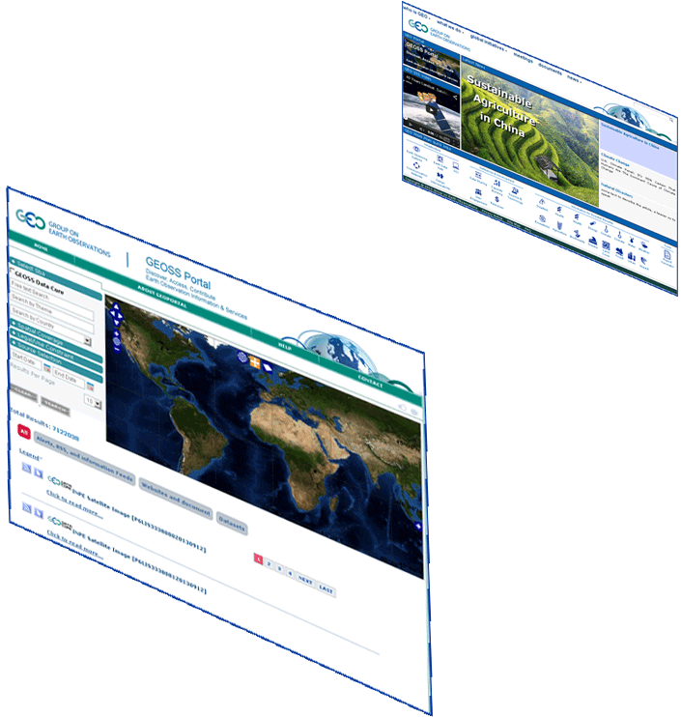

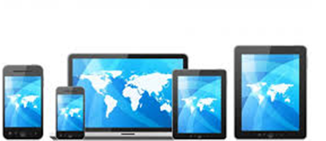

























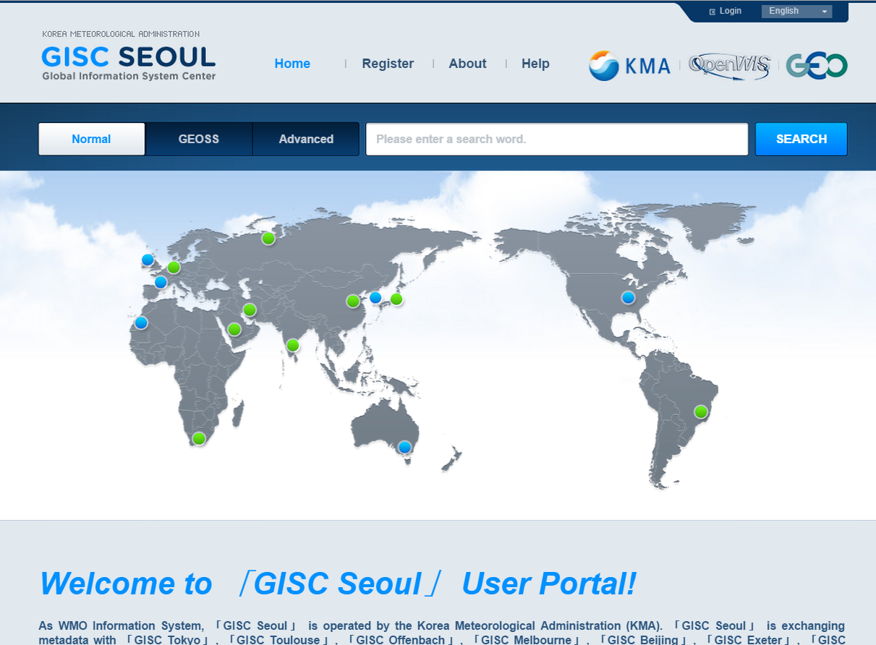


Interoperability Prj with GEOSS : GEOSS Introduction
GEO
Home Page
GEOSS
Community
Portals
About 120
Supply Systems
GEOSS Portal
Brokering
Framework
Registry
(CSR)
WIS
(DWD node)
Semantic engines
GCI
.. .
WIS
(KMA node)
Data Providers Brokered (capacities, systems, networks, etc.)

Slide 5



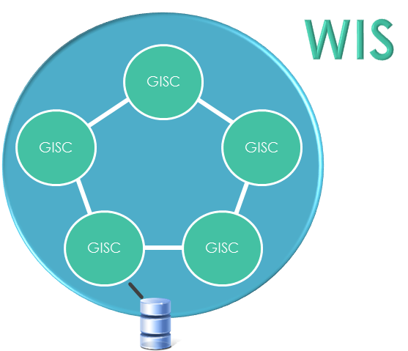

Interoperability Prj with GEOSS : Conception
Outline
GEOSS
Metadata
content
[ Purpose]
Transform to ISO 19115/19139
schema
Service for Meteorological MD
+ Non-Meteorological MD
Supplement metadata
on Time Stamp
[ Agreement with CNR]
Expose the OAI-PMH extended
interface
KMA
- Periodical harvesting the ISO based GEOSS MD : selective harvesting
CNR
- Implementing OAI-PMH 2.0 and supporting update : “deleted records” and “set”
World Wide Web
WIS-OAI-PMH (with optional features)
KMA Harvester
WIS (KMA node)
harvester and Portal

Slide 6
Interoperability Prj with GEOSS : GEOSS Metadata
N. | OAI Set | Feature | N. | OAI Set | Feature | N. | OAI Set | Feature
1 | One Geology | Include invalid information leading to error | 11 | CEOS WGISS Integrated Catalog | Not “dateStamp” Format | 22 | Arc GIS | Not “dateStamp” Format
2 | Knossos | Not following UTF-8 format | 12 | NIWA data Catalog | Not “dateStamp” Format | 23 | GMOS Database | -
3 | EEA SDI Catalog | Not following UTF-8 format | 13 | NWA data catalog | Miss “dateStamp” | 24 | US Data Gov. | No link to cache data
4 | South African Evrt.Obrt.Net | Miss “dateStamp” | 14 | New Zealand Government Geodat. | Not “dateStamp” Format | 25 | IRIS Station | Miss “dateStamp”
5 | EGASKRO | Not following UTF-8 format | 15 | BYU World Water Data | Not “dateStamp” Format | 26 | Red Vial | Not “dateStamp” Format
6 | IODE | Duplicate it with others:SeaData. | 16 | ISPRA Monitoring network | Miss “dateStamp” | 27 | Limites | Not following UTF-8 format
7 | SeaDataNet | Not “dateStamp” Format | 17 | Global River Discharge Dat. | Miss “dateStamp” | 28 | New Zealand Monitoring Net. | Miss “dateStamp”
8 | PANGEA | Miss “dateStamp” | 18 | Global River Discharge Dat.Set. | Miss “dateStamp” | 29 | RASAQM | Not following UTF-8 format
9 | NASA Global Change Mst.Drt. | Not “dateStamp” Format | 19 | MEDINA SDI | - | 30 | Canadian Monitoring Net. | -
10 | NOAA Unified Access Framework | Not “dateStamp” Format | 20 | MEDINA BP Broker | Miss “dateStamp” | 31 | New Zealand Gov. Data | Nothing based on ISO19115
11 | Webservice Energy Catalog | Not “dateStamp” Format | 21 | Data Integration &Analysis Syst. | Not following UTF-8 format | 32 | FedEO | -

Slide 7
Interoperability Prj with GEOSS : Metadata Processing
GEO DAB | GISC Seoul
Setting each harvesting to each OAI-SET of DAB
MD Mgt.
Service
MD
Harvestor
(OAI-PMH)
Schema
Validation
Check
valid
Extending
MD
Yes
MD Sending Module
(OAI-PMH)
Invalid
No
Message
Processing
Ext. MD
Decoding Module
Check on
UTF-8
GEOSS
MD
Check on Update : New or Old
Yes
Remove
HTML Special Character
MD Indexing
(Searching Engine)
GEOSS
MD
Assembly
No
Missing dateStamp
Setting
Message
Processing
ISO19139 filtering
MD Update for modified and deleted
GEOSS
MD(DB)
GEOSS
MD(Index)

Slide 8
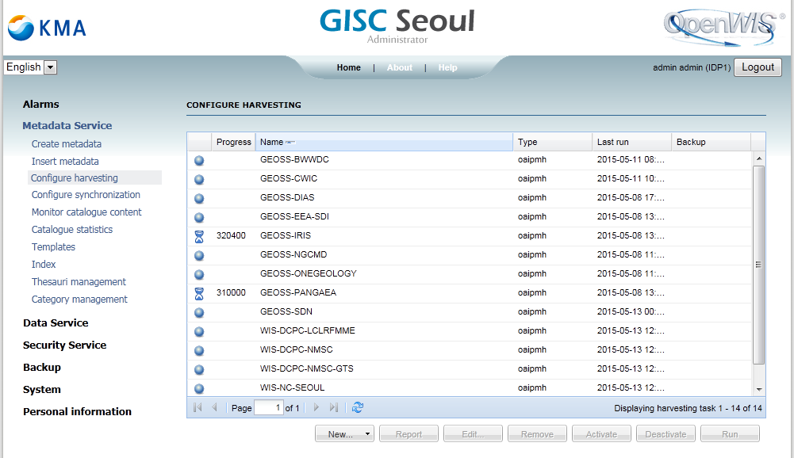
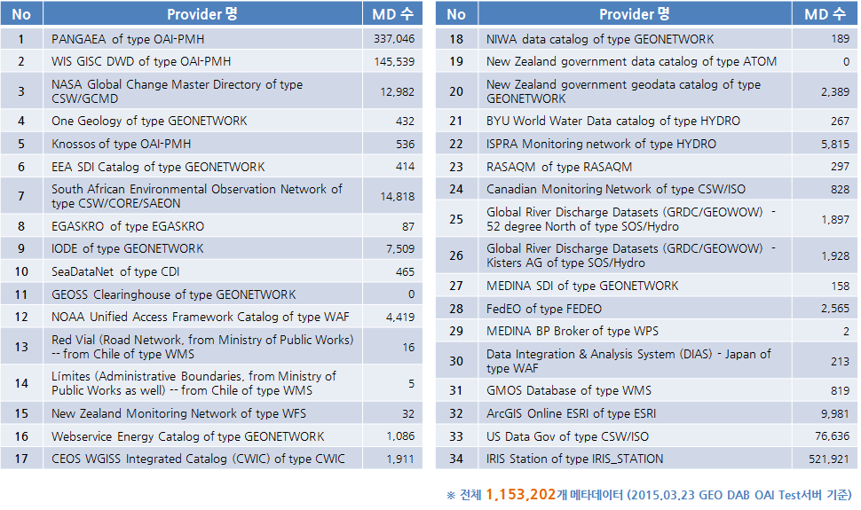
Interoperability Prj with GEOSS : Harvesting Result
[ Harvesting]
The admin Portal operates and controls the harvesting from MD
[ Status]
The number of GEOSS metadata to each 34 sets is shown on the table.

Slide 9
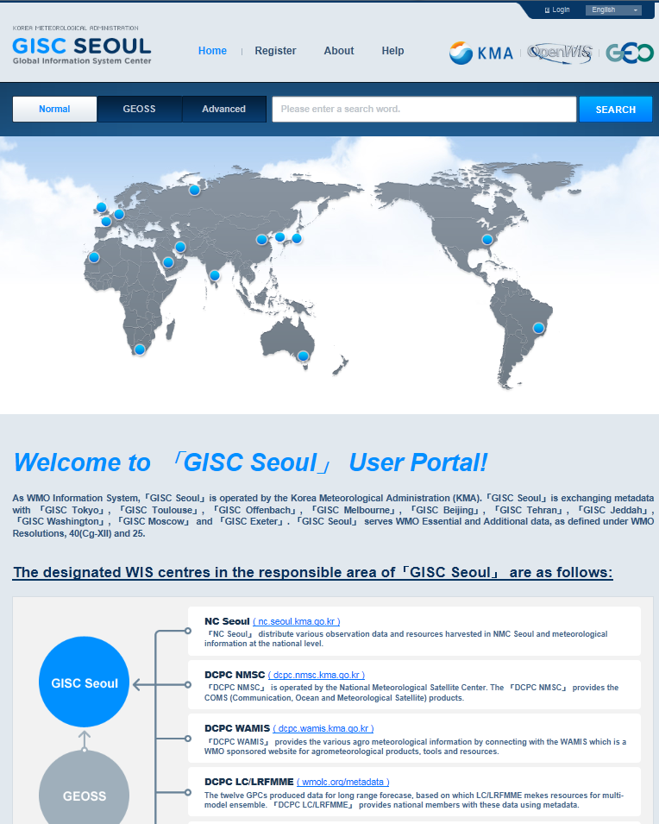
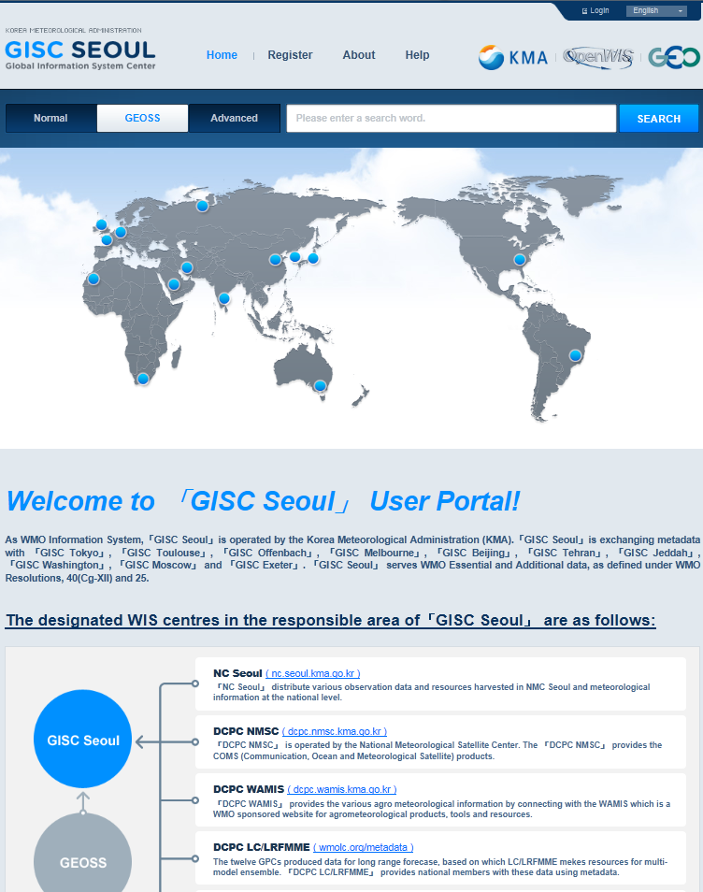
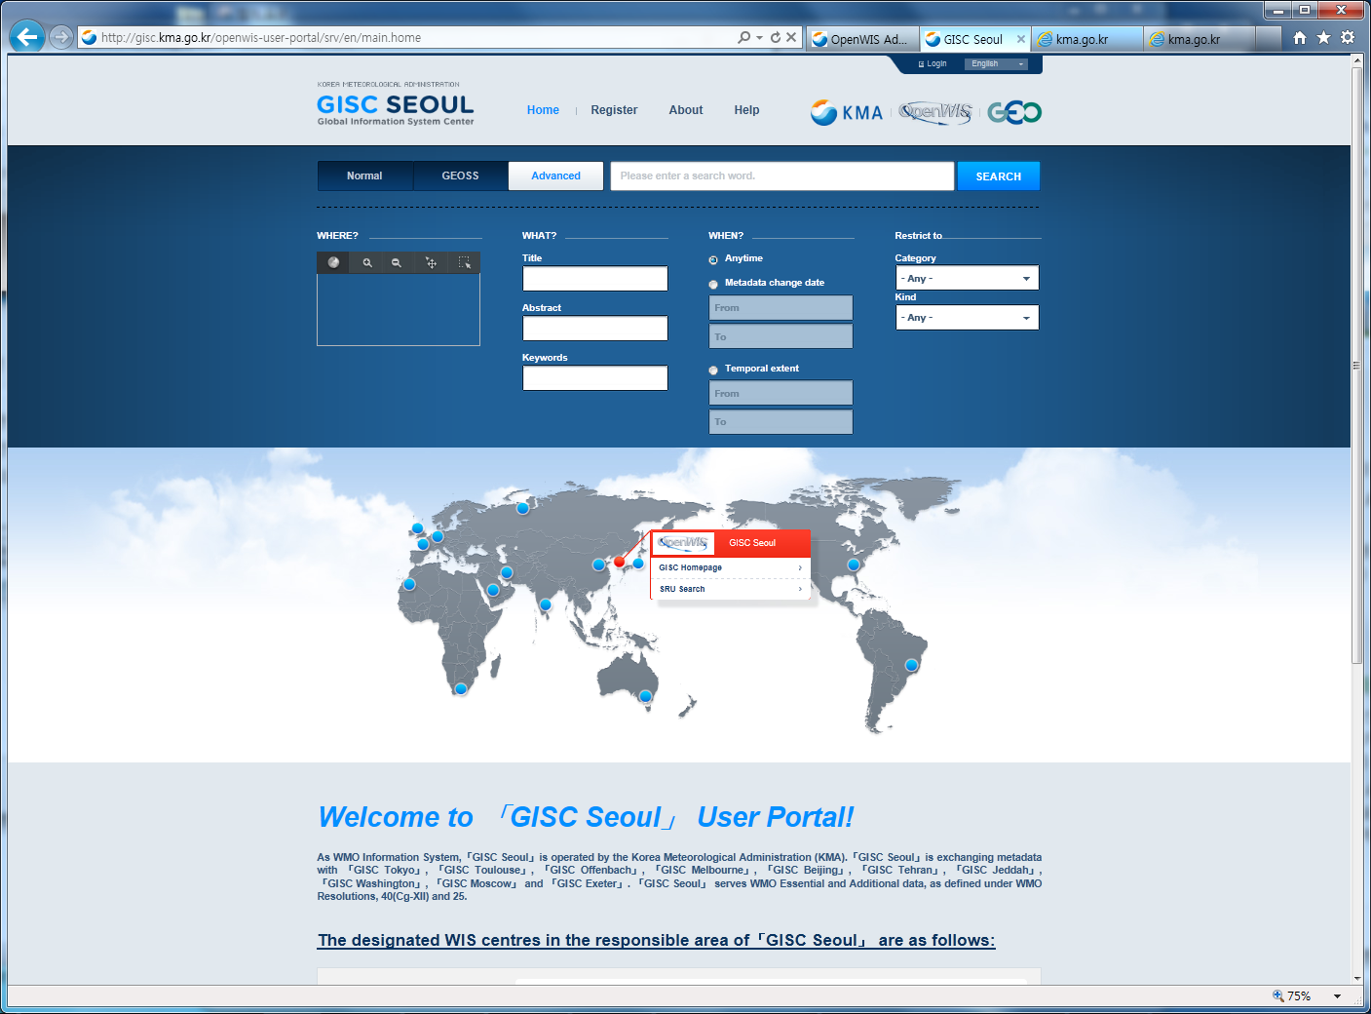
Service of GEOSS Metadata
[ Searching menu]
Provide three kinds of search-services : (1) Normal, (2) GEOSS, (3) Advanced
(2) GEOSS : only GEOSS
(1) Normal : WIS+GEOSS
(2) GEOSS : only GEOSS
(3) Advanced
WIS & GEOSS
Only GEOSS

Slide 10
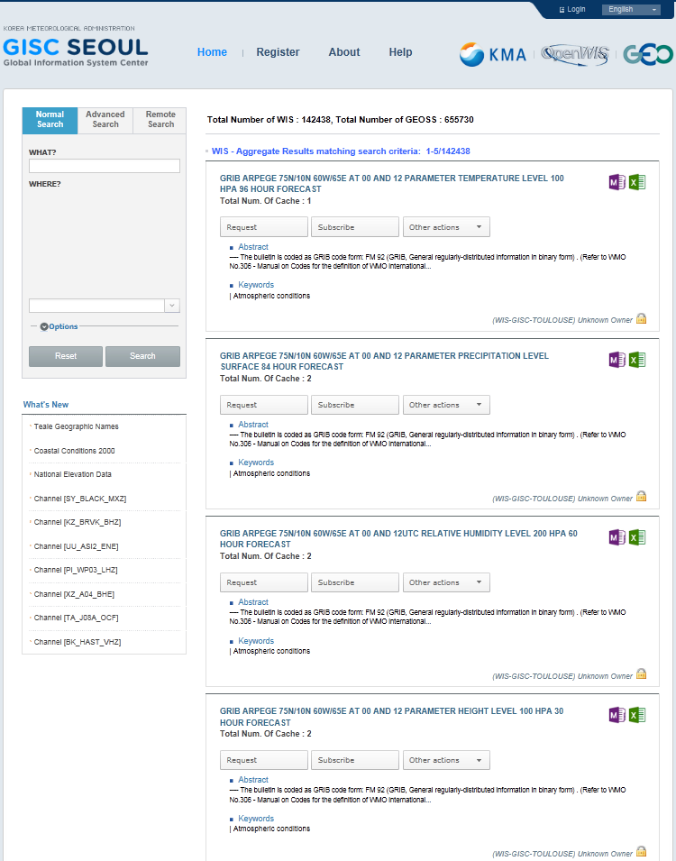
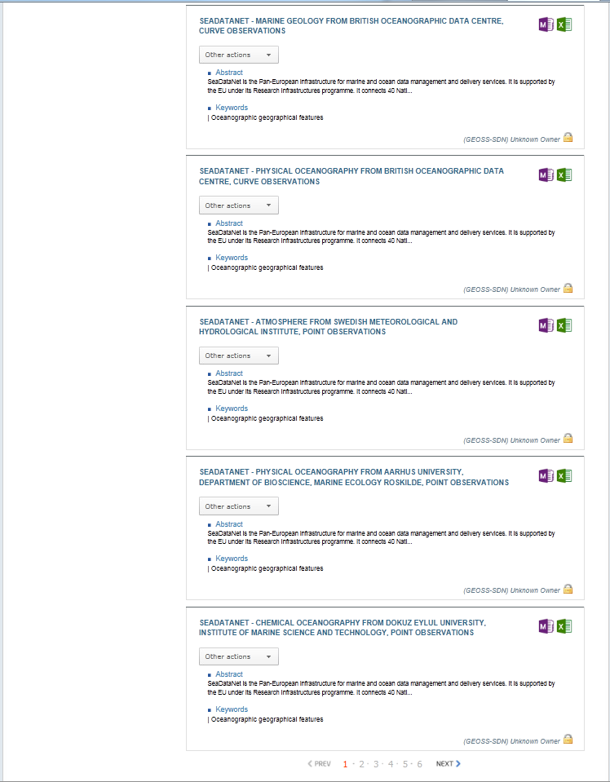
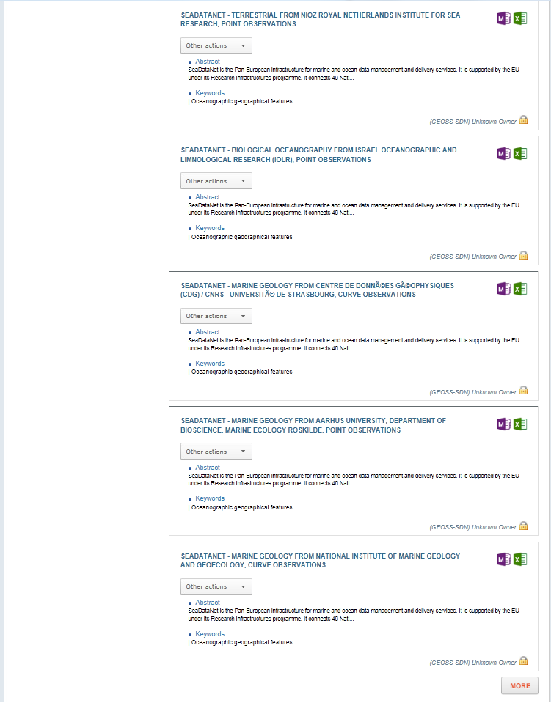
Service of GEOSS Metadata
[ Searching Result]
Provide separate searching result.

Slide 11
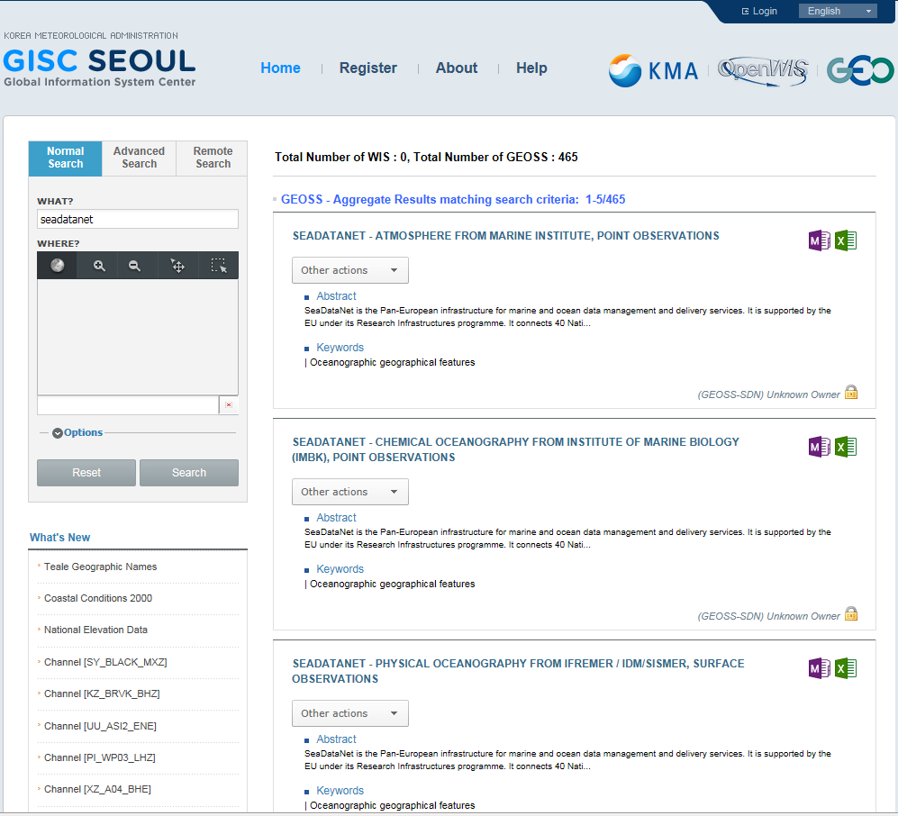
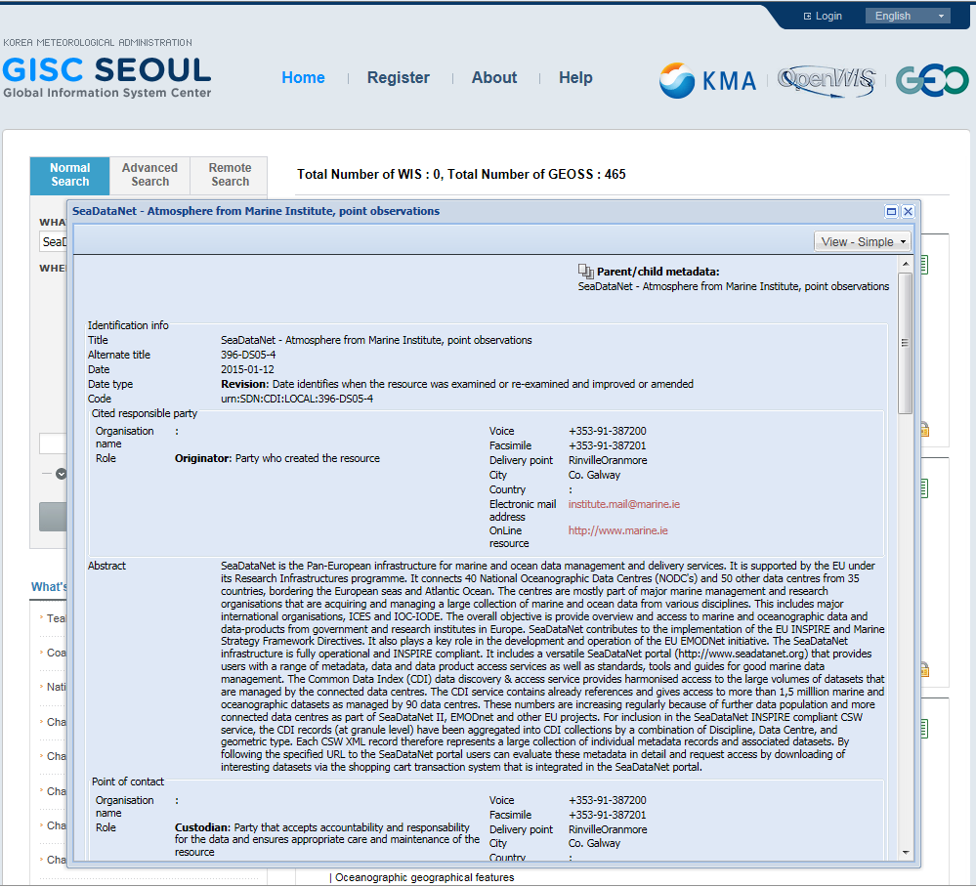
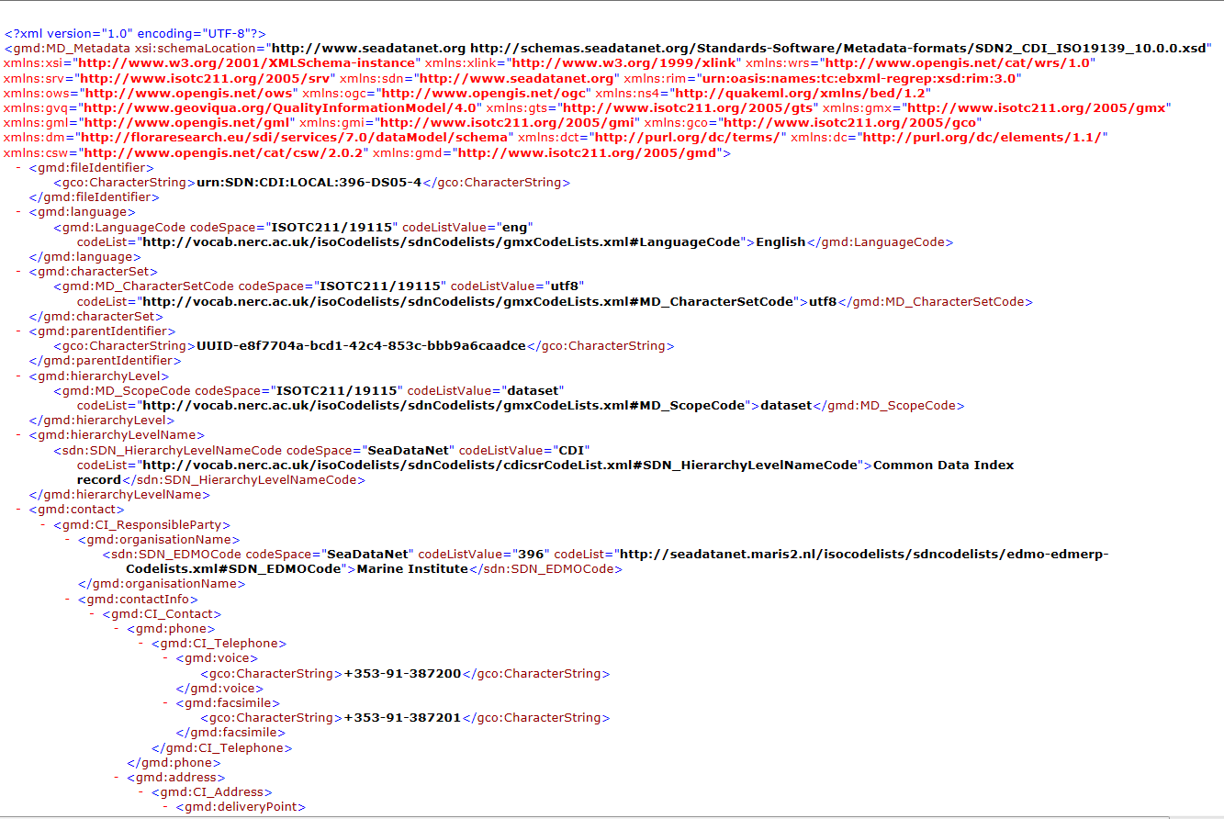
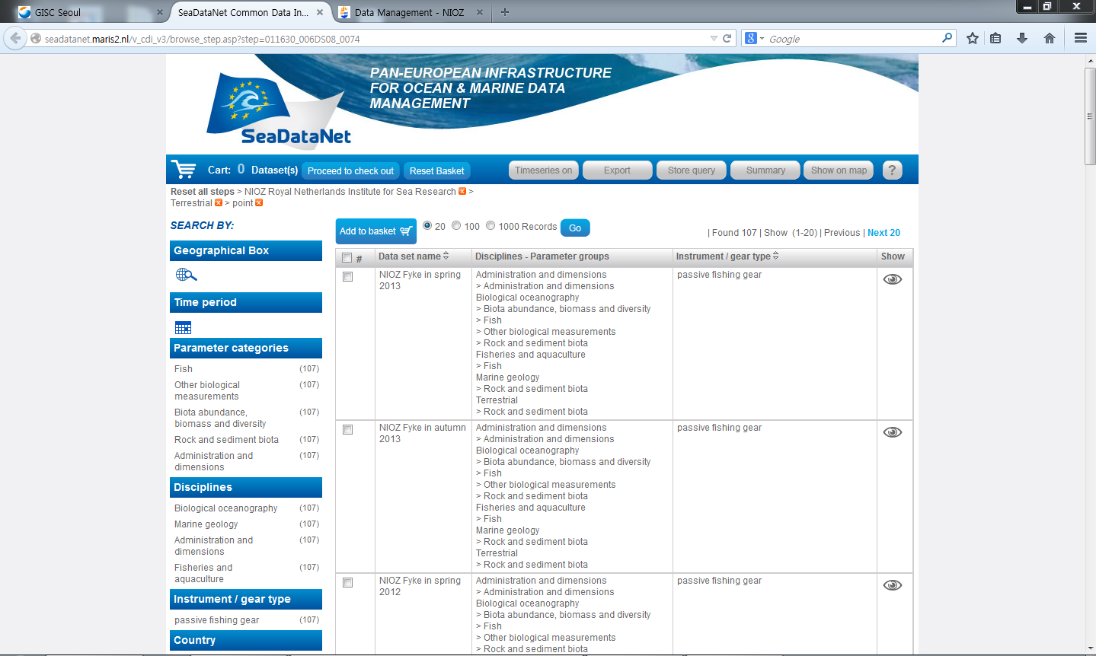
Service of GEOSS Metadata
[ For Example]
If we select one GEOSS Metadata, “SeaDataNet”, …
Searching Result and Hyperlink
Display Metadata

Slide 12
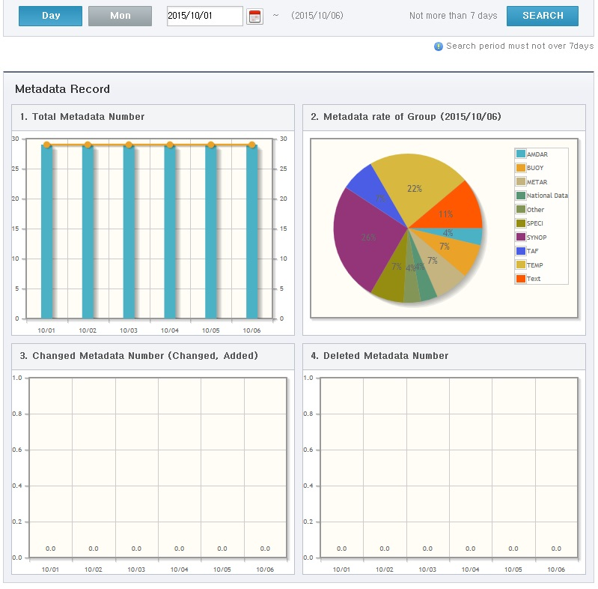
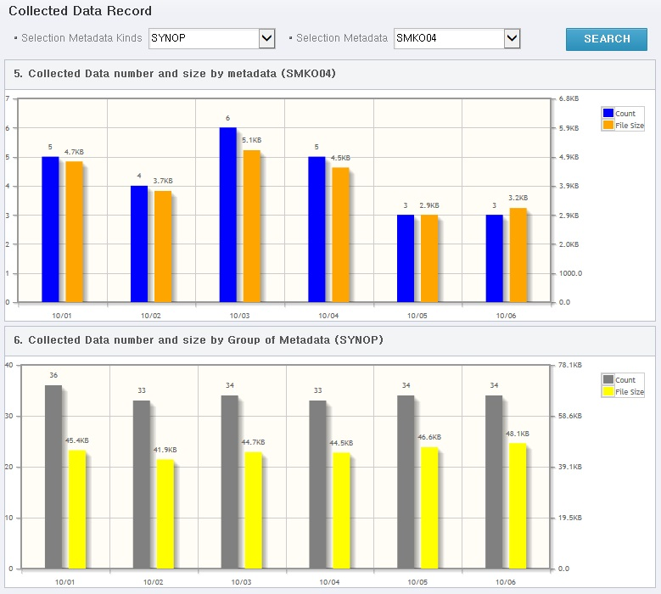
Improvement/Capacity Building
[ Statistics Service : e.g. NC Seoul]
Outline
[ Improvement]
Make visitors identify the status
of data : how many updated, how much size, etc
[ Capacity Building]
Workshop
- held in Apr. 2015 to improve the service
- apply OpenWIS to DCPC LC-LRFMME

