Slide 1
Some thoughts
WMO; Ad hoc inter-programme workshop on representation of WIGOS and climate metadata

Slide 2
Thoughts for Data Exchange
We need to balance:
  Sending everything in a message
  Passing WIGOS Metadata by reference
  Similarly for other climate metadata, e.g. data lineage and provenance
  All data (including metadata) needs to be machine navigable
    To support future automated services

Slide 3
Thoughts for Data Exchange
Many people will just want ‘42’
But need to navigate to the context describing ‘42’
  As Required

Slide 4
Thoughts for Data Exchange
For Discovery Metadata
  We have ‘metadata’ catalogues
What do we have for
  Observations Metadata
  Data Provenance
  What experiences with SOS?
    Is this an option?

Slide 5
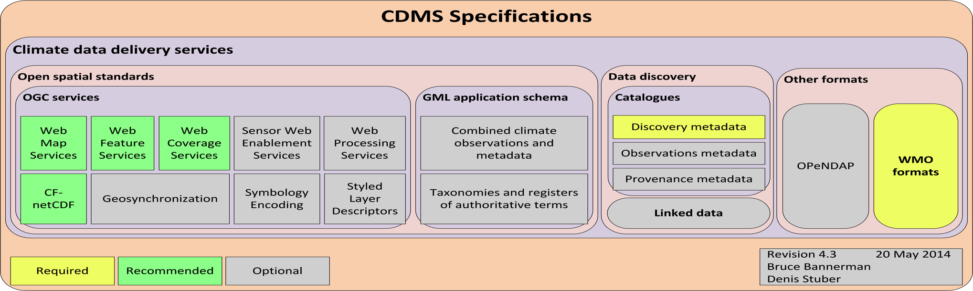
CDMS Climate Data Delivery

Slide 6
Thank you for your attention
Bruce Bannerman
b.bannerman@bom.gov.au
Australian Bureau of Meteorology
Co-chair ET-CDMS

