Slide 1
WIGOS Metadata
Some perspectives…
Karl Monnik
Observations & Infrastructure Division
Co-chair of TT-WMD

Slide 2
WIGOS Metadata
Ensuring maximum usefulness of WIGOS observations
Especially as the nature of observations change
  Much WIder than just the GOS
  Non-standardised observations
  Obs external to NHMS
Integrity of observations being challenged

Slide 3
GCOS (Global Climate Observing System) Climate Monitoring Principle #3
“The details and history of local conditions, instruments, operating procedures, data processing algorithms and other factors pertinent to interpreting data (i.e., metadata) should be documented and treated with the same care as the data themselves.”

Slide 4
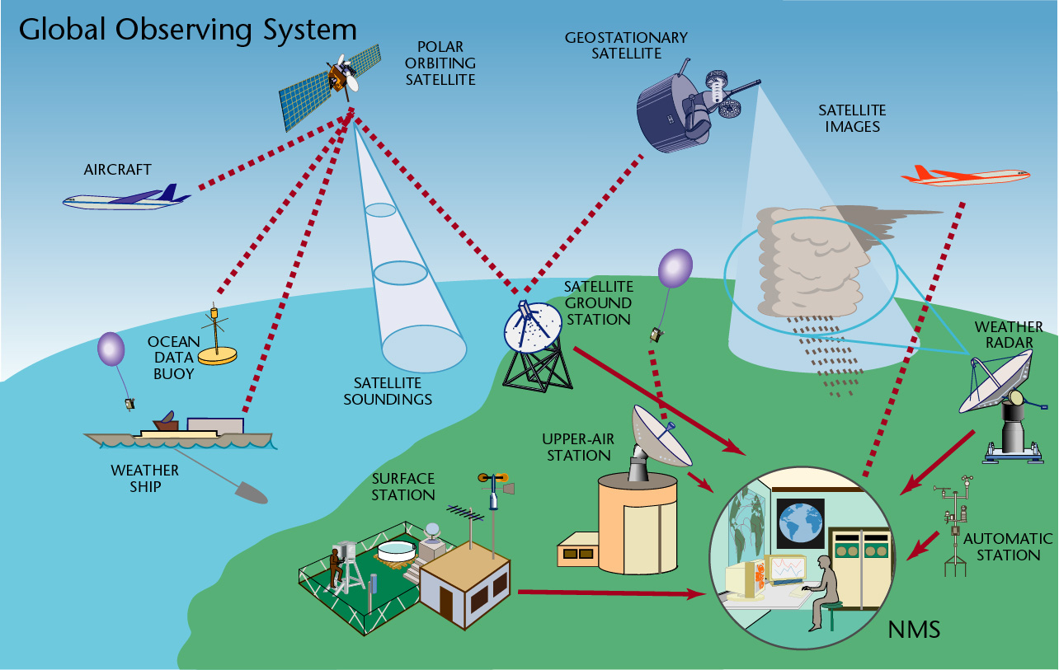
GOS part of WIGOS

Slide 5
What is SitesDb ?
The Bureau’s Corporate Database of Site Specific Information (Metadata).
    Lat, Long, Name, Environment, Photos, Identifiers … etc
    Equip type/make, S/N, Replacements, Last check, Faults … etc
What SitesDb provides
    Network Definitions and Structures – eg Basic Observing System hierarchy
    Network Costing – eg Cooperative Observer funds management
    Network Performance – eg AWS, EFB, Upper Air performance
    Auditing Information – location and history of major equipment assets
    Fault Reporting & Notification – web and email integration
    Maintenance Management - Maintenance Scheduling, Configuration info etc.
    Quality Monitoring – eg performance checks, inspection & maintenance frequency
    Asset Management – eg Age Profiles etc.
    and more …………..

Slide 6
What is SitesDb and why was it developed?
Bureau’s corporate repository of station specific metadata and directly supports a variety of station and network management processes.
Developed out of necessity - number of disparate sources of station information - paper files, databases, spreadsheets, diaries, knowledge held by individuals, etc
Operational since 1997 - increasingly valuable tool from both an operational and management perspective underpinning many day-to-day program activities.
Integral part of the Bureau’s Information Systems - pivotal to the organizations Data Management Strategy.
Not just historical station metadata - many station and network management functions.

Slide 7
SitesDb Project Objectives
Provide an accurate and unified database of current and historical information (metadata) relating to Bureau Observation Sites.
Directly support the Climate Archive and assist with Observations, Engineering and Hydrology program functions.
Provide an accurate source of data from which other systems can update common information (Station dictionaries etc).
Replace many of the functions of paper Station Files, (registration of new stations, station inspections etc.)
Rationalize and enhance a number of independent systems in Climate Archive, Observations & Infrastructure, Hydrology and Regions.
Provide a core facility around which other program specific tables may be developed.

Slide 8
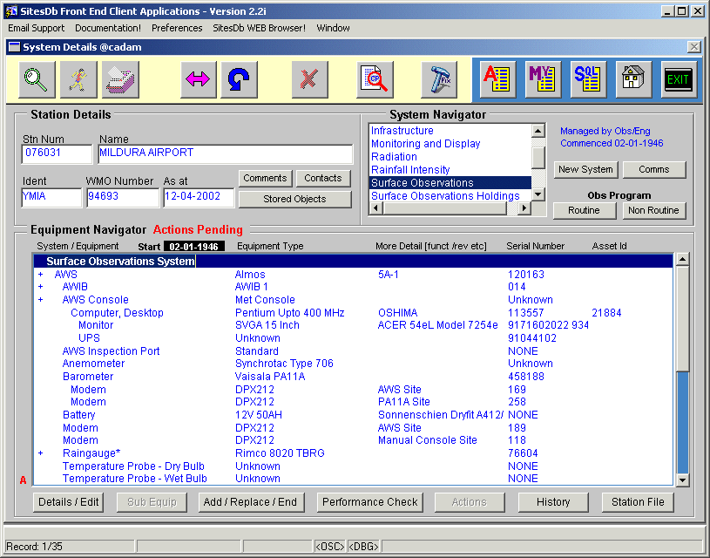
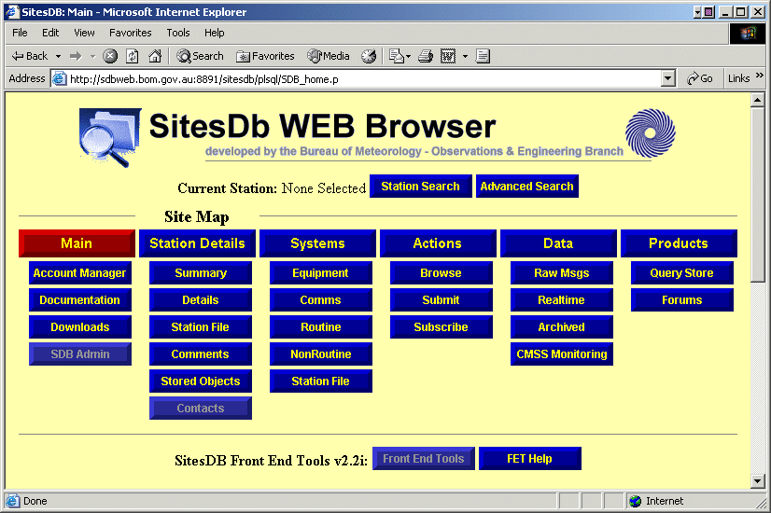
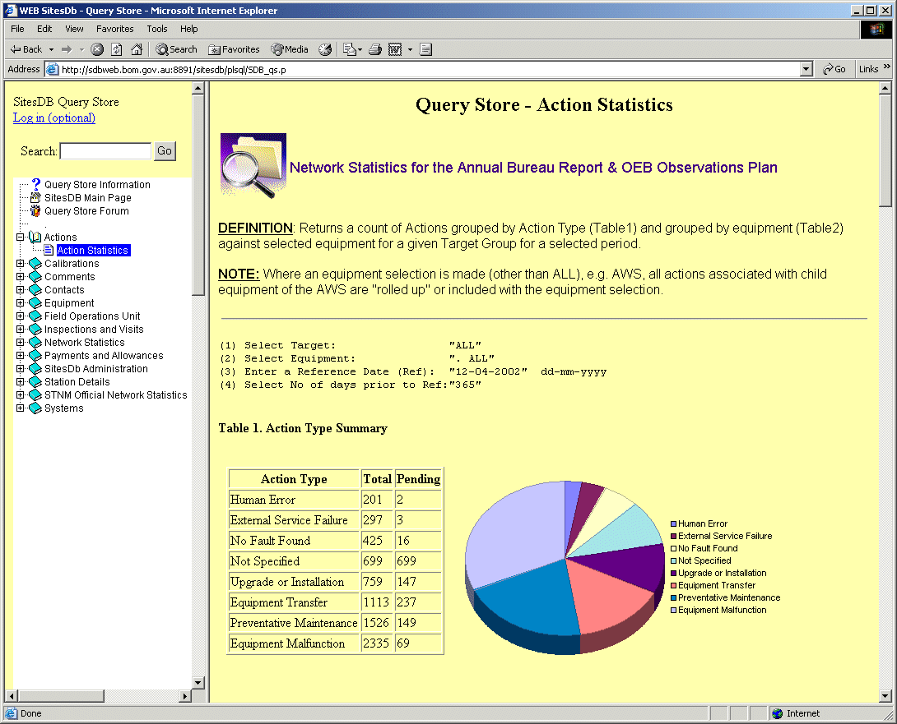
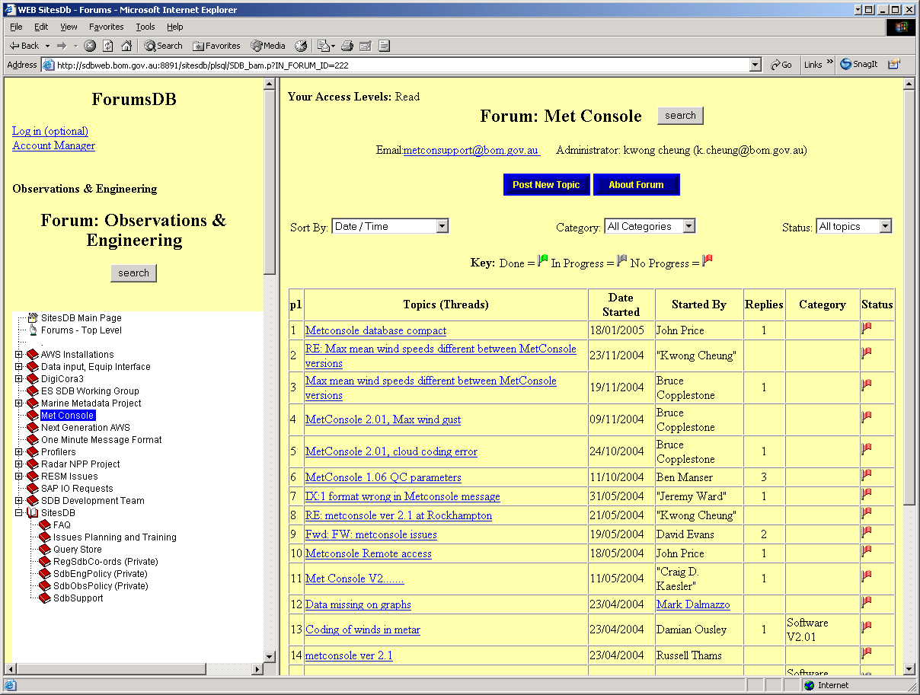
What are the SitesDb System Components ?
Front End Tools
SitesDb Web Browser
Query Store
Forums
Maintain
Browse
Report
Discuss / Resolve
WEB Server
Oracle
Application
Server
Facts Table
Approx 200 users maintaining data
Approx 200K entries last 12 months
Storing 60K documents (objects)
30K to 60K hits per month
Access to over 150 dynamic reports
Many forums - help /discuss /resolve
Client Server
Oracle
Database

Slide 9
How is SitesDb Used ?
Front End Tools
International Stations
Regional
Systems
BNOC
Dictionary
Australian Stations
Network Management
Fault Reporting
Annual Reports
International Reports
Audits
Performance Indicators
Planning
Quality Control
Spares Management
Annual Stationery
O&I, Marine & Hydro
Programs
Maintain Data (200)
Observations
Engineering
Hydrology
Specialist HO users
SitesDb
OTHER
Databases
Station Details
ROCS etc
CMSS Monitoring
AWS Reporting
CMSS
Metadata
Station History
Sensor Types/Replacements
Performance Checks
Faults
ADAM
Climate Archive
Climate data
Data Records
Research
Activities
Climate
Products
Financial & Asset Manage
Reference Info to assist FMS
Financial and Asset Reports
Radar Metadata
Hydro Met & BMRC
Rainfall Ground truth

Slide 10
SitesDB Basic Structure
Contacts
Comments
Stationery
Actions
Station Details
Objects
Inspections
Programs
Comms
Systems
Equipment
Perf Check
Actions
Equip_type
Sub-Equip

Slide 11
How does SitesDb assist Climate?
Sources of inhomogeneity:
  1. Changes in location
  2. Changes in instrumentation
  3. Changes in exposure or environment
  4. Changes in observation practice
  5. Changes in data processing
All are recorded in SitesDb

Slide 12
Station objects/image

Slide 13
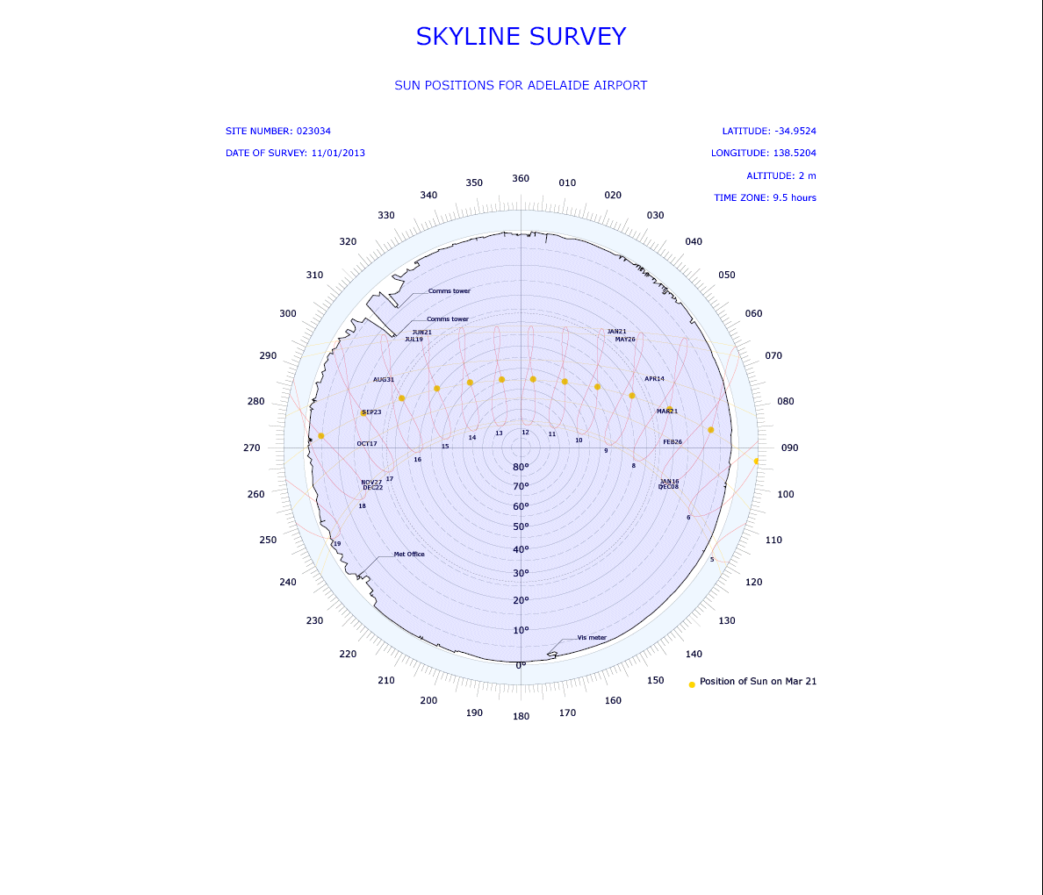
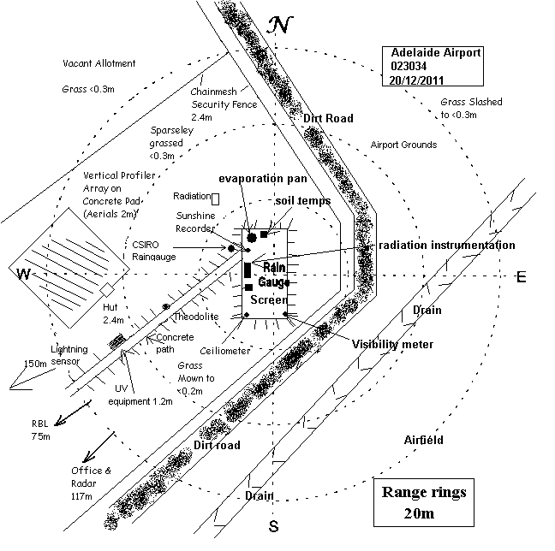
Station siting

Slide 14
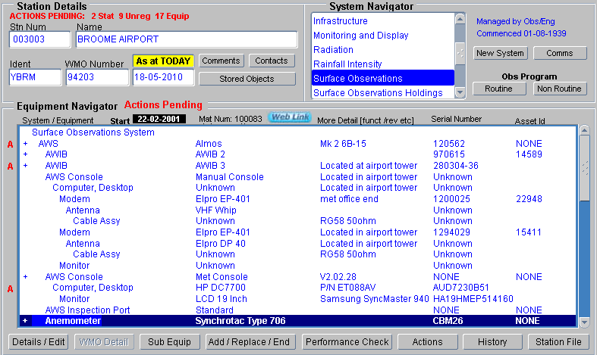
Parent & child relationship
Hierarchical relationship where the child equipment requires any parent equipment to operate.

Slide 15
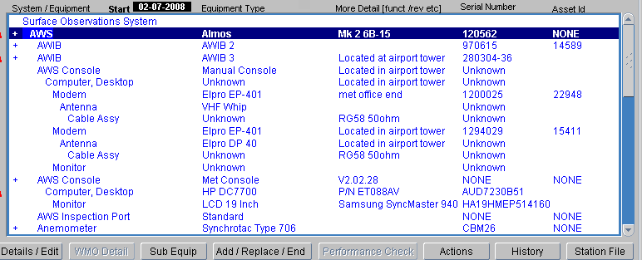
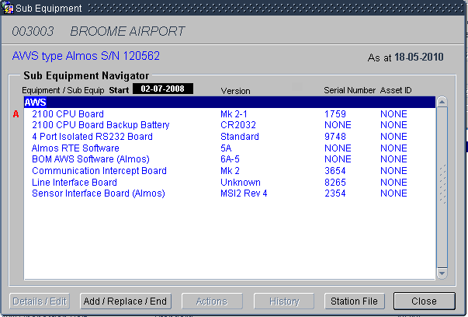
Equipment and sub-equipment
Equipment sub-equipment describes components of equipment based on four requirements;
1. Fault reporting
2. Configuration management
3. Equipment tracking
4. Spares management
Sub-equipment moves with equipment.

Slide 16
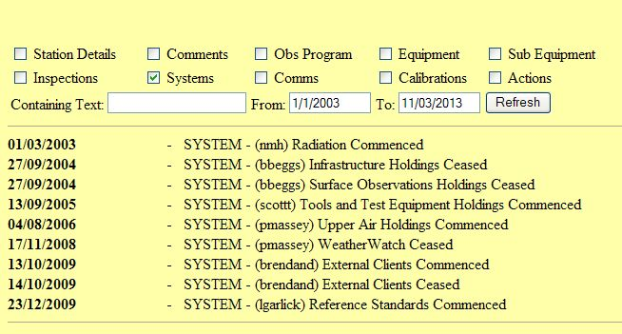
System & Equipment
16/02/1955 - INSTALL - (bbeggs) Barometer (Type Kew pattern mercury S/N - 1769) Surface Observations
16/02/1955 - INSTALL - (bbeggs) Barometer (Type Kew pattern mercury S/N - 1846) Surface Observations
07/05/1992 - INSTALL - (akn) Barometer (Type Vaisala PA11A S/N - 458180) Surface Observations
01/07/1992 - REMOVE - (bbeggs) Barometer (Type Kew pattern mercury S/N - 1846) Surface Observations
01/12/1996 - REMOVE - (bbeggs) Barometer (Type Kew pattern mercury S/N - 1769) Surface Observations
16/12/2002 - REMOVE - (akn) Barometer (Type Vaisala PA11A S/N - 458180) Surface Observations
17/12/2002 - INSTALL - (akn) Barometer (Type Vaisala PTB220B S/N - W4920008) Surface Observations

Slide 17
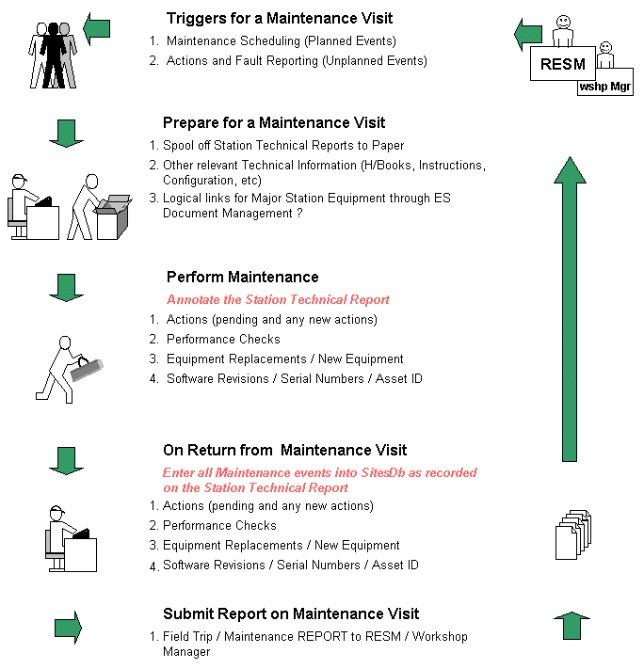
Typical Workflow with SitesDb

Slide 18
SitesDb
Station metadata – broad range of operational information
Historical record of all aspects of station environment & equipment
Combines disparate sources of information
Provides tools for managers and staff to manage daily program, prioritise, record, report

Slide 19
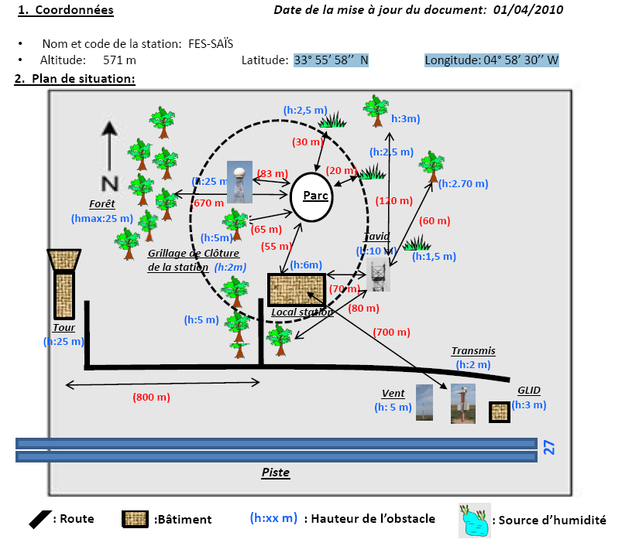
Morocco

Slide 20
MSC History
Previous in-house solution circa 1994
Desire for national consistency ~2004
2008 Decision to replace with a commercially available tool (Oracle)
Fell in line with Departmental strategy for asset management (Oracle purchased Feb 2009)
MSC went Live Feb 28, 2011

Slide 21
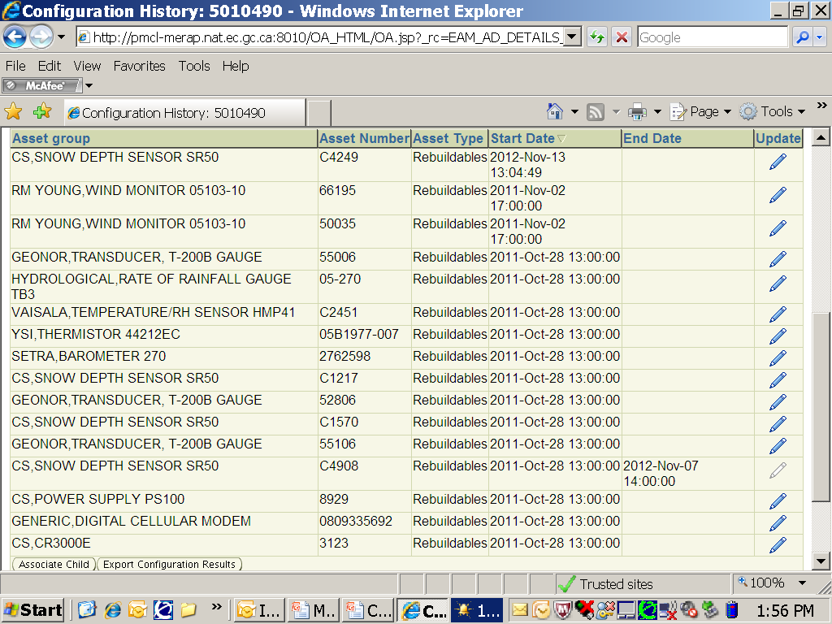
Display of Sensors at the Station

Slide 22
A Metadata standard for FENGYUN polar satellite data has been drafted. it is for procedure of data collecting, process, archiving, dissemination.
The Core Metadata comprises of 8 parts.
Part 1. Metadata entity information
Part 2. Data resource description information
Part 3. Data quality information
Part 4. Reference system information
Part 5. Coverage information
Part 6. Archiving information
Part 7. Delivery information
Part 8. Complementary information

Slide 23
NHMS Insights
Very little routine exchange of metadata
Global standards are application specific
Every NHMS has their own method of MD storage
Paper records are still prevalent

Slide 24
Questions?

