Slide 1
WIGOS Metadata Standard
& OSCAR/Surface development and implementation
Jörg Klausen
MeteoSwiss
Co-chair ICG-WIGOS TT-WMD
Chair OPAG EPAC ET-WDC
OSCAR Project manager
IPET-MDRD-2, 22-25 June 2015, Melbourne

Slide 2
Acknowledgments
ICG-WIGOS, TT-WMD
  Sue Barrell, Bertrand Calpini, …
  Brian Howe, Karl Monnik, Joe Swaykos, Tony Boston, Uli Looser, Ercan Büyükbas, Zhao Licheng, Antonio Mestre, Tim Oakley, Steve Foreman, Dean Lockett, Luis Nunes, Roger Atkinson, …
Project Team at MeteoSwiss
  Jürg Mannes, Lucia Cappelletti, Bertrand Calpini, Marc Musa, Martin Brändli, Lars Koppa, Sascha Spreitzer, Christian Walder, Estelle Grüter, Marc Leutenegger, Stefan Sandmeier, Martin Schäfer, Alex Rubli, Claudia Sigg, Markus Abbt, Walter Brunelli , Josefa Mettler, …
Project Team at WMO
  Wenjian Zhang, Lars Peter Riishojgaard, Etienne Charpentier, Timo Pröscholdt, …
Project Team at European Dynamics
  Nassos Michas, Christina Kaskoura, Martin Ulmann, Lia Christou, Nektaria Pappa, …
JCOMMOPS, GAW WDCs, NDACC, ET-WDC, …
Financial contributions
  Federal Department of Foreign Affairs, MeteoSwiss, WMO, Met Norway

Slide 3
Motivation

Slide 4
About observations …
«We cannot manage what we cannot measure» (J. Butler)
  Observations are needed
What’s the meaning of «42»?
  Basic metadata are needed for any use of data
Observations can be used in different ways
  For adequate use of data, adequate information about the data is critical
The whole is more than the sum of the pieces
  Smart co-location / combination of observations has a much larger potential than single observations

Slide 5

Data or Metadata?
Position of aircraft making AMDAR observations
Surface pressure observation used for GPS IWV inversion
Total ozone data used to calibrate radio sonde observation
One man’s data
are another man’s metadata
Data and metadata
must hold on to each other!

Slide 6

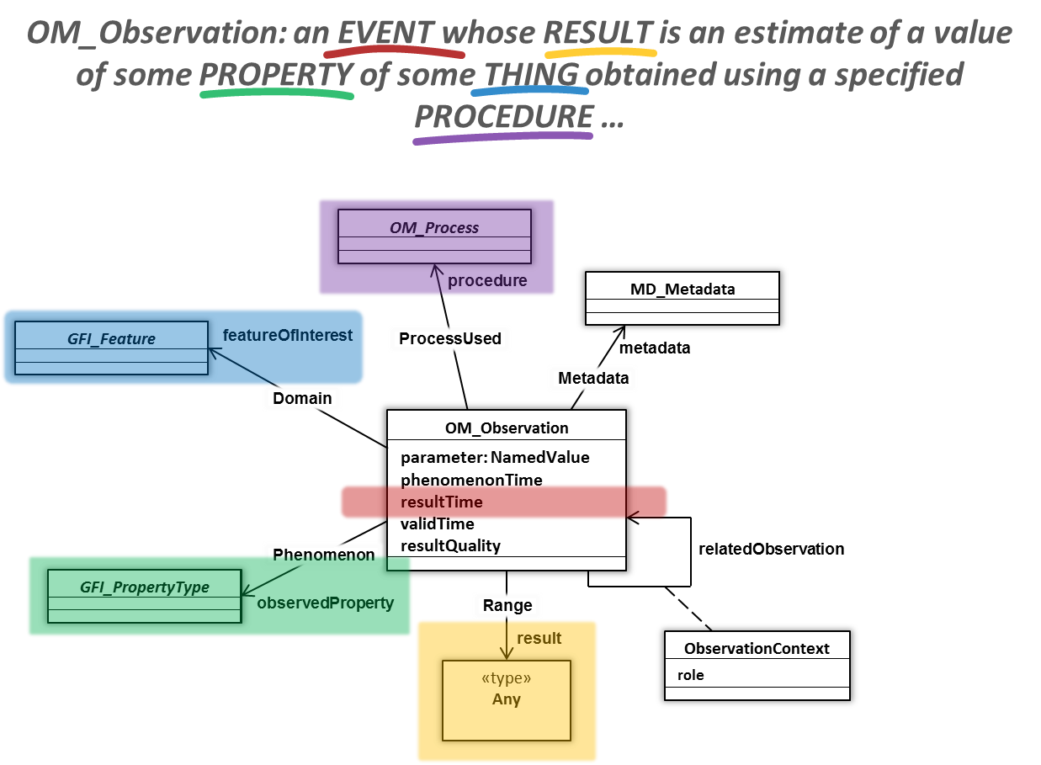

WIS & WIGOS Metadata
WIS
Make observations discoverable and accessible
Describe data policy
→ Operational
Geographical Extent
Keywords
MD_Metadata
Contact
Distribution
Legal Constraints
Describe observation to
enable adequate use
Support rational evolution
of observing systems → RRR
Semantic standard developed
and under review
Formalization coming soon
Adoption by Members in phases 2016-2020
WIGOS
MD_Metadata: Something somewhere that can be accessed under certain conditions and about which someone knows more.

Slide 7
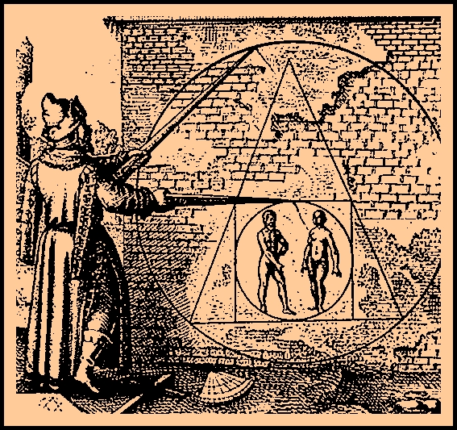
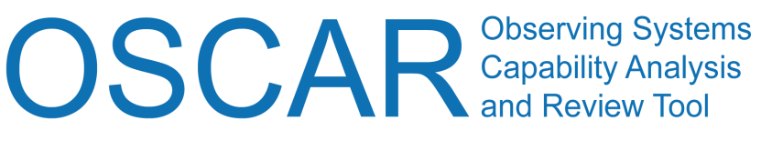
WIGOS Metadata Standard
Principles
Scope
… or, how to square the circle
Enable adequate use of observations
Timestamp every piece of metadata
For all internationally exchanged observations
For all types of observations
Metadata updates in a timely/useful manner
Applicable to all disciplines
Acceptable to and applicable by all Members
Forward-looking but also respecting legacy
Observed variable
Purpose of observation
Station/platform
Environment
Instruments and method of observation
Sampling
Analysis/processing and reporting
Data quality
Ownership and data policy
Contact

Slide 8
TT-WMD Terms of Reference
Identify the information needed to allow the majority of users to use WIGOS observations in appropriate contexts and in a defensible way;
Create the WIGOS Core Metadata Standard that allows the essential information to be exchanged unambiguously, regardless of the format used for the transfer;
Define a mechanism for maintaining the WIGOS Core Metadata Standard, including [elements] additional to the Core and coordinate with the ICG-WIGOS Task Team on Regulatory Material (TT-WRM) on any appropriate documentation as needed for WIGOS related Manual(s) and Guide(s);
Implement within the WIGOS Core Metadata Standard, and the WMO Core Metadata Profile, a standard method of providing users with an indication of the quality of the data, and to do so in a way that distinguishes with the quality management of the data (“quality of the observation”) and ensuring that the user is able to identify which applications the data are suitable for (“classification” of the observation”);
To coordinate regularly with the ICG-WIGOS as needed and report at least annually to the ICG-WIGOS on the progress;
To complete its tasks and hand over additional requirements to its successor (if required) in time for approval by Cg-17.

Slide 9
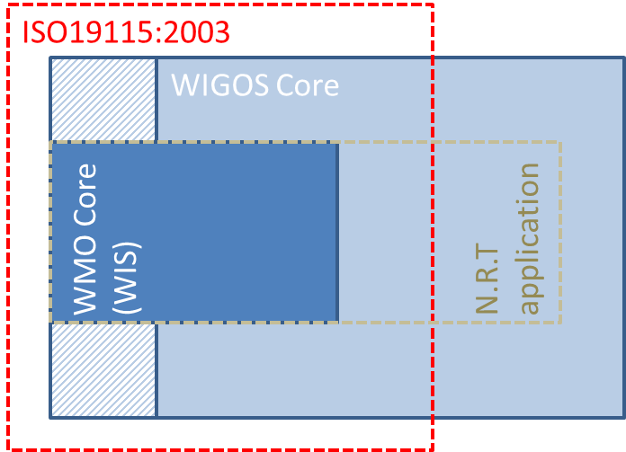
Profiling of WIGOS Metadata Standard
Specify sub-sets of standard for particular application areas, e.g.
  Particular science projects
  Climate
  Air Traffic
  NWP Assimilation
  Warnings
  Road Forecasts
Profiling makes standard more manageable at the risk of precluding future data use.
Profiles must not simply eliminate the “difficult elements”
Metdata demands

Slide 10
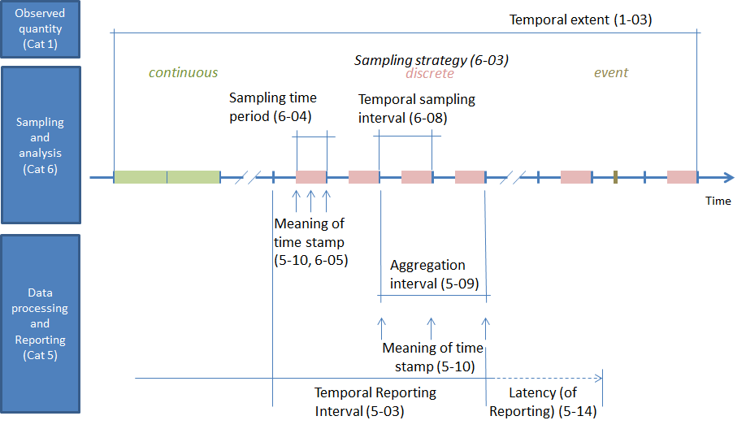
Concepts of Time in WIGOS Metadata

Slide 11
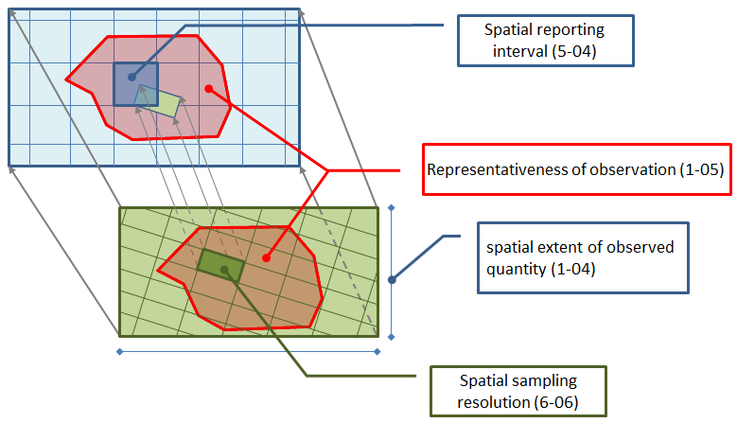
Concepts of Space in WIGOS Metadata

Slide 12
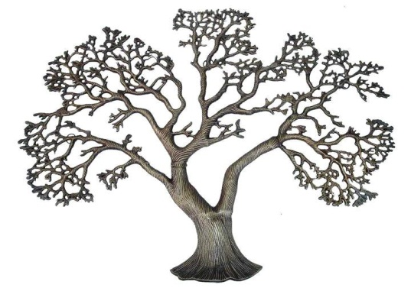



Considerations for WIGOS Metadata
Generation
  Various levels of granularity
Transmission
  Various intervals for (incremental) update
Access and use
  By humans (researchers, managers, the public)
  By machines (services)
WIGOS
WIS
Rather invariant
intermediate
Very dynamic

Slide 13
Logical Data Model
StationSet
Station
Observation
Contact
Observation Segment
Instrument
Contact
Contact
NB: Station=Platform, mobile or fixed

Slide 14
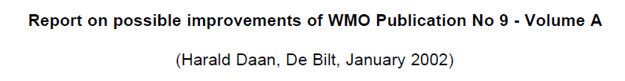
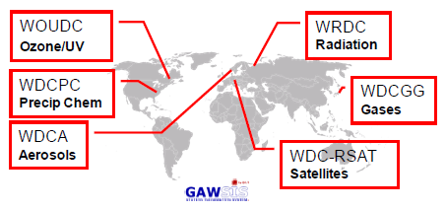
Why OSCAR/Surface?
WIGOS = WMO Integrated Global Observing System
Need comprehensive overview of Members’ capabilities
  Existing catalogues provide essential services, but
    only sub-sets of global capabilities
    limited or very specialized metadata models
  No history of observing systems
Pub 9 Vol A needs improvement
  only internationally used synoptic and upper-air stations
  very limited information on individual stations/platforms
WIGOS RRR needs information on surface-based capabilities to complement space-based capabilities

Slide 15

WIGOS RRR
(RRR = Rolling Review of Requirements)
WIGOS RRR process needs to know about capabilities
Analysis
«Critical Review»
Improved services for society
Guidance for Action
Surface-based observing systems
RRR
Capabilities
Requirements
Space-based observing systems
Notes:
Recently discovered a thorough analysis of Vol A, by

Slide 16
Current Status

Slide 17
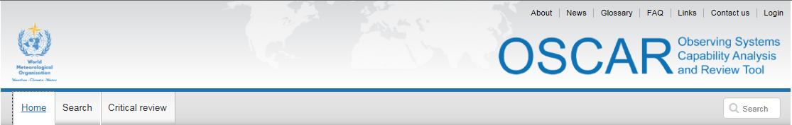

Web Application
Industry-standard technology stack
  Oracle DB, ArcGIS
  JEE, AngularJS
Safe and secure, traceable
Publicly available for anonymous use
Management console for registered users

Slide 18
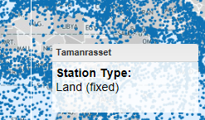
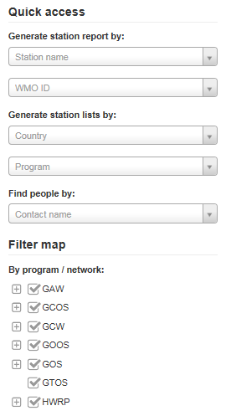
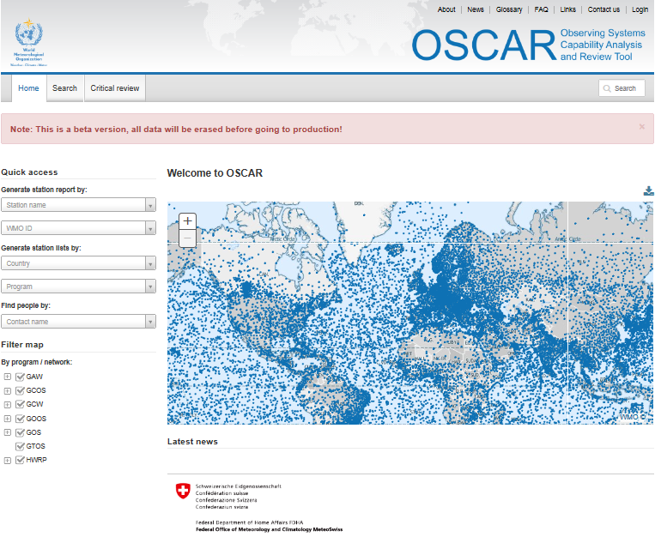
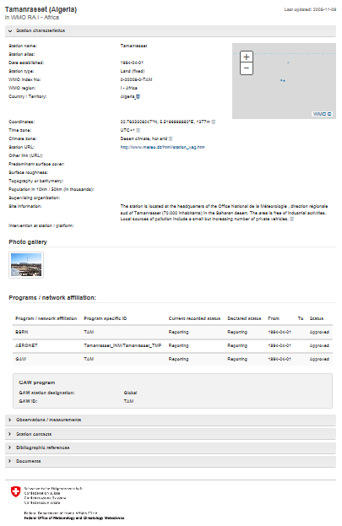
OSCAR quick access & reports
Quick access
&
Map filter
+ click
=
Detailed station report

Slide 19
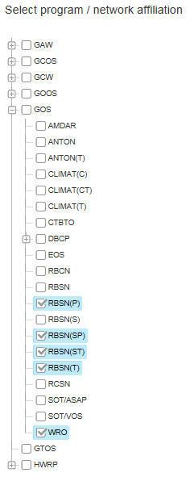
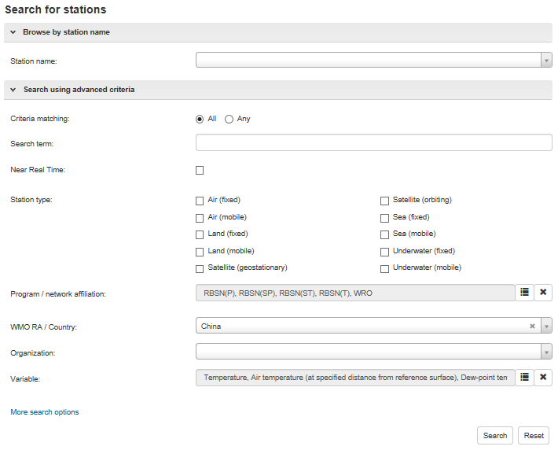
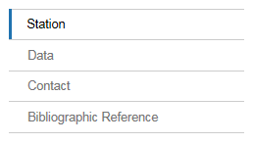
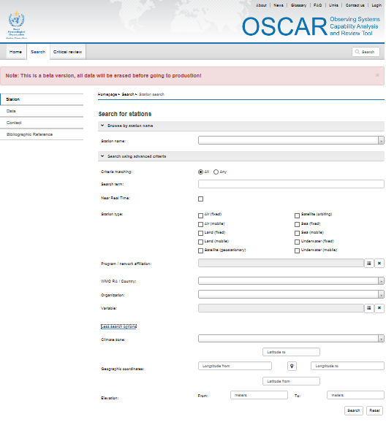
OSCAR search
Various search targets
Instruments (soon)
Finely tuned search

Slide 20
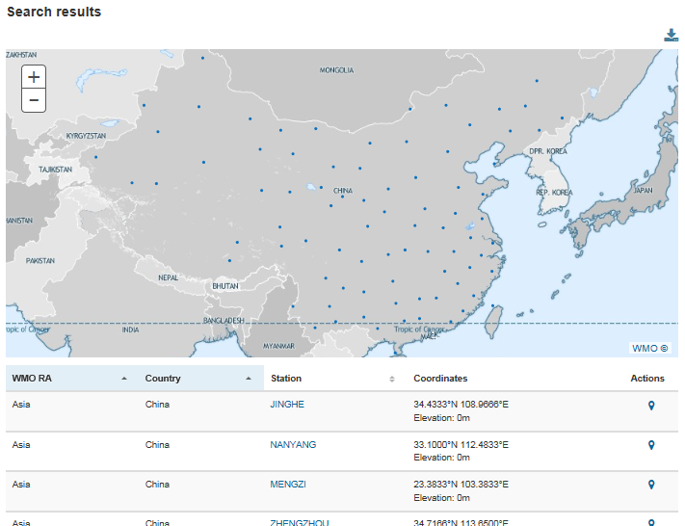
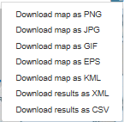
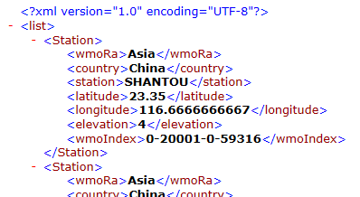
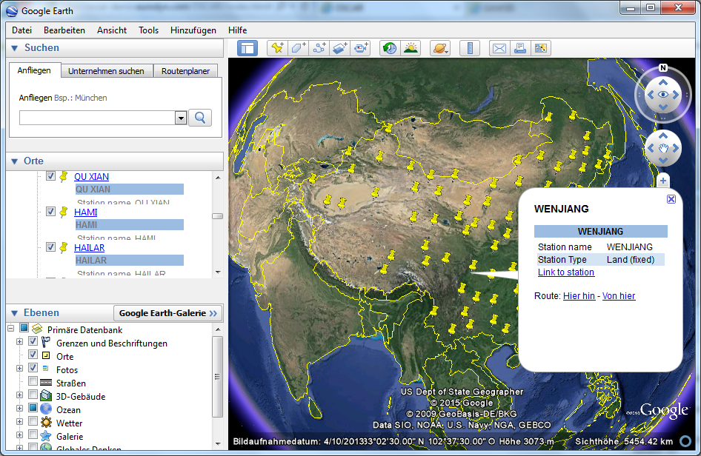
OSCAR search results
Download for further analysis
Integration with GoogleEarth

Slide 21
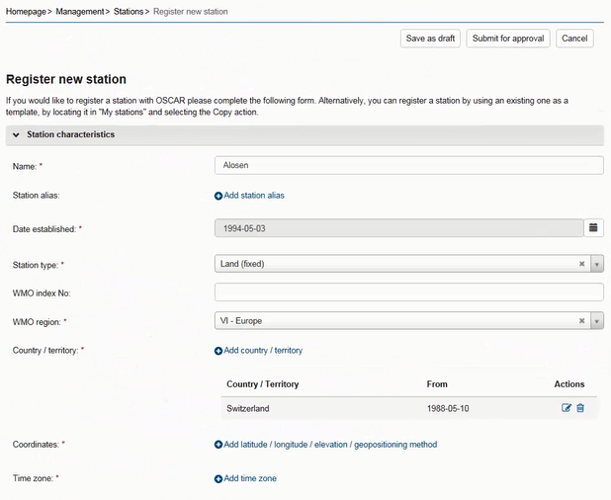
OSCAR management console
Stations
  Basic characteristics
  Photos
  History
Observations
  Location
  Variable
  Methods
  Instruments
  Quality and uncertainty
  History
Contacts
Bibliographic references

Slide 22
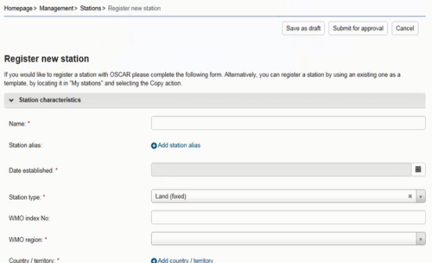

Security and user management
Authentification by identity provider (Swiss Government)
Authorization within application based on
«trust-relationships» and various «user roles»
Register
Edit all stations in country
Also: register new contact
Admin
NFP
Edit assigned stations
Also: register new contact
Station contact

Slide 23
Data integration
# stations
1’053
13’026
11’387
762
GAWSIS
  Metadata for the Global Atmosphere Watch
WMO Pub 9 Vol A
  Catalogue of synoptic and upper-air stations of GOS
JCOMMOPS
  Marine element of GOS / GOOS
WMO Radar DB
  World-wide radars
Amdar
  Coming soon …

Slide 24
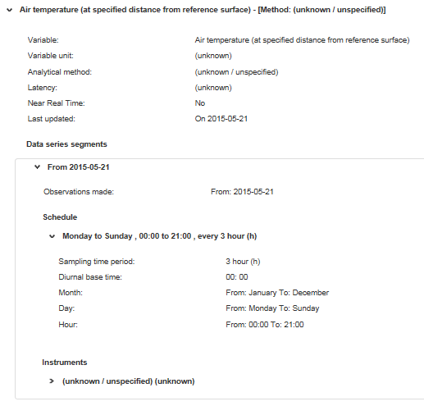
What you can do for OSCAR
Review your stations, correct and complement information on observations
Unit: unknown
Method: unknown
Latency: unknown
Uncertainty: unknown
… more unknown
Instrument: unknown

Slide 25
Outlook

Slide 26
Outlook
Thorough beta-testing of functionalities
Quality control of migrated information
Implement batch upload/download functionality of «Vol A» information → Phase-out of «Vol A»
More adequate map projection and higher-resolution maps
Develop ABOS/AMDAR-specific parts
Operationalize OSCAR/Surface (by 2015/Q4)
Integrate wind profilers
Extend functionalities (subject to further funding)
  Integrate «Requirements» module
  Integrate «Space» capabilities module
  Agree and develop algorithms for RRR

Slide 27
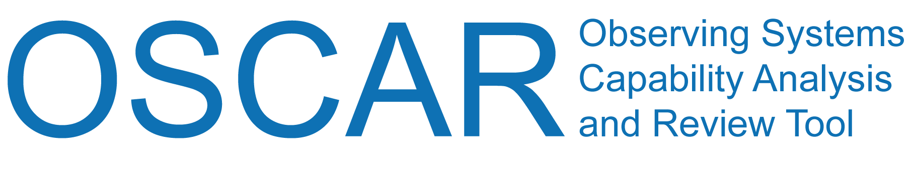
Thanks for your attention!
Web-based platforms for the WMO Integrated Global Observing System
_ covering land, air, ocean and space
_ documenting stations and observations, and their histories
_ enabling comparison of requirements and capabilities (RRR)
_ facilitating network planning
_ applicable to all WMO Application Areas
_ supporting your service to society!
coming now …
oscar.wmo.int/surface

Slide 28
Supplementary material

Slide 29
Data Integration «Vol A»
1. Basics
All stations integrated with territory, positions
New WMO identifier from old WMO index and sub-index
ObsRems (as character string under station description)
Station class (from ObsRems)
  A (aerodrome), AGRIMET (agromet station), C (coastal), HD/A (helideck, offshore), HU/FC (hurricane, tropical cyclone or typhoon forecast centre), HY/A (seaplane base), L (lightship), LH (lighthouse), M (mountain station), R/FC (River forecast centre), TI/WA/FC (Tidal wave forecast centre)

Slide 30
Data Integration «Vol A»
2. Observations
Surface observation program (from WMO No. 544)
  Manned station
    “Pressure", "Wind (direction and speed)", "Air temperature", "Humidity", "Present weather", "Past weather", "Cloud amount", "Type of cloud", "Height of cloud base", "Visibility“
  Automatic station (from “AUT” flag in ObsRems)
    “Pressure", "Wind (direction and speed)", "Air temperature", "Humidity“, “Precipitation (yes/no)”
Barometer height (from HA) for observation “pressure”
Additional observations (from ObsRems)
  40 variables (only well defined variables integrated)
Upper-air observations (from UA-1 … UA-4)
  «R»: PTU, wind
  «P», «W», «WP»: wind

Slide 31
Data Integration «Vol A»
3. Schedules
Surface
  Consider synoptic schedules (from SO-1 … SO-8)
  Consider (semi-)hourly observations (from ObsHs)
  Consider some constraints concerning weekdays (from ObsRems)
Upper-Air
  Consider upper-air schedules (from UA-1 … UA-4)
  Consider some constraints concerning weekdays (from ObsRems)
Schedules are formally correct, but can be redundant
No schedules for «additional» observations
(too little information available)

Slide 32
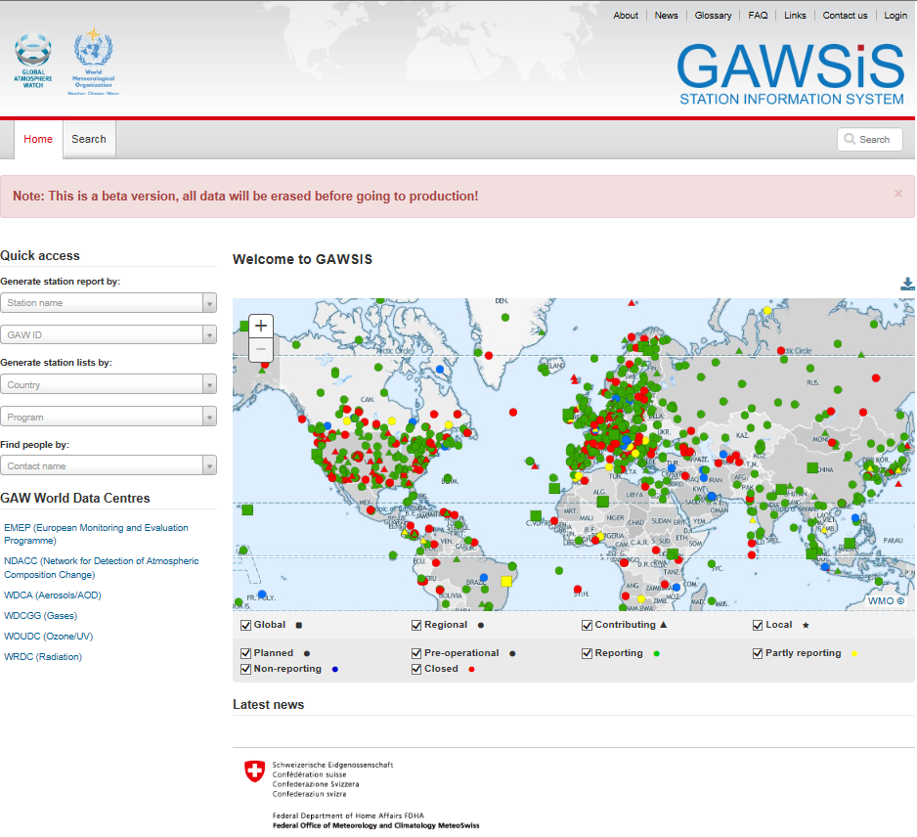
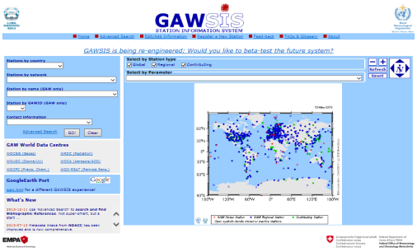
https://gawsisdepl.meteoswiss.ch/GAWSIS
WIGOS metadata standard-compliant
Historization
GO LIVE in 2015/Q3
Please sign up for
Beta-testing!

Slide 33
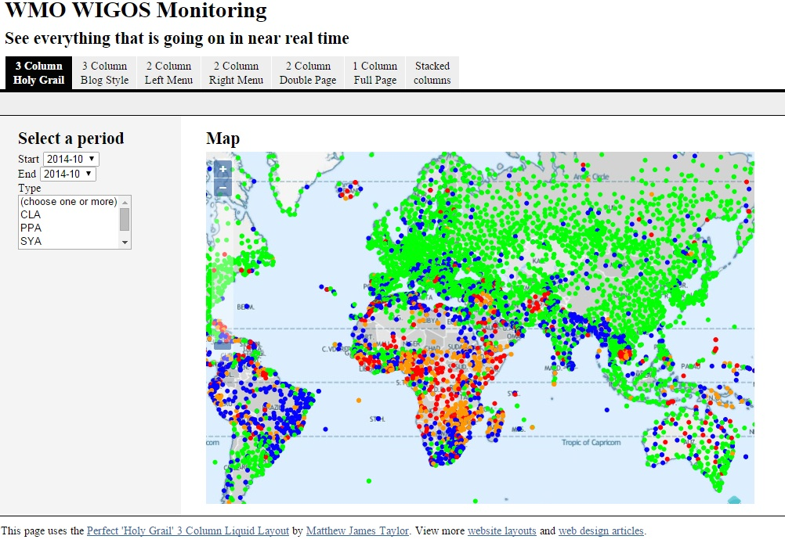
Source: Sue Barrell, Cg-17 WIGOS side event

