Slide 1
Quality Assurance and Quality Control of the Australian Climate Data Record
Meaghan Flannery
Manager Data Quality Control Unit
WMO; Ad hoc inter-programme workshop on representation of WIGOS and climate metadata

Slide 2
Outline
Data Lifecycle and Data Provenance
Metadata
Quality Assurance (QA) and Quality Control (QC)
Why QA/QC is important

Slide 3
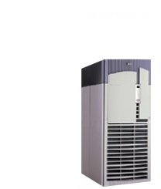
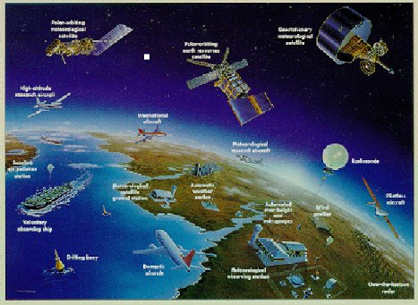
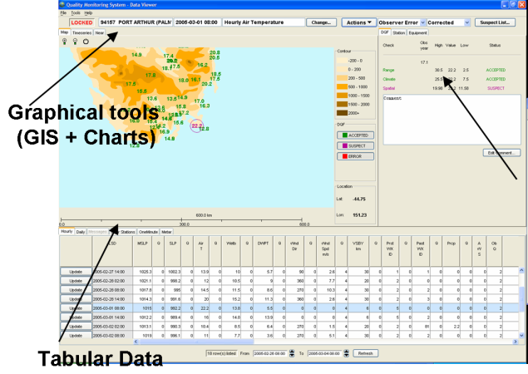
Data Lifecycle
The Data lifecycle: …Documentation of all processes involved in the end product of a data point value from sensor through to final archive and product generation.
Quality Control
High Quality Data Sets
Product Generation

Slide 4
Data Lifecycle
Data generated
Sensor generates value either automatically; or data is manually read from an instrument; or data is estimated from a non instrumental source
Data recorded
AWS or ASOS-CS compiles data into parameter; or manually read value is entered into a station record
Data transmitted
Data is transmitted automatically by AWS or ASOS-CS (usually via coded message); or data is manually coded and transmitted
Data ingested into Database
Automatically from message ingest or data is digitised after the event from the station record
Quality Control of raw data sets
Raw data is assessed for relevance either automatically, semi-automatically or manually
Value added datasets
High Quality Datasets using temporal analysis of record and homogenisation techniques

Slide 5
Data Provenance
Data Provenance: The ability to trace and verify the creation of data, how it has been used or moved among different databases, as well as altered throughout its lifecycle…
    Data Provenance provides for
        Traceability
        Reproducibility
        Data Confidence

Slide 6
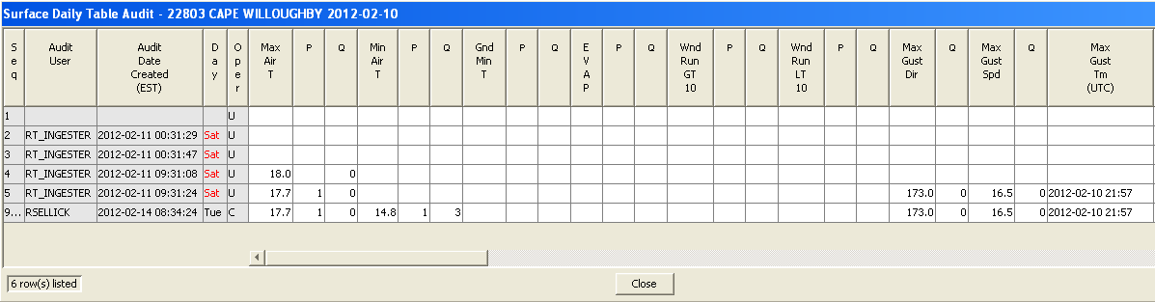
Data Provenance
Data Provenance is achieved through:
Archiving and identifying data at all stages of it’s life cycle i.e.
  Station record scans stored in addition to digitised data
  AWS messages stored in addition to ingested data
  Raw data stored in addition to the QC datasets and value added datasets
  Metadata is ‘tied’ to the data record
  Complete audit trail and monitoring of QC decisions and operator ID

Slide 7
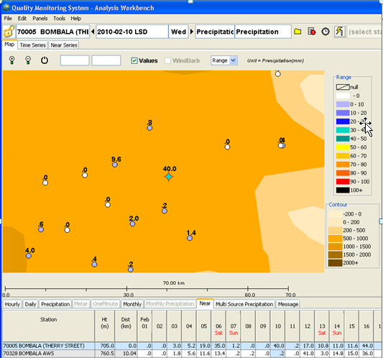
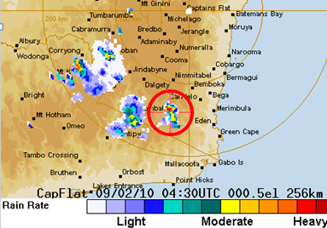
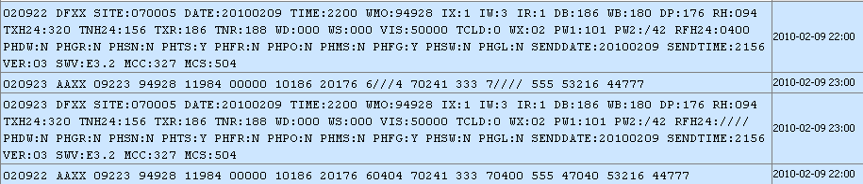
Example of Risk to Data Provenance
Regional Correction that does
not meet data provenance guidelines
AIFS Correction

Slide 8
Metadata
Metadata: …A set of data that gives information about the data.
Metadata can be about the data itself, how the data is generated (parameter algorithms), and processed (including quality control method)

Slide 9
Metadata Unpacked (Not a Definitive List)
Data / sensor / station location
Sensor metrics / specifications / User Acceptance Testing
Type of instrument / Instrument ID / AWS type
AWS algorithms for parameter generation
Time of observation
Ingest method
Station elevation and topography
Instrument calibration and checks
Station history file
Site exposure and site diagrams / photographs with skyline imagery
Inspection visits
Staff training (level of competency)
Original data (hardcopy, or archival quality image; message storage)
Data transmission, ingestion and storage process for hardcopy and electronic data
Quality control / processing algorithms
Quality control flagging process (justifications for flags and operator ID)
And ….

Slide 10
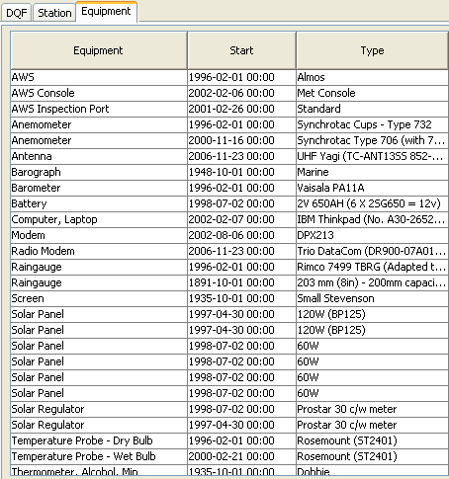
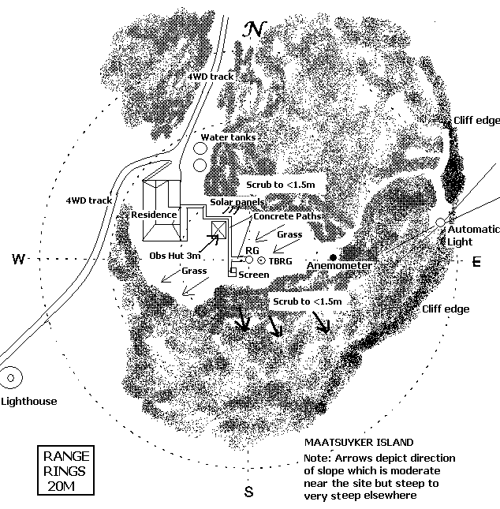
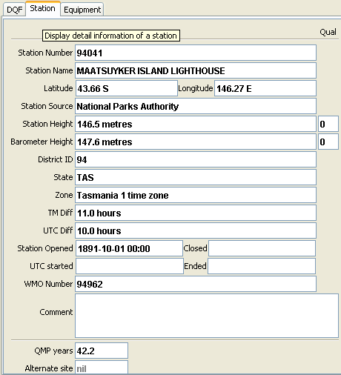
Metadata Standard Examples

Slide 11
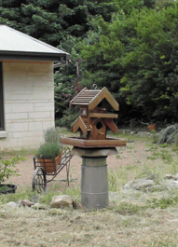
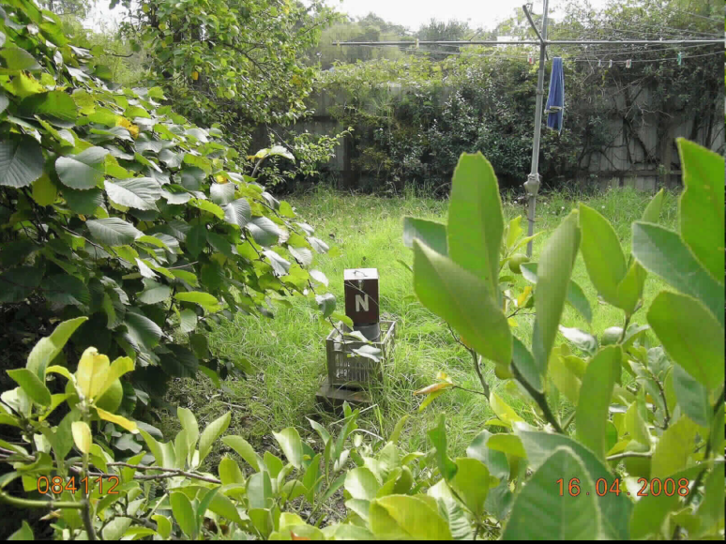
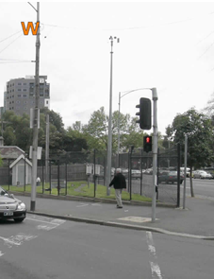
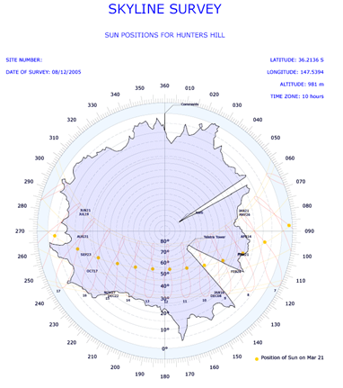
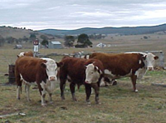
Metadata Siting - SitesDB

Slide 12
Metadata
Metadata of Method and Process
Algorithms used to generate data at the AWS / ASOS-CS and manual observation procedures.
Ingest and data transmission process
QC algorithms and procedures used to identify suspect data
Flagging procedures for data quality and data source
Supervision and adherence to best practice and WMO guidelines
Metadata provides confidence in the data for the user

Slide 13
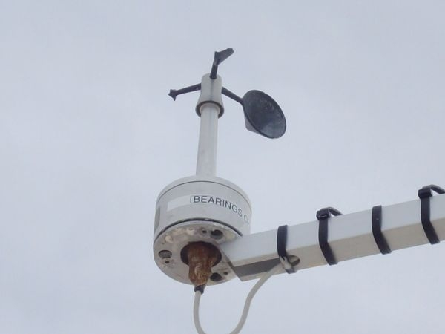
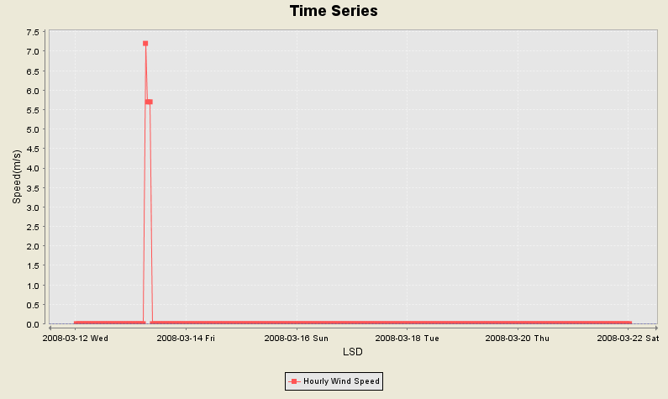
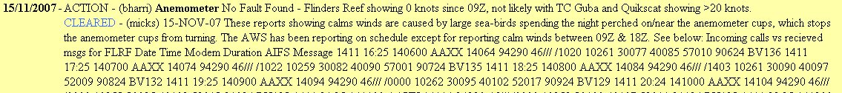
The Importance of 'Metadata' - Sensor
Flinders Reef - 200783

Slide 14
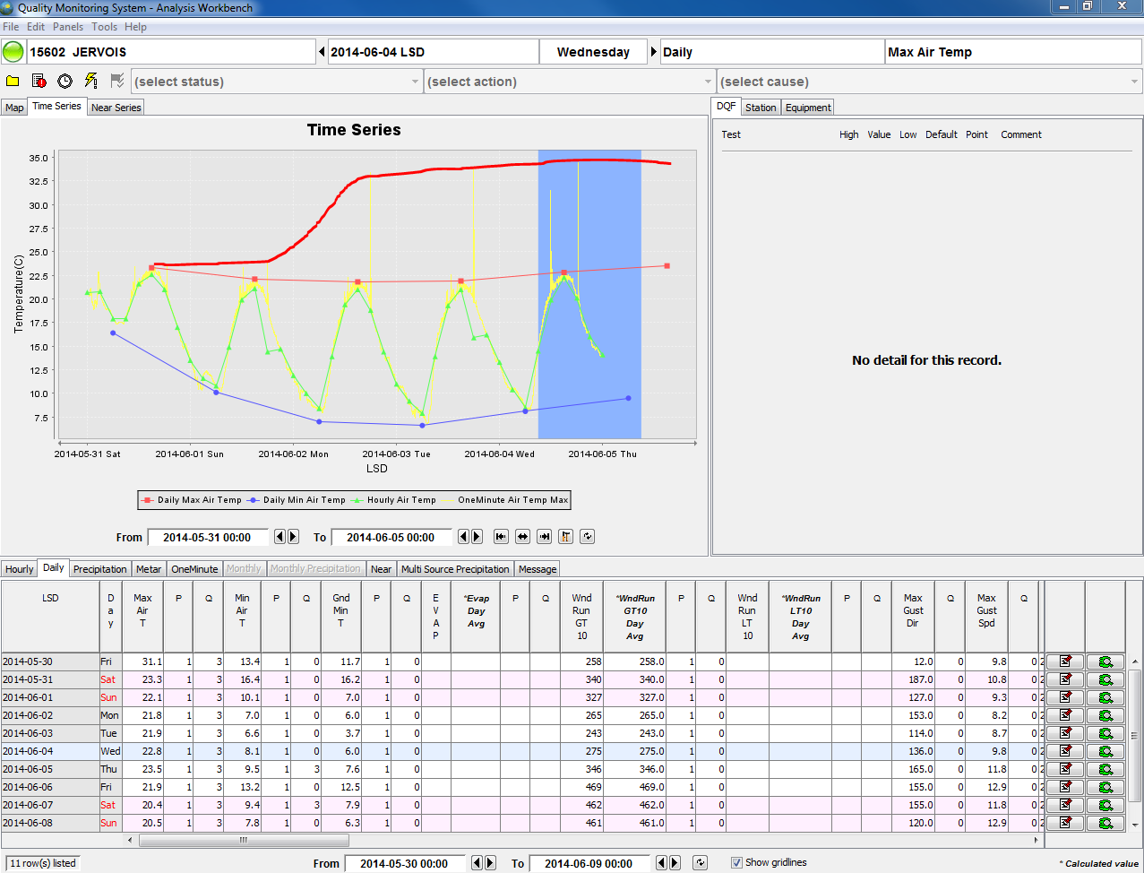
The Importance of 'Metadata' - Sensor

Slide 15
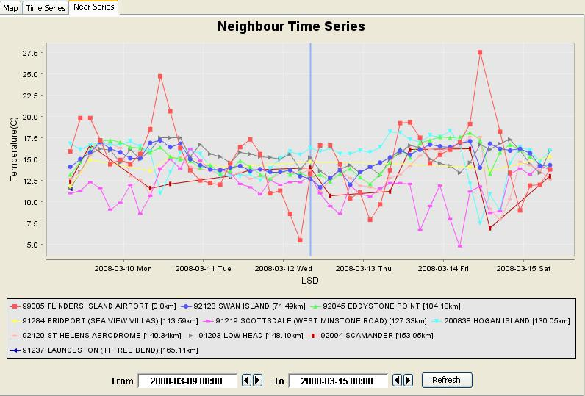
The Importance of 'Metadata'
Faulty Humidity Sensor – Flinders Island

Slide 16
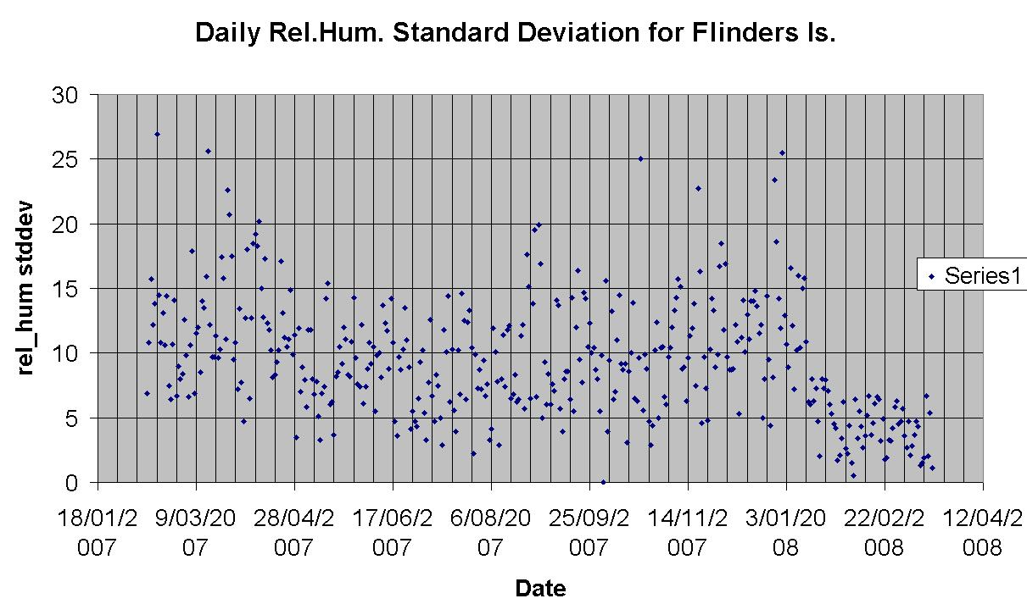
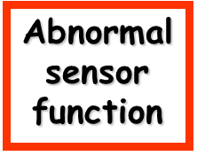
The Importance of 'Metadata'
Faulty Humidity Sensor – Flinders Island
Normal sensor function
Data Flagged
Back to this pt

Slide 17
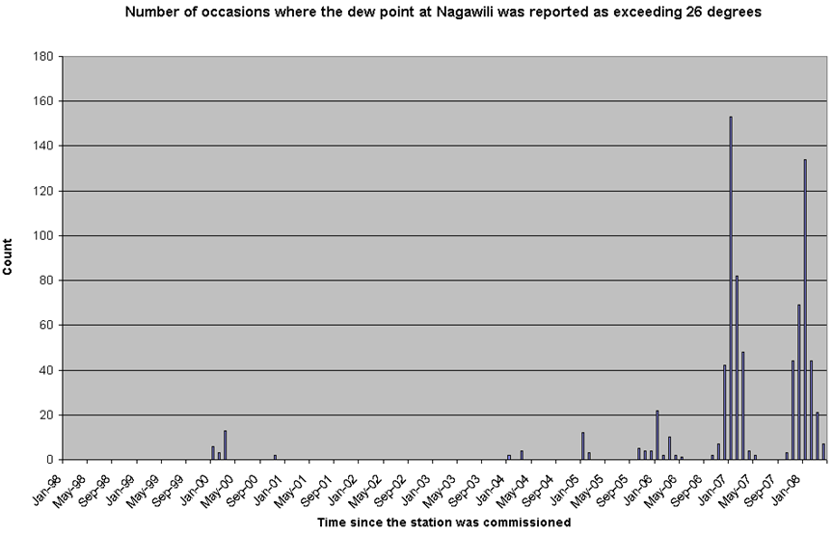
The Importance of 'Metadata'
Faulty Humidity Sensor – Ngayawili

Slide 18
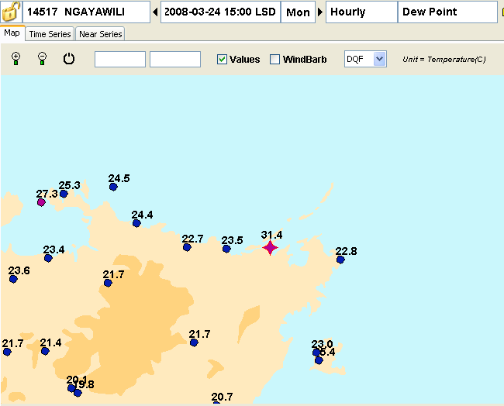
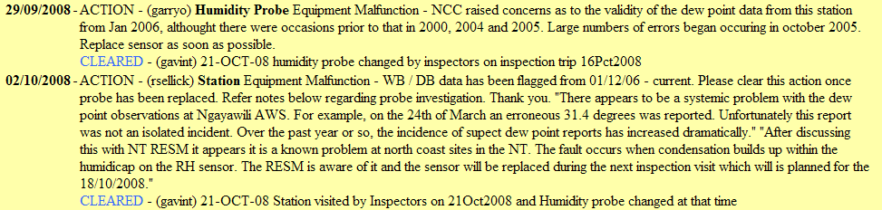
The Importance of 'Metadata'
Faulty Humidity Sensor – Ngayawili
Dew Point is
too high
Rotronics MP101-T4-W4W
Humidity Probe

Slide 19
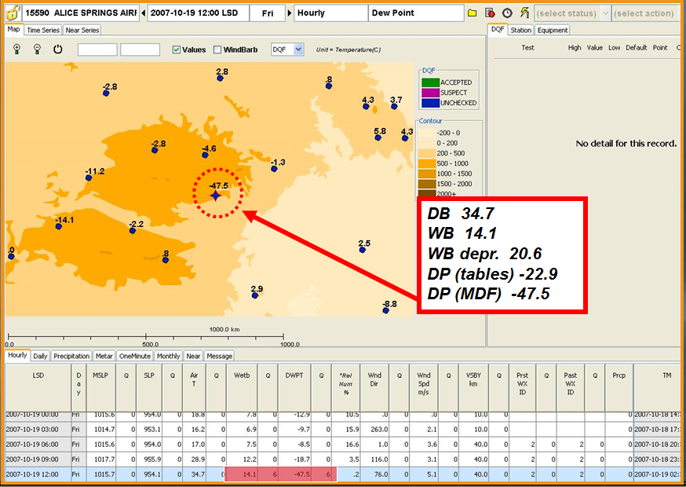
The Importance of 'Metadata' - Practices
Alice Springs M.O.

Slide 20

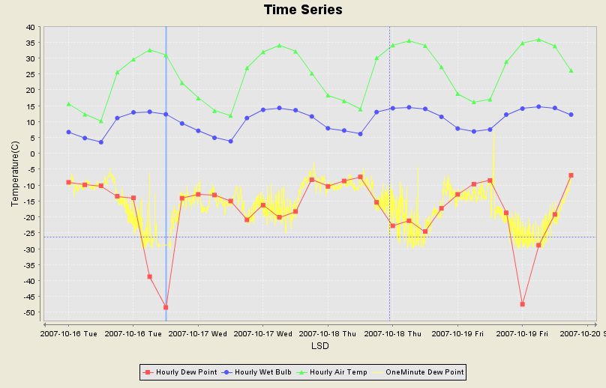
The Importance of 'Metadata' - Practices
Alice Springs M.O.

Slide 21
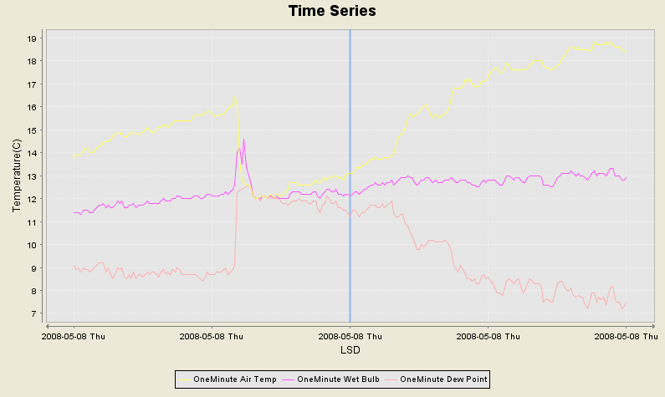
The Importance of 'Metadata' - Practices
Mildura M.O.
Noon 2008-05-08

Slide 22
The Importance of 'Metadata' - Practices
Metar
2008-05-08 12:00 MSLP=1023.8 SLP=1017.5 AT=16.4 WB=12.8 DWPT=9.4
OneMinute Data
2008-05-08 12:00 MSLP=1023.9 SLP=1017.5 AT=13.1 WB=12.1 DWPT=11.2
Field Book entry
2008-05-08 12:00 MSLP=1023.9 SLP=1017.5 AT=13.1 WB=12.2 DWPT=09.4
050802 DFXX SITE:076031 DATE:20080508 TIME:0200 WMO:94693 SLP:10175 QFF:10239
QNH:10239 PTA:8006 PTC:2002 DB:+164 WB:+094 DP:+114 RH:065 TN33:+049 WD:119
WS:003 WDV:059 WSN:000 WGSM10:006 WGSH03:008 WGDM10:152 WGDH03:147
WGTM10:0155 WGTH03:0119 IW:4 VIS:35000 AVIS:9999 TCLD:1 TCL:1 TCM:0 TCH:0 CL1A:1
CL1T:6 CL1H:020 CL1D:180 CEIL:CLR BLW 125 IX:1 WX:02 PW1:002 PW2:002 WXA:// PWA://
RFM10:0000 RFH03:0000 IR:4 QCAP:00000 QCDB:02000 QCWB:02000 QCDP:00000
QCRH:02000 QCWS:01000 QCWD:01000 QCRF:01000 QCVS:01000 VER:03 SWV:M2.01.38.00
SENDDATE:20080508 SENDTIME:0206 IT:+299 BV:135 AL:/ OUT:0000 MSN:0097 MEC:923
MCC:605 MCS:754
Comments in Field Book Remarks: Screen Cleaned @11:10LST
QC Issues
MDF and Metar DB probably
sourced from LIG (DQCU needs
this information to apply QualFlag 3
– high certainty )
A8 has been filled in from
Metconsole screen, not from
the corrected MDF
WB temp is different for Metar,
OMD, A8 and MDF. (DQCU
applies a QualFlag 6 – suspect
read
Metadata used by DQCU to explain OMD temperature anomalies

Slide 23
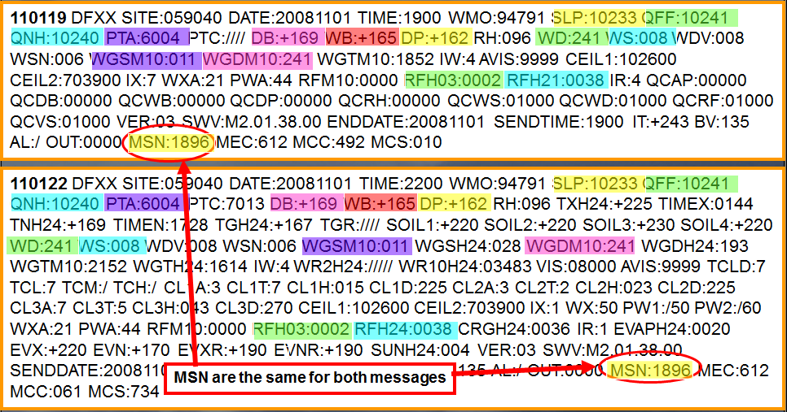
The Importance of 'Metadata'
Metconsole Issues (Data Provision)
Coffs Harbour M.O.
6am & 9am 2008-11-02
6am values are the same as 9am Obs
The 9am Obs are in error
This can be detected by filling in A8 from coded message

Slide 24
Quality Assurance and Quality Control
Quality Assurance: …The overall process providing a measure of confidence that the product will meet quality requirements.
Quality Control: …The process or processes within the Quality Assurance method that ensures Quality Assurance outcomes are met. This includes operational techniques to determine validity thereby fulfilling requirements for ‘quality’.
Metadata is essential to Quality Assurance process

Slide 25
Quality Assurance and Quality Control
What is ‘Quality’ ?
Ensuring that the data archived is the same as the data recorded at the sensor…
AND
…That this data is representative of a meteorological event
AND
…That this is a consistent outcome with time

Slide 26
Quality Assurance and Quality Control
QC method assessing data validity
Automatic
Semi Automated
Manual

Slide 27
Quality Assurance and Quality Control
Assessment techniques and tests (some examples…)
Spatial inconsistency
Inconsistency with other parameters
Rapid change / spikes – Internal and temporal consistency
Climatological outliers
Repetition and duplication
Period gaps (missing observations)
Temporal and time series
Heuristic Algorithms
Multivariate Analysis
And others…

Slide 28
Quality Assurance and Quality Control
Error types associated with QC tests
False positives (Type I Error)
The test rejects the test assumption that the ‘data is representative of a meteorological event’ resulting in valid data identified as ‘suspect’
Often targets valid outliers/extremes labelling data as ‘suspect’ and resulting in the data record being smoothed
Results in incomplete data sets if valid data identified incorrectly as ‘suspects’ are not identified

Slide 29
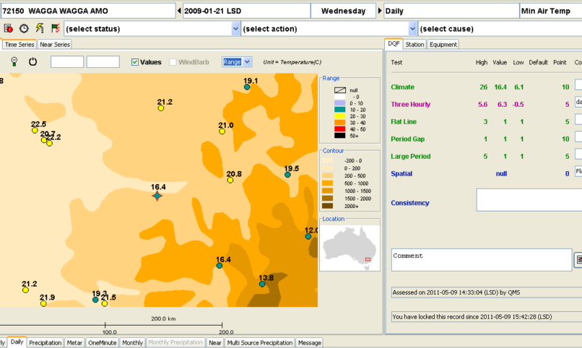
Example of Type 1 Error – False Positive

Slide 30
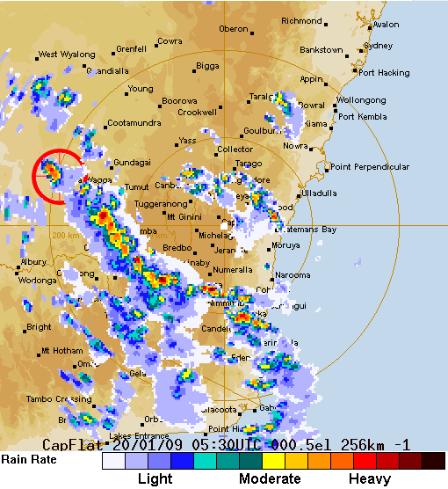
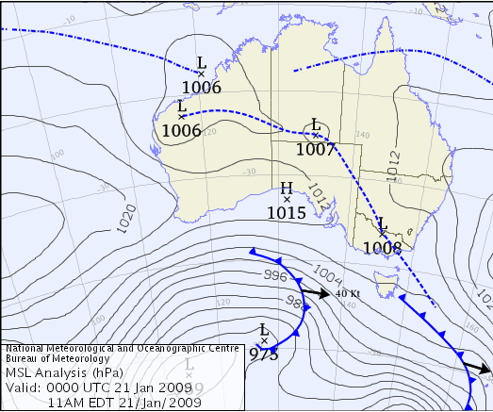
Example of Type 1 Error – False Positive

Slide 31
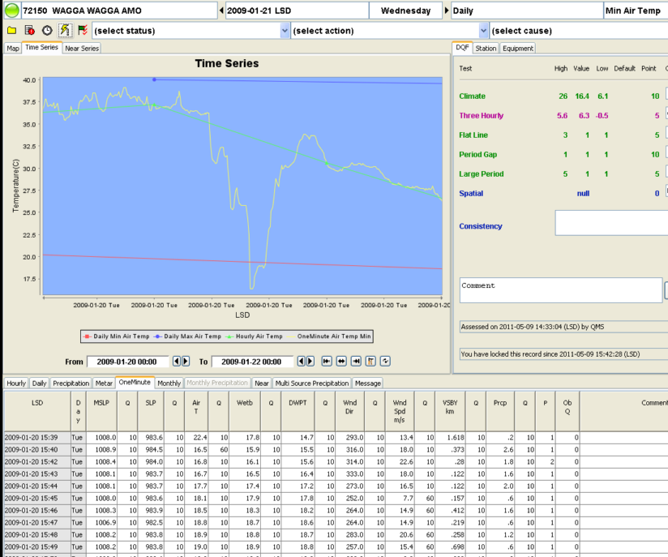
Example of Type 1 Error – False Positive

Slide 32
Quality Assurance and Quality Control
Error types associated with QC tests
False negatives (Type II error)
The test fails to reject the test assumption that the ‘data is not representative of a meteorological event’ resulting in erroneous data identified as ‘valid’
Introduces error into the data record
Presents as statistically insignificant
Controlling test limits to minimise Type I errors will usually increase
Type II errors

Slide 33
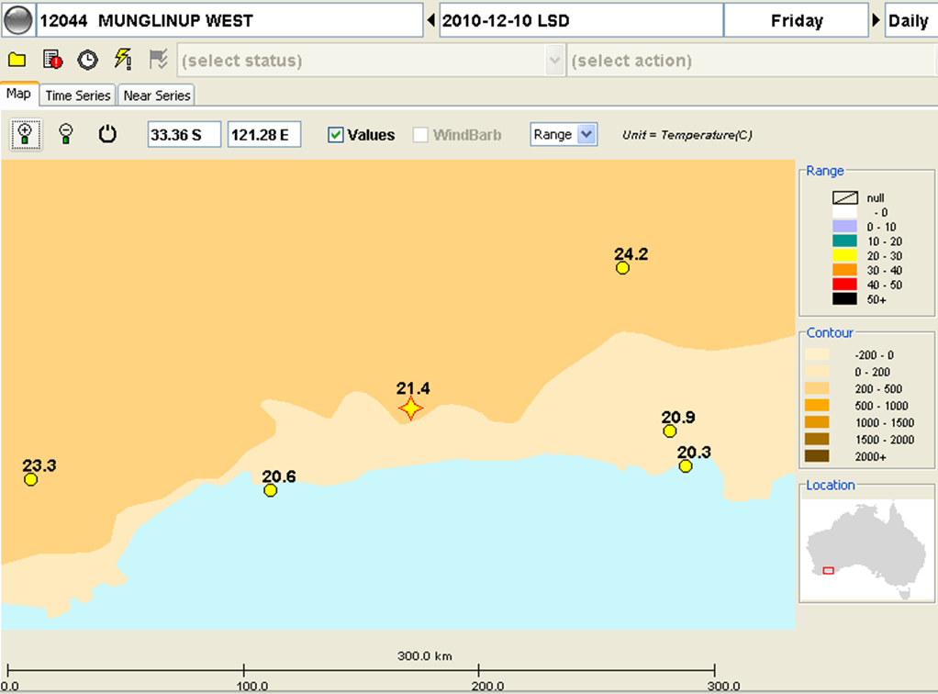
Example of Type II Error – False Negative

Slide 34
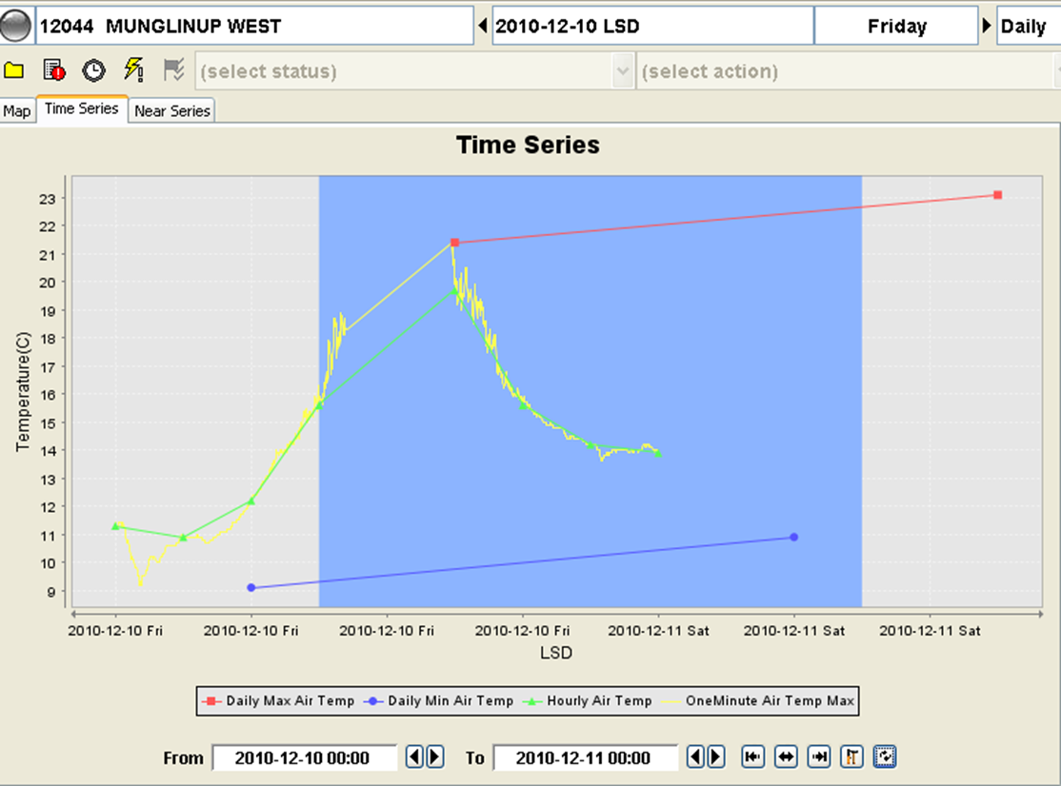
Example of Type II Error – False Negative

Slide 35
Quality Assurance and Quality Control
Benefits and risks of Quality Control Process
Automated systems
Consistent and objective processing of all data
Increased false positive and false negative errors
Cost effective model
Suited to high density networks and networks with high frequency data
Suited to AWSs with multiple sensors

Slide 36
Quality Assurance and Quality Control
Benefits and risks of Quality Control Process
The Semi-automated skilled operator model
Automated testing is performed to identify ‘suspect’ values where testing limits are optimised for the identification of all statistically identifiable errors, which are then evaluated manually
Significantly lower rate of type I and type II errors than fully automated QC testing
More resource intensive than fully automated QC
Allows for data recovery
Benchmark system for evaluating fully automated QC performance and the UAT of new data provision and data processing systems
Requires highly skilled staff and process management to ensure objective analysis
WMO endorsed best practice QC method

Slide 37
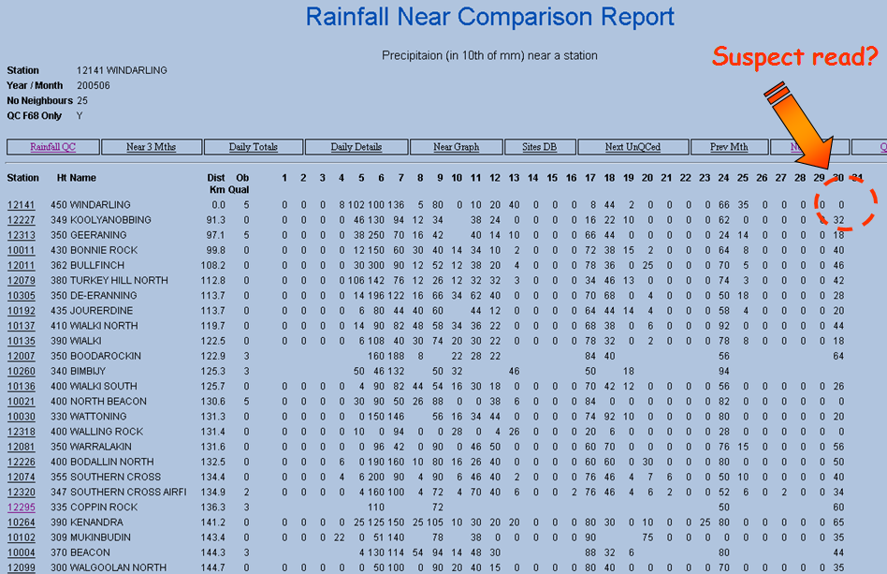
Quality Assurance and Quality Control
Benefits and risks of Quality Control Process

Slide 38
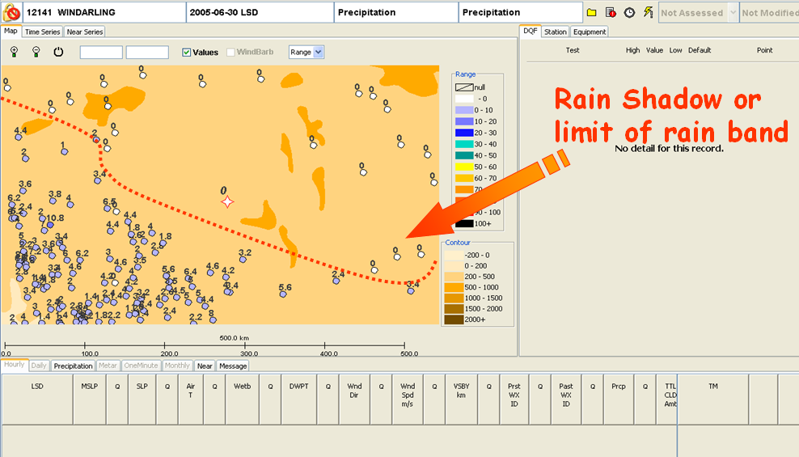
Quality Assurance and Quality Control
Benefits and risks of Quality Control Process

Slide 39
Quality Assurance and Quality Control
Benefits and risks of Quality Control Process
Fully Manual QC
Resource intensive
Used to quantify false negative errors for testing algorithm efficacy in QC system development
Less objective than other methods
Encourages reactive QC that only evaluates part of the data sets
Without statistical testing there is a tendency in evaluating data to skew to the normal and
Prone to human error, requires highly skilled staff and management process
Significantly lower data confidence levels if sole QC method

Slide 40
Quality Assurance and Quality Control Benefits of Quality Control
Benefits of QCB
Data recovery for some methods leading to more complete data sets
Promotes user confidence in the data within the limits of the QC method and metadata available
Enables network monitoring to identify systemic and procedural errors
Feedback loop to data providers on station / parameter / data delivery performance
Validation of extremes leading to more reliable datasets
Greater accuracy and confidence for Climate Prediction and Modelling

Slide 41
Summary
Quality Assurance and Quality Control is fundamental to the management of the climate record
Climate data quality underpins products and services
Metadata and provenance is vital to ensuring confidence in the data
Fully automated QC is superior to manual QC however the semi-automated skilled operator model minimises errors and allows for data recovery

Slide 42
Future Challenges
Implications to provenance, QA/QC with the ingestion of crowdsourced/3rd party data
FOI considerations
Risk to climate monitoring
Limited metadata
Quality of the metadata is difficult to quantify
Limited availability of metadata in the QC process
Unknown station / sensor quality
Lack of consistency and non adherence to standards within the network (data sets) – installations, sensors, data provision platforms, data provision, AWS parameter algorithms, site inspections, maintenance and observational practices, UAT and systems testing
Limited or no capacity to store metadata for QC and FOI use
Contamination of quality datasets
Temporal longevity of station datasets
If flagging for quality is introduced (i.e., AWS site quality) maintaining the currency of this rating is an issue

Slide 43
Facing the Challenge…the Logistics
Developing QMS to accommodate the metadata and data quality uncertainty of 3rd party data into current processing
Significant expansion of network may require automated processing of 3rd party data
Utilising flags / tiers to indicate level of QC, 3rd party metadata quality (siting, AWS, unknown metadata etc)
Ensuring hybrid datasets include data source flags
Encouraging high frequency data provision from 3rd party data providers
Storage considerations for high frequency 3rd party data including security issues (consider accessing external portals for this information)
QC systems would require upgrading in processing speed, process sophistication and storage
Access to online training to educate data providers in best practice

Slide 44
Facing the Challenge… Risks and Benefits
District 3rd party data providers may falsify data for material gain (i.e. drought assistance)
Enhanced networks and data availability
High frequency data and enhanced networks – simplifies QC
3rd party data providers may dispute QC decisions – require a crowdsourcing method to address this
Lack of metadata introduces risk into the FOI process
The provision of QC'ed data for clients will have increased risk of data error which may have negative commercial impact however there will be more data available
Bureau's reputation may be compromised by the provision of poor quality 3rd party data if the uncertainty of the data is not provided
It is important to have a network of high quality to 'anchor' 3rd party and crowdsourced data particularly in data sparse regions.

Slide 45
Thank you for your attention
Meaghan Flannery
m.flannery@bom.gov.au
+61 3 96694100

