Slide 1
Approach to model-driven development of data exchange standards
Jeremy Tandy
WMO; Ad hoc inter-programme workshop on representation of WIGOS and climate metadata

Slide 2

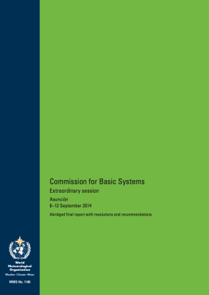



Specification to data encoding
Requirements model
WMO regulation and other specifications
Application Schema
(aka ‘conceptual model’)
XML instance documents
********
****
*******
XML Schema 1.0
Schematron .
« conforms to »
********
SCH
**
*******
**********
**
*********
« derived from »
Validatable data products
*********
Technology independent description of content and structure of information to be exchanged for a given application
Validation schema and rules

Slide 3
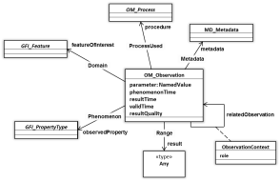

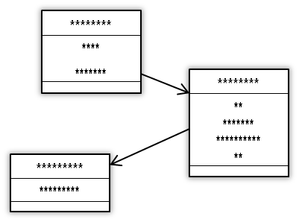
Application Schema and Profiles
data models from ISO 19100-series of geographic information standards …
► Observations and Measurements
O&M
create an Application Schema that describes the concerns of your domain … create only the elements special to your problem space
► Weather, Water, Climate (METCE)
METCE
create a Profile that provides further specialisation … progressively adding more detail and constraint
► Meteorological observation data (WIGOS)
WIGOS
Key point: Profiles mean you only need to govern and manage the extra bits special to your problem!

Slide 4
… more Profiles
O&M
METCE
WIGOS
COAS
► (land-surface based) Climate Observations Application Schema (COAS)
CLIMAT
► CLIMAT message (derived from FM-71) – report of monthly values from a land station
Further specialisation provides more detail – removes the ‘degrees of freedom’ in data exchange and makes for more robust data exchange

Slide 5


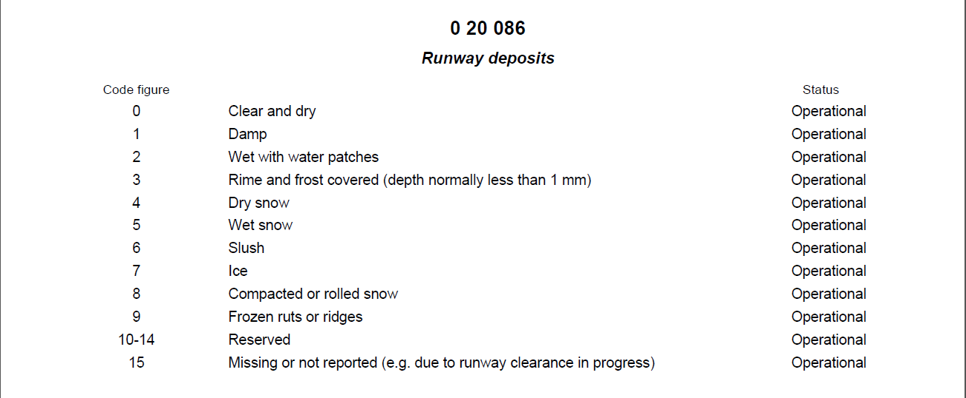
Nominal value-types; regulated set of terms (code-table)
IWXXM METAR/SPECI
«DataType»
AerodromeRunwayState
+ runway : Runway [0..1]
+ cleared : Boolean [0..1]
+ contamination : RunwayContamination [0..1]
+ snowClosure : Boolean [0..1]
+ depositType : RunwayDeposits [0..1]
+ depthOfDeposit : DepthOfDeposit [0..1]
+ brakingAction : BrakingAction [0..1]
+ frictionCoefficient : FrictionCoefficient [0..1]
Technical Regulation mandates the use of terms only from a specified controlled vocabulary
Excerpt from BUFR edition 4 Code- and Flag-tables
Notes:
The set of nominal values permitted for a given attribute are expressed as code-tables in WMO Technical Regulation – normally WMO No. 306 Manual on Codes, supplementary code-tables can be found in other publications (e.g. WMO No. 49-2 Meteorological Service for International Air Navigation)

Slide 6

Design choice: avoid use of «enumeration» entities (fragile)
IWXXM METAR/SPECI
«DataType»
AerodromeRunwayState
+ runway : Runway [0..1]
+ cleared : Boolean [0..1]
+ contamination : RunwayContamination [0..1]
+ snowClosure : Boolean [0..1]
+ depositType : RunwayDeposits [0..1]
+ depthOfDeposit : DepthOfDeposit [0..1]
+ brakingAction : BrakingAction [0..1]
+ frictionCoefficient : FrictionCoefficient [0..1]
«enumeration»
RunwayDeposits
+ Clear_and_dry
+ Damp
+ Wet_with_water_patches
+ Rime_and_frost_covered
+ Dry_snow
+ Wet_snow
Excerpt from BUFR edition 4 Code- and Flag-tables
Notes:
Crucial design choice NOT to use «enumeration» entities in the conceptual model.
Use of «enumeration» entities will lead to a fragile model; changes to membership of code-lists would result in changes to the model, thus requiring new XSD to be published and hence force modification to software systems bound to those XSD.
Given the biannual amendment cycle for WMO No. 306 Manual on Codes, such a regime would be prohibitive.

Slide 7
Best practice: use «CodeList» class (external reference)
IWXXM METAR/SPECI
«DataType»
AerodromeRunwayState
+ runway : Runway [0..1]
+ cleared : Boolean [0..1]
+ contamination : RunwayContamination [0..1]
+ snowClosure : Boolean [0..1]
+ depositType : RunwayDeposits [0..1]
+ depthOfDeposit : DepthOfDeposit [0..1]
+ brakingAction : BrakingAction [0..1]
+ frictionCoefficient : FrictionCoefficient [0..1]
«CodeList»
RunwayDeposits
Excerpt from BUFR edition 4 Code- and Flag-tables
Notes:
Use «CodeList» classes in the conceptual model to reference an externally managed controlled vocabulary / dictionary.
Rely on existing governance regime – maintain the code-lists outwith the model & refer to the code-tables in the context of existing Technical Regulation.

Slide 8

The WMO Codes Registry service: resolving identifiers
<iwxxm:runwayState>
<iwxxm:AerodromeRunwayState>
<iwxxm:depositType
xlink:href=“http://codes.wmo.int/bufr4/codeflag/0-20-086/1”
xlink:title=“Damp”/>
</iwxxm:AerodromeRunwayState>
</iwxxm:runwayState>
“codes” sub-domain prefix added to wmo.int Internet domain name to enable redirection using DNS …

Slide 9
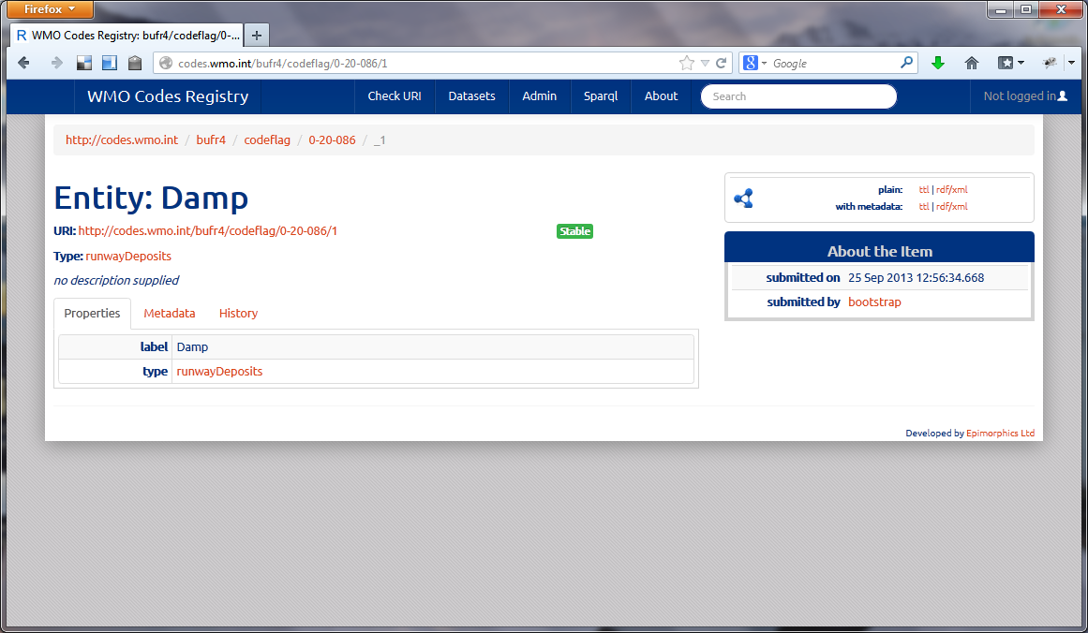
The WMO Codes Registry service: resolving identifiers

Slide 10
WMO Codes Registry
WMO Codes Registry is the Service that resolves these HTTP URIs
Provides useful information about each identified resource or concept (as determined by WMO) – using content negotiation to render both human- and machine-readable content (HTML, RDF/XML, Turtle & JSON-LD)
Operated by Met Office on behalf of WMO
Built using open-source Registry software developed by UK Government

Slide 11
HTTP URIs assigned to code-tables too …
<complexType name="RunwayDepositsType">
<annotation>
<appinfo>
<vocabulary>
http://codes.wmo.int/bufr4/codeflag/0-20-086
</vocabulary>
<extensibility>none</extensibility>
</appinfo>
<documentation>
Type of deposit on a runway [..snip..]
</documentation>
</annotation>
<complexContent>
<extension base="gml:ReferenceType"/>
</complexContent>
</complexType>
IWXXM METAR/SPECI
«DataType»
AerodromeRunwayState
+ runway : Runway [0..1]
+ cleared : Boolean [0..1]
+ contamination : RunwayContamination [0..1]
+ snowClosure : Boolean [0..1]
+ depositType : RunwayDeposits [0..1]
+ depthOfDeposit : DepthOfDeposit [0..1]
+ brakingAction : BrakingAction [0..1]
+ frictionCoefficient : FrictionCoefficient [0..1]
«CodeList»
RunwayDeposits
tagged values:
vocabulary = “http://codes.wmo.int/bufr4/codeflag/0-20-086”
extensibility = “none”
We needed an external reference from the model to the code-table; “vocabulary” tagged value is code-table URI

Slide 12
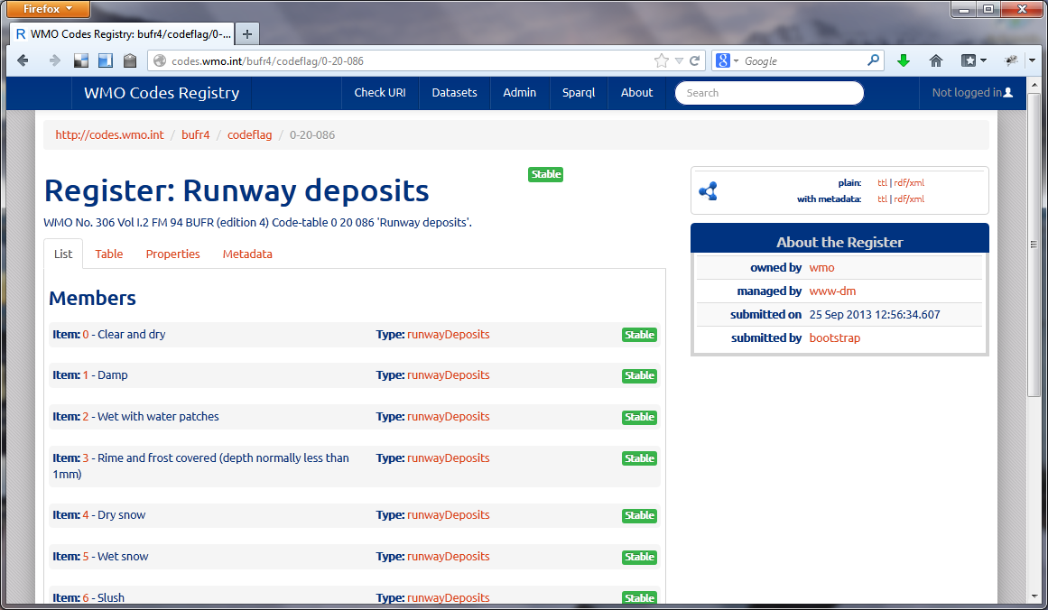
HTTP URIs assigned to code-tables too …
Each code-table is published as a “Register” … which registers do we need to publish?

Slide 13
Thank you
…

