Slide 1
METCE Specific
XML Schema Serialization

Slide 2
Introduction
During the development of AvXML, specializations to the standard XML serialization have been implemented. These include
  Serialization of «CodeList» type
  Serialization of UML classes as attributes to an XML element
  Serialization of <quantity/> element
  Serialization of nilReason attribute

Slide 3
Serialization of «CodeList» type

Slide 4
Serialization of UML classes as attributes to an XML element
Selected UML classes of Simple Types can be serialized as attributes to the corresponding XML element of another UML class

Slide 5
Serialization of <quantity/> element

Slide 6
Serialization of nilReason attribute

Slide 7
Implementation
Hong Kong, China had implemented these transformation specializations in FullMoon. However, the community is not particularly active in advancing FullMoon to meet new standards
Sparx Systems has kindly implemented these specializations into their GML exporter since EA11*
* It should be noticed that certain stereotypes in EA UML profile for GML have a slightly
different format that their equivalents in FullMoon. XMIs published so far (up to AvXML 1.1)
are for FullMoon so care should be taken when importing these XMIs into EA10 or above.
This should be rectified in future release of XMIs of AvXML.

Slide 8
Activation
Please refer to the original requirement specifications to Sparx Systems for the implementation of the specializations
At first, activation are expected for individual Class. For some reasons, Sparx Systems chose to implement activation at «Leaf» level. i.e. All Classes under the same «Leaf» and satisfy the necessary criterion will be serialized in the specified way.

Slide 9
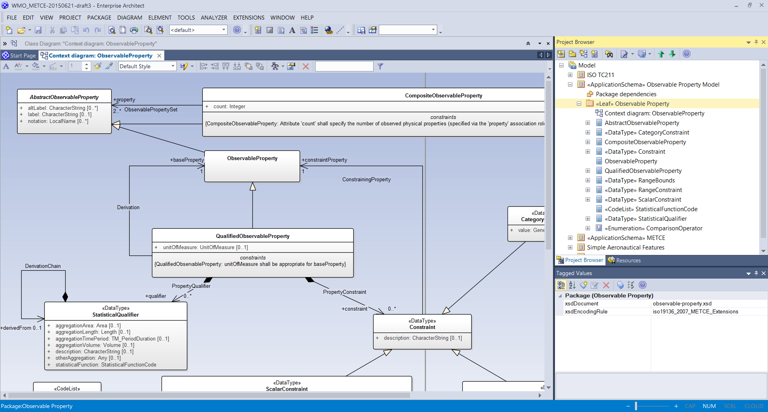
Example
«Leaf» Observable Property
Tagged value: xsdEncodingRule = iso19136_2007_METCE_Extensions

Slide 10
Thank you for your attention
B.L. Choy
blchoy@hko.gov.hk

