Slide 1
Extending WIGOS encoding with CDMS Spec
WMO; Ad hoc inter-programme workshop on representation of WIGOS and climate metadata

Slide 2
A brief recap

Slide 3
Climate data management challenge
One conclusion from UK Parliamentary Inquiry into ClimateGate:
  "...It is not standard practice in climate science to publish the raw data and the computer code in academic papers. However, climate science is a matter of great importance and the quality of the science should be irreproachable. We therefore consider that climate scientists should take steps to make available all the data that support their work (including raw data) and full methodological workings (including the computer codes...)."

Slide 4
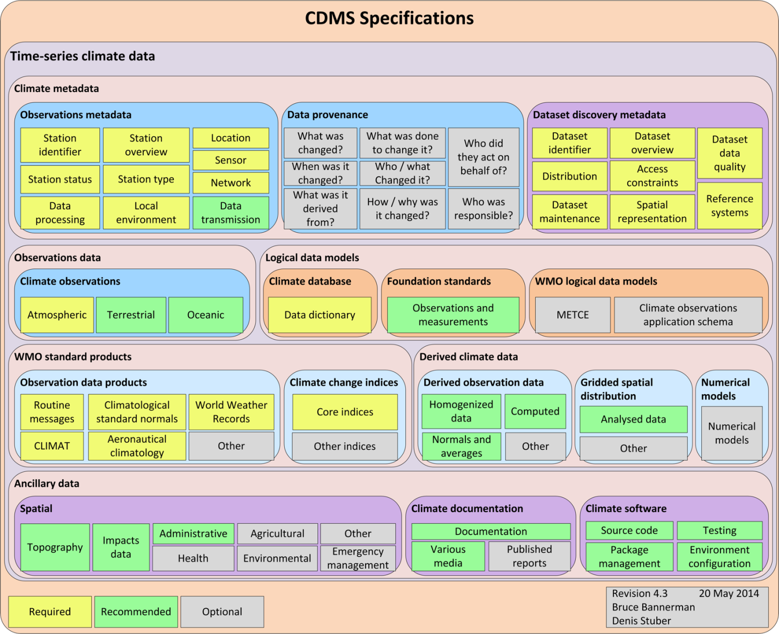
Time-series climate data

Slide 5
To note:
View of what climate is data is expanding, e.g.:
  GCOS Essential Climate Variables
  We need formal data definitions for climate data
We need comprehensive Climate Metadata for effective data management, including:
  Observations Metadata
  Discovery Metadata
  Data Provenance Metadata
  With rapidly increasing use of 3rd party data, we also need to understand:
    Data Intellectual Property constraints
Also:
  Understanding the varying quality of our data
  Data uncertainty
  Our data is interrelated

Slide 6
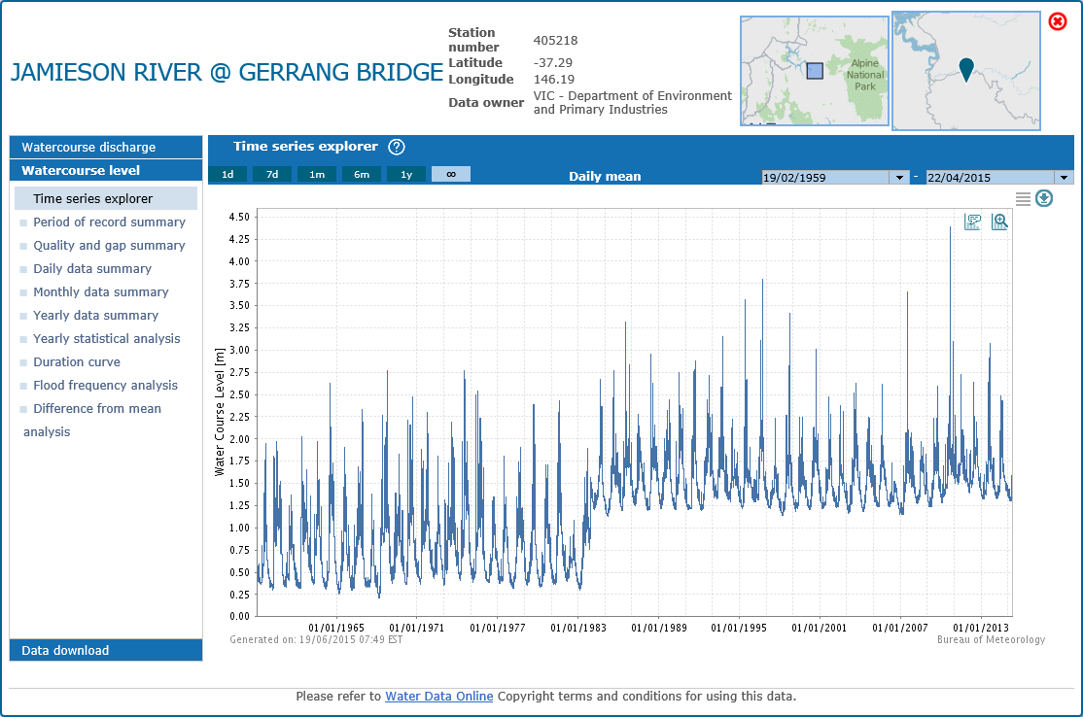

Slide 7
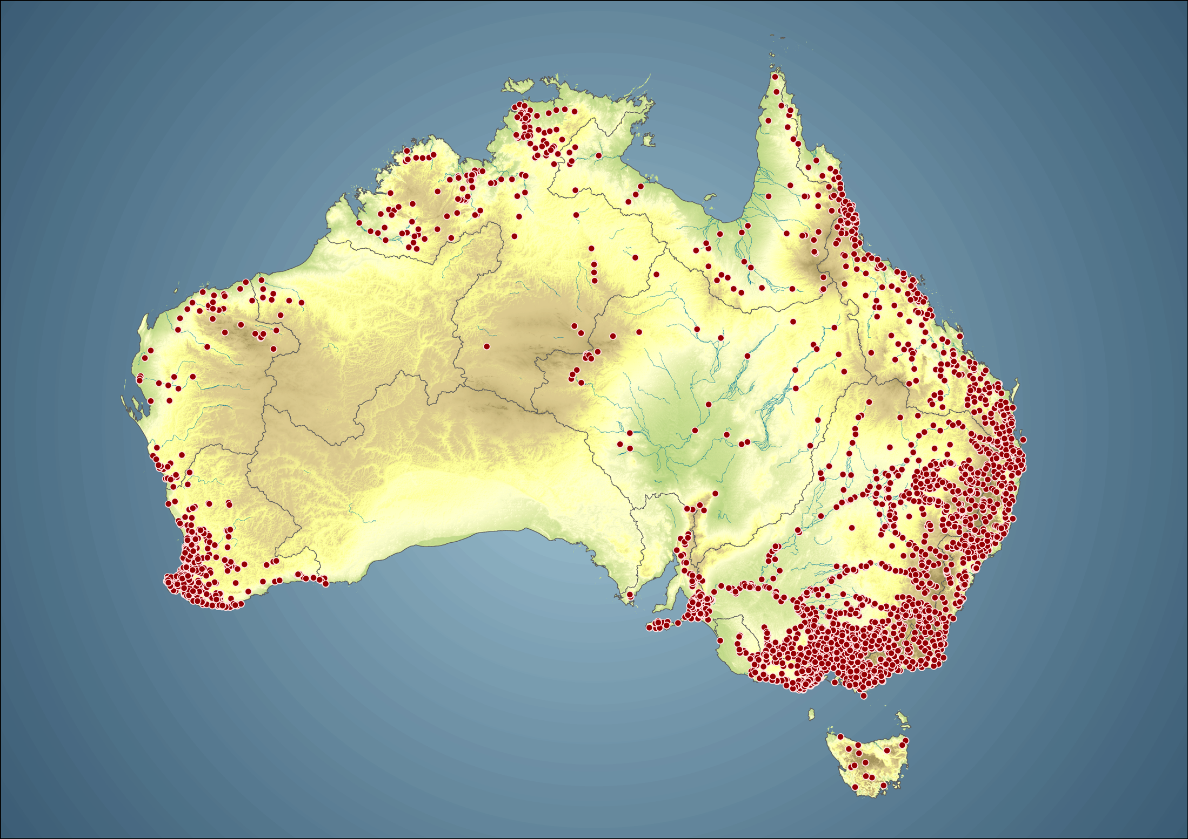

Slide 8
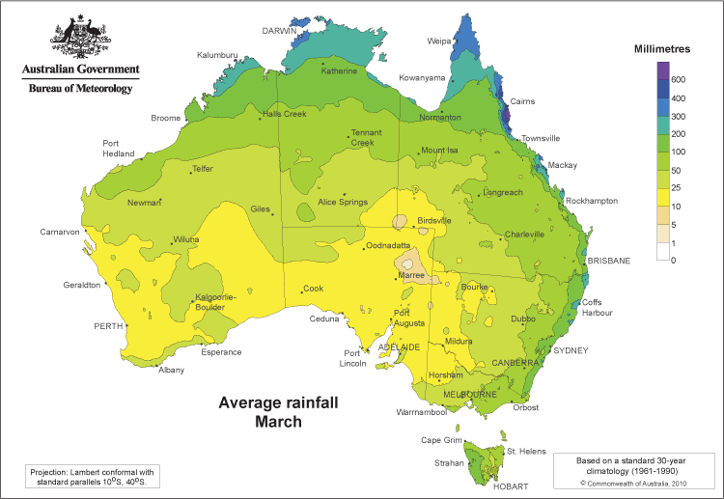

Slide 9
ET-CDMS

Slide 10
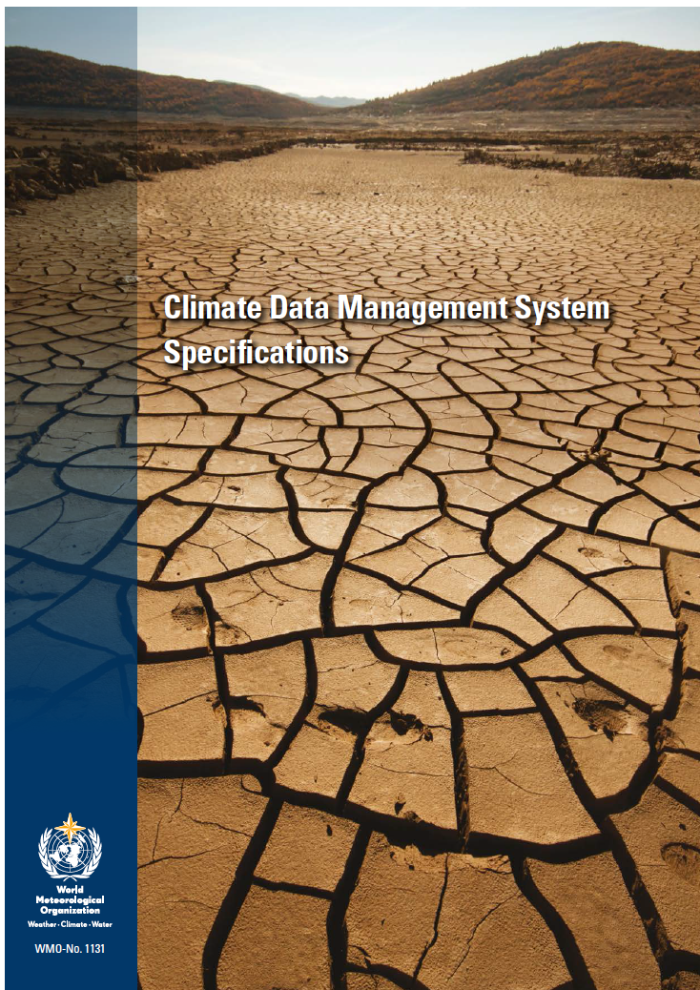
WMO No. 1131, Climate Data Management System Specifications

Slide 11
Climate Data Management System Specifications
The CDMS Specs describe:
  a high level conceptual architecture
  functionality required in next generation CDMS
Defined as:
  a set of components
  classified as required, recommended, optional
  meet needs of developed and developing countries
Expect NMHS to meet requirements in 3-5 year time frame
Also:
  Considerations for how to upgrade existing CDMS
  Recommendations

Slide 12
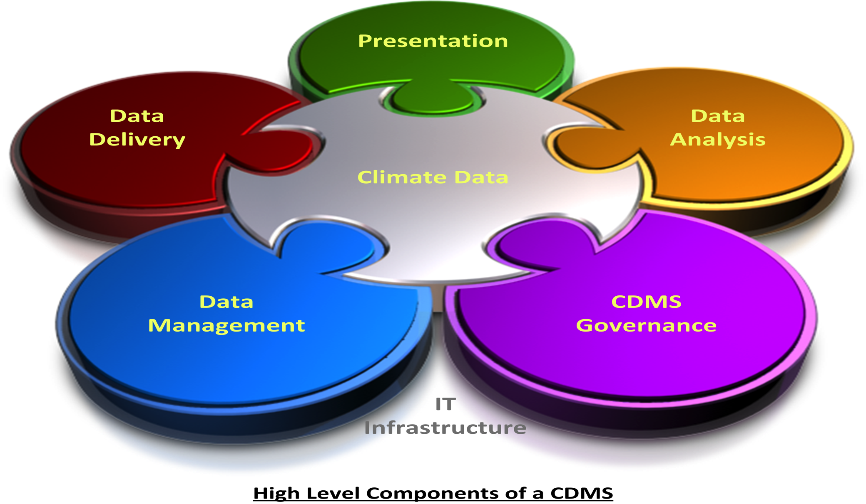
High Level Components

Slide 13
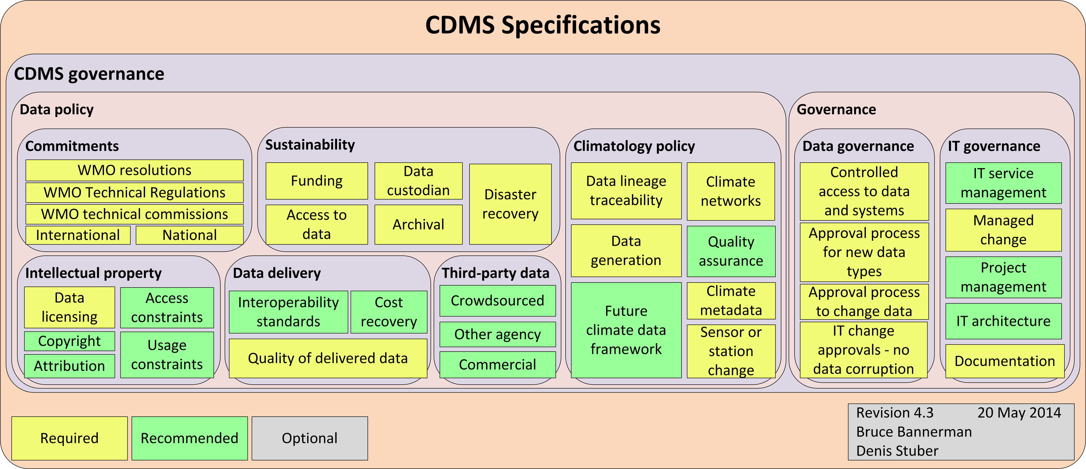
CDMS Governance

Slide 14
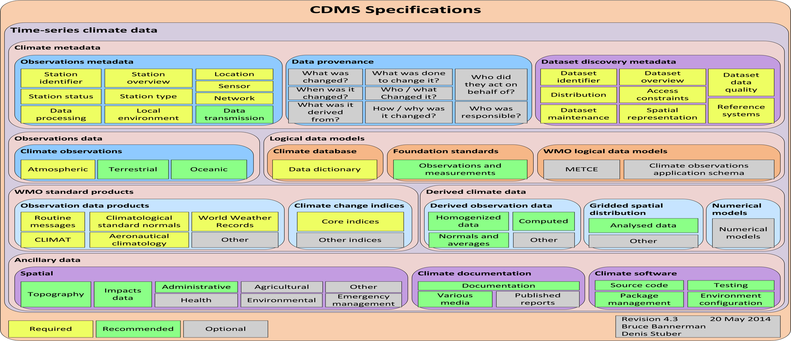
CDMS Timeseries Climate Data

Slide 15
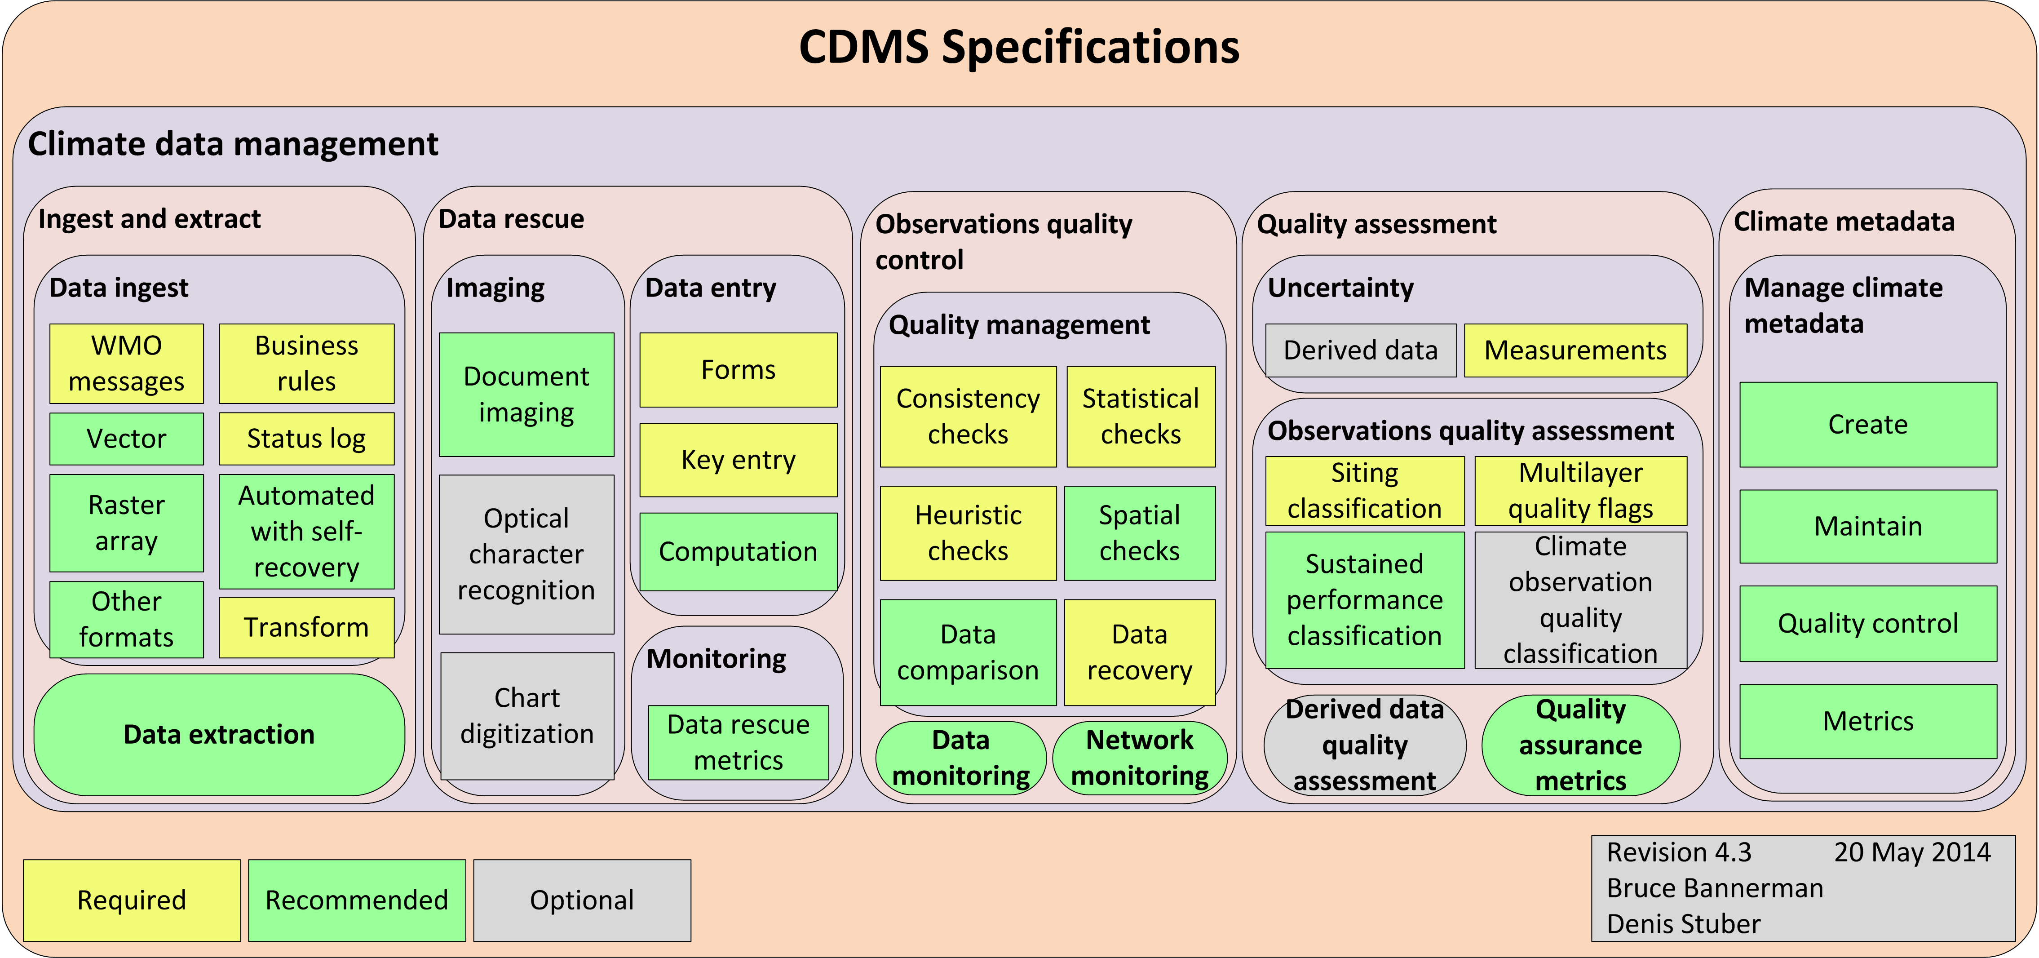
CDMS Climate Data Management

Slide 16
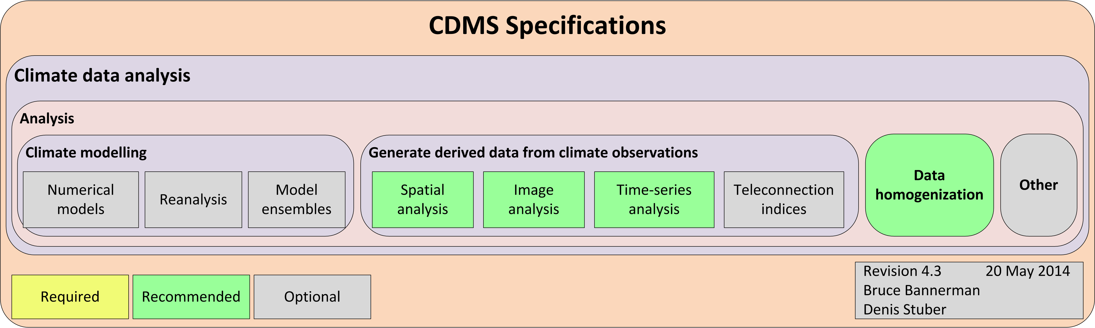
CDMS Climate Data Analysis

Slide 17
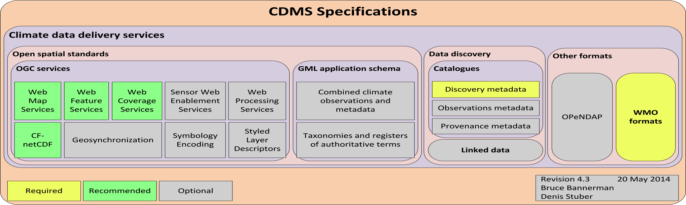
CDMS Climate Data Delivery

Slide 18
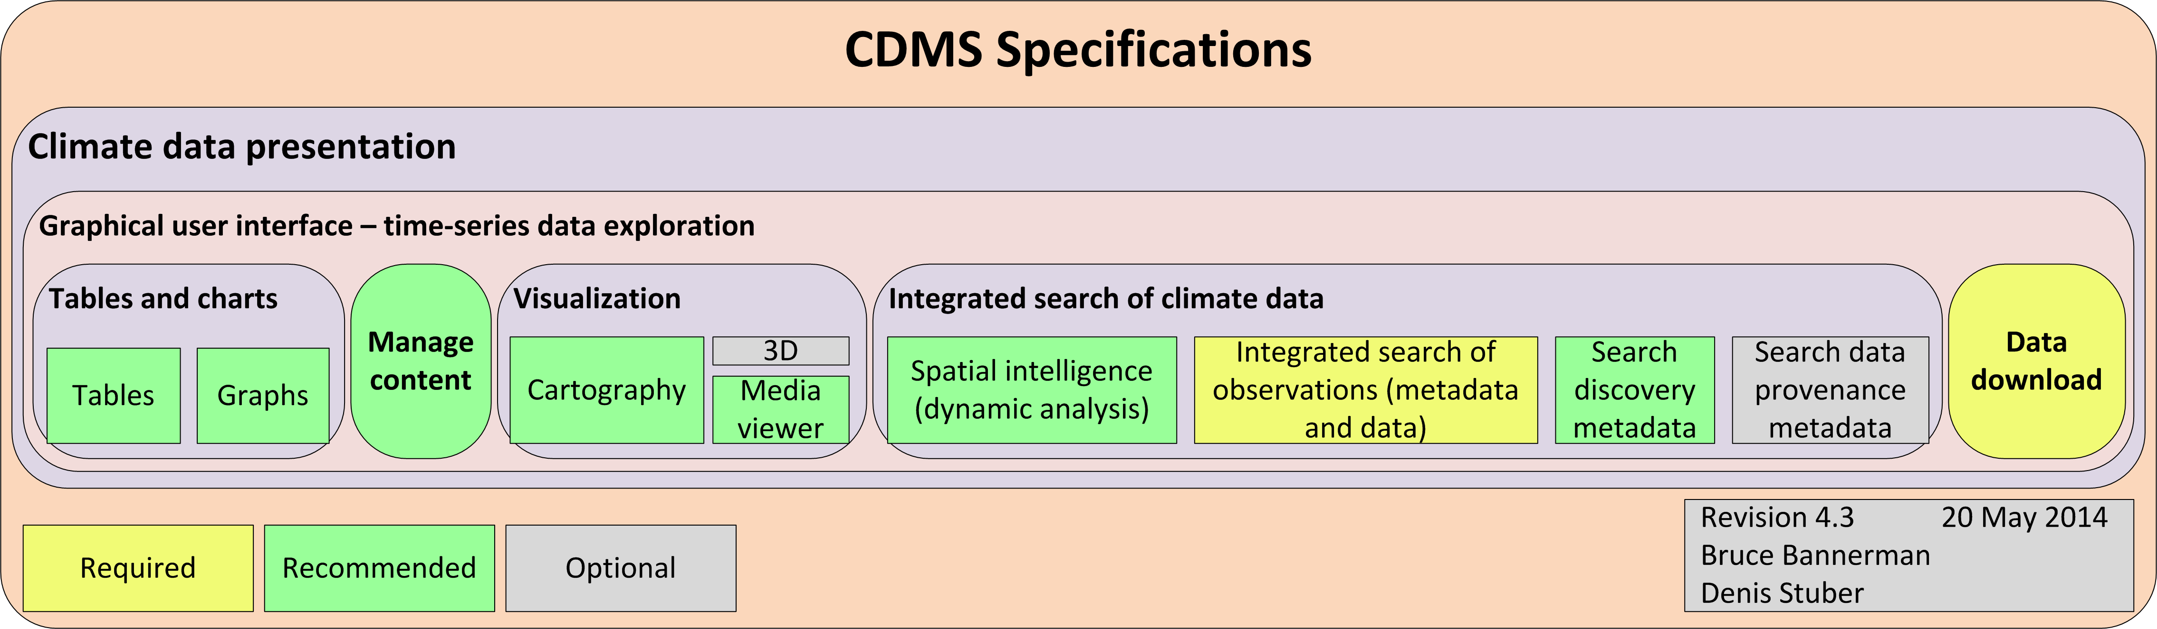
CDMS Climate Data Presentation

Slide 19
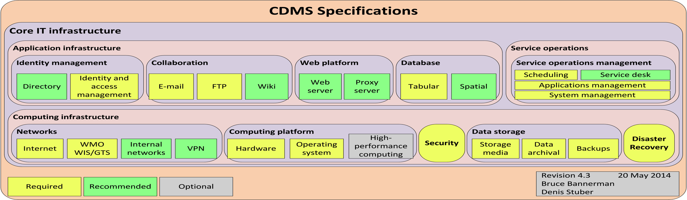
CDMS Climate Data Presentation

Slide 20
Status of CDMS Specs
Published July 2014
Endorsed:
  CCl 16
  CBS-Ext 2014
  Cg 17
Cg 17
  Resolution 4.2.3(2)/1 (Cg-17)
    Further develop aspects of CDMS Specs as WMO Standard
    Referenced in WIS Regulations
    Steve?

Slide 21
Of Observations metadata
CCl / WIGOS adhoc meeting on Observational Metadata in Geneva on November 2014 concluded that:
  WIGOS Metadata and Climate Observations Metadata are essentially the same
  We only want one Observations Metadata Standard:
    i.e. WIGOS Observations Metadata Standard
We may find through IPET-MDRD data modeling work that WIGOS Metadata and Climate Observations Metadata are more closely aligned

Slide 22
Extending WIGOS Metadata encoding with CDMS Spec

Slide 23
CDMS Governance

Slide 24
CDMS Timeseries Climate Data

Slide 25
CDMS Climate Data Management

Slide 26
CDMS Climate Data Delivery

Slide 27
CDMS Climate Data Presentation

Slide 28
Strategic considerations

Slide 29
ET-CDMS Vision (draft)
Extend WIS to facilitate easy exchange, replication and use of a consistent Global Climate Record
  This will require:
    Consistent climate data policy and framework
    Formal definitions of climate data
    Application schema to support consistent and semantic data exchange
    Efficient and effective next generation CDMS and Climate databases that:
      support data replication
      have consistent functionality regardless of technology

Slide 30
Open-CDMS
Preliminary planning underway:
  Develop an open source next generation CDMS
  Based on WMO No.1131, CDMS Specifications
  Governance possibly via OpenWIS Association
  NMHS pool and share investment and resources
  Reuse open source applications and libraries where possible
  Provide upgrade path for existing open source CDMS
  Meet needs of developing and developed countries
    Different component configurations packaged e.g.:
      CDMS-light
      CDMS-heavy

Slide 31
Open-CDMS
Open-CDMS could potentially provide NMHS with consistent functionality for:
  Observations Metadata management
  replication to OSCAR

Slide 32
Thank you for your attention
Bruce Bannerman
b.bannerman@bom.gov.au
Australian Bureau of Meteorology
Co-chair ET-CDMS

