Slide 1
Managing a historical climate record
IPET-MDRD-2
WMO; Ad hoc inter-programme workshop on representation of WIGOS and climate metadata

Slide 2
Climate data management challenge
One conclusion from UK Parliamentary Inquiry into ClimateGate:
  "...It is not standard practice in climate science to publish the raw data and the computer code in academic papers. However, climate science is a matter of great importance and the quality of the science should be irreproachable. We therefore consider that climate scientists should take steps to make available all the data that support their work (including raw data) and full methodological workings (including the computer codes...)."

Slide 3
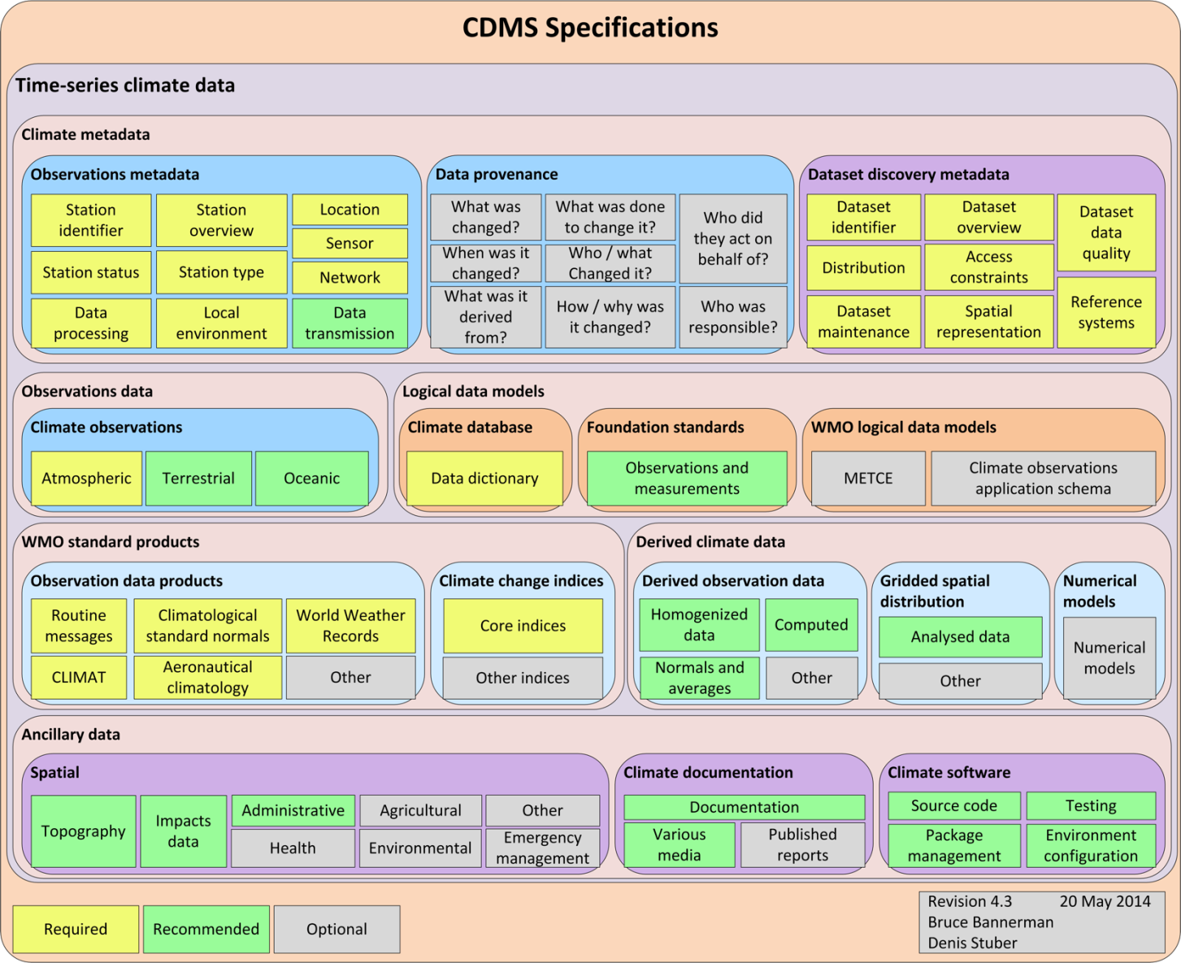
Time-series climate data

Slide 4
Climate data is interrelated #1
It includes:
A time-series of observations of a specific phenomena at a single sensor, including:
  estimations of the value of an observed property
  a detailed understanding of the conditions under which the observation was made
  any changes that have been made to the observation (e.g. due to Quality Assurance processes etc)

Slide 5
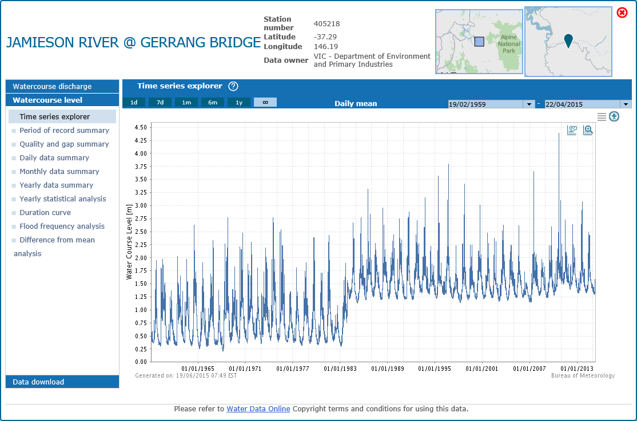

Slide 6
Climate data is interrelated #2
It includes:
2. A collection of the time-series observations described at #1, of the same phenomena, at the same time steps, perhaps in the form of a discrete coverage (time-series).

Slide 7
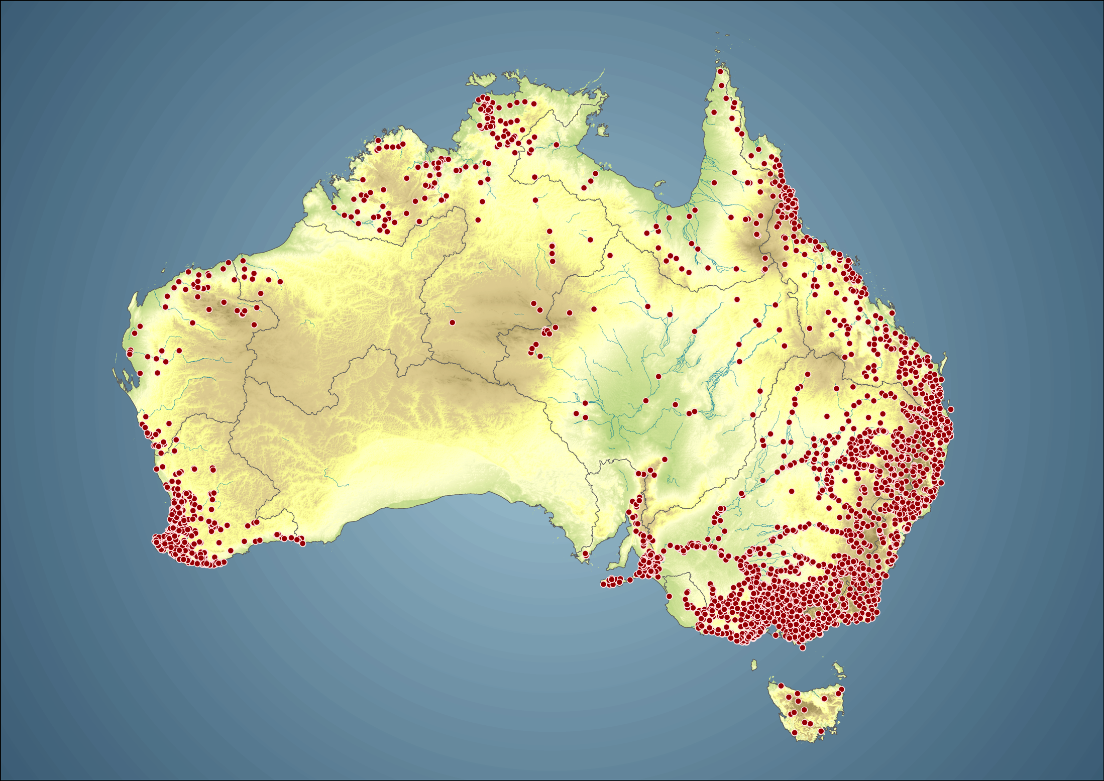

Slide 8
Climate data is interrelated #3
It includes:
A time-series representing the distribution of values of the collection of time-series observations described at #2 represented as perhaps a:
  continuous two dimensional coverage
  continuous coverages as three dimensional cubes
  continuous coverage as n-dimensional models
  an ensemble, comprising a number of models
  where these time-series coverages /cubes / models represent the outputs of some analytical process.

Slide 9
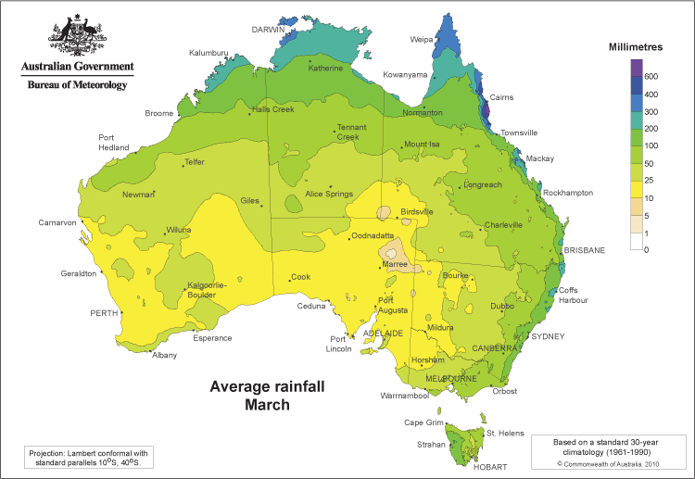

Slide 10
Data lineage and provenance
When a paper is published, a climate scientist needs to be able to refer to:
the analytical data that underpins the paper (perhaps the n-dimensional continuous coverage time-series at #3).
the quality assured observations data that the continuous coverages at #3 were derived from at #2 and #1 (with details as to why each change to the Quality Assured observations described at #1 were made).
the ‘raw’ observations data described at #1, with details as to the conditions, sensors etc that the observation was made under.
the version of the software source code that was used to manipulate the data at #1, #2, and #3.
This is not a trivial data management problem to address, however its resolution will provide a solid data management grounding for future climate science and help address much spurious debate.

Slide 11
Some properties of climate data
Long QA cycles
Multiple quality states
Data Provenance
  What was changed
  When was it changed
  Why was it changed
  How was it changed
  Who changed it, etc
Intellectual Property constraints
  Increasingly important with 3rd Party data
This also applies to Observations Metadata

Slide 13
Observations metadata
Observations metadata is critical to ensuring good quality climate data
We’ll explore this over the next presentations:
  Denis: Experiences of Observations Metadata requirements in Developing Countries
  Meaghan: Bureau of Meteorology climate data quality management
  Blair: Experiences in establishing and using an homogenised high quality climate network (ACORN-SAT)
  Blair and Meaghan: Defending the Climate Record: Responding to Parliamentary Inquiries and Freedom of Information requests

Slide 14
Thank you for your attention
Bruce Bannerman
b.bannerman@bom.gov.au
Australian Bureau of Meteorology
Co-chair ET-CDMS

