Slide 1
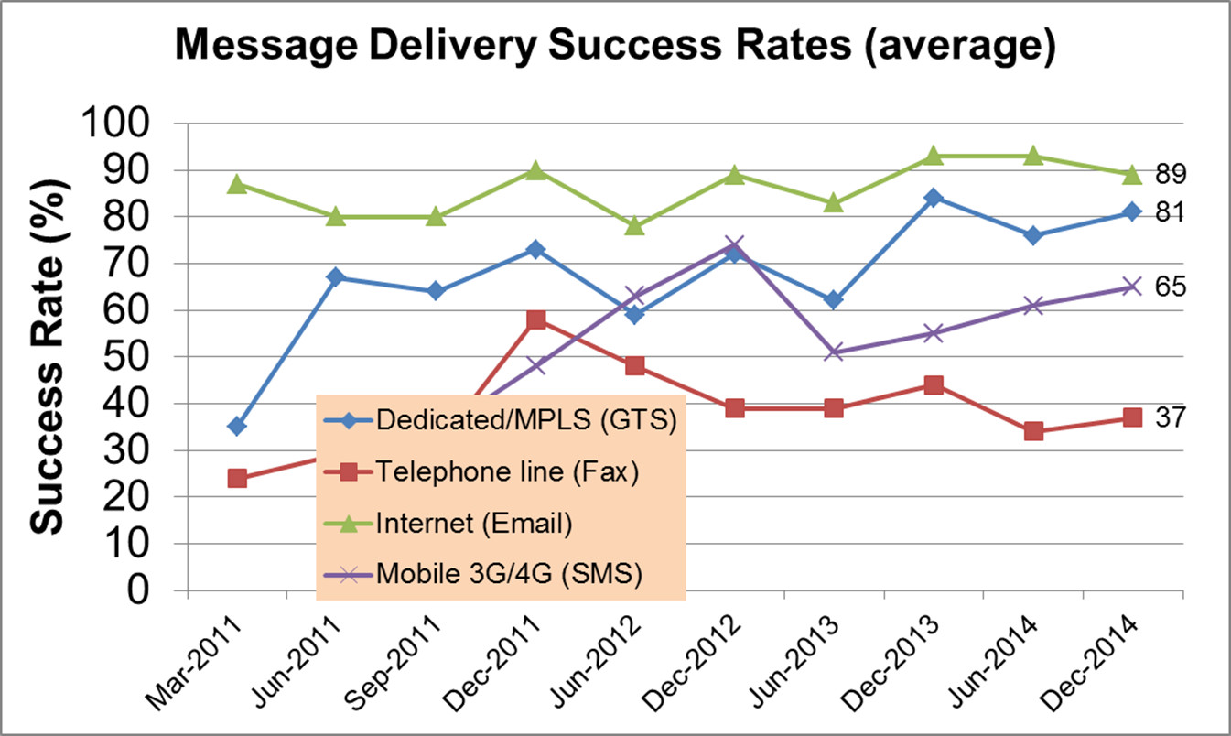
Indian Ocean Practices
Tsunami Service Provider: Australia, India and Indonesia

Slide 2
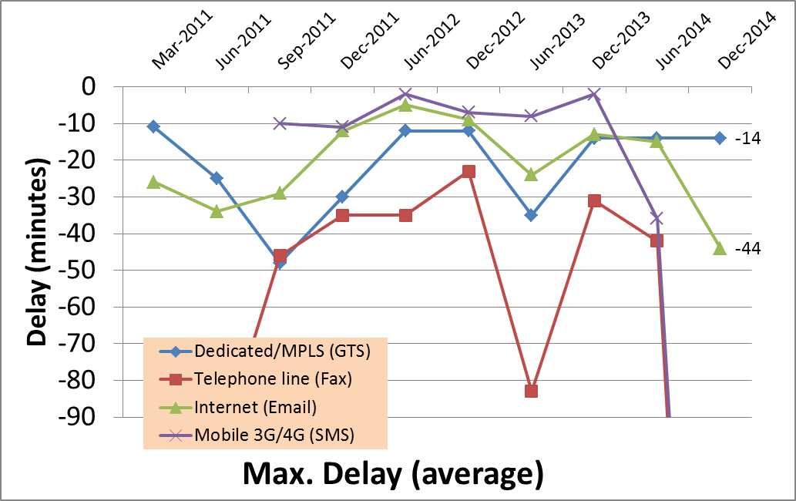
Indian Ocean Practices
Tsunami Service Provider: Australia, India and Indonesia
-318
-342

