Slide 1
Status of WCD Prototype at GISC Beijing
GISC Beijing
2015.1.28

Slide 2
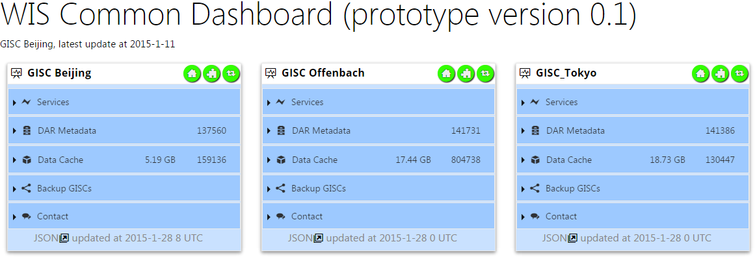
WCD Prototype (V0.1) at GISC Beijing
http://wisportal.cma.gov.cn/monitor/test/dashboard
Basic GUI view of Monitor.JSON
Basic view tiles of realtime monitor.json of CMA, DWD, JMA
Fetching realtime monitor.jsons
JSON Schema validation (after fetching)

Slide 3
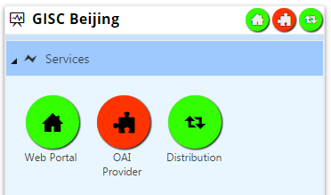
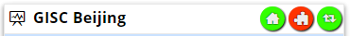
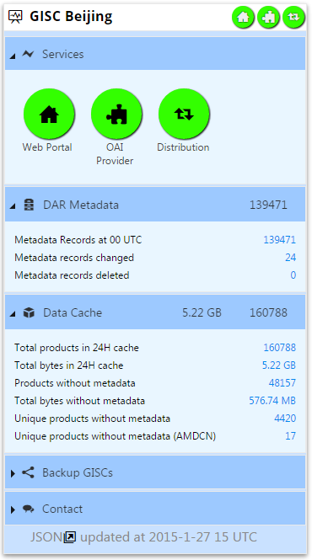
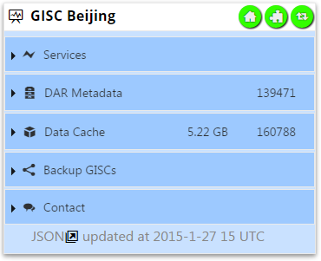
Fold / Expand more details
Brief View:
Key services status
  Service UP
  Service DOWN
DAR Metadata capacity
24H Cache capacity

Slide 4
Status of WCD Prototype v0.1
Dev. Progress of Pilot Features:
JSON Message Spec. (Joint Proposal v0.1) |  | Participated in discussion & drafting
JSON files available online (proposal v0.1) http://wisportal.cma.gov.cn/monitor/test/json/monitor.json http://wisportal.cma.gov.cn/monitor/test/json/centres.json http://wisportal.cma.gov.cn/monitor/test/json/events.json | Milestone 1 | achieved
JSON reports realtime info. of GISC Beijing centres.json & events.json are placeholders now | Milestone 2 | achieved
Remote JSON files fetching and schema validation |  | achieved
Visual Metrics (suggested by TT-DC) |  | ongoing
Dashboard GUI for events.json files |  | ongoing
Dashboard GUI for centres.json files |  | ongoing

Slide 5
Thank you !

