Slide 1
RA I WIS Implementation Plan Workshop
22-26 September 2014
WMO; WIS

Slide 2
Agenda for the week
Mon
1 ORGANIZATION OF THE SESSION
1.1 Opening of the meeting
1.2 Adoption of the agenda
1.3 Working arrangements
2 BACKGROUND ON WIS
2.1 WIS Overview
2.2 WIS Competences
2.3 WIS Discovery Metadata
Visit to SAWS?
3 PLANNING FOR WIS
3.1 WIS Regulations and guidance
3.2 Summary of WIS implementation plans in other regions
3.3 Reports from sub-regional WIS/WIGOS workshops
4 STATUS OF WIS IN RA I
4.1 GISC Pretoria
4.2 GISC Casablanca
4.3 Other GISCs supporting RA I
4.4 Reports from sub-regions
4.4.1 Northern
4.4.2 Central
4.4.3 Eastern
4.4.4 Southern
5 PRIORITY ACTIVITIES FOR IMPLEMENTING WIS IN RA I
6 CREATE RA I WIS
IMPLEMENTATION PLAN
7 MONITORING THE RA I WIS IMPLEMENTATION PLAN
8 ANY OTHER BUSINESS
9 CLOSURE OF MEETING
Weds
Mon
Tue
Thu
Fri

Slide 3
WIS Overview
Topics
Introduction to WIS
Status of WIS
Exploiting WIS
Future directions

Slide 4
WIS Competences
Topics
What is a competence
WIS Competences
WIS Training and Learning Guide

Slide 5
WIS Discovery Metadata
Context
Manage Data Discovery
Manage Data Flow

Slide 6
Agenda for Wednesday
PM
AM
3 PLANNING FOR WIS
3.1 WIS Regulations and guidance
4.3 GISC Toulouse
4.4 GISC Offenbach
4.1 GISC Pretoria
4.2 GISC Casablanca
3.2 Summary of WIS implementation plans in other regions
3.3 Reports from sub-regional WIS/WIGOS workshops
4 STATUS OF WIS IN RA I
4.4 Reports from sub-regions
4.4.1 Northern
4.4.2 Central
4.4.3 Eastern
4.4.4 Southern
4.4.5 Western
5 PRIORITY ACTIVITIES FOR IMPLEMENTING WIS IN RA I

Slide 7
WIS Regulations and Guidance

Slide 8
Regulations and Guidance
Technical Regulations Vol I. (WMO No 49)
Manual on WIS (WMO No. 1060)
Guide on WIS (WMO No. 1061)
Manual on GTS (WMO No. 386)
Guide on VPN (WMO No. 1116)
Guide on IT Security (WMO No. 1115)
WIS metadata guidance (http://wis.wmo.int/page=md_index)
Find WMO No. documents from: https://www.wmo.int/pages/library/
WIS in a nutshell: http://wis.wmo.int/page=wis-in-a-nutshell
… and more information from http://www.wmo.int/wis

Slide 9
Manual on WIS

Slide 10
Manual on WIS
Part I: Organization and responsibilities
Part II: Designation procedures for WIS centres
Part III: Functions of WIS
Part IV: WIS Technical Specifications (and Appendix D – recommended by CBS)
Part V: WIS discovery metadata (and Appendix C)

Slide 11
Agenda for Wednesday
PM
AM
3 PLANNING FOR WIS
3.1 WIS Regulations and guidance
4.3 GISC Toulouse
4.4 GISC Offenbach
4.1 GISC Pretoria
4.2 GISC Casablanca
3.2 Summary of WIS implementation plans in other regions
3.3 Reports from sub-regional WIS/WIGOS workshops
4 STATUS OF WIS IN RA I
4.4 Reports from sub-regions
4.4.1 Northern
4.4.2 Central
4.4.3 Eastern
4.4.4 Southern
4.4.5 Western
5 PRIORITY ACTIVITIES FOR IMPLEMENTING WIS IN RA I

Slide 12
WIS Regional implementation plans

Slide 13
WIS Implementation Plan: Region 6
1 Executive Summary
2 Introduction
3 Scope and purpose of the RA VI WIS Implementation Plan
4 Description of WIS
5 WIS in Region VI (Europe)
6 WIS planning and implementation by RA VI Members
7 Risks associated with WIS implementation
8 RA VI WIS Implementation Plan – execution and timeline

Slide 14
WIS Implementation Plan: Region 5
1 Executive Summary
2 Introduction
3 Scope and purpose of the RA-V WIS Implementation Plan
4 Description of WIS
5 WIS in Region V (South-West Pacific)
6 WIS planning and implementation by RA-V Members
7 Challenges associated with WIS implementation in RA-V
8 RA-V WIS Implementation Plan – Execution and Timeline

Slide 15
WIS Implementation Plan: Region 4
Let’s make a plan….

Slide 16
WIS Implementation Plan: Region 3
1 Executive Summary
2 Introduction
3 Scope and purpose of the RA-III WIS Implementation Plan
4 Description of WIS
5 WIS in Region III (South America)
6 WIS planning and implementation by RA-III Members
7 Challenges associated with WIS implementation in RA-III
8 RA-III WIS Implementation Plan – Execution and Timeline

Slide 17
WIS Implementation Plan: Region 2
1. Executive Summary
2. Introduction
3. Scope and purpose of the RA II WIS Implementation Plan
4. Description of WIS
5. WIS in Region II (Asia)
6. WIS planning and implementation by RA II Members
7. Risks associated with WIS implementation
8. RA II WIS Implementation Plan – execution and timeline

Slide 18
WIS Implementation Plan: Region 1
And that is why we are here….

Slide 19
Risks identified
 | RA-II | RA-III | RA-V | RA-VI
General WIS acceptance | X | X | X | X
Lack of staff resources for operational WIS centre | X | X | X | X
Metadata knowledge | X | X | X | X
Insufficient bandwidth of communication links | X | X | X | X

Slide 20
Status of WIS in RA-I
Perception of readiness

Slide 21
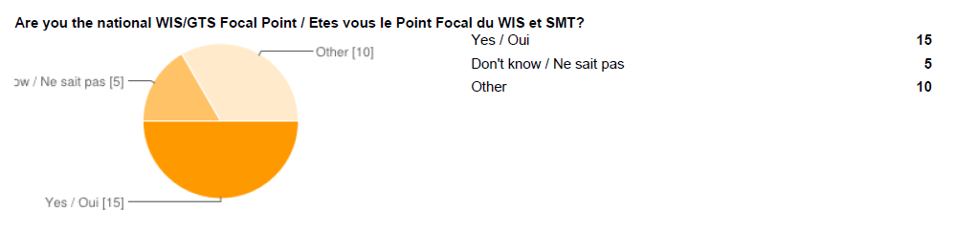
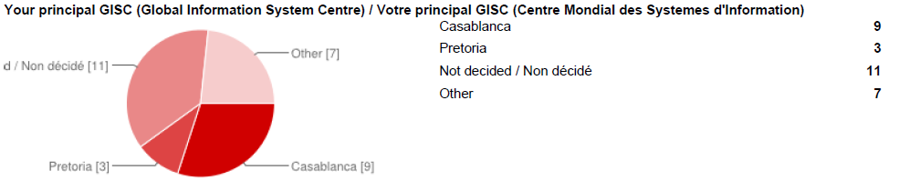

Slide 22
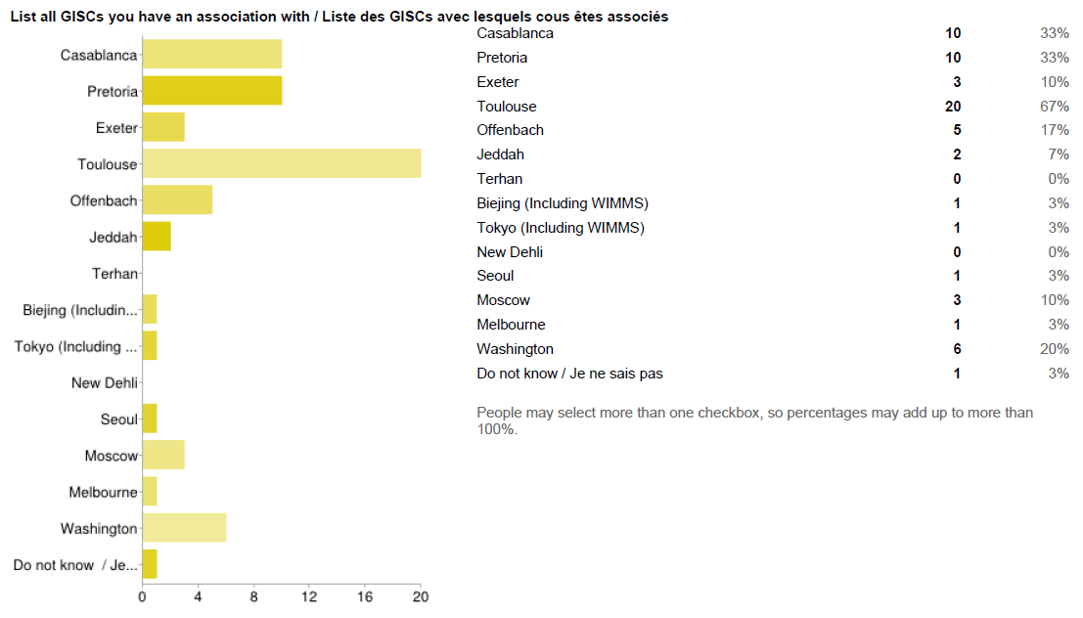

Slide 23
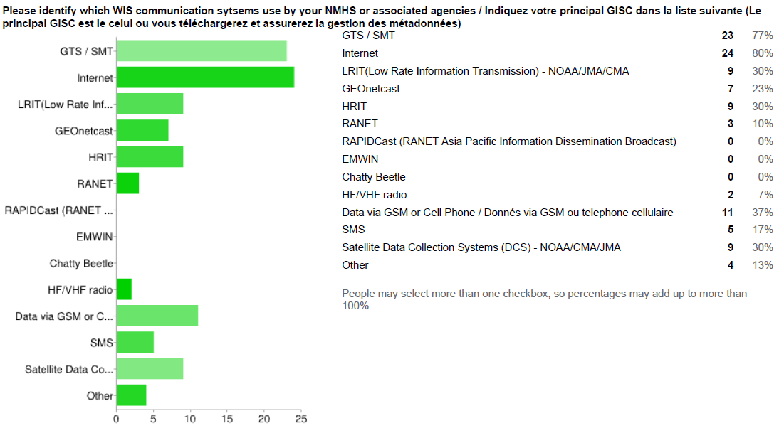

Slide 24
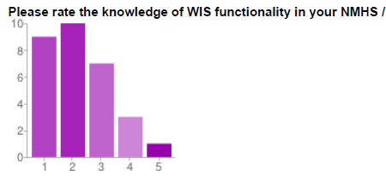
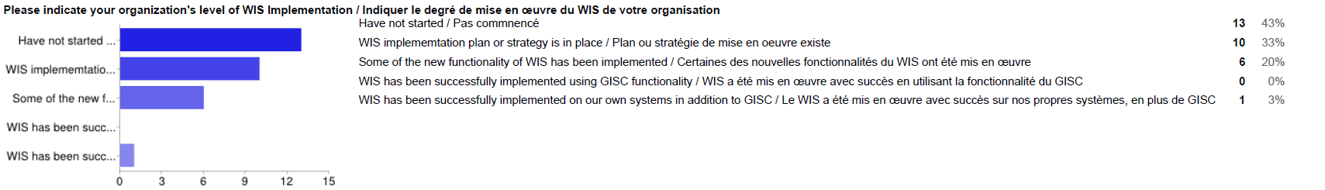

Slide 25
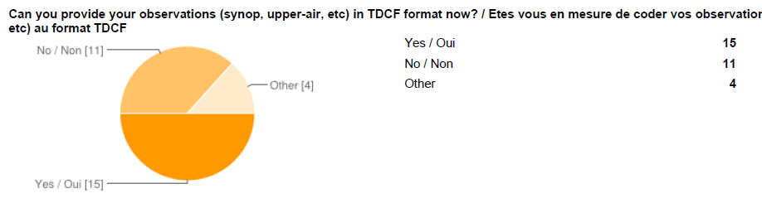

Slide 26
Now for your regional reports

Slide 27
Sub-regions
Northern – Haddouch
Western - Dieme
Central – Kamunga
Eastern – Mutai
Southern – Kapaso

Slide 28
Priority activities

Slide 29
What might need to be addressed? - 1
People Communications
  What is WIS? – PRs and senior managers (inside and outside NMHS) and to technical staff
  Highlight the benefits of WIS
Develop the appropriate skills and competences of staff – initially and ongoing
Collaboration with other organizations and partners (eg ASECNA)
Use RMDCN to connect Dakar and Nairobi
  And add logical connection between Casablanca and Pretoria

Slide 30
What might need to be addressed? - 2
Repair GTS
  Remove routes that are not functioning and make sure that countries all have a working connection
  Make sure that all countries have adequate speeds to exchange the volume of information in the time required
Pair GISCs and major RTHs as way of exploiting capabilities for technology and training
  Pretoria/Nairobi
  Casablanca/Dakar

Slide 31
What might need to be addressed? - 3
Create detailed plan that can be monitored
Plan must include development of capability to keep technologies up to date with changes in technology, user needs and WIS specifications
Implement relationships between GISC and members – technical and working practices
Enable telecommunications within countries that allow information to be gathered and distributed
  to meet international obligations
  To share between organizations in the country

Slide 32
What might need to be addressed? - 4
Metadata
  All centres to produce and maintain metadata records
    Essential for GTS information
    For any other information that the country wishes to make known to others (and could be to others within the country)
Ensure that all countries have implemented their relationship with the principal GISC (the PR needs to make the formal request).

Slide 33
Flow of information - 1
Creation of digital reports at manual station for transmission
Automatic digital transmission of AWS information to national/sub-national collection point
Telecommunications connection from observing site (or production office) to national/sub-national centre
National/sub-national collection centre
National/sub-national data store
Display/production system (integration of information from multiple sources)
Create reports in TDCF
Transmit information to national users

Slide 34
Flow of information - 2
Transmit information to international users – management of data flow (including GTS)
International telecommunications connections
Reception of information from international centres (including GTS)
Data store for international information (ideally the same as the national/sub-national data store to allow seamless use of information)
Long term storage and protection of informationCreation and maintenance of WIS Discovery metadata records

Slide 35
Flow of information - 3
Delivery of non-real time national products through the WIS
Implementation of centres other than the NMHS as WIS National Centres (or DCPCs)
National Centre/DCPC compliance with WIS requirements
Exploit GISC and other WIS facilities to provide more information to national users
National training in WIS – users
National training in WIS – operators of WIS infrastructure

Slide 36
Thank you for your attention
wis-help@wmo.int

