Slide 1
WIS Overview
Steve Foreman, WMO Secretariat
RA I WIS Implementation Planning Workshop
WMO - WIS

Slide 2
Topics
Introduction to WIS
Status of WIS
Exploiting WIS
Future directions

Slide 3
Introduction to WIS

Slide 4
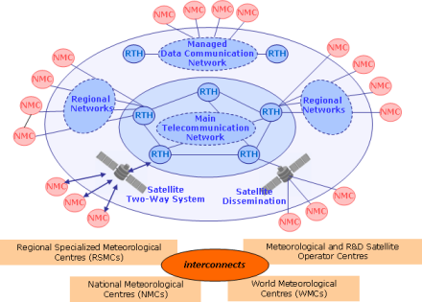
World Weather Watch
Launched in 1963, to support global collaboration in operational weather forecasting and weather research
Three core components: GOS, GTS, GDPFS
GTS - the Global Telecommunication System: collects, exchanges, and distributes observational data and forecasting products

Slide 5
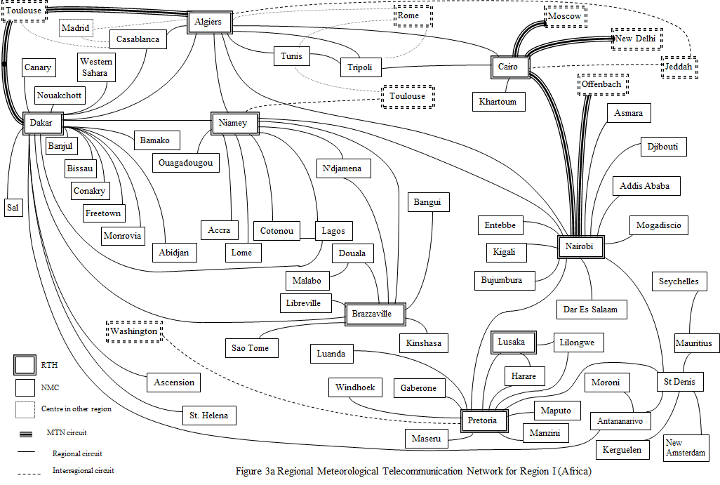
GTS in Region I

Slide 6
Sample telecomms connections in RA I
RA I National Centres WIS and GTS links
Country | Centre location | Link bandwidth Kb/s | Link Type & Protocol | RTH | GISC
Algeria | Algiers | 64 |  | Toulouse | Casablanca
Algeria | Algiers | 0,05 |  | Rome | Casablanca
Angola | Luanda |  | NI | Pretoria | Pretoria
Benin | Cotonou | 1,2 | IP | Niamey | Casablanca
Botswana | Gaborone | 64 | IP | Pretoria | Pretoria
Burkina Faso | Ouagadougou | 19,2 | IP | Niamey | Casablanca
Burundi | Bujumbura |  | NI | Nairobi | Casablanca
Cabo Verde | Sal | 0,05 | IP | Dakar | Casablanca

Slide 7
Annual WWW monitoring results - SYNOP

Slide 8
Annual WWW monitoring results - TEMP

Slide 9
Annual WWW monitoring results - CLIMAT

Slide 10
Progress of migration to TDCF- SYNOP

Slide 11
Progress of migration to TDCF- TEMP

Slide 12
Limitations of GTS
GTS is Reliable But…
  Difficult to know what is there
  Need special connections
  Hard to set up routine delivery
  “WWW club”

Slide 13
WMO Information System (WIS) aims to…
Add to GTS
Make it easier to
  find data
  fetch data
  publish data
Serve whole WMO community
Allow migration to new technologies

Slide 14
Vision of WIS
WMO Members decided that WIS will:
Use international industry standards
Build on the Global Telecommunication
System (GTS), with a smooth and
coordinated transition;
Provide operational and time-critical data exchange, as well as data access and retrieval services;
Support all WMO and related international programmes.
Notes:
In 2003, the member nations of WMO decided that WIS will :
Use international industry standards for protocols, hardware and software;
Build on the existing WMO Global Telecommunication System (GTS), with special attention to a smooth and coordinated transition;
Provide operational and time-critical data exchange, as well as data access and retrieval services;
Support all WMO and related international programmes.

Slide 15
Implementation of WIS (Cg-XV, 2007)
WIS is evolving in two parallel parts:
Part A: GTS continued consolidation and further improvements for data and products delivery
Time-critical and operation-critical delivery based
on real-time “push” via dedicated telecommunications
Timely delivery based on delayed mode “push”
via combination dedicated + public networks
Part B: extension of services through flexible
data discovery, access and retrieval services,
as well as flexible timely delivery
Notes:
WIS is evolving in two parallel parts:
Part A: GTS continued consolidation and further improvements for data and products delivery
Time-critical and operation-critical delivery based on real-time “push” via the dedicated telecommunications network
Timely delivery based on delayed mode “push” via a combination of dedicated and public networks
Part B: extension of services through flexible data discovery, access and retrieval services, as well as flexible timely delivery

Slide 16
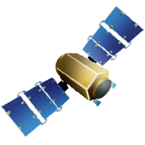
GTS structure
RTH
Regional Telecommunication Hub
NMC
National Metrological Centre
MTN
Main Telecommunication Network
RMTN
Regional Meteorological Telecommunication Network
NMC
NMC
NMC
MTN
RTH
NMC
RTH
RTH
RTH
RTH
NMC
RTH
RTH
NMC
NMC
RMTNs
NMC
NMC
Notes:
We saw this too, but note that the RMDCN is the RA VI RMTN. ECMWF allows RA VI Members to sponsor other countries to join the RMDCN as happened in the IMTN project which saw the MTN being pretty much migrated to the RMDCN too.
ECMWF then agreed to allow the WIS Core Network be on the same contract so that all GISCs are allowed to join the RMDCN, at least in theory. Politics has stuck its nose in here. We will discuss later.

Slide 17
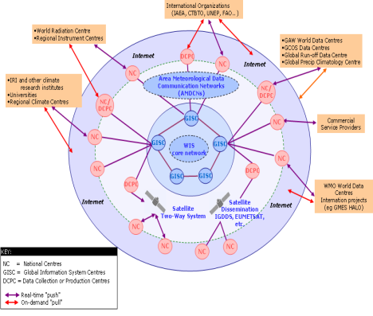

WIS structure
National Centre:
contributes information to WIS
distributes WIS information to national users
National Centre
Data Collection or Production Centre:
Collects, prepares or analyses information, or
Manages sub-regional exchange of information
Data Collection or Production Centre
Global Information System Centre:
Holds catalogue of all information available through WIS
Manages global exchange of information
Global Information System Centre
17

Slide 18
The MTN and WIS Core Network
RMDCN
GISC
Moscow
IMTN
GISC
Exeter
GISC
Beijing
GISC
Tokyo
GISC
Offenbach
GISC
Seoul
GISC
Toulouse
WIS Core Network
GISC
Jeddah
GISC
Casablanca
GISC
Tehran
GISC
Pretoria
GISC
New Delhi
GISC
Washington
GISC
Brasilia
GISC
Melbourne
Notes:
Now WMO is taking a step beyond managing data messages.
In committing to WIS, WMO has moved to an overarching approach based on managing the data and information.
The core network of WIS is the MTN, but not all GISCs are on the RMDCN run MTN yet.
New centres on the MTN include Pretoria and Casablanca. GISCs Tehran and Brasilia are still working on their connection to the RMDCN NG

Slide 19









Adding data to WIS
WMO Pizza Programme
DCPC
19
Notes:
WMO has a new Programme - the Pizza Programme. The Programme has set up a DCPC to collect and package pizzas for international exchange.
Someone who makes pizzas wants to distribute them through the DCPC.
The first step is to negotiate with the DCPC the method of delivery:
Pizzaworld: truck, flying saucer, bicycle.......
WIS world: GTS, ftp, email, http upload........
They also need to discuss the formats:
Pizzaworld: triangles, squares, stars....
WIS world: GRIB, BUFR, NetCDF, XML......
Once they have agreed these protocols, the trucks can start delivering the triangle pizzas!

Slide 20
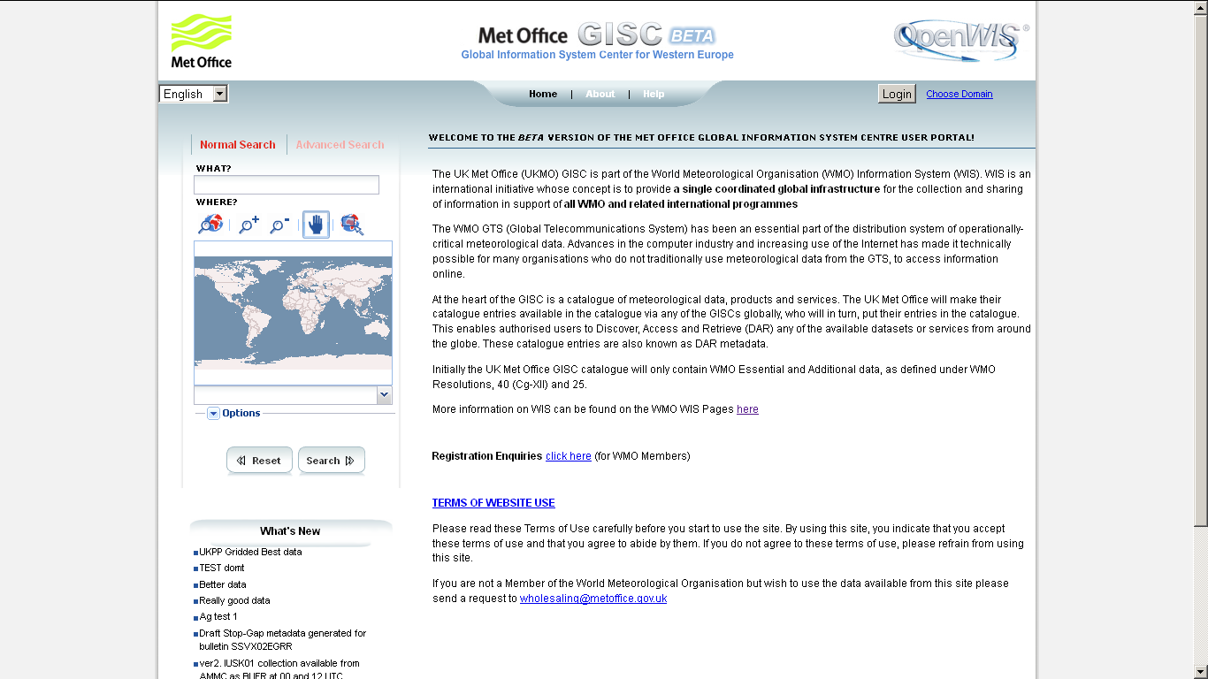
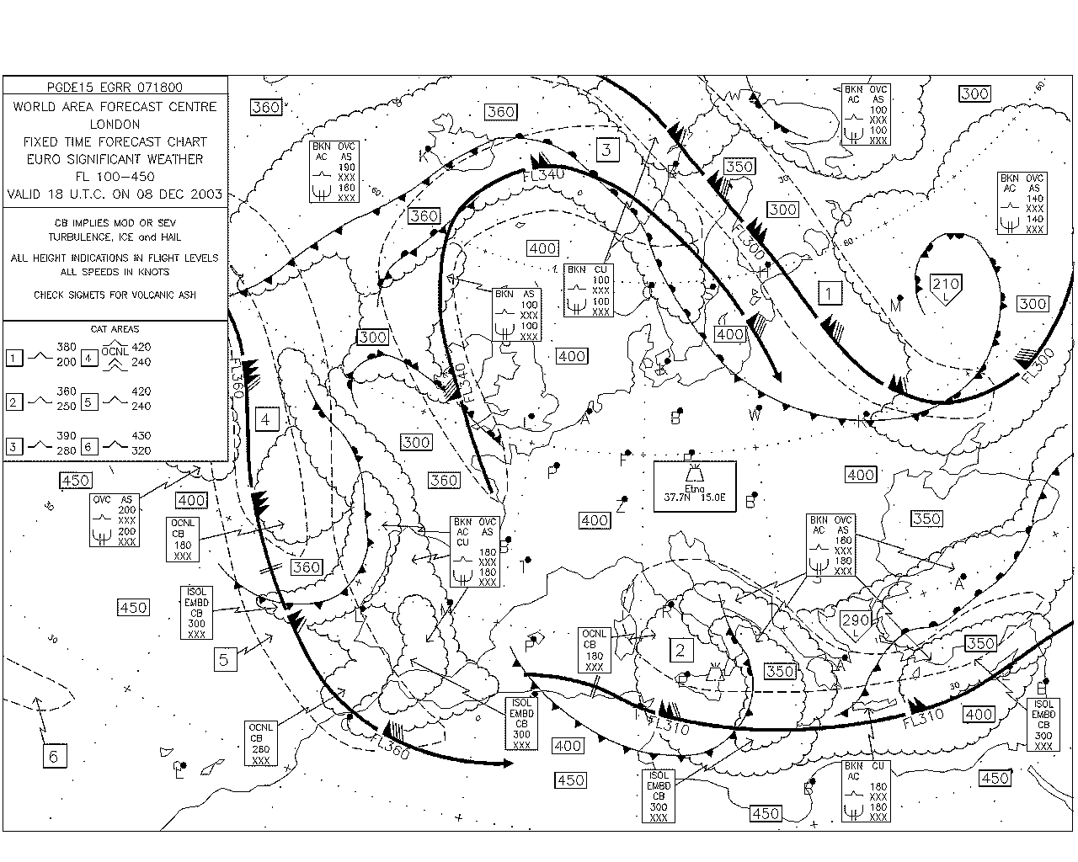
Discovery, Access, Retrieval
GISC
User
Searches catalogue at GISC
Asks GISC/DCPC for product
2
DCPC
1
DCPC
Passes WIS metadata to GISC
DCPC
Passes product to user
3
20

Slide 21
WIS Compliance Specifications
Existing centres within WMO Member States may apply for designation as one of the functional centres forming the core infrastructure of WIS:
  Global Information System Centres (GISCs)
  Data Collection or Production Centres (DCPCs)
  National Centres (NCs)
Designation requires a statement of compliance
with WIS requirements
The Manual on WIS (WMO No 1060) is
the authoritative source for specifications applicable
to WIS GISCs, DCPCs, and NCs
The Manual on WIS also lists centres and their Principal GISC
Notes:
Existing centres within WMO Member States may apply for designation as one of the three types of WIS Centers.
As of 2013, WMO Members have proposed 15 GISC's and about 121 DCPC's and over 220 NCs. The totals around 360 and is expected to grow as Climate and Hydrology centres join WIS.
To be officially designated as a WIS Centre requires a demonstrated capability to implement the WIS Compliance Specifications There are specific procedures for having a candidate WIS Centre endorsed by WMO Expert Teams.
Although Members may still nominate to provide a GISC, CBS believes that 15 GISCs is enough unless new technology allows a way to operate more GISCs and meet the interchange requirements without increasing operating costs to existing GISCs.
In contrast, Members are encouraged to identify further NCs and DCPCs to enrich the overall data holdings and services available to WMO Members.

Slide 22
Status of WIS

Slide 23
WIS Compliance Specifications
Existing centres within WMO Member States may apply for designation as one of the functional centres forming the core infrastructure of WIS:
  Global Information System Centres (GISCs)
  Data Collection or Production Centres (DCPCs)
  National Centres (NCs)
Designation requires a statement of compliance
with WIS requirements
The Manual on WIS (WMO No 1060) is
the authoritative source for specifications applicable
to WIS GISCs, DCPCs, and NCs
The Manual on WIS also lists centres and their Principal GISC
Notes:
Existing centres within WMO Member States may apply for designation as one of the three types of WIS Centers.
As of 2013, WMO Members have proposed 15 GISC's and about 121 DCPC's and over 220 NCs. The totals around 360 and is expected to grow as Climate and Hydrology centres join WIS.
To be officially designated as a WIS Centre requires a demonstrated capability to implement the WIS Compliance Specifications There are specific procedures for having a candidate WIS Centre endorsed by WMO Expert Teams.
Although Members may still nominate to provide a GISC, CBS believes that 15 GISCs is enough unless new technology allows a way to operate more GISCs and meet the interchange requirements without increasing operating costs to existing GISCs.
In contrast, Members are encouraged to identify further NCs and DCPCs to enrich the overall data holdings and services available to WMO Members.

Slide 24
Status of WIS implemetation
WIS became operational in Jan. 2012
There are now
  15 GISCs
  136 DCPCs
  223 NCs
  150,000 metadata records in the global catalog, and increasing…

Slide 25
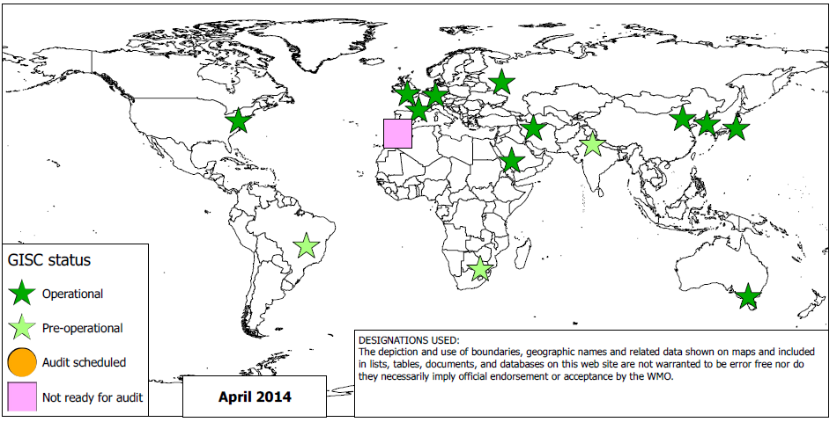
GISC status

Slide 26
WIS centres (May 2013)

Slide 27
Some well known DCPCs
ECMWF
EUMETSAT
NCAR
NESDIS-NCDC/NODC/NGDC
GRDC
WDCs for GHG, Ice
…

Slide 28
Exploiting WIS

Slide 29
Global Earth Observations
System of Systems (GEOSS)
Earth
System
Models
Global Earth
Observations
System of
Systems
(GEOSS)
Other
Data
Sources
GEOSS Clearinghouse / Broker
Data and Product Users
Earth
Observation
Systems
WMO
Information
System
(WIS)
National Centres
WIS Global Information System Centres (GISC's)
Data Collection or Production Centres (DCPC's)
Notes:
Let’s look at GEOSS first, because here the WIS is a contributing system to GEOSS so it is easier to see the linkage between them that takes place through the GISC.
The WIS Architecture is very similar to the GEOSS Architecture as agreed in the GEOSS 10 Year Plan and Reference Document.
The primary interface for interoperability between WIS and GEOSS occurs at the GEOSS Data Broker which acts as a Clearinghouse.
Because both GEOSS and WIS adopted the same ISO standard search service, WIS GISC's can search the GEOSS Clearinghouse and WIS catalogs are searchable by users of GEOSS Clearinghouse.
Interestingly, the discovery metadata flow between GEOSS Portal and WIS GISCs is different. GEOSS chose to harvest all WMO Discovery Metadata and serve this information from its own system. WIS has chosen not to harvest and host the entire GEOSS catalogue but to use the GEOSS Search and Retrieval by URL standard (SRU) based on ISO 23950 supported by GEOSS and WIS. SRU allows WIS users to search the GEOSS catalogue by passing the search question to the GEOSS server via the SRU interface. This means that GISCs do not have to scale their capacity to store GEOSS metadata which is something over which they would have had no control. Also, much of WMOs metadata is available through GEOSS so management would also be more complex.
It is important to note that data and product users can access WIS GISC's and DCPC's either directly or by a referral from GEOSS.
The same is true of all WIS Centres: broader catalogues and access portals supplement but need not replace existing catalogs or portals.

Slide 30
Global Observing System (GOS)
Global Observing System
of WWW (operated by NMHS's)
WWW
Global
Observing
System
(WWW GOS)
WMO Global Telecommunications System (GTS)
and Regional
Telecommunication
Hubs
(also known as
WIS DCPC's)
observations (satellite and surface)
Data and Product Users
inter-comparison and validation
National Meteorological Centres
(also known as WIS NC's )
WMO
Information
System
(WIS)
WIS Global Information System Centres (GISC's)
Notes:
WMO’s Global Observing System provides observations of the state of the atmosphere and ocean surface.
These observations are used for the preparation of weather analyses, forecasts, advisories and warnings, and for climate monitoring and environmental activities carried out under programmes of WMO and other relevant international organizations.
GOS is operated by National Meteorological Services, national or international satellite agencies, and involves several consortia.
The most common data formats in this area are GRiB (GRIdded Binary) and BUFR (Binary Universal Form for the Representation of meteorological data). In addition to these binary encoded formats, WMO uses the character encoded CREX (Character Representation for EXchange of data).
WMO's GTS is part of WIS. GTS Regional Telecommunications Hubs (WIS DCPC's) support external interfaces for data access. The National Meteorological Centres (WIS NC's) also support interoperability with external systems.
Here, some common services for data exchange are OpenDAP (Open-source Project for a Network Data Access Protocol) and Thredds (Thematic Real-time Environmental Distributed Data Services).

Slide 31
Global hydrologocical data including WHYCOS
Global
Hydrological
data including
WHYCOS
regional Hydrological Cycle
Observing Systems (HYCOSs)
Data and Product Users
National Hydrological Services (also known as WIS NC's)
Global Data Centres
(also known as WIS DCPC's)
WMO
Information
System
(WIS)
WIS Global Information System Centres (GISC's)
Notes:
WMO’s Hydrological Observations, including the World Hydrological Cycle Observing System (WHYCOS), focuses on strengthening cooperation among National Hydrological Services, and coordinating measurement and collection of surface and ground water data, from networks of hydrological and meteorological stations.
External interfaces for data discovery, access, and retrieval include National Hydrological Services (WIS NC's), and Global Data Centres (WIS DCPC's) such as the Global Runoff Data Centre.
Data holdings are available through each of the Hydrological Cycle Observing Systems that comprise WHYCOS.
Although there may be not much international standardization of hydrology data, it seems there is a growing awareness of the need for it.
Some hydrological data is being disseminated using WaterML, an XML schema created by the Consortium of Universities for the Advancement of Hydrologic Science.

Slide 32
Global Atmosphere Watch (GAW)
Global
Atmosphere
Watch
(GAW)
Observing systems contributing to GAW
World Data Centres
(also known as
WIS DCPC's)
Data and Product Users
National Centers
(includes WIS NC's)
GAWSIS Web site
WMO
Information
System
(WIS)
GAW Web site
WIS Global Information System Centres (GISC's)
Notes:
The Global Atmosphere Watch (GAW) strengthens the ability to predict climate, weather and air quality, by maintaining and applying global, long-term observations of the chemical composition and selected physical characteristics of the atmosphere.
External interfaces for data discovery, access, and retrieval are at the GAW Web site, and the GAW World Data Centres (WIS DCPC's):
Ozone & UV
Greenhouse Gases
Aerosols
Radiation
The Global Atmosphere Watch Station Information System (GAWSIS) is a prime focal point for data accessibility.
Pilot projects are underway on the interoperability of GAW World Data Centres and access services, including data in the format known as NetDCF (Network Common Data Form).

Slide 33
World Climate Programme (WCP)
WIS National Centres (operated by NMHS's)
World
Climate
Programme
(WCP)
National Climate Data Management Systems
National Climate
Forecast Systems
Data and Product Users
Regional Climate Centers (WIS DCPC's)
World Climate
Data Centres
(WIS DCPC's)
Global Climate Forecast
Producing Centres
(WIS DCPC's)
WMO
Information
System
(WIS)
WIS Global Information System Centres (GISC's)
Notes:
The World Climate Program (WCP) coordinates activities in climate data collection, monitoring, research, prediction, applications and training. WCP facilitates climate data and metadata collection through various global climate observing systems, and climate data should be available through international exchange.
WCP also assists in implementing Regional Climate Centers.
External interfaces for data discovery, access, and retrieval include:
National Meteorological Services,
Regional Climate centers,
World Climate Data Centers and
Global Climate Forecast Producing Centers.
WCP requires access to a wide variety of data in many different formats, especially given the need to deal with archived data.

Slide 34
Global Climate Observing System (GCOS)
Global
Climate
Observing
System
(GCOS)
GCOS Baseline and Comprehensive Networks, and Satellites
Global Observing System Information Centre [Web portal] (DCPC)
Data and Product Users
GCOS and related Monitoring and Analysis Centres (includes WIS DCPC's)
Observations
Product Generation
WMO
Information
System
(WIS)
WIS Global Information System Centres (GISC's)
Notes:
The Global Climate Observing System (GCOS) is co-sponsored by WMO, the UNESCO Intergovernmental Oceanographic Commission (IOC), the United Nations Environment Programme (UNEP), and the International Council for Science (ICSU).
GCOS focuses on the comprehensive observations required for monitoring climate, detecting change, assessing the impacts, and improving models of the climate system.
The GCOS programme facilitates the taking of the needed observations by national or international organizations in support of their own requirements as well as of common goals.
GCOS builds on, and works in partnership with, other existing and developing observing systems such as the WMO Global Observing System and Global Atmosphere Watch, the Global Ocean Observing System, and the Global Terrestrial Observing System.
GCOS has many external interfaces that are opportunities for interoperability: the Global Observing System Information Centre, GCOS Monitoring and Analysis Centres, and the many specific Atmosphere, Ocean, and Terrestrial Networks for observations, related data centres and archives designated relevant to climate.

Slide 35
Global Ocean Observing System (GOOS)
Global
Ocean
Observing
System
(GOOS)
Observations
WMO Global Telecommunications System (GTS)
Data and Product Users
Product Generation
JCOMM Data Portals
(also known as WIS DCPC's )
IODE Ocean Portal
(also known as a WIS DCPC )
WMO
Information
System
(WIS)
WIS Global Information System Centres (GISC's)
Notes:
The Global Ocean Observing System (GOOS) focuses on sustained observations of the oceans, generation of oceanographic products and services, and interaction between research, operational, and
user communities.
GOOS is designed to:
monitor, understand and predict weather and climate;
describe and forecast the state of the ocean,
including living resources;
improve management of marine and coastal ecosystems
and resources;
mitigate damage from natural hazards and pollution;
protect life and property on coasts and at sea; and,
enable scientific research.
GOOS is implemented by member states via their government agencies, navies and oceanographic research institutions, working together in a wide range of thematic panels and regional alliances.
Key external interfaces providing opportunities for interoperability are: the WMO GTS, the Joint WMO/IOC Technical Commission for Oceanography and Marine Meteorology (JCOMM) Data Portal, and the International Oceanographic Data and Information Exchange (IODE) Ocean Data Portal.
The Ocean Data Portal includes "Ocean Teacher": an extensive set of online learning modules that include data management and metadata as well. Here, the metadata describes as course prerequisites and learning objectives. This is just one example that the WIS discovery function must deals with much more than geospatial metadata.

Slide 36
Global Terrestrial Observing System (GTOS)
Global
Terrestrial
Observing
System
(GTOS)
Calibration / Validation
Terrestrial Ecosystems Monitoring Sites (TEMS)
Data and Product Users
Observations
GTOS Data Centres Directory
GTOS Resources Directory
WMO
Information
System
(WIS)
National Centres
WIS Global Information System Centres (GISC's)
WIS Data Collection or Production Centres (DCPC's)
Notes:
The Global Terrestrial Observing System (GTOS) is a programme for observations, modelling, and analysis of terrestrial ecosystems to support sustainable development. GTOS facilitates access to information on terrestrial ecosystems so that researchers and policy makers can detect and manage global and regional environmental change.
External interfaces for data discovery, access, and retrieval include the GTOS Data Centres Directory, the GTOS Resources Directory, and the Terrestrial Ecosystems Monitoring Sites (TEMS) database.
Here I would mention the Geonetwork opensource project which is being applied broadly in this area, including the TEMS database among many others. We anticipate that many of the WIS Centres will be using Geonetwork as a portal for access to maps and other geospatial data resources.

Slide 37
WMO Priority Areas
WIS is critical to the following priority initiatives of WMO
  WIGOS Framework
    WMO Integrated Global Observing System
    WIS provides the interoperability layer as well as providing WIS data exchange and discovery
  GFCS
    Global Framework for Climate Services
    WIS supports the Climate Services Information System (CSIS Pillar), and
    Observations and Monitoring Pillar
  Expected Result 1 & 2 – Services and Disaster Risk Reduction
    WIS enables Members and decision makers access to authoritative, high quality weather, climate and water information
Notes:
In order to better understand the reasons for WIS and its benefits, it is worth considering the role WIS plays in WMO’s operational and critical services that underlie all Members NMHS and Climate activities. In particular, we have spoken of several observing systems under WMO and with their partners. WIGOS provides a framework that effectively integrates these observing systems as if they were one in the terms of coordination and planning. WIS provides the interoperability layer of WIGOS as well as making it easier for earth observing systems to share information across WMO.
Global Framework for Climate Services is especially dependent on WIS in its observation and monitoring pillar just as WIGOS is. It is also dependent on WIS and its interoperability set of standards and practices for its Climate Services Information Systems which not only need to incorporate WIS and other WMO activities but take advantage of WIS’s heritage and learning to make the CSIS an efficient and effective information management system in its own right facilitating the providing of Climate services.
Similarly, Expected Results 1 and 2 of WMO 2012-15 Strategic Plan clearly depend on WIS to enhance the ability of Members and their decision makers to access authoritative, high quality weather, climate and water information. WIS will make it easier for increasing the visibility of NMHS and WMO as the authoritative soruce and make it easier to access WMO information.

Slide 38
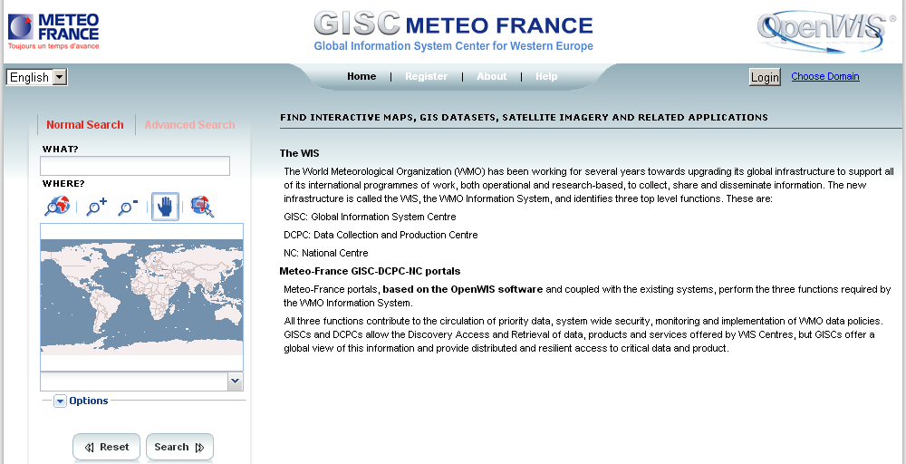
Find the information
Visit a GISC Listed on
http://www.wmo.int/giscs
Search box
e.g.
Tsunami Pacific
Can search by area

Slide 39
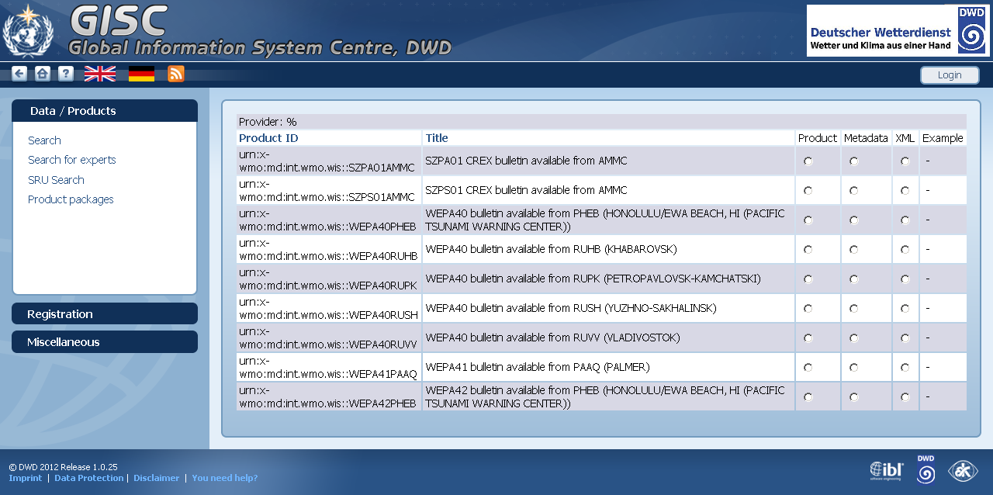
Select which record is of interest
Look at metadata

Slide 40
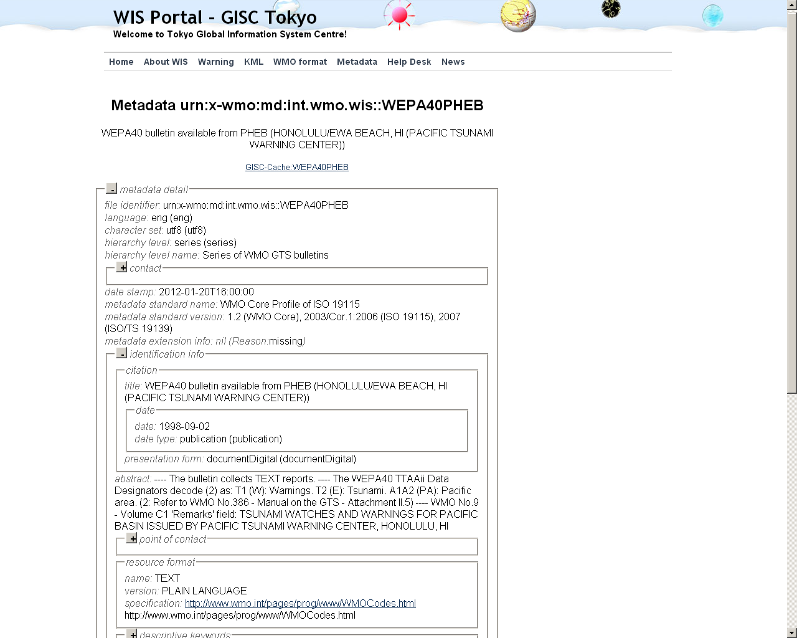
Check that it is what you need

Slide 41
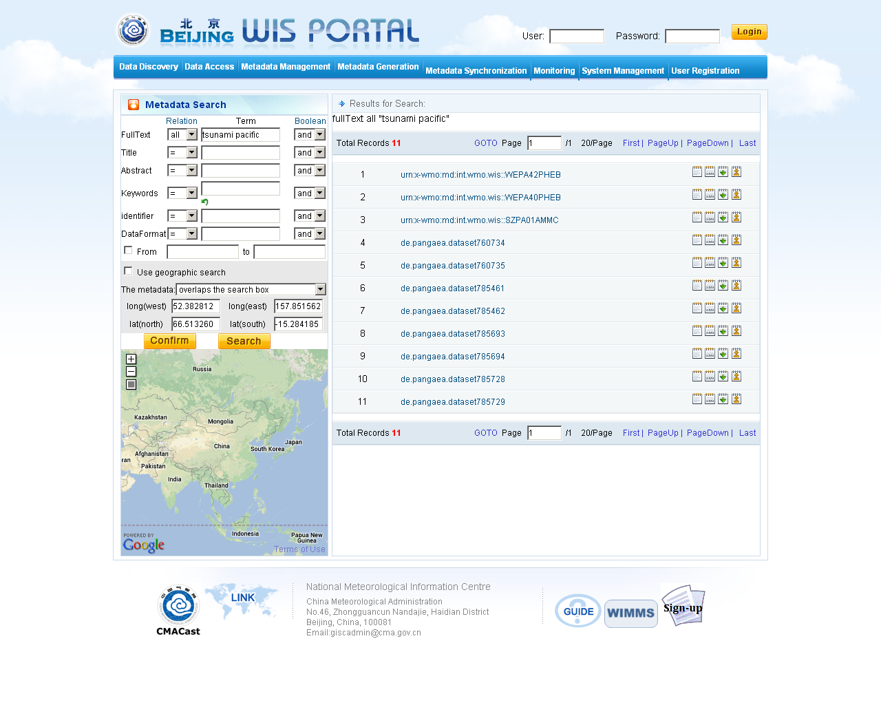
And then download or ask for as routine
Download now
Subscribe – receive data as they arrive

Slide 42
Future directions

Slide 43
Future directions of WIS
Assist data providers to make their data discoverable through WIS
Support the integration of different observing systems
Support the implementation of climate services
Improve data discovery interfaces, e.g. integrate basic tools for visualisation

Slide 44
Commission for Basic Systems – Expert Teams on WIS
CBS Open Programme Area Group on Information Systems and Services
  ET on Telecommunication Infrastructure
  ET on WIS Centres: Task Team on GISCs
  Inter-Programme ET on Data Representation Maintenance and Monitoring
  Inter-Programme ET on Metadata and Data Representation Development

Slide 45
WIS Reference Documents
WMO Technical Regulation Vol I. (WMO No 49)
Manual on the WMO Information System (WMO No 1060)
Guide to the WMO Information System (WMO No 1061)
These and other important documents such as the
“Designation Procedures for GISCs and DCPCs” can be found on the WIS web site:
http://www.wmo.int/wis
Notes:
You can find the key reference documents about WIS at this URL.
The primary document is the Manual on WIS (WMO No 1060) published in January 2012 as an addition to the WMO Technical Regulation 49 (Technical Regulations, Volume I: General Meteorological Standards and Recommended Practices). It was further updated at EC-65 with the addition of CBS 16 changes including all the discovery metadata information. Recommended practices and clarifications are provided in the Guide to the WMO information (WMO No 1061) which was updated at CBS 15 in 2012 and published following approval at EC-65.
Other useful reference documents are the "WIS Compliance Specifications“ and Functional Architecture. These contain the interface specifications I have just presented, plus some more general aspects of WIS and were the basis of the Manual and Guide on WIS.
Tech Reg 49 Volume I - http://library.wmo.int/opac/index.php?lvl=notice_display&id=14073
Manual on WIS – WMO No 1060 – http://library.wmo.int/opac/index.php?lvl=notice_display&id=9254
Guide to WIS – WMO No 1061 - http://library.wmo.int/opac/index.php?lvl=notice_display&id=6856

Slide 46
Topics
Introduction to WIS
Status of WIS
Exploiting WIS
Future directions

Slide 47
Thank you for your attention
wis-help@wmo.int

