Slide 1
WIS Discovery Metadata
Steve Foreman, WMO Secretariat
RA I WIS Implementation Planning Workshop
WMO; OBS/WIS

Slide 2
Data Management in WIS architecture
Context
Manage Data Discovery
Manage Data Flow

Slide 3
Context

Slide 4
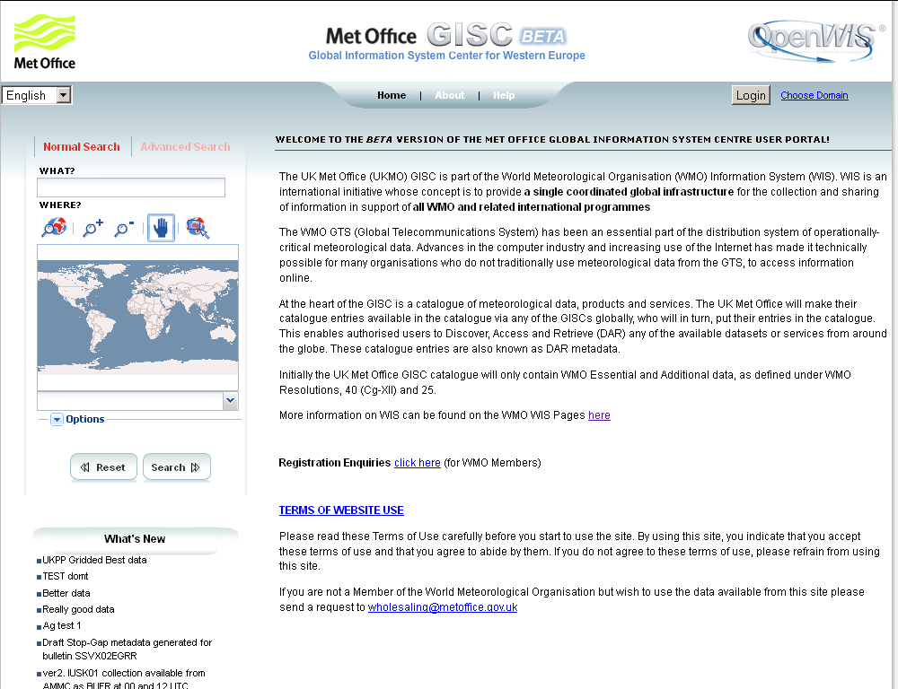
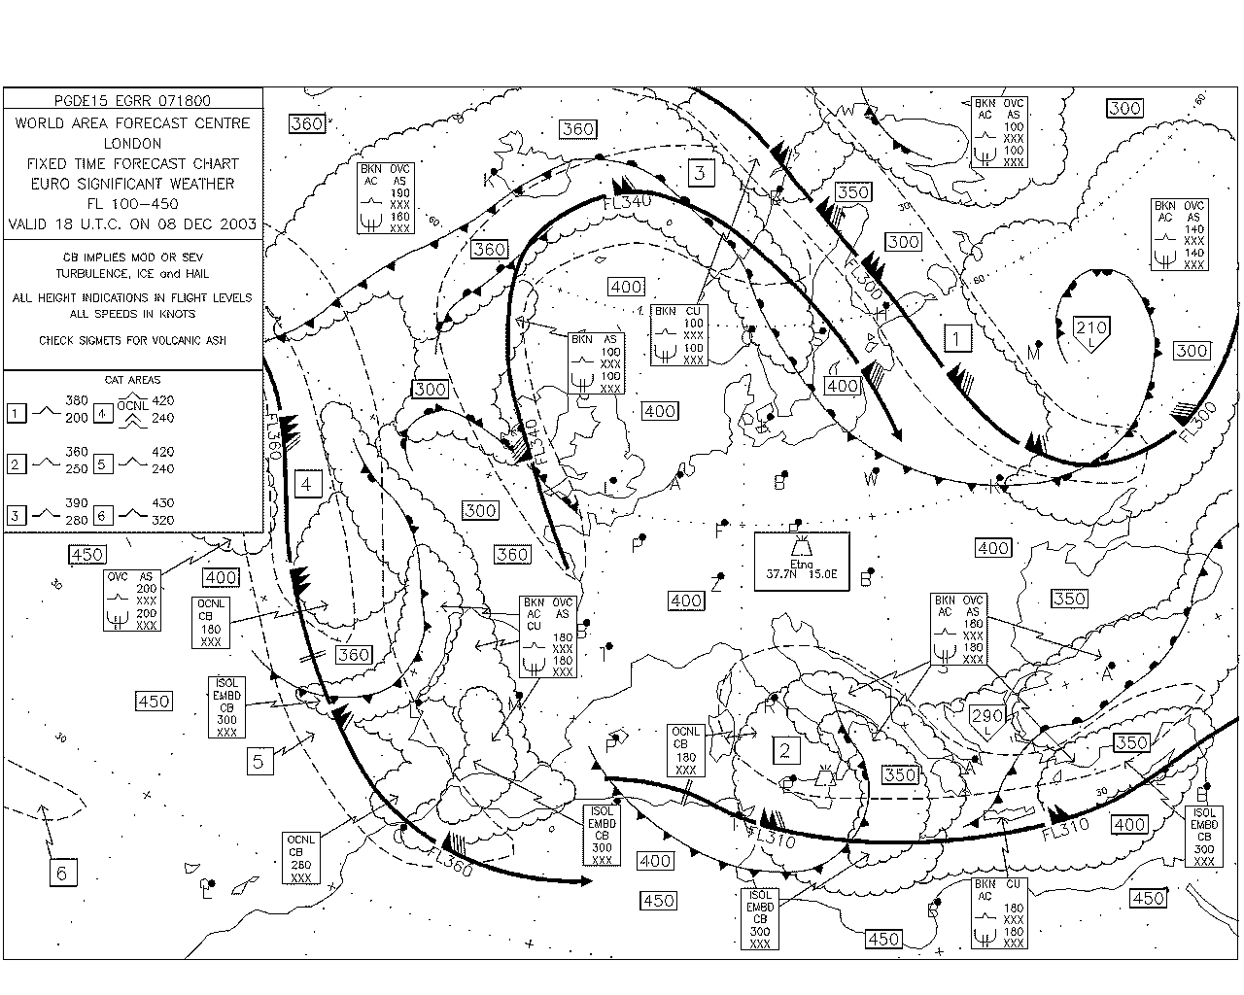
Discovery, Access, Retrieval
User
Searches catalogue at GISC
Asks GISC/DCPC for product
GISC
2
DCPC
1
DCPC
Passes WIS metadata to GISC
DCPC
Passes product to user
3
4

Slide 5
WIS Competences
Infrastructure
  Manage the physical infrastructure
  Manage the operational applications
Data
  Manage the data flow
  Manage the data discovery
External interactions
  Manage WIS centre-centre interactions
  Manage user interactions
Operational Service
  Manage the operational service

Slide 6
3. Manage the data flow - Performance
Ensure collection and distribution of data and products as per data policy
Publish data and products
Subscribe to data and products
Encode, decode, validate and package data and products
Create, update and maintain data flow catalogues
Manage connectivity between centres
Control the data flow to meet service levels

Slide 7
3. Manage the data flow – knowledge and skill
System and network monitoring and viewing tools
Data formats and protocols
Licensing and data policies
Message and file switching systems

Slide 8
4. Manage the data discovery - performance
Create and maintain discovery metadata records describing products and services
Add, replace or delete metadata records within the catalogue
Ensure that all information and service offerings from a WIS centre have complete, valid and meaningful discovery metadata records uploaded to the catalogue

Slide 9
Manage the data discovery - knowledge and skill
Metadata entry and management tools
Policies and standards
Discovery metadata concepts and formats
Written English

Slide 10
Manage the data discovery
Things you learn here are needed for the section on data flow

Slide 11
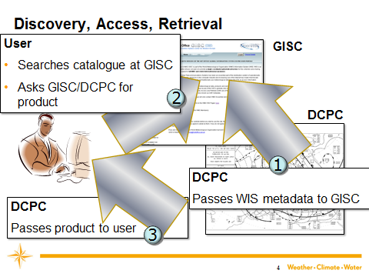
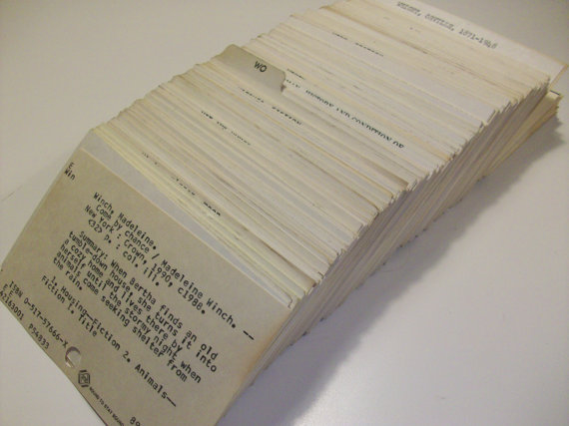
Metadata records
To do this…
… we need to know about the data sets

Slide 12
Metadata in WIS
For “global exchange” data:
GISC adds access from cache
GISC
National Centre or DCPC editor creates and maintains metadata records and states delivery methods
GISC
GISC
GISC
GISC
User chooses data and selects delivery method

Slide 13
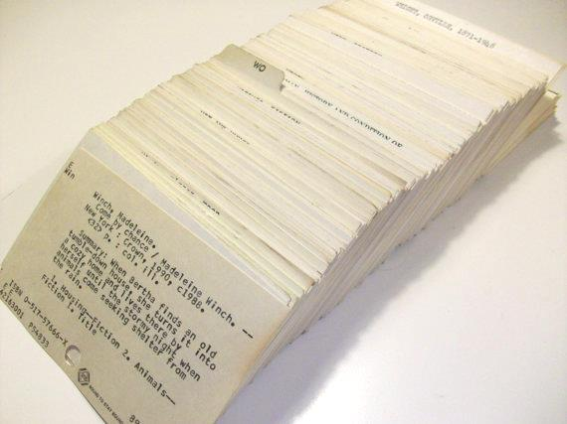
Contents of (WIS Discovery) metadata record
Dataset title
Dataset reference date
Dataset responsible party
Geographic location of the dataset
Dataset topic category
Dataset descriptive keywords
Abstract describing the dataset
Distribution format
Online resource
Dataset language
Dataset character set
Spatial resolution of the dataset
Additional extent information for the dataset (vertical and temporal)
Spatial representation type
Reference system
Lineage
“Other” constraints
Metadata file identifier
Metadata standard name
Metadata standard version
Metadata language
Metadata character set
Metadata point of contact
Metadata date stamp
ISO 19115
ISO 19139

Slide 14
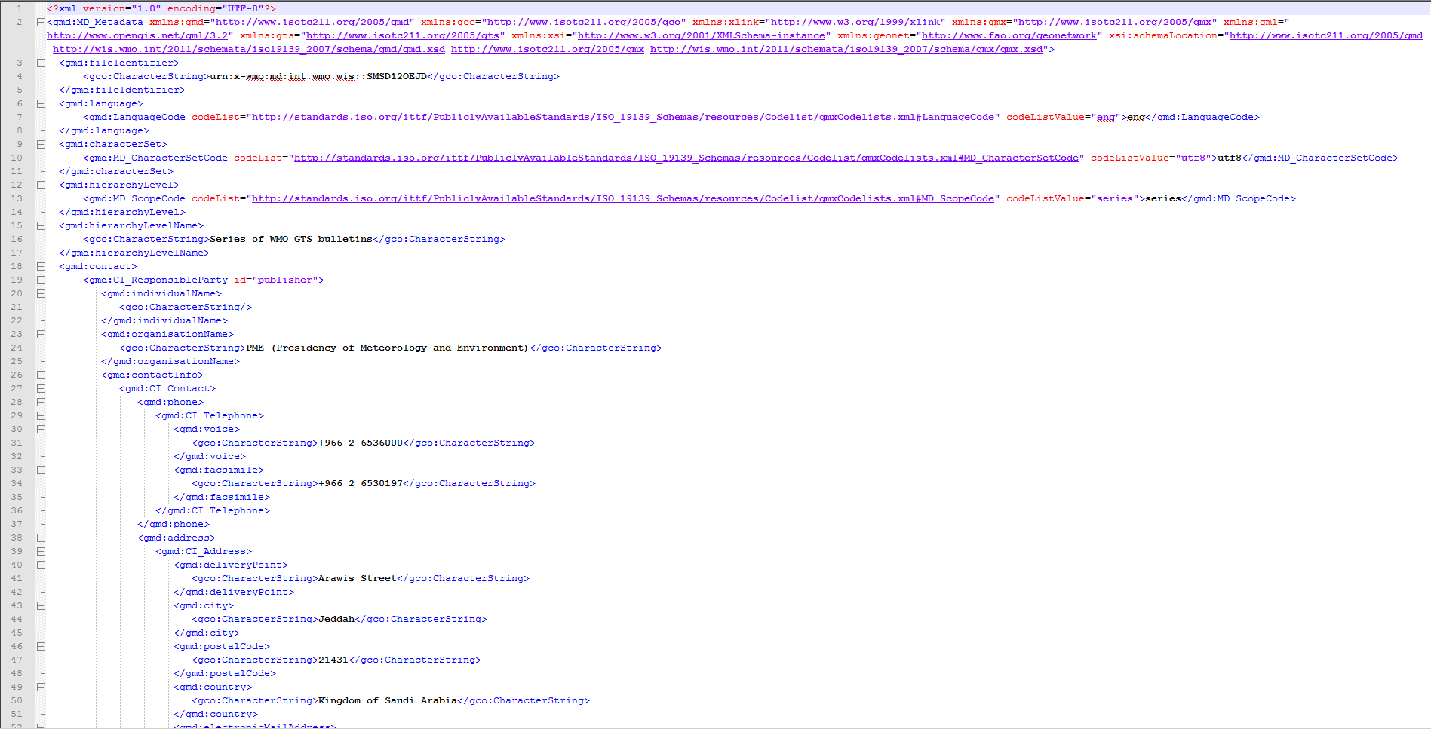
A metadata record
This is a metadata record in XML.
Only machines or software developers need to work with this.

Slide 15
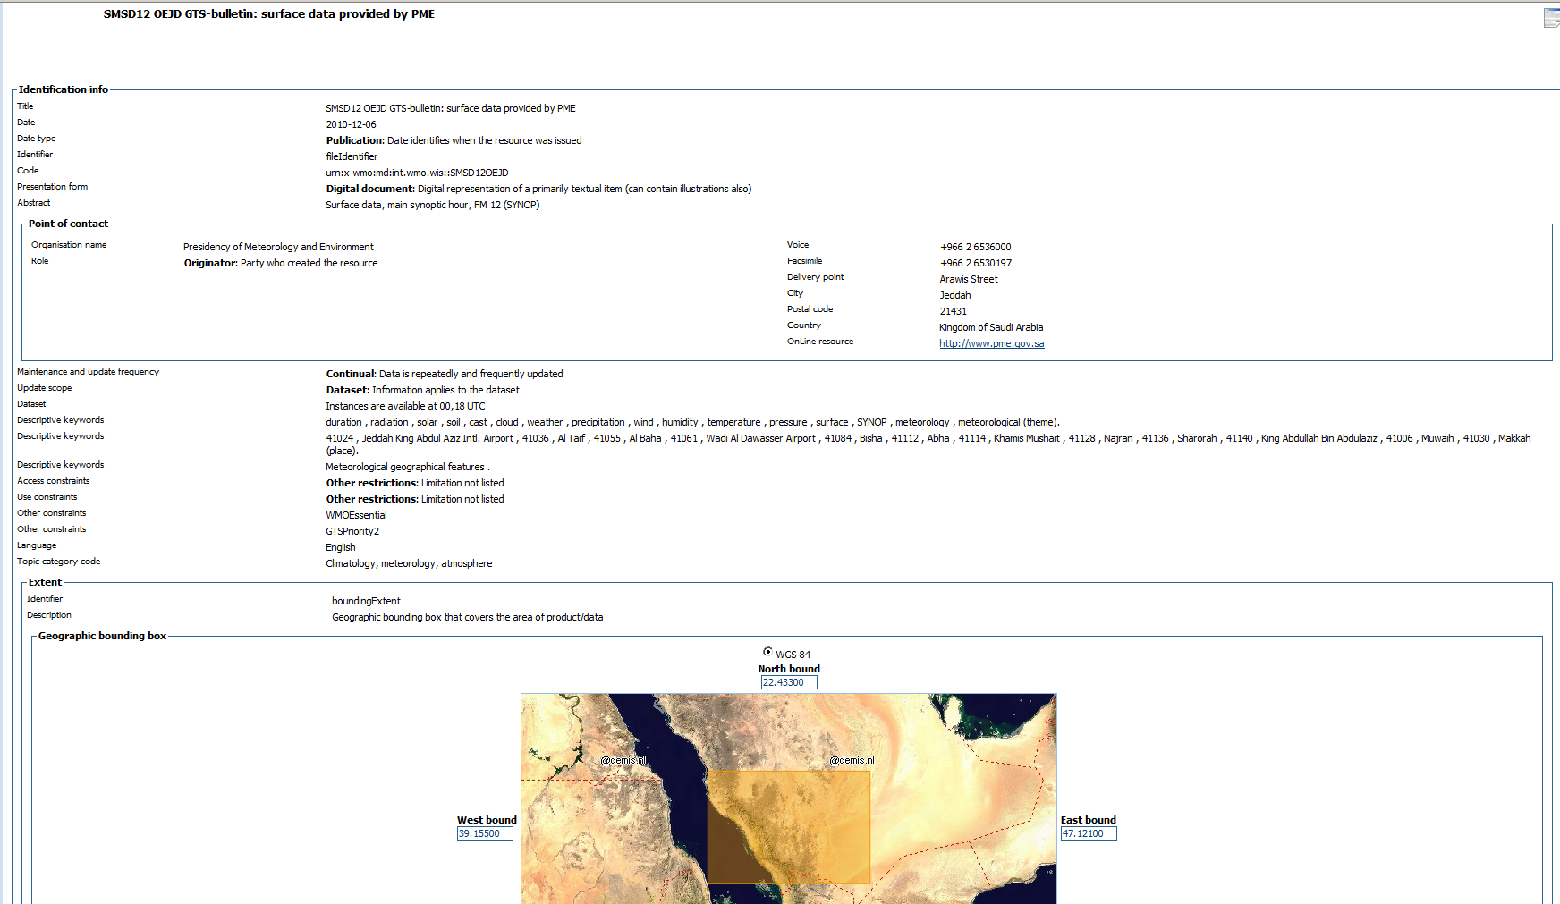
Human readable metadata record

Slide 16
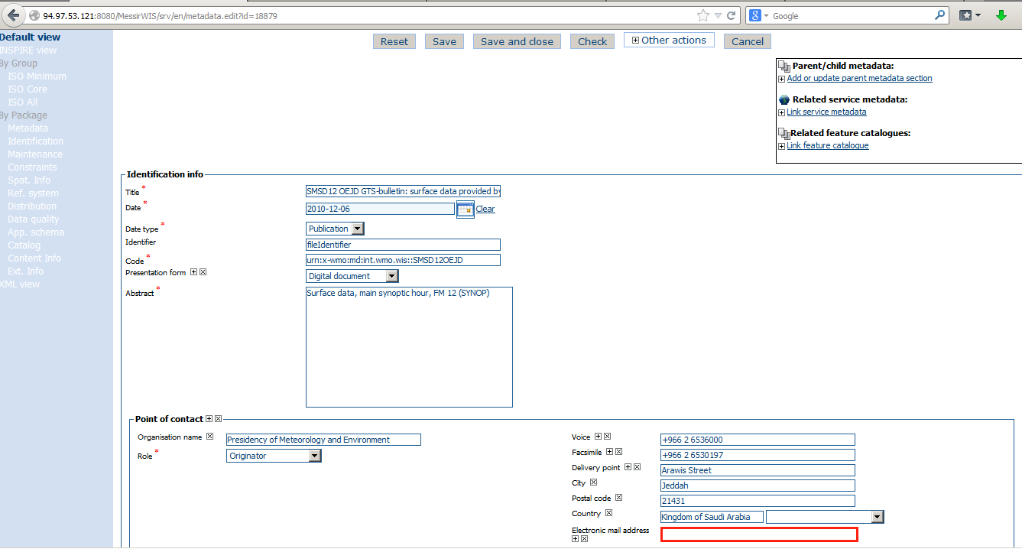
Editing metadata using a GISC interface
Create and edit records using a form
If you have a lot of metadata records for similar items, your GISC can help you automate creating the records.

Slide 17
What to include in a metadata record
Dataset title
Dataset reference date
Dataset responsible party
Geographic location of the dataset
Dataset topic category
Dataset descriptive keywords
Abstract describing the dataset
Distribution format
Online resource
Dataset language
Dataset character set
Spatial resolution of the dataset
Additional extent information for the dataset (vertical and temporal)
Spatial representation type
Reference system
Lineage
“Other” constraints
Metadata file identifier
Metadata standard name
Metadata standard version
Metadata language
Metadata character set
Metadata point of contact
Metadata date stamp
A meaningful title – include the TTAAii CCC or filename for GTS items

Slide 18
What to include in a metadata record
Dataset title
Dataset reference date
Dataset responsible party
Geographic location of the dataset
Dataset topic category
Dataset descriptive keywords
Abstract describing the dataset
Distribution format
Online resource
Dataset language
Dataset character set
Spatial resolution of the dataset
Additional extent information for the dataset (vertical and temporal)
Spatial representation type
Reference system
Lineage
“Other” constraints
Metadata file identifier
Metadata standard name
Metadata standard version
Metadata language
Metadata character set
Metadata point of contact
Metadata date stamp
To help users find datasets.
duration , radiation , solar , soil , cast , cloud , weather , precipitation , wind , humidity , temperature , pressure , surface , SYNOP , meteorology
41024 , Jeddah King Abdul Aziz Intl. Airport

Slide 19
What to include in a metadata record
Dataset title
Dataset reference date
Dataset responsible party
Geographic location of the dataset
Dataset topic category
Dataset descriptive keywords
Abstract describing the dataset
Distribution format
Online resource
Dataset language
Dataset character set
Spatial resolution of the dataset
Additional extent information for the dataset (vertical and temporal)
Spatial representation type
Reference system
Lineage
“Other” constraints
Metadata file identifier
Metadata standard name
Metadata standard version
Metadata language
Metadata character set
Metadata point of contact
Metadata date stamp
Most people use the abstract to decide whether a dataset meets their needs. Repeat phrases from the title and keywords to help explain what the dataset contains.

Slide 20
What to include in a metadata record
Dataset title
Dataset reference date
Dataset responsible party
Geographic location of the dataset
Dataset topic category
Dataset descriptive keywords
Abstract describing the dataset
Distribution format
Online resource
Dataset language
Dataset character set
Spatial resolution of the dataset
Additional extent information for the dataset (vertical and temporal)
Spatial representation type
Reference system
Lineage
“Other” constraints
Metadata file identifier
Metadata standard name
Metadata standard version
Metadata language
Metadata character set
Metadata point of contact
Metadata date stamp
Mandatory for GTS
WMOEssential
WMOAdditional
WMOOther

Slide 21
What to include in a metadata record
Dataset title
Dataset reference date
Dataset responsible party
Geographic location of the dataset
Dataset topic category
Dataset descriptive keywords
Abstract describing the dataset
Distribution format
Online resource
Dataset language
Dataset character set
Spatial resolution of the dataset
Additional extent information for the dataset (vertical and temporal)
Spatial representation type
Reference system
Lineage
“Other” constraints
Metadata file identifier
Metadata standard name
Metadata standard version
Metadata language
Metadata character set
Metadata point of contact
Metadata date stamp
No two records may have the same identifier. If you update the contents of a metadata record, keep the identifier the same. WIS will replace the old version with the new one.
The form is
urn:x-wmo:md:int.wmo.wis::SMSD12OEJD

Slide 22
Publishing your metadata
Only users authorized by PR can update metadata records
Metadata are not published when you save them
  you can edit over several sessions
  mistakes are not published immediately
  GISCs will only publish when asked to

Slide 23
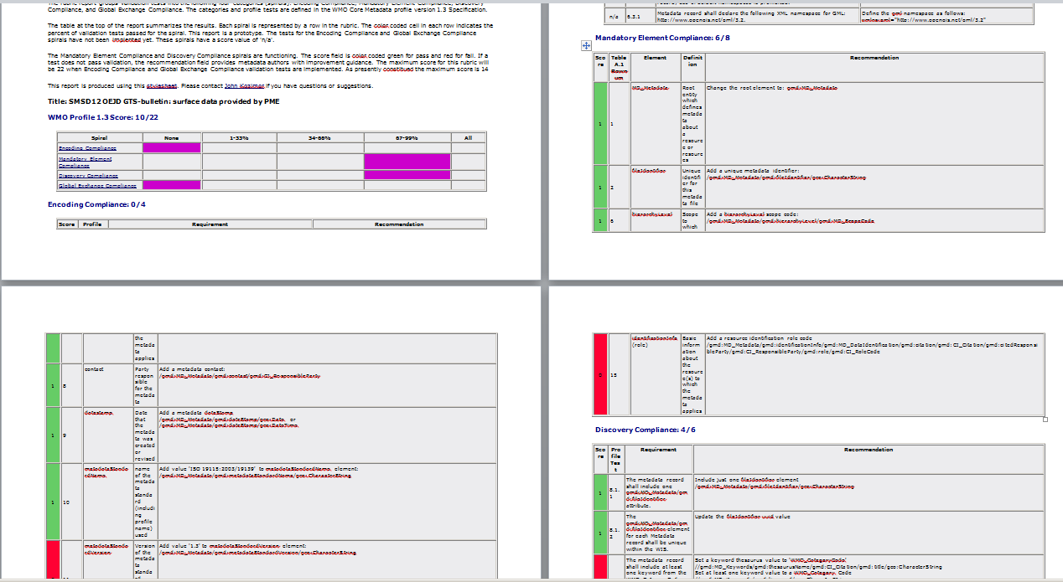
What makes good metadata?
Meets the technical requirements
Contains information users need to find data
All the is information available in English
  But you can add other languages to your own records
You can see how far your metadata meet the technical requirements at:
http://www.ngdc.noaa.gov/docucomp/validationServicesWmo

Slide 24
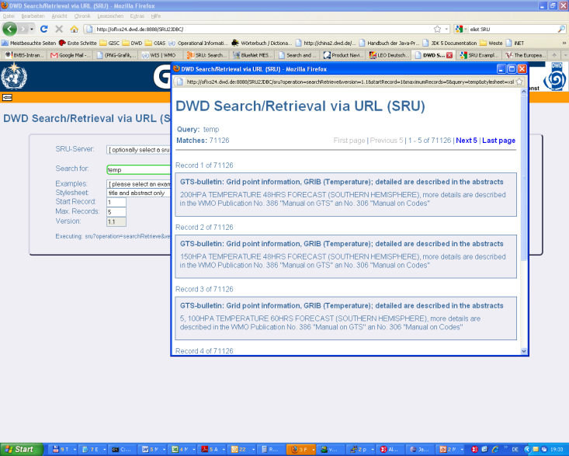
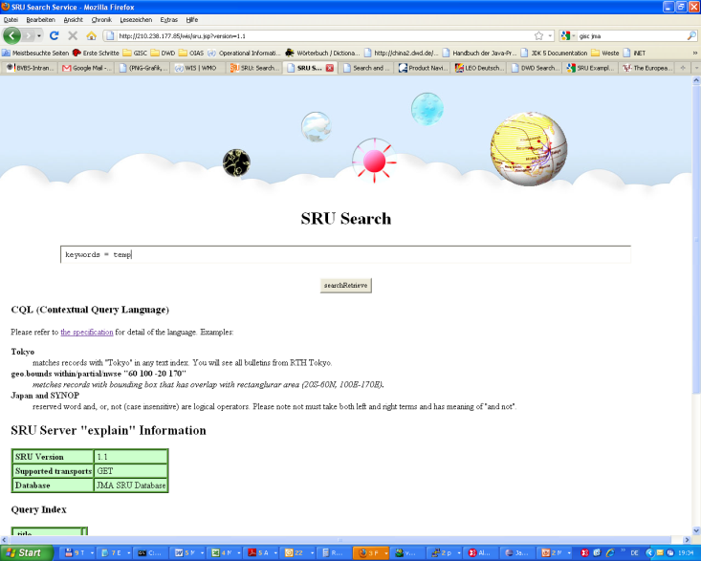
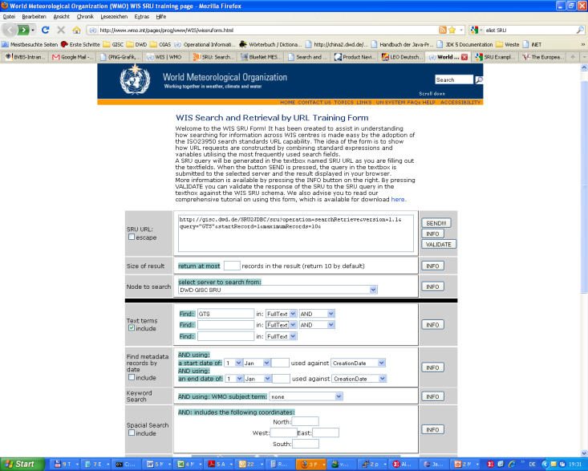
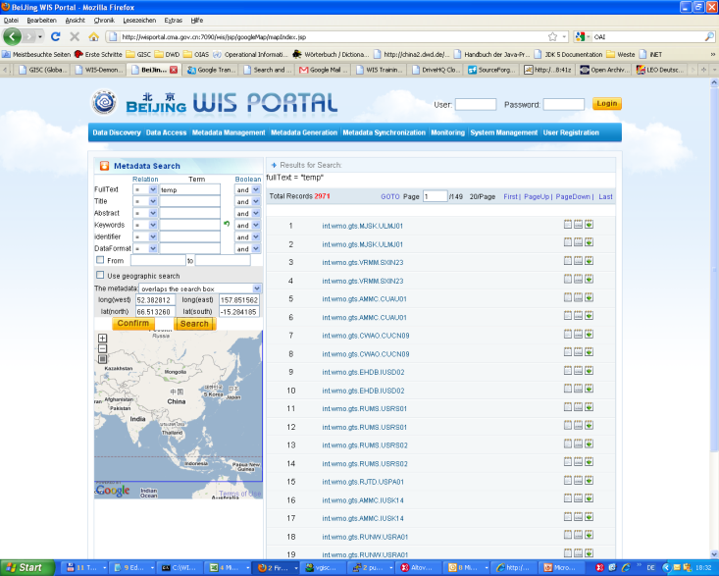
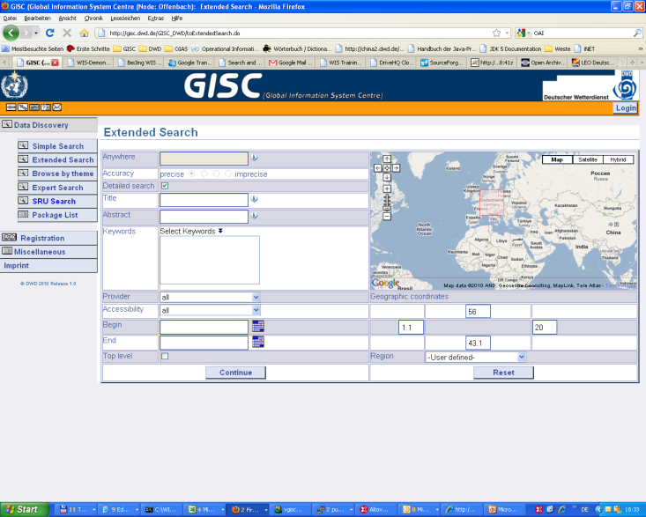
Tools to search metadata
Try searching at any of the GISCs listed as operational at http://www.wmo.int/giscs.html

Slide 25
Manage the data flow

Slide 26
3. Manage the data flow - Performance
Ensure collection and distribution of data and products as per data policy
Publish data and products
Subscribe to data and products
Knowledge and Skills
Data formats and protocols
Licensing and data policies

Slide 27
Data policy
WMO Resolutions 40 (Cg-XII) and 25 (Cg-XIII)
WMOEssential – “free exchange”
WMOAdditional – encourage exchange but limitations on use
WIS Discovery metadata also has
WMOOther – not covered by Res 40 or 25 but has constraints

Slide 28
Data formats
Traditional Alphanumeric Codes
  Unable to represent new types of observation
  Too few station identifiers
  Migration due to complete November 2014
Table Driven Code forms (GRIB, BUFR, CREX)
  Flexible
  Not widely used outside operational meteorology
From outside World Weather Watch
  XML, netCDF and others

Slide 29
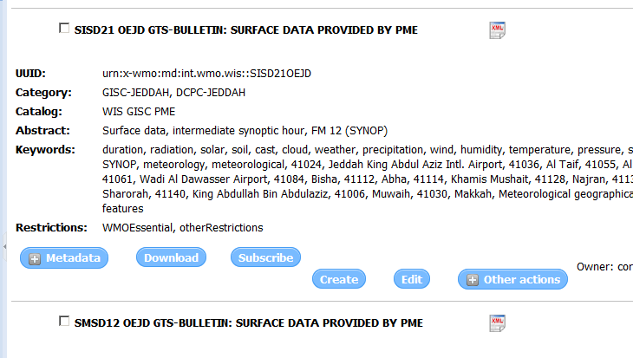
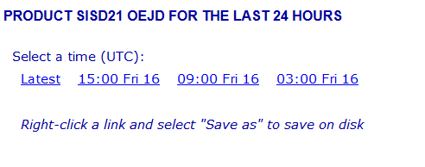
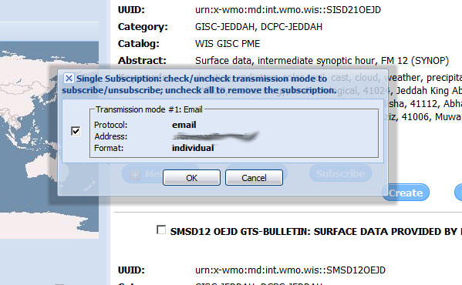
Subscribe to data products

Slide 30
Summary

Slide 31
3. Manage the data flow - Performance
Ensure collection and distribution of data and products as per data policy
Publish data and products
Subscribe to data and products
Knowledge and Skills
Data formats and protocols
Licensing and data policies

Slide 32
4. Manage the data discovery - performance
Create and maintain discovery metadata records describing products and services
Add, replace or delete metadata records within the catalogue
Ensure that all information and service offerings from a WIS centre have complete, valid and meaningful discovery metadata records uploaded to the catalogue

Slide 33
Manage the data discovery - knowledge and skill
Metadata entry and management tools
Policies and standards
Discovery metadata concepts and formats
Written English

Slide 34
Resources

Slide 35

Resources
Manual on WIS (WMO-No 1060) Part 5 and Appendix 2: http://wis.wmo.int/wis-manual
Guide to the WIS (WMO-No 1061): http://wis.wmo.int/wis-guide
Draft guidance on WIS metadata: http://wis.wmo.int/page=WmoCoreMetadata
Table driven code form migration: http://www.wmo.int/pages/prog/www/WMOCodes.html#Codes
Data policy: WMO resolutions 25 and 40: http://www.wmo.int/pages/about/exchangingdata_en.html

Slide 36


Slide 37
Thank you for your attention
wis-help@wmo.int

