Slide 1
Monitoring – October 2013
WMO; Name of Department (ND)

Slide 2
Traditional Alphanumeric Codes – time series

Slide 3
Traditional Alphanumeric Codes – time series

Slide 4
Traditional Alphanumeric Codes – time series

Slide 5
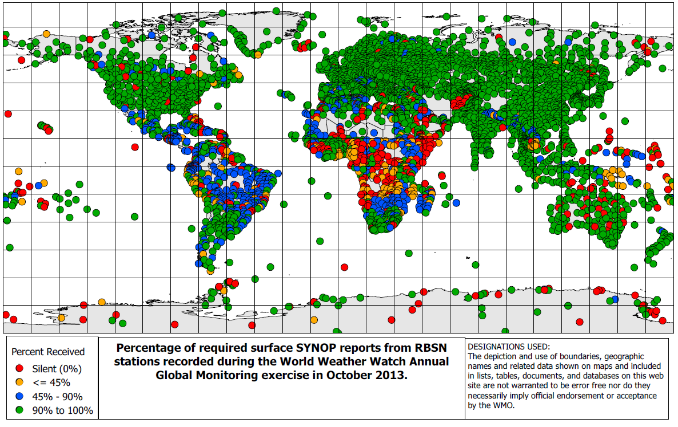
SYNOP

Slide 6
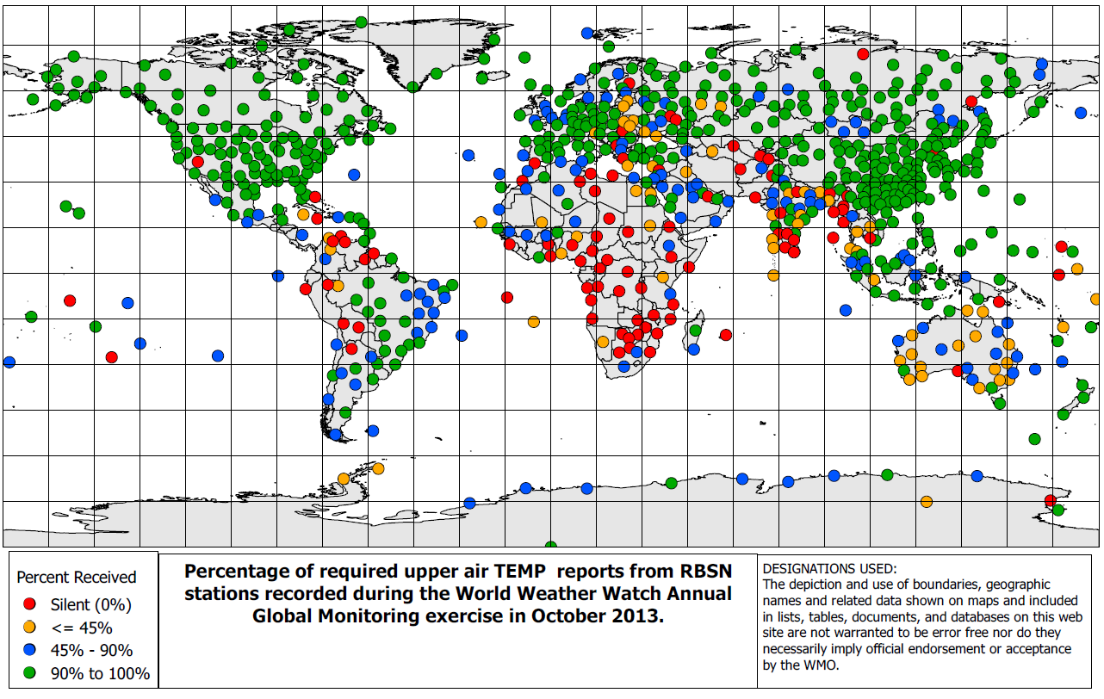
TEMP

Slide 7
CLIMAT

Slide 8
Migration to TDCF

Slide 9
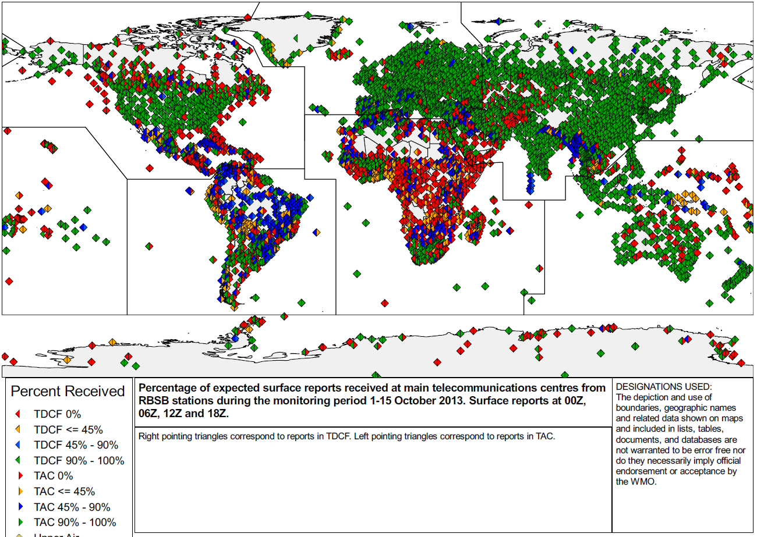
Surface

Slide 10
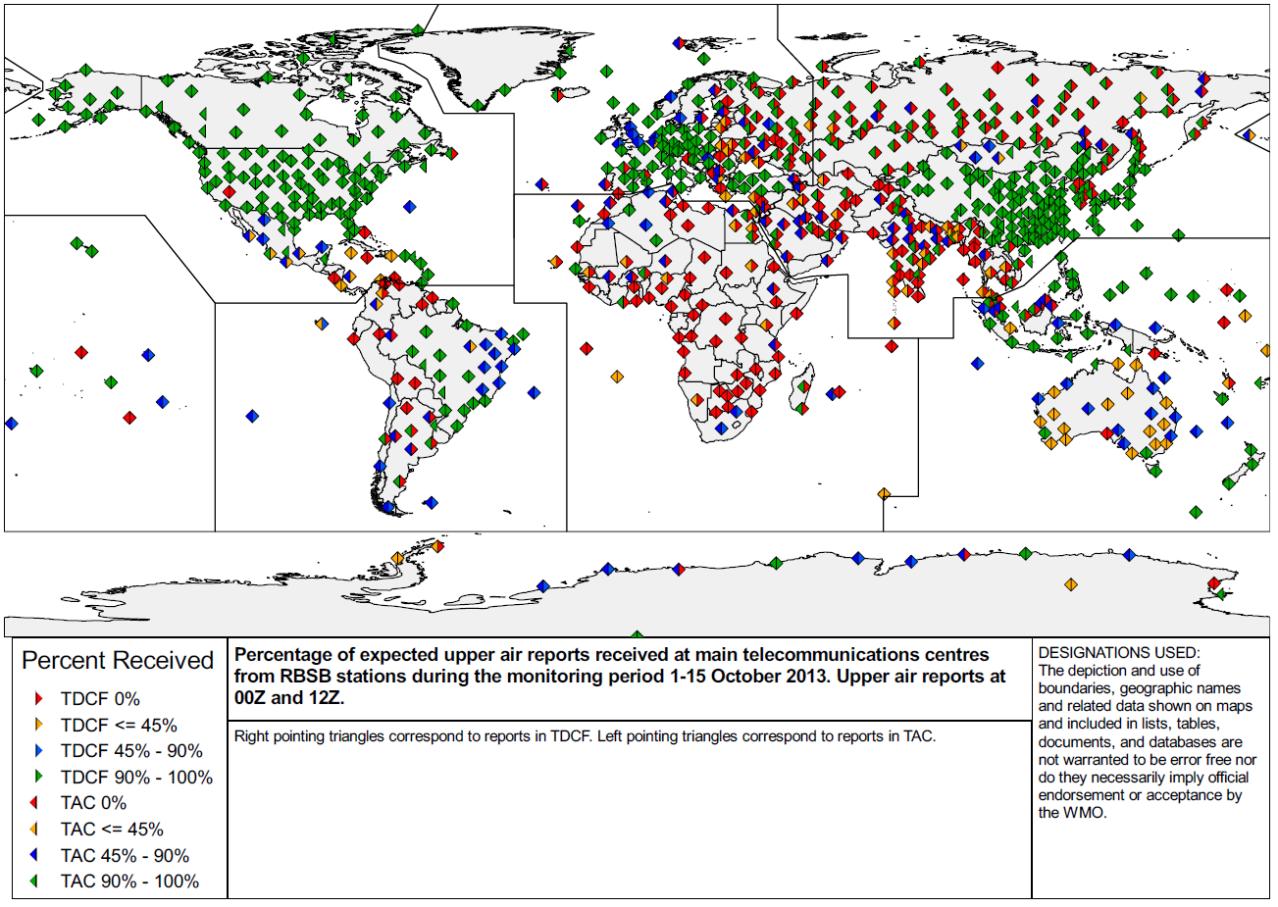
Upper Air

Slide 11
Thank you for your attention
This space can be used for
contact information

