Slide 1


Designing the Climate Observing Systems of the Future
Betsy Weatherhead
U. Colorado at Boulder
Bruce Wielicki V. Ramaswamy
NASA Langley NOAA GFDL
Ray Pierrehumbert
Jesus College, Oxford University
6th Workshop on the Impact of Various Observing Systems on NWP
WMO, Shanghai, China, May 10-13, 2016

Slide 2
Weather and Climate Observations:
The Challenge
Intro
VOI
Priorities
C-OSSES
Conclusion
Both weather and climate science require observations
  Improving observations will improve both weather and climate capabilities.
  Both require basic observations: temperature, pressure, humidity, winds.
  Both require global observations for some key objectives.
BUT
  Specifics of what each community needs can be very different.
  Some past investments have under-delivered.
The solution will likely be found together.

Slide 3
The Challenge for Climate Science
Intro
VOI
Priorities
C-OSSES
Conclusion
Many climate observing systems are inadequate to address climate science needs.
Some systems are in a state of decline.
Limited resources for investment.
Some past investments have under-delivered.

Slide 4
What is the right amount to invest in climate science?
Intro
VOI
Priorities
C-OSSES
Conclusion
Global Value of Improved Climate Information
NASA CLARREO Climate Accuracy Framework (BAMS, 2013)
Interagency Memo on Social Cost of Carbon (2010)
Integrated Climate /Economic Model (DICE, 2009)
Cooke et al., Journal of Environment, Systems, and Decisions, July 2013,
paper has open and free distribution online: doi:10.1007/s10669-013-9451-8
Interdisciplinary Integration of Climate Science and Economics

Slide 5
VOI Estimation Method
Intro
VOI
Priorities
C-OSSES
Conclusion
BAU Emissions
Climate Sensitivity
Climate Change
Economic Impacts

Slide 6
VOI Estimation Method
Intro
VOI
Priorities
C-OSSES
Conclusion
BAU Emissions
Climate Sensitivity
Climate Change
Economic Impacts
Fuzzy
Lens #1
Fuzzy
Lens #2
Natural Variability Uncertainty
Observing System Uncertainty
Societal Decision

Slide 7
VOI Estimation Method
Intro
VOI
Priorities
C-OSSES
Conclusion
Reduced Emissions
Climate Sensitivity
Reduced
Climate Change
Reduced Economic Impacts
BAU Emissions
Climate Sensitivity
Climate Change
Economic Impacts
Fuzzy
Lens #1
Fuzzy
Lens #2
Natural Variability Uncertainty
Observing System Uncertainty
Societal Decision

Slide 8
VOI Estimation Method
Intro
VOI
Priorities
C-OSSES
Conclusion
Reduced Emissions
Climate Sensitivity
Reduced
Climate Change
Reduced Economic Impacts
BAU Emissions
Climate Sensitivity
Climate Change
Economic Impacts
Fuzzy
Lens #1
Fuzzy
Lens #2
Natural Variability Uncertainty
Observing System Uncertainty
Societal Decision
Climate Science VOI

Slide 9
VOI vs. Discount Rate
Run 1000s of economic simulations and then average over
the full IPCC distribution of possible climate sensitivity
Discount Rate | VOI (US 2015 dollars, net present value)
2.5% | $17.6 T
3% | $11.7 T
5% | $3.1 T
Advanced Climate Observing System:
Return on Investment: $50 per $1
Cost of Delay: $650B per year
Even at the highest discount rate, return on investment is very large

Slide 10
Analyze current investment strategies for climate observations
Intro
VOI
Priorities
C-OSSES
Conclusion
To date, investment in climate observations has been considered as a part of general scientific investment.
Similar to weather forecasts, there is a shift towards understanding that climate research and services are necessary for economic planning and infrastructure.
Value of Information (VOI) research

Slide 11
Climate Change Questions
Trends
  Many parameters have changed and are expected to change.
  Trends are fundamental to observing systems for climate.
  Attribution of change is fundamentally important.
Processes
  Specific processes are key to understanding.
  Interconnections, Drivers/Response
  Attribution and scenario development are important
Projections
  Understanding which parameters are going to make the biggest influence on future climate.

Slide 12
Addressing the World Climate Research Program’s Grand Challenges
Intro
VOI
Priorities
C-OSSES
Conclusion
Design of Future Climate Observing Systems
Monitor the Earth
Advance Climate Processes
Improve Climate Projections
Clouds, Circulation and Climate Sensitivity
Melting Ice and Global Consequences
Climate Extremes
Regional Sea-level Change and Coastal Impacts
Water Availability
Clouds, Circulation and Climate Sensitivity
Melting Ice and Global Consequences
Climate Extremes
Regional Sea-level Change and Coastla Impacts
Water Availability
Clouds, Circulation and Climate Sensitivity
Melting Ice and Global Consequences
Climate Extremes
Regional Sea-level Change and Coastal Impacts
Water Availability
We may have additional Grand Challenges.
Each category is really a set of questions.
GRUAN addresses key priorities for fundamental measurements in monitoring the Earth.
Basic Weather and climate observations are tied to all existing priorities.

Slide 13
Understanding the breadth of climate needs for observations.
Intro
VOI
Priorities
C-OSSES
Conclusion
Evaluation of current observational capabilities
  Across all platforms
  Current and Future
Design of Future Climate Observing Systems
Monitor the Earth
Advance Climate Processes
Improve Climate Projections
Clouds, Circulation and Climate Sensitivity
Melting Ice and Global Consequences
Climate Extremes
Regional Sea-level Change and Coastal Impacts
Water Availability
Clouds, Circulation and Climate Sensitivity
Melting Ice and Global Consequences
Climate Extremes
Regional Sea-level Change and Coastla Impacts
Water Availability
Clouds, Circulation and Climate Sensitivity
Melting Ice and Global Consequences
Climate Extremes
Regional Sea-level Change and Coastal Impacts
Water Availability

Slide 14
Do we have enough observations?
Do we have the right kind of observations?
Both weather and climate observations need to address four important questions:
  What do we monitor
  Where? How frequently? How accurately?

Slide 15
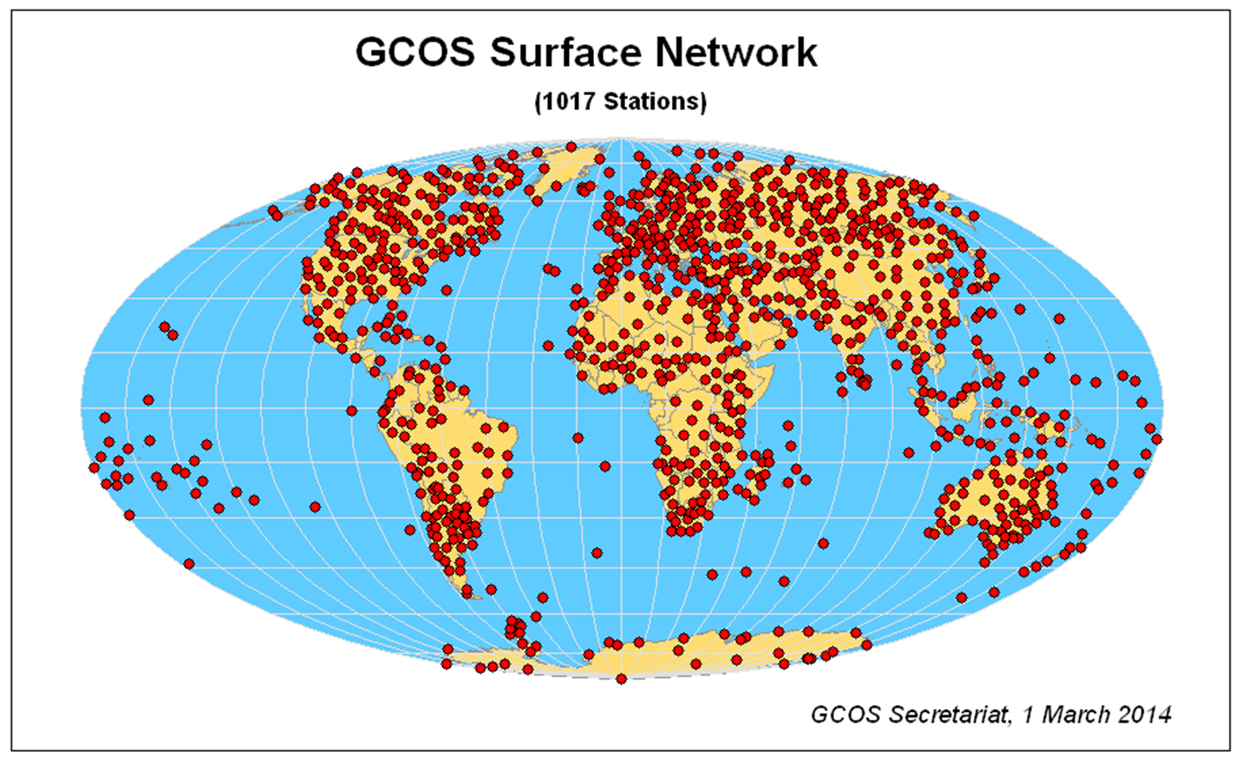
Global Reference Upper Air Network, April 25, 2016

Slide 16
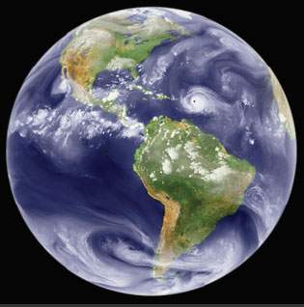
Evaluating Future Weather Observations
Weather forecasting includes a
diverse set of forecasting
needs, often on the timescale
of hours to months.
Real time observations are
critical
Global observations are important.
Key questions address physics/chemistry of the Earth
OSSEs can look a the effectiveness of different observations to address these needs.

Slide 17
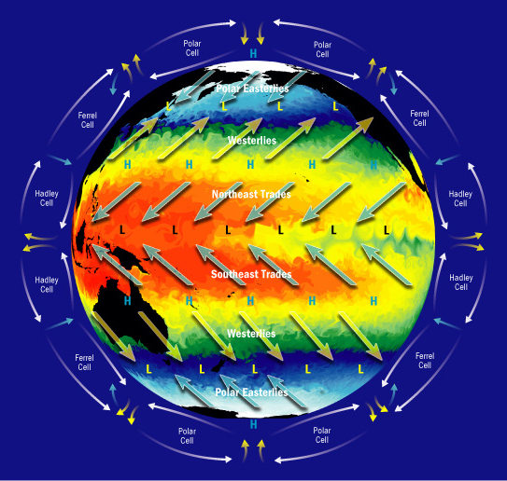
Evaluating Future Climate Observations
Climate Science includes a
diverse set of scientific
questions, often on
timescales of seasons to
decades.
Long-term trends are
fundamental.
Global observations are critical.
Key questions address physics/chemistry/biology of Earth
Climate OSSEs look at the effectiveness of different observations to address these questions.

Slide 18
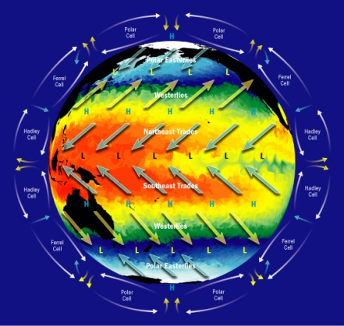
Weather
Climate
Concerned with variability
Must estimate for non existing observations
Four attributes:
  Where, what, accuracy, additional measurements
Metric of success:
  Improved forecasts
Timescale of interest: hours to weeks
Concerned with accuracy
Concerned with variability
Must estimate for non existing observations
Four attributes:
  Where, what, accuracy, additional measurements
Metric of success:
  detecting specified phenomena
Timescale of interest: months to decades
Highly concerned with accuracy
Shared Observing
Systems

Slide 19
Climate Observation Simulation System Experiments
Intro
VOI
Priorities
C-OSSES
Conclusion
We can simulate the value of proposed observing systems to their ability to address climate science needs.
We can use natural variability on appropriate time scales to understand the power of a system to address a testable hypothesis.
We can control four parameters in our observing systems:
  What we measure
  Where we measure
  How frequently
  How accurately
Choices on all four of these issues affect our ability to effectively address scientific questions.

Slide 26
We can control only four aspects of monitoring to detect trends
Where we monitor
What frequency
What accuracy
What we monitor

Slide 27
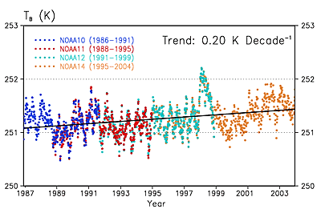
Where to monitor?
Satellites can offer global coverage.

Slide 28
Notes:
Blue circles are existing sites; green squares are proposed sites.

Slide 34
We can control only four aspects of monitoring to detect trends
Where we monitor
What frequency
What accuracy
What we monitor

Slide 35
What frequency?
Inherent memory in environmental data results in redundancy of measurements.
Daily data may be more than needed.
Less than daily measurements may obscure diurnal changes
MacDonald, BAMS, 2005

Slide 39
Notes:
It’s hard to identify how much variability is too much variability, but clearly variability increases as time proceeds.

Slide 40
How long will it take to detect trends?

Slide 42
How does frequency of measurement affect how long we will have to monitor to detect trends?
In general: Monitoring less frequency:
Increases magnitude of variability (bad for trends)
Decreases autocorrelation (good for trends)
Reduces representativeness (do we really know what happened?)

Slide 43
We can control only four aspects of monitoring to detect trends
Where we monitor
What frequency
What accuracy
What we monitor

Slide 44
What accuracy?
Relative accuracy is all that’s needed for trend detection.
Relative accuracy is extremely hard to maintain for decades without absolute accuracy.
Improved accuracy may save decades in monitor or may be irrelevant.

Slide 45
Case Example
Uncertainty: ±2% ; Trend: 4% per decade
Result:
  First ten years of data are still unsubstantial
Improving Accuracy to ±1% saves five years of monitoring

Slide 46
Notes:
Going back to our original example of detecting trends in ozone recovery.

Slide 47
Is accuracy ever the limiting factor in detecting trends?

Slide 48
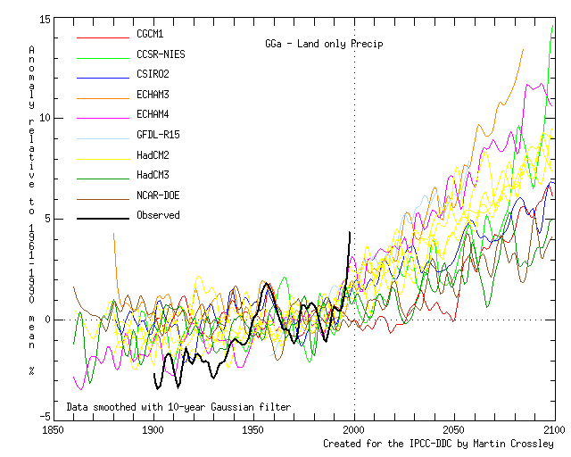

Slide 49
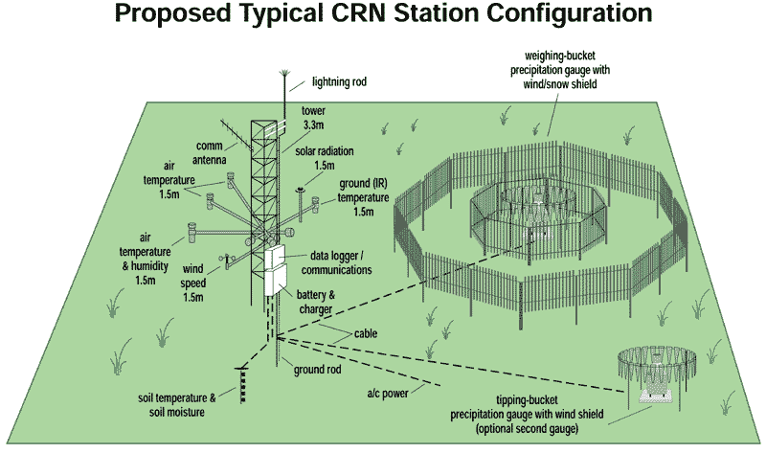

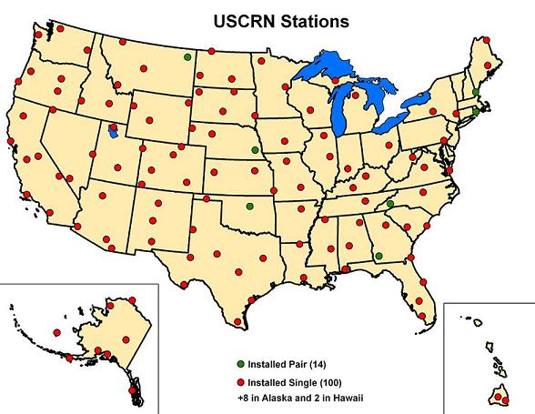
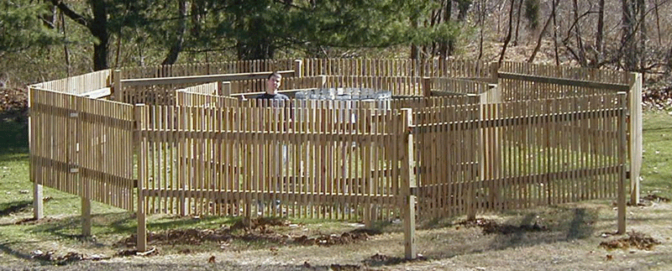

Slide 50
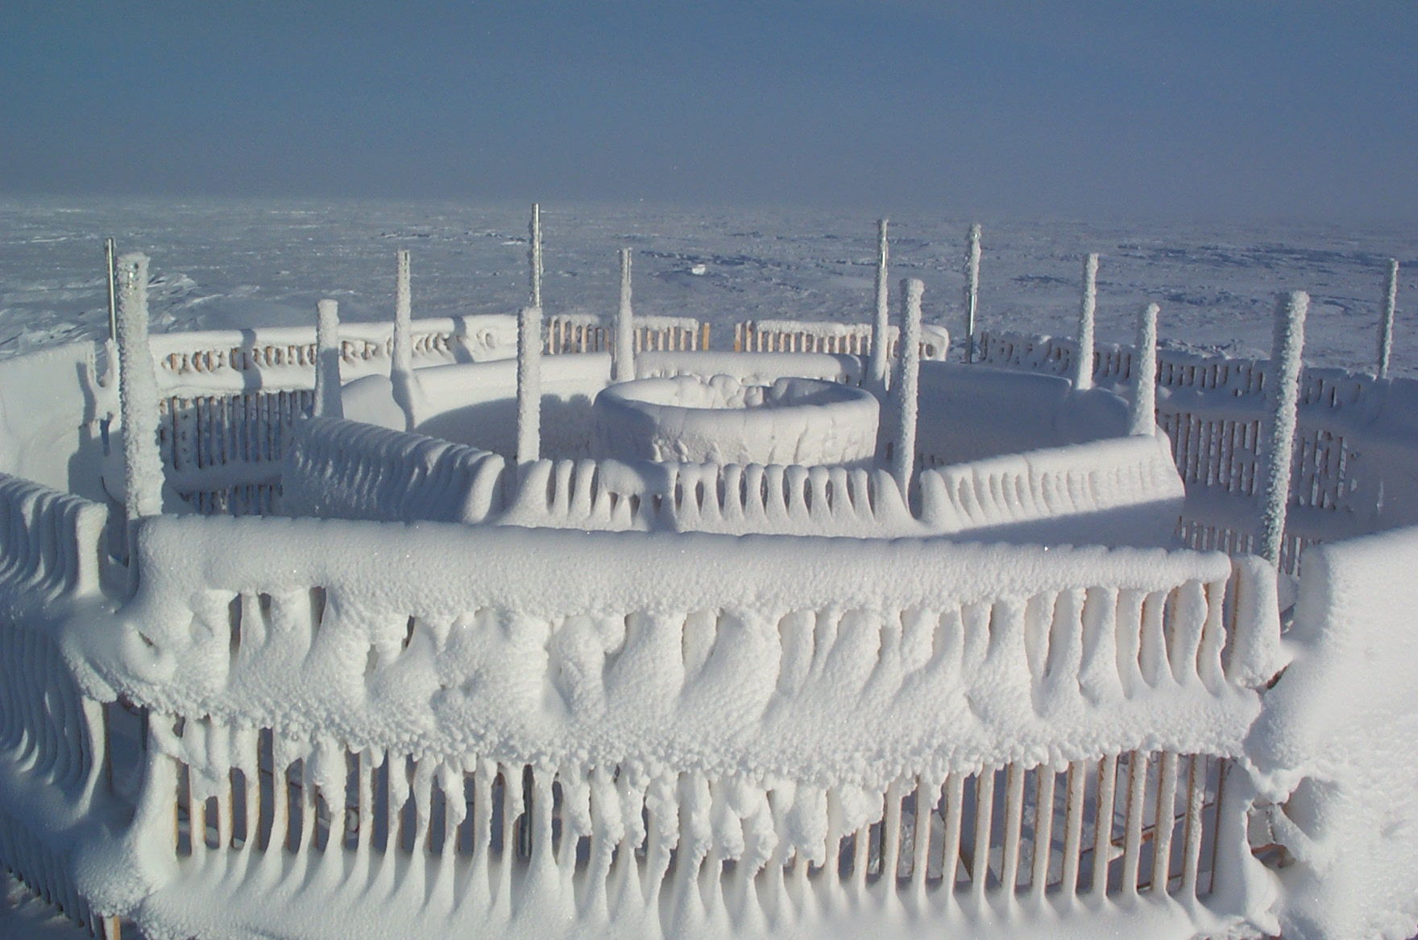
Blowing snow impact: blocking snow fence
Barrow, CRN- DFIR, Mar 3/03

Slide 51
Wind-induce undercatch:
WMO intercomparison results

Slide 52
Accuracy Decisions
Accuracy can change over time—
  Sometimes introducing a bias.
Improved accuracy is often very expensive.
In situ measurements are generally much more accurate than remote sensing.
Satellite observational accuracy can often involve degradation of optics and orbit.
  …but may be improved with data assimilation.

Slide 53
Accuracy Decisions
Accuracy can change over time—
  Sometimes introducing a bias.
Improved accuracy is often very expensive.
In situ measurements are generally much more accurate than remote sensing.
Satellite observational accuracy can often involve degradation of optics and orbit.
  …but may be improved with data assimilation.

Slide 54
Improved Accuracy or More Sites?
Improved Accuracy
Clearer understanding of what we’ve measured
Costs often increase exponentially
Time for trend detection decreases
Additional Sites
Costs increase in a known manner
Time for trend detection decreases - usually slightly
Representativeness improves and expands
“Insurance” for site failures

Slide 55
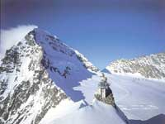
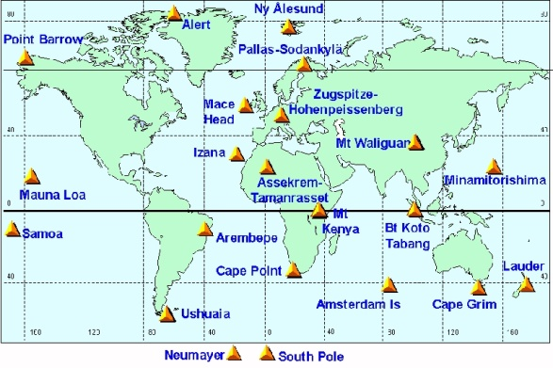

Optimization Problem:
We want to detect a global trend as early as possible for a given cost.
We want to detect a global trend pattern as early as possible for a given cost.
We want to augment the existing monitoring network to achieve the earliest detection for a given cost.
Metric: earliest detection
Constraint: cost

Slide 56
Tropical widening and global warming
1° latitude century⁻¹
Main point:
Hadley cell and dry zone boundaries are related
Lu et al., GRL, 2007
Notes:
Main points here:
Models show widening in each hemisphere under GW scenarios
Large spread of trends in the models
The HC edge and dry zones are related to one another

Slide 57
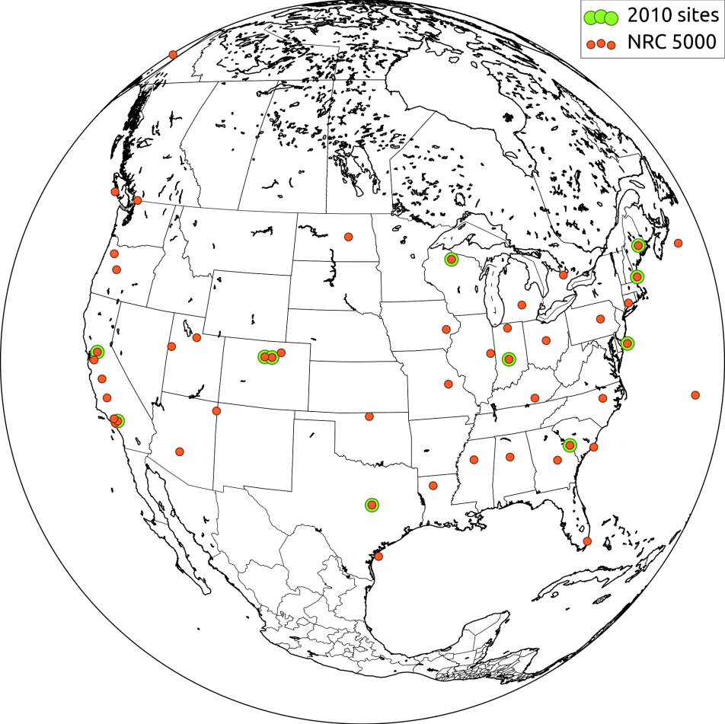
Identifying Carbon Fluxes
Identifying seasonal fluxes of Carbon 14 is an important scientific challenge.
Perhaps not possible with the current monitoring configuration.
Observing System Simulation Experiments help us to identify what observations are needed.

Slide 58
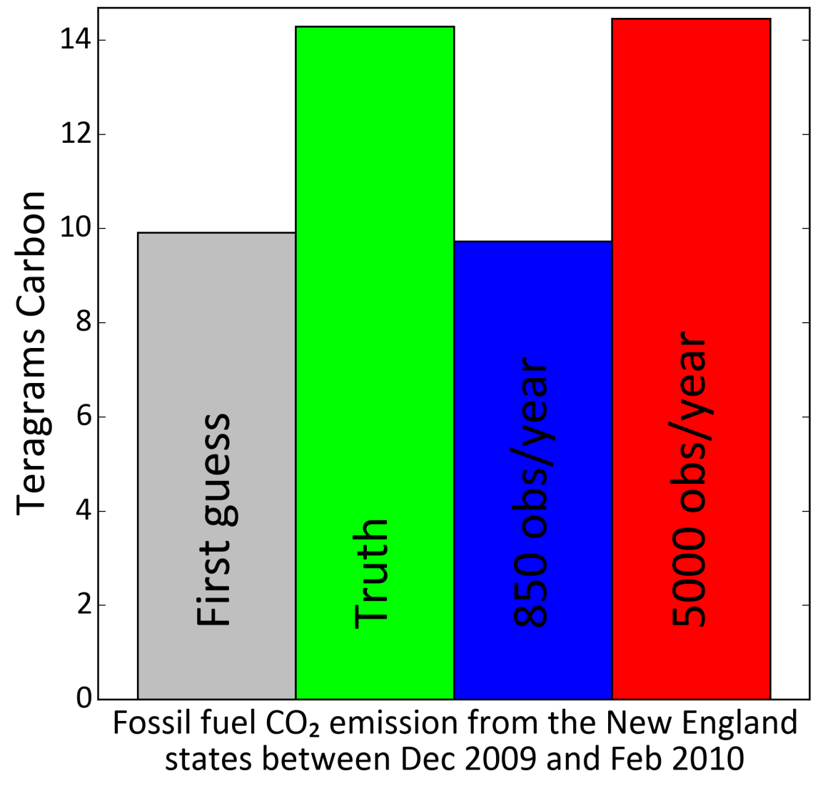
Climate OSSE results
Current OSSE results indicate that 850 obs/ytear (most collected in CONUS to date) will not be able to give us regional fluxes. 5000 obs likely would.

Slide 59
Climate OSSEs
Intro
VOI
Priorities
C-OSSES
Conclusion
Climate OSSEs can estimate success of proposed observing systems.
What, where, when and how accurate can all be addressed in a climate OSSE.
  Trend assessment
  Process studies
  Improved climate models
Realistic variability and appropriate measurement uncertainty all need to be addressed objectively.
Current ad hoc climate OSSEs can result in overpromising and wasted investments.

Slide 60
Areas of Collaboration
Common decisions will need to be made for any one observing system.
Work off of same reference data.
Make use of Nature Run!
  Climate community has much to learn about short term variability and spatial inhomogeneities.
  Satelllite observations require in depth understanding of spatial inhomogeneities
  Additional observing systems need to be evaluated with respect to existing observations.
Make same assumptions about existing and planned observations.
Seasonal forecasts
Carbon flux processes
WMO can serve as an ideal forum for discussions and focusing recommendations.

Slide 61
Overlap between climate and weather OSSEs
Need for integrated use of datasets
Need for reliable, useful, continuous datastreams
Concern for:
  Where we monitor
  What frequency
  What accuracy
  What we monitor
Need for global information
Special care needed with reference observations.
Value to identifying common priorities.

Slide 62
Conclusion
Intro
VOI
Priorities
C-OSSES
Conclusion
We need to take an analytical approach to weather and climate observations.
We need to be very specific and careful about what needs to be monitored, where, how frequently and how accurately.
  The answer will depend on the question.
Weather and Climate can make mutually beneficial decisions about observations.
WIGOS has the ability to coordinate and communicate priorities.
Now is the time.

Slide 67
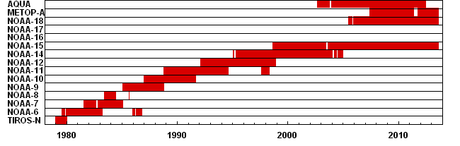
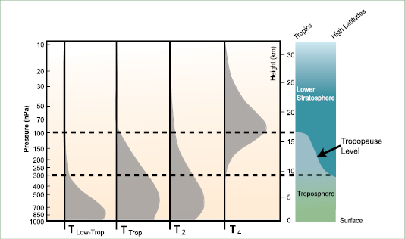
Remote Sensing Challenges for Climate OSSEs
Piecing together different instruments:
Interpreting integrated source infomration

Slide 68
We can control only four aspects of monitoring to detect trends
Where we monitor
What frequency
What accuracy
What we monitor

Slide 69
Climate Observing System Simulation Experiments:
The need to look at observations jointly
Remote sensing observations are sensitive to multiple influences:
  Temperature and humidity both affect GPS occultation results.
  The value of combined datasets can be much more valuable than any individual dataset.
In situ observations are sensitive to multiple influences: wind, local influences, temperature.

Slide 70
Climate Observing System Simulation Experiments:
The need to look at observations jointly
Notes:
We need to look at long-term records with the understanding that many things could be changing at once.

Slide 71
Integration
We make choices about all four of the parameters we control.
These choices have direct impact on how long we will likely need to monitor in order to detect trends.
Optimal choices exist?
  Better choices exist.
  e.g. More sites or higher accuracy?
All choices will affect our ability to detect trends and the scientific questions we may ask of the emerging data.

Slide 72
Identifying Priorities
Intro
VOI
Priorities
C-OSSES
Conclusion
Climate Services Priorities may be well addressed on a national basis.
Research priorities require discussions among modelers, observationalists, meteorologists).
To date, engagement has started with US entities: USGCRP, AGU, AMS, Decadal Survey, informal and formal discussions.
Winners and losers—everyone has their pet project.
Surprisingly strong, positive feedback.
Sense of urgency and unity.

Slide 73
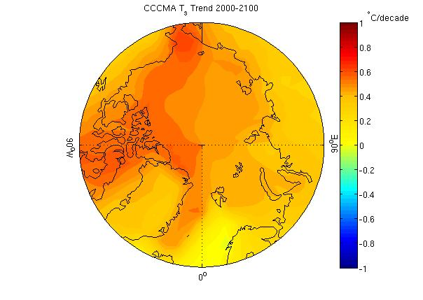

Slide 74
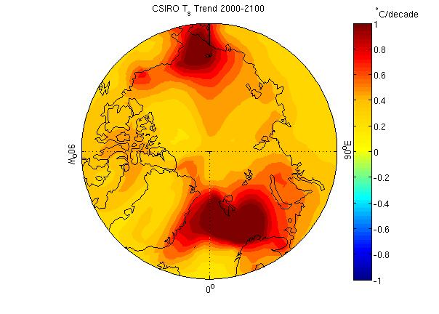

Slide 75
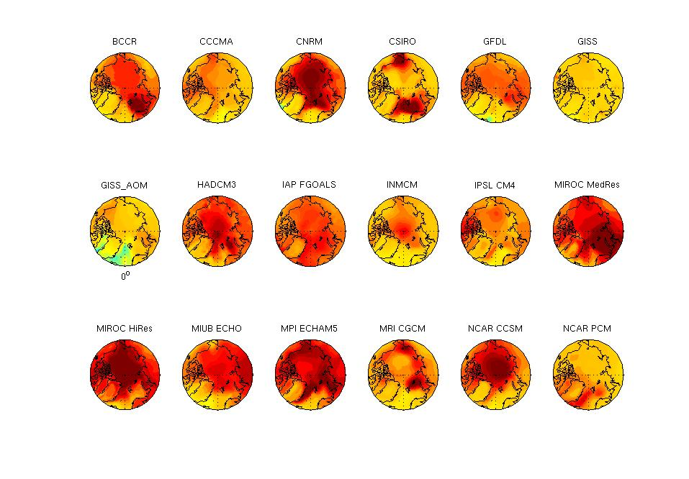
Surface Temperature increase in C/decade, from 2000-2100
Darkest red = 1 C/decade (10C/century)
Yellow = 0; green is slightly negative, and due to ocean circulation changes.

Slide 76
Statistical Trend Models
Typically (e.g. in excel):
temperature = seasonal + Aerosols + trend + Noise
This implies many assumptions
  The trend is independent of season.
  Temperature responds in a linear manner to aerosols.
  The trend is linear.
  The variability is constant.
  The data are normally distributed.
  Each datapoint is independent.
  The data are perfectly accurate.

Slide 77
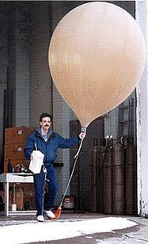
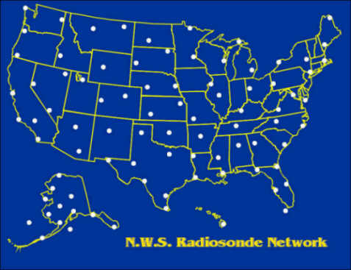
Daily temperature measurements with balloons

Slide 78
Complication: It’s a three dimensional problem!

Slide 79
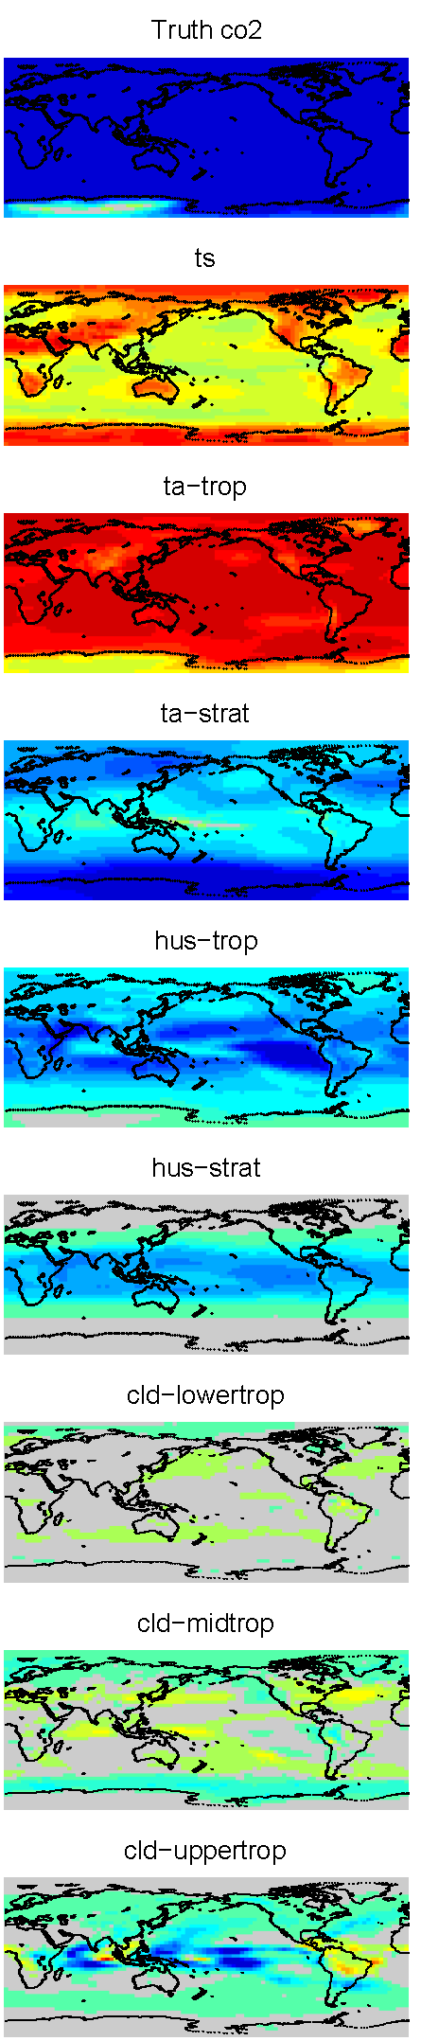
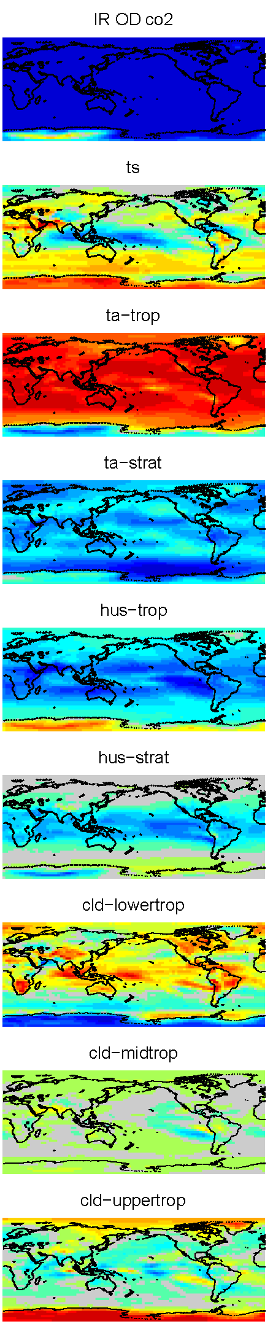
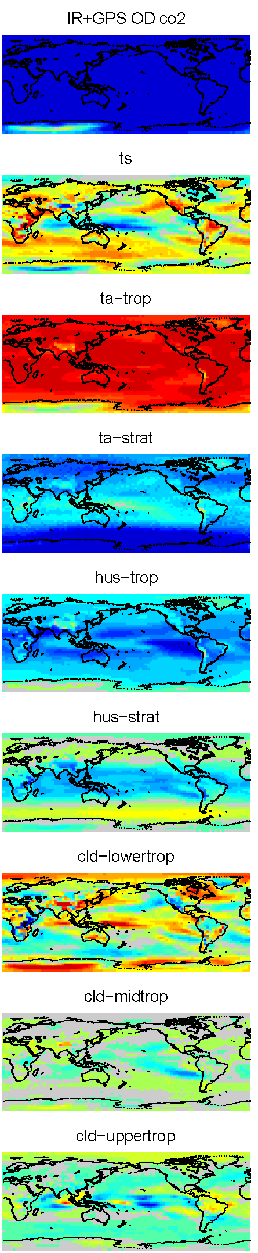
Joint OD results
CO₂
T_{s}
T_{trop}
T_{strat}
q_{trop}
q_{strat}
C_{low}
C_{mid}
C_{hgh}
“Truth” | IR-only | IR+RO
 | RMS (IR) | RMS (IR+RO) | G.M.
CO₂ | 0.10 | 0.11 | -2.73
T_{s} | 3.27 | 3.88 | 3.35
T_{trop} | 2.02 | 0.98 | 9.78
T_{strat} | 0.25 | 0.09 | -0.47
q_{trop} | 1.32 | 0.73 | -4.99
q_{strat} | 0.10 | 0.12 | -0.27
C_{low} | 3.76 | 3.66 | 0.18
C_{mid} | 1.36 | 1.25 | 0.07
C_{high} | 3.05 | 1.07 | -1.18
Unit: W m⁻²

