Slide 1
FSOI adapted for used with 4D-EnVar
The WMO 6th Workshop on the Impact of Various Observing Systems on NWP
Shanghai, China
Simon Pellerin, Mark Buehner and Ping Du
10-13 May 2016

Slide 2
Motivation
4DVar for both global and regional DA replaced by 4D-EnVar (Nov 2014) at ECCC
Development/support essentially discontinued of tangent linear and adjoint of forecast model (~2010)
Therefore, to perform FSOI in context of 4D-EnVar, requires adapting the approach of the previous FSOI to avoid use of adjoint of forecast model
Pure ensemble approach exists (e.g. as used at NCEP; OTA et al., 2013), but can only give impact of observations assimilated in EnKF
At ECCC numerous observation types assimilated in 4D-EnVar not assimilated in EnKF (AIRS, IASI, CrIS, SSMIS, Geo-rad, GB-GPS)
New FSOI approach combines elements of standard adjoint approach (analysis step) and pure ensemble approach (forecast step)

Slide 3
Basic idea of FSOI
Goal is to partition with respect to arbitrary subsets of observations the forecast error reduction from assimilating these observations:
$$∆e^{2}= {\left(e_{t+∆t}^{fa}\right)}^{T}C\left(e_{t+∆t}^{fa}\right)−{\left(e_{t+∆t}^{fb}\right)}^{T}C\left(e_{t+∆t}^{fb}\right)$$
Scalar measure of forecast error
$$e_{t+∆t}^{fb}=M\left(x_{t}^{b}\right)−x_{t+∆t}^{a}$$
Assimilation of obs
$$e_{t+∆t}^{fa}=M\left(x_{t}^{a}\right)−x_{t+∆t}^{a}$$
Forecast Error
$$x_{t}^{b}→x_{t}^{a}$$
$$\frac{∂∆e^{2}}{∂x_{t+∆t}}$$
t-6h
t
Time
t+∆t
$$\frac{∂∆e^{2}}{∂y^{o}}$$

Slide 4
FSOI general approach
Forecast error reduction from assimilating all observations:
This can be rewritten as a sum of contributions from each observation, allowing the calculation of contribution from any subset of obs:
Where the sensitivity of the change in forecast error to each observation can be written as (using the chain rule):
$$∆e^{2}= {\left(e_{t+∆t}^{fa}\right)}^{T}C\left(e_{t+∆t}^{fa}\right)−{\left(e_{t+∆t}^{fb}\right)}^{T}C\left(e_{t+∆t}^{fb}\right)$$
$$∆e^{2}≈\sum_{i}{{\left(y^{o}−H\left(x^{b}\right)\right)}_{i} ∂∆e^{2}/∂{y_{i}^{}}^{o}}$$
$$\frac{∂∆e^{2}}{∂y^{o}}=\left(\frac{∂x_{t}}{∂y^{o}}\right)\left(\frac{∂x_{t+∆t}}{∂x_{t}}\right)\left(\frac{∂∆e^{2}}{∂x_{t+∆t}}\right)$$
=(
)
(
Adjoint of Fcst
)
(
Sens. wrt fcst.
Sens. wrt obs
Adjoint of DA
)

Slide 5
New FSOI approach Forecast step uses ensemble, DA step like variational approach
Instead of using adjoint of forecast model, sensitivities propagated to analysis time using extended background ensemble forecasts → requires use of 100% ensemble B in analysis step
The analysis increment is a (spatially varying) linear combination of the background ensemble*, the propagated increment is assumed to be the same linear combination of the ensemble* at the forecast time
Adjoint of analysis step uses standard variational approach
*actually the deviations
of the ensemble
members from the
ensemble mean state
Assimilation of obs
Atmospheric State
$$x_{t}^{b}→x_{t}^{a}$$
=(
)
(
Adjoint of Fcst
)
(
Sens. wrt fcst.
Sens. wrt obs
Adjoint of DA
)
t-6h
t
Time
t+∆t

Slide 6
Formulation
Change in forecast error (with respect to norm $C$) is given by:
$$∆e^{2}= {\left(e_{t}^{fa}\right)}^{T}C\left(e_{t}^{fa}\right)−{\left(e_{t}^{fb}\right)}^{T}C\left(e_{t}^{fb}\right)$$
Denote gradient of this with respect to any quantity as: $\hat{\left(∙\right)}=∂∆e^{2}$ / $∂\left(∙\right)$
Write $∆e^{2}$ as a sum of contributions from each obs:
$∆e^{2}≈{\left(y^{o}−H\left(x^{b}\right)\right)}^{T}\left({\hat{y}}^{o}\right)$
Where:
$$\hat{δx_{t}}=C\left(e_{t}^{fa}+e_{t}^{fb}\right)$$
$$\hat{v}=B_{t}^{T/2}\hat{δx_{t}}$$
$${\hat{y}}^{o}=R^{−1}HB_{0}^{1/2}\left(\hat{z}+\hat{v}\right)$$
And $\hat{z}$ is obtained by minimizing the cost function:
$$J\left(\hat{z}\right)=\frac{1}{2}{\hat{z}}^{T}\hat{z}+\frac{1}{2}{\left(HB_{0}^{1/2}\left(\hat{z}+\hat{v}\right)\right)}^{T}R^{−1}\left(HB_{0}^{1/2}\left(\hat{z}+\hat{v}\right)\right)$$
Based on extended ensemble at forecast time
$$B_{0}^{T/2}M_{0,t}^{T}$$
→sensitivity wrt forecast
→sensitivity wrt control vector
→sensitivity wrt observations

Slide 7
FSOI experiments with new approach
Performed EnVar analyses with 100% ensemble B matrix at 0Z and 6Z
Chose 12h forecast impact instead of 24h to minimize problem with using fixed covariance localization functions
Forecast error measured with dry global energy norm up to 100hPa relative to GDPS final cycle analyses
Compared results with using adjoint of forecast model instead of ensemble to propagate sensitivities from forecast→analysis time
Ensemble and analysis grid has 50km grid-spacing, adjoint model has 100km grid-spacing (adjoint never run at the higher resolution)
No NMC component of the B matrix
Evaluated FSOI at both 0Z and 6Z over 20 days in February, 2011

Slide 8
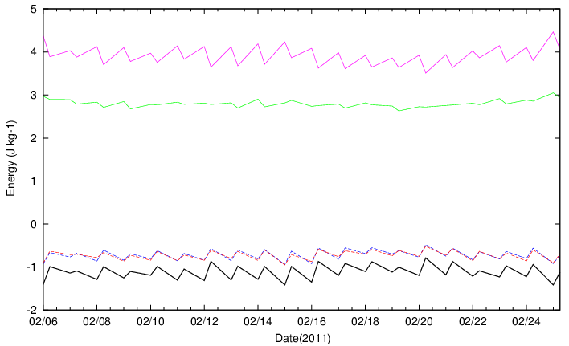
Preliminary Results Actual and estimated change in 12h forecast error from assimilating observations at 0Z and 6Z
Error in 18h forecast Total FSOI with ensemble
Error in 12h forecast Total FSOI with adjoint model
Real change in error

Slide 9
Preliminary Results Number of assimilated observations
40 cases: 0Z+6Z over 20 days
Ensemble
Adjoint model

Slide 10
Preliminary Results Daily average impact on 0Z+6Z 12h forecasts
Overall, similar results between ensemble and adjoint for propagation forecast→analysis time
Surface and some humidity obs have relatively larger impact when using ensemble
Raob and AMSU-A obs have relatively larger impact when using adjoint model
Ensemble
Adjoint model
J/kg

Slide 11
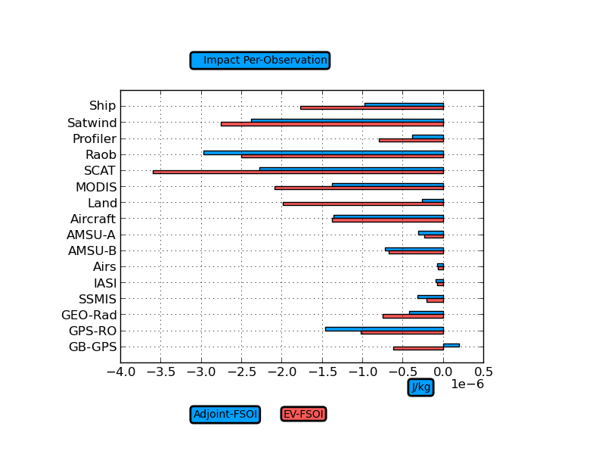
Preliminary Results Impact per observation
Overall, similar results between ensemble and adjoint for propagation forecast→analysis
Differences for Land obs amplified, since relatively small number
Using adjoint model suggests Ground-based GPS degrades the forecast, opposite found when using ensemble (overall impact small, so difficult to measure?)
Ensemble
Adjoint model
J/kg

Slide 12
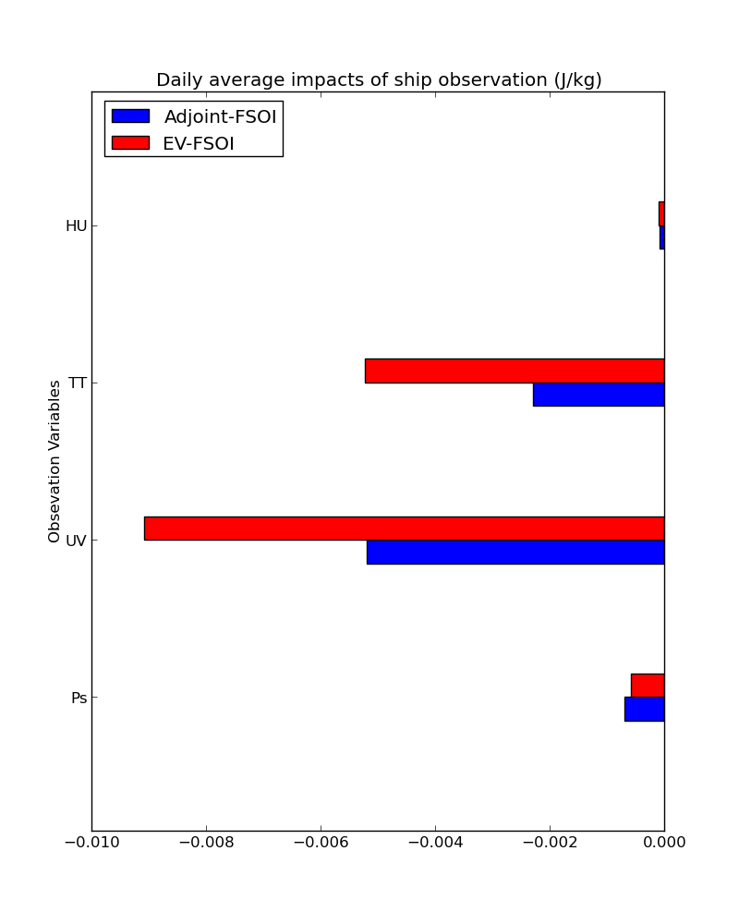
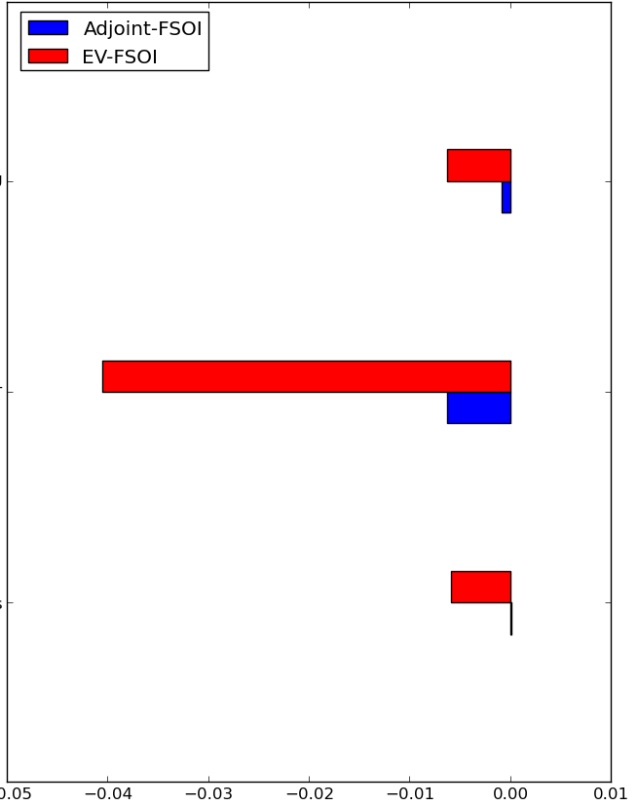
Preliminary Results Average daily impact for land observations
Ensemble Adjoint model
Land
Ships & Buoys
humidity
humidity
temperature
temperature
wind
surface pressure
surface pressure
J/kg
J/kg

Slide 13
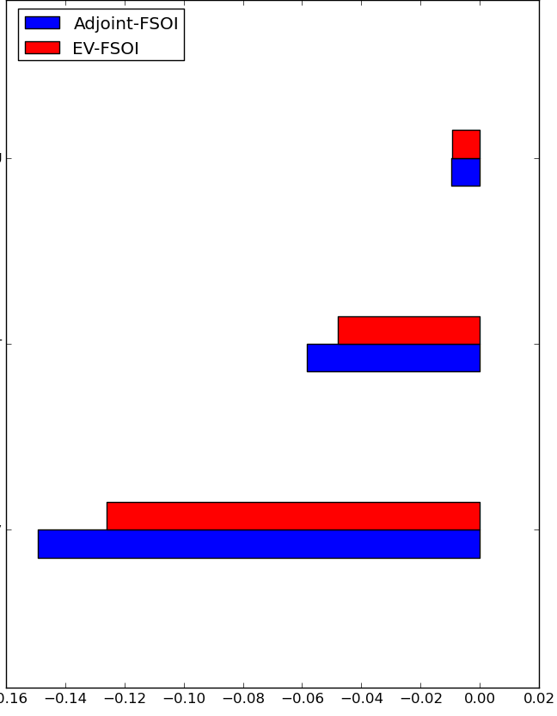
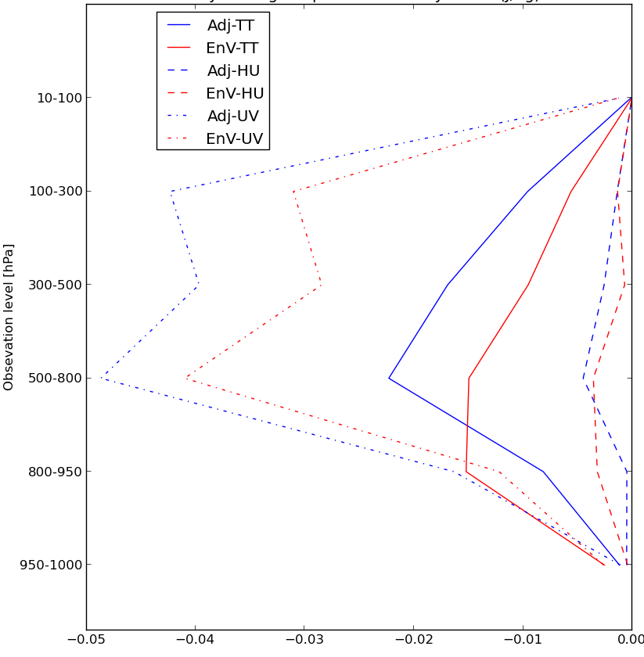
Preliminary Results Average daily impact for raob observations
Ensemble Adjoint model
Raob (by variable)
Raob (by var/level)
humidity
humidity
temperature
Ping is working on it…
temperature
wind components
wind components
J/kg
J/kg

Slide 14
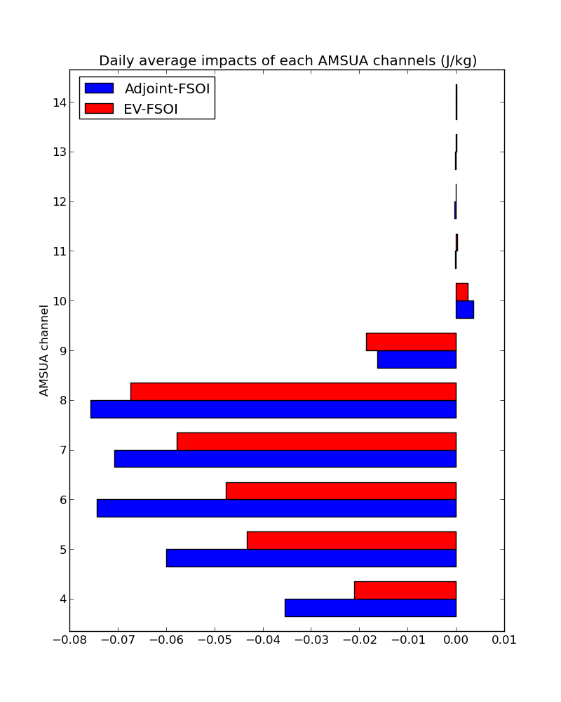
Preliminary Results Daily average impact for each AMSU-A channel
Forecast error measured only from sfc to 100hPa
Channel 8 peaks around 150hPa, channel 9 around 70hPa
Impact from using ensemble is more clearly increasing with height; with adjoint model it is more evenly distributed among upper tropospheric channels
Ensemble
Adjoint model
J/kg

Slide 15
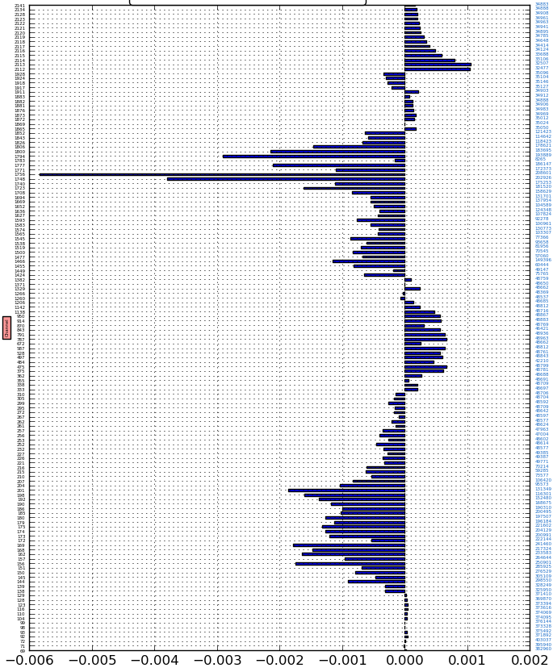
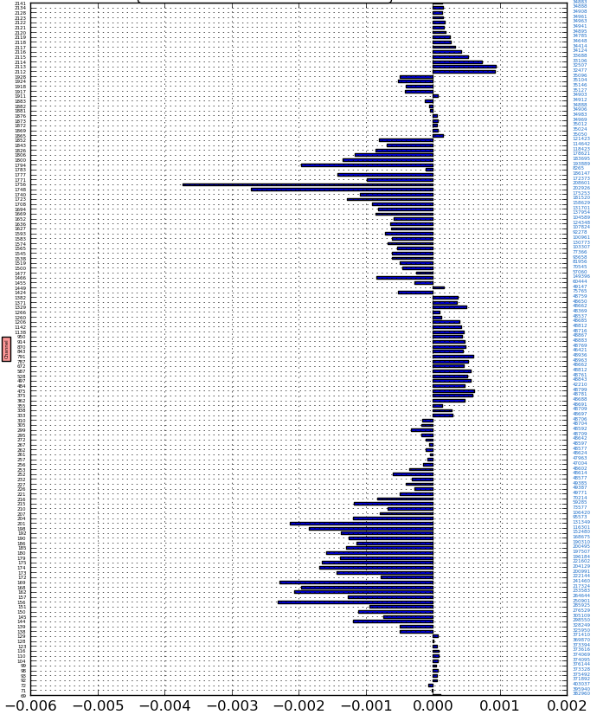
Preliminary Results Daily average impact for each AIRS channel
Ensemble
Adjoint model
near-sfc temperature
near-sfc temperature
tropospheric
humidity and temperature
tropospheric
humidity and temperature
near-sfc temperature and humidity
near-sfc temperature and humidity
tropospheric temperature
tropospheric temperature
stratospheric temperature
stratospheric temperature
J/kg
J/kg

Slide 16
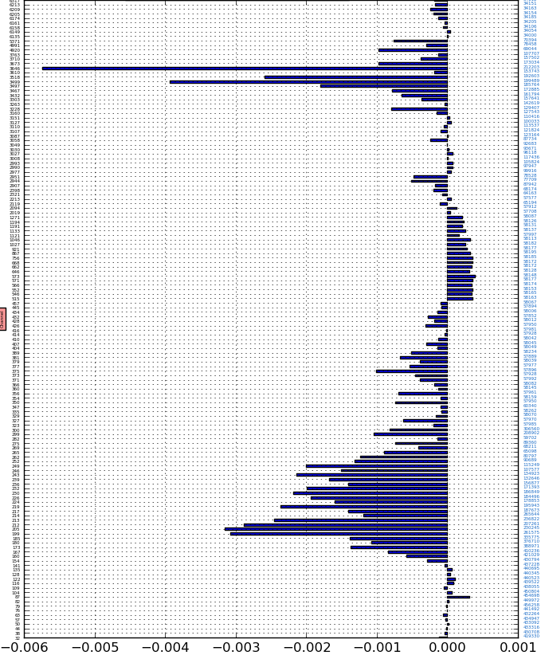
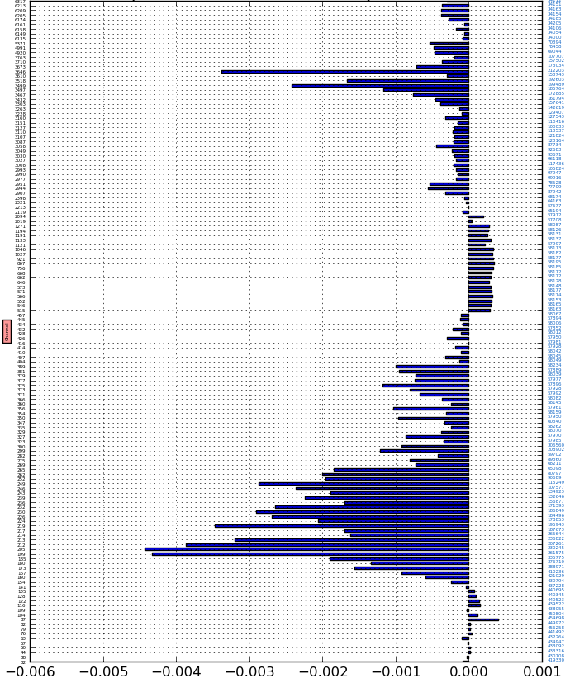
Preliminary Results Daily average impact for each IASI channel
Ensemble
Adjoint model
near-sfc temperature and humidity
near-sfc temperature and humidity
tropospheric
humidity and temperature
tropospheric
humidity and temperature
Only channels with oppositely signed impact
near-sfc temperature and humidity
near-sfc temperature and humidity
tropospheric temperature
tropospheric temperature
stratospheric temperature
stratospheric temperature
J/kg
J/kg

Slide 17
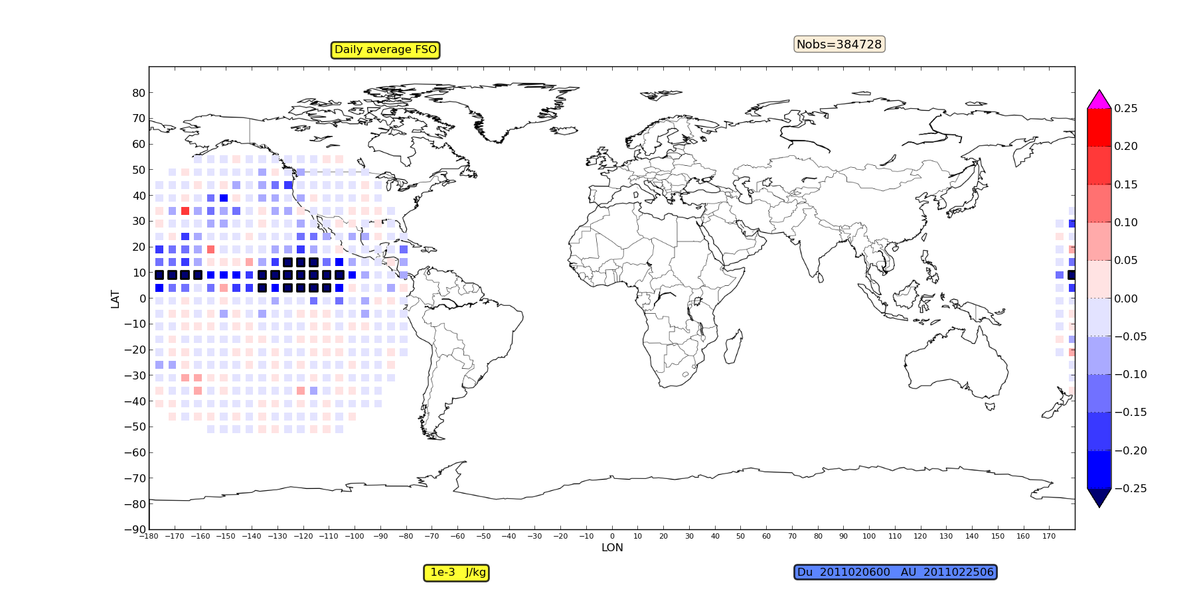
Preliminary Results Daily average impact for GeoRad in 5˚x5˚ boxes
Even detailed spatial impact of single geostationary satellite humidity channel is similar between approaches
Localized regions near the equator have much higher impact, partially due to higher number of assimilated obs
Ensemble
Adjoint model

Slide 18
Conclusions
Preliminary results with new FSOI approach adapted for use with EnVar seem promising and similar to results using adjoint model
More detailed analysis underway to better understand differences:
explained by: vertical ensemble localization?
nonlinear ensemble vs. linear adjoint propagation?
ADJ linearised wrt the model init. with 2011 4D-Var anal.
Introducing a simple flow-following covariance localization should enable accurate 24h forecast impacts (e.g. Ota et al. 2013)
Redo for recent period (January 2015) to include all currently used instruments and extend to 24h impact → allow comparison with other centres through international FSOI intercomparison project
Routine (operational) application would require:
extension of 256-member background ensemble forecasts from 9h to 30h (for impacts on 24h forecasts)
then, additional cost of computing FSOI for a given measure of forecast error similar to cost of 4DEnVar analysis

Slide 19
Thank you for your attention

