Slide 1
Forecast Sensitivity Observation Impact with Observation-Based Objective function Carla Cardinali many thanks to Gabor Radnoti

Slide 2
Outline
Operational FSOI → FSOI-J_{E}
FSOI-Jo: new objective function which verify
24h forecast against observations
Observation Impact comparison
Observation type total impact
Impact distribution
Impact variability
AMSU-A and GPS-RO
Conclusion

Slide 3
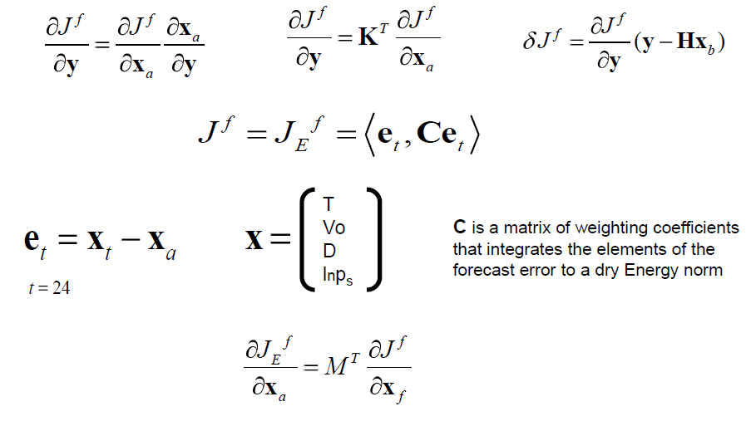
Forecast Sensitivity Observation Impact FSOI-Je
Operational configuration

Slide 4
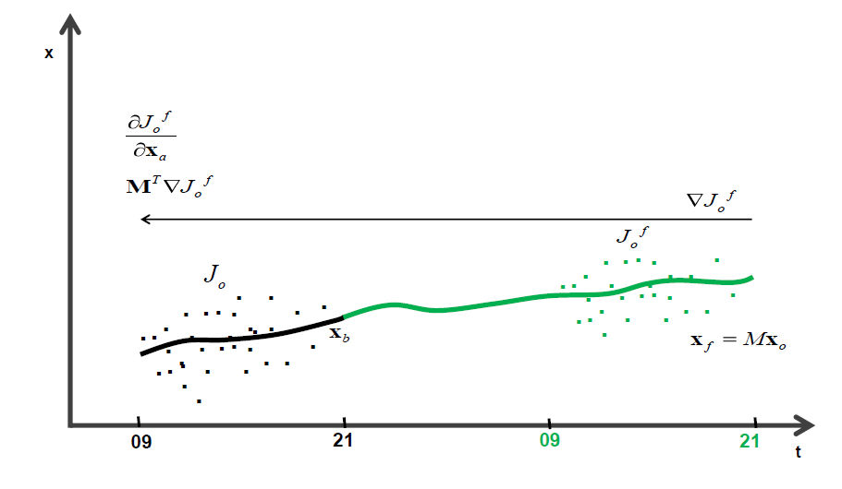
Forecast Sensitivity Observation Impact FSOI
Observation-based objective function
J_{o}^{f}
J_{o}^{f}
o
R⁻¹
o

Slide 5
Forecast Sensitivity Observation Impact FSOI
Operational configuration New configuration

Slide 6
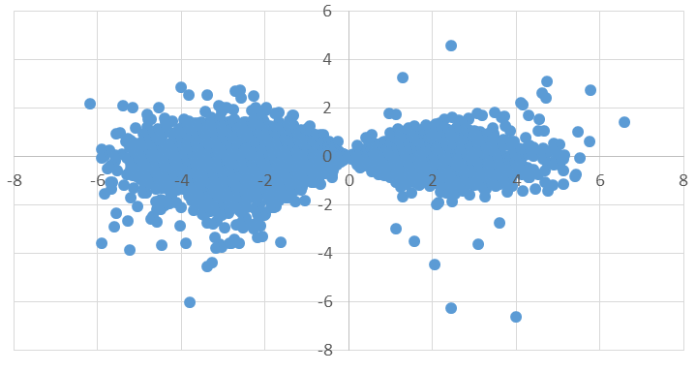
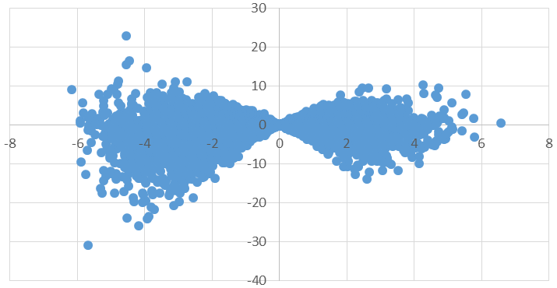
Forecast Sensitivity Observation Impact FSOI
y-Hx_{b}
y-Hx_{b}
FSOI-Je
FSOI-Jo
51% Obs
FSOI-Je < 0
61% Obs
FSOI-Jo < 0

Slide 7
GPS-RO Observation Impact

Slide 8
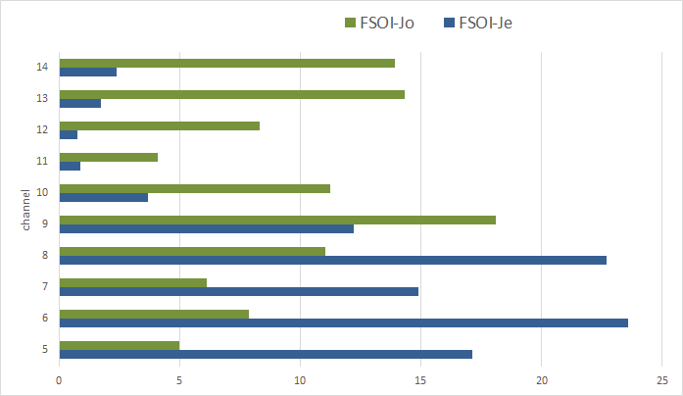
AMSU-A Observation Impact
%

Slide 9
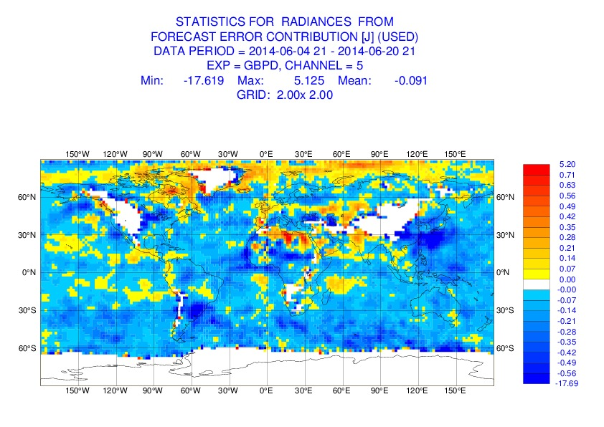
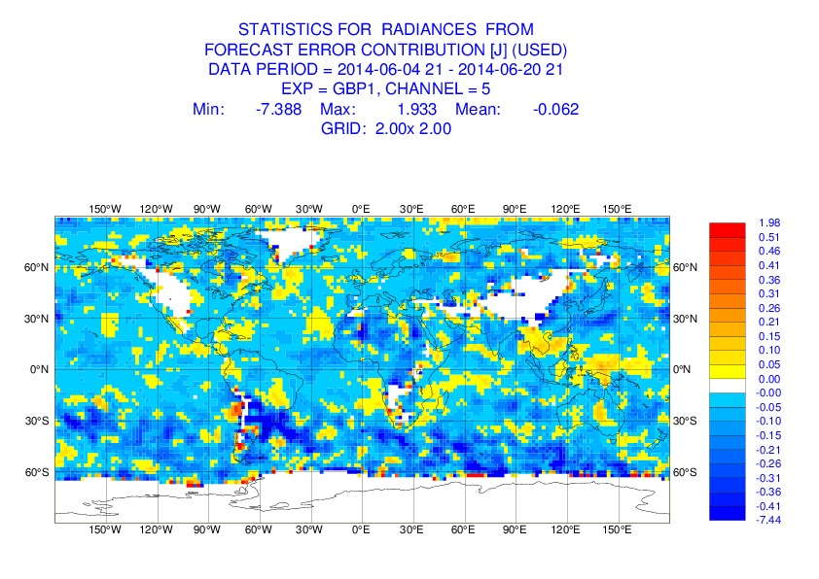
Observation Impact
FSOI-Je
Forecast verified against analysis
24 h forecast error
+ FcE increase
- FcE decrease
AMSU-A Channel 5
Lower Troposphere- Surface
FSOI-Jo
Forecast verified against observations

Slide 10
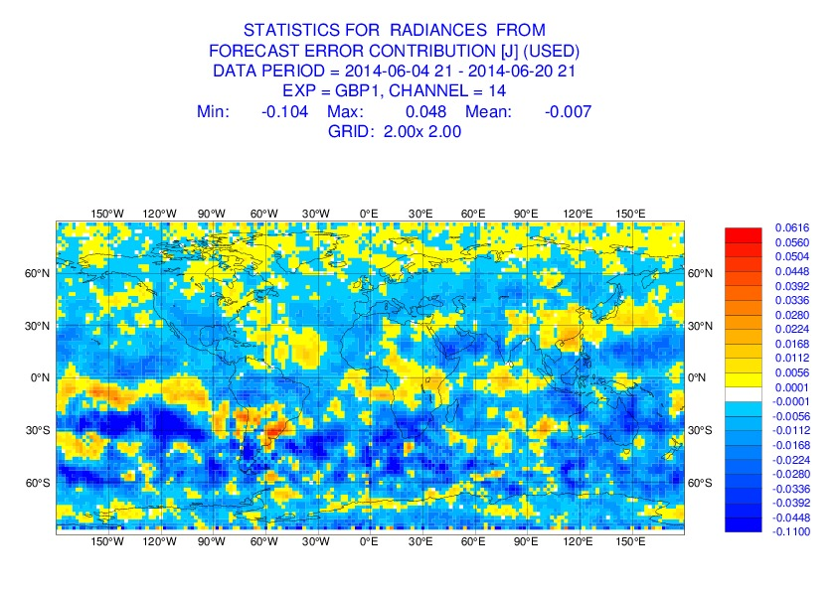
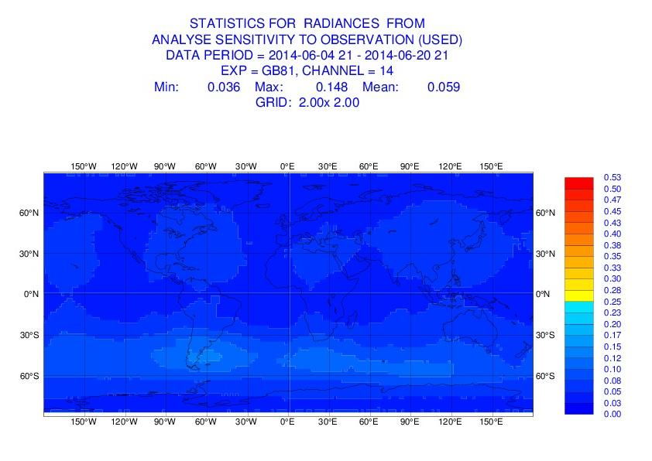
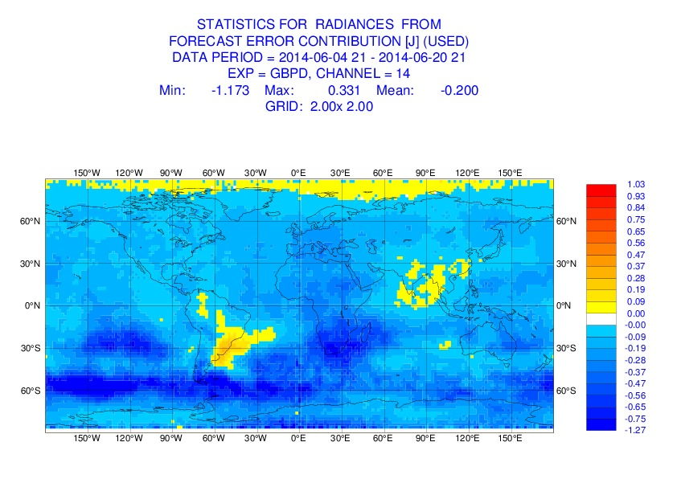
Observation Impact
FSOI-Je
Forecast verified against analysis
24 h forecast error
+ FcE increase
- FcE decrease
AMSU-A Channel 14 Stratosphere
FSOI-Jo
Forecast verified against observations
0 ≤ Observation Influence ≤ 1
Mean DFS

Slide 11
Conclusion
The new objective function provides a verification field independent from the model
disentangle degradation due to model bias with degradation
due to observation quality
The objective function weights are the observations accuracies which are different from the energy weights:
Larger in the stratosphere
Smaller in the troposphere
FSOI-Jo shows larger observation impact than FSOI-Je impact
in the stratosphere and smaller in the troposphere
FSOI-Jo (10%) correlates better than FSOI-Je with DFS
61% of the observations contribute to decrease the forecast error to be compared with 51% for FSOI-Je

