Slide 1
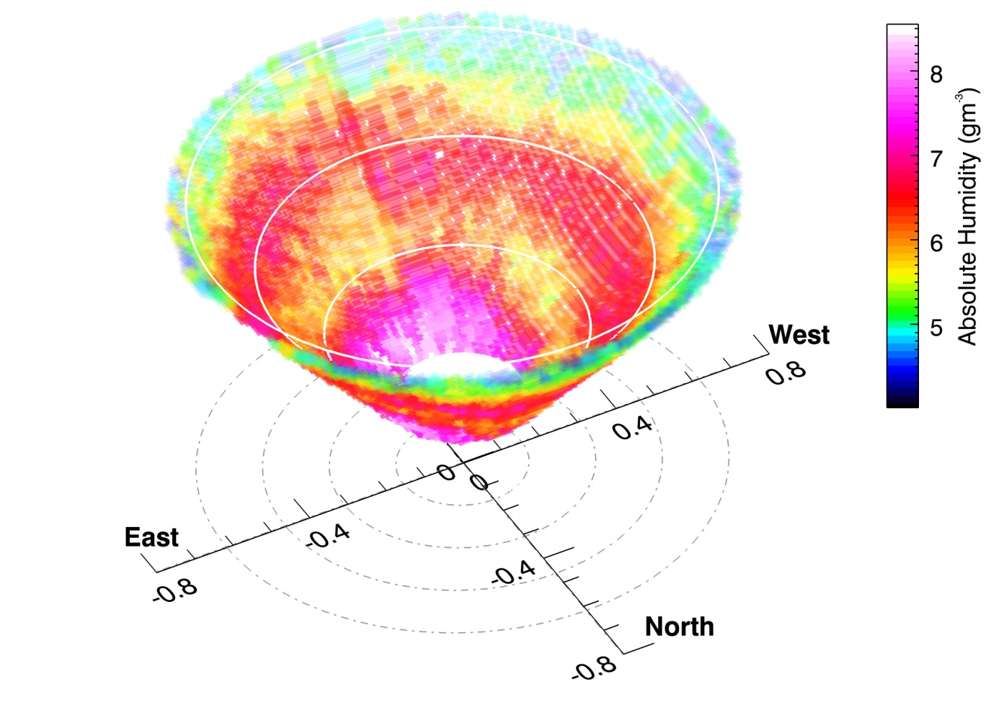
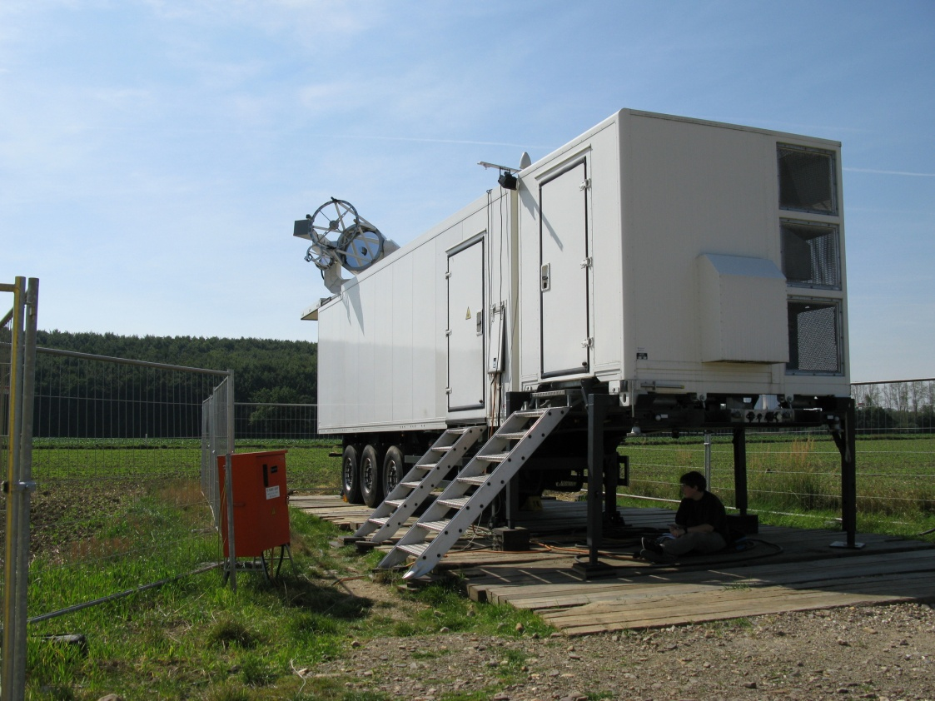
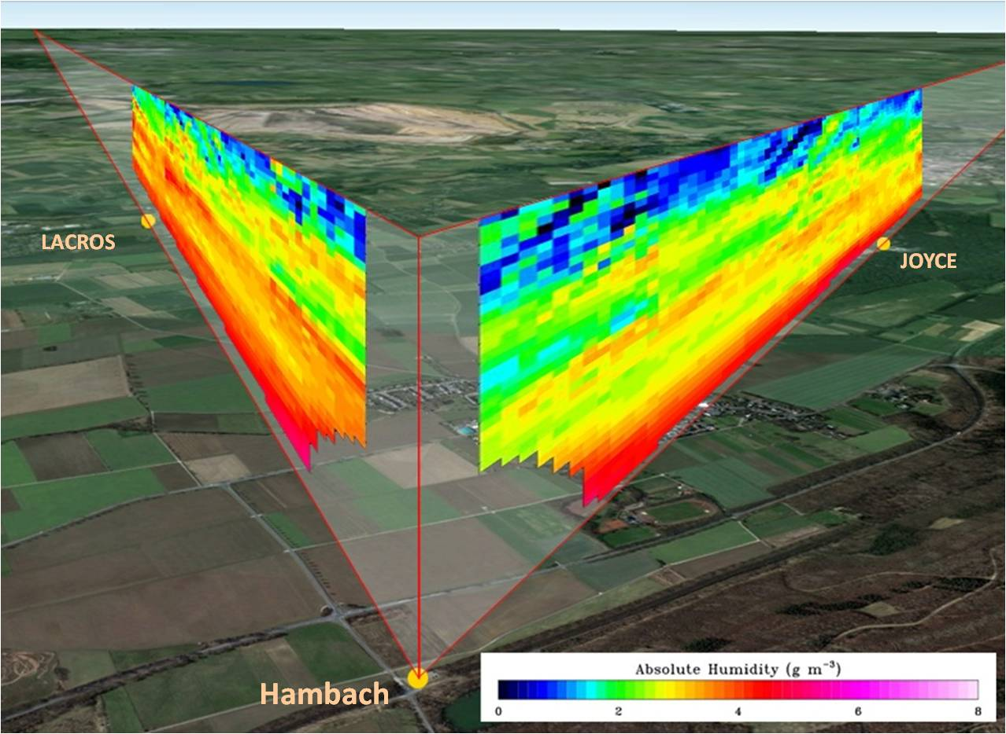
New Observations of Lower Tropospheric
Water‐Vapor and Temperature Fields and Their
Impact on Short‐Range Weather Forecasting
Volker Wulfmeyer, Andreas Behrendt, Eva Hammann, Florian Späth, Shravan Muppa, Simon Metzendorf, Andrea Riede, Stephan Adam, Thomas Schwitalla Institute of Physics and Meteorology (IPM) University of Hohenheim (UHOH) Stuttgart, Germany
Outline:
Importance of accurate simulations of the land-atmosphere system
Status of lower tropospheric observations
IPM water-vapor and temperature lidar systems
First temperature lidar data assimilation study
Theses and outlook: Commercialization

Slide 2
Sensitivity of Mesoscale Model Output to Turbulence Parameteriza-tion (TP) and LS-Schemes (WRF, 2km)
The Impact of TP on the Evolution of Clouds and Precipitation (WRF, 2km):
22. 08. – 15. 09. 2009
DIAL
YSU-NOAHMP
YSU-NOAH
MYNN-NOAHMP
MYNN-NOAH
TR32, Sept. 8, 2009, Jülich, Germany
(Milovac et al. JGR 2016)
ABL too deep in all cases. Variability of the order of 1 g m⁻³. Strong sensitivity on both LS-schemes and TPs.
Strong influence on clouds and precipitation.
Notes:
Models are only as good as the data which were used to their improvement and verification.
What is the status of the simulation of the land-atmosphere system?
This can only be investigated by accurate measurements of the diurnal cycle of the PBL from the land surface to the entrainment layer, particularly of vertical profiles of thermodynamic variables such as moisture and temperature.
Unfortunately, we have only a few observing systems, which are able to resolve the vertical structure such as for humidity.
Discussion left
Discussion right

Slide 3
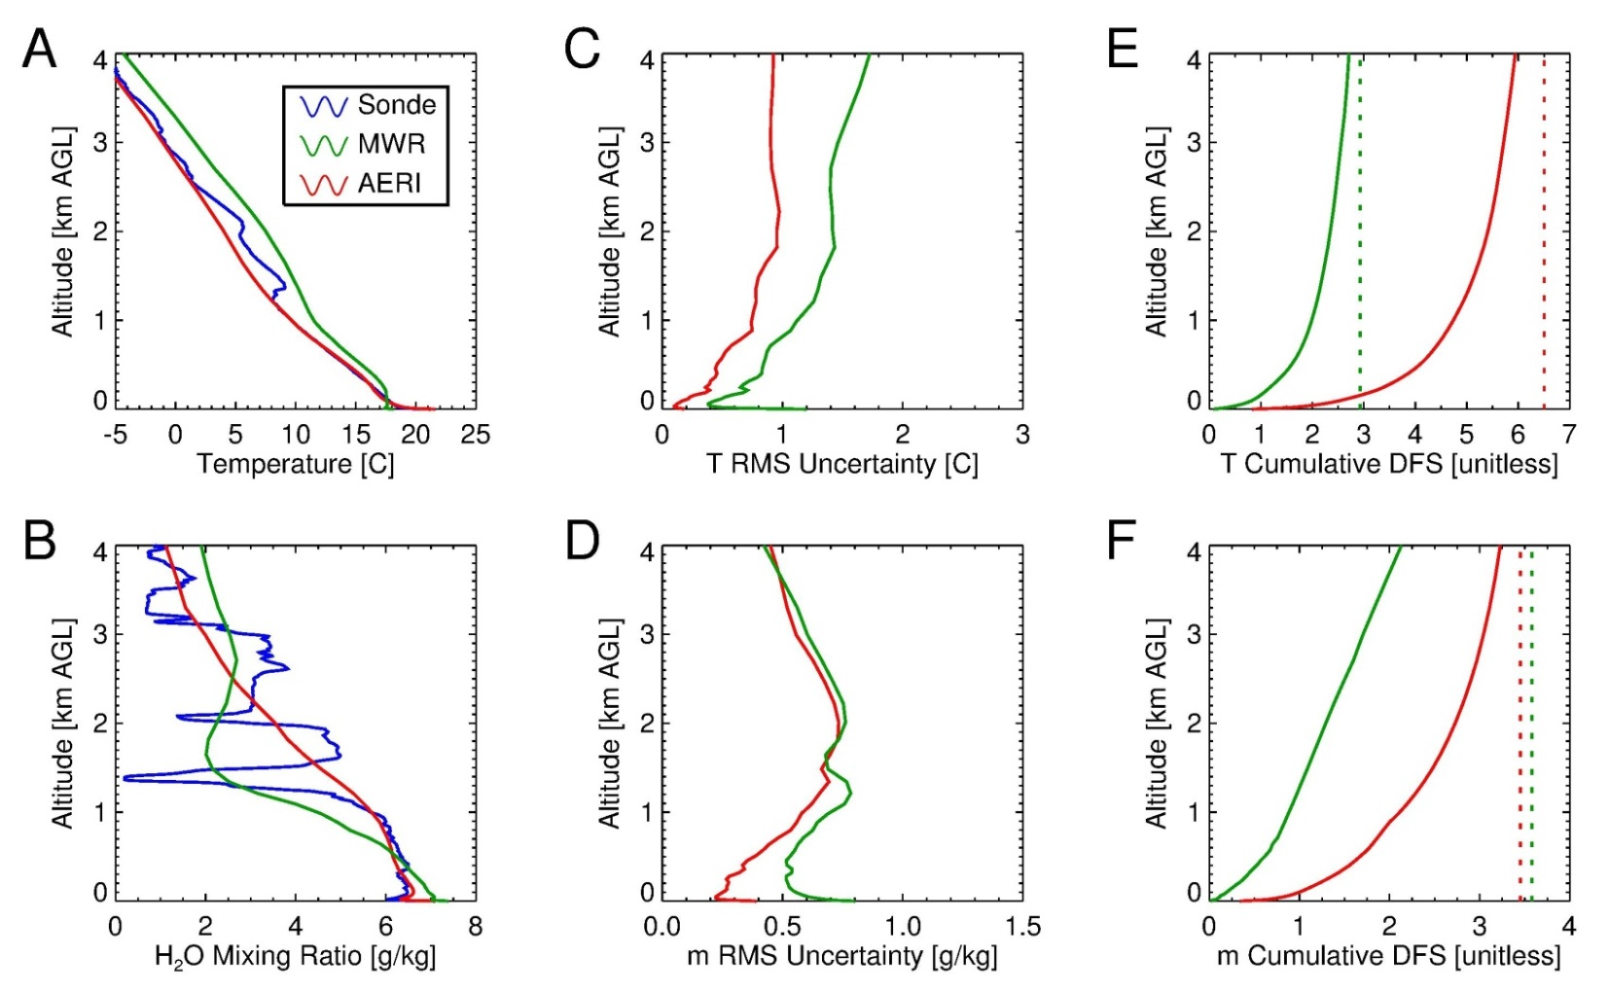
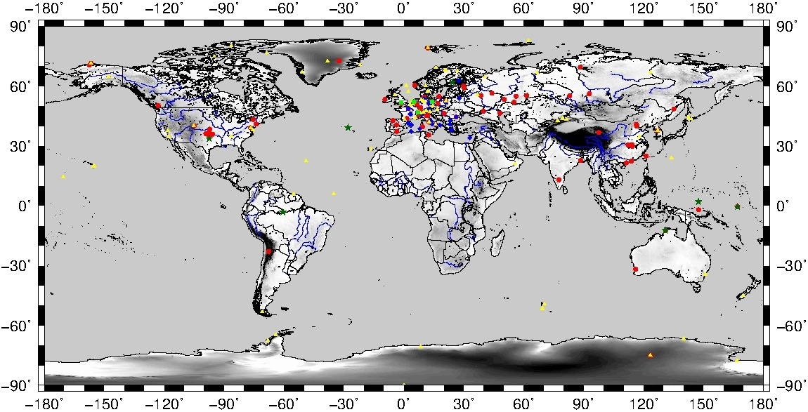
2) The Horizontal and Vertical Structure of the ABL: „Terra Incognita“ in Earth System Observation
(for further details see Wulfmeyer et al. Rev. Geophys. 2015)
Global network of passive and active TD profilers. Red circles: MWRs, blue diamonds: EARLINET stations with potential WV and T profiling capabilities, green squares: WV and T lidar systems at observatories, yellow triangles: NDACC
profiler stations, and dark green stars: ARM sites.
Already at 1 km, the width of the averaging kernel is ≈500 m for IR and ≈1000 m for MW remote sensing.
Notes:
Überdeckung and quality

Slide 4
Requirements for Earth System Research and Predictions
Parameter | Monitoring | Verification | Data assimilation | Process studies | Lidar
Vert. res. In ABL, m Surface layer Mixed layer Interfacial layer Lower free trop. | 10 – 30 100 – 300 10 - 100 300 - 500 | 10 – 30 100 – 300 100 300 - 500 | 10 – 30 100 – 300 100 300 – 500 | 10 10 – 100 10 – 100 100 | 5 50 50 100
Time resolution, min | < 60 | < 15 | 5 – 15 | 1/60 - 1 | 1/6 in ABL
WV noise error , % | < 10 | < 5 | < 10 + error covariance matrix | < 10 | < 5 + error covariance
WV bias, % | 2 – 5 | 2 – 5 | < 5 | < 10 | 2 - 5
T noise error , K | 1 | 1 | 1 | 0.5 | 1 + err. cov.
T bias , K | 0.2 – 0.5 | 0.2 – 0.5 | 0.2 – 0.5 | 0.2 – 0.5 | 0.2 – 0.5
Latency , min | --- | --- | 1 for nowcasting, 1 to 60 for short-range | --- | immediately
Hor. res. of network | Down to meso-γ-scale | Meso-γ-scale | Meso-γ-scale | Turbulent to meso-γ-scale | tbd
Coverage | All climate regions |  |  |  | yes

Slide 5
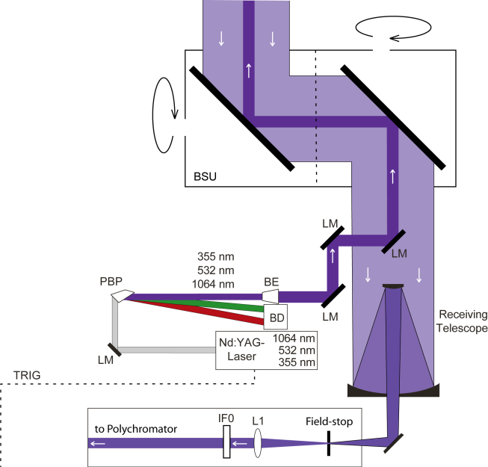
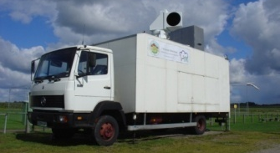
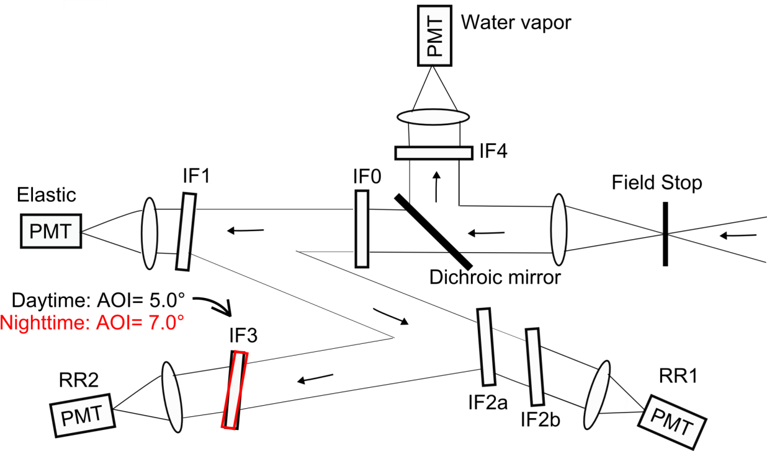
3) IPM 3D Temperature and Water-Vapor Raman Lidar
Flashlamp-pumped, tripled Nd:YAG laser with 10 W average power in the UV.
Behrendt et al. AO 2004, Radlach et al. ACP 2008, Hammann et al. ACP 2015,
Behrendt et al. ACP 2015
Notes:
Short, refer to Andreas

Slide 6
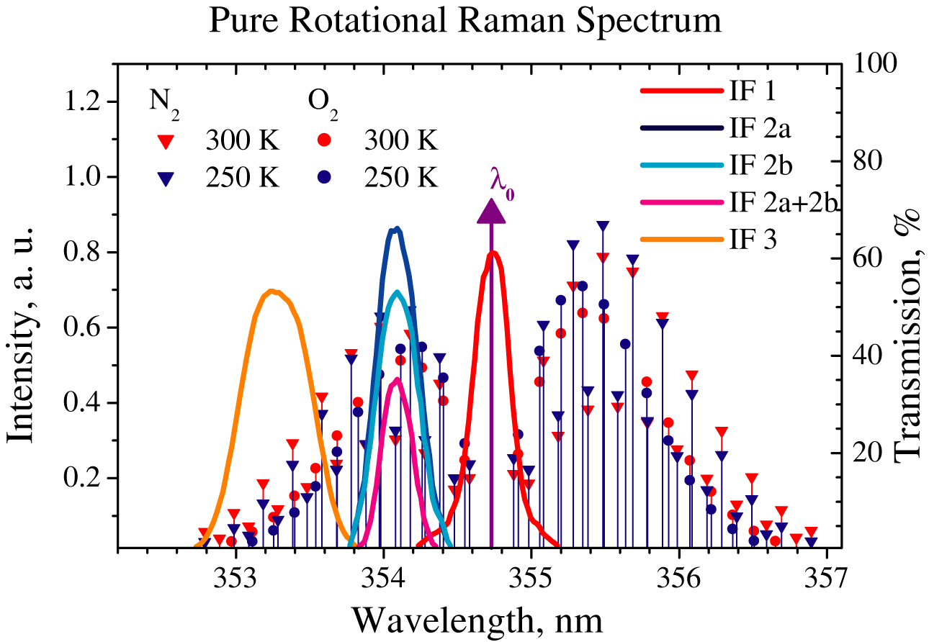
Temperature Rotational Raman Lidar (TRRL)
Inelastic Raman scattering intensities are Boltzmann distributed. Derivation and error analysis:
,
Calibration with surface data or soundings necessary, further details see pubs.
Thus, the statistical error scales according to
The vertical error correlation corresponds to ΔR.
Notes:
HSRL not considered but also possible. Only high-resolution daytime ABL measurements.

Slide 7
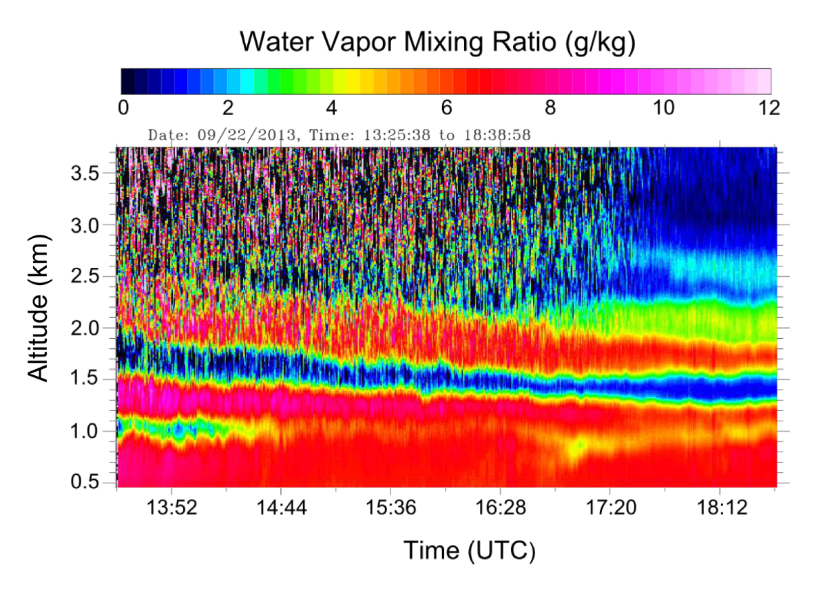
IPM WV and T Raman Lidar Performance
Time-height cross section of water-vapor mixing ratio with resolutions of 30 s, 150 m:
Temperature profile, May 19, 2013, 13-13:30 UTC, 100-m resolution:
Globally-unique, ground-based remote sensing system with high temporal and spatial resolution of 10 min, 300 m up to 4 km with error of < 1 K (Wulfmeyer et al. ROG 2015, Behrendt et al. ACP 2015).
Notes:
Short: Radiosonde less representative, measurements of gradients are now possible.

Slide 8
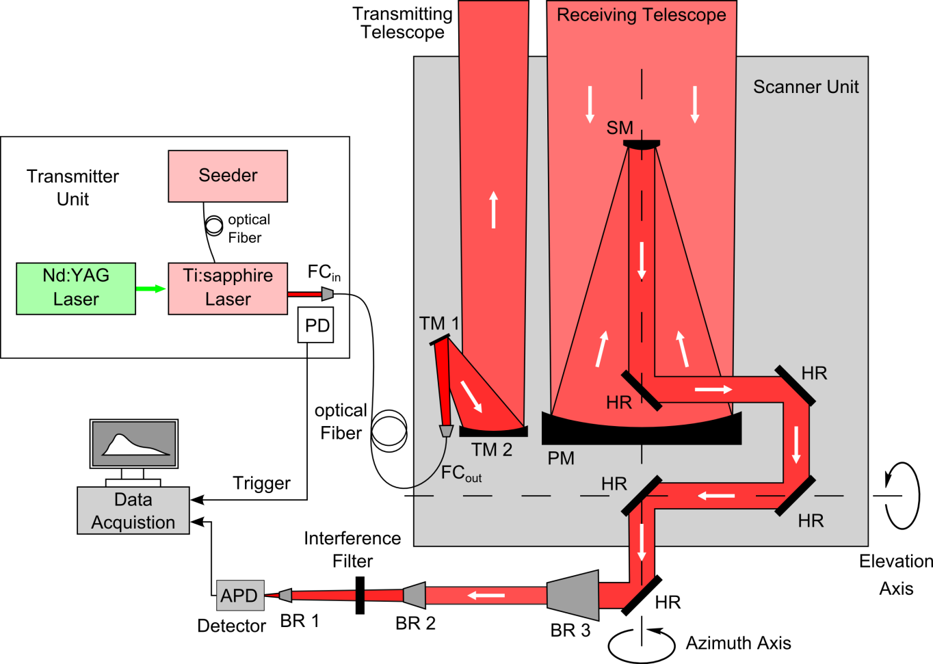
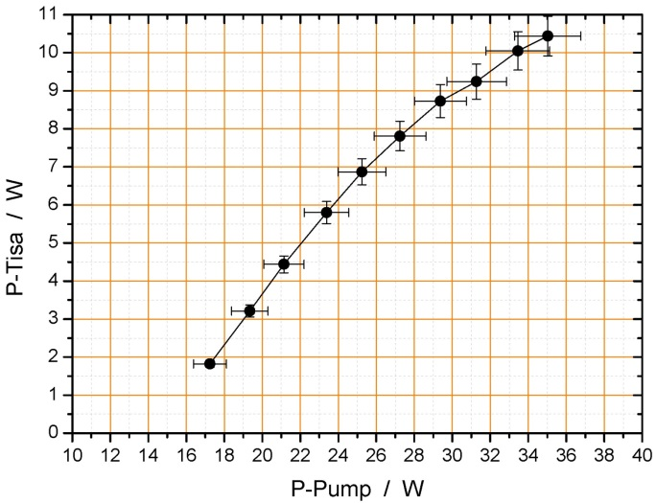
IPM 3D Water-Vapor Differential Absorption Lidar
For further details see: Wagner et al. AO 2011, 2013; Metzendorf et al. CLEO 2015; Wulfmeyer et al. JAS 2015; Späth et al. AMT 2016)
10-W laser transmitter with extra-ordinary power and stability

Slide 9
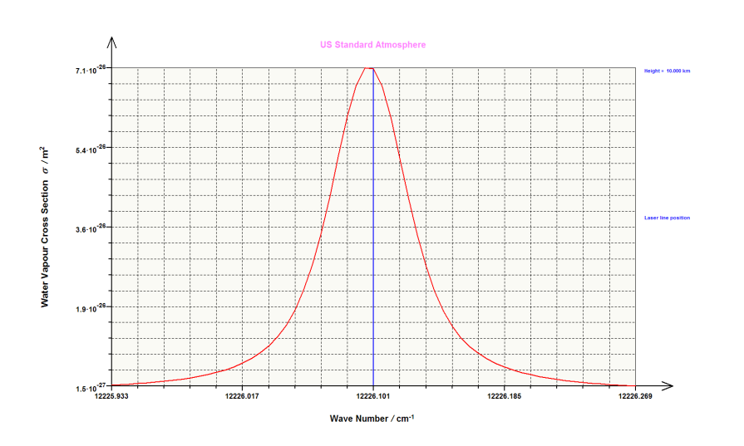
Water-Vapor Differential Absorption Lidar (DIAL)
Methodology and error analysis, DIAL derives the absolute humidity:
R
I_{on}
I_{off}
Layer of the gas
to be detected,
e.g., water vapor
I
No calibration required!
10 km, US standard atm.
Wulfmeyer and Walther AO 2001a,b
1.8 GHz
FWHM
Very demanding with respect to laser transmitter spectrum.

Slide 10
3D Water-Vapor Observations with DIAL During HOPE
4.2 km
4.2 km
80-cm scanner
HD(CP)² Observational Prototype Experiment (HOPE) 2013 (see hdcp2.zmaw.de), IOP 5 on April 20, 2013, 06:03-07:24 UTC, scan time: 10 min, resolution: 60-300 m.
Globally-unique, ground-based remote sensing system with very high accuracy (bias ≈ 2 %) as well as temporal and spatial resolution of 10 min, 300 m up to 4 km with error of < 0.1 g kg⁻¹ (Wagner et al. AO 2011, 2013; Späth et al. AMT 2016)

Slide 11
First Investigation of 3D Water-Vapor Fields with DIAL
50⁰ conical scan on August 22, 2014, 0840-0855 UTC. The data are plotted for 200 m up to 800 m. The scales are given in km.
Späth et al. AMT 2016
Notes:
11

Slide 12
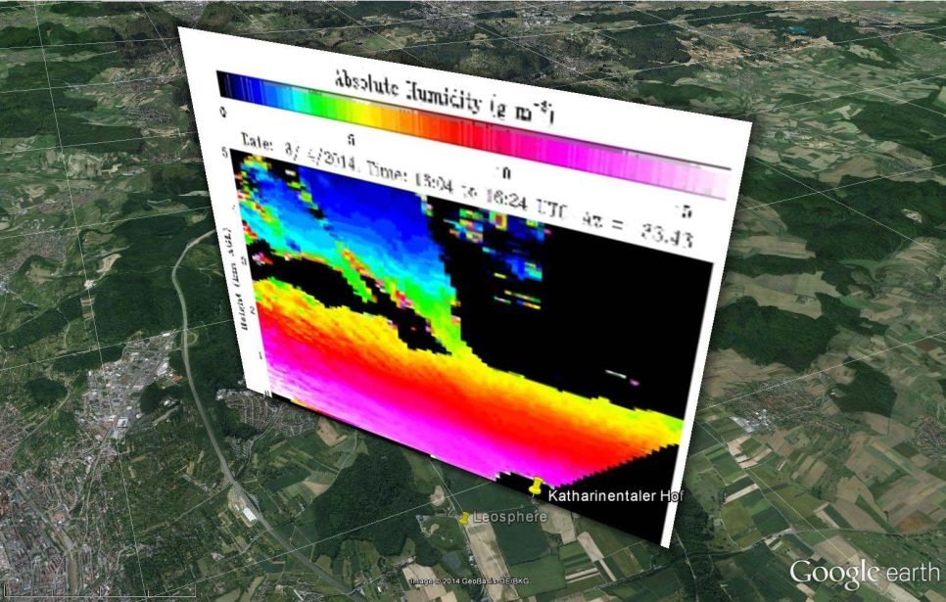
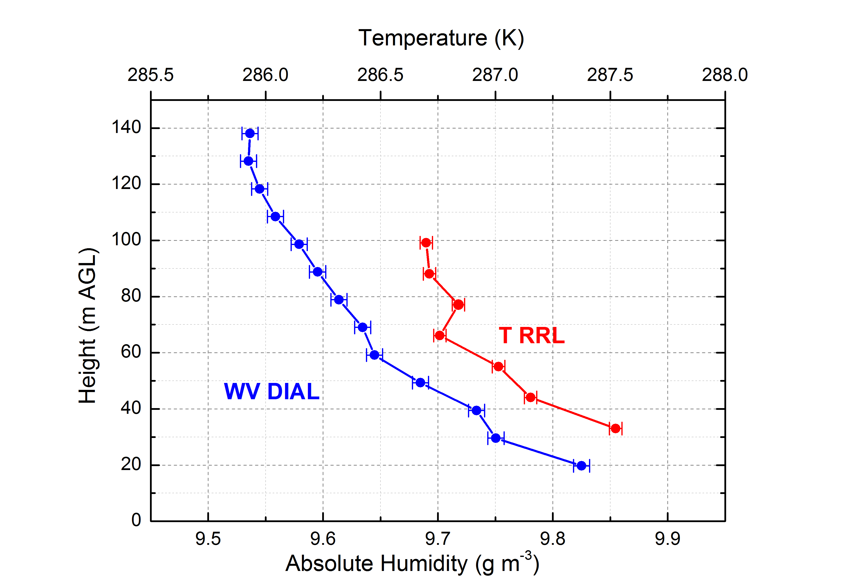
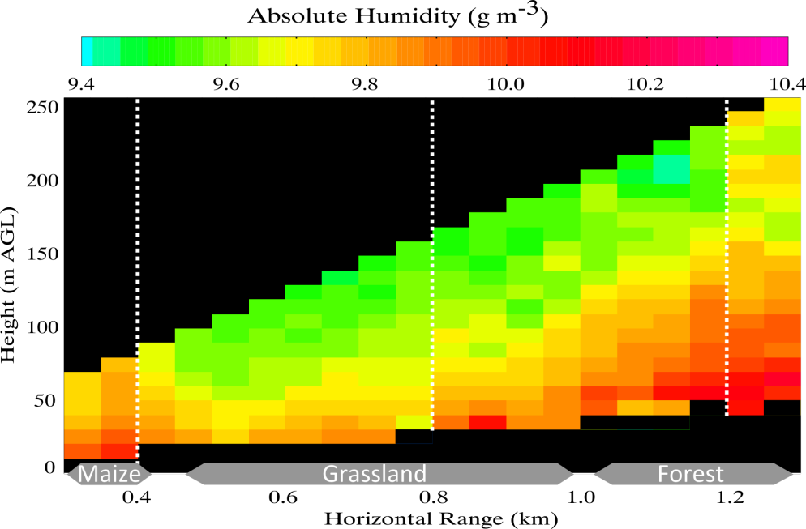
First Simultaneous Remote Sensing of Surface Layer Water-Vapor and Temperature Profiles
Water-vapor differential absorption lidar
Temperature rotational Raman lidar
Notes:
12

Slide 13
Requirements for Earth System Research and Predictions in Comparison to Ground-based Lidar Performance
Parameter | Monitoring | Verification | Data assimilation | Process studies | Lidar
Vert. res. In ABL, m Surface layer Mixed layer Interfacial layer Lower free trop. | 10 – 30 100 – 300 10 - 100 300 - 500 | 10 – 30 100 – 300 100 300 - 500 | 10 – 30 100 – 300 100 300 – 500 | 10 10 – 100 10 – 100 100 | 2 50 50 100
Time resolution, min | < 60 | < 15 | 5 – 15 | 1/60 - 1 | < 1/6 in ABL
WV noise error , % | < 10 | < 5 | < 10 + error covariance matrix | < 10 | < 5 + error covariance
WV bias, % | 2 – 5 | 2 – 5 | < 5 | < 10 | 2 – 5
T noise error , K | 1 | 1 | 1 | 0.5 | 1 + err. cov.
T bias , K | 0.2 – 0.5 | 0.2 – 0.5 | 0.2 – 0.5 | 0.2 – 0.5 | 0.2 – 0.5
Latency , min | --- | --- | 1 for nowcasting, 1 to 60 for short-range | --- | immediately including errors
Hor. res. of network | Down to meso-γ-scale | Meso-γ-scale | Meso-γ-scale | Turbulent to meso-γ-scale | Tbd
Coverage | All climate regions |  |  |  | Yes
Parameter | Monitoring | Verification | Data assimilation | Process studies | Lidar
Vert. res. In ABL, m Surface layer Mixed layer Interfacial layer Lower free trop. | 10 – 30 100 – 300 10 - 100 300 - 500 | 10 – 30 100 – 300 100 300 - 500 | 10 – 30 100 – 300 100 300 – 500 | 10 10 – 100 10 – 100 100 | 5 50 50 100
Time resolution, min | < 60 | < 15 | 5 – 15 | 1/60 - 1 | 1/6 in ABL
WV noise error , % | < 10 | < 5 | < 10 + error covariance matrix | < 10 | < 5 + error covariance
WV bias, % | 2 – 5 | 2 – 5 | < 5 | < 10 | 2 - 5
T noise error , K | 1 | 1 | 1 | 0.5 | 1 + err. cov.
T bias , K | 0.2 – 0.5 | 0.2 – 0.5 | 0.2 – 0.5 | 0.2 – 0.5 | 0.2 – 0.5
Latency , min | --- | --- | 1 for nowcasting, 1 to 60 for short-range | --- | immediately
Hor. res. of network | Down to meso-γ-scale | Meso-γ-scale | Meso-γ-scale | Turbulent to meso-γ-scale | tbd
Coverage | All climate regions |  |  |  | yes

Slide 14
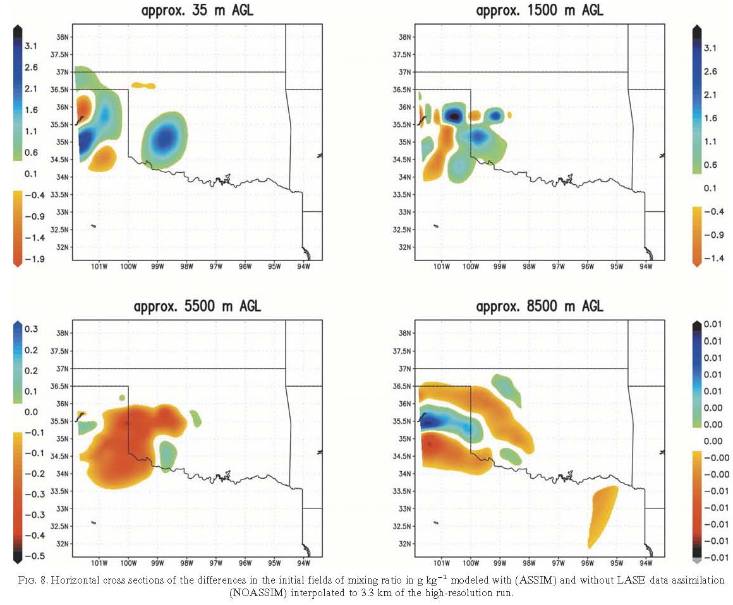
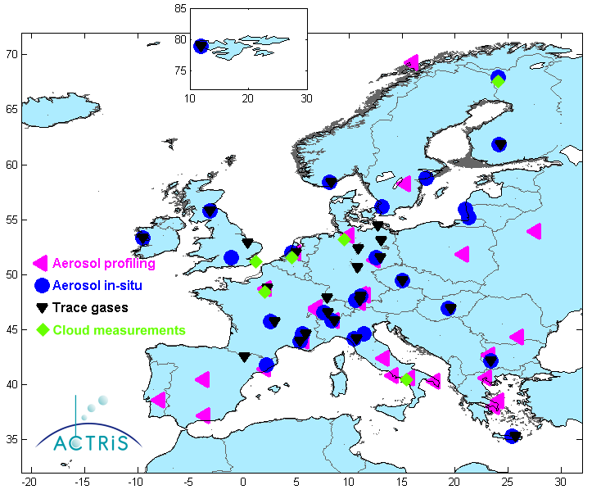
Pioneering Active Remote Sensing Data Assimilation (DA) Impact Studies at IPM with DWD and MRI
Mesoscale water-vapor lidar (airborne NASA LASE system) 4DVAR DA study during IHOP_2002: Wulfmeyer et al. MWR 2006
Water-vapor Raman lidar 4DVAR DA study during Launch_2005: Grzeschik et al. JTECH 2008
New GPS slant total delay forward operator and DA studies: Zus et al. MetZet 2008, 2011; Bauer et al. Tellus 2011; Schwitalla et al. QJRMS 2011
16.04.2010
Forward operator for backscatter lidar developed (Geisinger et al. ACP submitted).
Forward operator for polarization radar under development in collaboration with MRI (Kawabata et al. ISDA 2016).
Lidar backscatter DA with DWD for making use of its huge information content on aerosol microphysics and dynamics.
Notes:
IPM performed a variety of pioneering studies in this connection.
RADAR connection!!!
A ground-braking progress under all forcing conditions can only be expected,
if clear-air dynamial and thermodynamical profiler data are available in the environment of convective systems.

Slide 15
4) Temperature RRL Impact Study Using WRF 3DVAR 1-h RUC During HOPE, April 24, 2013
Temperature field measurement with resolutions of 10 min and 200 m. Profiles and error covariances available in real time with negligible latency.
Notes:
Es ist sooo schön!!!
Assimilation from 9-18 UTC except 14 UTC

Slide 16
Impact Analyses of TRRL DA
13:00 UTC
Model temperature profiles corrected up to the lower troposphere.
ABL depth and inversion strengths also corrected.
Notes:
Probleme der Radiosonden

Slide 17
Large-Scale Impact of TRRL DA
Adam et al. M.Sc. PhD Thesis, University of Hohenheim 2015; Adam et al. QJRMS 2016, submitted.
Impact region of 100 km influenced by B matrix.
The dipole is mainly due to a correction of the inversion layer.
Strong analysis increments also in the water-vapor field.
More data from field campaigns available for impact studies.
Notes:
Data from

Slide 18
5) Theses and Outlook
Three prerequisites for progress in Earth system research and forecasting:
Thorough verification of models with respect to high-resolution thermodynamic profiles and dynamics in the lower troposphere.
Improved process understanding of LA interaction in the land system. This is the way to cure errors of the parameterization chains instead of band-aid approaches.
Convective-scale DA with observations of clear-air thermodynamics and dynamics resolving the structure of the ABL → will also strongly improve radar impact.
Accurate simulations need high-quality observations (!)
of thermodynamics and dynamics on the mesoscale,
which must resolve the vertical structure of the lower troposphere,
with well-defined, high vertical and temporal resolution as well as accuracy,
to be obtained routinely in networks with a wide coverage,
to be investigated with respect to their impact by mesoscale OSSEs.
This gap cannot be closed by passive remote sensing systems.
A new generation of active sensors is waiting for commercialization. The tide is high to launch a comprehensive development and deployment program.
A comprehensive research and instrument development/deployment program should be designed and started to resolve this situation.
Notes:
Radar data tell us where and how much it is raining.
Dynamical and thermodynamical data tell us why it is raining and how much it will rain.

Slide 19
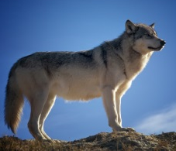
New Operational, Autonomous WV and T Profiler
3D-scanning unit
Control unit
Receiver unit
Key specifications:
High accuracy and resolution of T and WV profiling during day- and nighttime up to ≈4 km
Eye safe
Size comparable to ceilometer
Continuous operation for more than 5 years
Operation on buoys considered
Spaceborne operation envisioned in collaboration with ESA (EE10) and NASA via US NAS RFI#2
High-power laser unit
Notes:
Tough, compact, powerful, and robust like a wolf. Please contact me …
DECADAL SURVEY FOR EARTH SCIENCE AND APPLICATIONS FROM SPACE…

Slide 20
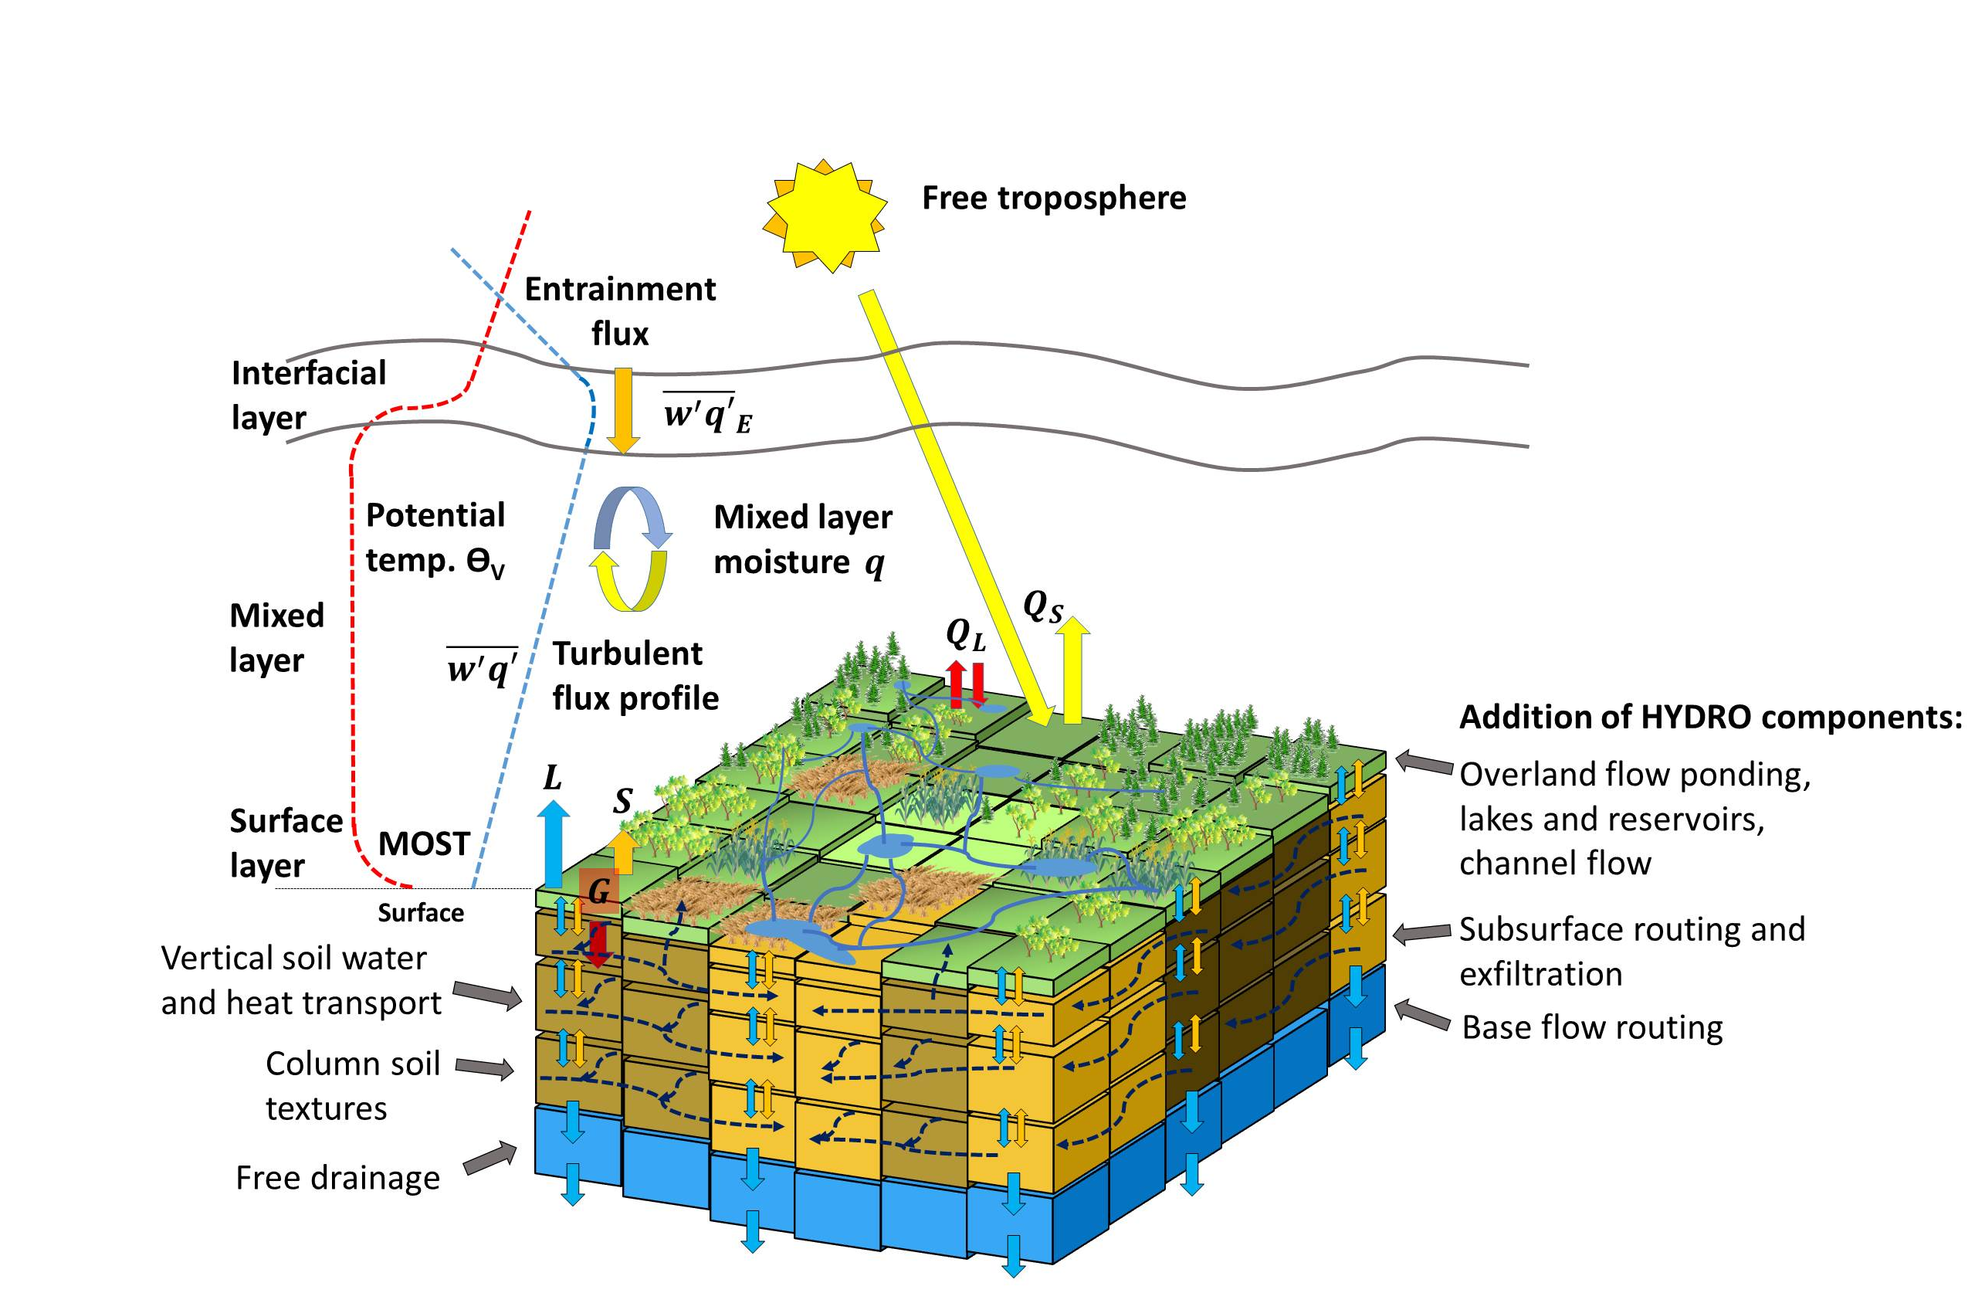
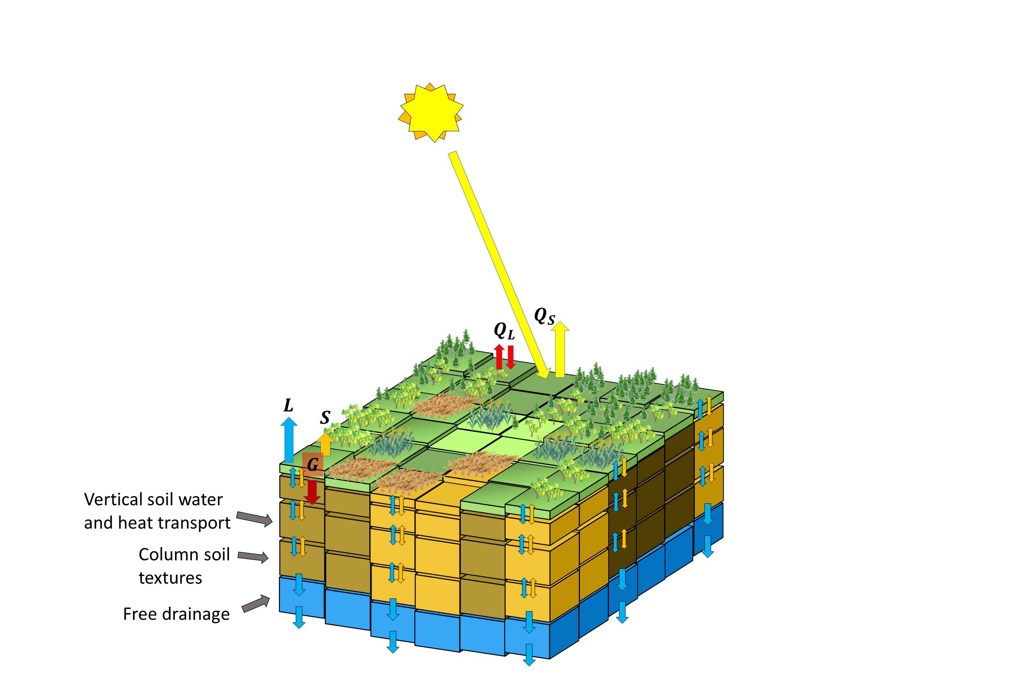
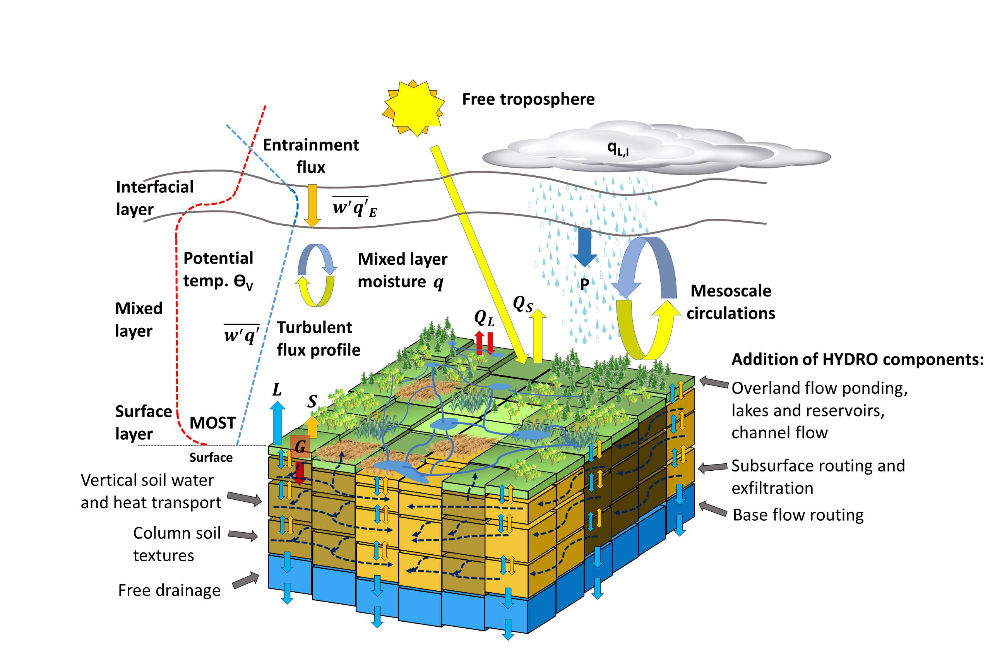
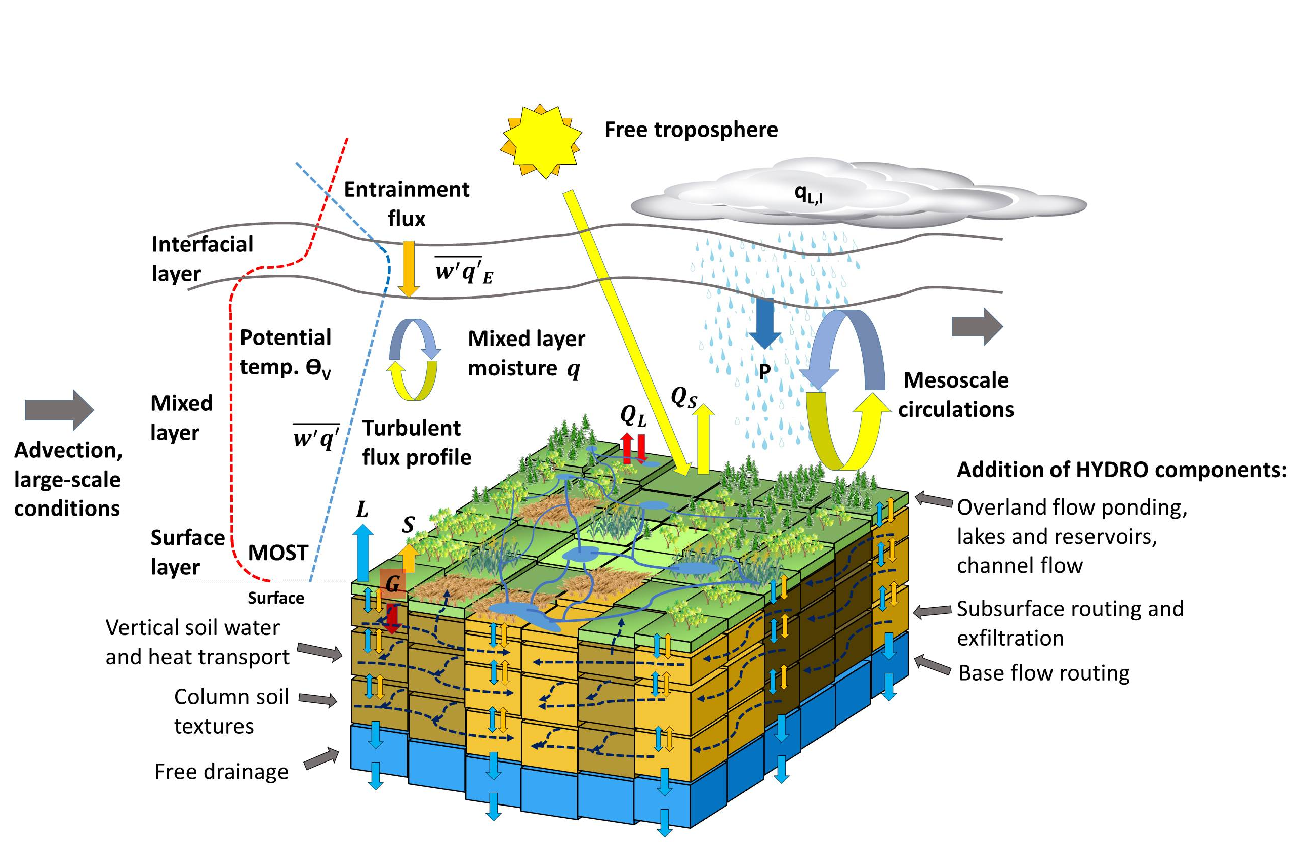
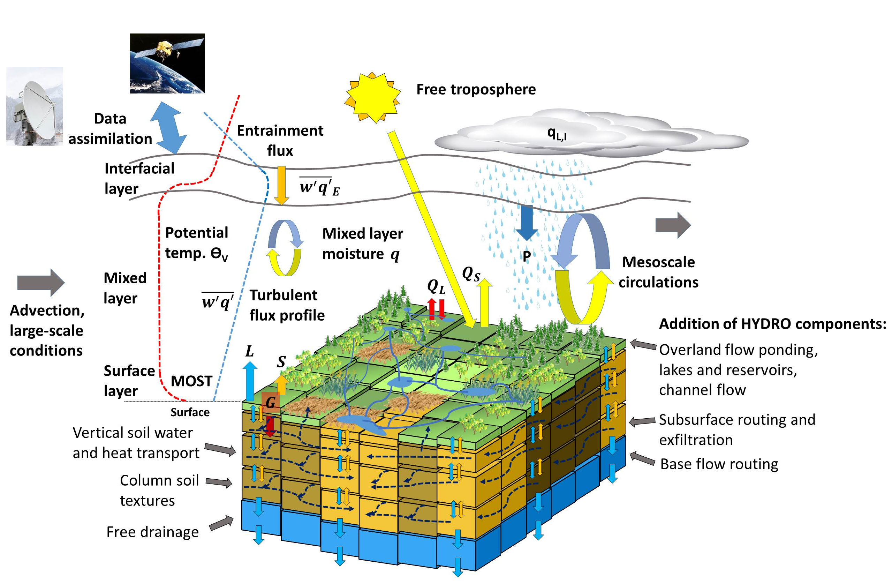
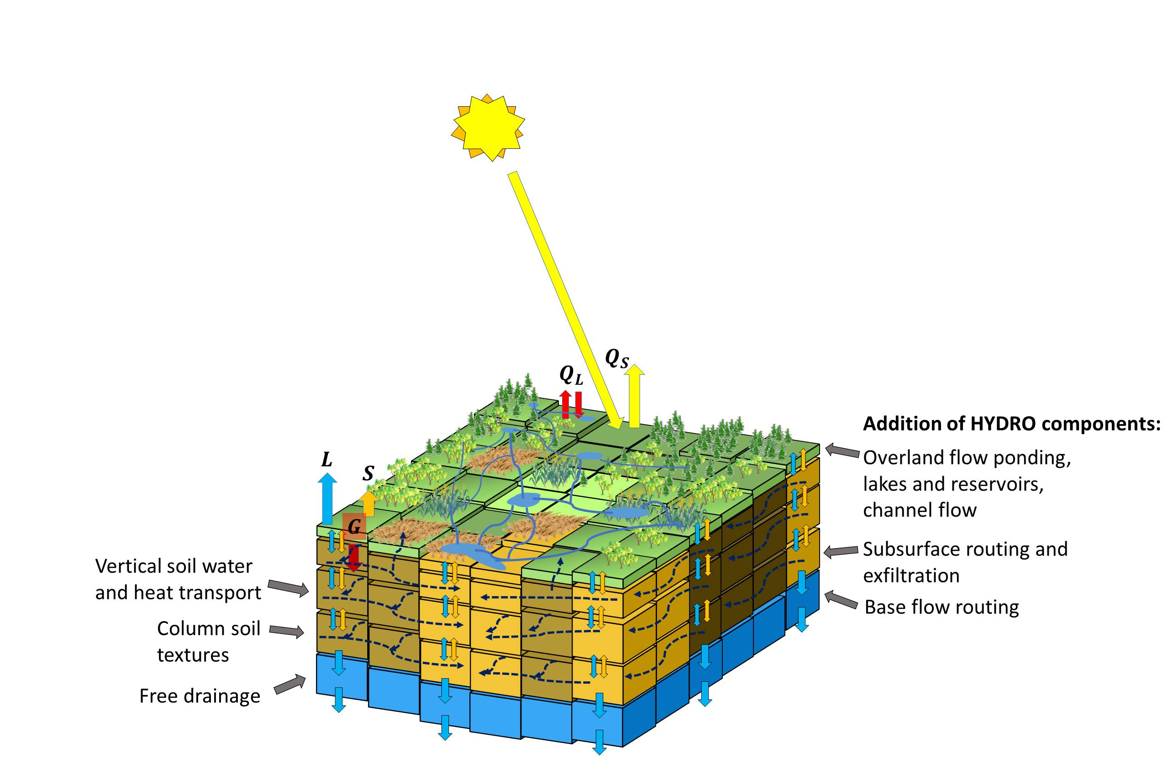
Towards Seamless Prediction: The WRF-NOAH(-MP-HYDRO) Model System
Grzeschik et al. JTECH 2008, Schwitalla et al. QJRMS 2011, Schwitalla and Wulfmeyer MetZet 2013, Kawabata et al. 2014, Geisinger et al. EGU AS1.8 2015
CORDEX-Europe for WCRP: Warrach-Sagi et al. CD 2013, Vautard et al. CD 2013, Kotlarski et al. GMD 2014
Milovac et al. GMD 2015, submitted
Root growth and leaf area dynamics: Gayler et al. EES 2013, WRR 2014
Irrigation: Branch et al. HESS 2014
Notes:
First of all, let me introduce the model world. We are operating the WRF-NOAH-MP model system at our institute in Hohenheim.
This model is especially interesting because it can be used for all forecast ranges from
nowcasting, to short-range probabilistic weather prediction, to regional climate simulations.
It has a sophisticated representation of LS processes and contains several state of the art parameterazions of boundary layer, cloud, and precipitation processes.
Furthermore, different DA techniques can be applied.
Last but not least, it has the potential to be coupled to various end-user models such as agricultural models, hydrological and matter transport models.
- RRTMG Strahlung für long wave and short wave (alle 4 Domänen) - Morrison 2-Moment Mikrophysik (alle 4 Domänen) - Noah-MP land surface (alle 4 Domänen) - Keine Parametrisierung Deep convection - natürlich (alle 4 Domänen) - Eigenständige Parametrisierung für die Flache Konvektion (außer in der 111 m Domäne) - Nutzung empfohlen bis etwa 200 m Auflösung - YSU Turbulenz (außer in der 111 m Domäne - dort abgeschaltet) - Surface layer scheme Monin-Obukhov

Slide 21
Convection Permitting Channel Simulation Using WRF-NOAH (20-65 N) From July – August 2013
Exp. setup:
Convection-permitting resolution of 0.03°
12000*1500*57 ≈ 10⁹ grid cells up to model top at 10 hPa
15 levels up to 1500 m AGL
1-km WHSD soil texture, IGBP MODIS land cover
RRTMG radiation, YSU PBL, Morrison 2-moment microphysics
Forcing data from ECMWF analysis all 6 h
SST data from OSTIA project @ 6 km
Notes:
Outline is al follows:

Slide 22
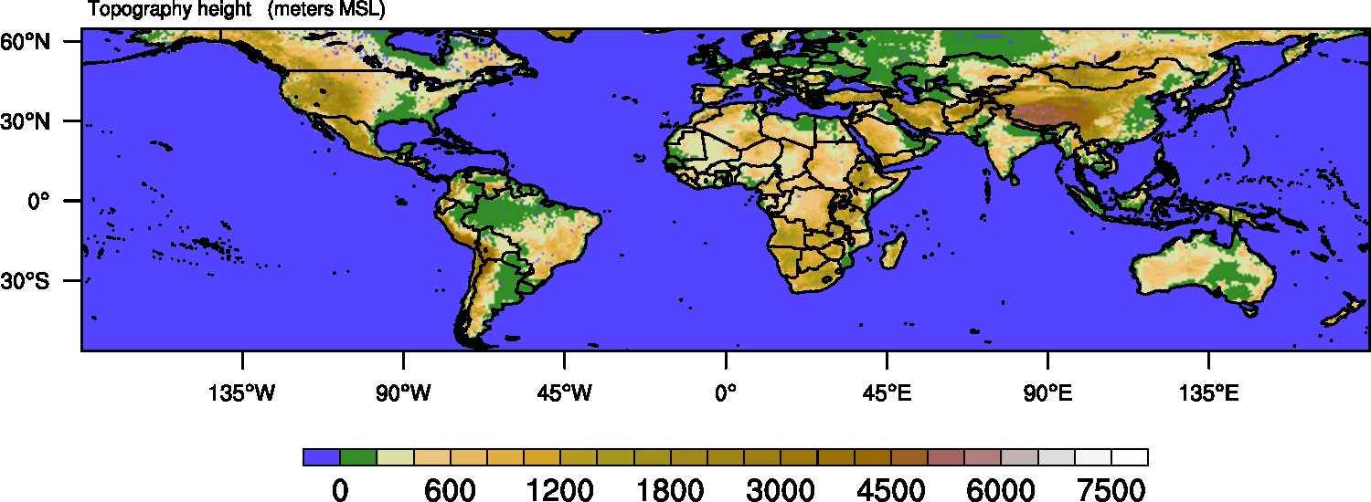
New Design
Exp. setup:
Convection-permitting resolution of 0.03°
12000*3000*57 ≈ 2⋅10⁹ grid cells up to model top at 10 hPa
15 levels up to 1500 m AGL
1-km WHSD soil texture, IGBP MODIS land cover
RRTMG radiation, YSU PBL, Morrison 2-moment microphysics
Forcing data from ECMWF analysis all 6 h
SST data from OSTIA project @ 6 km
Notes:
Outline is al follows:

Slide 23
IPM Integrated Forecast System for QPE and QPF
Boundaries (deterministic or ensemble prediction system)
Data of meteorological services and
research institutes
Convection permitting WRF-NOAH-MP model simulations of X^{b} with error covariance B
Model observation forward operators H(X)
Forward Operators
Forward Operators
Forward Operators
High frequency
Rapid Update Cycle (RUC)
Atmospheric obs.: - In-situ
- GPS ZTD and STD
- AMV
- Radar Doppler and reflectivity
- Lidar
- Polarimetric radar
- Passive rem. sens.
VAR or EnKF providing state vector Xª and analysis error covariance A
Observation vector Y with error covariance R
Soil-land-surface obs.: - Streamflow
- In-situ soil and veg.
- Hyperspectral obs.
Forecast or reanalysis ensemble, update of B
WRF-Var
WRF-Var
Verification and Calibration
(Streamflow DA: Warrach-Sagi and Wulfmeyer GMD 2012)
Notes:
Folie vorher aber größer
Nochmal die einzelnen Teile erklären, v.a. wo ist der Anfang!

Slide 24
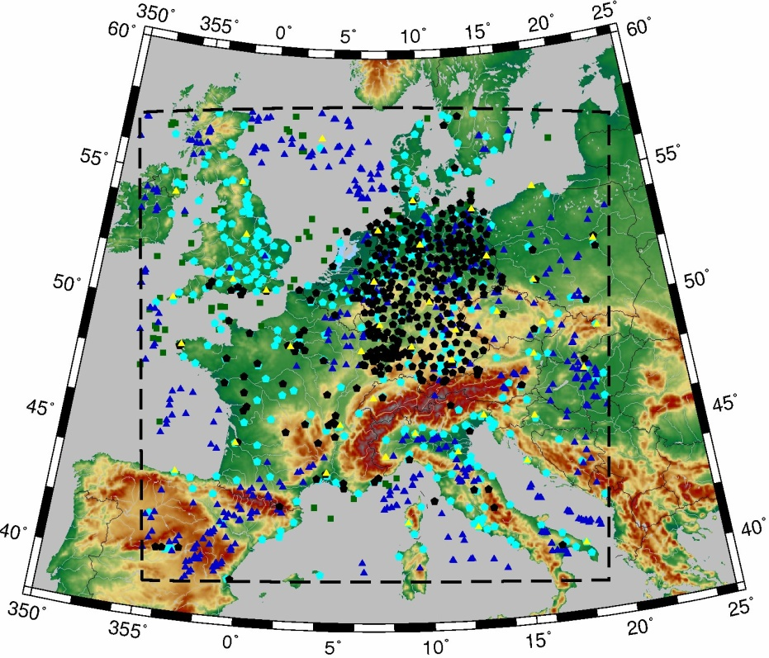
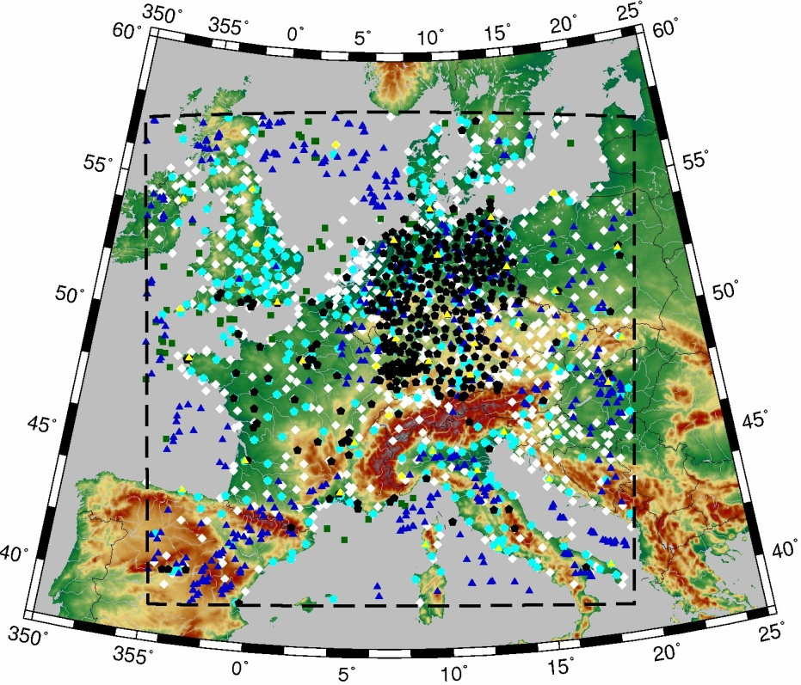
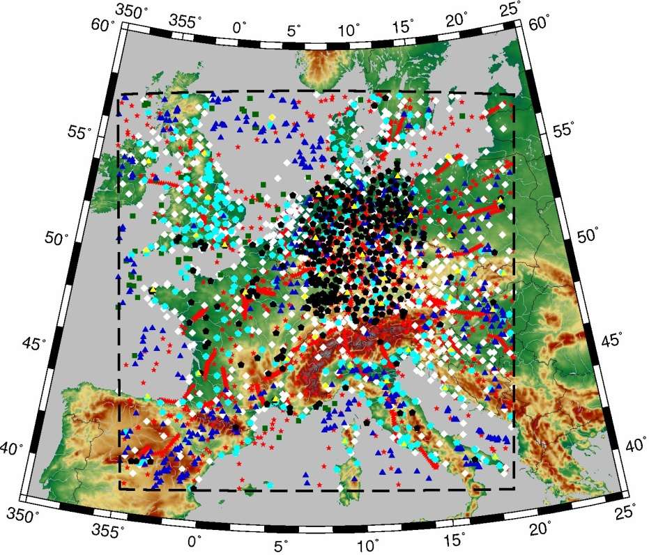
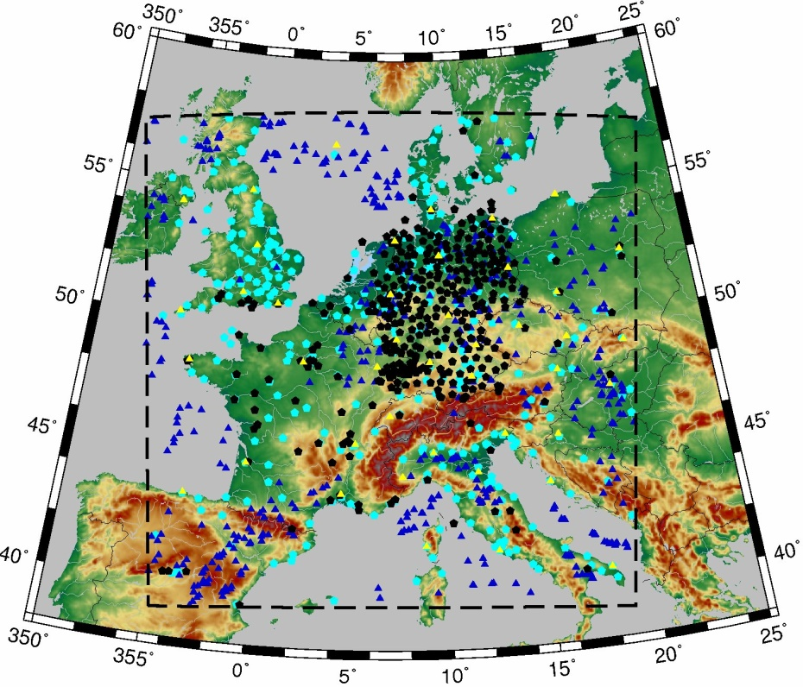
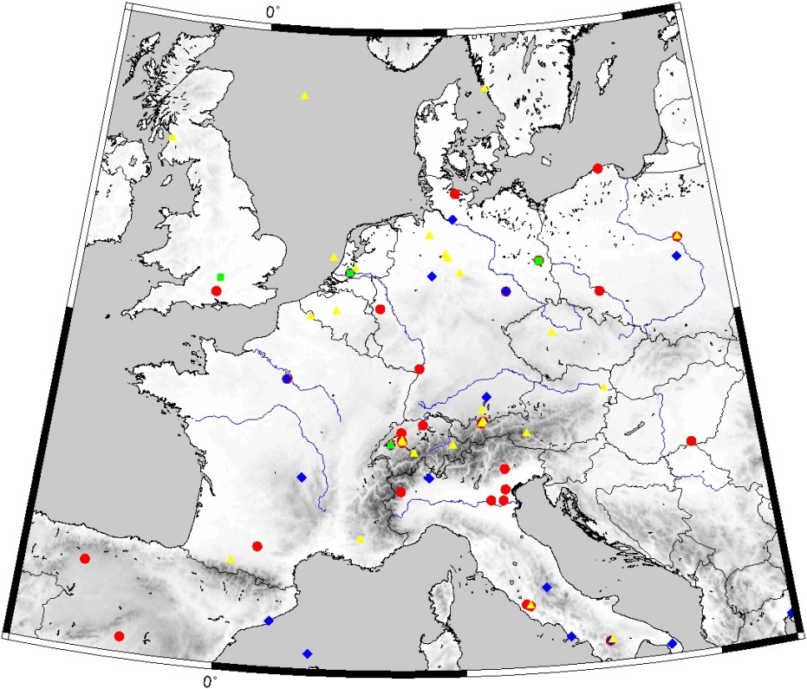
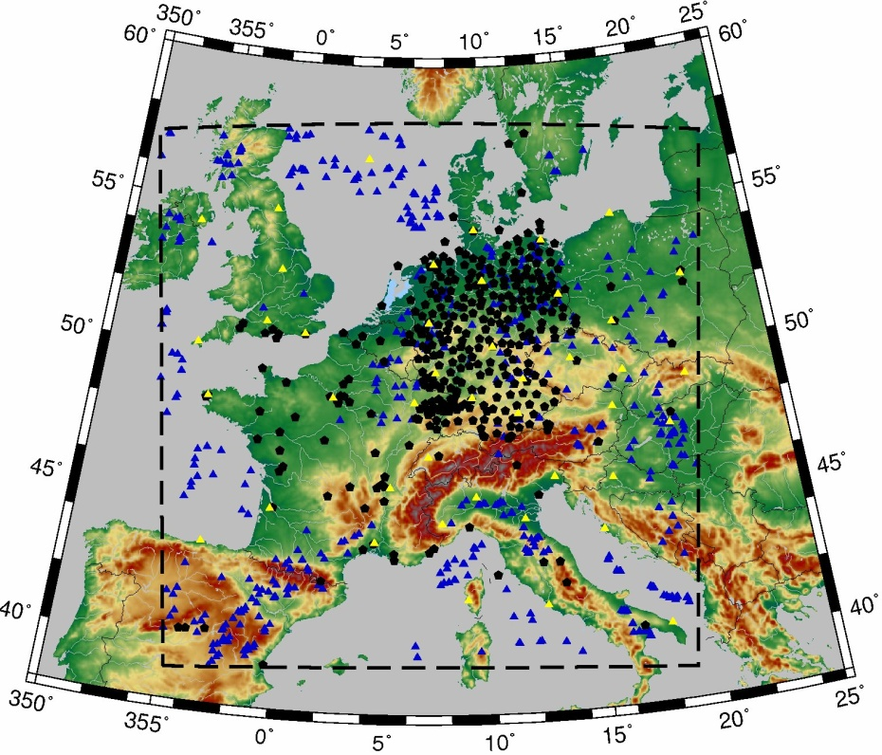
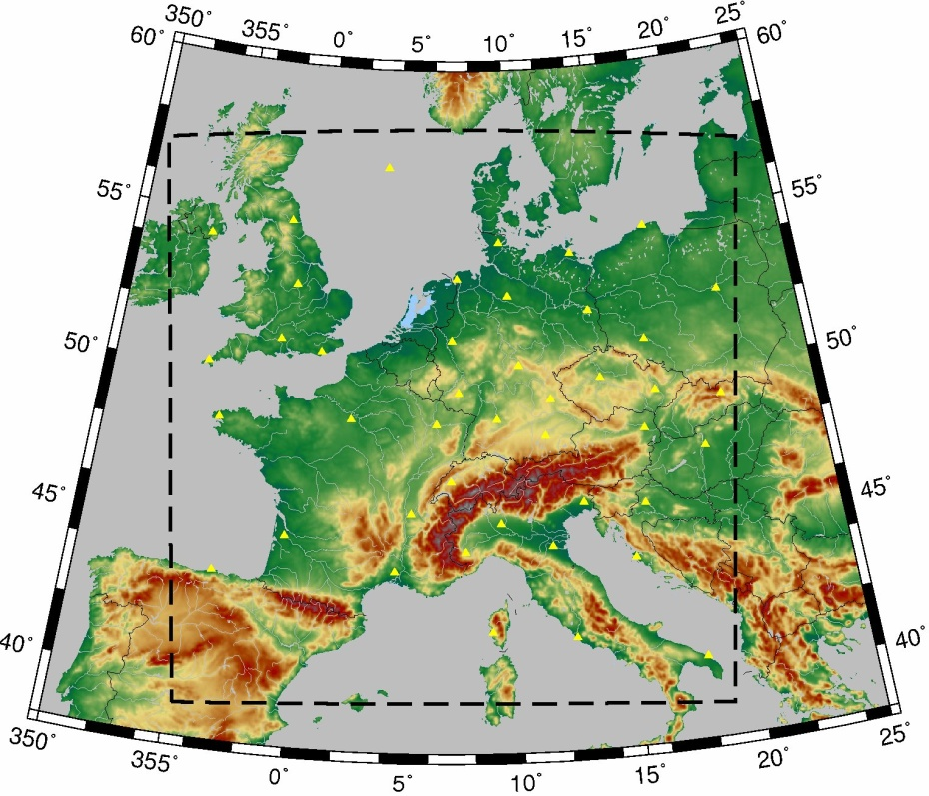
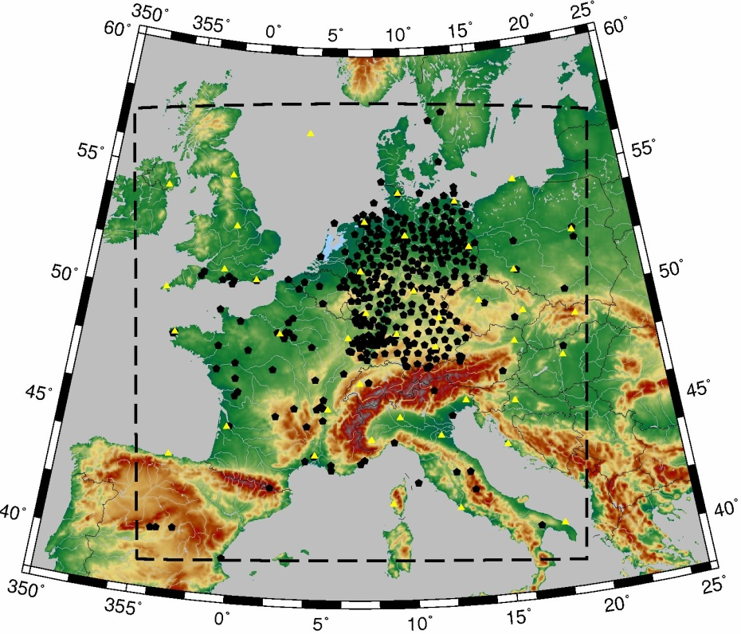
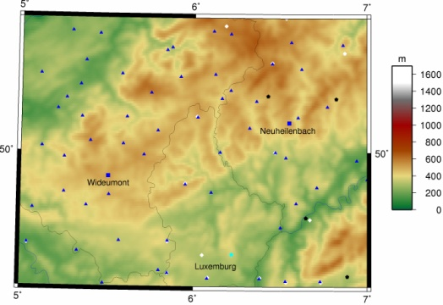
Obs. for QPE-QPF for (www.caos-project.de)
Yellow: Upper air soundings
Black: GPS Zenith Total Delay (ZTD)
Dark blue: atmospheric motion vectors
Light Blue: metar airport
Green: Ship reports
White: synop
Red: aircraft amdar, acars, airep
Black diamonds: Radar sites
Thermodyn. profiler sites (not assimilated):
Yellow triangles: NDACC profiler stations
Blue diamonds: EARLINET stations
Green squares: Observatories
Red circles: Microwave radiometers
3.6-km domain
Attert catchment
Huge gaps in T and WV profiles important constraint for radar impact
Thermodyn. environment not reflected by radar data
-> Important error source!
1-km domain,
200 km x 200 km
Germany
Belgium
Neuheilen-bach
Wideumont
Luxem-bourg
Notes:
How does our model perform with respect to the initial fields provided by data assimilation.
For this purpose, we studied the QPE performance.
For the assimilation we used the following data set.
No profilers assimilated, no impact expected due to low density.
Looks impressive but huge data gaps on mesoscale dynamics and thermodynamics.
Hard time for us on this catchment scale.

Slide 25
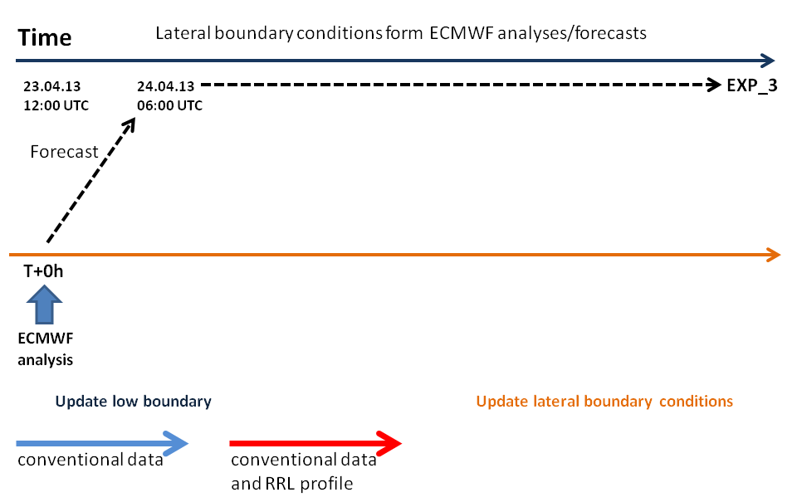
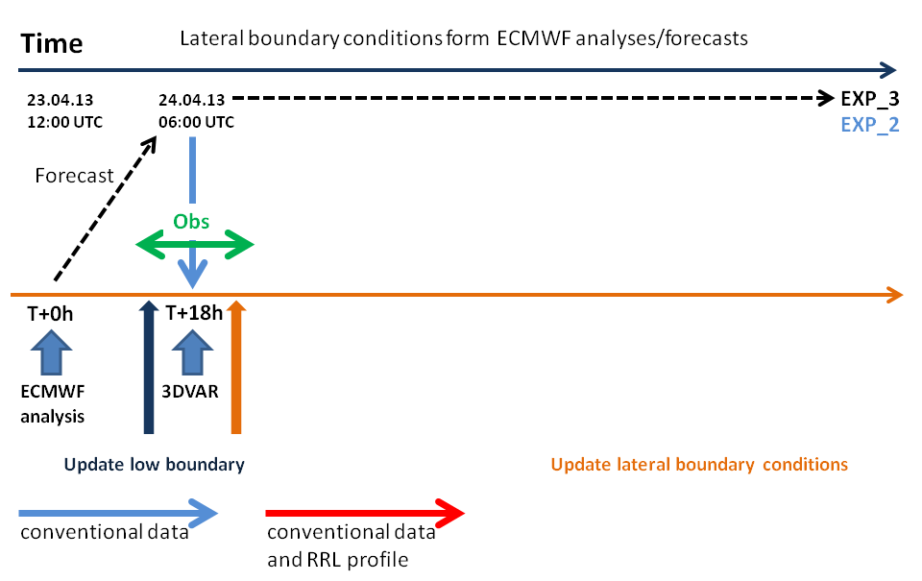
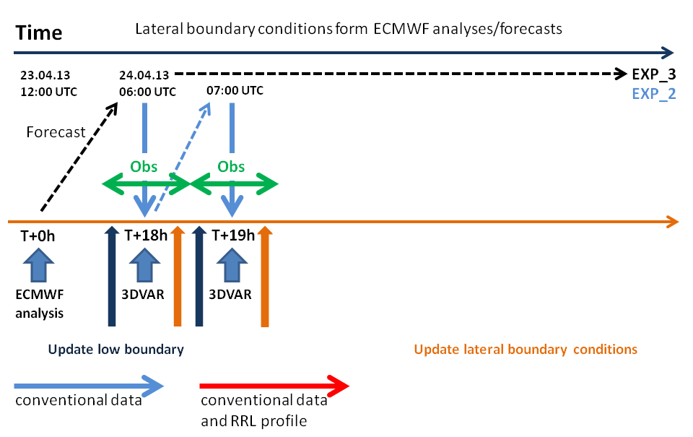
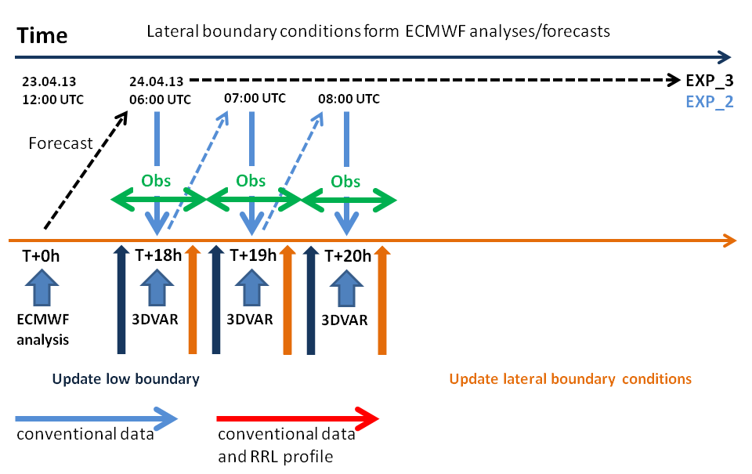
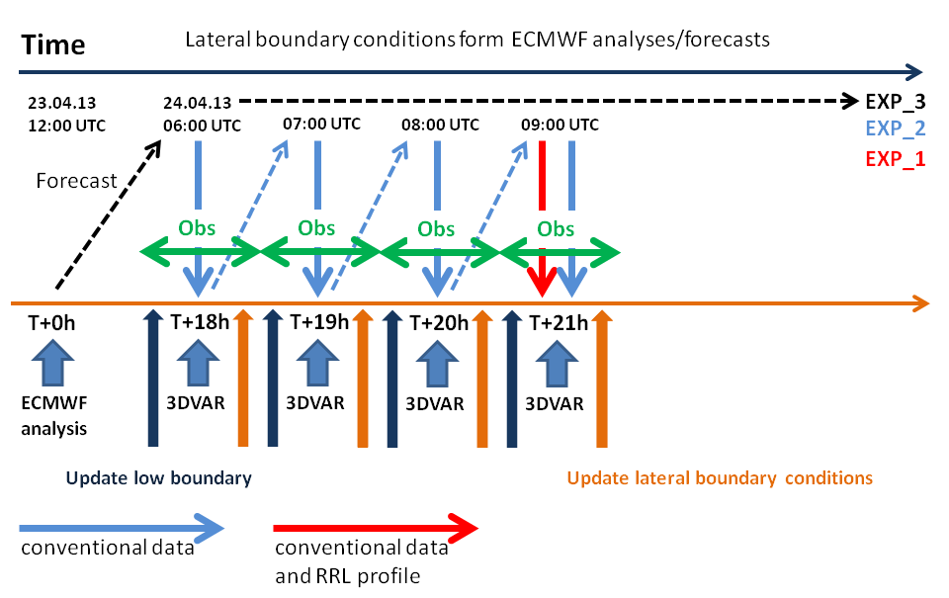
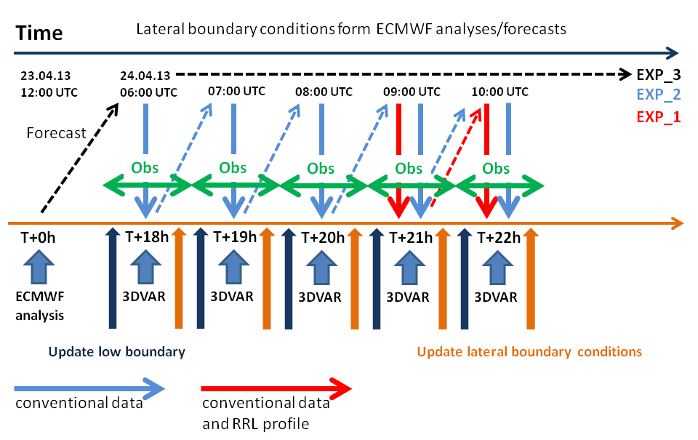
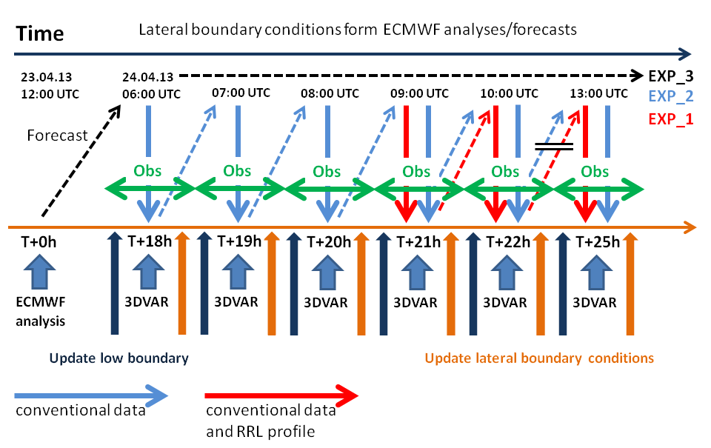
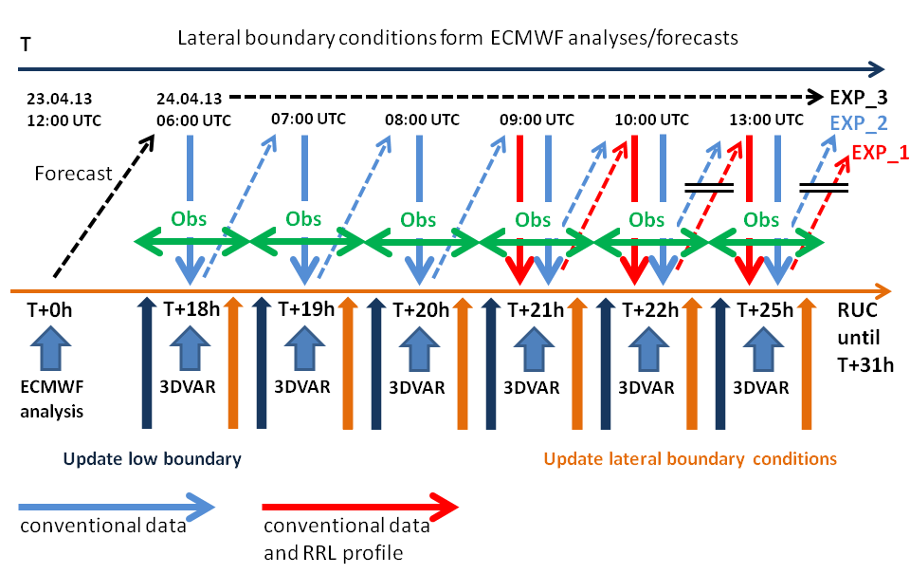
Rapid Update Cycle

Slide 26
Impact of the TRRL Data Assimilation on ABL Structure, Depth, and Inversion Strength
Adam et al. ILRC 2015, Adam et al. In preparation for publication in QJRMS, 2016.
TRRL DA corrects the ABL depth z_{i} .
The inversion strength is also improved.

Slide 27
Understanding LA Feedback. Example: Latent Heat
Temperature profile
Latent heat flux profiles
Free atmosphere
Entrainment layer (EL)
Entrainment flux
Flux divergence
Moisture tendency equation
ABL
Mixed layer (ML)
Atmospheric stability
Surface layer (SL)
Horizontal wind
Energy balance closure (EBC)
Soil and canopy temperature
Canopy and aerodyn. resistance, photosynthesis
Soil and canopy water content evolution
LA feedback is the result of a two-way interaction of land system variables.
Notes:
How can be understand the importance of SA feedback?
Example LH flux at the surface:
The LH is nothing than the eddy covariance between w’ and q’
This is parameterized by the turbulent diffusion equation and correspondingly by the bulk exchange equation
These parameterizations are part of all model systems
In modern LS models, this equation is considered separately for the canopy and the upper soil layer.
Consequently, for understanding of LA feedback, processes in the soil, the canopy, the atmospheric surface layer, and the ABL including entrainment must be observed, simultaneously.
How can we address this challenge?
In a nutshell, we are striving to improve process understanding and model physics by combining holistic 3D observational data on the land system.

Slide 28
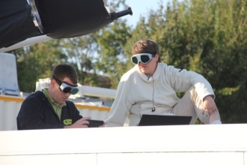
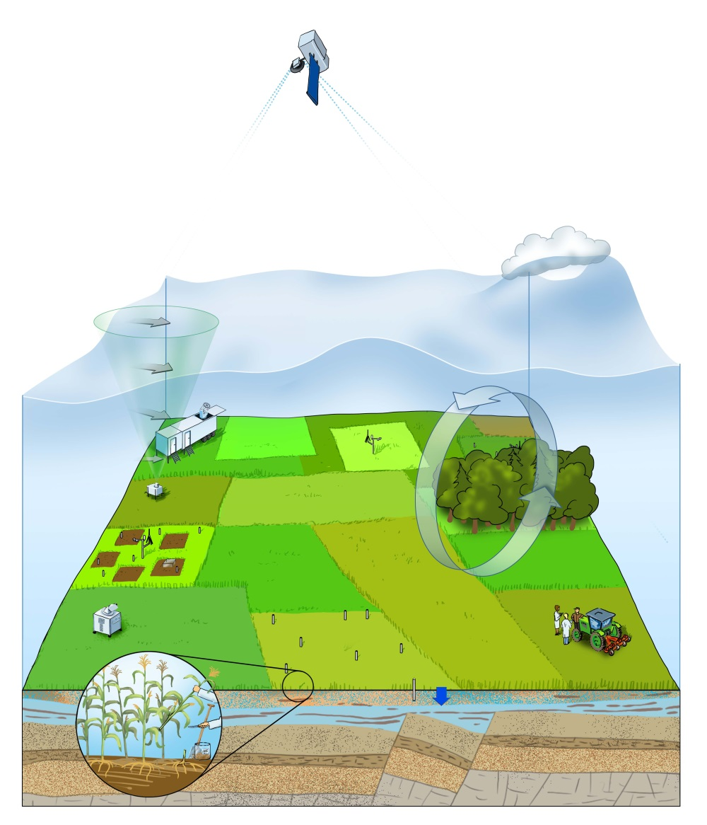
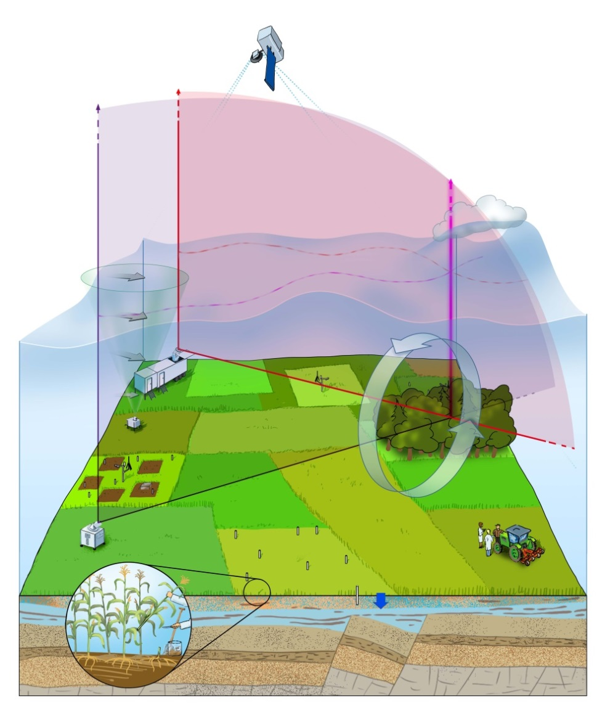
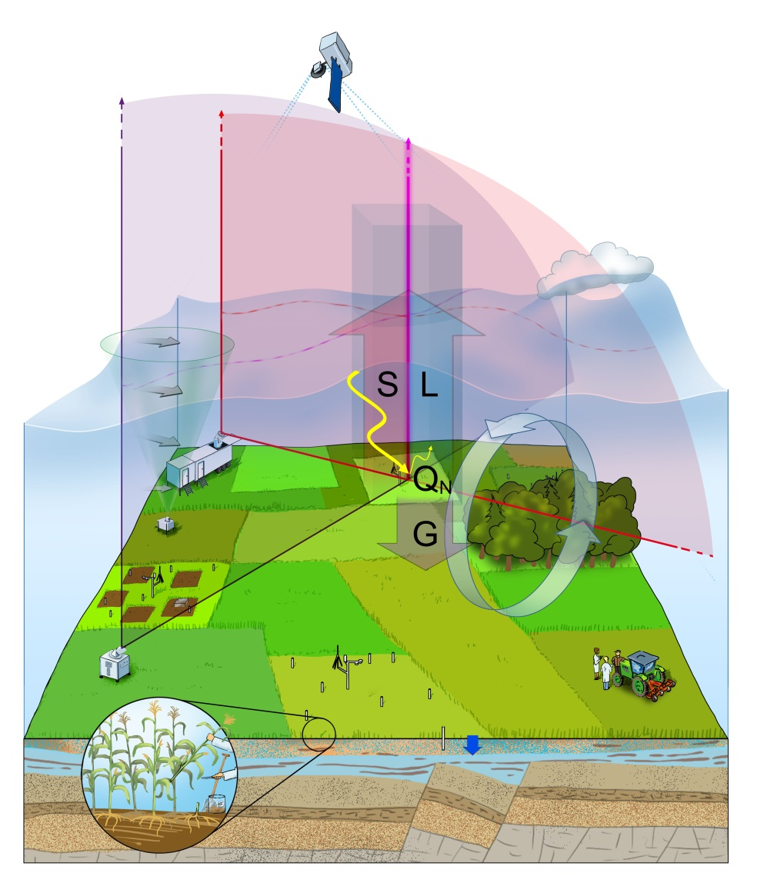
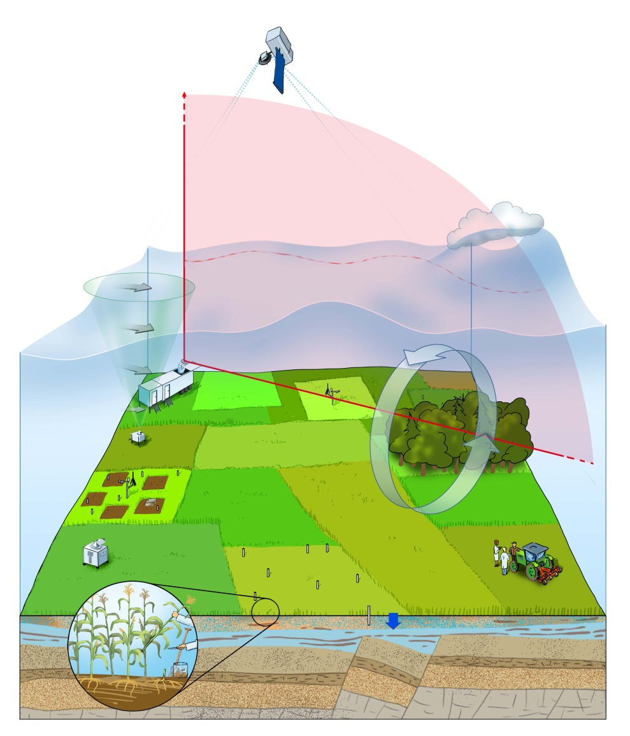
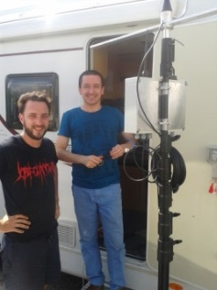
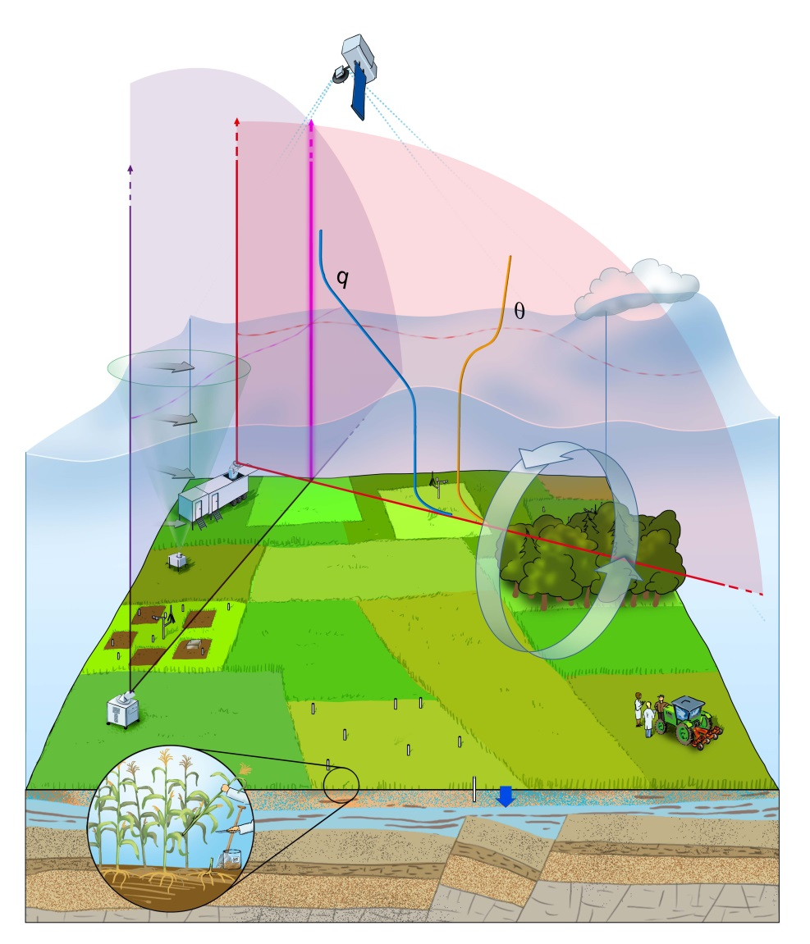
Sensor Synergy within the Surface-Atmospheric Boundary Layer Experiment (SABLE), August 2014
$${\overline{T^{′}w′}}_{E}$$
$${\overline{q^{′}w′}}_{E}$$
$$\overline{{q′}^{2}}$$
$$q(x,z)$$
$$\overline{{w′}^{2}}$$
$$\overline{{T′}^{2}}$$
T$(x,z)$
$$\vec{\text{V}}(z)$$
ABL top
Scanning Doppler, CO₂, WV and T lidars (LMD, IPM)
Surface energy balance measurements
$$u^{∗}$$
$$S,L$$
Scanning Doppler lidar (KIT, Leosphere)
Mesoscale vortex
LAI, albedo (UHOH)
Soil moisture network (UFZ, UHOH)
See DFG Research Unit 1695 klimawandel.uni-hohenheim.de
New generation of LSA experiments in preparation at different sites. Now it is possible to measure LS and entrainment fluxes simultaneously.
Notes:
Combine with surface flux measurements and measurements of heteorogeneity

Slide 29
5) Series of Comparisons with Radio Soundings
DIAL: 20 min, 130-300 m
Späth et al. ACP 2014

Slide 30
Measurements of Fluctuations with High SNR
Courtesy: Matthias Mauder, KIT
Resolutions: 10 s, 50 m
The data will be exploited to analyze turbulent moments up to the forth order and fluxes.
Notes:
Also in presence of clouds (detrainment, entrainment)

Slide 31
ABL Profiling During HOPE, April 24, 2013, 11-12 UTC
Proposed similarity relationship (Turner et al. JGR 2014, Wulfmeyer et al. JAS 2015):
Convective velocity scale
Moisture gradient
Brunt-Vaisala frequency
Gradient Richardson number
YSU non-local TP (Hong and Dudhia MWR 2006):
Behrendt et al. ACP 2015, Muppa et al. BLM 2015
First lidar profiling of temperature variance and sensible heat flux. For process studies, model verification, and advancing turbulence parameterizations, simul-taneous measurements of fluxes and gradients of T, WV, and wind are essential.

Slide 32
Ensemble Simulation of Humidity Using Various Turbulence Parameterization Schemes: TR32, Sept. 8, 2009, Jülich, Germany
2-km WRF-NOAH:
DIAL
YSU
QNSE
MYNN 2.5
MYJ
ACM2
2-km WRF-NOAH:
YSU-NOAHMP
YSU-NOAH
MYNN-NOAHMP
MYNN-NOAH
Milovac et al. JGR 2015, in review
ABL too deep in all cases. Variability of the order of 1 g/m³. Strong sensitivity on both LS-schemes and turbulence parameterizations.
Notes:
Also gradients and fluxes are different
Necessary to study also surface flux variability and heterogeneity

Slide 33
ABL Evolutions, Sept. 8, 2009, Jülich, Germany
Notes:
In the clear ABL most important challenges:
Stable ABL
Nightime-daytime transition
Afternoon transition
CBL with clouds

Slide 34
The Impact of ABL Parameterization on the Evolution of Clouds and Precipitation
WRF-NOAH 3.5.1 configuration:
PARAMETERI-ZATION | SWITCHES
Microphysics | Morrison 2-moment
Radiation | RRTMG
PBL & surface layer | ACM2 + Revised MM5 MYJ + ETA similarity MYNN+ Revised MM5 YSU+ Revised MM5
89 full σ levels (20 levels in the first 2200 m)
Run performed in the NWP mode
Simulation period: 22. 08. – 15. 09. 2009
3 months spinup
Milovac et al. JGR 2015, submitted
Strong influence of ABL turbulence parameterization on the 2D structure of clouds and precipitation as well as on QPF.
Notes:
As Aristotle stated: „A system is more than the sum of its pieces“.
This becomes very clear when you look at a system as complex as the land system.
The land system consists of the compartments soil, vegetation, atmosphere including anthropogenic influences.
It is controlled by
the soil moisture and textures,
Human activities changing the state of the soil and the land-cover (3, LAI, albedo),
The system is driven by the radiation (4) causing a specific EBC (5),
The variability of the fluxes in combination with entrainment results in a specific horizontal and vertical distribution of the ABL,
This influences the vertical stability and by horizontal temperature gradients the horizontal transport of air masses
This can lead to the development of convergence lines and clouds and precipitation.
Different regimes:
- radiation driven
- soil moisture limited
How do models meet this enormous challenge to simulate the land system?

