Slide 1

WMO Hydrological Observig System
in
WIGOS
Silvano Pecora, ARPAE, Italy
Commission for Hydrology (CHy)
Workshop on the Vision for WIGOS in 2040
Surface-based perspective
WMO, Geneva. 18-20 October 2016

Slide 2
WMO Hydrological Observing System (WHOS)
Background:
No analogue to World Weather Watch within hydrology.
No portal to real-time hydrological data of NHSs, or direct online access to NHS historical data.
WHYCOS is capacity building, not data delivery.
Given increasing number of NHSs with real-time and
historical data available online, as well as systems that facilitate data exchange and interoperability (e.g., WaterML 2.0), improved accessibility is achievable goal.

Slide 3
WMO Hydrological Observing System (WHOS)
A WMO Hydrological Observing System (WHOS) was proposed and agreed by the CHy Advisory Working Group as the means to provide the most comprehensive hydrological component in fulfillment of the WIGOS objective of “an integrated, comprehensive, and coordinated system which is comprised of the present WMO global observing systems.”
WHOS is conceived as a portal to facilitate access to already available on-line real-time and historical data, drawing from the water information systems of countries around the world that make their data freely and openly available, including HYCOS projects.

Slide 4
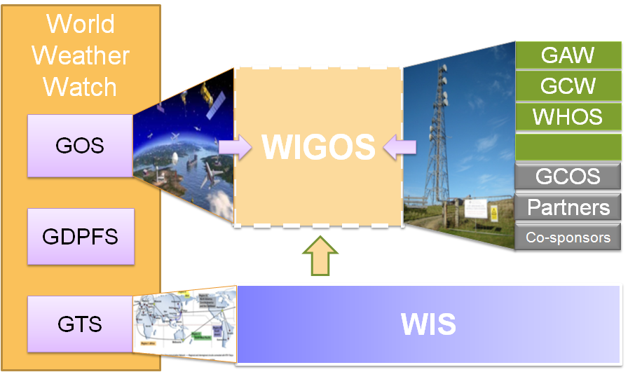
WMO INTEGRATED GLOBAL OBSERVING SYSTEM (WIGOS) and
WMO HYDROLOGICAL OBSERVING SYSTEM (WHOS)
In June 2015 the President of CHy informed Cg-17 of CHy proposal to develop WHOS as the CHy contribution to WIGOS
  Congress welcomed the effort and urged the president of CHy to continue guiding WHOS to full implementation
  Congress urged the promotion of WHOS among NHSs and the hydrological community

Slide 5
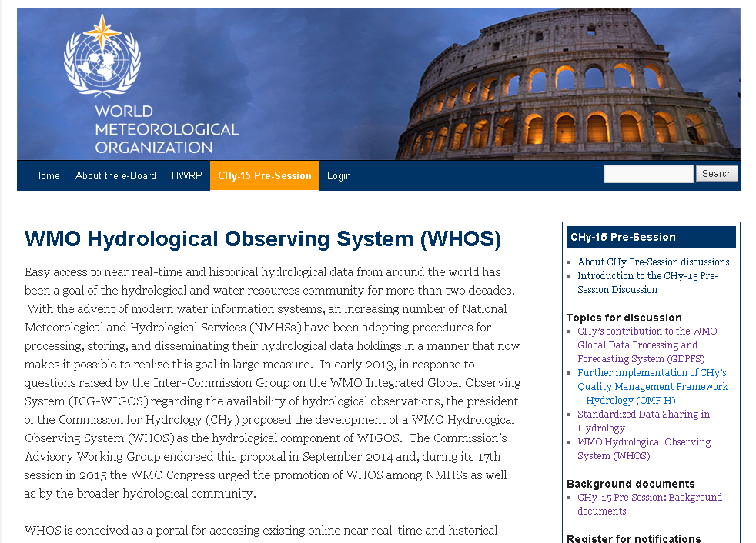
WMO CHy-15 pre-session discussion

Slide 6
WMO Hydrological Observing System (WHOS)
Implementation:
Phase 1:
Map interface with links to those NHSs that make their real-time and historical stage and discharge data available online. implemented in August 2015.
Phase 2:
A fully WIS/WIGOS compliant services-oriented framework linking hydrologic data providers and users through a hydrologic information system enabling data registration, data discovery, and data access.
Beta version for CHy-15 review and endorsement (Dec 2016)
Initial implementation for EC approval (June 2018)

Slide 7
WHOS PHASE 1

Slide 8
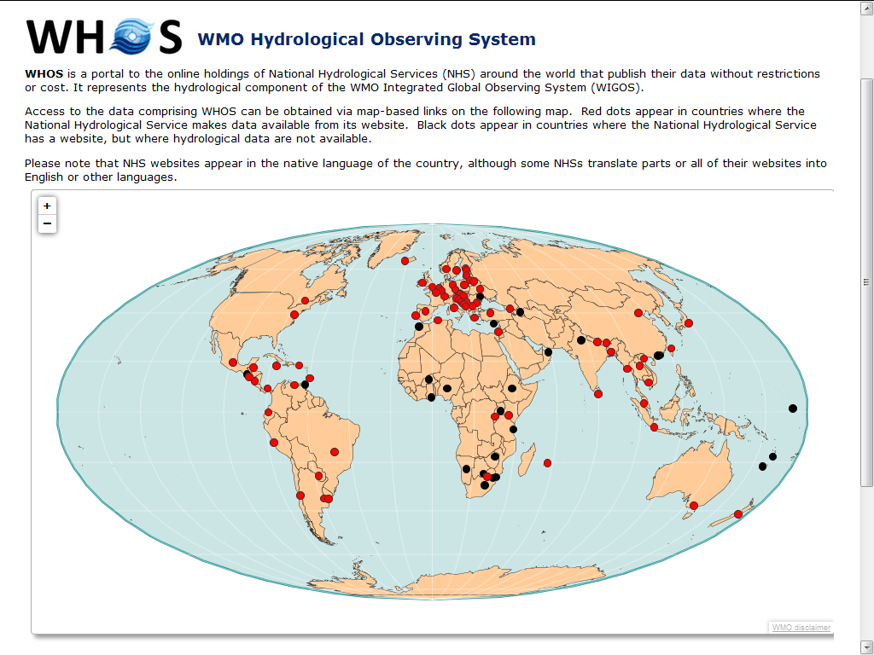
http://www.wmo.int/pages/prog/hwrp/chy/whos/index.php

Slide 9
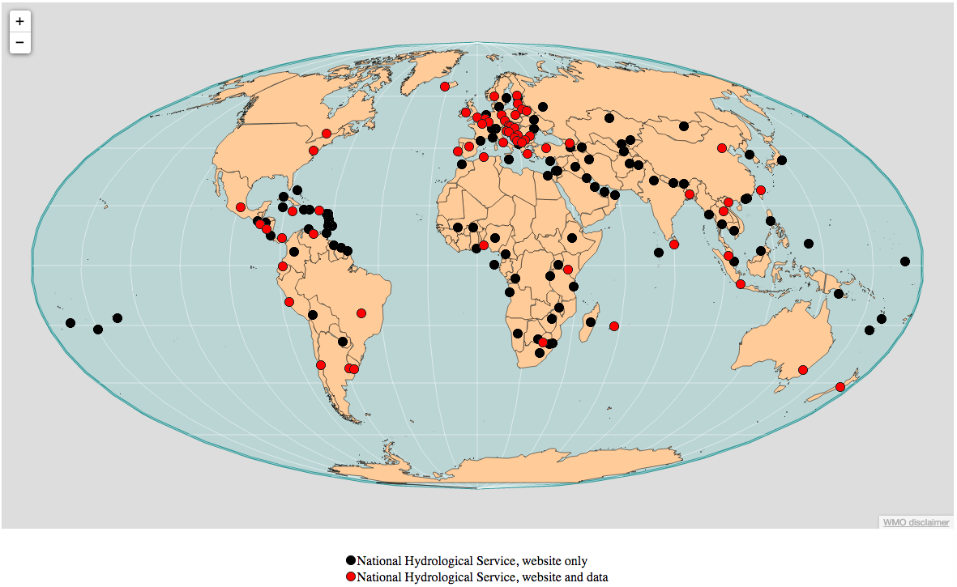
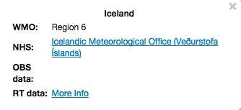
WMO Hydrological Observing System (WHOS)
Phase 1 -- WorldWide Map Portal
http://www.wmo.int/pages/prog/hwrp/chy/whos/

Slide 10
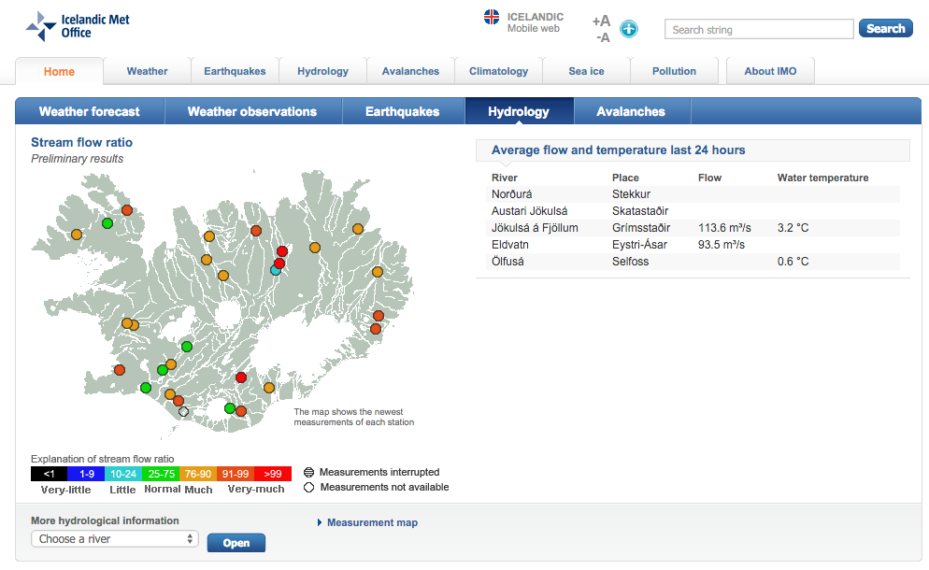
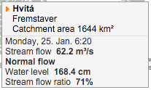

Slide 11
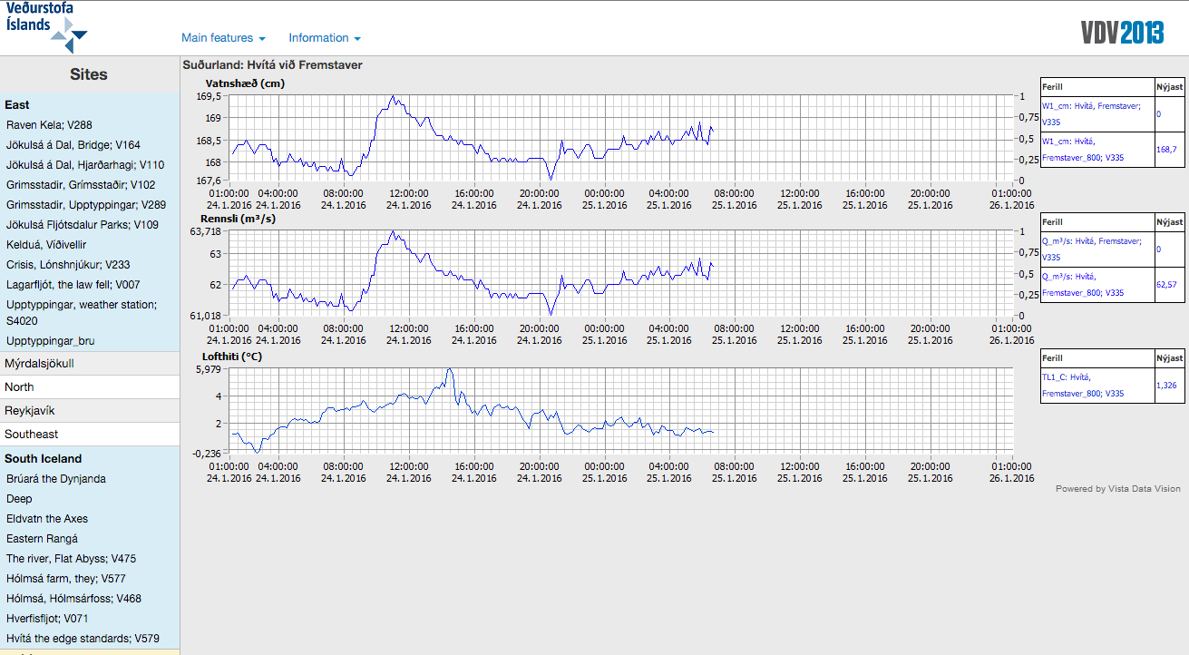

Slide 12
WHOS PHASE 2

Slide 13
The Road Further Ahead in Hydrology
Using WMO and OGC Standards
HydroCatalog
(register)
CSW
HydroProvider
WFS
SOS2
(WaterML 2)
HydroClient

Slide 14
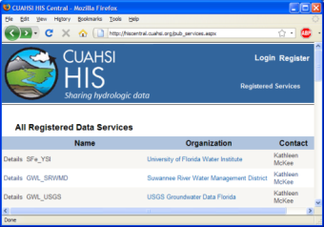
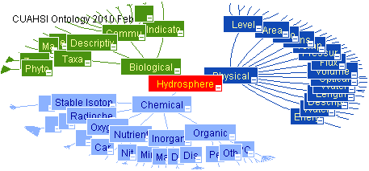
HIS System Overview
USGS
HIS Central
Metadata
Catalog
Data
Web
Service
HIS Central
Hydrologic Ontology
Data
Registration
NHS
Data
Data Access
Data Discovery
HydroServers
Users
(HydroDesktop)

Slide 15
WaterML2 and SOS2
EPA
Locations
GetSites
GetSiteInfo
GetVariableInfo
GetValues
Data
Variables
UT
Date Ranges
USGS
Data
Data
WaterML2
Data
Repositories
SOS2
Web Service
Client
TRANSFORM
EXTRACT
LOAD
SOS2 is how you ask for data
WaterML2 is the format of what comes back

Slide 16
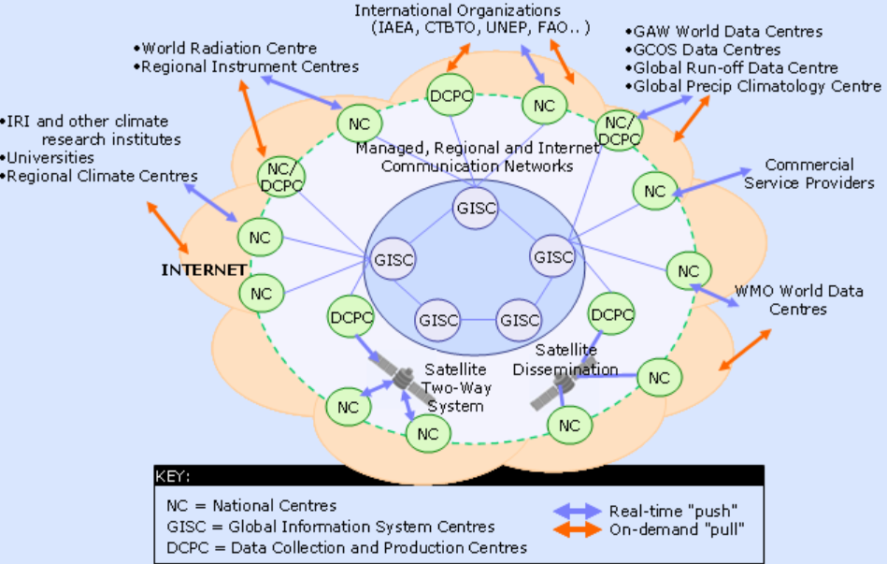


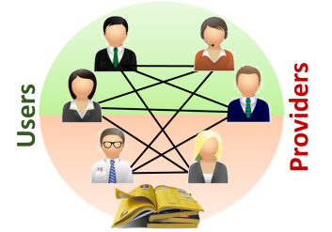
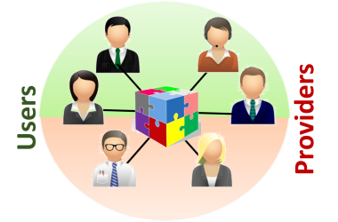
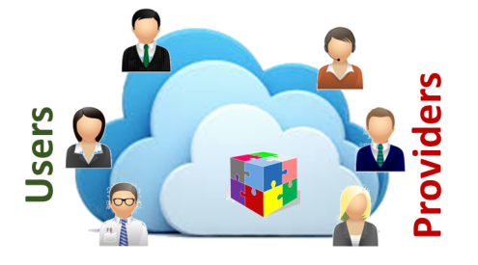

Hydrologic data exchange revolutions
2012
2014
2017
2020
1st Revolution
2nd Revolution
[Service driven]
Catalog of catalogs
3rd Revolution
[Brokering pattern]
Brokering framework
4th Revolution
[Big Data]
Cloud-based architecture
[… .]
… .
Discovery
Discovery and Access
[functionality]
(re-)Use
[functionality]
[functionality]

Slide 17
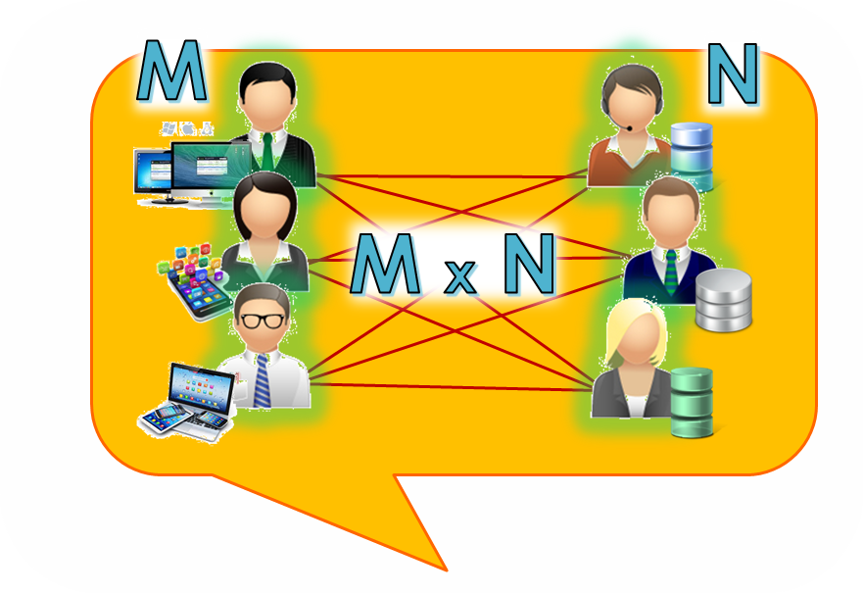
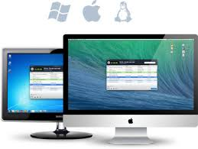







Virtual Community Approach
Service Providers
Service Users
Data Applications
Data Infrastructures
Virtual-Collaborative
Management approach
Registry
[Governance]

Slide 18
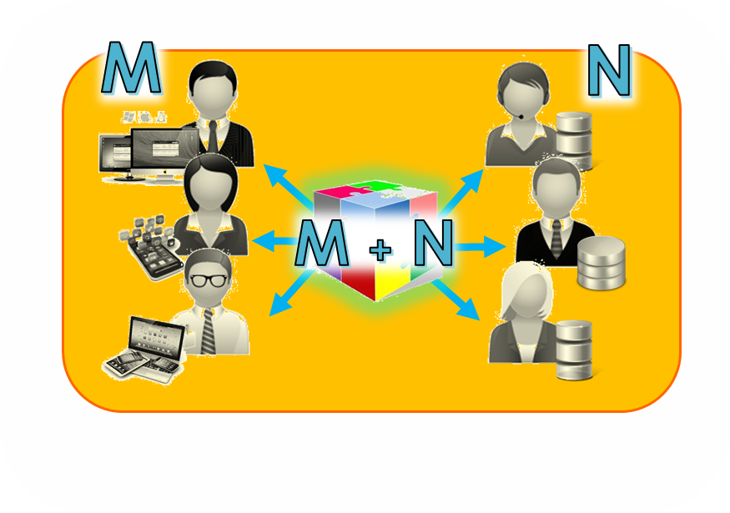


Broker Approach
Service Providers
Service Users
Data Infrastructures
Data Applications
Mediation
Mediation
Mediation
Mediation
Collaborative-Acknowledged
Management approach
Mediation
Mediation
[Governance]

Slide 19
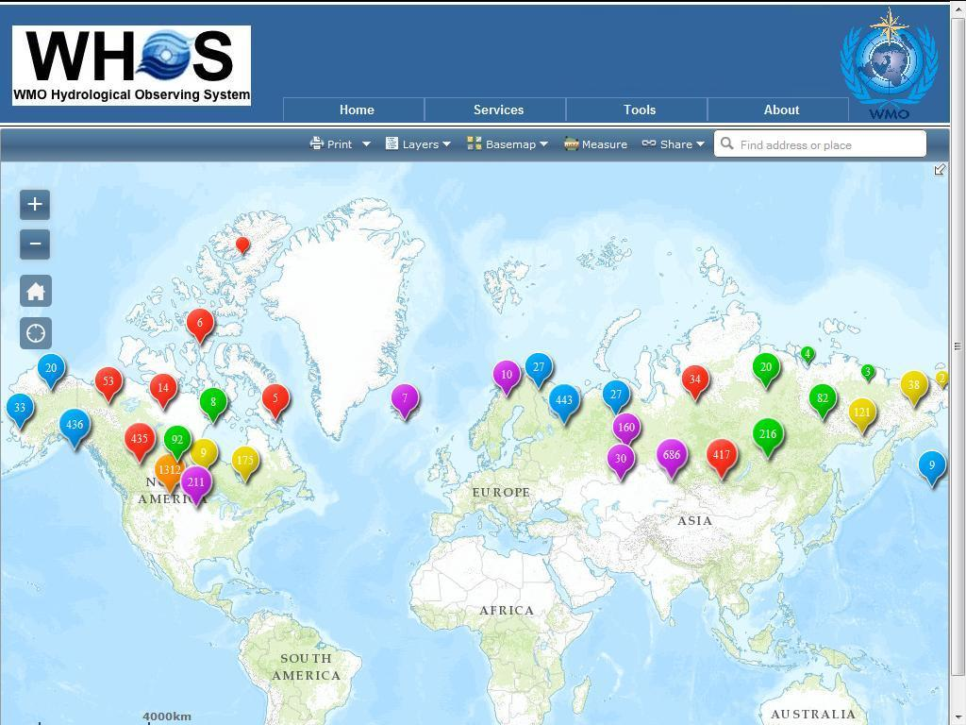
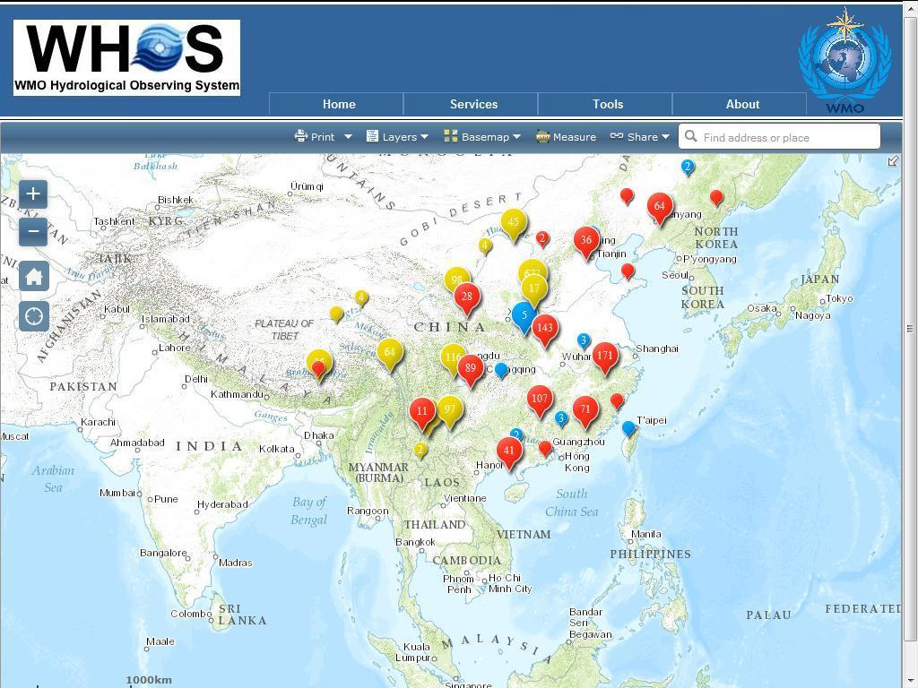
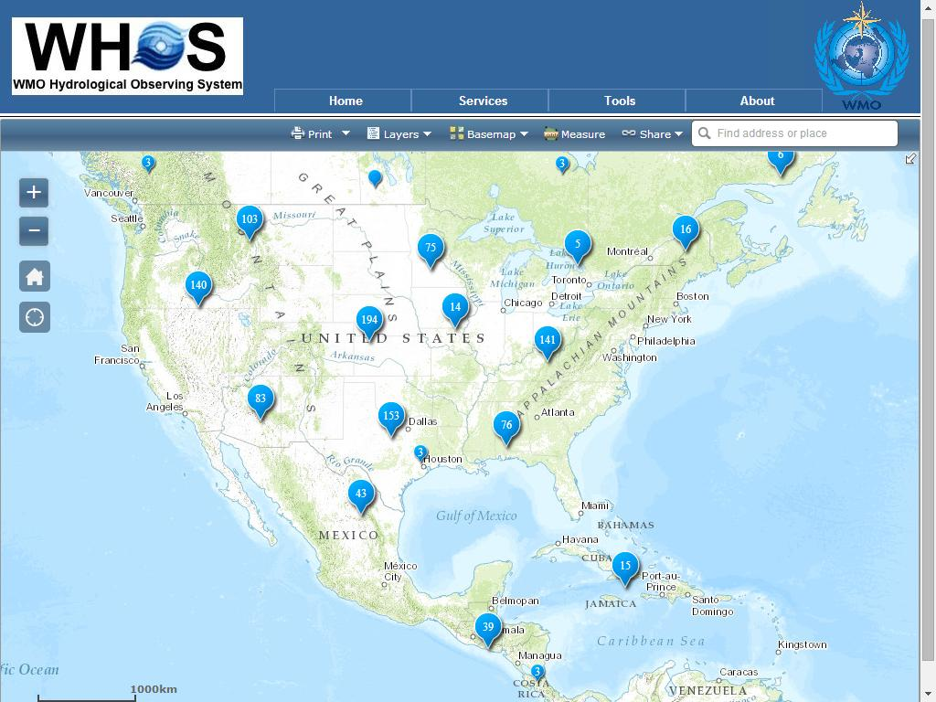
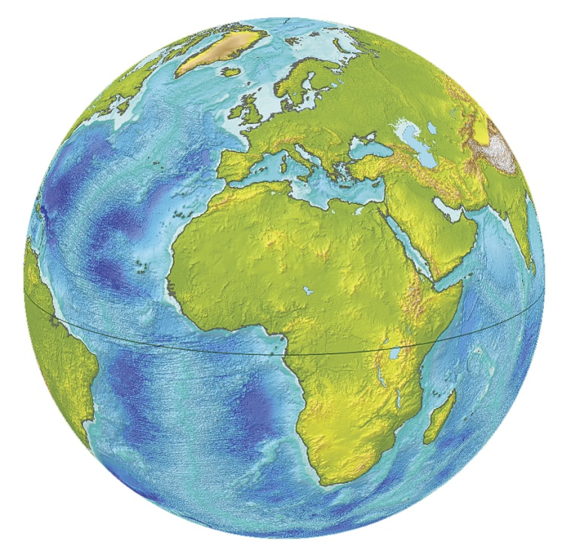
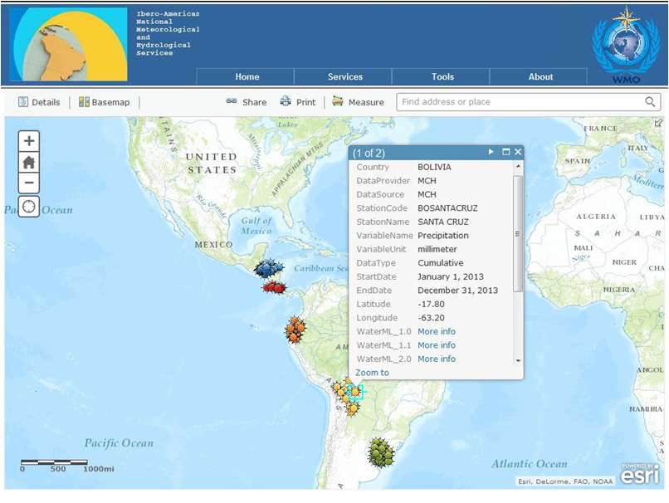
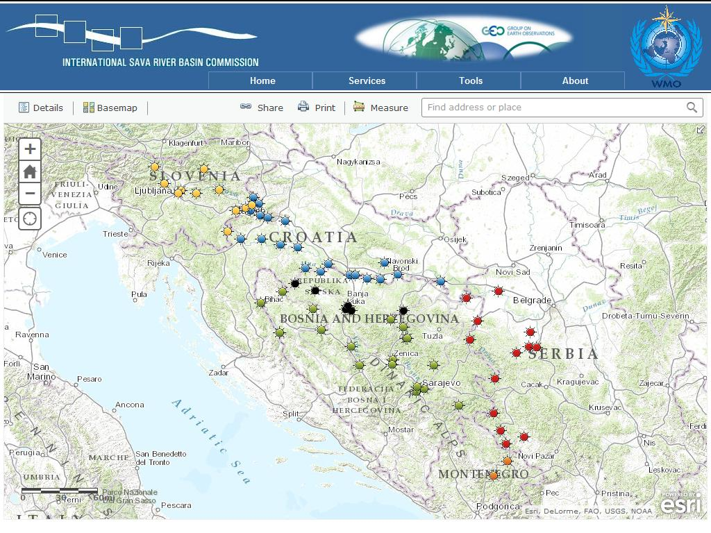
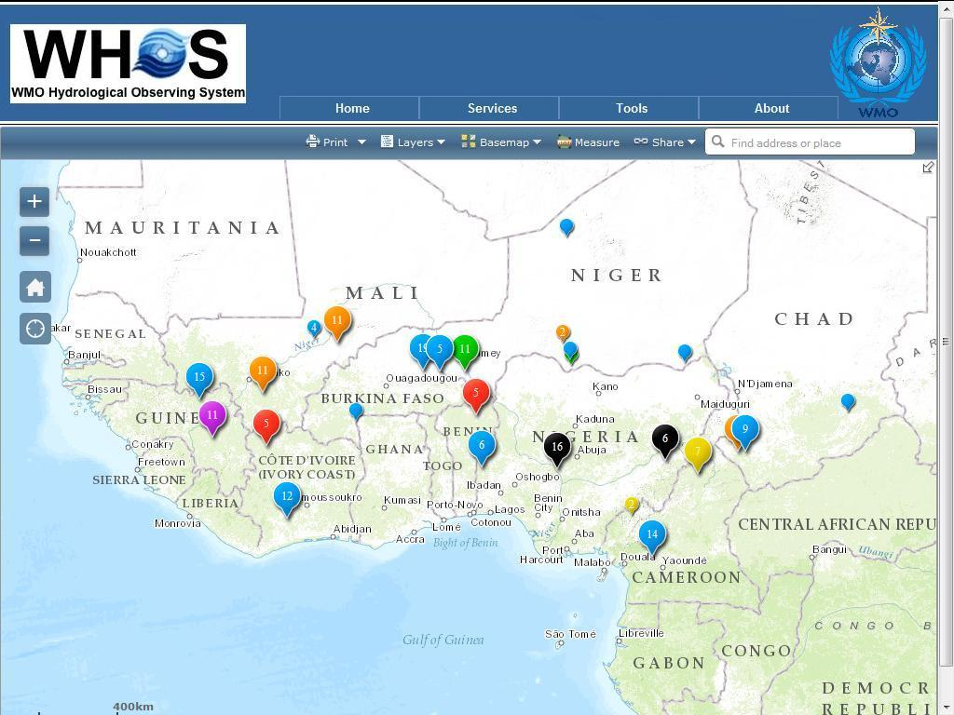
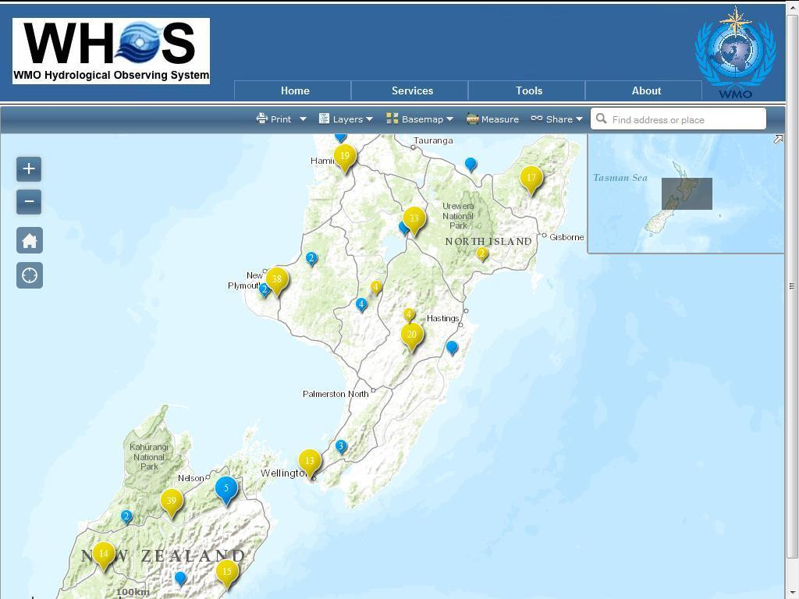
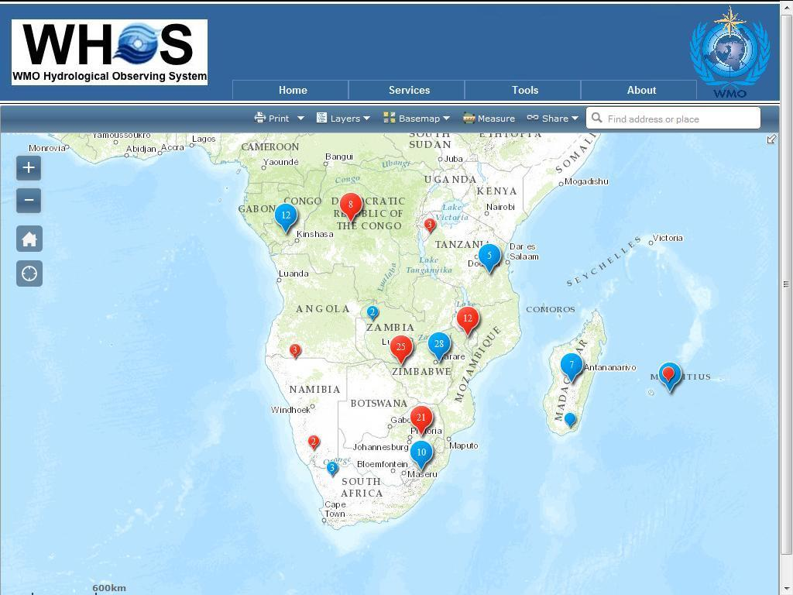
DEMONSTRATIONS ON HYDROLOGIC DATA EXCHANGE

Slide 20
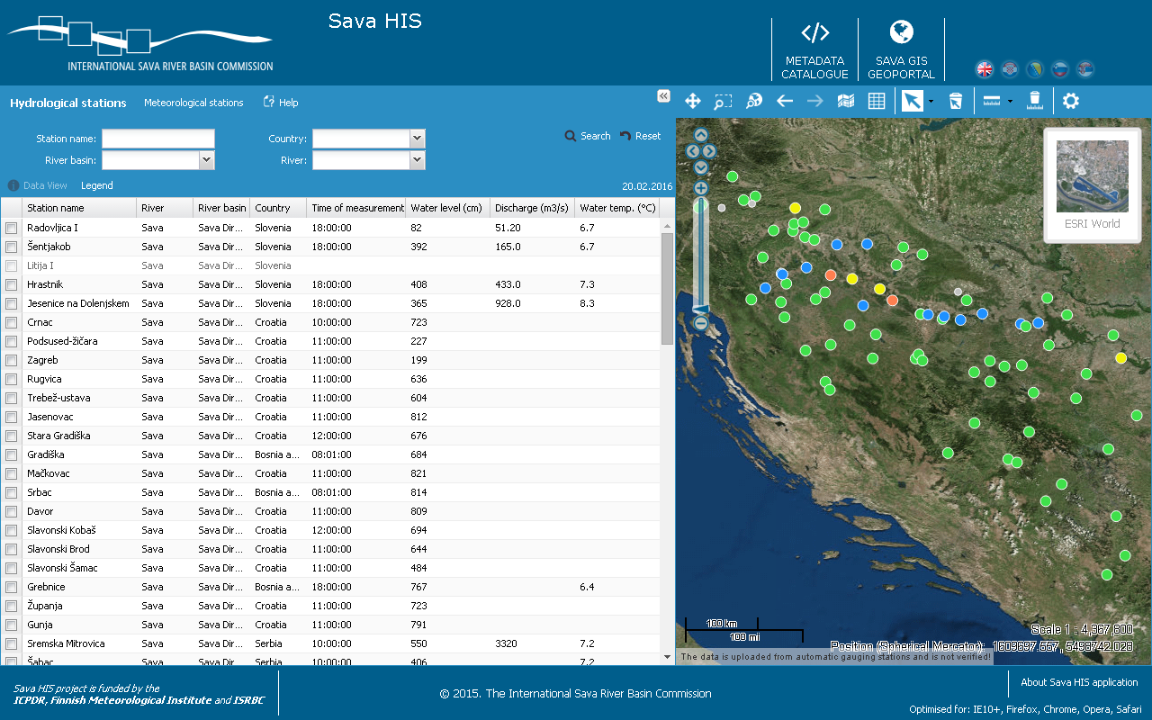
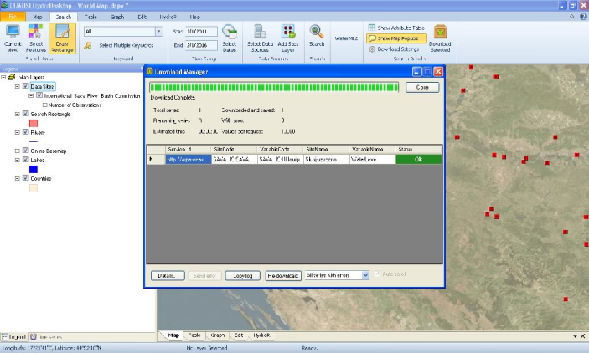
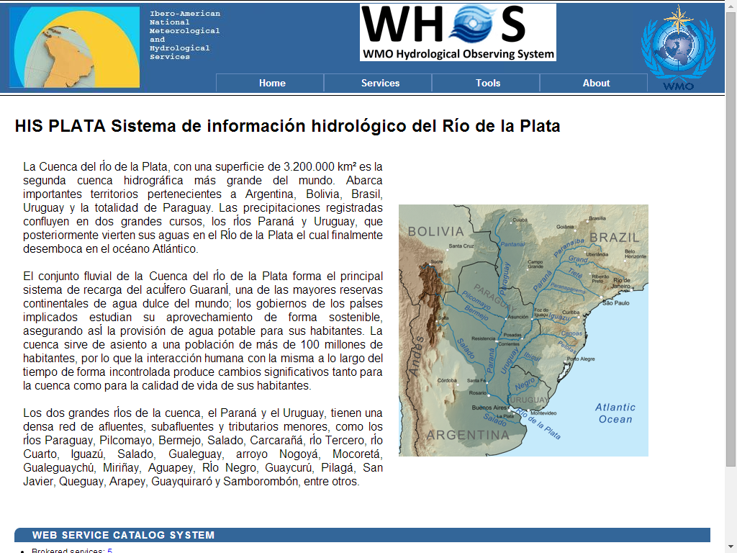
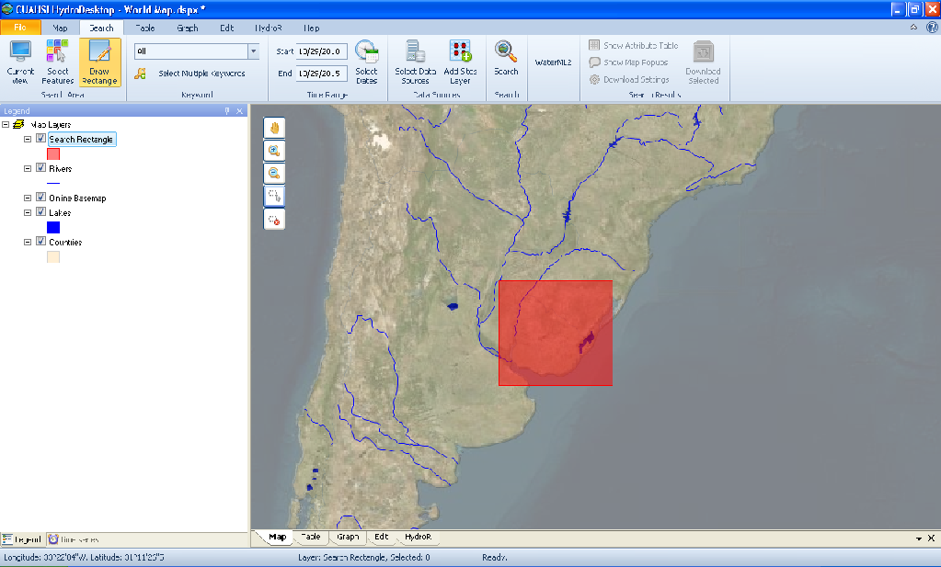
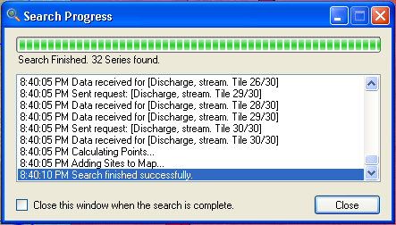
FROM DEMONSTRATIONS TO OPERATIONAL SYSTEMS
The Sava HIS
The Plata HIS

Slide 21
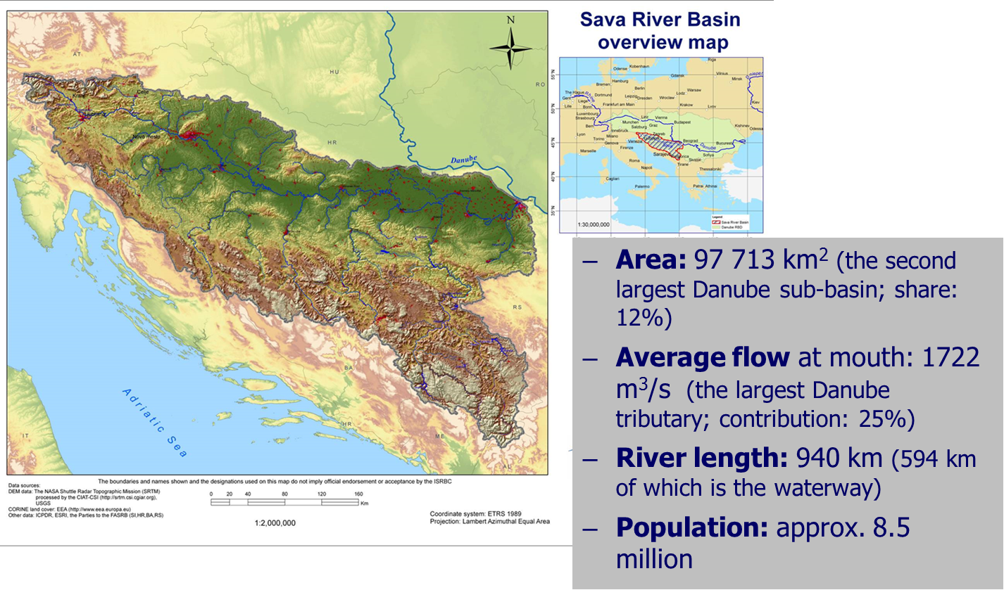
The SAVA River Basin
Geographic area :

Slide 22

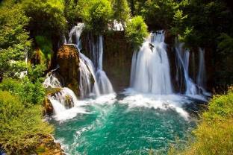
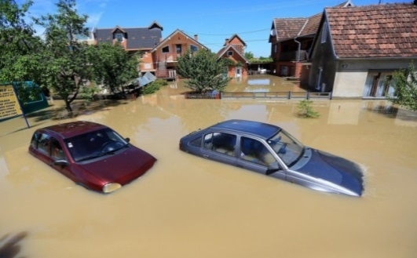
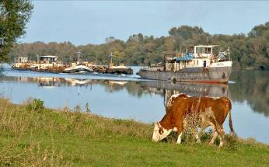
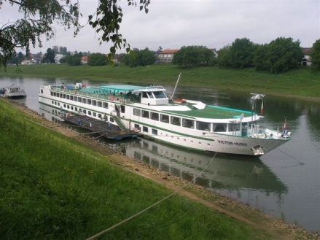
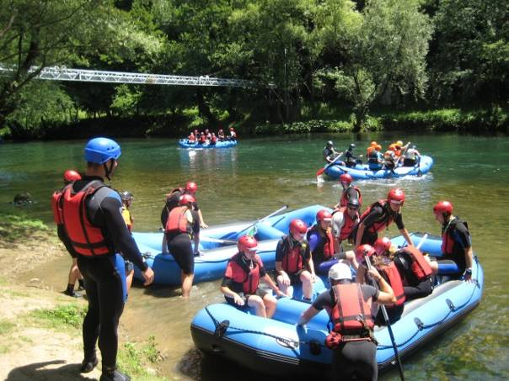
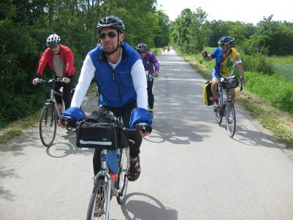
International Sava River Basin Commission
Scope of cooperation
Management plans
(river basin, flood risk, sediment, climate change adaptation)
Integrated systems
(information, forecasting, warning)
Economic activities
(navigation, river tourism)
Harmonization of regulation
(national → EU)
Protocols to the FASRB
Notes:
Established in 2005 (Secretariat: in 2006; Seated in Croatia)
Established for implementation of the Framework Agreement on the Sava River Basin (FASRB)
Four countries involved
Bosnia and Herzegovina,
Croatia,
Serbia and
Slovenia
Montenegro

Slide 23
HIS in the SAVA River Basin

Slide 24
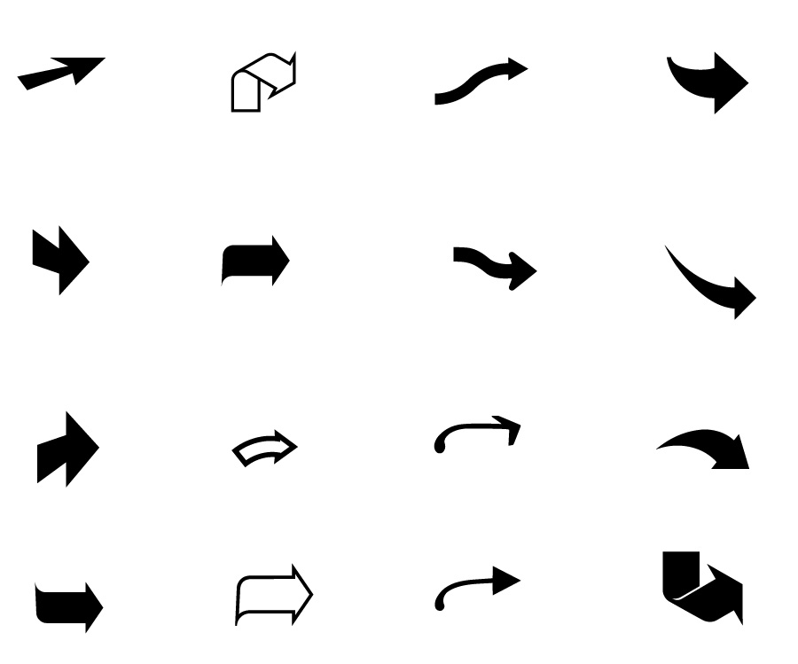



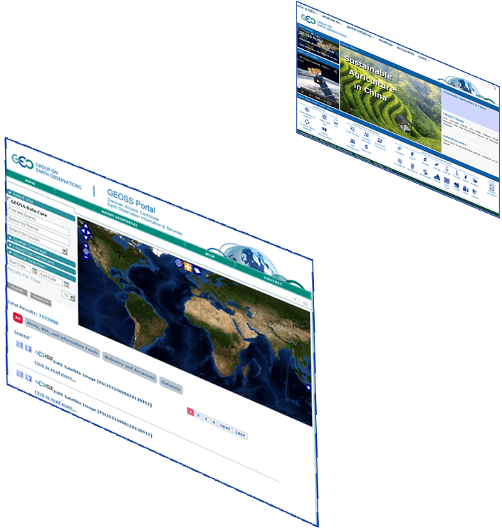
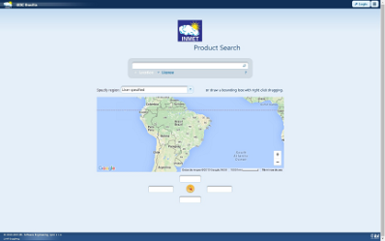


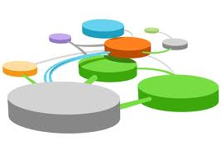





Hydrologic Information System in the Plata basin
CIC
Home Page
GISC Brasilia
Home Page
Argentina
Bolivia
PLATA HIS Portal
5 national
brokered systems
Brasil
Paraguay
Broker
and
Mediator
Systems
Registry
Semantic engines
Uruguay
...
.. .
Brokered Data Providers (capacities, systems, networks, etc.)
.. .
.. .
Hydrologic tools (tested interoperability)

Slide 25
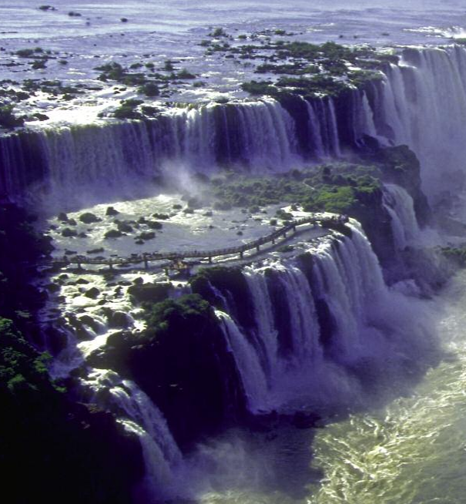
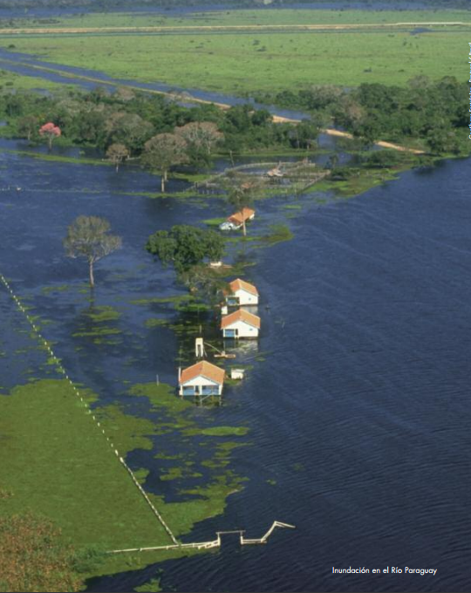
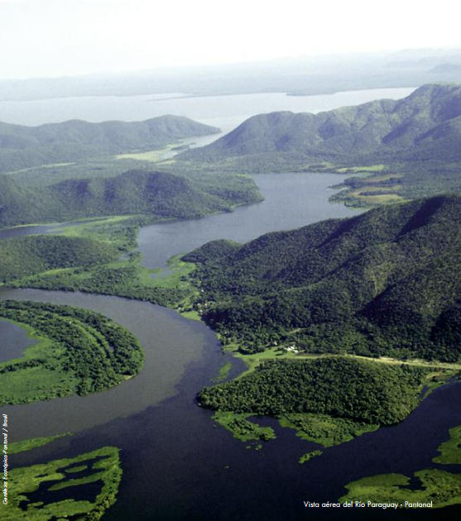
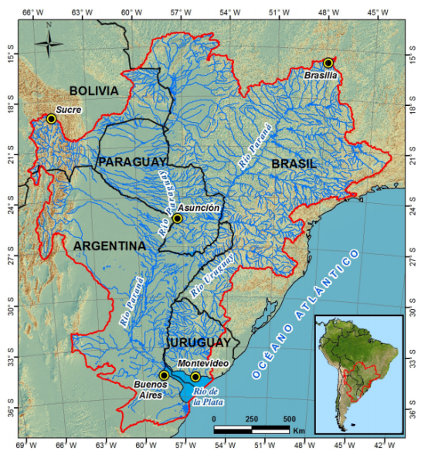
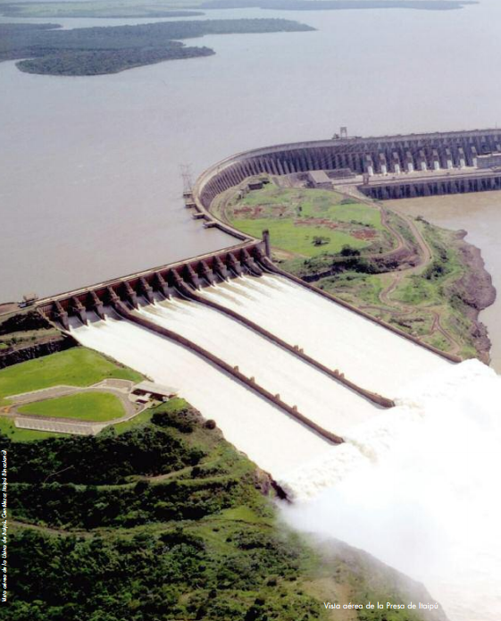
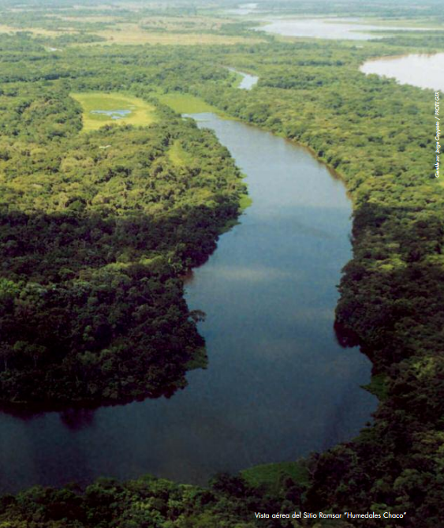
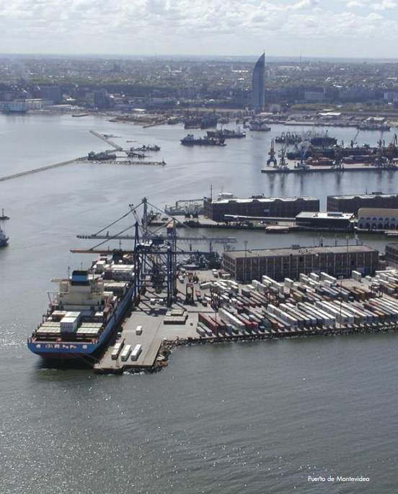

Slide 26
HIS in La Plata Basin

Slide 27
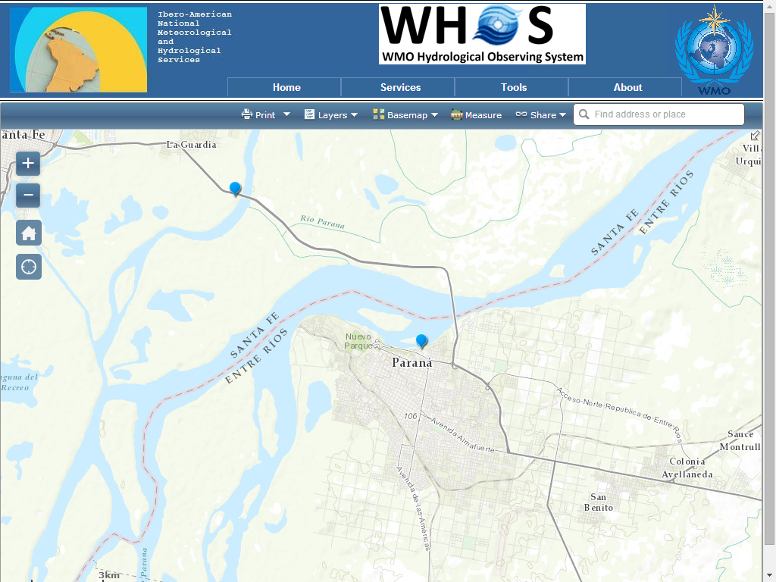






Slide 28

Advanced developments in Arctic-HYCOS
Notes:
28

Slide 29

Notes:
29

Slide 30

Notes:
30

Slide 31

Notes:
31

Slide 32
Notes:
32

Slide 33

Notes:
33

Slide 34

Notes:
34

Slide 35

Notes:
35

Slide 36

Notes:
36

Slide 37

Notes:
37

Slide 38

Notes:
38

Slide 39
IMPLEMENTATION OF A BROKER CATALOG SERVICE accessor, harvester and profiler

Slide 40


Slide 41

Notes:
http://wateroffice.ec.gc.ca/index_e.html

Slide 42


Slide 43


Slide 44




Slide 45


Slide 46



Slide 47
HYDROLOGICAL STANDARDS

Slide 48

International Standardization of WaterML
Hydrology Domain Working Group (HDWG)
  standards for water data: WaterML 2.0 suite
  organizing Interoperability Experiments (IEs)
  focused on different sub-domains of water
Chairs:
  Ilya Zaslavsky (USA)
  Tony Boston (Australia)
  Silvano Pecora (Italy)
Iterative Development
OGC
http://external.opengis.org/twiki_public/bin/view/HydrologyDWG/WebHome

Slide 49
WMO/OGC Hydrology Domain Working Group
WaterML2 suite
TimeseriesML 1.0
Timeseries
(OGC IS 15-042r3)
(OGC IS 15-043r3)
WaterML2Part2: Ratings, Gaugings, Sections
(OGC IS 15-018r1)
WaterML2Part1:
Timeseries
Observation
(OGC IS 10-126r4)
WaterML2Part3:
Water Quality Observation (OGC BP 14-003)
SOS 2.0
Hydrology Profile
(OGC BP 14-004r1)
Hydrologic Information Standards:
of hydrologic (water) features
WaterML2Part4: Groundwater Features GroundwaterML2 (OGC IS 16-XXX)
Identification,
Observation,
Representation
…(RiverML)…:
Channel Geometry
(continuation tbd)
WaterML2Part5: Surface Water Features
HY_Features
(OGC IS 16-XXX)
SoilML component:
Soil-water (collaboration tbd)
WaterML2PartX: River Network Topology
(OGC IS YY-XXX)
CSML3 component:
Atmospheric-water
(collaboration tbd)

Slide 50
WMO HYDROLOGICAL ONTOLOGY

Slide 51


HYDROLOGICAL ONTOLOGY

Slide 52

Notes:
hiscentral.ddns.net:8088/ontology/

Slide 53


Slide 54


Slide 55

Notes:
PREFIX : <http://www.semanticweb.org/ontologies/hydrology#>
PREFIX rdf: <http://www.w3.org/1999/02/22-rdf-syntax-ns#>
select distinct ?name
where {?x rdf:type :Variable.
?x :variablename ?name.
?x :searchedBy ?y.
?y rdf:type :Concept.
?y :conceptname ?z.
filter regex(?z, "level, stream", "i" )}

Slide 56

http://codes.wmo.int/
Notes:
http://codes.wmo.int/

Slide 57
HYDROLOGICAL ATTRIBUTES of GAGES

Slide 58
WIGOS Metadata Standard
- Approved at Cg-17 June 2015
Source: https://www.wmo.int/pages/prog/www/wigos/documents/Cg-17/WIGOS_Metadata.pdf

Slide 59




OSCAR quick access & reports
Quick access
&
Map filter
+ click
=
Detailed station report

Slide 60
List of elements specified in the WIGOS Metadata Standard and the phases for implementation by Members
http://www.wmo.int/pages/prog/www/wigos/documents/Cg-17/Cg-17-d04-2-2(3)-add1-MANUAL-ON-WIGOS-approved_en.docx
Notes:
http://www.wmo.int/pages/prog/www/wigos/documents/Cg-17/Cg-17-d04-2-2(3)-add1-MANUAL-ON-WIGOS-approved_en.docx

Slide 62

GAGES II - Geospatial Attributes of Gages for Evaluating Streamflow, version II
This dataset, termed "GAGES II", an acronym for Geospatial Attributes of Gages for Evaluating Streamflow, version II, provides geospatial data and classifications for 9,322 stream gages maintained by the U.S. Geological Survey (USGS).
This dataset has two purposes: (1) to provide users with a comprehensive set of geospatial characteristics for a large number of gaged watersheds, particularly for gages with long flow record, and (2) to provide a determination of which of those watersheds represent hydrologic conditions which are least disturbed by human influences ("reference gages"), compared to other watersheds within ecoregions.

Slide 63
GAGES II - Data Assembly and Organization 1/3
The main data spreadsheet is broken into 27 worksheets (spreadsheet tabs), which represent general types of variables. These are described here:
- BasinID: Basic identification characteristics of the stream gage (e.g., name, drainage area, lat/long, water resources region). Also included are four flags indicating whether the gage is a part of other pertinent streamgage networks: the Hydrologic Benchmark Network (HBN), the old Hydro-Climatic Data Network (HCDN), the new HCDN (HCDN-2009), and the National Streamflow Information Program Sentinel (NSIP-S) network.
- Bas_Classif: Reference/non-reference classification and primary information that went into the classification decision, including the hydro-disturbance index, pertinent Annual Data Report (ADR) remarks regarding flow alteration, and screening comments from NAWQA personnel visual evaluation.
- Bas_Morph: Basin morphology (compactness ratio, centroid location).
- Bound_QA: Information regarding the results of Quality Assurance checks for the basin boundaries.
- Climate: Climate characteristics (e.g., mean precipitation, temperature).
- Climate_Ppt_Annual: Mean basin precipitation, annually from 1950-2009.
- Climate_Tmp_Annual: Mean basin air temperature, annually from 1950-2009.
- FlowRec: Characteristics of the flow record, to include the flow matrix by year since 1900.
- Geology: Geological characteristics (e.g., dominant geology in watershed).
- Hydro: Hydrologic characteristics derived from GIS data (e.g., stream order at the streamgage, base-flow-index, runoff).
- HydroMod_Dams: Information about historical and current dams in the watershed.

Slide 64
GAGES II - Data Assembly and Organization 2/3
- HydroMod_Other: Information about other anthropogenic hydrologic modifications (e.g., percent canals in watershed or on mainstem, presence of permitted pollution discharge sites, estimate of water withdrawal, presence of irrigated agriculture, presence of power plants).
- Landscape_Pat: Landscape pattern metric(s) (e.g., fragmentation of undeveloped land).
- LC06_Basin: Percentages of land cover circa year 2006 in the watershed, from NLCD06. For the Alaska-Hawaii-Puerto Rico records these data are from 2001 (NLCD01), because the 2006 data were not available for those three areas.
- LC06_Mains100: Percentages of land cover classes in 100-m mainstem buffer (approx. 100 m each side of mainstem stream line).
- LC06_Mains800: Percentages of land cover classes in 800-m mainstem buffer (approx. 800 m each side of mainstem streamline).
- LC06_Rip100: Percentages of land cover classes in 100-m riparian buffer (approx. 100 m each side of all streamlines in watershed).
- LC06_Rip800: Percentages of land cover classes in 800-m riparian buffer (approx. 800 m each side of all streamlines in watershed).
- LC_Crops: Percentages of land cover classes in the watershed from the USDA NASS 2009 Crop Data Layer (CDL).
- Nutrient_App: Estimates of nitrogen and phosphorus application in the watershed.
- Pest_App: Estimates of agricultural pesticide application in the watershed.
- Pop_Infrastr: Measures of population density and infrastructure (roads, impervious surfaces) in the watershed. Includes percent increase in urbanization from 2001 to 2006, from NLCD.
- Prot_Areas: Percent area of the watershed in "protected" land cover zones (e.g., National Parks, Wilderness Areas)
- Regions: Site location and percent of watershed area in various regions (e.g., EPA Level II or III ecoregions).
- Soils: Soils characteristics.
- Topo: Topographic characteristics (e.g., mean basin elevation, mean slope).
- X_Region_Names: A crosswalk of codes from the "Regions" worksheet to their names or descriptions.

Slide 65
GAGES II - Data Assembly and Organization 3/3
Each specific variable in the variable description spreadsheet has several pieces of information about it. These are:
VARIABLE_TYPE: Variable type; indicates the type of variable (one of the 27 types above) and in which worksheet the data are contained in (e.g., "Hydro").
VARIABLE_NAME: The variable name (e.g., "STRAHLER_MAX").
DESCRIPTION: A text description of the variable (e.g., "Maximum Strahler stream order in watershed").
EXTENT: Spatial extent of GIS processing for that variable: either "watershed", "site", "riparian", or "mainstem". Unless indicated otherwise "watershed" indicates that the value represents the mean for the watershed for that parameter, "site" represents the value for the point location at the streamgage, "riparian" represents the mean for the riparian zone indicated, and "mainstem" represents the mean for the mainstem zone indicated.
STORAGE TYPE: Storage type: either "character", "integer", "floating point", or "date".
UNITS: Units (e.g., "percent" or "sq km").
TIME PERIOD: Time period of the source data (e.g. "1971-2000").
PROCESSING METHOD: Type of processing: either "grid", "vector polygon", "vector line", "vector point", or "join".
ADDITIONAL NOTE ON PROCESSING OR DATASET: Additional information about unusual or noteworthy aspects of processing, including No Data values, if applicable.
SOURCE DATA: Source of data (e.g., "NHDPlus"); usually the agency, organization, or program that created the data.
NOMINAL RESOLUTION/SCALE OF SOURCE DATA: Spatial resolution or scale (e.g., "1:100,000", or "30-m resolution grid").
CITATION: Reference for source data and/or processing method.
WEB SITE FOR SOURCE DATA: URL for source data, if online.

Slide 66

BROKERING GAGE ATTRIBUTES

Slide 67

QGIS and WEBSERVICES

Slide 68

HYDROLOGICAL ANALYSIS BY WEBSERVICES

Slide 69
DATA PROVIDERS AND CATALOGS

Slide 70

Views

Slide 71


Slide 72


Slide 73


Slide 74


Slide 75
BROKER PROGRAMMING

Slide 76


Slide 77
HYDROLOGICAL APPLICATIONS

Slide 78


Slide 79

Import data from a WaterML2 webserver
Notes:
79

Slide 80

Import WaterML2 data from a directory
Notes:
80

Slide 81

Archive use case analysis
Event analysis
Event review/ inquiry
Simulation results
Post event reports
Forecast Products
Communication notes
Initial model state
Model run settings
NWP forecasts
Rating Curves
Observations
Model setup
docs
Model
verification
Model
calibration
Informative
event
Training
materials
Data types:
Time series
Model data
(native)
Documents
& images

Slide 82

DEWETRA and the Po river basin
Notes:
82

Slide 83

Notes:
83

Slide 84

Notes:
84

Slide 85
WHOS
where and how

Slide 86

WHOS IN THE CLOUD
WHOS
Big Data dimensionalities know as V axes
volume
variety
velocity
veracity
visualization

Slide 87


TRAINING on HYDROLOGIC DATA SHARING

Slide 88
THE REAL ESSENCE OF WHOS

Slide 89



Linking people everywhere with hydrologic data, maps and models

Slide 90

Thank you for your attention

