Slide 1
Complementarity of Space- and Surface-Based Observing System
Lars Peter Riishojgaard
WIGOS Project Office, WMO Secretariat
WMO; Observing and Information Systems Department)

Slide 2
Overview
What does the “I” in WIGOS mean?
Space-surface complementarity
About complementarity and the unique role of space-based observations
Resilience of (WI)GOS
The challenge of adapting to changing technologies; an example
Summary and Conclusions

Slide 3
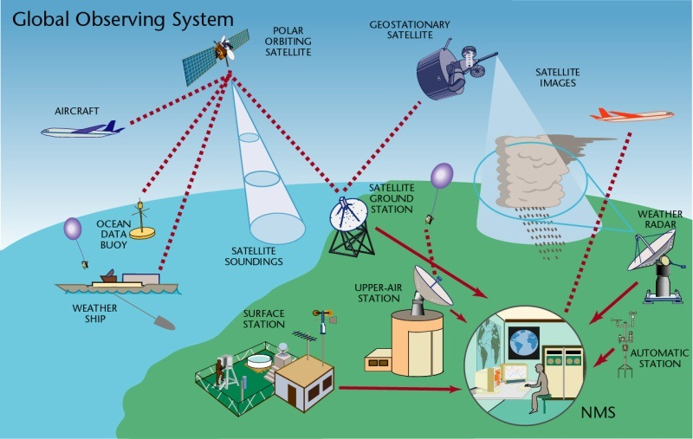
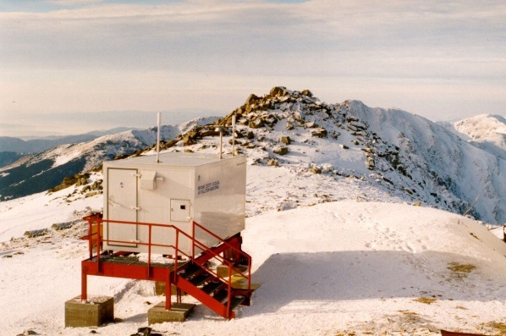
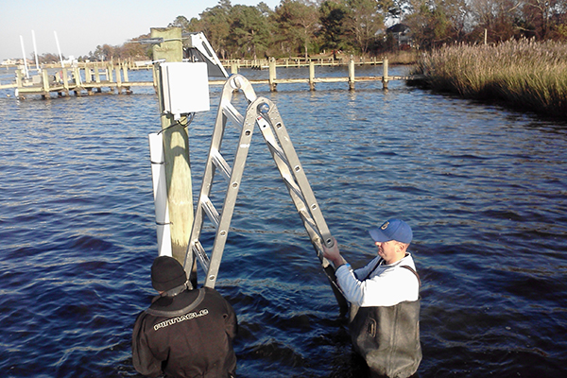
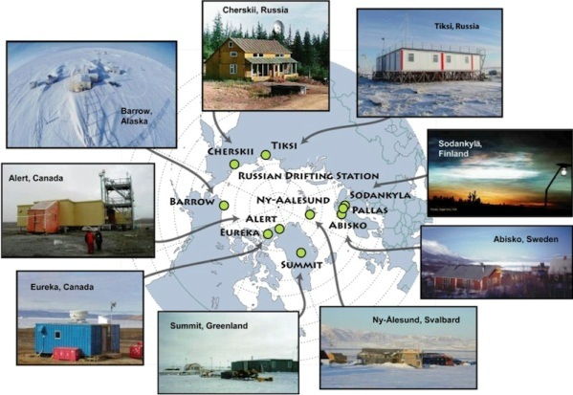
WMO Integrated Global Observing System (WIGOS) Components:
Global Observing System (WWW/GOS)
Observing component of Global Atmospheric Watch (GAW)
WMO Hydrological Observations (including WHYCOS)
Observing component of Global Cryosphere Watch (GCW)

Slide 4
What does integration mean in the context of WIGOS ?
Integration across organisational boundaries
Between NMHS-owned and third-party data
Integration across application areas (weather, climate, air quality, …)
“One measurement, many uses”
Integration across platforms and systems
Complementarity of surface- and space-based data
Integration in the design phase
Holistic approach to design of WIGOS; space components designed taking into account plans for surface components, and vice versa

Slide 5
Complementarity of space-based and surface-based observation
Many measurements can be done both from space and from the surface
Global coverage is relatively easily achieved from space
Extensive horizontal coverage with frequent revisits is readily achieved from geostationary and highly elliptical orbits
Certain measurements are done better (i.e. more easily or more accurately) in situ, e.g. surface pressure, near-surface trace gas concentrations
Satellite measurements require ground-based measurements for calibration and validation

Slide 6
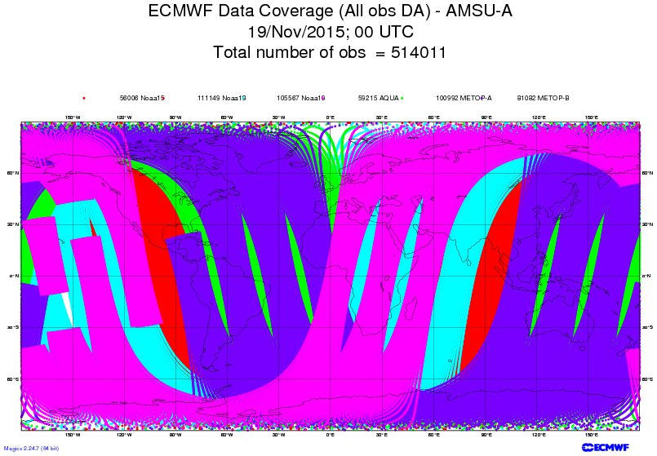
Example of measurement done well from
space: global temperature and humidity
profiles from AMSU-A

Slide 7
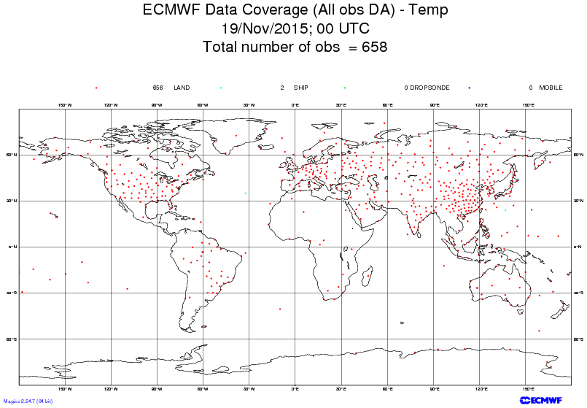
Example of measurement done well from
the surface: vertical profiles of wind (plus temperature and humidity from radiosondes

Slide 8
On the resilience of the GOS
Similar levels of NWP skill can be achieved via different avenues, including different mixes of observational data
In spite of known and recognized gaps, there is a certain amount of resilience/robustness/redundancy in the Global Observing System
From the Fifth WMO Workshop on the Impact of Various Observing Systems on NWP, Sedona, 2012 (WMO Technical Report 2012-1):
“In terms of NWP impact there is now no single, dominating satellite sensor; {…} The OSE results indicate that the current global observing system is more resilient in the sense that when one sensor or sensor-type is withheld from the assimilation, others compensate, at least partially”

Slide 9
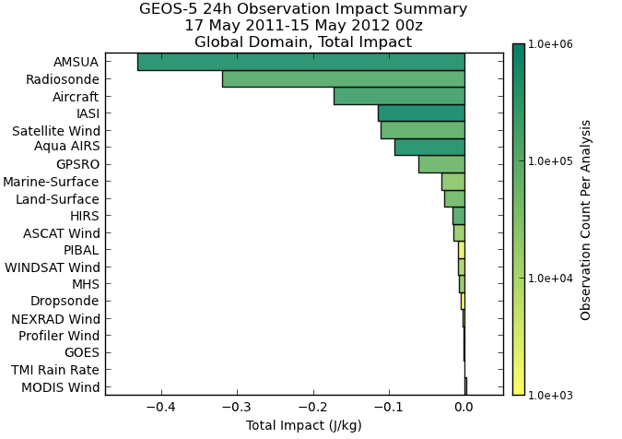
OSE and FSO
FSO (Forecast Sensitivity to Observations) are based on the adjoint of the model/analysis system or an ensemble approach
1. Define a cost function penalizing the difference between a 24-hour forecast and its verifying analysis
2. Run a 24-hour forecast before and after analyzing new observations
3. Run the adjoint/ensemble approach to identify which observations contributed the most to minimizing this cost function
Approach focuses exclusively on the short (quasi-linear) range
Results show the impact of observations in the presence of all other observations
Gelaro et al, Fifth WMO Impact Workshop, Sedona 2012
August 16
2012 AMS Summer Community Meeting, Norman OK

Slide 10
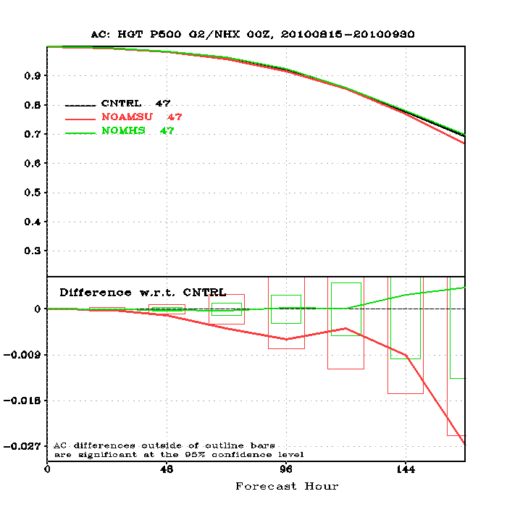
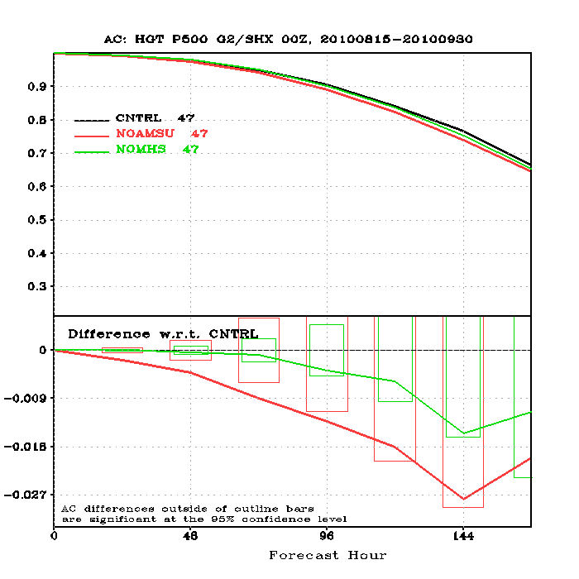
No AMSU-A / No MHS
Northern Hemisphere
Southern Hemisphere
Jung, 5th WMO Impact Workshop, Sedona 2012

Slide 11
J. Eyre, Sedona 2012
AMV impact
Forecast Sensitivity to Observations (FSO)
BOGUS
Scatwind
GPSRO
HIRS
PILOT
AMSUA
AMSUB
SEVIRI
BUOY
Control
SHIP
Aircraft
AMV_denial
AIRS
TEMP
IASI
SSMIS
WINPRO
Dropsonde
SYNOP
TCBOGUS
MODIS/AV
Satwind
-5%
0%
5%
10%
15%
20%
25%
30%
35%
Percentage of total impact
When AMVs are denied, scatterometer winds partially compensate
WMO Impact Workshop Report, CMA/NMC

Slide 12
J. Eyre, Sedona 2012
Satellite surface wind impact
Forecast Sensitivity to Observations (FSO)
SHIP
BUOY
HIRS
Satwind
AMSUA
AIRS
MODIS/AVHRR
PILOT
IASI
Control
Dropsonde
Scat_denial
SEVIRI
SYNOP
SSMIS
AMSUB
TEMP
Aircraft
WINPRO
GPSRO
TCBOGUS
Scatwind
BOGUS
-5%
0%
5%
10%
15%
20%
25%
30%
35%
When ASCAT, ERS-2 and WindSat winds are denied, other surface-marine observations partially compensate
WMO Impact Workshop Report, CMA/NMC

Slide 13
Planning and design for space-based versus surface-based observing systems
Space programs typically have (very) long lead times
High technological and financial bars to entry, centrally controlled, structured planning
Operational meteorological satellite agencies largely know what will be flying the next 20 years, and have limited flexibility to adjust their plans
(Research agencies tend to be more agile, typically maintaining some flexibility to accommodate innovation)
Surface-based observing capabilities increasingly tend to elude any attempt at centralized planning
Mobile technologies, innovation, commodification of sensors, crowd sourcing, push toward commercialization, …

Slide 14
Unplanned data of opportunity
(example)

Slide 16
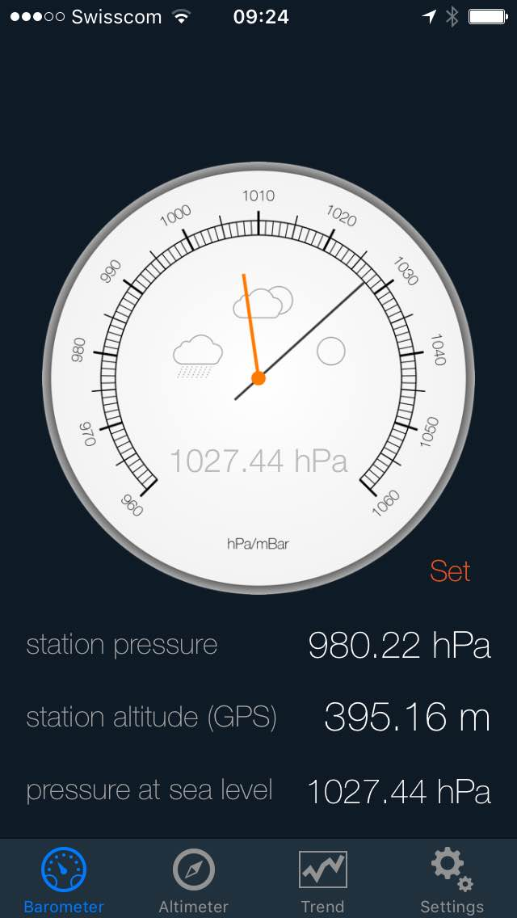
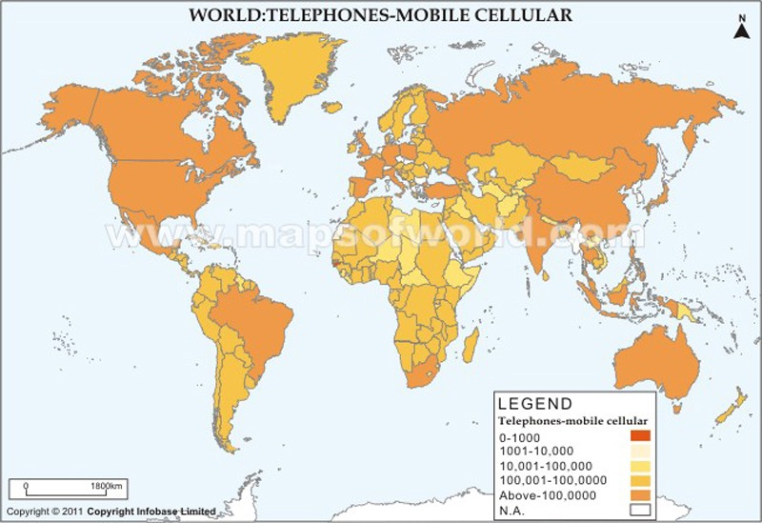
Unplanned data of opportunity
(2nd example)
Approaching 200 million barometers in people’s pockets and handbags (iPhone 6 series alone), providing pressure and 3D-location via GPS
Good global coverage, continuous flow of data
(Calibration, dissemination, assimilation issues to be explored)
How do we adjust to this?

Slide 17
Summary and conclusions
Complementary roles of surface- and space based systems means that the future evolution of the two should be planned together
Space provides global coverage
Surface-based systems provide better accuracy for certain parameters
Surface-based observing systems currently evolve much more rapidly than space-based, and largely in uncontrolled (and uncontrollable) fashion; this makes planning difficult!
Optimal response to this rapidly evolving scenario will require unprecedented agility in implementation

Slide 18
Thank you for your attention
lriishojgaard@wmo.int

