Slide 1
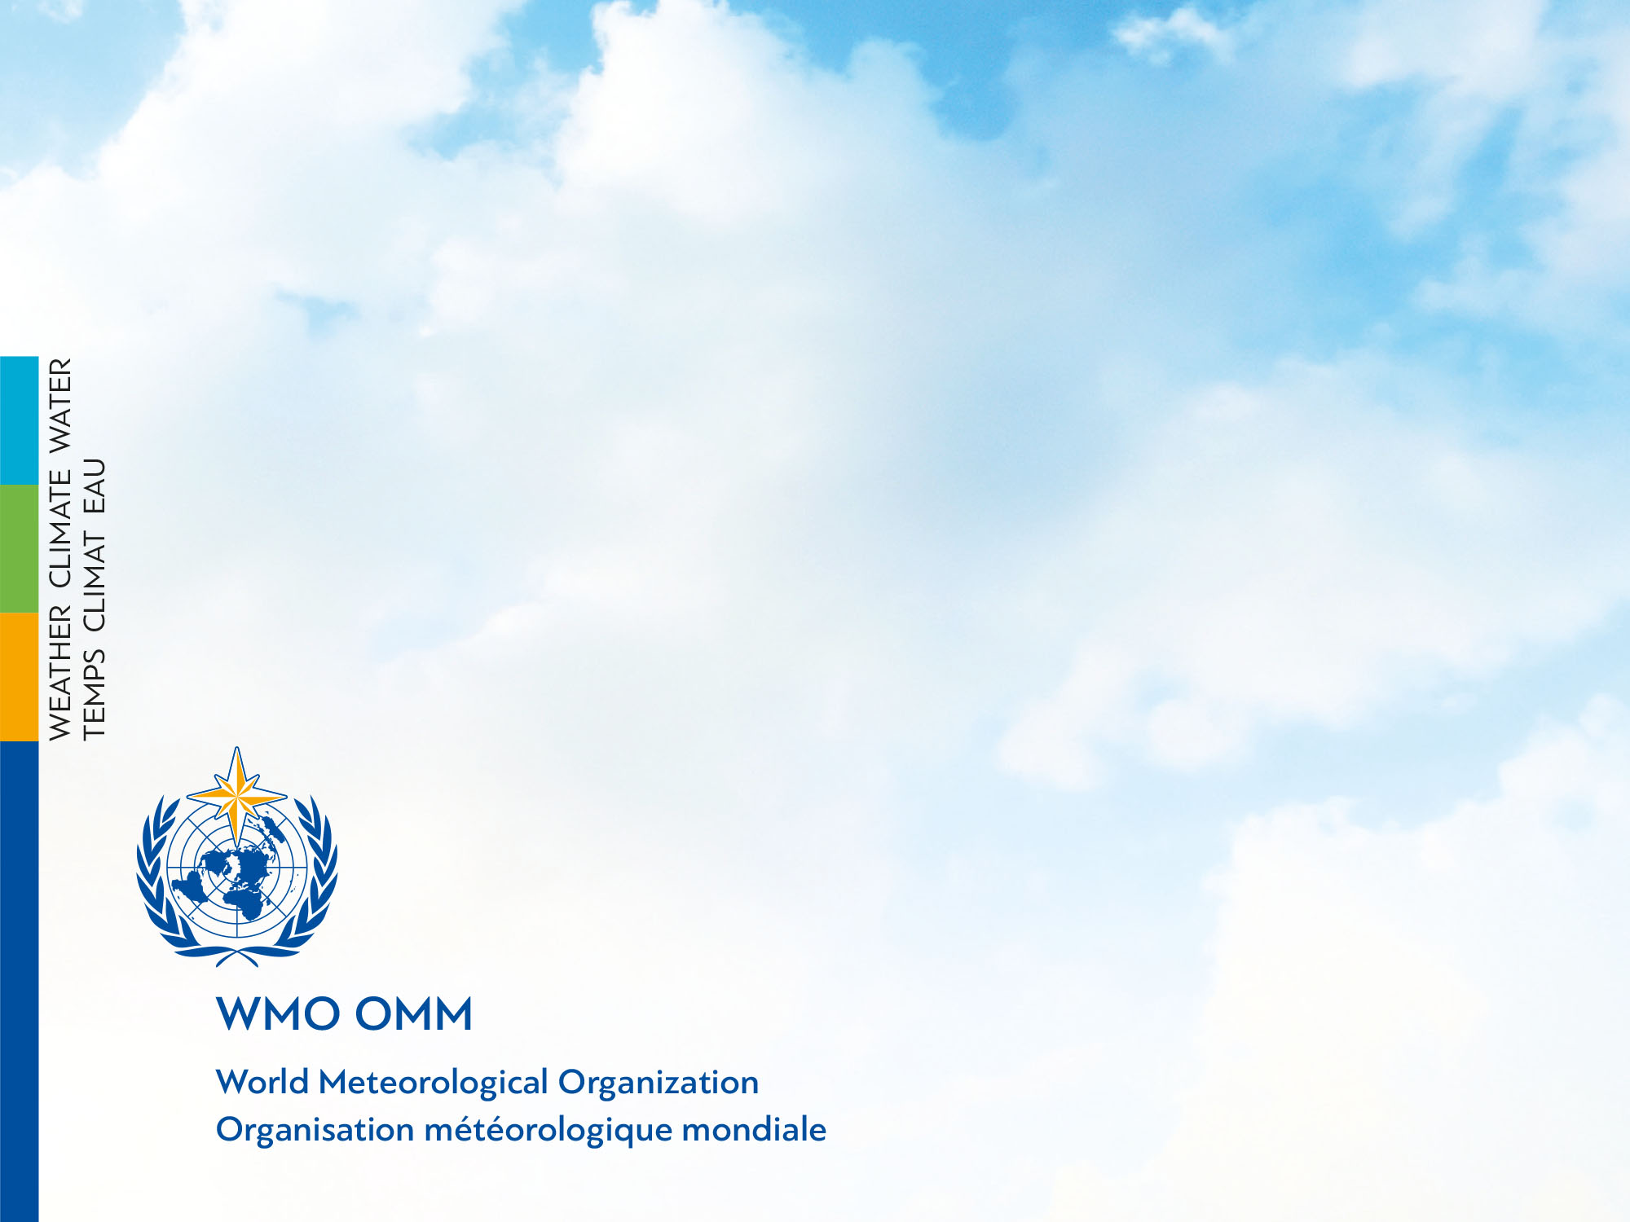
WIGOS in 2040 – Requirements in 2040?
Lars Peter Riishojgaard
WIGOS Project Office, WMO Secretariat

Slide 2
WIGOS in 2040; how dare we?
A personal and selective look 25 years back in time:
  Forecasting done almost exclusively by humans; hand analysis
  Operational skill (500 hPa ACC above 0.6) of global NWP: 3-4 days
    Public perception of skill lower; often irrelevant to local weather
    HIRLAM – a regional limited area model run at 50 km resolution provided no additional skill beyond that of the global models
  Satellite data used qualitatively (GEO images), quantitative use still almost a decade away
  Many space-based observing technologies still to come, e.g. GPSRO (1995), microwave sounders (1998), hyperspectral IR sounders (2002)
  Global environmental agenda dominated by the ozone hole (discovered in 1985, Montreal protocol ratified in 1989)
    Many climate scientists more concerned about a coming ice age due to variations in Earth’s orbit than about “greenhouse effect”
  World wide web just invented (first web browser 1990)
  GSM (mobile phone technology) about to emerge (1991)
  …

Slide 3
Mission of Met Services
(according to the WMO Convention)
Protection of life and property
Safeguarding the environment
Contributing to sustainable development
Promoting long-term observation and collection of meteorological, hydrological and climatological data, including related environmental data,
Promotion of endogenous capacity-building
Meeting international commitments,
Contributing to international cooperation

Slide 4
Purpose of WMO
(WMO Convention)
To facilitate worldwide cooperation in the establishment of networks of stations for the making of meteorological observations;…
To promote the establishment and maintenance of systems for the rapid exchange of meteorological and related information;
To promote standardization of meteorological and related observations and to ensure the uniform publication of observations and statistics;
… e), f)

Slide 5
Takeaway message:
  Many of the capabilities that we have today and many of the problems we are faced with would be truly astonishing to someone fresh out of the early 1990’s
  Anything too specific that we would write today about technology, capabilities, etc. in 2040 will likely be completely laughable already 10 or 15 years from now
  What is written (and implied) in the WMO convention about the overall role of Met Services and about the role of organization in society looks remarkably fresh!
  We could assume this as our guidance and focus on the challenges driven by broader societal trends rather than on the specifics of how we will meet them

Slide 6
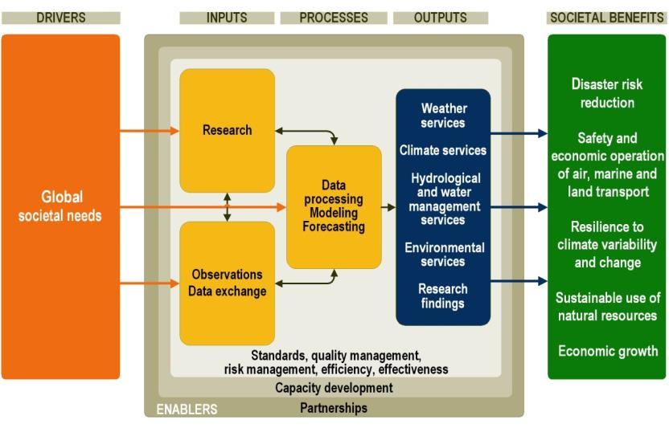
DRIVING FORCE FOR WIGOS VISION 2040
WMO STRATEGIC PLAN – Global Societal Needs
WIGOS

Slide 7
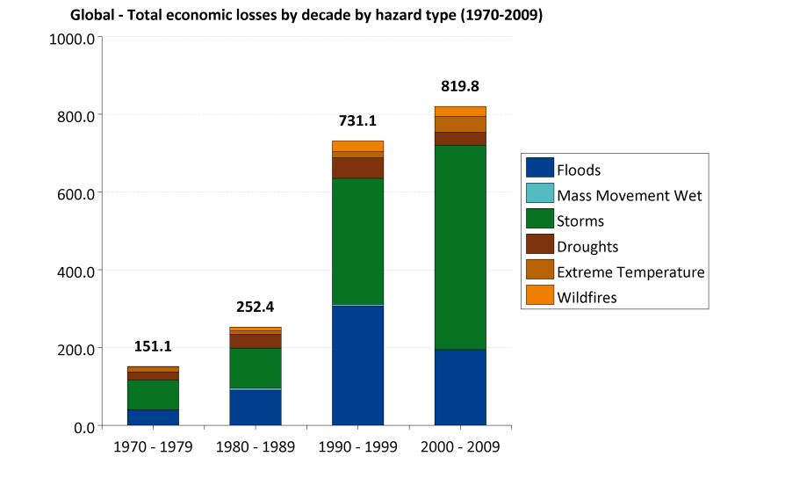
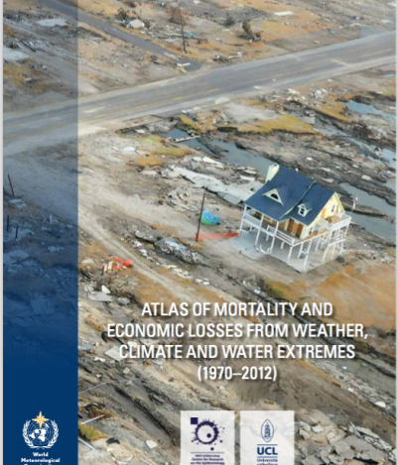
WMO Strategic Priority 1- DRR!
The global total economic losses by decade and by hazard type in USD billions adjusted to 2011
The warmer planet, leading to more frequent extreme Weather & Climate events
Global population above 9 billion in 2040, with growing settlements in costal regions & megacities (50%72%)
780 million have no access to clean water
7 million premature death due to air pollution
Increase of vunerability & greater loses !!!
WMO: Dr Zhang

Slide 8
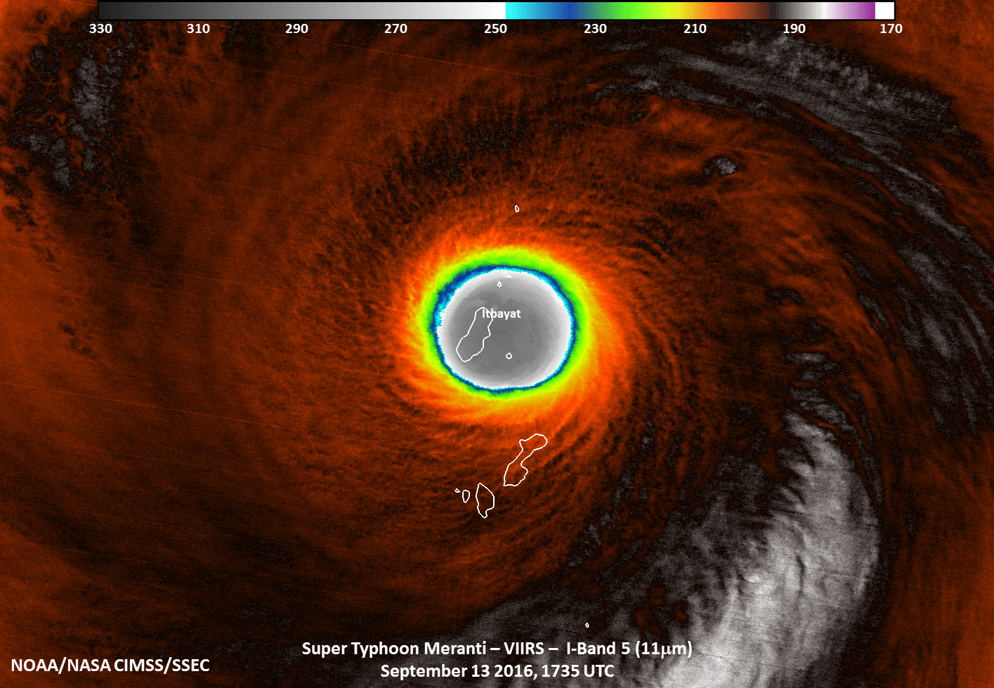
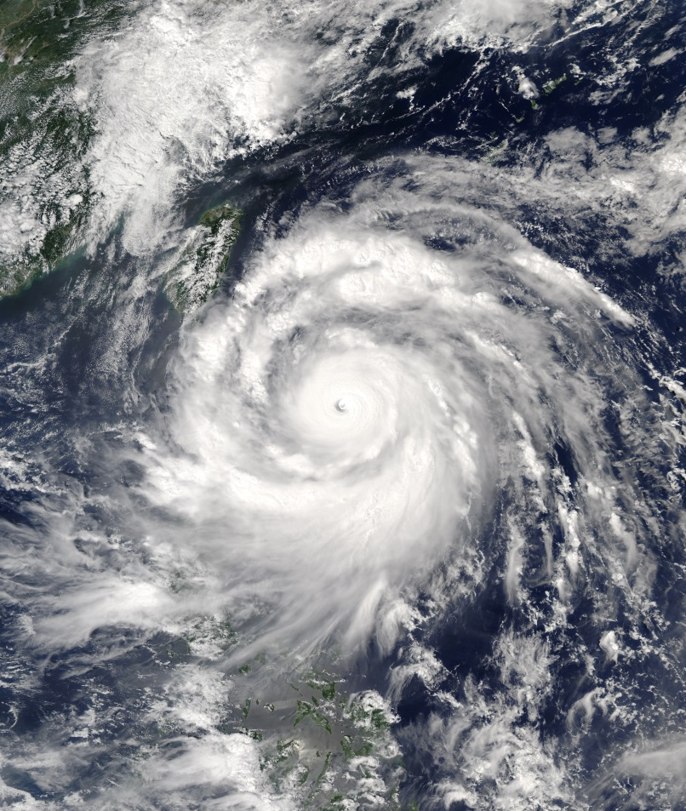
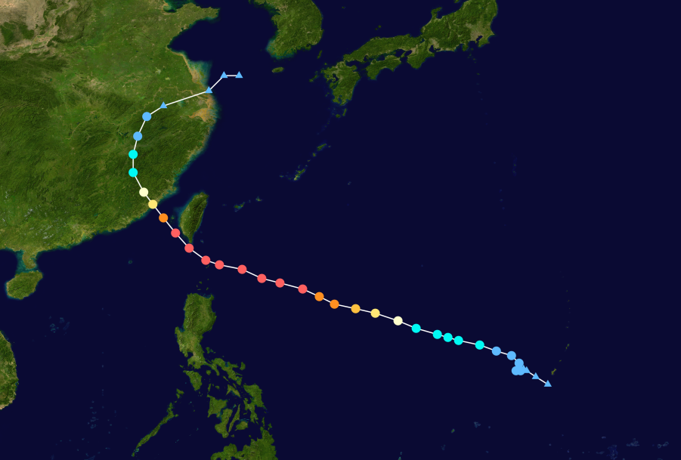
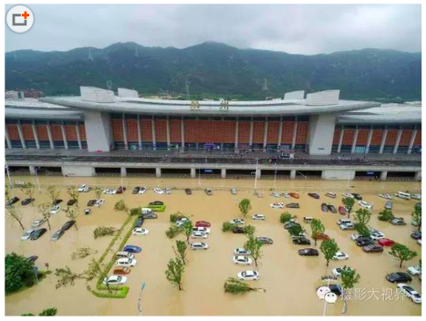
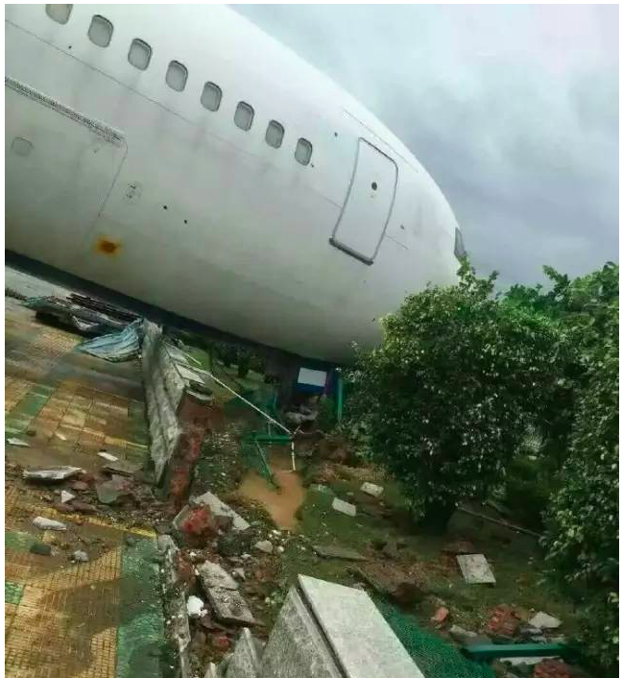
Typhoon Meranti, one of the most intense typhoons (landfall in China on Sept. 15, 2016)
Basic Data:
  Highest Winds: 220km (10"), 305 KM (1")
  Lowest Pressure: 890 hPa
Impact:
  Philippines, Korea and East China (Taiwan & Fujian),
Losses in Fujian alone
  Died: 28
  Missing: 15
  Enjured: 50
  Impacted: 304,320
  Economic lost : 21 Billion (RMB)

Slide 9
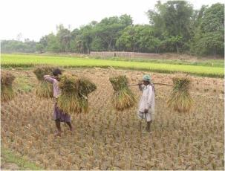
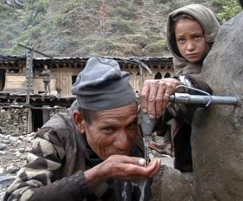
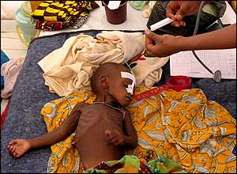
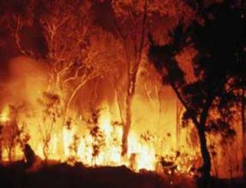

WMO Strategic Priority 2- Climate Services need more & better climate observations
Agriculture
Water
Energy
Disaster Risk Reduction
Health
Notes:
9
All climate-sensitive sectors can and will benefit from climate services. However, four areas have been identified by the High Level Task Force as urgent priorities and where the most short-term benefits could be obtained. Thus Climate Services targeted particularly in enhancing the ability to cope with climate related incidents shall be the main focus.
(Click) First of all Agriculture and food security:
With a better analysis of climate risks and availability of seasonal forecasts, farmers can plan optimal planting dates, the best mix of crops to grow and which disease- and pest-resilient varieties to choose. This can help to improve food security and reduce poverty. Climate scientists and farmers must develop close partnerships to effectively use seasonal forecasts and develop coping strategies in the event of natural disasters.
(click) Secondly, Water:
Water availability can provide or deny life-supporting needs. It can lead to enhanced food production but also to extreme water stress, high levels of poverty and even loss of life. Improved climate predictions give water resource managers the necessary information to plan and operate their systems more efficiently.
(click) Thirdly, Health:
Weather and climate conditions have direct and indirect impacts on health. They can increase the risk of epidemics of airborne and waterborne diseases, as well as malnutrition, heatstroke and respiratory problems. Climate prediction and information facilitate early warnings and surveillance, as well as interventions and resource allocation management
(click) Lastly, Disaster Risk Reduction:
Climate-related disasters such as flooding or drought have great impacts on communities and their socio-economic activities. Early warning systems can prevent loss of life, livelihood and property by alerting people to specific threats and enhancing the level of preparedness.
Thus, it is in these four areas that climate services will be developped in the short term until 2017.

Slide 10
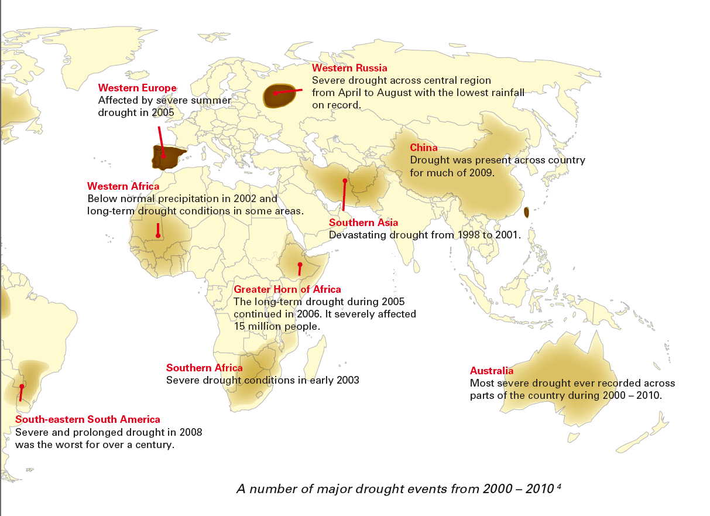
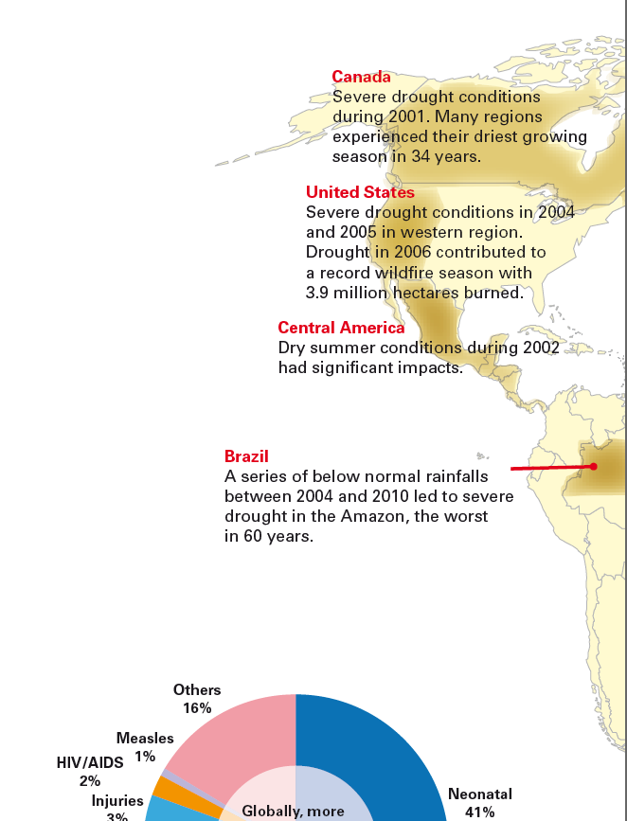
A number of major drought events from 2000 – 2010

Slide 11
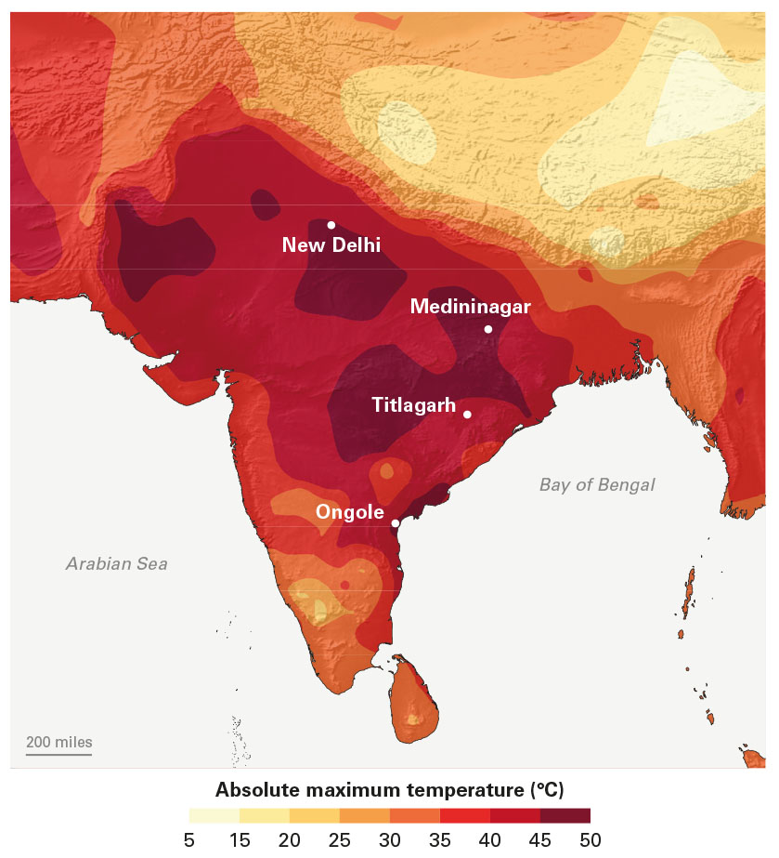
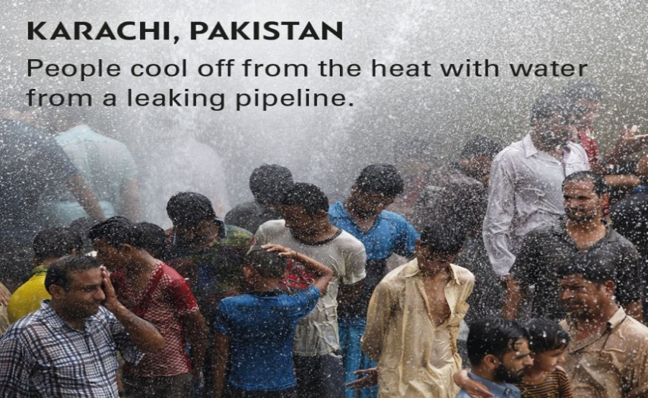
Heat Waves, Cold Waves, Extreme precipitations, Flooding and flash floods : Impact to health !
Summer 2015, South Asia: major heat wave in India and Pakistan: more than 3000 deaths

Slide 12
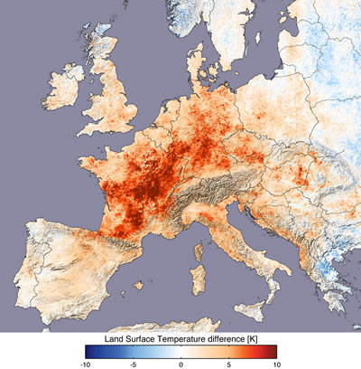
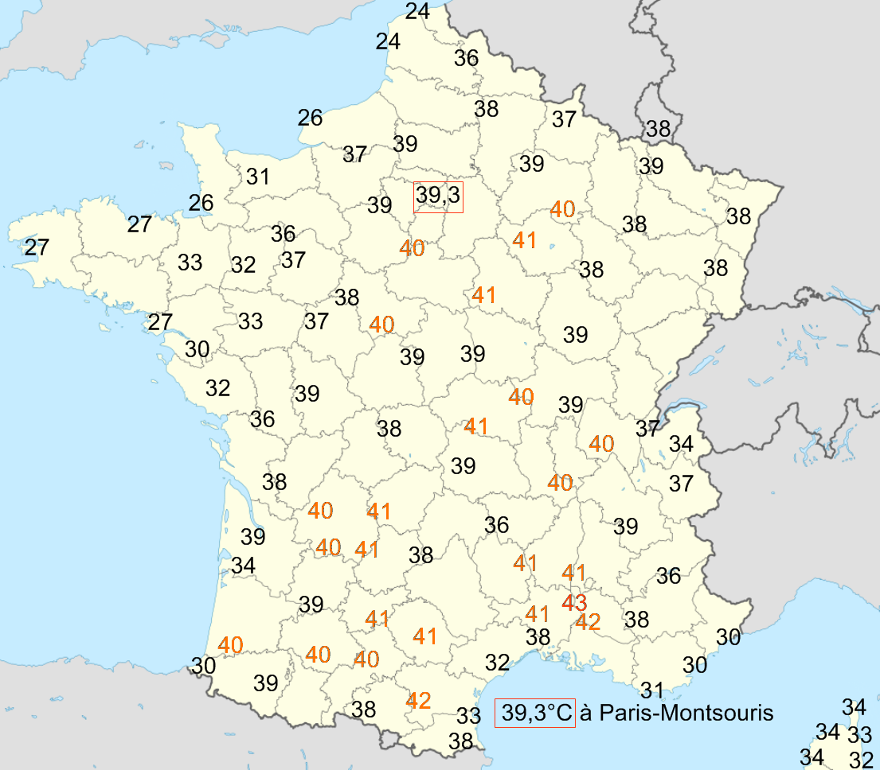
European heat wave 2003;
Worst in over 500 years
Estimates generally range from 30-80.000 excess deaths across Europe

Slide 13
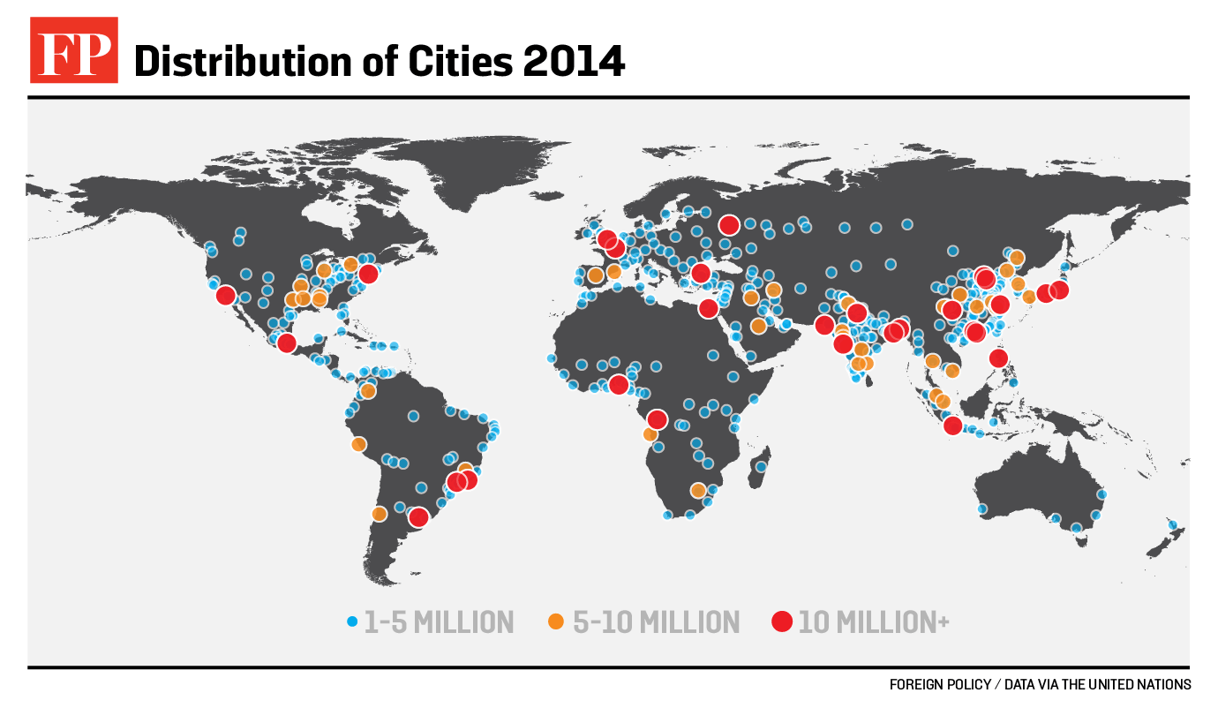
In 2040 many more people than today will live in cities, including megacities, vulnerable to poor air quality, water shortages, heat island effects, extreme weather events, rising sea level (along coast lines) etc.

Slide 14
Requirements for climate services
(We are only beginning to understand what this means)
We know that observing systems will need to support
  Monitoring
  Research (process understanding)
  Adaptation
  Mitigation
… but we should also be prepared to provide guidance on
  Exposure
  Vulnerability
  Potential impact
This will require interdisciplinary work with earth scientists from other disciplines, economists, demographers, local authorities, etc!

Slide 15


Slide 16
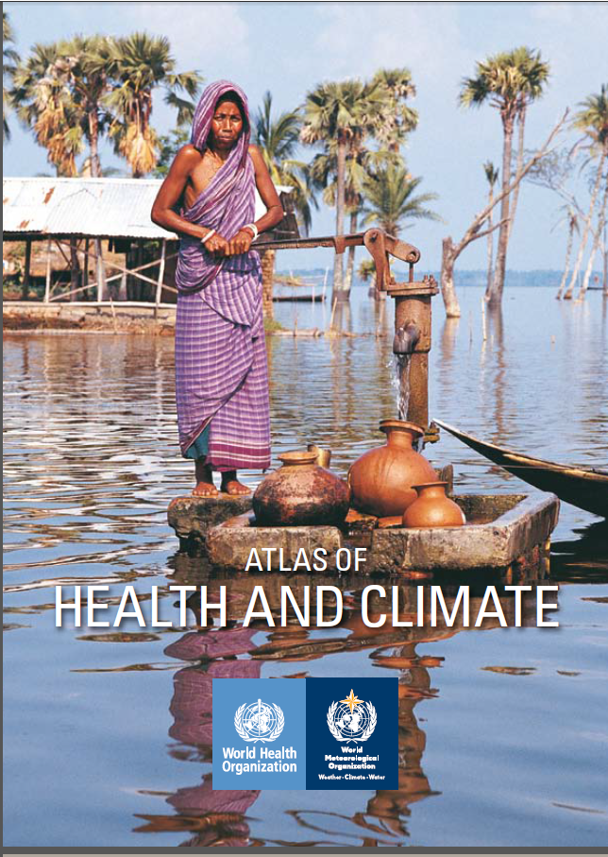
World Health Organization (WHO) and WMO Jointly published Atlas of Health And Climate in Oct. 2012
The Atlas illustrates some of the most pressing current and emerging challenges.
Droughts, floods and cyclones affect the health of millions of people each year.
Climate variability and extreme conditions such as floods can also trigger epidemics of diseases such as diarrhoea, malaria, dengue and meningitis, which cause death and suffering for many millions more.
The Atlas gives practical examples of how the use of weather and climate information can protect public health.
Notes:
16

Slide 17
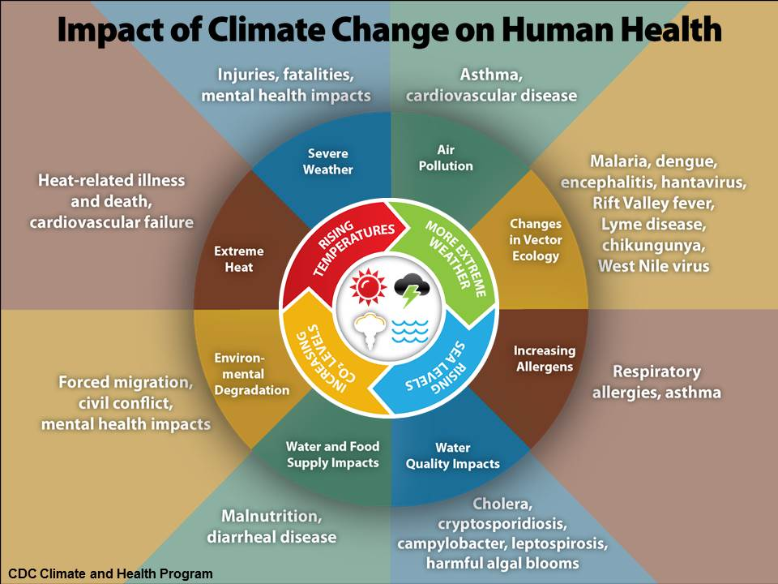

Slide 18
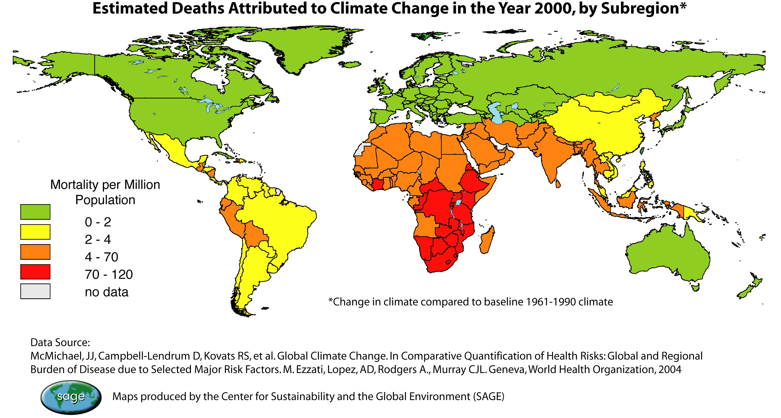

Slide 19
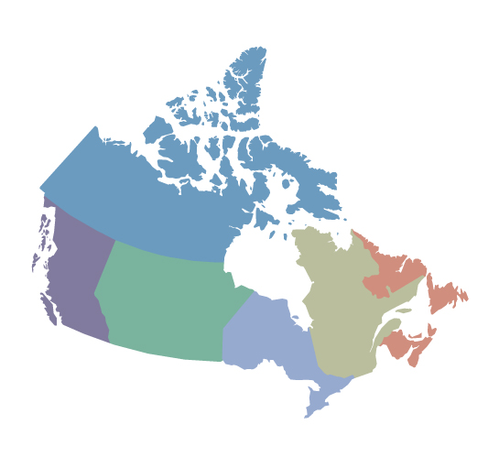
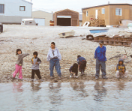
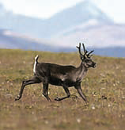
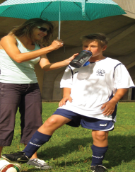
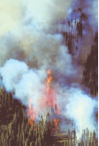
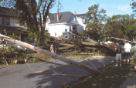

Health risks in Canada from climate change
Dangerous
travelling conditions
Permafrost melt damaging infrastructures
Changes in drinking water quality and quantity
Food security - changing animal distributions
Heat–related illnesses and deaths
Health impacts from
more severe storms
Psychosocial impacts from droughts
Water-borne diseases from floods
Expansion of Lyme
Disease vector
Respiratory illnesses
from forest fires
Source: Health Canada, 2008
Notes:
Climate Change and Health in Canada
The phenomenon of human-induced global climate change can no longer be refuted. According to the 2007 report of the Intergovernmental Panel on Climate Change (IPCC): “Warming of the climate system is unequivocal, as is now evident from observations of increases in global average air and ocean temperatures, widespread melting of snow and ice and rising global average sea level.”
One of the most disturbing implications of climate change is its potentially devastating impact on human health. The World Health Organization (WHO) has reported: “A warmer and more variable climate threatens to lead to higher levels of some air pollutants, increase transmission of diseases through unclean water and through contaminated food, to compromise agricultural production in some of the least developed countries, and increase the hazards of extreme weather… Temperature shifts will encourage the spread of infectious diseases… An increase in extreme weather events like floods and droughts will have a dramatic impact on health.”
A national climate change and health vulnerability assessment was released in 2008 by Health Canada entitled Human Health in a Changing Climate: A Canadian Assessment of Vulnerabilities and Adaptive Capacity . In the report, it provides information on how climate change may impact the health of Canadians across the country. To obtain a copy of this report, please refer to the following website: http://www.hc-sc.gc.ca/ewh-semt/climat/eval/index-eng.php)

Slide 20
Additional requirements from “traditional” NMHS customers, e.g.
Transportation safety
  Weather continues to be primary hazard to aviation and navigation
  A host of weather-related issues contribute to capacity limits of (near-) saturated airports
Energy production and dissemination
Planning and scheduling for agriculture, construction and other sectors
Basic human activities, both professional and recreational
…
Tailoring systems (including observing systems) to meet these requirements must be done in collaboration with the customers, application area by application area; do the NMHSs have the resources and the willingness to do this?

Slide 21
Final thoughts
Demand for meteorological products and services will likely be much higher in 2040 than it is now
Unlikely that NMHSs will have near-monopoly on observations, products and services
A stronger role for the private sector in all three areas is likely
  Issues regarding ownership and data exchange for observational data in particular must be sorted out
If we maintain that the provision of meteorological services is a “public good” a continued strong government role will be needed in areas such as watches, warnings, official records for forensic weather, climate monitoring, mitigation, adaptation, …
A clear vision from WMO on this is urgently needed!

Slide 22
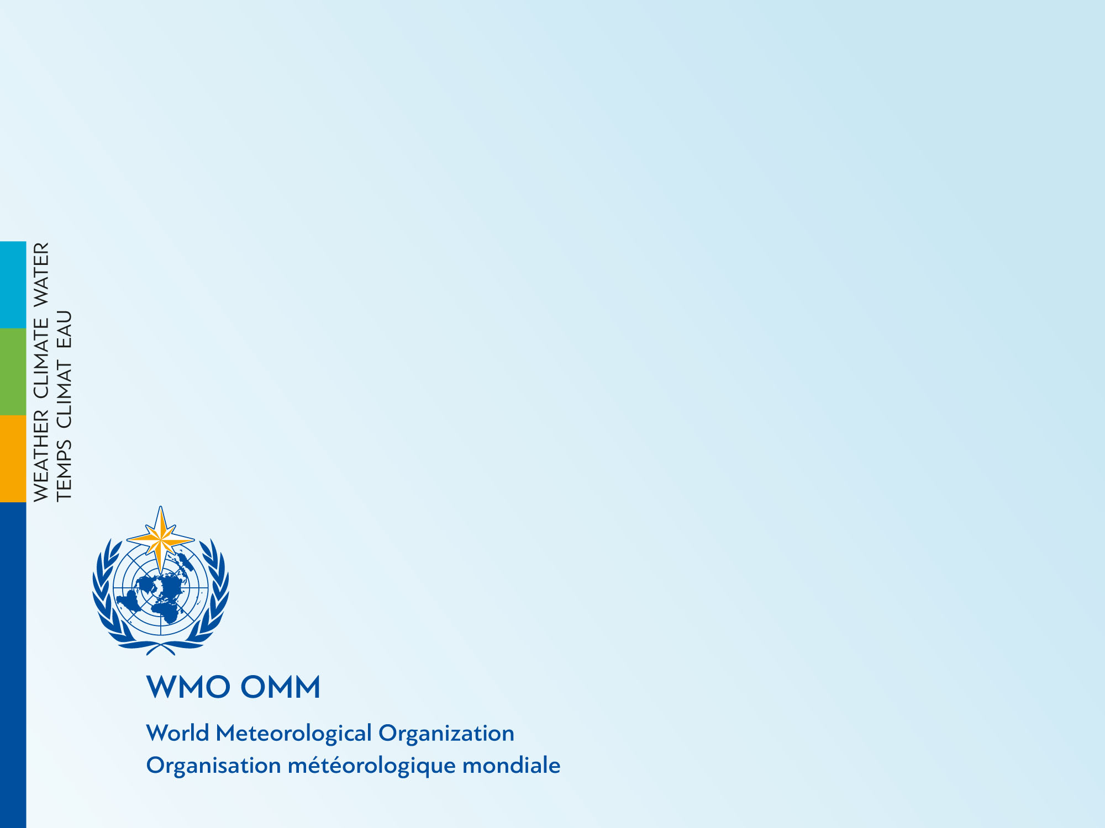
Thank you
Merci

