Slide 1
Integration of non-NMHSs data - an Australian view
Sue Barrell/Karl Monnik

Slide 2
Outline
Bureau external AWS ingestion strategy
Potential partnership opportunities
Australian Ocean Observing Partnership

Slide 3
Bureau External AWS ingestion strategy
Invest in developing and maintaining high-priority relationships that take time, effort and planning
Then engage more widely and promote benefits of data sharing
Implement additional system developments that provide efficiencies
Make it easy to submit metadata and alerts re changes
Maintain catalogue of external data including restrictions on use
Provide in-kind support to external parties
To support new data sharing relationships
Provide guidance materials
Simplify internal documentation on observing station implementation and operation for public use.

Slide 4
Bureau External AWS ingestion strategy/2
Evaluate external data
To understand system uncertainties and performance characteristics
Evaluate impact on NWP skill
Potential for future NWP assimilation of variable height and 3m wind
Implement data sharing agreements
Develop an audit schedule for review of external party relationships
Develop Bureau offerings and pursue partnerships
Ease of ingestion, access and visualisation
End-to-end observation services, from network design and install, to maintenance and operations, to integrated products and training
Explore new opportunities and keep an eye on crowdsourcing

Slide 5
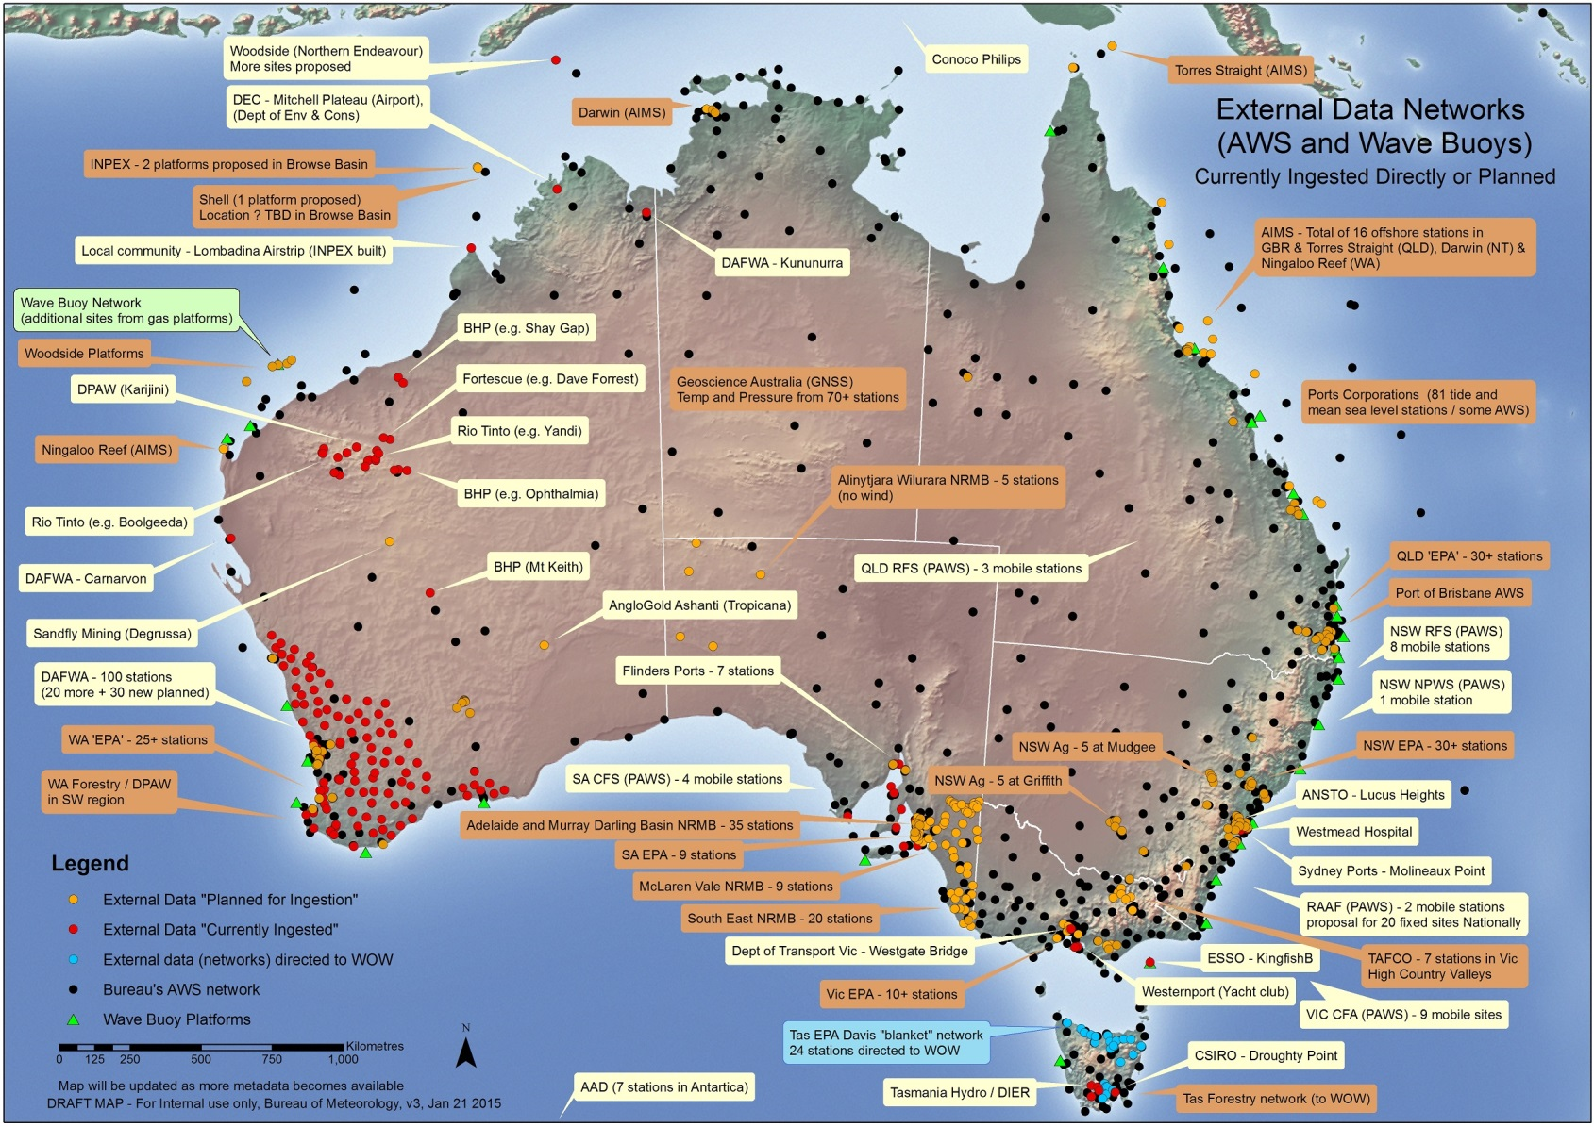
Potential external partners (existing opportunities)

Slide 6
Australian Ocean Observing Partnership (AOOP)
No single agency responsible for ocean observations
Many players, federal/state/local government, research
Strength/diversity in numbers but difficult to influence government
Operational dependency on research-funded systems
Need to ensure sustained and nationally coordinated observations of Australia's coastal and ocean environment
Basic/ongoing observations and supporting systems that meet national needs
Experimental/targetted observing systems such as R&D, special purpose, development/innovation pilots
Need to secure and share realtime and longterm data streams
Seek to develop tightly-coordinated national approach
Partners representing supply & demand (Bureau, Navy) and R&D community

Slide 7
AOOP – draft objectives & principles
To optimise design and operation of ocean observing systems, for efficiency, effectiveness and planned redundancy
To influence government investment in sustained ocean observations
To drive open, discoverable, accessible, retrievable ocean data
To set strategic directions for evolution of Australia's basic ocean observing system
To leverage capabilities, standards etc of basic ocean observing system in design of experimental systems
To facilitate migration of relevant candidate observing systems to operations
To coordinate and leverage international engagement
To plan, monitor, extract and assess benefits

Slide 8
Thank you

