Slide 1
Global Cryosphere Watch
TT-WMD-6
27-29 November 2017
Submitted by
Rodica Nitu
TT-WMD-6, 27-29 November 2017, Zurich, Switzerland

Slide 2
Outline
GCW overview and data requirements
Data and metadata exchange
Gaps and forward plan

Slide 3
Global Cryosphere Watch
GCW to be mainstreamed and implemented in WMO Programmes as a cross-cutting activity, by 2020
Developed similar to GAW
GCW Data Portal interoperability: WIS, WIGOS,
http://gcw.met.no/metamod/search;
Products – Trackers, assessments on the state of the cryosphere;
Information and services –
Develop an integrated glossary of cryosphere terms;
Website: http://globalcryospherewatch.org/
Also, lake and river ice, icebergs…

Slide 4
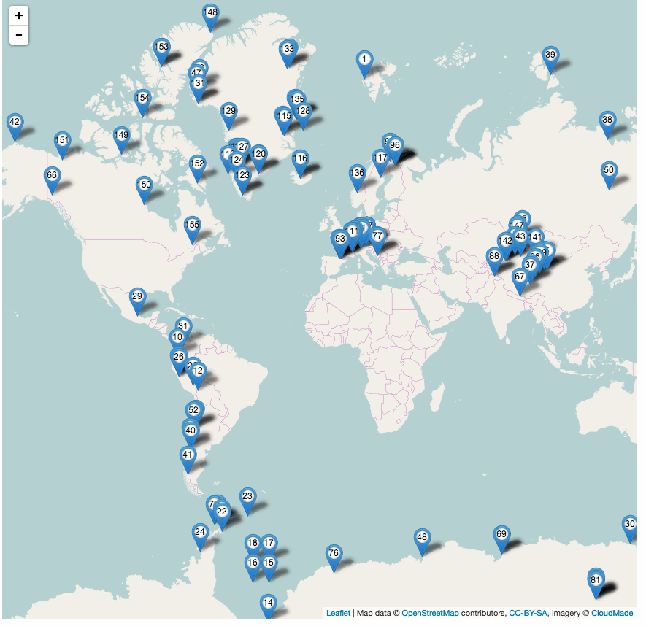
GCW surface network 2017:
GCW observing network:
a component of WIGOS
120 stations (CryoNet and contributing)
13 NMHSs, 15 Universities, Research, non-NMHS operational programmes.

Slide 5
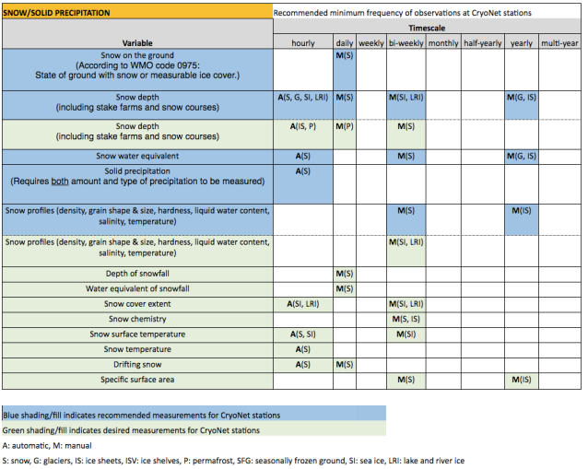
CryoNet Measurements: Required, Recommended, Desired
http://globalcryospherewatch.org/cryonet/variables/recommended_variables.html
10 cryosphere components
52 recommended cryosphere variables
66 desired cryosphere variables,
Meteorological observations
Notes:
To ensure a unique, high-quality network of surface observations, stations and sites are evaluated for inclusion in CryoNet based on several factors. Fulfilling the minimum requirements does not in itself guarantee acceptance as a CryoNet station. Other criteria that are considered by the CryoNet Team when evaluating applications include (1) the number of recommended variables that are measured (see the lists), (2) the continuity and length of the data record, (3) the extent to which data are available and accessible, (4) sustainability of the station, (5) conformity to GCW best practices, and (6) the location and representativeness of the proposed station relative to the geographic distribution of existing CryoNet stations.

Slide 6
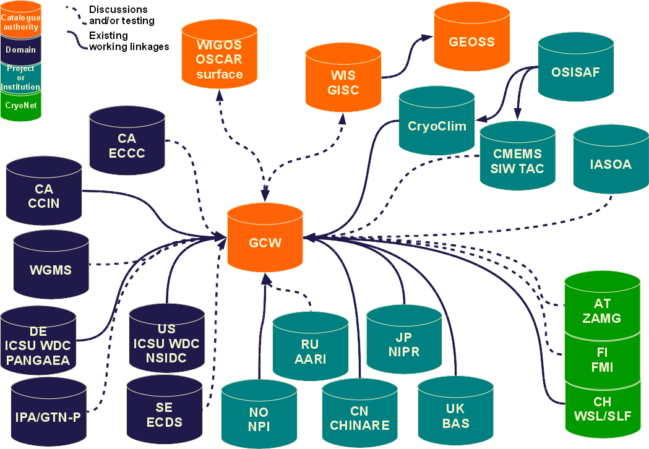
GCW Data Portal
Integrating data centres
Searchable index
Underlying metadata structure
Includes configuration metadata
Discovery metadata exchange
Uses OAI-PMH for harvesting metadata
Representation: GCMD DIF, ISO 19115, XSLT, including semantics
Data:
Data from host data centre
Not a data repository today
Uses OPeNDAP
Use of CDM
Relying on CF standard names and structures, and OGC WMS
Will extract, timestamp, and create BUFR

Slide 7
GCW: platform for broad engagement on cryosphere observations and research
Red outline: NMHSs
Blue outline: other organizations
Grey background: desired future collaborations
Environment and Climate Change Canada
FINNISH METEOROLOGICAL INSTITUTE
Arctic and Antarctic Research Institute (Russ Fed)
Chinese
Academy
of Science
WMO
PSTG
(space
agencies)
Notes:
GCW is a mechanism of WMO to engage a broad range of organizations which are active in cryosphere research and observations.
The mozaic of organizations engaged is testimony of the relevance of the GCW initiative to research and operational organizations

Slide 8
Data Accessibility
Current situation
Mainly connected to major data centres
Lacking connection to CryoNet stations
Acknowledge that WMO standards are hard to be supported by the scientific community
Interoperability
Metadata
Protocols (✓)
Structures (✓)
Semantics/terminology (-)
Data
Protocols (✓)
Formats (-)
Semantics/terminology (-)
Common data model (-)

Slide 9
Cryosphere Element | Variable | IGOS 2007 | OSCAR | GCW CryoNet minimum
 |  |  |  | * Recommended measurements.
 |  |  |  | § desired measurement’.)
Sea Ice: | Sea ice thickness | * | * | *
 | Sea ice motion | * | * | §
 | Sea ice deformation (diverg/ converg) |  |  | §
 | Sea ice draft |  |  | §
 | Sea ice surface characteristics | * | *
 | Snow depth on ice | * | * | Included as snow on surface
 | Sea ice cover | * | *
 | Sea ice surface temperature | * | * | §
 | Sea ice extent/edge | *
 | Sea ice concentration | * |  | *
 | Leads/polynyas | * |  | §
 | Ice age | *
 | Ridge height | * |  | §
 | Melt onset, duration of melt | * |  | (see next line)
 | Sea ice salinity profile (vertical) |  |  | §
 | Sea ice stratigraphy |  |  | §
 | Sea ice temperature profile (vertical) |  |  | §
 | Sea ice phenomena (dates of freeze-up, fast-ice form/breakout, melt onset, break-up) |  |  | *
 | Volume/Mass flux | *
 | Sea ice elevation |  | * | * ‘freeboard’
 | Sea ice type |  | * | * (level/rafted/ridged & floe descriptor)
 | Sea ice class (pack, fast ice) |  |  | *
 | Form of ice (floe size, fast ice width) |  |  | *
 | Stage of ice development |  |  | *
 | Sea ice stage of melting |  |  | *

Slide 10
SNOW Recommended Measurements for CryoNet Stations and how they compare with WMO Code Registry, WIGOS and OSCAR
Variable (source: GCW recommended variable list) | Included in the WMO Code Registry (y/n) | WMO Identifier | Included in OSCAR | Is it defined (No, W, O) | Definition: agreement with GCW Glossary definitions?
Snow on the ground | No | n/a | n/a | No | Not defined in GCW Glossary compilation
Snow depth | Yes | 629 | Yes | Yes, W,O | 6 def’s in GCW glossary plus 1 called “depth of snow” (AMS). WIGOS/OSCAR definitions are in agreement.
Snow Water Equivalent | Yes | 631 | Yes | Yes, W,O | Somewhat; GCW glossary has 5 related definitions, but agreement is needed (IPCC def looks clearest).
Solid Precipitation | No | n/a | No | No | n/a
Snow profiles (density, grain shape & size, hardness, liquid water content, salinity, temperature) | No | n/a | No | No | n/a

Slide 11
Annex 2. WIGOS/OSCAR variables and their agreement with CryoNet list and/or GCW Glossary compilation
Variable (primary source is the WIGOS/ OSCAR table) | Included in the WMO Code Registry (y/n) | WMO Identifier | Included in OSCAR | Is it defined (No, W, O) | Definition: agreement with GCW Glossary definitions? | Comments
Ice | No | 10017 | Yes | No | 10 different definitions of ice in GCW Glossary. | WIGOS/OSCAR table refers to “clouds” as the medium. The 10017 code doesn’t seem to exist in the online WMO codes list.
Snow/Ice/Glacier | No | 10077 | Yes | No | Not in GCW glossary. | WIGOS/OSCAR table – refers to “sea-water” as medium. The 10077 code doesn’t seem to exist in the online WMO codes list.
Ice | No | 10078 | Yes | No | 10 different definitions of ice in GCW Glossary. | WIGOS/OSCAR table – refers to “sea-water” as medium.
Snow/Ice/Glacier | Yes | 10094 | Yes | No | Not in GCW glossary. | WIGOS/OSCAR table refers to “ice-water(?)” as species. WMO Codes Notation is “lakeSnowIceGlacier”. Unclear of what this refers to.
Ice | Yes | 10095 | Yes | No | 10 different definitions of ice in GCW Glossary. | WIGOS/OSCAR table refers to “ice-water(?)” as species. WMO Codes Notation: “ice” (same as identifier #10104). Not sure why “ice” has two identifier numbers.
Snow/Ice/Glacier | Yes | 10102 | Yes | No | Not in GCW glossary. | WMO Codes Notation is “landSurfaceSnowIceGlacier”.
Glacier | Yes | 10103 | Yes | No | 14 different definitions of “glacier” in GCW glossary.
Ice | Yes | 10104 | Yes | No | 10 different definitions of ice in GCW Glossary. | WMO Codes Notation is “ice” (same as identifier #10095). Not sure why “ice” has two identifier numbers.
Snow | Yes | 10105 | Yes | No | 14 different definitions of “snow” in GCW glossary.
Snow/Ice/Glacier | Yes | 10109 | Yes | No | Not in GCW glossary. | WMO Codes Notation is “riverSnowIceGlacier”
Ice | Yes | 10110 | Yes | No | 4 different definitions of “river ice" | WIGOS/OSCAR table refers to “river” as medium. WMO Codes Notation is “riverIce”

Slide 12
Some variables of the GCW recommended observing programme refer to the same measurand for different domains, e.g. temperature, which is included as:
snow surface temperature,
snow temperature,
ground temperature (permafrost or seasonally frozen ground),
rock glacier spring temperature (permafrost),
surface temperature (surface-air temperature) for sea ice;
ice surface temperature (lake ice or river ice)
air temperature,
temperature profiles:
snow profiles,
ice/firn temperature profile (point) for glaciers, ice caps, or ice sheets;
sea ice temperature profile (vertical),
ice temperature profile (vertical) for river or lake ice.

Slide 13
Gaps
Include in the Metadata standard all cryosphere variables (CryoNet); currently, WIGOS metadata is not supported by the GCW Data Portal.
Develop simple, broadly accepted definitions and link to the scientific community (tables 1.01, 1.02) ;
Finalise Best Practices Guides to support the development of metadata (measurement method table 5.02)
Harvesting of metadata from submissions to GCW;
Assigning Station IDs;
Station vs site or cluster or….
Engage the international community (Arctic Data Committee, Scientific Committee for Antarctic Research, community based monitoring, etc…)

Slide 14
Thank you
rnitu@wmo.int

