Slide 1
FEEDBACK FROM VARIOUS COMMUNITIES
Hydrology
Agenda item 4.6
Tony Boston , Silvano Pecora
TT-WMD-6, 27-29 November 2017, Zurich, Switzerland

Slide 2
Outline
WHOS (WMO Hydrological Observing System)
Provision of WHOS metadata to OSCAR/Surface
Arctic-HYCOS station metadata

Slide 3
WMO Hydrological Observing System (WHOS)
A WMO Hydrological Observing System (WHOS) was proposed and agreed by the CHy Advisory Working Group as the means to provide the most comprehensive hydrological component in fulfillment of the WIGOS objective of “an integrated, comprehensive, and coordinated system which is comprised of the present WMO global observing systems.”
WHOS is conceived as a portal to facilitate access to already available on-line real-time and historical data, drawing from the water information systems of countries around the world that make their data freely and openly available, including HYCOS projects.

Slide 4
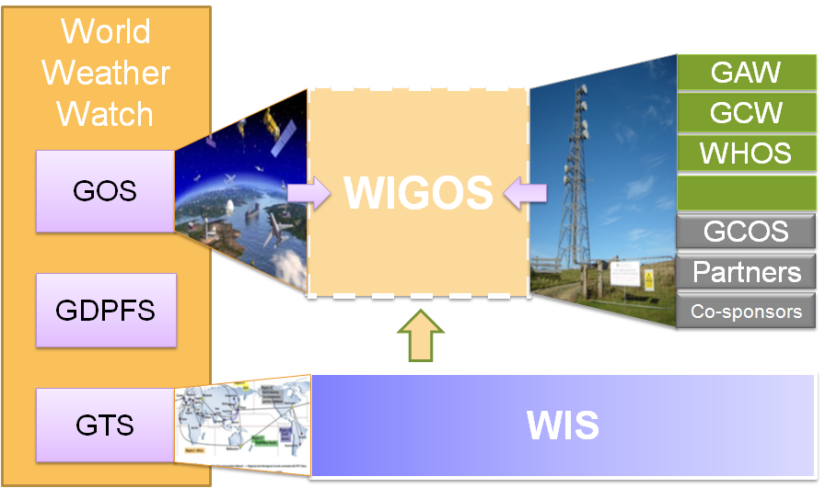
WMO INTEGRATED GLOBAL OBSERVING SYSTEM (WIGOS) and WMO HYDROLOGICAL OBSERVING SYSTEM (WHOS)
In June 2015 the President of CHy informed Cg-17 of CHy proposal to develop WHOS as the CHy contribution to WIGOS
Congress welcomed the effort and urged the president of CHy to continue guiding WHOS to full implementation
Congress urged the promotion of WHOS among NHSs and the hydrological community

Slide 5
WMO CHy-15 pre-session discussion

Slide 6
WMO Hydrological Observing System (WHOS)
Implementation:
Phase 1:
Map interface with links to those NHSs that make their real-time and historical stage and discharge data available online. implemented in August 2015.
Phase 2:
A fully WIS/WIGOS compliant services-oriented framework linking hydrologic data providers and users through a hydrologic information system enabling data registration, data discovery, and data access.
Beta version for CHy-15 review and endorsement (Dec 2016)
Initial implementation for EC approval (June 2018)

Slide 7
WHOS PHASE 1

Slide 8
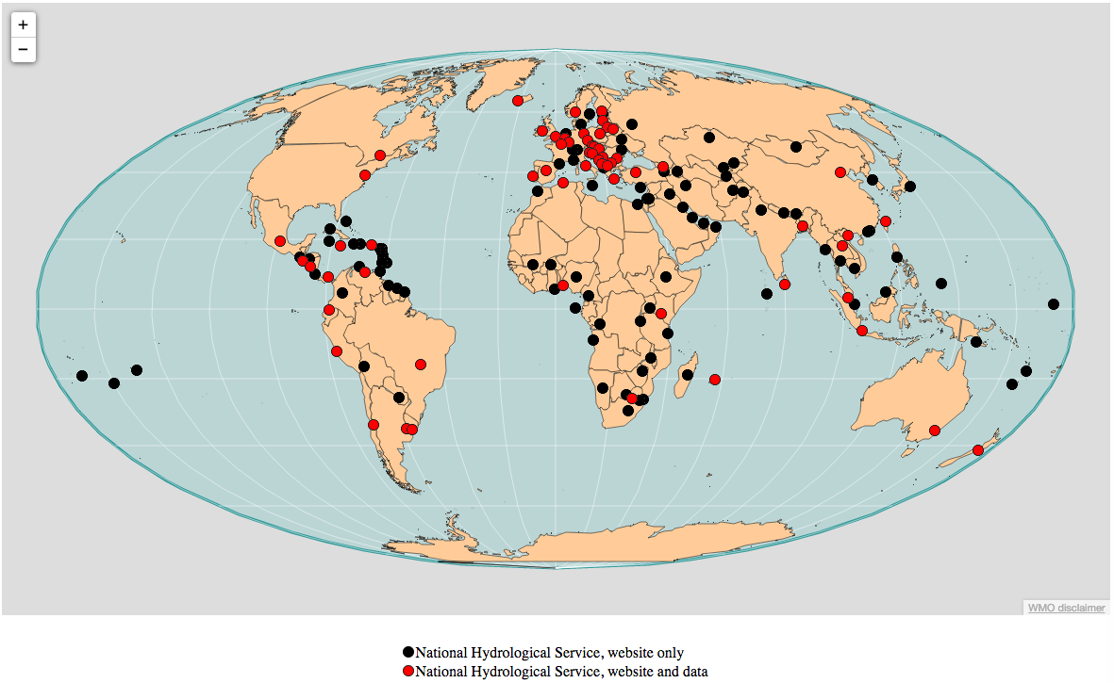
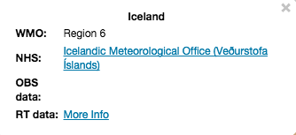
WMO Hydrological Observing System (WHOS)
Phase 1 -- WorldWide Map Portal
http://www.wmo.int/pages/prog/hwrp/chy/whos/

Slide 9
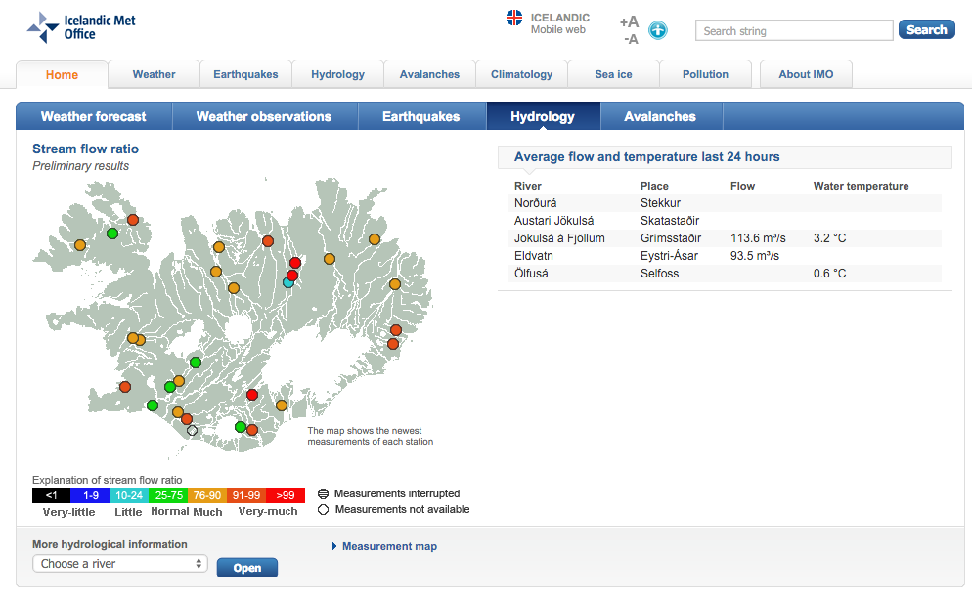
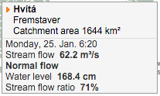

Slide 10
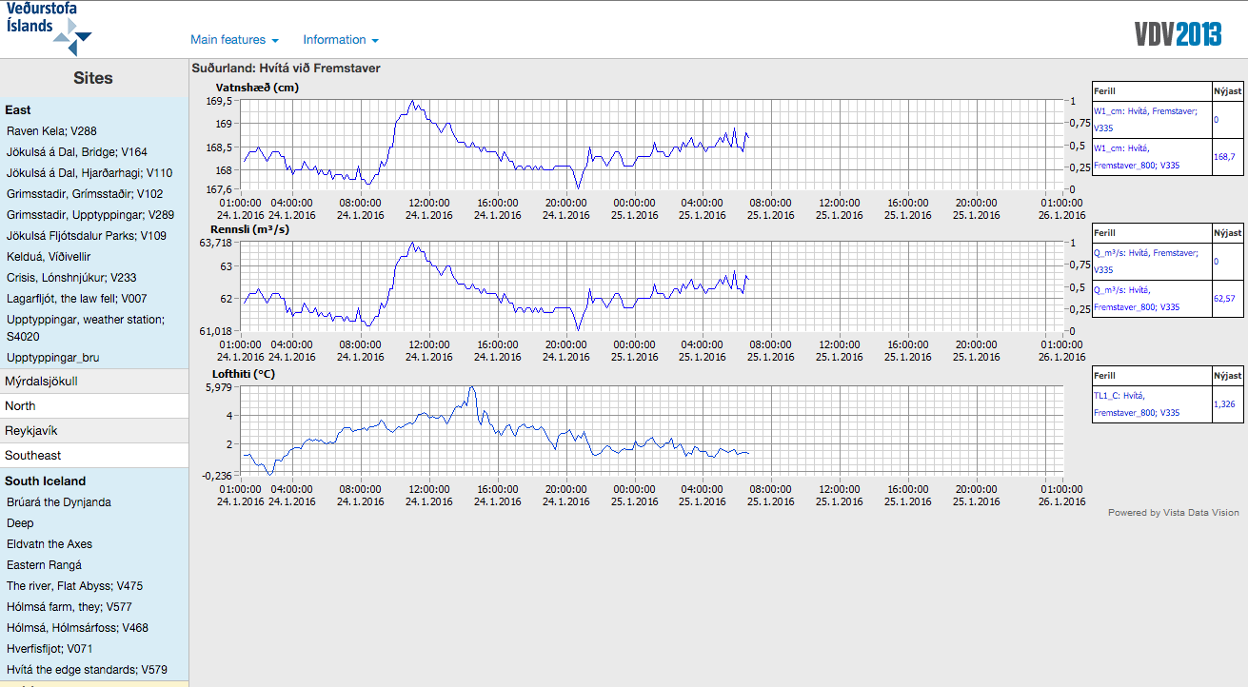

Slide 11
WHOS PHASE 2

Slide 12
WHOS Phase 2
Using WMO and OGC Standards
HydroCatalog
(register)
CSW
HydroProvider
WFS
SOS2
(WaterML 2)
HydroClient
http://hiscentral.ddns.net/whos/

Slide 13
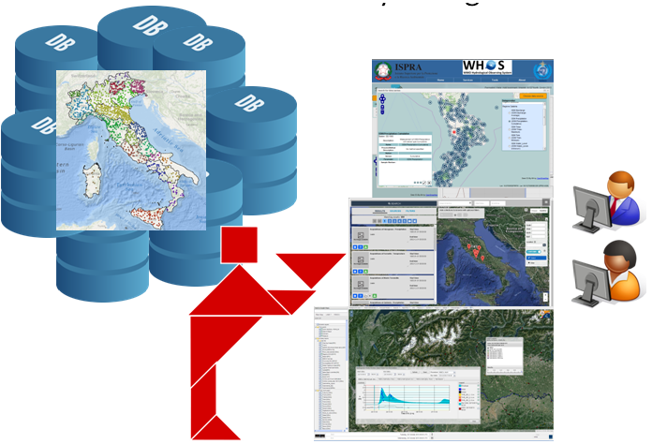
Federated hydrological data in WHOS
http://www.hiscentral.isprambiente.gov.it/hiscentral/

Slide 14
WHOS interfaces
OAI-PMH interface endpoint can be used to harvest WHOS content as:
Dublin core
ISO 19139
2006 schema
2007 schema
Wigos Metadata Standard
http://arpa-er.geodab.eu/gi-cat-arpa/services/oaipmh?wsdl

Slide 15
jOAI Harvester - configuration
WHOS OAI-PMH endpoint
SetSpec is optionally used to limit the harvest to a single source
Metadata format to be used. One of:
oai_dc
ISO19139
wigos

Slide 16
Arctic-HYCOS project

Slide 17
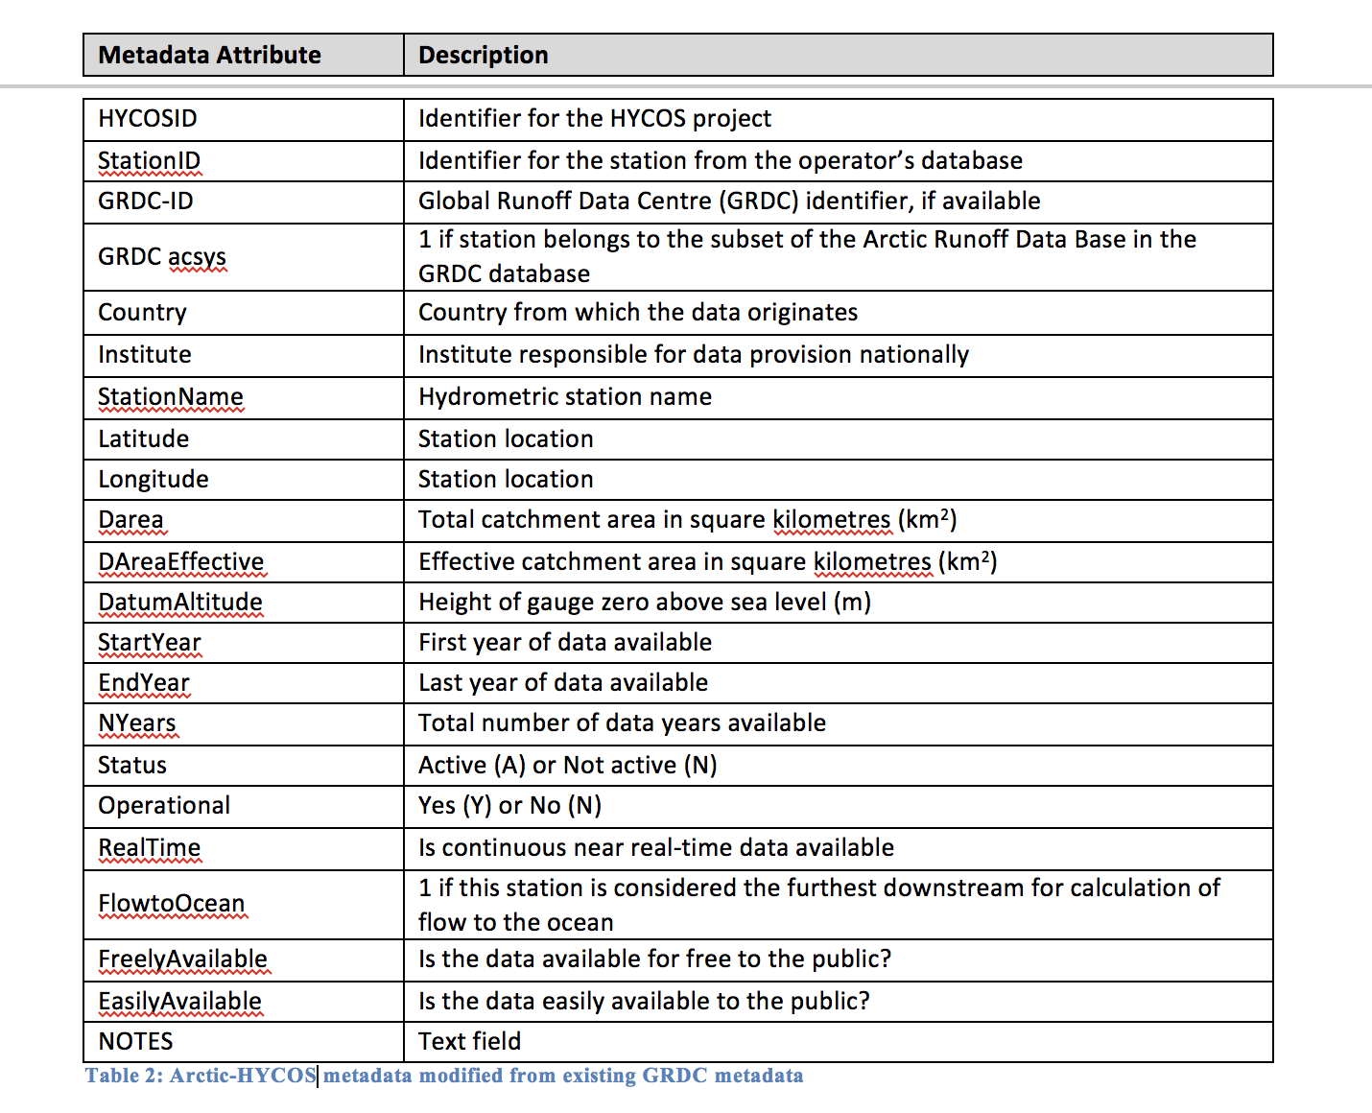
Arctic-HYCOS station metadata

Slide 18
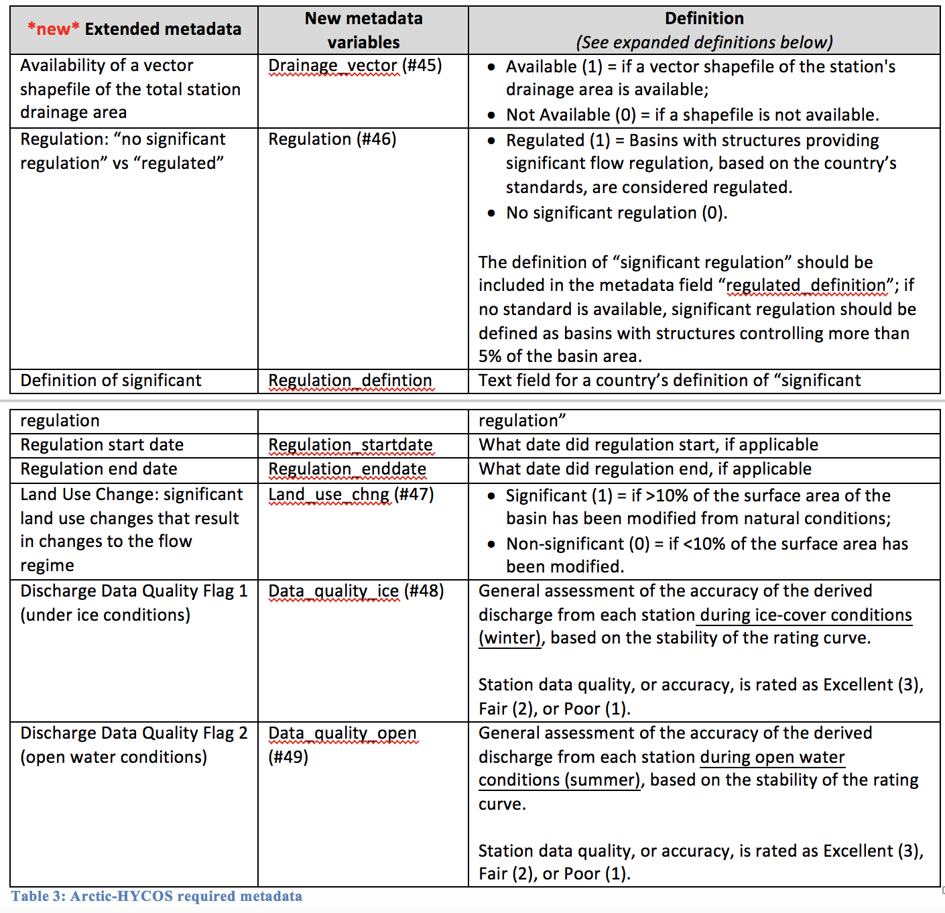
Arctic-HYCOS station metadata (2)

Slide 19
Thank you
tony.boston@anu.edu.au

