Slide 1
Relation between WIS and WIGOS metadata
5.1
Secretariat
TT-WMD-6, 27-29 November 2017, Zurich, Switzerland

Slide 2
Outline
WIS and WIGOS metadata
Observing times
Linking WIS to WIGOS and WIGOS to WIS

Slide 3
WIS and WIGOS metadata

Slide 4
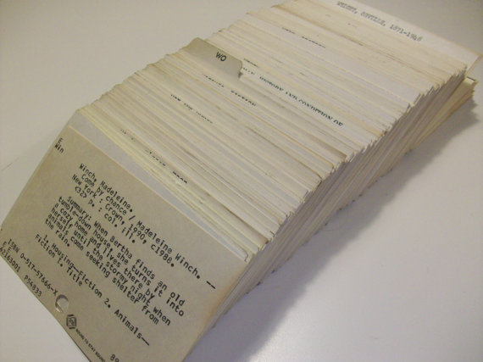
WIS Discovery Metadata
Dataset title
Dataset reference date
Dataset responsible party
Geographic location of the dataset
Dataset topic category
Dataset descriptive keywords
Abstract describing the dataset
Distribution format
Online resource
Dataset language
Dataset character set
Description of “dataset”
Title: brief (“one line”) description of it
Abstract: summary of what is in the it
Creation and modification dates: dates of changes to the it
Contact: organization responsible for it
Category: broad indication of its contents
Bounding box: area covered by it
Time period: period covered by it
GTS distribution: is it to be exchanged in near real-time?
Data policy: who may use it
Admin
Unique identifier for metadata record
Spatial resolution of the dataset
Additional extent information for the dataset (vertical and temporal)
Spatial representation type
Reference system
Lineage
“Other” constraints
Metadata file identifier
Metadata standard name
Metadata standard version
Metadata language
Metadata character set
Metadata point of contact
Metadata date stamp

Slide 5
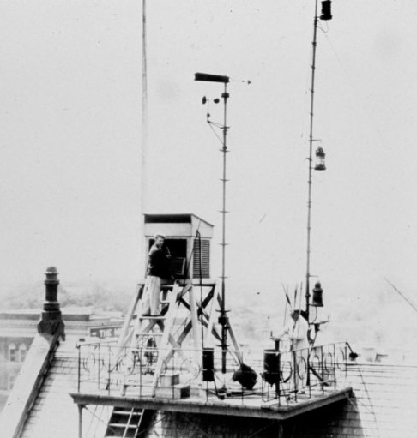
High level content
1. Observed Quantity
2. Purpose of Observation
3. Data Quality
4. Environment
5. Data Processing and Reporting
6. Sampling and Analysis
7. Station/Platform
8. Method of Observation
9. Ownership and Data Policy
10. Contact

Slide 6
Observing times

Slide 7
High level content
1. Observed Quantity
2. Purpose of Observation
3. Data Quality
4. Environment
5. Data Processing and Reporting
6. Sampling and Analysis
7. Station/Platform
8. Method of Observation
9. Ownership and Data Policy
10. Contact
When creating the observation

Slide 8
WIGOS metadata – reporting times
Records when observations are scheduled to be made.
This makes no statement on whether observations are exchanged.
Some observations may not be made routinely available to other organizations.
Some observations may not be retained.

Slide 9
WIS metadata – reporting times
World Weather Watch routine reporting (GTS reports)
Required information | Where in metadata | Value
Contains observation(s) | WMO_CategoryCode | weatherObservations
Observation Facility | Keyword Type: place; Thesaurus name: “WMO WIGOS station identifiers” | http://data.wmo.int/wigosid=0-a-b-c
Is exchanged | WMO_Distribution_Scope_code | GlobalExchange, RegionalExchange
Time | Keyword Type: temporal | hh:mm:ssZ
Parameter | Keyword | No guidance available
Issues
WIGOS Id is guidance only – introduced 2017
Parameter – no guidance provided

Slide 10
WIS metadata – reporting times (2)
Metadata records
GTS data are described using one metadata record for each bulletin name. For example, Synoptic reports for Dakar are recorded alongside reports from other stations in bulletins:
Traditional alphanumeric codes
SMSG01GOOY (00Z, 06Z, 12Z and 18Z)
SISG20GOOY (03Z, 09Z, 15Z and 21Z)
Table Driven Code Forms
ISMA01GOOY (00Z, 06Z, 12Z and 18Z)
ISIA20GOOY (03Z, 09Z, 15Z and 21Z)
However the metadata records for these bulletins
only contain only the IIiii form of station identifiers
do not state that the data are for GTS global exchange
do not state weatherObservations
This is typical – metadata records were written before the guidance

Slide 11
WIS metadata – reporting times (3)
Catalogue
WeatherObservations
hh:mm:ssZ
Station
Select only observations
Find observation times
Combine observation times for stations
Issues
Time difficult to extract and could match other items.
WIGOS Id orIIiii - could be embedded in other information.
No “codified” parameter or report types.
Overlap of WMO_CategoryCode – authors only use one.

Slide 12
WIS metadata – reporting times (4)
Conclusions
Required information is not “structured”
Reliance on pattern-matching will lead to errors
No standard terminology for parameters
Not clear what is in the schedule
Records use “synopticMeteorology” but not “weatherObservation”
Mixes forecasts and observations
WIS metadata standard would need to be revised to support a reliable catalogue for reporting schedules

Slide 13
Linking WIS to WIGOS and WIGOS to WIS

Slide 14
Linking to WIS and WIGOS metadata
http://data.wmo.int/wisid=fileIdentifier
http://data.wmo.int/wisid=urn:x-wmo:md:int.wmo.wis::SMVA02DTTA
http://data.wmo.int/wigosid=0-a-b-c
http://data.wmo.int/wigosid=0-20000-0-03808

Slide 15
WIS and WIGOS metadata contents
Creating a catalogue of reporting schedules from WIS metadata
Not feasible without changes to WIS metadata standard
Linking to WIS and WIGOS metadata records

Slide 16
Thank you
wis-help@wmo.int

