Slide 1
WIGOS Data model
– standards introduction

Slide 2
Introduction
This presentation briefly introduces ISO standards for conceptual modelling that provide context and structure to the data modelling we are doing.

Slide 3
What is the data model?
An 'implementation-neutral' formal definition of the WIGOS standard.
Defined in 'UML' – Unified Modelling Language
Agrees the semantics and relationships
Can be used to derive 'standard' implementations:
Exchange formats (e.g. XML Schema)
Database designs
Inform machine to machine interface design?
Other?

Slide 4
Established Standards for Information Modelling
OGC - Open Geospatial Consortium
Implementation of many ISO concepts
Particularly around web services and information/data
Note that some of the OGC implementation standards are also ISO standards (e.g. GML 3.2.1 is the same as ISO 19136)
ISO TC 211 - Geographic information/Geomatics
Extensive, mostly abstract, model for geographic information and services

Slide 5
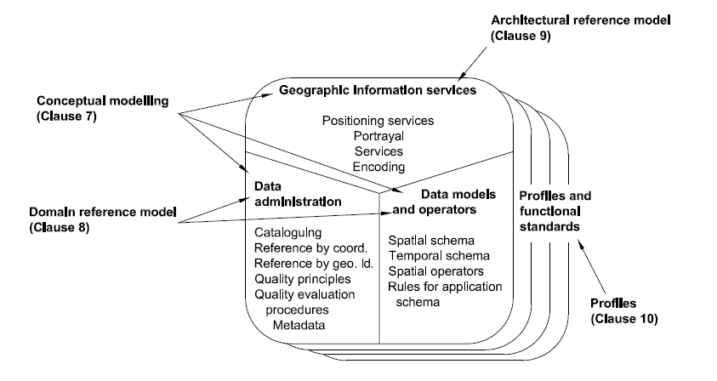
ISO 19101 Geographic Information Reference Model
It starts… "Every comprehensive standardization effort needs a reference model…"

Slide 6
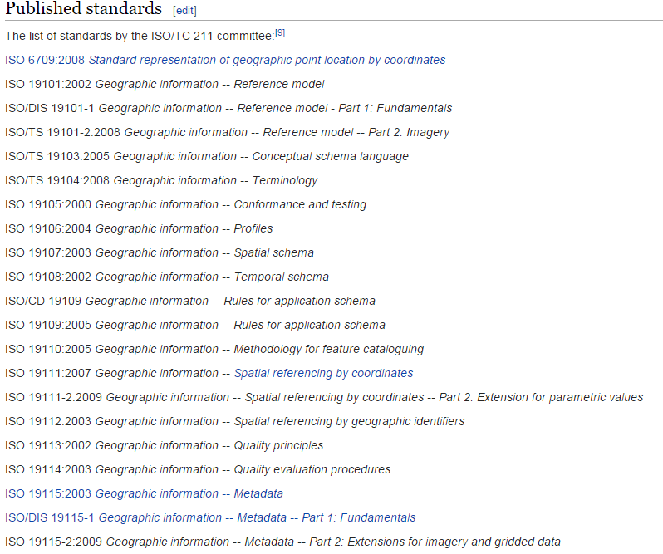
Some of the ISO TC211 Suite of standards…
The ISO standards can be considered to be a re-useable resource for our models – particularly around the representation of space, time, geometries etc.
As well as defining core concepts like features, coverages, observations.
Source: Wikipedia 2015

Slide 7
Conceptual Modelling in the ISO standards ISO 19109 – Rules for Application Schema
Two main topics of interest:
The General Feature Model
Rules for modelling Application Schema in UML
Or in other words:
What is our agreed 'meta-model'?
What should a conformant information model look like?

Slide 8
The General Feature Model
"A feature is an abstraction of real-world phenomena"
Concept of feature is not restricted to 'vector' features.
A feature could be an Observation, a Sensor, a Station, a Road, a Coverage... Pretty much anything.
We are aiming to identify the feature types needed for WIGOS Observation Metadata
The GFM defines the structure for classifying features that we need to keep in mind when we build our data model.

Slide 9
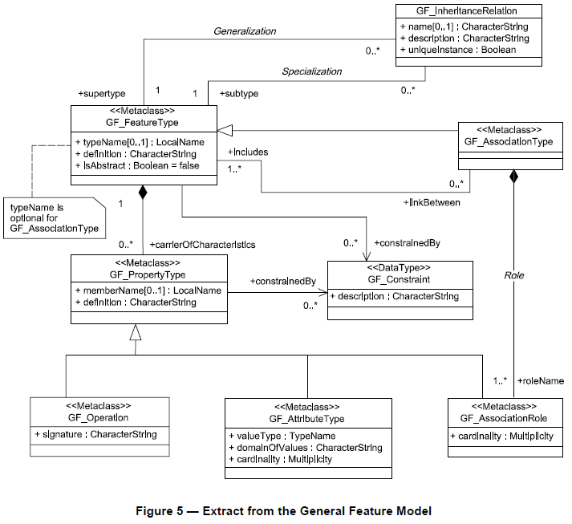
GFM – a 'metamodel' for feature types
A feature type is defined by:
[1] a name and description
[2] its attributes/properties
[3] association roles
[4] defined behaviour of the feature type.
Additional concepts:
[5] feature associations between the feature type and itself or other feature types
[6] generalization and specialization relationships to other feature types
[7] constraints on the feature type.
[6]
[1]
[2]
[7]
[5]
[3]
[4]

Slide 10
The General Feature Model - what it all means for WIGOS Observation Metadata:
We are aiming to identify the feature types needed to represent WIGOS Observation Metadata.
We need to:
Identify these feature types
Give them names and definitions
Identify the properties (attributes) of these feature types
Decide on what form the values of these properties should take (the value of a property may be another feature or simple 'data types').
Identify the relationships between different feature types and the nature of those relationships
Identify any constraints that should be placed on the feature types
We will encode all of the above in a UML model known as an 'Application Schema'.
This UML model then becomes our agreed definition – from which other forms (documentation, XML schemas, database schemas etc.) can be derived.

Slide 11
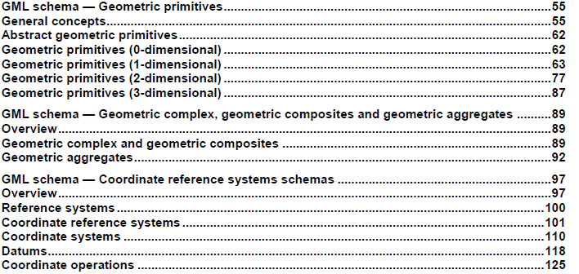
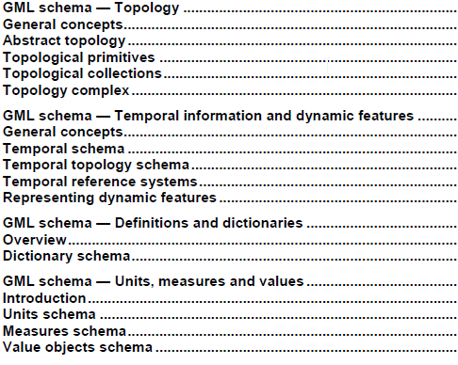
GML as an implementation of ISO standards.
UML defined according to ISO 19109 can be automatically transformed into a GML application schema (an XML Schema encoding).
GML = OGC Geography Markup Language/ISO 19136
GML is an extensive XML-based implementation of the ISO TC211 standards, particularly around spatial types, coordinate reference systems etc.

Slide 12
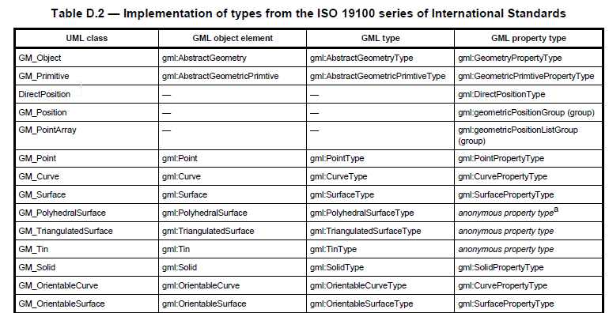
GML implementation of ISO continued
Implementation of ISO 19000 standards
See Annex D of GML 3.2.1 for complete table (several pages long)

Slide 13
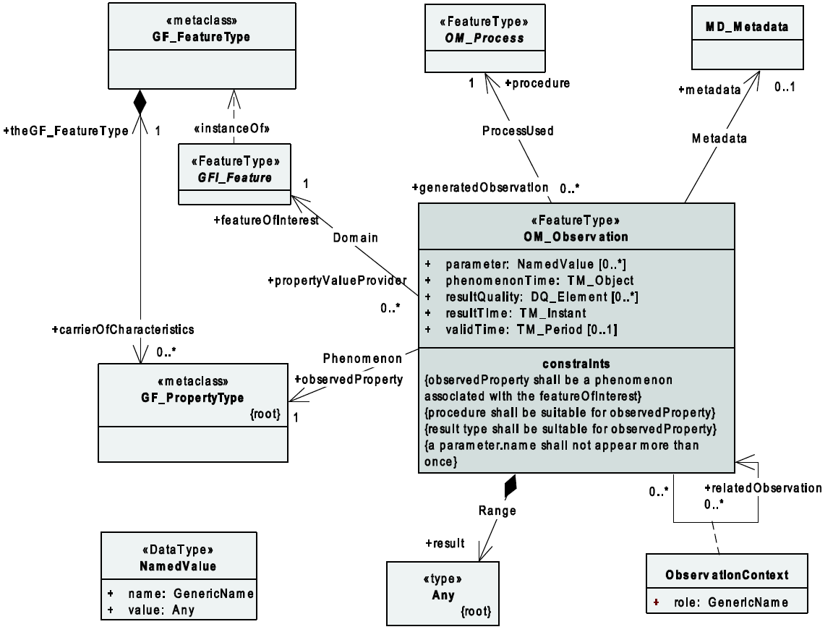
19156: Observations & Measurements
An observation is an act […] through which a number, term or
other symbol is assigned to a phenomenon.
It involves application of a specified procedure […]
The result of an observation is an estimate of the value of a property of some
feature.
*plus Discovery metadata

Slide 14
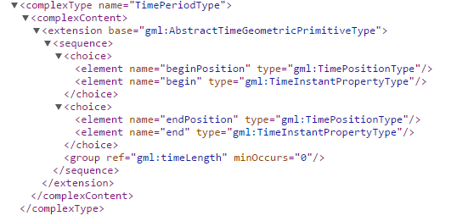
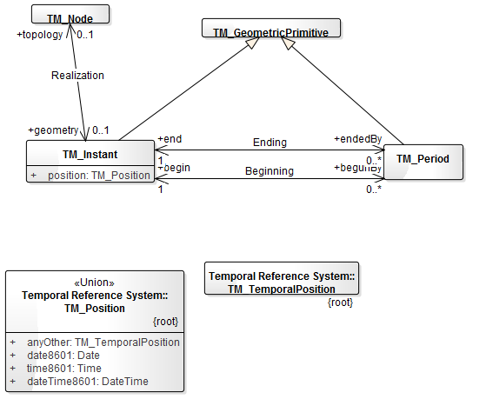
Using ISO in models gives us GML encodings
ISO 19108 UML model
GML Schema
GML Encoding Example
<gml:TimePeriod gml:id="t-ipet-mdrd-2-meeting">
<gml:beginPosition>2015-06-21T23:00Z</gml:beginPosition> <gml:endPosition>2015-06-25T07:00Z</gml:endPosition> </gml:TimePeriod>
GML has done the hard work of defining the encoding details
http://schemas.opengis.net/gml/3.2.1/

Slide 15
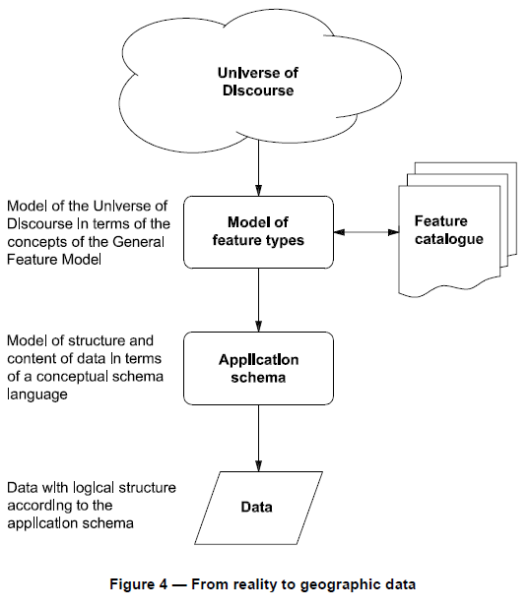
ISO 19109: Building an information model
Conceptual
Model
Start by clearly defining the scope
WIGOS Standard
Model in terms of the 'General Feature Model'
Derive an 'Application Schema'
Encode data
Logical
Model
UML
WIGOS
Data
Model
GML App
Schema
(could be others)
Physical
Model
XML instances,
Database records,
… etc..
Data

Slide 16
Thank you for your attention
Dominic Lowe
d.lowe@bom.gov.au

