Slide 1
The interaction between WDQMS and OSCAR/Surface
1st Meeting of TT-OD 27.11.2018 Geneva
Estelle Grueter et al.

Slide 2
Starting point
Request by ICG-WIGOS:
«3.1.4 ICG-WIGOS requested that “quantitative monitoring information from the WDQMS to become part of the station report in OSCAR/Surface”, which will provide valuable additional information.”
What do OSCAR/Surface Users really need ? → different attempts to find out but still not really clear
Output of Meetings (6/11/17 and 20/11/17):
OSCAR/Surface wants:
an aggregated value per station and observation
for each calendar month
Not only actual but also historical

Slide 3
WDQMS in a nutshell
The WIGOS Data Quality Monitoring System (WDQMS) consists of three main functions:
the WIGOS Quality Monitoring Function: comparison of the observational data ‘received’ at the WIGOS Monitoring Centre against declared reporting frequency ( → OSCAR/Surface)
the WIGOS Evaluation Function: evaluation if there is an issue with the observational data received at the Monitoring Centre or some other component of WIGOS, such as the metadata records held in OSCAR/Surface.
the WIGOS Incident Management Function: monitoring and management of the Incidents raised by the Evaluation Function incl. tracking of progress with Incident ‘investigation and resolution’.

Slide 4
Interfaces between WDQMS & OSCAR (strategic level)
WDQMS
OSCAR
Primary purpose | Describe how well WIGOS is providing required observations, and report findings, incidents (Quality monitoring & incident mgt. of global/national assets) | Understanding observational data, GAP analysis, support WDQMS, support CPDB, use as national DB (Technical doc/analysis of global/national assets)
Users | Members, Regional WIGOS centres, users of data | Network planners/managers, global/regional/national levels, data users (scientists, eg. climatologists), international organizations
Variable scope | Individual observed variable (P, T, U, more if available) | Individual observed variable (P, T, U, radiation, chemical composition, hydrology,…)
Temporal aggregation | 6-hourly or else highest resolution available | Monthly (actual as well as historical)
Spatial aggregation | Individual location of observation (station level) | Individual location of observation (station level)
KPI = key performance indicator

Slide 5
Interfaces between WDQMS & OSCAR (strategic level)
WDQMS
OSCAR
Imports Displays | Declared status, schedules (present) | «real» status (monthly) Contacts, organizations
Exports | «real» status (daily) | Declared status, schedules (present, past) KPIs on metadata completeness Focal Point Activity
Access | Restricted to Focal Points | Public
KPI = key performance indicator
Agreement: monthly aggregated values for each calendar month and each variable in OSCAR/Surface (not only actual but also historical)

Slide 6
Aggregation for OSCAR/Surface →Daily aggregation across Monitoring centres
So far ..
ECMWF
JMA
NCEP
EUCOS
…..
Monitoring Results
Monitoring Results
Monitoring Results
Monitoring Results
Monitoring Results
e.g. 6 out of 8 5 out of 8 7 out of 8 6 out of 8 ….
Aggregation
1 value / variable / station / month
To be done ..

Slide 7
Daily aggregations WDQMS
Challenges
Aggregated value needed for OSCAR/Surface → user requirements not really clear. → what exactly needs to be delivered?
Does not only concern Data availability, but also Timeliness and Quality
Rules:
Data Availability:
Proposal: → value considered to be reported if at least one of the monitoring centres is using it.
→ Aggregation from 6 hourly /stn/obs → daily/stn/obs → monthly/stn/obs → per each center → afterwards overall
Timeliness and Quality: ??
Average over all centres? Information comparable?

Slide 8
Outputs of WDQMS
Data availability: total number of meteorological bulletins (TAC/BUFR) received during a defined period (e.g. 24 hours) compared to the required number of bulletins as determined by the observing schedule in OSCAR/Surface
Timeliness: delay between the nominal observation time of a particular observation message type issued at site of a Member and reception time at users´ database of this message received via GTS.
Quality: Combining trueness and precision as outlined in ISO5725 (mainly derived from “Observation minus Background” (O-B) NWP results from Global NWP Centres for particular parameters such as air pressure, air temperature, wind and relative humidity observations.

Slide 9
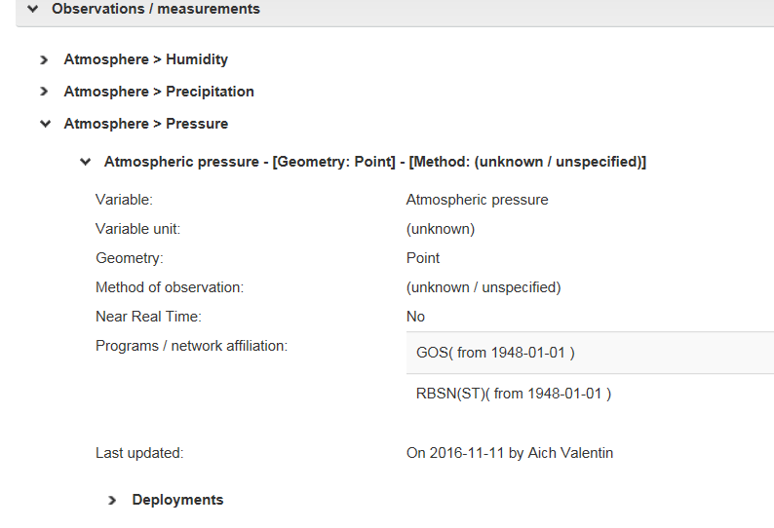
Aggregation per variable: Display?
In discussions how and where to implement this information it showed, that
It isn’t clear, if this aggregated value has to be calculated for each observation in relation to the program to which it contributes .. The user might apply different criteria to check the needed availability
Display of reporting status:
Do we use categories and if so → related to Thresholds of Requirements (would have to be set specifically depending on priority, region etc)

Slide 10
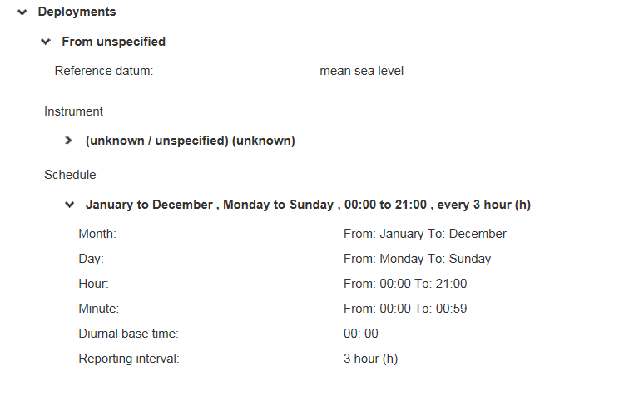
Generic vs specific information
Another question: where to put the information? → Observations: → not a specific setting but the observation in general or
→ Deployments → specific setting of how it is carried out
.. or here.. or?
Here …

Slide 11
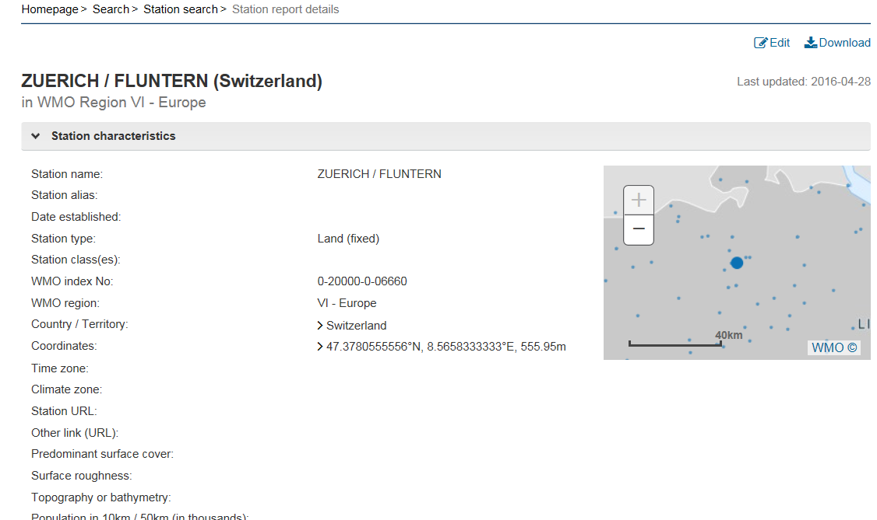
What information is needed in OSCAR/Surface?
Is only a performance status required per variable or is there any need for a «station»-wise point of view? → aggregation across variables necessary? → if no guidance: do people not do it anyway?
Regularly reporting
Occasionally reporting
Not reporting

Slide 12
Possible Solutions
Challenges:
We still don’t know the concrete requirements about how this information is going to be used within OSCAR/Surface
We can decide it’s not needed to come up with a guideline how to aggregate across variables but people might nonetheless start to do it → guideline how to do would be helpful
Challenge of categorisation (e.g. «reporting» = % of reported values) → applied categorisation can differ from country to country depending on used criteria. Relation to thresholds of requirements?
Proposals:
Not definitely specified user needs: → create table (see next slide) to deliver basis in order that they can calculate in OSCAR/Surface their required actions itself.
Using of M2M-Interface to deliver aggregated values to OSCAR/Surface

Slide 13
Data delivered to OSCAR/Surface /1
ID | Attribute | Description | Explanation
1 | Attribute being aggregated (table WMS 1-01?) – this needs to be considered carefully. | Observed variable – measurand | Variable intended to be measured, observed or derived, including the biogeophysical context
 | Geometry?
2 | Location indicator (table WMS 3-06) | Station/platform unique identifier (WSI)
3 | Type of Aggregation
4 | Aggregation Result (table WMS 8-03 and 8-04?) | Quality flag Quality flagging system | An ordered list of qualifiers indicating the result of a quality control process applied to the observation Reference to the system used to flag the quality of the observation

Slide 14
Data delivered to OSCAR/Surface /2
ID | Attribute | Description | Explanation
5 | [+ Units of Result] – linked to 1 & 2?
6 | Aggregation Period (table WMS Table 7-09?) | Aggregation period | Time period over which individual samples/observations are aggregated
7 | Aggregation Methodology (table WMS 7-01?) | Data-processing methods and algorithms | A description of the processing used to generate the observation and list of algorithms utilized to derive the resultant value
8 | Aggregation Provider (table WMS 7-02?) | Processing/analysis centre | Centre at which the observation is processed
9 | More?

Slide 15
Proposed next steps
Specification for implementation of this table in XML: → OSCAR/Surface project team with support of TT WDQMS
Implementation of an example in XML → OSCAR/Surface project team
Evaluation if adaption of OSCAR/Surface DB necessary to store this information → OSCAR/Surface project team
Implementation of this example using the M2M-API → OSCAR/Surface project team
But: this only comprises the delivery of the information to OSCAR/Surface but not how its going to be displayed there

Slide 16
Conclusion
Since the users need regarding the monitored status report within OSCAR/Surface is not really clear → proposal to send table with monthly values per station & observed variable
There are still open questions such as:
only values for Data availability or also Timeliness and Quality?
does this table need to contain the exact values or rather percentages or categories?
who will be able to provide answers to TT-WDQMS?
WDQMS only provides the information about the reported values but it’s not defining the way it will be visualized within Oscar/Surface

