Slide 1
Regional WIGOS Implementation Plan (R-WIP-I)
I.Zahumensky

Slide 2
XVI-RA-I (3-9 February 2015)
Resolution 8 (RA I-16) – WMO Integrated Global Observing System Implementation Plan for Regional Association I (Africa);
R-WIP-I should be:
supported by all the Members of the Region,
guided, supervised, monitored and updated by the Management Group of RA I, with periodic reports from appropriate subsidiary bodies in charge of WIGOS

Slide 3
XVI-RA-I (3-9 February 2015)
R-WIP-I should be further revised to accommodate new projects when submitted by Members,
President was authorized to approve any necessary revision of R-WIP-I during the intersessional period in consultation with the Management Group
RA-I/TT-WIGOS re-established.

Slide 4
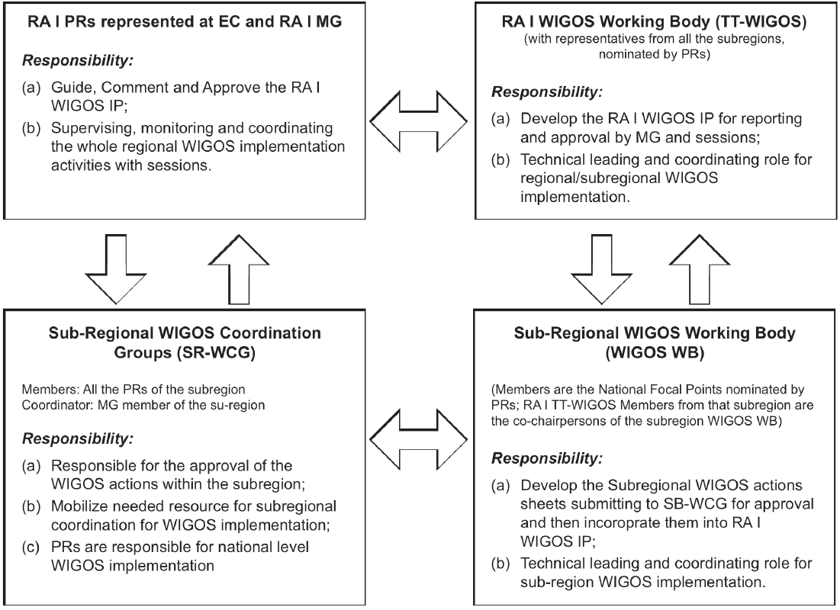
RA I WIGOS Governance and Working Structure

Slide 5
WIGOS Framework: Key activity areas
Management of WIGOS Implementation / operation
Collaboration with co-sponsors and partners
To oversee, guide and coordinate WIGOS
Data discovery, delivery & archival
Design, planning and optimised evolution
To ensure supply of and access to WIGOS observations
To plan, implement and evolve WIGOS component systems
Observing system operation & maintenance
Quality Management
To facilitate and support the operation of WIGOS
Communications and outreach
Capacity Development
Operational Information Resource
Standardization, interoperability & compatibility
Notes:
5

Slide 6
Plan for WIGOS Pre-operational Phase (PWPP)
Five priority areas:
National WIGOS implementation
WIGOS Regulatory and Guidance Material
WIGOS Information Resource
WIGOS Data Quality Monitoring System
Regional WIGOS Centres

Slide 7
Steps
Taking unto account:
Decisions by Cg-17
Progress achieved so far
Better understanding of WIGOS, lessons learned, experiences
Priorities for the RA I
Resources available

Slide 8
Table 2 WIGOS Implementation Activities
No. | Activity | Deliverables | Timeline | Responsibility | Estimated Costs (2012-2015) K CHF |  |  | Potential Risks
 |  |  |  |  | Total | ARB | Shortfall
1. Management of WIGOS Implementation in RA I
1.1 R SR N | Establish the Regional WIGOS Governance structure, including sub-regional responsible economic bodies (SADC, IGAD, ECOWAS, CEMAC/ECCAS, UMA etc.), and technical groups (ACMAD, ASECNA, ICPAC, AGRHYMET, etc.) for each subregion | RA I WIGOS Governance structure, incl. WGs established with TOR (see ANNEX 1, Figure 1) | 2012 | RA I MG, Sub-regional WIGOS Working Body; Governance |  | Low

Slide 9
Steps
To check Table 2 line-by-line:
Deliverable desirable to be achieved
Activities needed to achieve it
Realistic Deadline / Timeline
Responsibility
Realistic estimation of resources needed
Potential risks to deal with

Slide 10
Steps
To check Table 2 line-by-line:
Deliverable desirable to be achieved
Activities needed to achieve it
Realistic Deadline / Timeline
Responsibility
Realistic estimation of resources needed
Potential risks to deal with

Slide 11
Steps
To consider potential Pilot Projects on:
OSCAR implementation
Data Quality Monitoring
Incident Management
Establishment of RWC
Helping the LDCs of RAI

Slide 12
Thank you for your attention
www.wmo.int/wigos

