Slide 1
Role of AMCOMET and Regional Economic Communities (RECs) in the implementation of WIGOS
Dr J. R. Mukabana
Director (AFLDC & AMCOMET Secretariat)

Slide 2
African Ministerial Conference on Meteorology (AMCOMET) was established in April 2010 when African ministers responsible for Meteorology met in Kenya and adopted the Nairobi Ministerial Declaration
Let’s Recall:
The VISION of AMCOMET is to have a framework for cooperation to support security, socio-economic development and poverty eradication on a pan-African level through sound governance of the science of meteorology and its related applications
The MISSION of AMCOMET is to provide political leadership and guidance, policy direction and advocacy in the provision weather and climate services that meet societal needs

Slide 3
So far:
There has been 3 Sessions:
First Session was convened in Nairobi, Kenya, from 12 - 16 April 2010 Endorsement of the Conference Statement and adoption of the Nairobi Ministerial Declaration on development of Meteorology and its application in Africa
Second Session was in Victoria Falls, Zimbabwe, from 15-19 October 2012 Issued discussed include: Constitution and the Rules of Procedures Consideration of the Establishment of a Regional Climate Centre for Central Africa Compliance with ICAO Requirements on Quality Management Systems Integrated African Strategy on Meteorology (Weather and Climate Services) - adopted Feasibility of an African Regional Space Program
Third Session took place from 10 - 14 February 2015 in Praia, Cabo Verde The Session reviewed and endorsed the Implementation and Resource Mobilization Plan of the Integrated African Strategy on Meteorology (Weather and Climate Services) and also adopted the AMCOMET Constitution and Rules of Procedures, including a budget for the sustainability of AMCOMET.
And the Fourth Session has been proposed to be held in Tunisia sometimes in October 2016

Slide 4
The 5 Pillars
AMCOMET focuses on five (5) interrelated strategic pillars:
Increase political support and recognition of the critical role of National Meteorological and Hydrological Services;
Enhance weather and climate service delivery for sustainable development;
Improve access to meteorological services, in particular, for the marine and aviation sectors;
Support the provision of weather and climate services for climate change adaptation and mitigation; and
Strengthen partnerships with relevant institutions and funding mechanisms

Slide 5
Implementation and Resource Mobilisation Plan (IRMP) of the Integrated African Strategy on Meteorology (IASM)
The development of the Implementation Plan is an important aspect in the realisation of the goals of the Integrated African Strategy on Meteorology. The implementation plan lays out a 12-year (2016 – 2027) roadmap and methodology that will encourage policy makers to consider weather and climate services as key components of the development of Africa through effective mainstreaming into operational activities and development plans at the national, sub-regional and continental levels.

Slide 6
Currently, there are eight RECs in Africa recognised by the African Union (AU), each established under a separate regional treaty. They are: Arab Maghreb Union (UMA) Common Market for Eastern and Southern Africa (COMESA) Community of Sahel-Saharan States (CEN-SAD) East African Community (EAC) Economic Community of Central African States (ECCAS) Economic Community of West African States (ECOWAS) Intergovernmental Authority on Development (IGAD) Southern African Development Community (SADC)
Regional Economic Communities (RECs)

Slide 7
Linkages between AMCOMET and RECs
RECs constitute key building blocks for economic integration in Africa and can be viewed in line with:
The VISION of AMCOMET is to have a framework for cooperation to support security, socio-economic development and poverty eradication on a pan-African level through sound governance of the science of meteorology and its related applications

Slide 8
Regional Experiences
ECOWAS Meteorology Programme
Strategic Pillar 1 (SP1): Improving Service Quality and Service Delivery
Expected Result 1 (ER1): Enhanced Capabilities of NMHSs of ECOWAS member states to observe, monitor, exchange data produced and disseminate accurate and high quality information and services for security of life and property and sustainable development
ER 1 Outcome
1.1 Network of meteorological, hydrological and other climate sensitive sector observing systems strengthened to provide accurate environmental monitoring, weather, climate and water resources prediction and research; and assessments regarding impending climate change and its impacts;

Slide 9
Regional Experiences
ECOWAS Meteorology Programme
Activities
1 | Identify and mobilize resources for the implementation of necessary projects for the improvement of the meteorological and other sectors infrastructure and services, including human capacity development to deliver customer tailored services
2 | Operationalize the WMO implementation plans related to the GCOS, the WMO Integrated Global Observing System (WIGOS) and the WMO Information System (WIS)
3 | Optimize the density of the National Observing Stations of the ECOWAS member states
4 | Enhance Observation capabilities of NMHSs and enhance the capabilities of NMHSs and RCC to access existing satellite data and products.

Slide 10
Regional Experiences
East African Community (EAC) activities towards WIGOS Implementation
Task Force has urged the Partner States to:
Establish optimum number of observing stations in accordance with WMO recommendations
Support calibration of meteorological instruments and equipment;
Support continuous training and motivation of observers
Support implementation of the WMO Integrated Global Observing Systems (WIGOS), to address observation requirements of all WMO programs and Partners including those of Global Earth Observation System of systems (GEOSS)

Slide 11
Regional Experiences
Partnership in WIGOS: The SAWS Experience
Partners:
Department of Water Affairs & Sanitation
Agricultural Research Council (ARC)
MoUs exist to map the coverage of the surface observations within South Africa

Slide 12
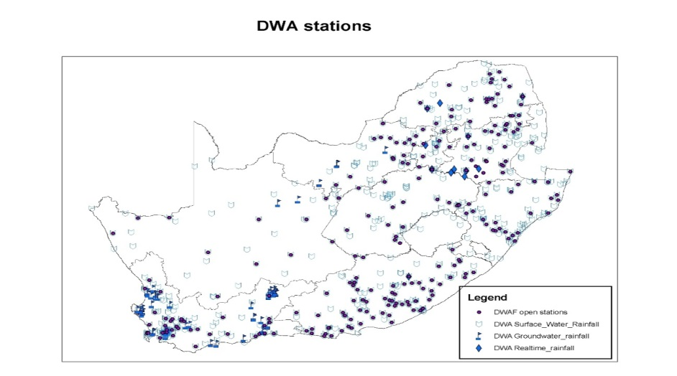
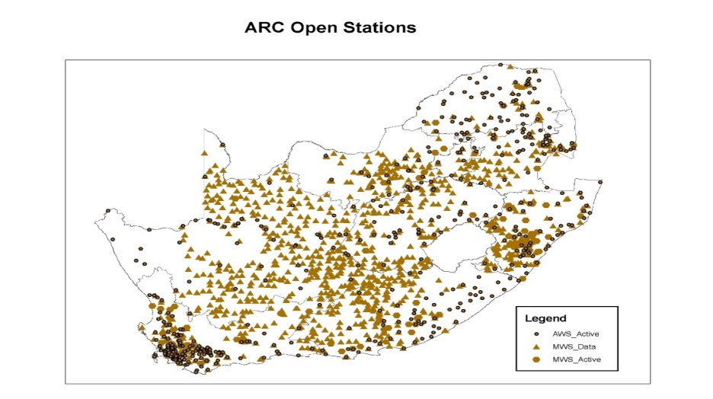
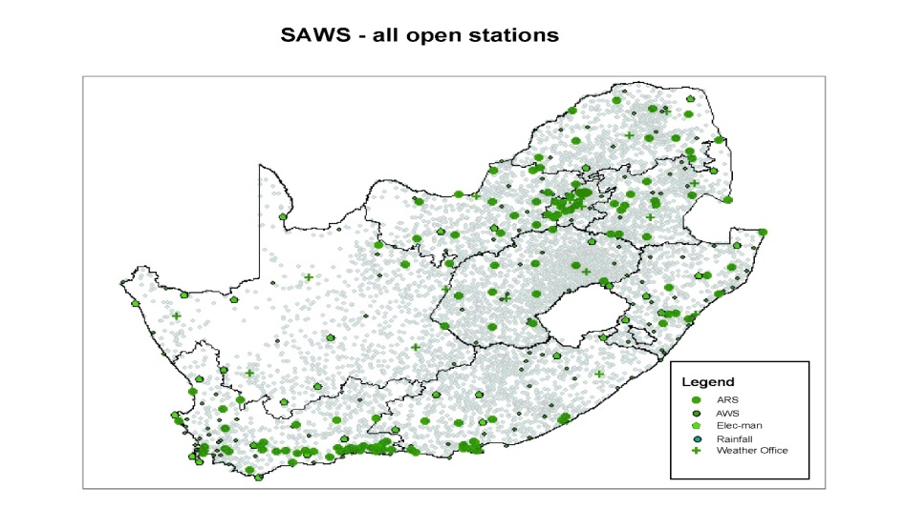
WIGOS Implementation progress within South Africa

Slide 13
Linkages between AMCOMET and WIGOS
In 2012, while preparing the Integrated African Strategy for Meteorology (Weather and Climate Services), the experts representing stakeholders noted that “the current status of the National Meteorological and Hydrological Services in Africa is worrisome, as it is far below the required level of basic operation. Most lack basic weather infrastructure network, telecommunication facilities, databases, human resources and computational capability to run numerical models, strategic plans, operational budget and specialized training”. These challenges limit their ability to deliver on their mandates, in particular to provide and disseminate weather and climate services useful for socio-economic development.
.

Slide 14
WMO Integrated Global Observing System (WIGOS)
WIGOS vision calls for an integrated, coordinated and comprehensive observing system to satisfy, in a cost-effective and sustained manner, the evolving observing requirements of Member States in delivering weather, climate, water and related environmental services.
WIGOS desires a framework for enabling the integration and optimized evolution of surface- and space-based observations. Together with the WMO Information System (WIS), the programmes will allow continuous and reliable access to an expanded set of environmental data and products, and associated metadata, resulting in increased knowledge and enhanced services across all relevant programmes.
WIGOS and its Implementation Plan (WIP) are very important in meteorological services and acts as “fuel” for weather and climate forecasting

Slide 15
The Regional WIGOS Implementation Plan for Africa
This Plan has been developed with a view to addressing:
regional aspects of user requirements;
Standardization of meteorological data;
observing system interoperability;
data compatibility;
data management;
quality management systems and procedures;
performance monitoring and data quality monitoring; and
improvements in observing networks/systems (manual and automatic).

Slide 16
The Regional WIGOS Implementation Plan for Africa
An important role of African NMHSs will be to assess and monitor regional requirements, identify regional gaps and identify capacity development projects within the Region to address those gaps. In addition, continuously monitoring.
Regional activities (such as CLIMDEV-AFRICA, WHYCOS projects, AMESD and MESA, AFRICAN AMDAR, etc.) having connection with WIGOS will be aligned to be in sink with the RA I WIGOS Implementation Plan
AMCOMET, as the overarching framework for coordination, will be leveraged to ensure strong collaboration with regional and sub-regional institutions such as ACMAD, MASA, IGAD, ECOWAS, ASECNA, SADC, ECCAS, AGRHYMET, UMA, IOC, among others, in the implementation of the WIGOS activities in the sub-regions

Slide 17
Concluding Remarks
AMCOMET as Overarching Framework for WIGOS Coordination
AMCOMET is the regional inter-governmental authority on meteorology and is the body that advises and provides policy and political guidance to African Union Heads of State and Government on all matters related to the development of meteorology and its application in Africa. As such, it can perform the oversight role for the regional coordinating mechanism to ensure the implementation of the goals of the Integrated African Strategy on Meteorology (Weather and Climate Services) and harmonization of all related activities in Africa

Slide 18
AMCOMET as Overarching Framework for WIGOS Coordination
Therefore, WIGOS will support the work of AMCOMET and by extension that of Regional Economic Communities (RECs). RECs as the building blocks of the African Union Commission (AUC), the development and implementation of AUC supported programmes and mechanisms will be facilitated. As AMCOMET brings political support, leadership and direction and with the cooperation of the RECs, as they are part of the AMCOMET process, the development of meteorology through regional approaches will minimise duplication of efforts among NMHSs. In this regard, harmonisation of the Integrated African Strategy on Meteorology (Weather and Climate Services) of AMCOMET within RECs programmes and operations will help promote inter-regional cooperation for socio-economic development within the context of climate and weather services. WIGOS programmes enhance the IASM and its IRMP and that of RECs

Slide 19
Thank you for your attention

