Slide 1
WIGOS Data Quality Monitoring System (WDQMS)
I.Zahumensky

Slide 2
Plan for WIGOS Pre-operational Phase (PWPP)
Five priority areas:
National WIGOS implementation
WIGOS Regulatory and Guidance Material
WIGOS Information Resource
WIGOS Data Quality Monitoring System
Regional WIGOS Centres

Slide 3
Trusted, authoritative & reliable Observations
Quality assured,
Quality controlled,
Well documented (i.e. WIGOS Metadata – Quality Index - available),
…
Notes:
3

Slide 4
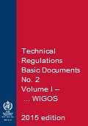
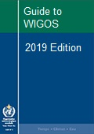
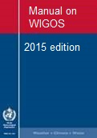
New WIGOS Guidance Material
more detailed information, best practices and procedures, explanation and examples on how to implement national observing systems …
WMO
Notes:
Request for sharing by Members those best practices, procedures to be used by others at the Regional / Global levels
The Guide should provide more detailed information, best practices and procedures, explanation and examples on how to implement standard and recommended practices and procedures specified in the Volume I, Part I – WIGOS of the WMO Technical Regulations (WMO-No. 49) and Manual on WIGOS into day-to-day operations.
The Guide is intended to be used by managers/supervisors and other technical staff of NMHSs responsible for planning, implementation, performance and operation of national observing systems/networks. These individuals are the target audience.

Slide 5
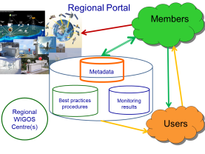
WIGOS Regulatory Framework for Monitoring
Standard & recommended practices and procedures
Routine (24/7) monitoring:
Functionality & Performance
Data availability & Data Quality
Incident Management

Slide 6
WMO Technical Regulations, Vol. I
2.4.3 Performance
2.4.3.1 Members shall continuously monitor the performance of their observing systems.
2.4.4 Quality Control
2.4.4.1 Members shall implement quality control for all observations for which they are responsible.

Slide 7
WMO Technical Regulations; Manual on WIGOS
2.4.3 Quality Control
2.4.3.1 Members shall ensure observations provided through their WIGOS component observing systems are quality controlled.
2.4.3.2 Members shall implement real-time quality control prior to exchange of observations via the WMO Information System.
2.4.3.4 Members shall also perform quality control of observations on a non-real-time basis, prior to forwarding the observations for archiving.

Slide 8
Quality control (QC) of observations
Examination to detect errors so that observations may be either corrected or flagged.
It should include procedures for returning to the source of observations to verify them and to prevent recurrence of errors.
Observations quality depends on QA and QC procedures applied, in order to:
eliminate sources of errors and
ensure the highest possible quality
for the optimum use of these observations by all possible users.

Slide 9
WMO Technical Regulations; Manual on WIGOS
2.4.5 Incident Management
2.4.5.1 Members should implement incident management to detect, identify, record, analyse and respond to any incident for restoring a normal observing system operation as quickly as possible, minimizing the negative impact, and preventing a future re-occurrence.
2.4.5.2 Members shall implement procedures to detect, analyse and respond to system faults and human errors at the earliest stage possible.

Slide 10
WDQMS - purpose and scope
Improved performance monitoring and reporting system for data availability and data quality:
online real/near-real/non-real time monitoring of the performance of WIGOS observing systems / stations / platforms registered under OSCAR;
It is essential for developing robust incident management practices and procedures that will lead to improved data quality.

Slide 11
WDQMS
It will allow Members to:
rapidly detect problems with the observational data being exchanged and
quickly identify actions that can solve any issues highlighted.
This in turn will lead to better availability and higher quality of observational data being made available to users

Slide 12
WDQMS - Milestones
Mid 2016: Initial monitoring capability for GOS surface-based components (by ECMWF, NWS/NCEP, potentially other NWP centres);
Mid 2017: Initial monitoring capability for all WIGOS components;
2018: Fully operational monitoring for GOS surface-based components and Incident Management functionality;

Slide 13
WDQMS - Milestones
Mid 2017: Mechanisms for routine reporting of monitoring results to EC, RAs and Members;
2017: Mechanisms and regional structures in place to handle Incident Management actions and support Members in improving data availability and quality.

Slide 14
Incident Management (IM) Pilot Project
RSMC Nairobi – the lead centre for the land surface observation monitoring in RA I;
Countries: Kenya (lead), Malawi, Tanzania, Uganda;
Collaboration with CBS ET in development of the IM specification (I.Q. 2016);

Slide 15
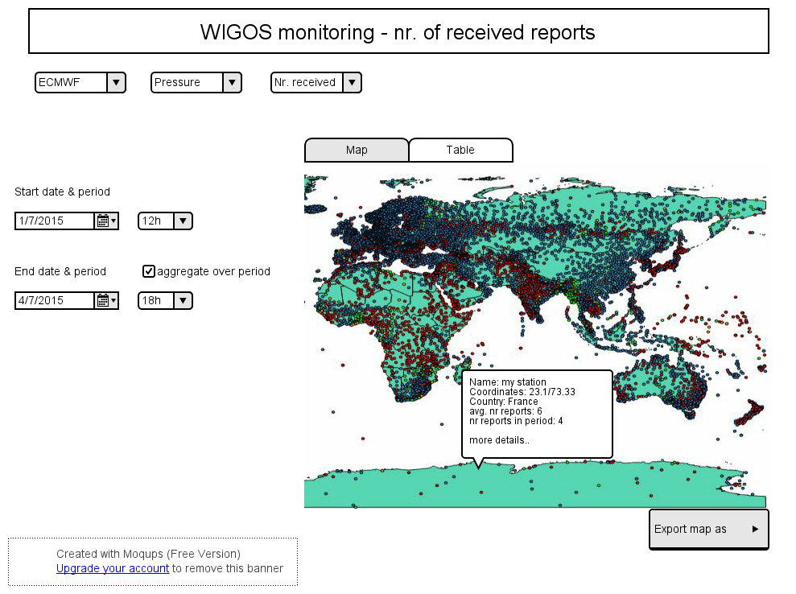

Slide 16
Concept of Regional WIGOS Centres
Regional performance monitoring of WIGOS networks (data availability, timeliness, quality)
Feedback to data providers, i.e. follow-up with data providers in case of data availability/data quality problems.
Notes:
WMD: WIGOS Metadata

Slide 17
Thank you for your attention
www.wmo.int/wigos

