Slide 1
The WIGOS Information Resource (WIR) An introduction – focused on OSCAR/Surface
Dr. Lars Peter Riishojgaard, WIGOS Project Office
WMO; Name of Department (ND)

Slide 2
Overview
The WIGOS Information Resource
The Observing Systems Capabilities and Review tool (OSCAR)
OSCAR/Surface
Volume A / OSCAR – transition plan
Capacity development
Surface beta-testing
Observational data quality and availability monitoring

Slide 3
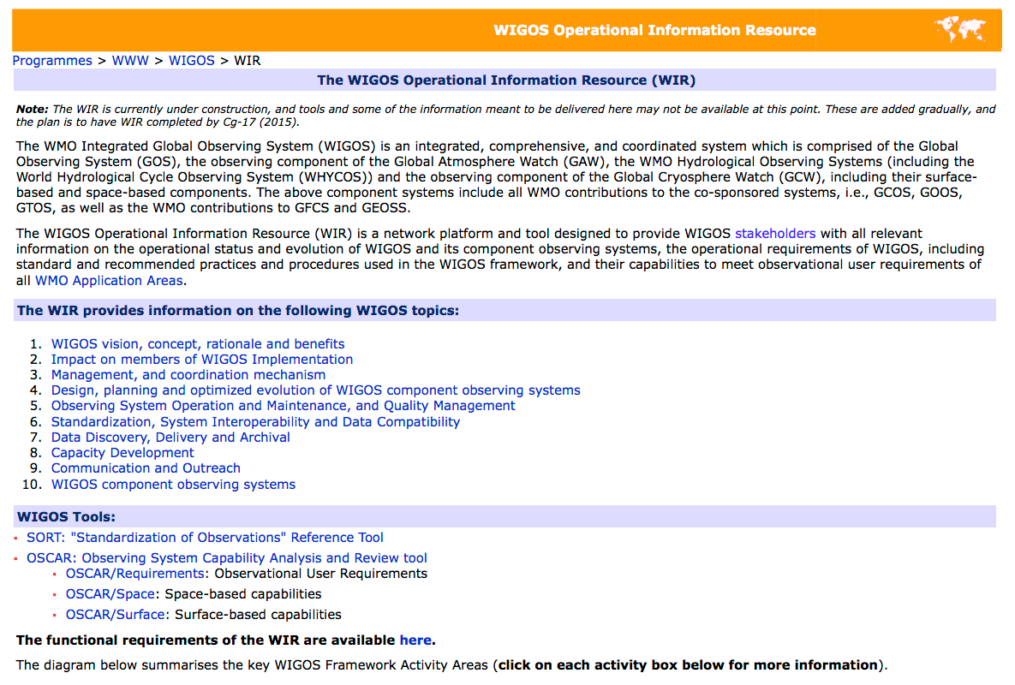

Slide 4
Contents of the WIR
WIGOS vision, concept, rationale and benefits
Impact on members of WIGOS Implementation
Management, and coordination mechanism
Design, planning and optimized evolution of WIGOS component observing systems
Observing System Operation and Maintenance, and Quality Management
Standardization, System Interoperability and Data Compatibility
Data Discovery, Delivery and Archival
Capacity Development
Communication and Outreach
WIGOS component observing systems

Slide 5
Main WIGOS Tools (11/2015)
SORT: "Standardization of Observations" Reference Tool
OSCAR: Observing System Capability Analysis and Review tool
OSCAR/Requirements: Observational User Requirements
OSCAR/Space: Space-based capabilities
OSCAR/Surface: Surface-based capabilities
OSCAR/Review: Gap analysis module

Slide 6
SORT
SORT is an electronic document navigation tool intended to facilitate the
SORT is a component of the WIGOS Operational Information Resource (WIR)
SORT shall provide {…} easy access to the information {…} consider when installing, configuring and operating {…} observing systems according to WIGOS Regulatory Material.
{…}SORT {…} is meant to deliver a modernized, standardized access to the up-to-date standards and recommended practices and procedures {…}

Slide 7
OSCAR
The WMO Roling Review of Requirements (RRR) is supported by three key databases of OSCAR:
OSCAR/Requirements, in which “technology free” requirements are provided for each application area, expressed in units of geophysical variables (260 in total currently), not measurands; not just atmosphere, also terrestrial, ocean, cryosphere, …
OSCAR/Space, listing the capabilities of all satellite sensors, whether historical, operational or planned
OSCAR/Surface, list surface-based capabilities; developed by MeteoSwiss for WMO, in beta-testing
http://www.wmo-sat.info/oscar/

Slide 8
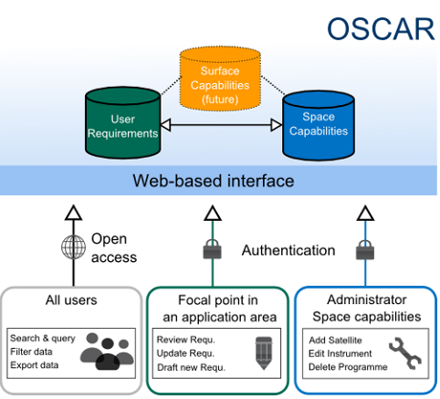
Web-based platform for WIGOS
Covering land, air, ocean and space
Documenting stations and observations, and their histories
Enabling comparison of requirements and capabilities (RRR)
Facilitating network planning
For all WMO Application Areas
Supporting your service to society.

Slide 9
OSCAR/Requirements
The following requirements are listed (separately for each of the 12 application areas and for all relevant variables):
Spatial (horizontal and vertical)
Temporal resolution (Observing cycle)
Uncertainty,
Data latency,
Each requirement is expressed in terms of 3 separate values:
Threshold (observations not useful unless this is met)
Break-through (optimum cost-benefit ratio)
Goal (exceeding this provides no additional benefit)

Slide 10
WMO Application Areas
Global Numerical Weather Prediction
High Resolution Numerical Weather Prediction
Nowcasting and Very Short Range Forecasting
Seasonal and Inter-annual Forecasts
Aeronautical Meteorology
Atmospheric Chemistry – recently split in 3 different areas
Ocean Applications
Agricultural Meteorology
Hydrology
Climate Monitoring (GCOS)
Climate Applications
Space Weather

Slide 12
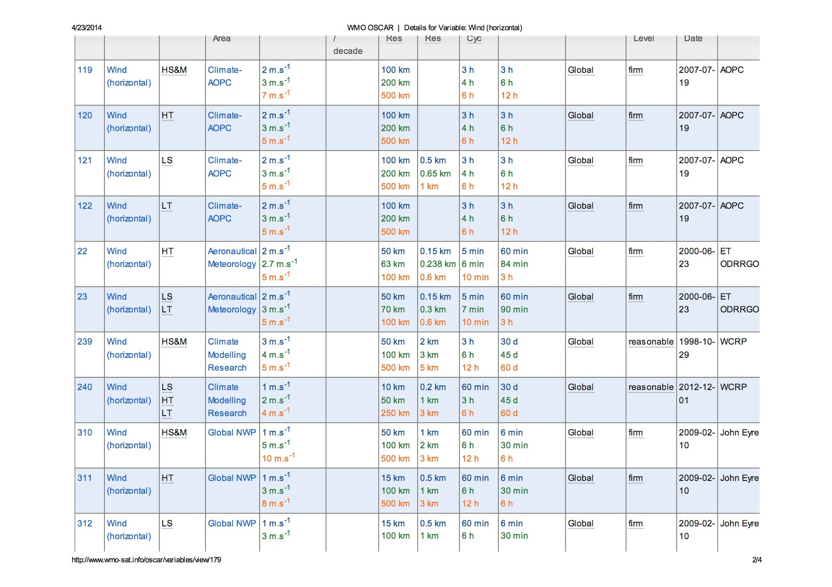

Slide 13
OSCAR/Space
Repository of metadata about all satellite sensors (past, present and future) relevant to WMO Programs and Application Areas
Instrument type, measurement technique
Instrument characteristics (mass, power, data rate)
Programmatic information, e.g. agency, measurement program, operating period, heritage, etc.
Orbit, coverage, repeat frequency, resolution
Capabilities, expressed in terms of geophysical variables that can be derived from the measurements provided by the sensor, listed in order of decreasing fidelity

Slide 14
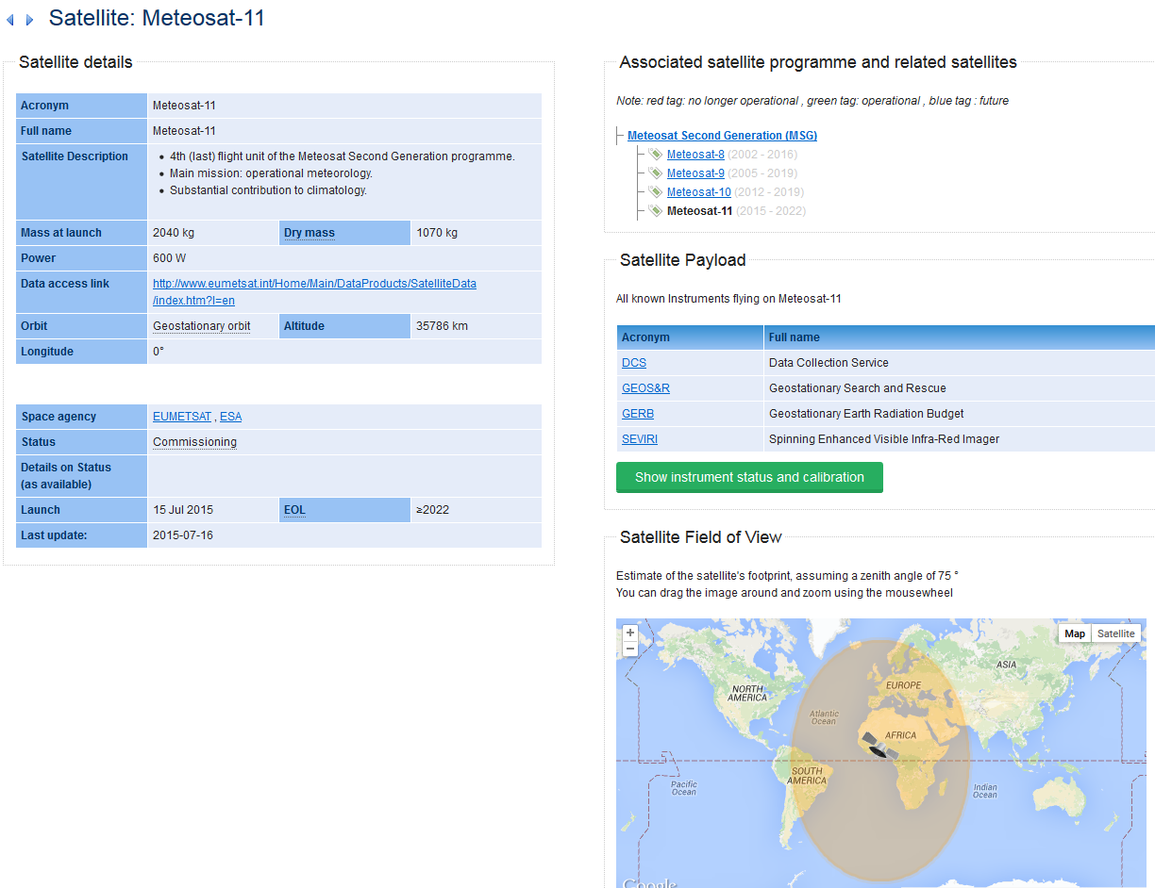

Slide 15
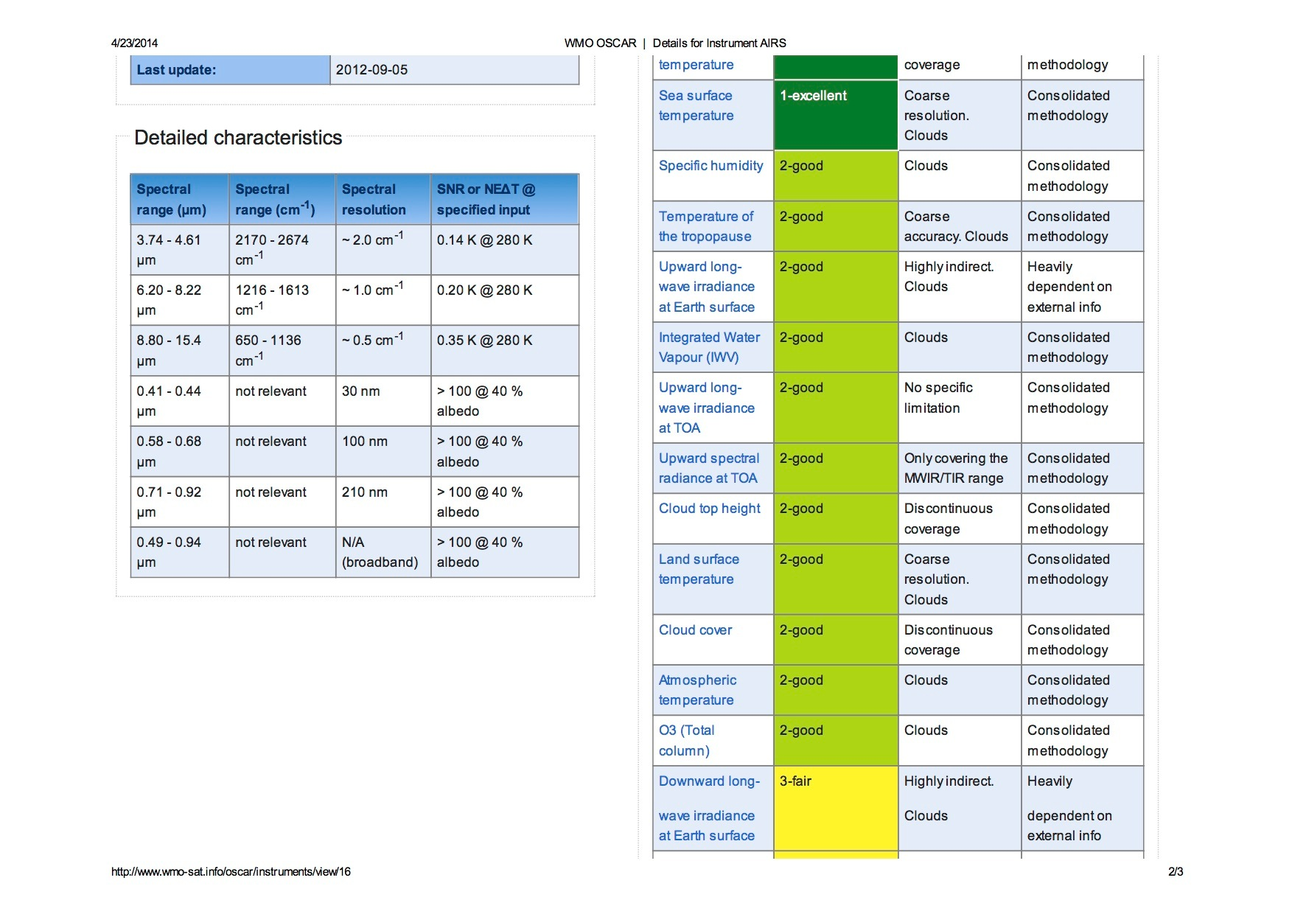

Slide 16
OSCAR/Surface
Repository of metadata for all surface-based observational assets under WIGOS (WMO and co-sponsored observing systems)
Highly heterogeneous system with multiple owners and operators, including surface stations, upper-air stations, aircraft, ships, buoys, radars,…
OSCAR/Surface will replace (among other things) WMO Pub. 9, Vol. A
Complex, resource-intensive undertaking, developed in collaboration between WMO and MeteoSwiss; most of the resources provided by the latter

Slide 17
Current status of OSCAR/Surface
Successful demonstration of phase 1 prototype at Cg-17 (May-June 2015)
OSCAR Booth
OSCAR side Event
OSCAR Brochure
Members obligations with regard to OSCAR included in Technical Regulations and WIGOS Manual to come into force in July 2016
Operational early 2016

Slide 18
Data integration
# stations
1’053
13’026
11’387
762
GAWSIS
Metadata for the Global Atmosphere Watch
WMO Pub 9 Vol A
Catalogue of synoptic and upper-air stations of GOS
JCOMMOPS
Marine element of GOS / GOOS
WMO Radar DB
World-wide radars
Amdar
Coming soon …

Slide 19
What should go into OSCAR/Surface?
Long answer: All WIGOS stations (WIGOS component observing system stations), all stations exchanging data internationally
Short answer: everything
Use OSCAR even when data is not shared
Rationale
Network planning
Network evolution documentation
OSCAR can be used as national station DB

Slide 20
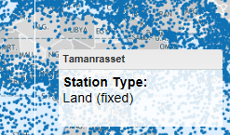
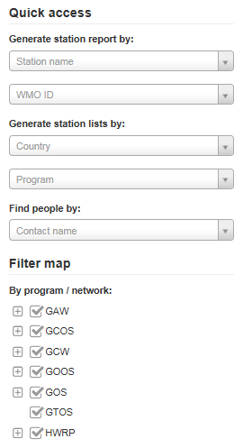
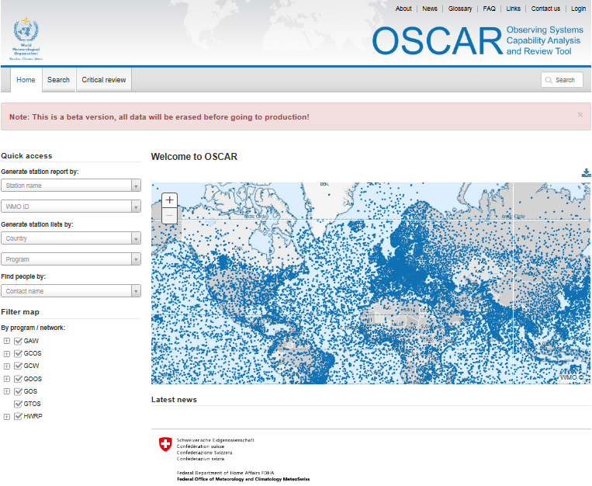
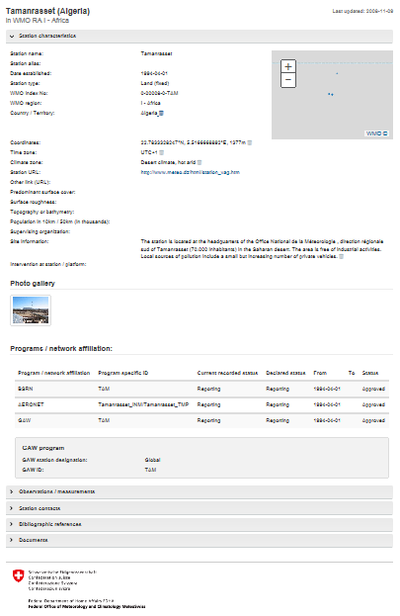
OSCAR quick access & reports
Quick access
&
Map filter
+ click
=
Detailed station report

Slide 21
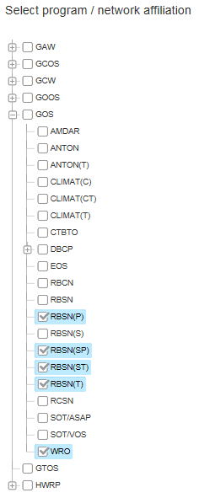
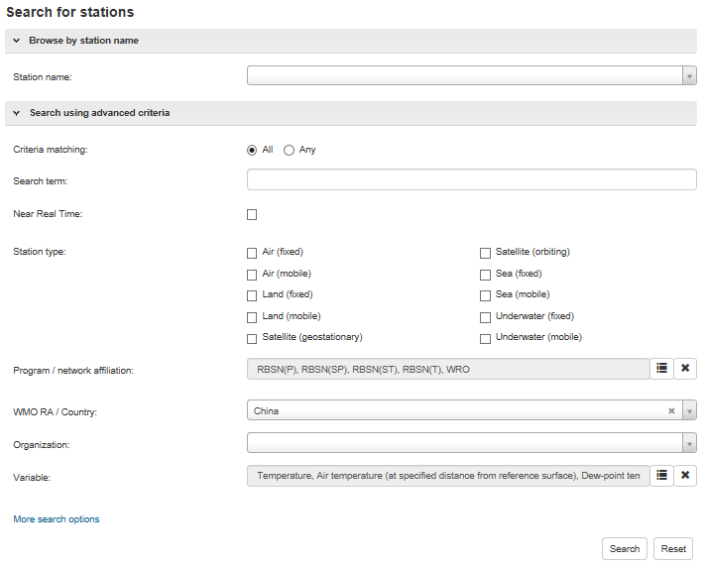
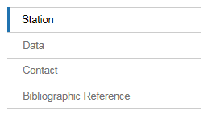
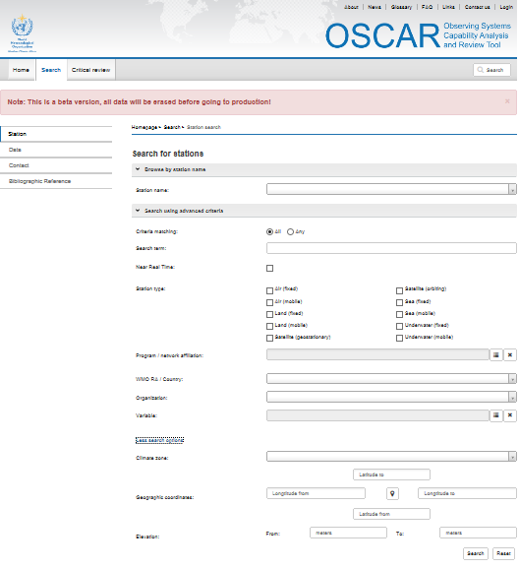
OSCAR search
Various search targets
Instruments (soon)
Finely tuned search

Slide 22
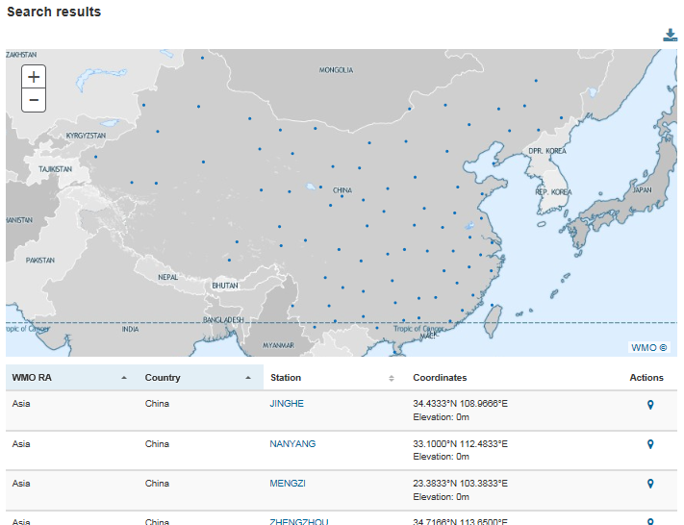
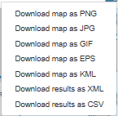
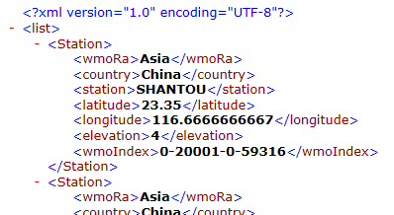
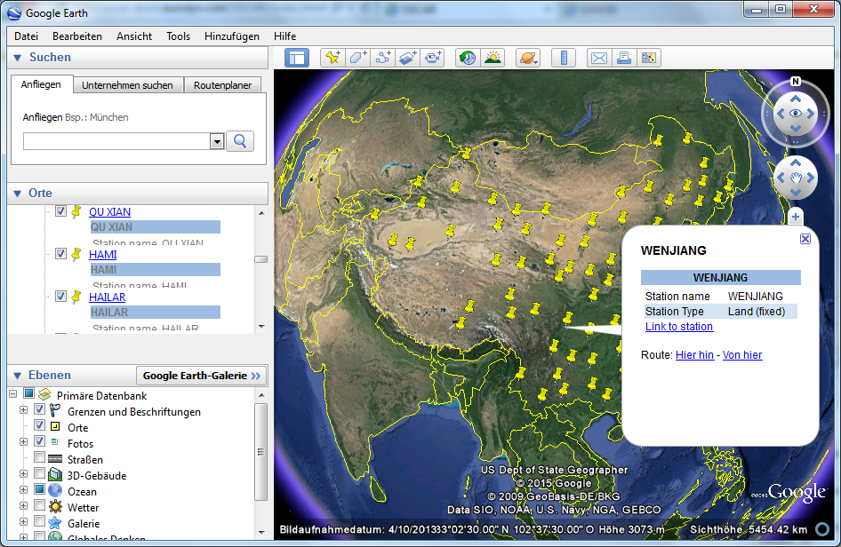
OSCAR search results
Download for further analysis
Integration with GoogleEarth

Slide 23
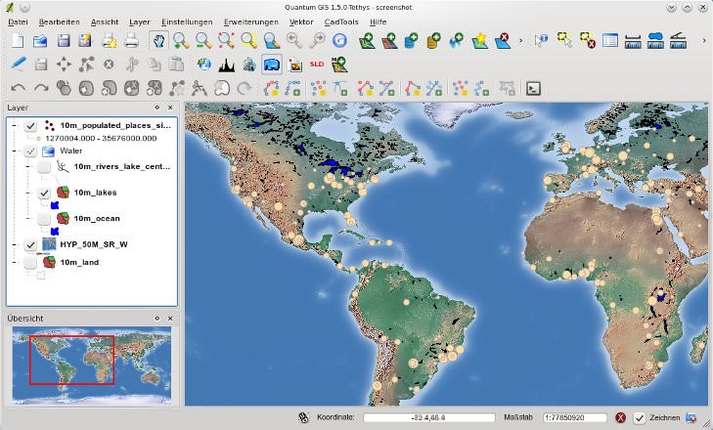
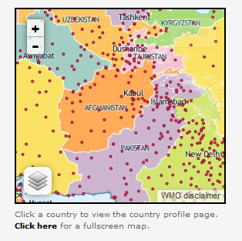
OSCAR as geospatial source
Information in OSCAR can be used by Geospatial Tools
Integration with QuantumGIS
Mashup for online maps
Integration with GoogleEarth

Slide 24
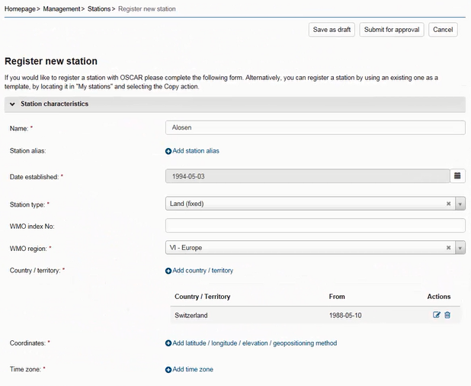
OSCAR management console
Stations
Basic characteristics
Photos
History
Observations
Location
Variable
Methods
Instruments
Quality and uncertainty
History
Contacts
Bibliographic references

Slide 25
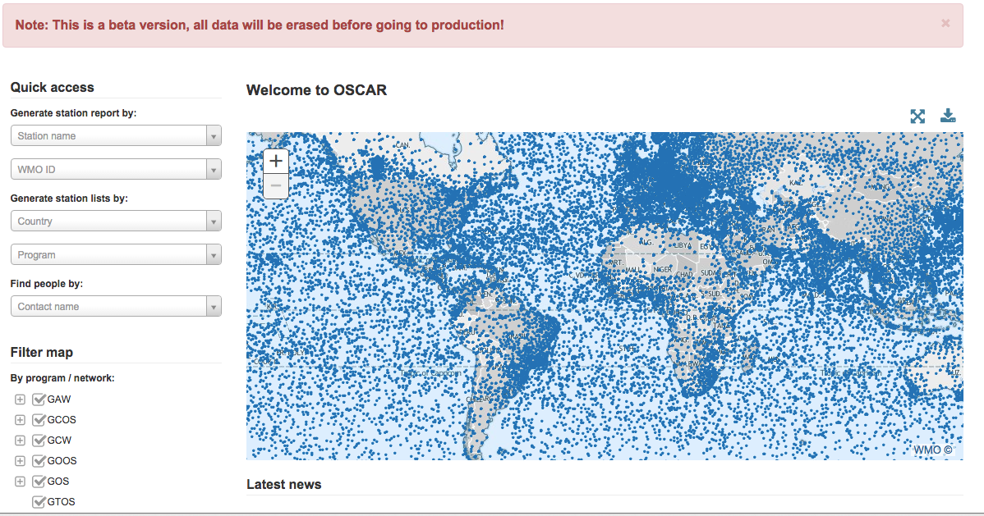
Screenshot from OSCAR/Surface beta-test version

Slide 26
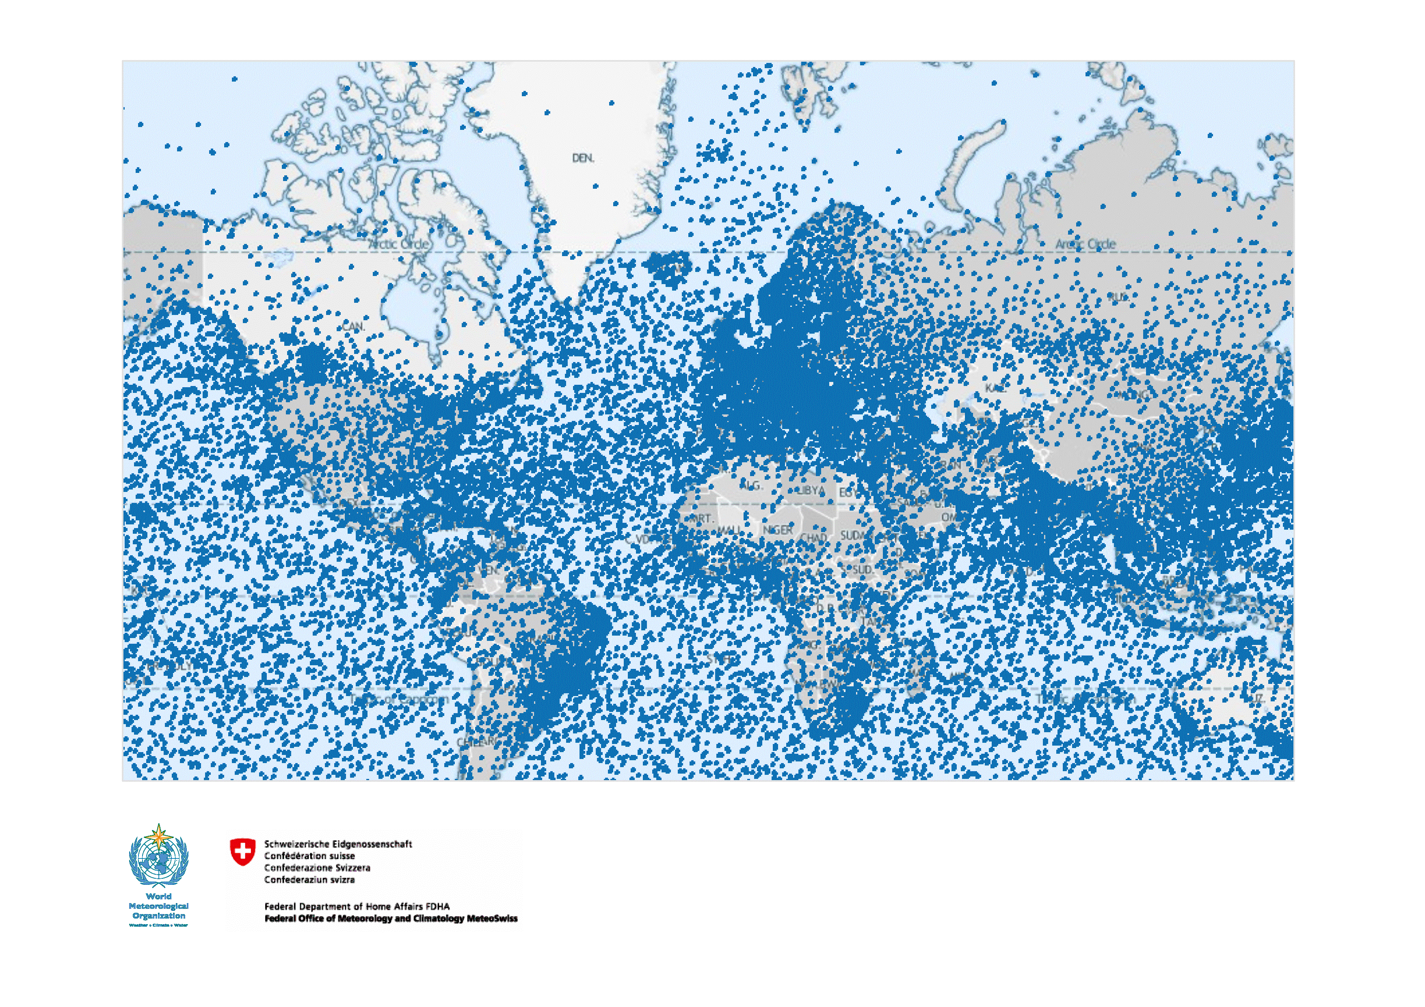
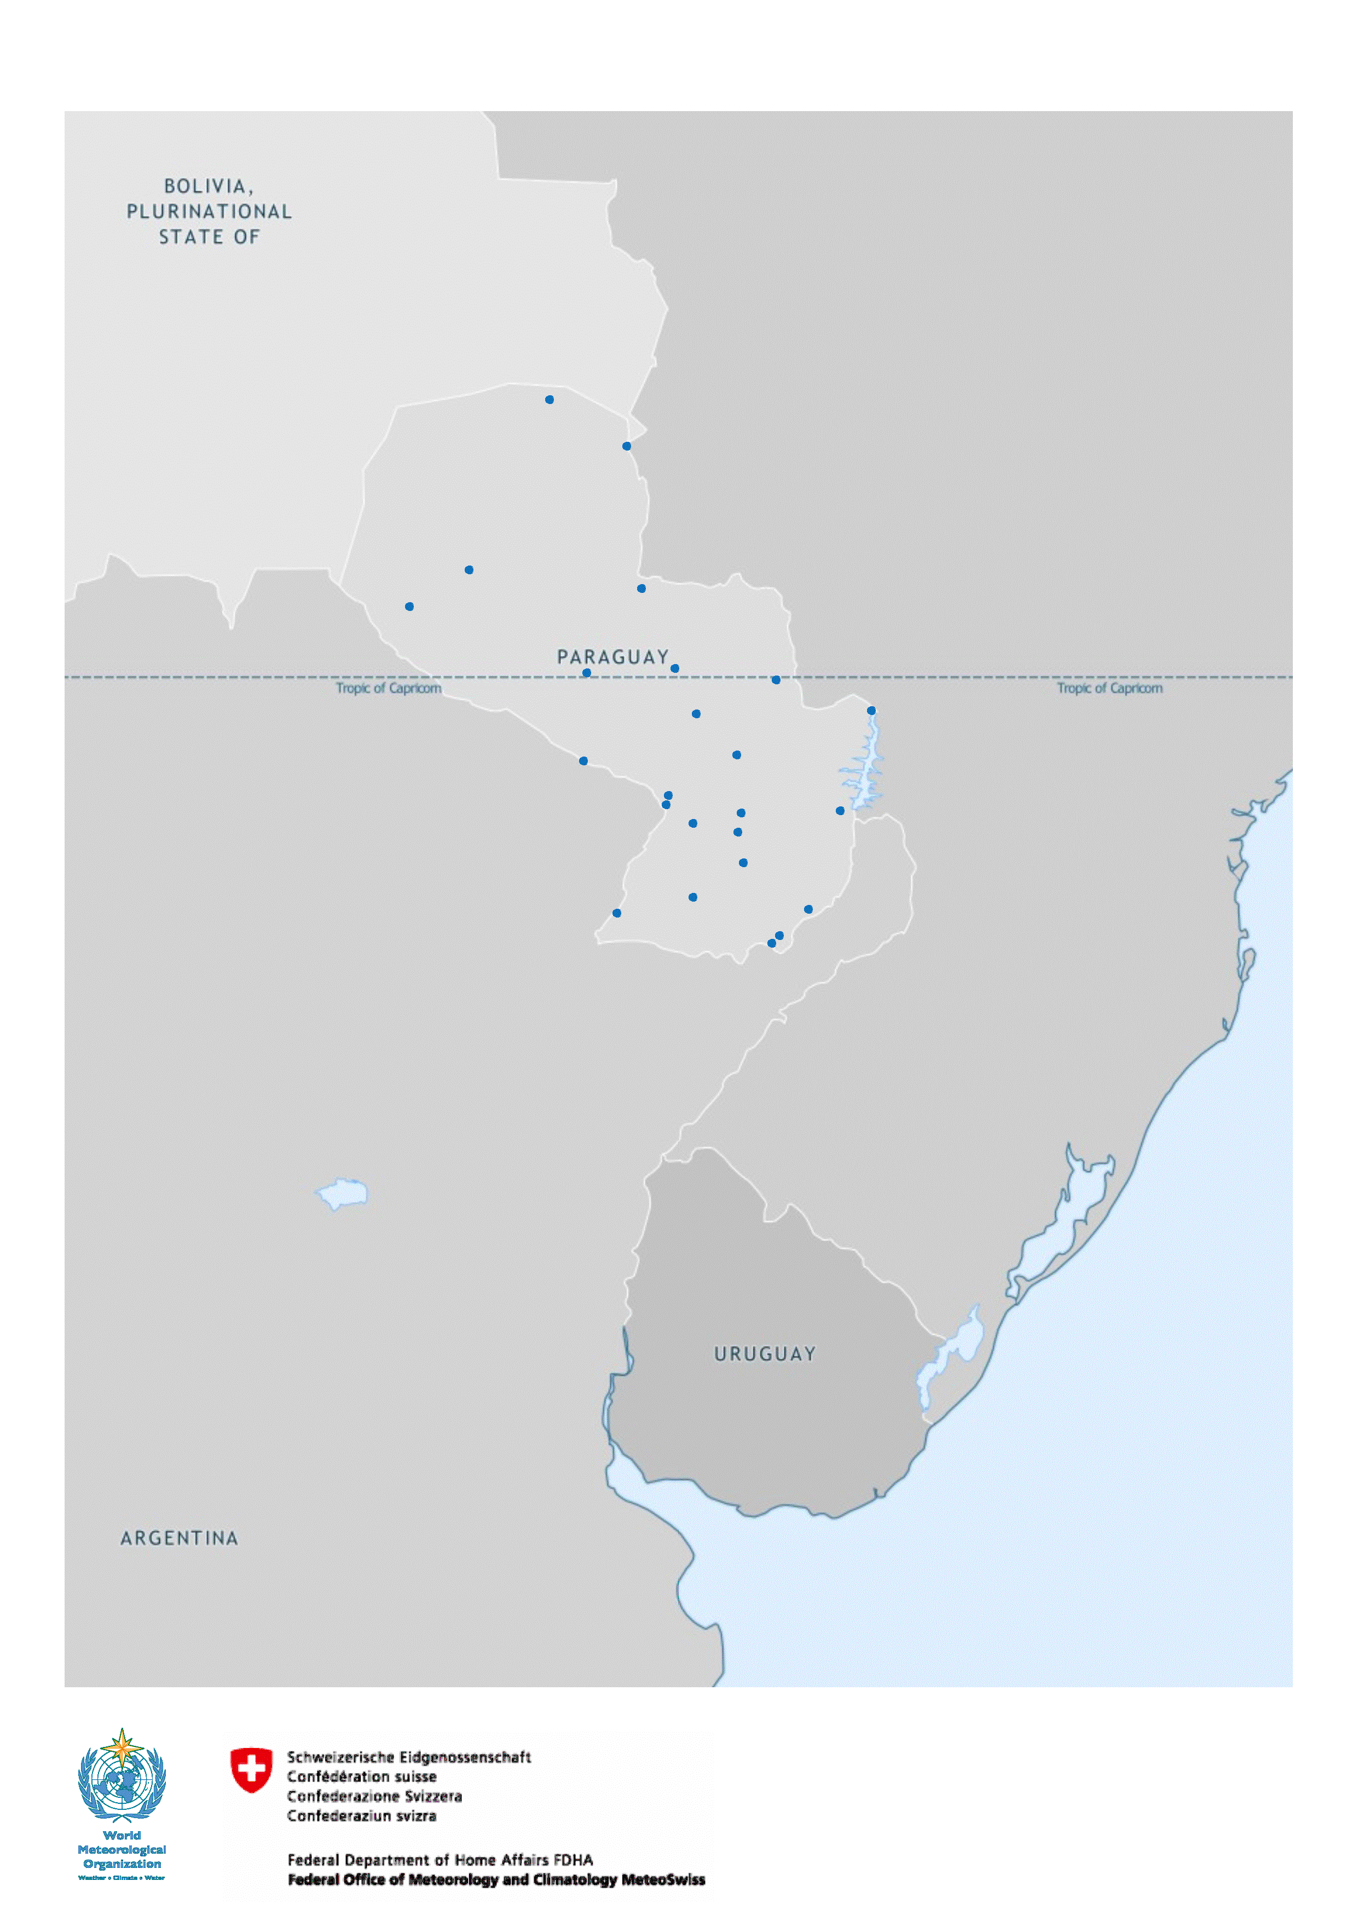
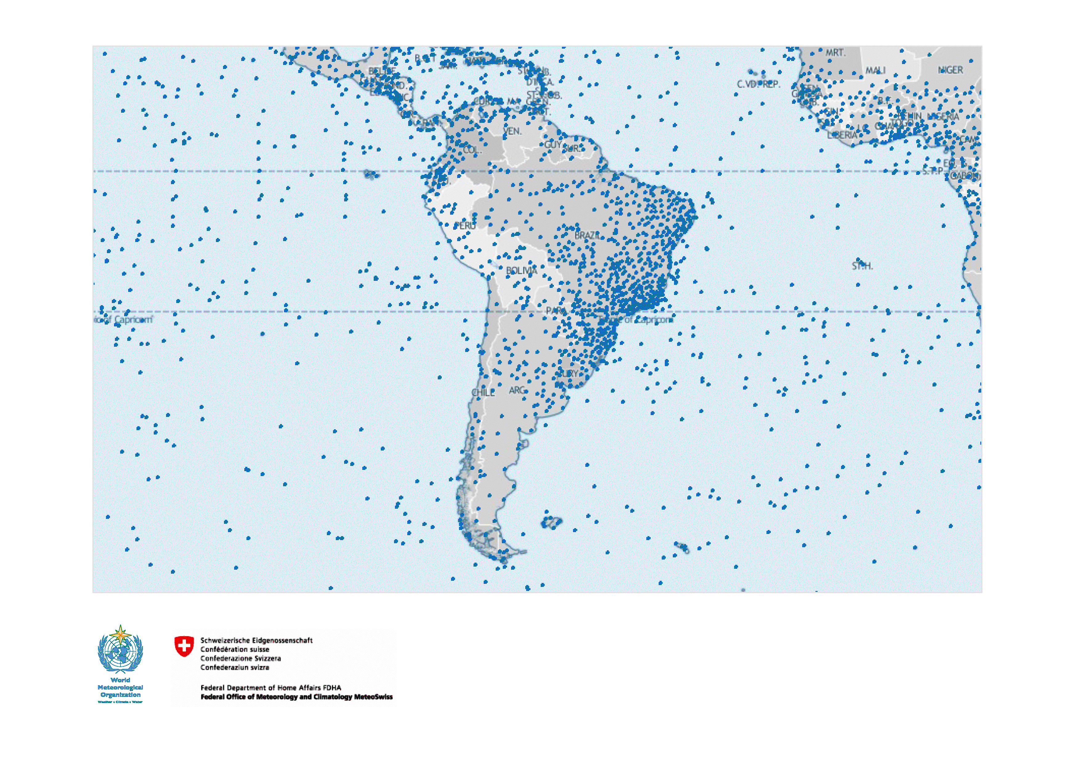
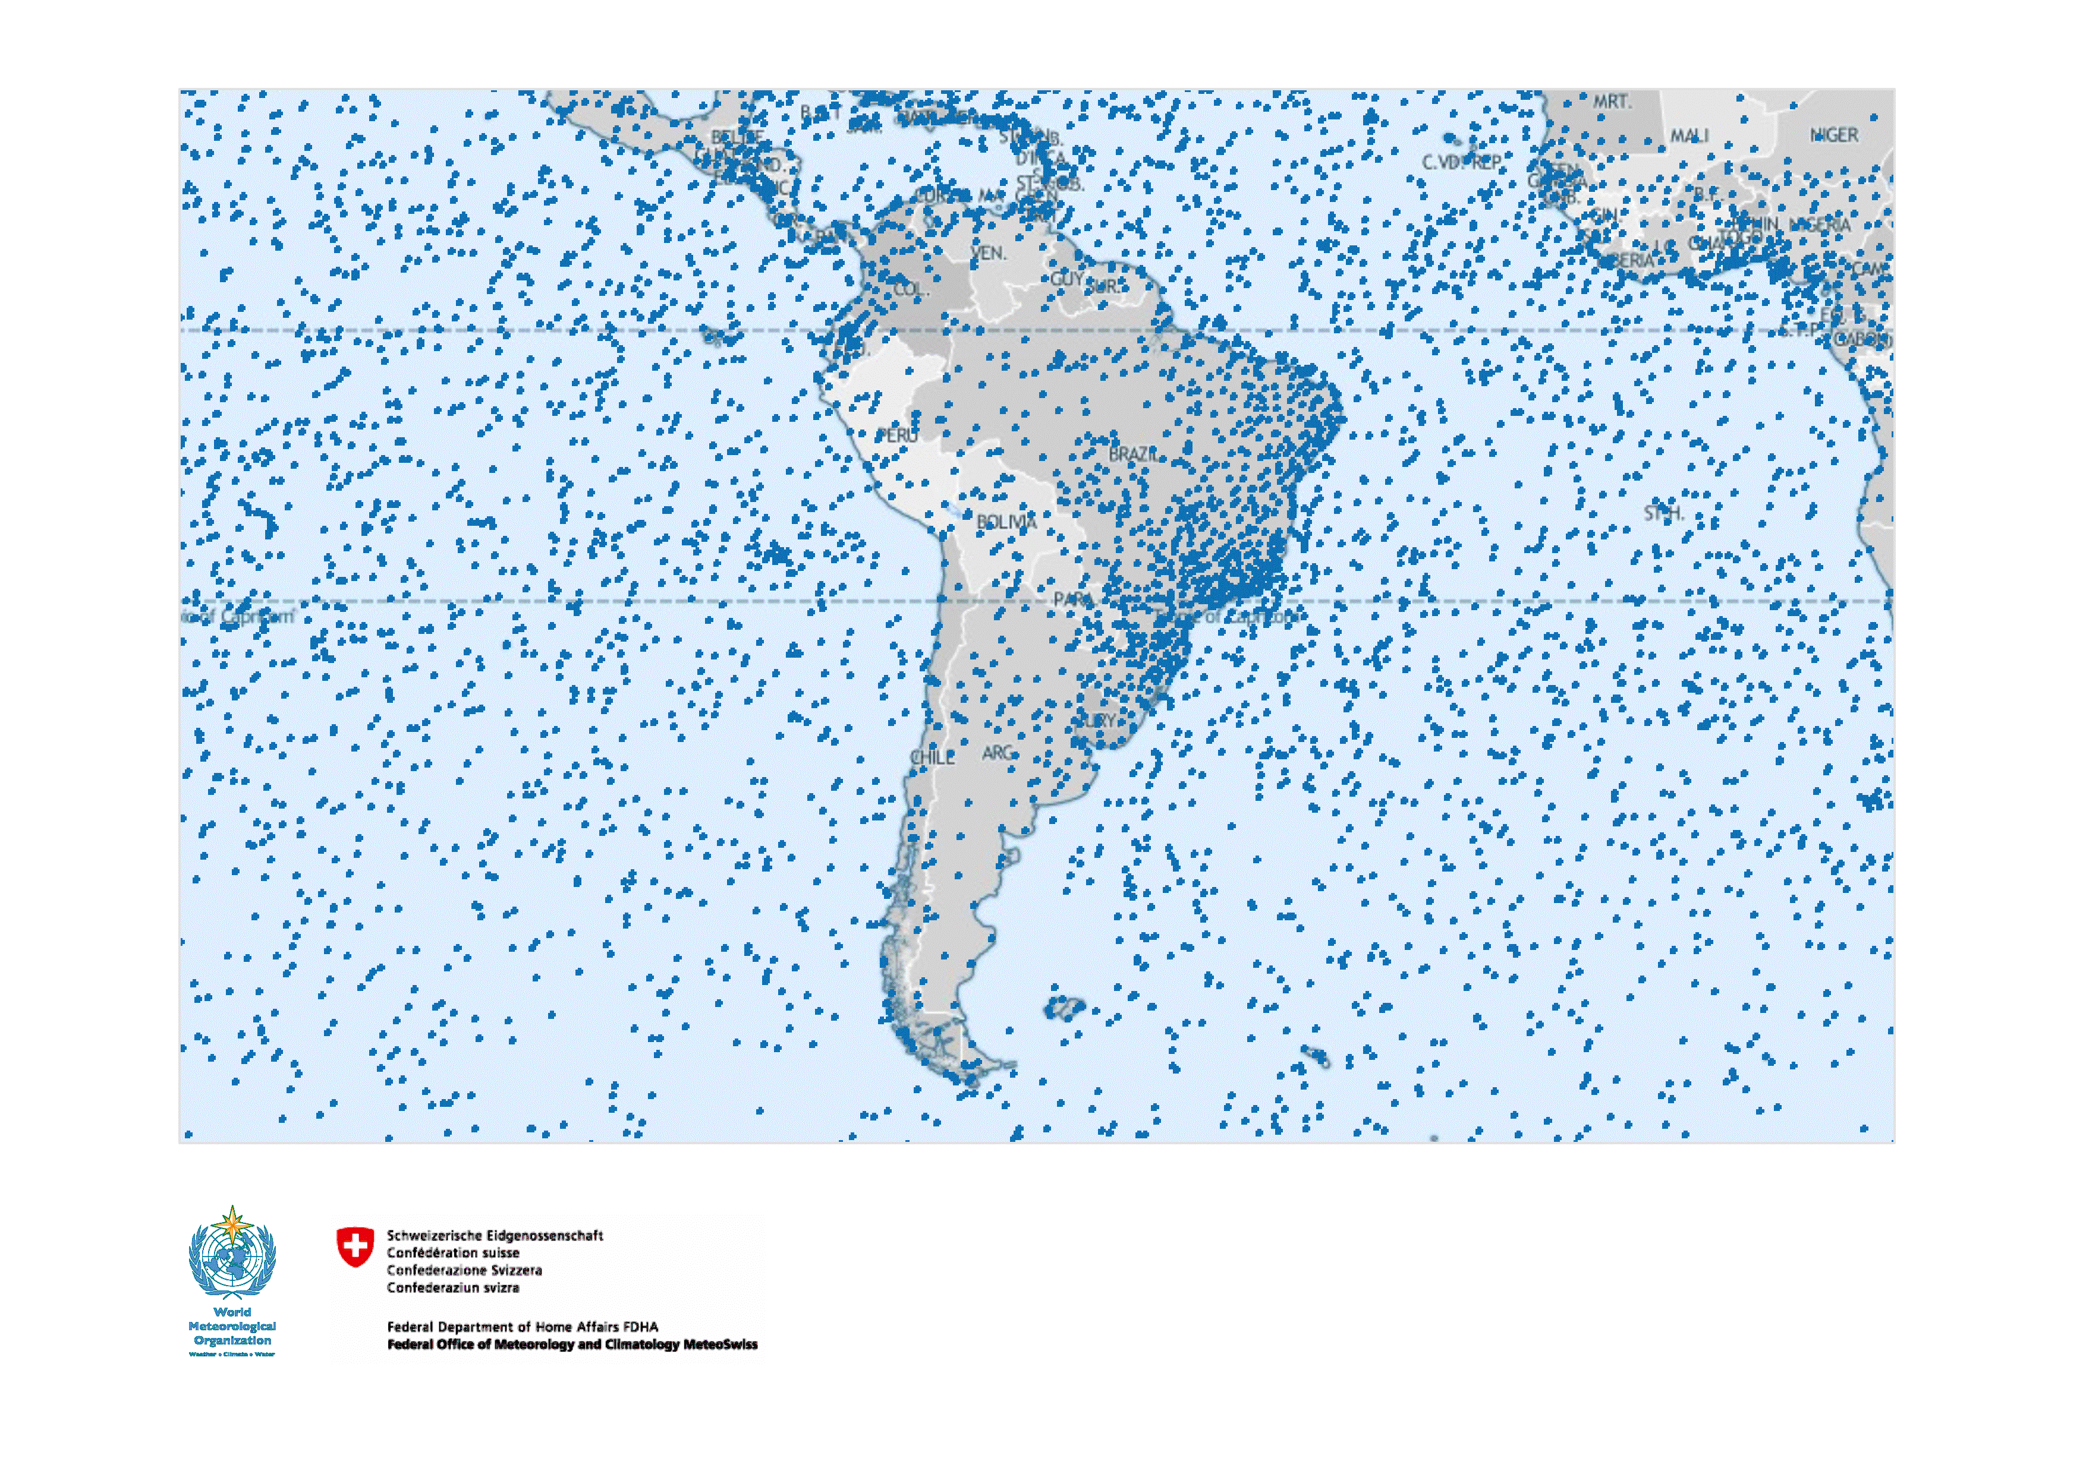
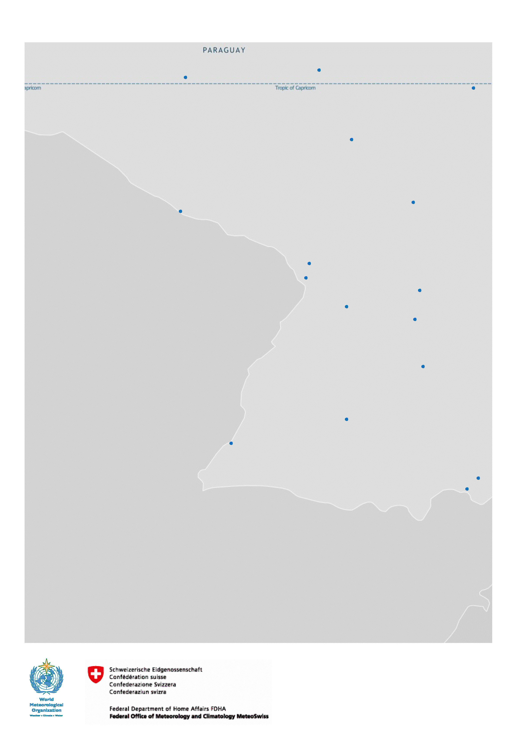

Slide 27
Plan for transition from Vol.A to OSCAR/Surface
Transition period: planned to start in February 2016 and to last for 2 years.
Members will be given the opportunity to decide between:
providing their WIGOS metadata directly via OSCAR
continuing to provide their metadata through existing WMO procedures
Uploads will be possible through:
user editing via the web interface, and
machine to machine interfaces/web service
At that point, OSCAR will become the official repository of WIGOS metadata, and will serve as the source for Vol. A

Slide 28
Plans for transition from Vol.A (Cont.)
OSCAR can generate reports similar to the existing Vol. A flat-files available on the WMO website. The new “Vol. A report” will maintain all current column headings but may not contain information in all columns.
Station information provided to WMO via current Vol. A procedures will be used to update WIGOS metadata in OSCAR.
Protocol and format for feeding information by batch-process (M2M) into OSCAR to be completed by mid-2016
By the end of the transition phase into OSCAR; Vol. A will officially cease to exist and related procedures used to maintain station information will be discontinued

Slide 29
What Members will need to do:
Comply with the WMO Technical Regulations; WMO-No. 49, Volume I, Part I – WIGOS and the Manual on WIGOS:
Keep records of WIGOS metadata
For those observations that are exchanged internationally:
Exchange also the associated WIGOS metadata
Review the information in OSCAR/Surface
Keep entries in OSCAR/Surface up to date
The more accurate and up-to-date the information in OSCAR/Surface is, the more useful it will be!

Slide 30
OSCAR Gap analysis module
(still in design phase)
Quantitative tool that matches observational data requirements against observational capabilities
Based on selection of requirement and pertinent observational capabilities, tool can illustrate whether or not different levels of requirement is met (by area or region)

Slide 31
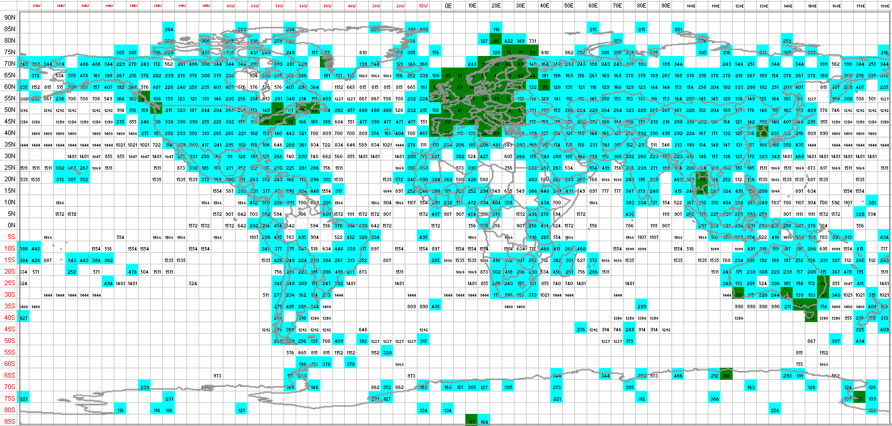
Surface pressure measurement capabilities against WMO requirements
(“capability” based on data received by ECMWF)

Slide 32
Thank you for your attention

