Slide 1
The WIGOS Pre-operational Phase
Guidance from Cg-17, EC-67 and TT-PWPP
RA-I Workshop on WIGOS (English language)
Walvis Bay, Nov 2-4 2015
Dr. Lars Peter Riishojgaard,
WIGOS Project Manager, WMO Secretariat

Slide 2
Outline
Introduction to WIGOS
Status of the WIGOS Framework
The next four years: The WIGOS Pre-Operational Phase
Impact on Member NMHS’s, in particular of OSCAR/Surface
Summary and conclusions
WMO

Slide 3
What is WIGOS?
WMO foundational activity addressing the observing needs of the weather, climate, water and environmental services of its Members
A framework for integrating all WMO observing systems and WMO contributions to co-sponsored observing systems under a common regulatory and management framework
Together with the WMO Information System (WIS), WIGOS is a WMO contribution to GEOSS.
WIGOS is not:
Replacing or taking over existing observing systems, which will continue to be owned and operated by a diverse array of organizations and programmes, national as well as international.

Slide 4
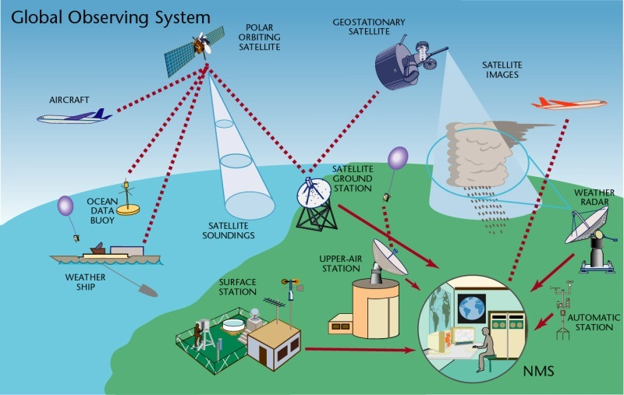
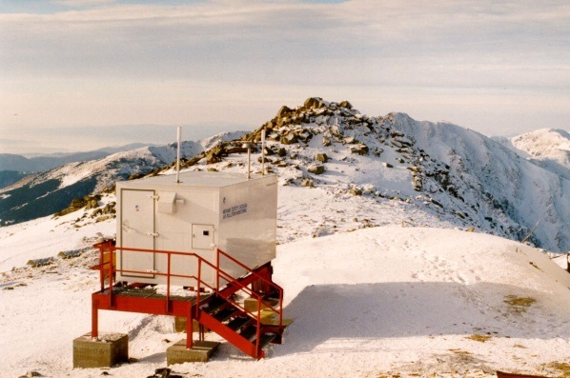
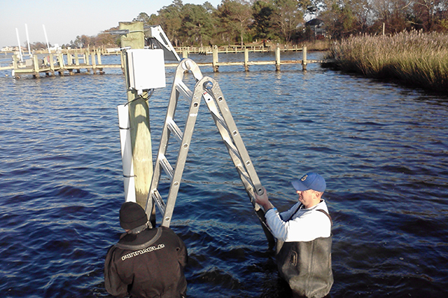
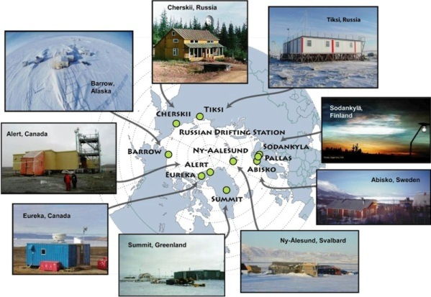
WIGOS Component Systems
Global Observing System (WWW/GOS)
Observing component of Global Atmospheric Watch (GAW)
WMO Hydrological Observations (including WHYCOS)
Observing component of Global Cryosphere Watch (GCW)

Slide 5
Why do we need WIGOS?
I. NMHS mandate typically broader now than when the World Weather Watch and the GOS were created, including e.g.
Climate monitoring, climate change, mitigation
Air quality, atmospheric composition from urban to planetary scales
Oceans
Cryosphere
Water resources
II. Technical and scientific advances:
Observing technology
Telecommunications
Numerical modeling and data assimilation
Increased user demand to access and use observations in decision making

Slide 6
Why do we need WIGOS?
III. Economic realities
Budgetary pressure on many NMHS, in spite of growing mandate and increasing demand for services
Efficiency by exploiting synergies
Integration of observing networks across disciplines (e.g. weather and climate)
Integration across organizational boundaries, e.g. between different national ministries/departments operating observing systems
Integration across technological boundaries, e.g. between surface- and space-based systems
Basic principle: One observation, many applications, many users

Slide 7
WIGOS Implementation Phase
WMO 16th Congress (2011): Implementation of WIGOS
Key deliverables for the 17th Congress (2015): Draft Technical Regulations on WIGOS; link here
Draft Manual on WIGOS; link here
WIGOS Metadata Standard; link here
Regional Implementation Plans
Proposal for the Pre-Operational Phase of WIGOS (2016-19)
All deliverables were approved by Cg-17

Slide 8
Regional WIGOS Implementation Plans
(R-WIPs)
R-WIPs developed for all WMO Regions by Regional WIGOS Task Teams or Working Groups, typically helped along by dedicated WIGOS Workshops
All WMO Regional Associations have approved their R-WIPs (Region I during its 16th Session in Praia in 2015)
Important now to align national priorities, VCP request and donor-funded projects with the respective R-WIP to the extent possible
Regional Working Structures to oversee and coordinate the WIGOS implementation are still developing, and differ from region to region
In Region I, the RA-I Task Team on WIGOS is responsible

Slide 9
RA-I WIGOS Implementation Plan
(R-WIP-I)
This will be reviewed on Day 3 of this Workshop, more details in presentation by Dr. Zahumensky
Current version lists a number of regional activities with deliverables, many somewhat generic in nature
Specific RA-I activities (from R-WIP-I, Table 2):
Design and plan observing systems in the Region (3.1)
Develop a design of new RBN, in close collaboration with CBS (3.2)
Establish mechanisms and systems to improve, monitor and document the quality of observations from the WIGOS Regional observing components (5.2)
Achieve the functionality of RICs and RRCs in all five subregions (5.)

Slide 10
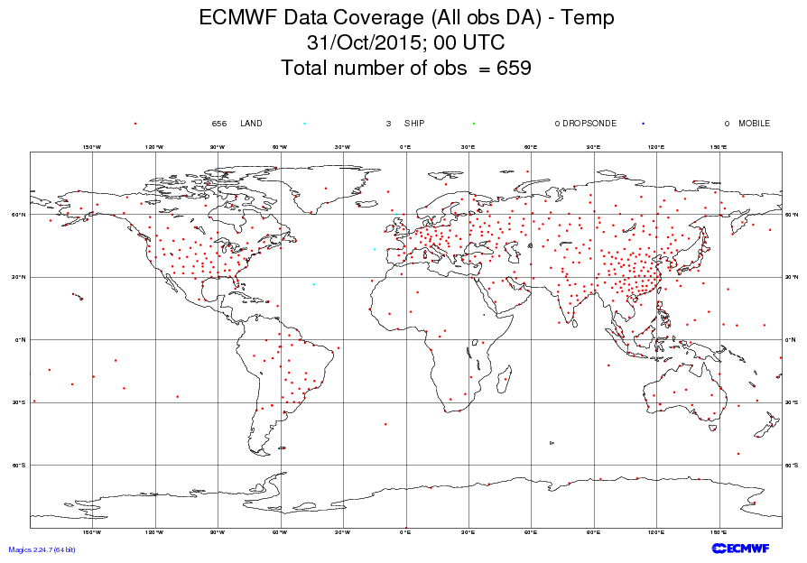
RAOB network;
(more observations
would be better)

Slide 11
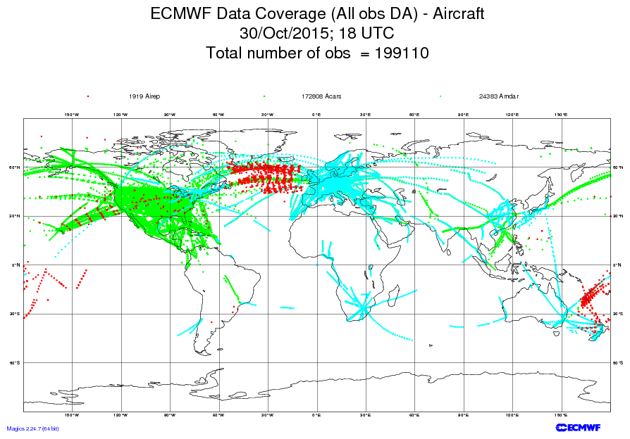
AMDAR and similar programs
provides opportunity for additional
upper air observations; currently
not fully developed in Africa

Slide 12
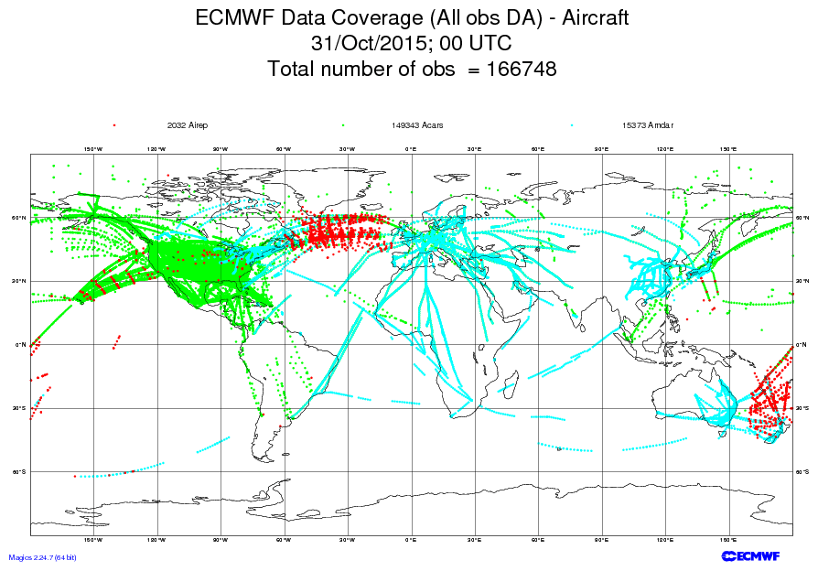
Some flight level data provided
by overnight long-haul carriers;
however very few profiles

Slide 13
The WIGOS Pre-Operational Phase (2016-2019)
Approved by WMO Congress-17
Increased emphasis on regional and national activities
Five main priority areas:
WIGOS Regulatory Material, supplemented with necessary guidance material
WIGOS Information Resource, including the Observing Systems Capabilities analysis and Review tool (OSCAR), especially OSCAR/Surface
WIGOS Data Quality Monitoring System (WDQMS)
Regional Structure; Regional WIGOS Centers
National WIGOS Implementation, coordination and governance mechanisms

Slide 14
I. Regulatory Material
The ”Manual on WIGOS” will be updated in 2019, with two main new elements:
Full integration of the Manual on the Global Observing System, which will be retired at that point
New material on Regional Basic Observing Networks (RBON), which will integrate the existing RBSN and RBCNs and include additional observing systems, such as radars, wind profilers ….

Slide 15
I. Guidance Material
Guidance material is most urgently needed in the following areas:
OSCAR, Metadata, Station IDs and Quality monitoring;
Regional WIGOS Centers, AWS, National partnerships;
National observing strategy, RBON, and integration of space-based observations
The areas listed under item 1. should be covered in the initial version of the “Guide to WIGOS”, to be made available before July 1 2016

Slide 16
II. WIR (OSCAR/Surface)
This is the implementation layer of the new WIGOS Metadata Standard: a modern, electronic, searchable inventory of all observing stations/platforms under WIGOS
Developed jointly by WMO and MeteoSwiss, with the Swiss government providing the major part of the funding
OSCAR/Surface will replace Volume A, but will also include information from similar inventories for other (non-GOS) components of WIGOS
Education and training Members in populating, editing and using OSCAR/Surface is a major focus area for 2016-2019

Slide 17
Near-term impacts on NMHS operations
(due to effective date of Manual on WIGOS, including the WIGOS Metadata Standard on July 1 2016)
In order to comply with the new regulatory material, Members will need to
Keep records of WIGOS metadata
For those observations that are exchanged internationally:
Exchange also the associated WIGOS metadata
Review station information and keep it up to date
The implementation of this takes place through OSCAR/Surface!

Slide 18
WIGOS Metadata
(loosely defined as “ancillary information that is necessary for optimally using the observation”; more stringent definition can be found in WIGOS Metadata Standard)
10 categories,
90 elements,
All stored in OSCAR/Surface
# | Category | Description
1 | observed quantity | Specifies the basic characteristics of the observed quantity and the resulting data sets.
2 | purpose of observation | Specifies the main application area(s) of the observation and the observing program(s) the observation is affiliated to.
3 | data quality | Specifies the data quality and traceability of the observation.
4 | environment | Describes the geographical environment within which the observation is made. It also provides an unstructured element for additional meta-information that is considered relevant for adequate use of the data and that is not captured anywhere else in this standard.
5 | data processing and reporting | Specifies how raw data are transferred into the reported physical quantities and reported to the users.
6 | sampling and analysis | Specifies how sampling and/or analysis are used to derive the reported observation or how a specimen was collected
7 | station/platform | Specifies the environmental monitoring facility, including fixed station, moving equipment or remote sensing platform, at which the observation was made.
8 | method of observation | Specifies the method of observation and describes characteristics of the instrument(s) used to make the observation. If multiple instruments used to generate the observation, then this category should be repeated.
9 | ownership and data policy | Specifies who is responsible for the observation and owns it.
10 | contact | Specifies where information about the observation or dataset can be obtained.
Notes:
Reliable & trusted Observations: Timely, Quality assured, Quality controlled, Well documented, Compatible

Slide 19
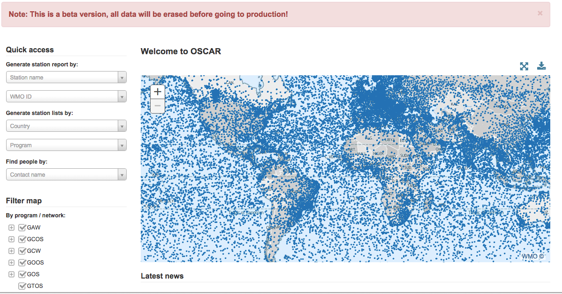
Screenshot from OSCAR/Surface beta-test version

Slide 20
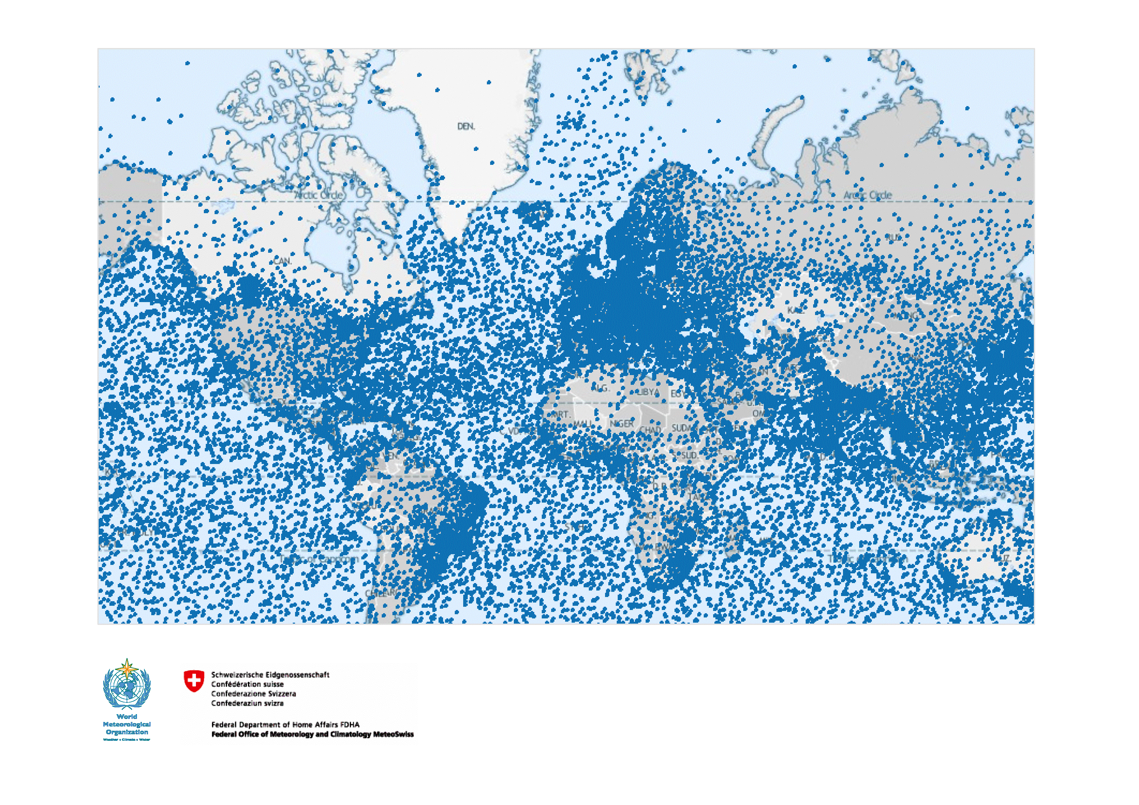

Slide 21
Plan for transition from Vol.A to OSCAR/Surface
Transition period: February 2016 - February 2016.
At the beginning of the transition period, OSCAR will become the official repository of WIGOS metadata, and will serve as the source of information published as Vol. A
Uploads and updates of information will be possible through either
Existing procedures used for Vol. A updates (Secretariat will then transfer information into OSCAR)
Or, directly by the NMHS and other users into OSCAR via:
Direct editing via the web interface, and
Machine to machine interface for automated uploads
At the end of the transition period, Vol. A will cease to exist, and updates will need to take place through OSCAR interface

Slide 22
Plans for transition from Vol.A (Cont.)
OSCAR can generate reports similar to the existing Vol. A flat-files available on the WMO website. The new “Vol. A report” will maintain all current column headings but may not contain information in all columns.
Station information provided to WMO via current Vol. A procedures will be used to update WIGOS metadata in OSCAR.
Protocol and format for feeding information by batch-process into OSCAR to be completed by mid-2016
By December 2017, transition to OSCAR completed; Vol. A will officially cease to exist and related procedures used to maintain station information will be discontinued

Slide 23
Final words on OSCAR/Surface
WG-TDI Members and National WIGOS Focal Points are strongly encouraged to test out OSCAR at:
https://oscar.meteoswiss.ch/OSCAR//index.html
and to provide their feedback to
tproescholdt@wmo.int

Slide 24
III. WIGOS Data Quality Monitoring System (WDQMS)
Real-time monitoring of performance (data availability and data quality) of all WIGOS components, searchable by region, country, station type, period, updated regularly (e.g. GOS every 6 hours)
This will allows us to monitor regional and national (actually station-level) performance of all WIGOS components, and analyse trends over time
A number of pilot projects involving ECMWF, NCEP, DWD, KMS and others are underway
Delayed mode monitoring of data quality as measured against reference sources of information.
Fault management system for tracking and mitigation of performance issues.

Slide 25
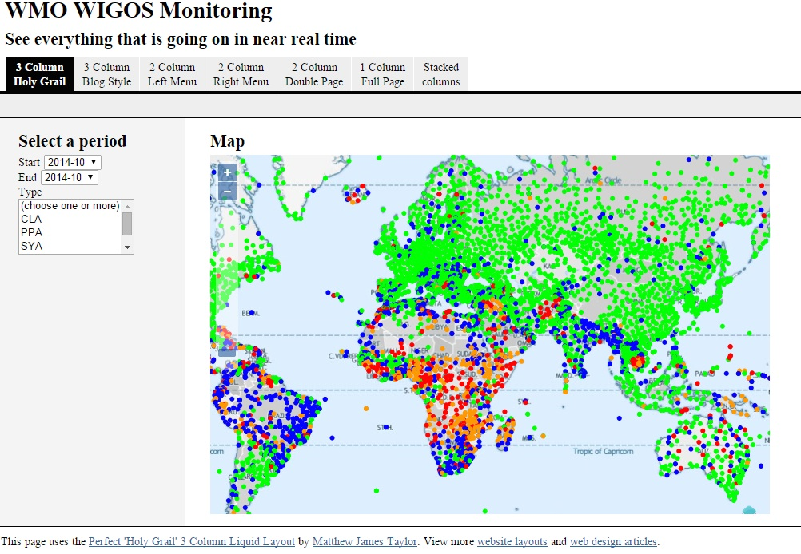

Slide 26
IV. Regional WIGOS Centers
Members already now requesting guidance and support from the WIGOS PO; some of this could be provided more efficiently and effectively by a regional entity, e.g. WIGOS Regional Centers
General role of WRC would be to monitor, coordinate and support the implementation activities in the Region (or sub-Region)
Specific areas of responsibility:
Regional support for OSCAR/Surface.
Regional support for WIGOS Data Quality Monitoring System, including
Data availability.
Data quality
Fault management, i.e. follow-up with data providers in case of data availability or data quality problems.
Regional network design.
Regional coordination of WIGOS implementation activities and projects.
…
The RWC concept will be developed further during the next two years

Slide 27
V. National Implementation, Coordination and Governance Mechanisms
Members requesting guidance on
OSCAR/Surface
Monitoring
Design, deployment, management of AWS (and other) networks
Development of National Partnership agreements
Quality Management approaches
Data policy issues
…
Response to these requests will be formulated in the roadmap for the WIGOS Pre-operational Phase

Slide 28
Summary and Conclusions
WIGOS global framework is now in place and will be further developed during the Pre-operational Phase (2016-2019)
Increased emphasis on Regional and National activities
At the technical level, OSCAR/Surface and the WIGOS Data Quality Monitoring Systems are the two most important element with a near-term impact on Members
Some WIGOS priorities for Region III already identified and translated into implementation projects
Further development and ongoing support is needed; not all Members in Region are active and engaged in the projects
Regional WIGOS Centers expected to play important role
The WIGOS Project Office is ready to help regional and national implementation efforts succeed in any way it can

