Slide 1
Role of RA I in the WIGOS Pre-operational Phase
A. Makarau
President of RA I
on behalf of Mr D. Konate, Vice-President of RA I

Slide 2
Outline
  Decisions by Cg-17
  XVI-RA I guidance
  Regional Basic Networks
  AMDAR observations
  WMO Weather Radar Database
  Regional Portal concept
  Conclusions
WMO
Notes:
2

Slide 3
Decisions by Cg-17
Regional Associations are requested to:
Assign high priority to the implementation and further development of WIGOS in their Regions
Update their R-WIP accordingly;
Strengthen their role in managing and supervising the implementation and further development of WIGOS;
Coordinate WIGOS implementation with the implementation of WIS and other WMO key priorities in their operating plans and work programmes;

Slide 4
Decisions by Cg-17
Collaborate on the development of the concept, and establishment of the Regional WIGOS Centres;
Provide regional support to Members in accordance with the Regional WIGOS Implementation Plan and in a response to their requests (subject to availability of resources or funds);
Notes:
The Concept of RWC will be presented by Dr. A: Makarau PM

Slide 5
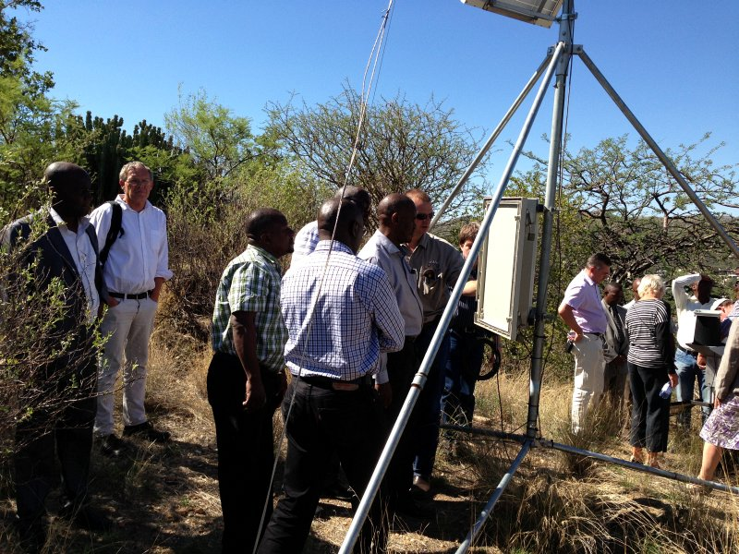
Decisions by Cg-17
Continue to promote capacity development, communications and outreach activities to assist Members in the implementation of WIGOS;

Slide 6
XVI-RA I guidance
It is desirable to:
strengthen and enhance partnership (4 “C”) through Region-wide organizations or sub-regional groupings overseeing the observing systems.
advance regional technical infrastructure
to meet the regional WIGOS requirements
translated into R-WIP

Slide 7
4 “C” stands for
  Collaboration
  Cooperation
  Coordination
  Communication
at regional, sub-regional levels for the mutual benefit for all Members …
“I win, you win, we all win …”
Notes:
7

Slide 8
Regional Basic Networks
Issue: reduced availability of RBSN data, especially upper-air data with a negative impact on the quality of medium-range forecast products over all Regions, not just over Region I itself;
RA should:
  assist Members in the implementation and operation of RBSN/RBCN stations;
  implement a Regional Basic Observing Network when a concept is approved;

Slide 9
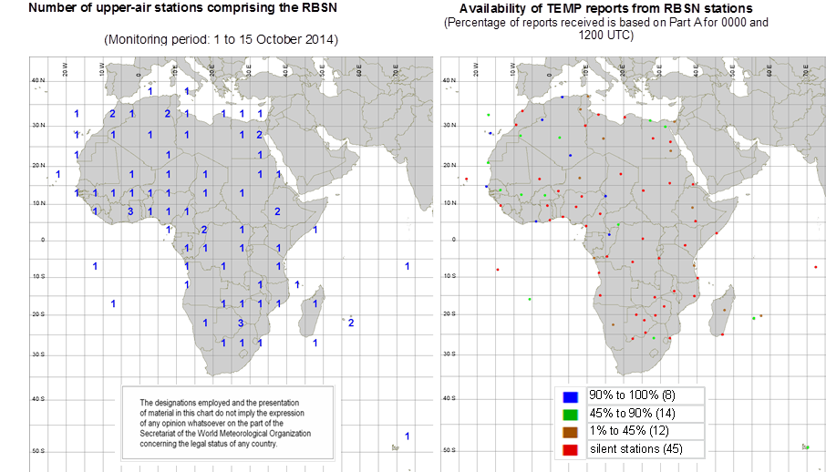
Notes:
Status of the upper-air stations and availability of TEMP reports during a monitoring period 1-15 Oct 2014

Slide 10
AMDAR - Flagship Programme 3 (FPr-3)
The development of AMDAR over Africa will be based on the Aircraft-Based Observations Programme Regional Implementation Plan for WMO Region I (A-RIP-I) under the Regional WIGOS Implementation Plan (R-WIP-I)
RA I WG on Observations, Telecommunication and Infrastructure should collaborate with CBS and CIMO on developing, maintaining and implementing the A-RIP-I for the enhancement and expansion of aircraft-based observations and AMDAR
Notes:
RA I session in 2015 agreed that expansion of the AMDAR Programme in Region I would provide a cost-effective way of addressing the continued challenges faced by the upper-air parts of the RBSN.
It further noted that the current coverage over much of the African continent is mainly through the collaboration between the South African Weather Service and South African Airways, British Airways and Lufthansa.
The Association encouraged other Met services to form similar collaborations with airlines to enhance observations, particularly in data sparse regions of the continent to assist with the development of the RA I AMDAR system.

Slide 11
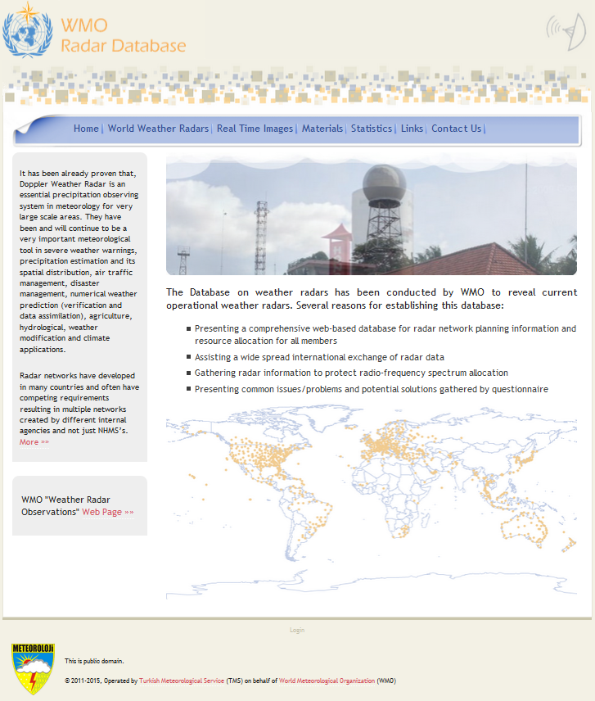
WMO Weather Radar Database
Purpose:
  WRD metadata
  Information to support radio-frequency protection
  Links to online radar data
Members should:
  Provide WMO Focal Points on Weather Radar Metadata
  Maintain data in the WRD
Notes:
WMO WRD was developed by the Turkish State Meteorological Service

Slide 12
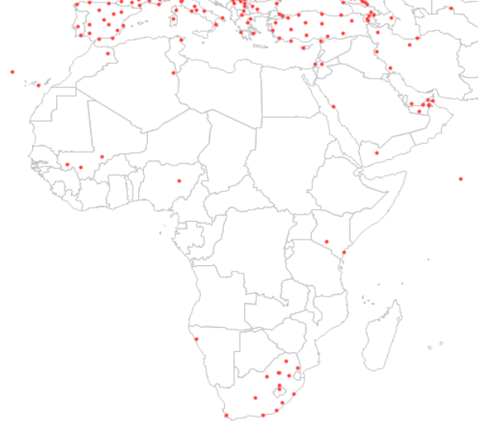
RA I
Radars

Slide 13
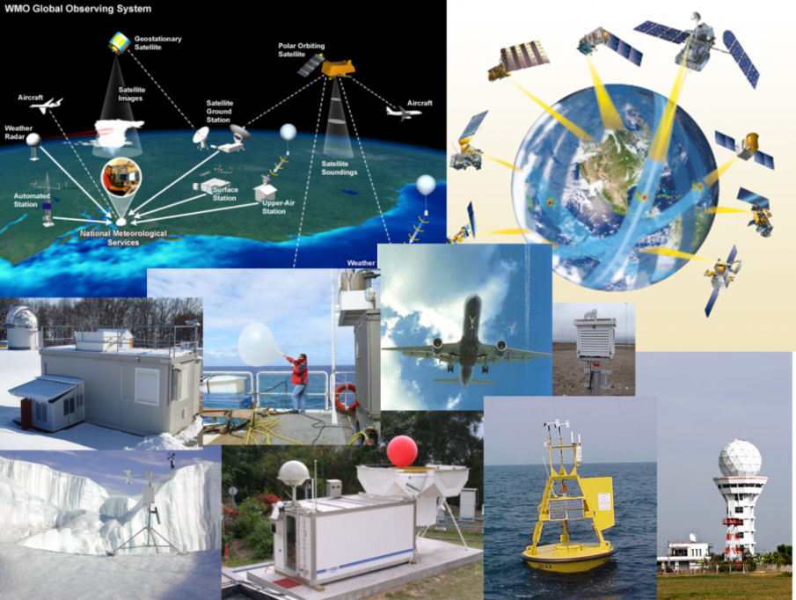
Regional Portal concept
Members
Metadata
Regional WIGOS
Centre(s)
Best practices procedures
Monitoring results
Users
Notes:
RA should support developement of Regional Portal
- More details in following presentations by A. Makarau on RWC and I. Zahumensky on WDQMS

Slide 14
Thank you for your attention
www.wmo.int/wigos

