Slide 1
Moving from the WIGOS Framework towards the Pre-operational Phase
A. Makarau
President of RA I

Slide 2
Outline
  WIGOS
  WIGOS Framework
  WIGOS Pre-operational Phase (2016-2019)
  Five Priority Areas of WPP
  Conclusions
WMO
Notes:
2

Slide 3
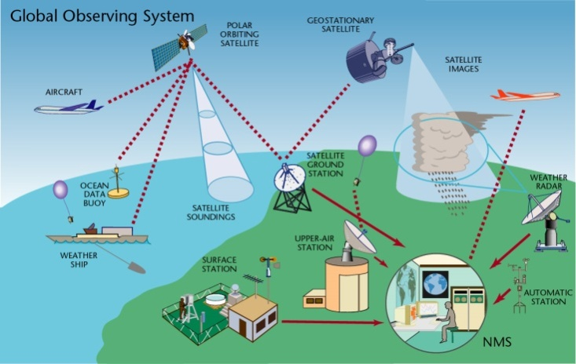
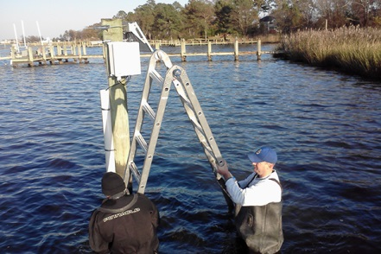
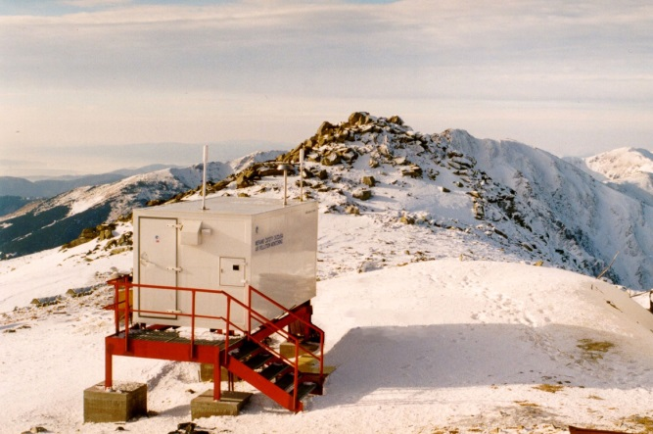
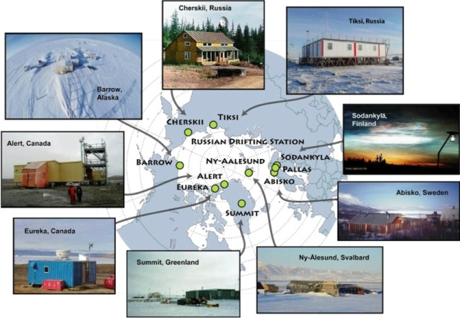
What is WIGOS?
A framework for integrating WMO observing systems and WMO contributions to co-sponsored observing systems,
… for better planning, operating and delivering observations to meet user needs, to enable more efficient and effective service delivery.
WIGOS includes:
  Global Observing System (GOS)
  WMO Hydrological Observing Systems
  observing components of:
    Global Atmospheric Watch (GAW)
    Global Cryosphere Watch (GCW)
  (surface-based and space-based sub-systems)
Note: WIGOS is neither … nor …
Notes:
3
Note: WIGOS is neither a new observing system nor WIS !

Slide 4

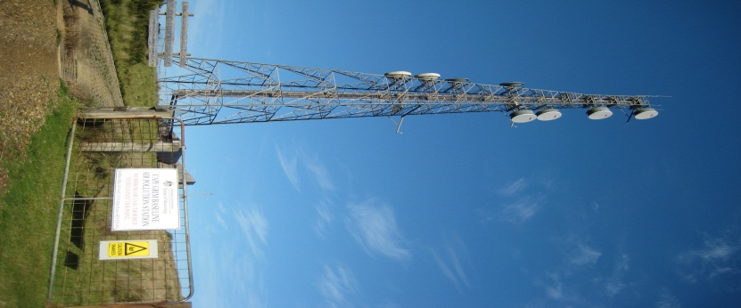
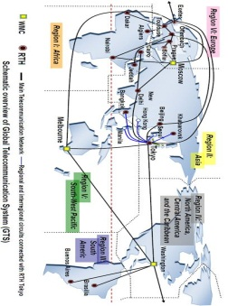
WIGOS: A (future) observing framework for WMO
World Weather Watch
GAW
WIGOS
GCW
WHOS
GOS
GCOS
Partners
GDPFS
Co-sponsors
WIS
GTS
Notes:
WIGOS will implement an observing framework for enabling the integration, interoperability, optimized evolution and best-practice operation of:
WMO observing systems, and
WMO’s contribution to co-sponsored systems.
WIGOS will use and exploit the WMO Information System (WIS)
To allow continuous and reliable access to an expanded set of reliable and trusted environmental data and products, and associated metadata

Slide 5
WIGOS Timeline
WIGOS Pre-operational Phase
2016-2019
Congress 16
Congress 17
Congress 18
Wigos – WMO Strategic priority
WIGOS
Concept
WIGOS
Framework
WIGOS
Operational

Slide 6
WIGOS Framework
At its simplest, the WIGOS framework is about:
  Documenting and implementing standard and recommended practices and procedures in making and sharing observations,
  Coordination, collaboration and building partnerships for efficiency and effectiveness,
  Integration and interoperability in all senses,
  Timely delivery of observations that meet user needs in a way they can use them,
  Empowering and extending the reach of NMHSs, reinforcing their leadership and building partnerships with contributors & users, … … …

Slide 7
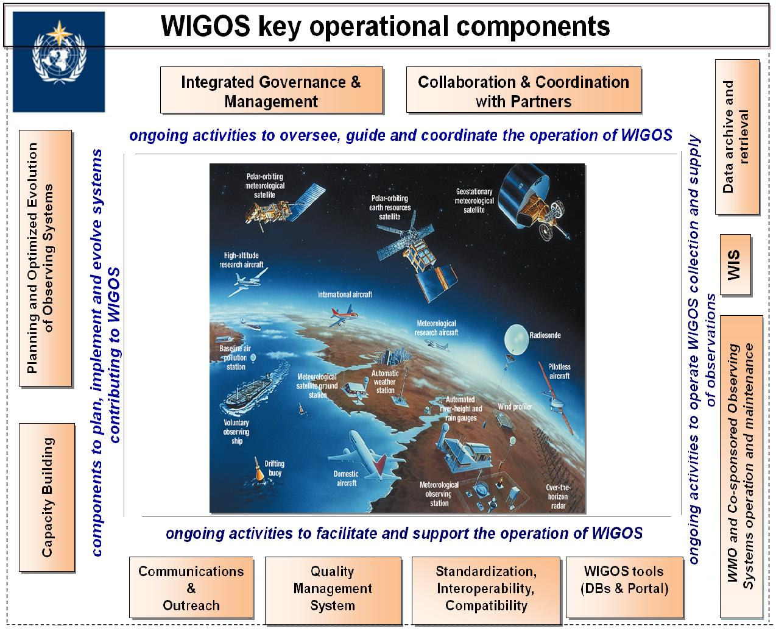

WIGOS Framework: Key activity areas
Management of WIGOS Implementation
Collaboration with WMO co-sponsored OSs and intl. partners & Progrs
To oversee, guide and coordinate WIGOS
Data Discovery and Availability
Design, planning and optimised evolution
To ensure supply of and access to WIGOS observations
To plan, implement and evolve WIGOS component systems
Observing System Operation & Maintenance
Quality Management
To facilitate and support the operation of WIGOS
Communications and Outreach
Capacity Development
WIGOS Information Resource
Standardization and interoperability
Notes:
7
So, we started with the WIGOS Framework – built around 10 key areas – or building blocks.
Significant progress achieved at:
WIGOS Regulatory Material
WIGOS Metadata Standard
WIR (mainly OSCAR)
R-WIPs, supported by a range of regional/subregional projects and CD activities
OND Principles specified in the Manual on WIGOS (search http://library.wmo.int/ for WMO-No. 1157 (Eng. version: http://library.wmo.int/pmb_ged/wmo_1157_en.pdf; Resolutions 25 and 26 respectively))

Slide 8
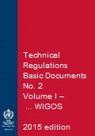
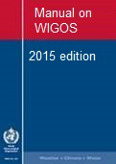
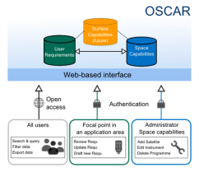
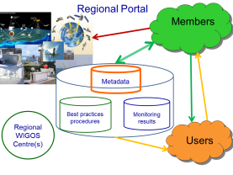
WIGOS Framework elements of particular relevance to Regions and Members
WIGOS Regulatory Material:
  Metadata Standard
  Station Identifiers
WIGOS Information Resource (WIR):
  Portal
  OSCAR (Observing Systems Capability Analysis and Review Tool)
  SORT (Standardization of Observations Reference Tool)
Routine (24/7) monitoring of all WIGOS components:
  Functionality & Performance
  Data Availability & Quality, Incident Management
Notes:
The Framework that describes processes, principles, procedures and practices to be included in the WMO Technical Regulations (WMO-No. 49). Vol. I., incl. Manual on WIGOS: search http://library.wmo.int/ for WMO-No. 1157 (Eng. version: http://library.wmo.int/pmb_ged/wmo_1157_en.pdf; Resolutions 25 and 26, respectively)

Slide 9
Why a WIGOS Pre-operational Phase?
Implementing the key building blocks of the WIGOS Framework during the Implementation Phase does not mean the job is done – much more to be done!
Staged approach, starting with the building blocks of the WIGOS Framework, moving now on national WIGOS implementation, with regional support
Need to develop a culture of compliance with the WMO Technical Regulations (WMO-No. 49)
(a critical success factor)

Slide 10
Why a WIGOS Pre-operational Phase (2)?
Key principle of WIGOS - an inclusive approach to the integration and sharing of observations from a diverse range of observing systems, both NMHS and non-NMHS owned, into a composite set of observations to help Members improve their services across all WMO application areas.
Members need practical guidance (best practices, procedures, examples, etc.)
Notes:
Getting value from observations means addressing emerging data challenges and opportunities
Enhance NMHS leadership – standards, network design, network management on behalf of 3rd parties, access to WIS
Lifecycle management also for efficiency, timeliness of access, archiving, tiered network management

Slide 11
Plan for WIGOS Pre-operational Phase (PWPP)
Objective of the WIGOS Pre-operational Phase
  To build on and strengthen the WIGOS framework to deliver a fully operational WIGOS in 2020;
  To place increased emphasis on regional and national activities.
Five priority areas
  National WIGOS implementation
  WIGOS Regulatory and Guidance Material
  WIGOS Information Resource
  WIGOS Data Quality Monitoring System
  Regional WIGOS Centres

Slide 12
1. National Implementation,
Coordination & Governance Mechanisms
Notes:
More details in SESSION 3: National WIGOS implementation

Slide 13
2. WIGOS Regulatory
and
Guidance Material

Slide 14
New WIGOS Regulatory Material
Members shall implement and manage their national observing systems in accordance with the provisions of the Technical Regulations, Volume I, Part I, and the Manual on WIGOS
Members shall continuously monitor the performance of their observing systems.
Members shall implement quality control for all observations for which they are responsible.
Members shall record, retain and make available internationally the observational metadata as specified in the Manual on WIGOS, section 2.5.
… … … … … …
Notes:
Just to mention some of them as examples
(see WIGOS Technical Regulations in: WMO-No. 1157 (Eng. version: http://library.wmo.int/pmb_ged/wmo_1157_en.pdf; Resolutions 25 and 26 respectively))

Slide 15
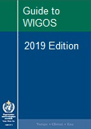
New WIGOS Guidance Material
WMO
more detailed information, best practices and procedures, explanation and examples on how to implement national observing systems …
Notes:
Request for sharing by Members those best practices, procedures to be used by others at the Regional / Global levels
The Guide should provide more detailed information, best practices and procedures, explanation and examples on how to implement standard and recommended practices and procedures specified in the Volume I, Part I – WIGOS of the WMO Technical Regulations (WMO-No. 49) and Manual on WIGOS into day-to-day operations.
The Guide is intended to be used by managers/supervisors and other technical staff of NMHSs responsible for planning, implementation, performance and operation of national observing systems/networks. These individuals are the target audience.

Slide 16
3. WIGOS Information Resource
Notes:
A specific presentation on WIR by L.P. Riishojgaard

Slide 17
4. WIGOS Data Quality Monitoring System
(WDQMS)
Notes:
A specific presentation by I. Zahumensky

Slide 18
5. Regional WIGOS Centres
Notes:
A specific presentation by A. Makarau

Slide 19
Conclusions
WIGOS to be implemented by Cg-18, but achieving full operation and compliance will be ongoing process;
WIGOS, with its strong and evolving foundation, will:
  Enable WMO to assist and guide Members, in context of all WMO priorities (DRR, GFCS, etc.)
  Enable RAs to support and evolve observing and service capacities with their Region
  Empower Members
    to design, evolve and sustain integrated observing systems that meet national needs; and
    To reinforce their national mandate and leadership, under WIGOS, WIS and WMO banners
Notes:
Implementation will, like GOS, be an ongoing thing but the foundation that we build now:
will position WMO well to assist and guide members, in the context of all of the WMO priorities (including GFCS, DRR etc) and
will equip regional associations to assist and evolve observing and service capacities within their region;
Will empower Members to design, evolve and sustain the observing systems that best meet national needs, and provide national leadership on integrated observations with the global brand recognition of WMO

Slide 20
Thank you www.wmo.int/wigos

Slide 21
WIGOS Framework: Key activity areas
ICG-WIGOS;
Regional WIGOS plans;
Some national WIGOS plans;
National readiness checklist;
Technical Regulations & WIGOS Manual;
Plan for WIGOS Pre-operational Phase
Management of WIGOS Implementation / operation
Collaboration with co-sponsors and partners
To oversee, guide and coordinate WIGOS
Data discovery, delivery & archival
Design, planning and optimised evolution
To ensure supply of and access to WIGOS observations
To plan, implement and evolve WIGOS component systems
Observing system operation & maintenance
Quality Management
To facilitate and support the operation of WIGOS
Communications and outreach
Capacity Development
Operational Information Resource
Standardization, interoperability & compatibility
Notes:
21

Slide 22
WIGOS Framework: Key activity areas
ICG-WIGOS;
Cross-representation;
Building partnerships;
WIGOS Project Office
Management of WIGOS Implementation / operation
Collaboration with co-sponsors and partners
To oversee, guide and coordinate WIGOS
Data discovery, delivery & archival
Design, planning and optimised evolution
To ensure supply of and access to WIGOS observations
To plan, implement and evolve WIGOS component systems
Observing system operation & maintenance
Quality Management
To facilitate and support the operation of WIGOS
Communications and outreach
Capacity Development
Operational Information Resource
Standardization, interoperability & compatibility
Notes:
22
GCOS, GCW, CGMS reps on ICG-WIGOS
Chair ICG-WIGOS on GCW, GCOS SC
Took while to establish PO but now working very effectively – need more resources to assist

Slide 23
WIGOS Framework: Key activity areas
Management of WIGOS Implementation / operation
Collaboration with co-sponsors and partners
To oversee, guide and coordinate WIGOS
EGOS-IP
Initiate Vision for WIGOS in 2040
Impact workshops
RRR extended to GAW
GCW Cryonet
WHOS
Space-based architecture for climate monitoring
Data discovery, delivery & archival
Design, planning and optimised evolution
To ensure supply of and access to WIGOS observations
To plan, implement and evolve WIGOS component systems
Observing system operation & maintenance
Quality Management
To facilitate and support the operation of WIGOS
Communications and outreach
Capacity Development
Operational Information Resource
Standardization, interoperability & compatibility
Notes:
23
RRR extended to GAW
Asking Congress to agree to establish the GCW Cryonet

Slide 24
WIGOS Framework: Key activity areas
Management of WIGOS Implementation / operation
Collaboration with co-sponsors and partners
To oversee, guide and coordinate WIGOS
Data discovery, delivery & archival
Design, planning and optimised evolution
To ensure supply of and access to WIGOS observations
To plan, implement and evolve WIGOS component systems
Observing system operation & maintenance
Link into WMO QMF;
Real-time monitoring availability & quality;
ECMWF/NCEP pilot
Quality Management
To facilitate and support the operation of WIGOS
Communications and outreach
Capacity Development
Operational Information Resource
Standardization, interoperability & compatibility
Notes:
24
WIGOS Data Quality Monitoring System
Electronic online real-time monitoring of performance (both data availability and data quality)
Pilot project underway with input from ECMWF and NCEP

Slide 25
WIGOS Framework: Key activity areas
Management of WIGOS Implementation / operation
Collaboration with co-sponsors and partners
To oversee, guide and coordinate WIGOS
Data discovery, delivery & archival
Design, planning and optimised evolution
To ensure supply of and access to WIGOS observations
To plan, implement and evolve WIGOS component systems
Observing system operation & maintenance
Quality Management
RA/sub-RA workshops; Reg/national projects;
Satellite requirements;
Align to WMO Capacity Development Strategy
To facilitate and support the operation of WIGOS
Communications and outreach
Capacity Development
Operational Information Resource
Standardization, interoperability & compatibility
Notes:
25
Especially RA-I projects, Cote d'Ivoire, Tanzania – hear more at side event on Wed 3 June.
RA-III multi-country integration

Slide 26
WIGOS Framework: Key activity areas
Management of WIGOS Implementation / operation
Collaboration with co-sponsors and partners
To oversee, guide and coordinate WIGOS
Data discovery, delivery & archival
Design, planning and optimised evolution
To ensure supply of and access to WIGOS observations
To plan, implement and evolve WIGOS component systems
Observing system operation & maintenance
Quality Management
To facilitate and support the operation of WIGOS
Regulatory Material; Cloud Atlas;
WIGOS metadata;
RMICs
CIMO priority tasks
Communications and outreach
Capacity Development
Operational Information Resource
Standardization, interoperability & compatibility
Notes:
26
Regional Marine Instrument Centres – focus on interoperability, standards and calibration

Slide 27
WIGOS Framework: Key activity areas
Management of WIGOS Implementation / operation
Collaboration with co-sponsors and partners
To oversee, guide and coordinate WIGOS
Data discovery, delivery & archival
Design, planning and optimised evolution
To ensure supply of and access to WIGOS observations
To plan, implement and evolve WIGOS component systems
Observing system operation & maintenance
Quality Management
WIGOS Information Resource (WIR);
Portal;
OSCAR/Requirements; OSCAR/Space;
OSCAR/Surface
To facilitate and support the operation of WIGOS
Communications and outreach
Capacity Development
Operational Information Resource
Standardization, interoperability & compatibility
Notes:
27
WIGOS Portal; operational, will be further developed
SORT (Standards of Observations Reference Tool); not yet developed; draft specifications are available
OSCAR (Observing System Capabilities and Review Tool)
OSCAR/Requirements; pre-operational; run by Secretariat
OSCAR/Space; still evolving; pre-operational, run by Secretariat
OSCAR/Surface; developed for WMO by at team lead by MeteoSwiss; prototype version introduced during Cg-XVII
Gap Analysis Module; in development

Slide 28
WIGOS Framework: Key activity areas
Management of WIGOS Implementation / operation
Collaboration with co-sponsors and partners
To oversee, guide and coordinate WIGOS
Data discovery, delivery & archival
Design, planning and optimised evolution
To ensure supply of and access to WIGOS observations
To plan, implement and evolve WIGOS component systems
Observing system operation & maintenance
Quality Management
To facilitate and support the operation of WIGOS
WIGOS Newsletter; Workshops; Collaboration;
Presentations;
Web reports & materials
Communications and outreach
Capacity Development
Operational Information Resource
Standardization, interoperability & compatibility
Notes:
28
Recognise need to communicate several layers into NMHSs and with partners
Collaboration – GCOS, GFCS,

Slide 29
WIGOS Framework: Key activity areas
Management of WIGOS Implementation / operation
Collaboration with co-sponsors and partners
To oversee, guide and coordinate WIGOS
Data discovery, delivery & archival
Design, planning and optimised evolution
To ensure supply of and access to WIGOS observations
To plan, implement and evolve WIGOS component systems
Regulatory material;
CIMO Technical Conferences;
Regional projects (eg.
ASECNA, RA-III, RA-VI)
Observing system operation & maintenance
Quality Management
To facilitate and support the operation of WIGOS
Communications and outreach
Capacity Development
Operational Information Resource
Standardization, interoperability & compatibility
Notes:
29
Bilateral collaborations – eg improved functioning of upper air stations in RA-I in collab with ASECNA -> more radiosondes in Africa

Slide 30
WIGOS Framework: Key activity areas
Management of WIGOS Implementation / operation
Collaboration with co-sponsors and partners
To oversee, guide and coordinate WIGOS
Data discovery, delivery & archival
WIS implementation;
WIGOS Metadata Standard;
Station IDs;
CCl-CBS Data management
Design, planning and optimised evolution
To ensure supply of and access to WIGOS observations
To plan, implement and evolve WIGOS component systems
Observing system operation & maintenance
Quality Management
To facilitate and support the operation of WIGOS
Communications and outreach
Capacity Development
Operational Information Resource
Standardization, interoperability & compatibility
Notes:
30
Request from Members for WIS and WIGOS to remain closely linked, especially in implementation and training, and in design of projects.
Big focus on need to facilitate integration of data from sources external to NMHS – a clear priority for GAW, JCOMM, GCW by their very nature and dependence on institutions external to NHMS.
Also important to realise the potential to extend the network coverage of NMHSs through such third party networks, including potentially private sector sources. WIGOS and WIS will help build the leadership of NMHSs through their standard-based and regulatory mandate.
In response to EC-65, ICG-WIGOS has conducted an assessment of the existing data sharing policies and will focus in the next period on developing guidance to help members

