Slide 1
WMO RA IV WIGOS Implementation Workshop
Overview of WIGOS activities in RA-IV
Curaçao
2 December 2015

Slide 2
RA IV WIGOS Implementation Plan Milestones
Creation: November 2012 in Costa Rica
Ratified by Members: April 2013 in Curaçao
Implementation stated immediately

Slide 3
KEY ACTIVITY AREAS FOR REGIONAL WIGOS IMPLEMENTATION
(a) Management of WIGOS implementation;
(b) Collaboration with WMO and co-sponsored observing systems;
(c) Design, planning and optimized evolution;
(d) Integrated Observing System operation and maintenance;
(e) Integrated Quality Management;
(f) Standardization, system interoperability and data compatibility;
(g) The WIGOS Operational Information Resource;
(h) Data and metadata management, delivery and archival;
(i) Capacity development;
(j) Communication and outreach.

Slide 4
Management of WIGOS implementation
Activity | Deliverables | Timeline | Responsibility
Regularly update the regional WIGOS Implementation Plan for RA IV (RWIP) | Regional WIGOS Implementation Plan (RWIP) for RA IV | Developed in 2012 and updated as needed | Maintained by TT-WIGOS approved by MG
RA IV Members to appoint National Focal Points and submit reports on progress of implementation of national plans | List of RA IV National Focal Points Updated national plans | 2013-2015 once per year | RA IV Members

Slide 5
Management of WIGOS implementation
Activity | Deliverables | Timeline | Responsibility
Report progress of RA IV R-WIP projects to RA IV MG | Progress reports | 2013-2015 once per year | Coordinators of Projects
Compile information from Members, other relevant partners and WMO sources as input to existing national observing systems in RA IV. | A report detailing all the current observing systems in the region, including the composition of networks, data outputs and who are the owners/operators. | 2013 | TT-WIGOS assisted by the Secretariat

Slide 6
Collaboration between observing systems: WMO, co-sponsored and other observing systems
Activity | Deliverables | Timeline | Responsibility
Interface with EC PORS on Global Crysophere Watch observational components | National and regional observing system designs consider emerging GCW requirements | 2013 and onwards | Relevant Members
Strengthened the collaboration with TCs and develop a feedback mechanism | Meteorological observing systems are compliant with the range of quality standards. | 2013-15 | Members
To work with the Secretariat to develop and implement the exchange of information for those co-sponsored of highest priority to the Region | Work with Secretariat to develop strategy for implementation of exchange of data. | 2013 and onwards | Members

Slide 7
Design, planning and optimized evolution of WIGOS and its regional, sub-regional and national observing components
Activity | Deliverables | Timeline | Responsibility
Compile the regional observational requirements including from: The Hurricane Committee’s Technical Plan; Marine Programmes including buoys and offshore platforms; Expanded space based observations including NESDIS activities; Expanded agro-met observations including USDA activities; Strategy for the architecture for climate monitoring from space. | Consolidated list of regional observations requirements. | 2013-14 | Members

Slide 8
Design, planning and optimized evolution of WIGOS and its regional, sub-regional and national observing components
Activity | Deliverables | Timeline | Responsibility
Create an inventory of the existing regional Networks, including a process for its ongoing maintenance. | Inventory and a plan for its periodic update. | 2013 and onwards | Members
Evolve as feasible, existing regional observation networks to meet WIGOS standards. | Regional networks which would evolve to meet WIGOS standards | 2013 and onwards | Members

Slide 9
Design, planning and optimized evolution of WIGOS and its regional, sub-regional and national observing components
Activity | Deliverables | Timeline | Responsibility
Evolve and implement National observing systems, following the guidance of: National Policy and priorities The technical guidance of the TCs as represented in the EGOS-IP and other observation system implementation plans; The regional priorities; Relevant actions identified in the Technical Plan of the Hurricane Committee; The need for “gap filling” and restoration of relevant silent stations. | Annual National reports of the improving WMO observing systems in Region IV. | 2013 and onwards | Member countries in Region IV.

Slide 10
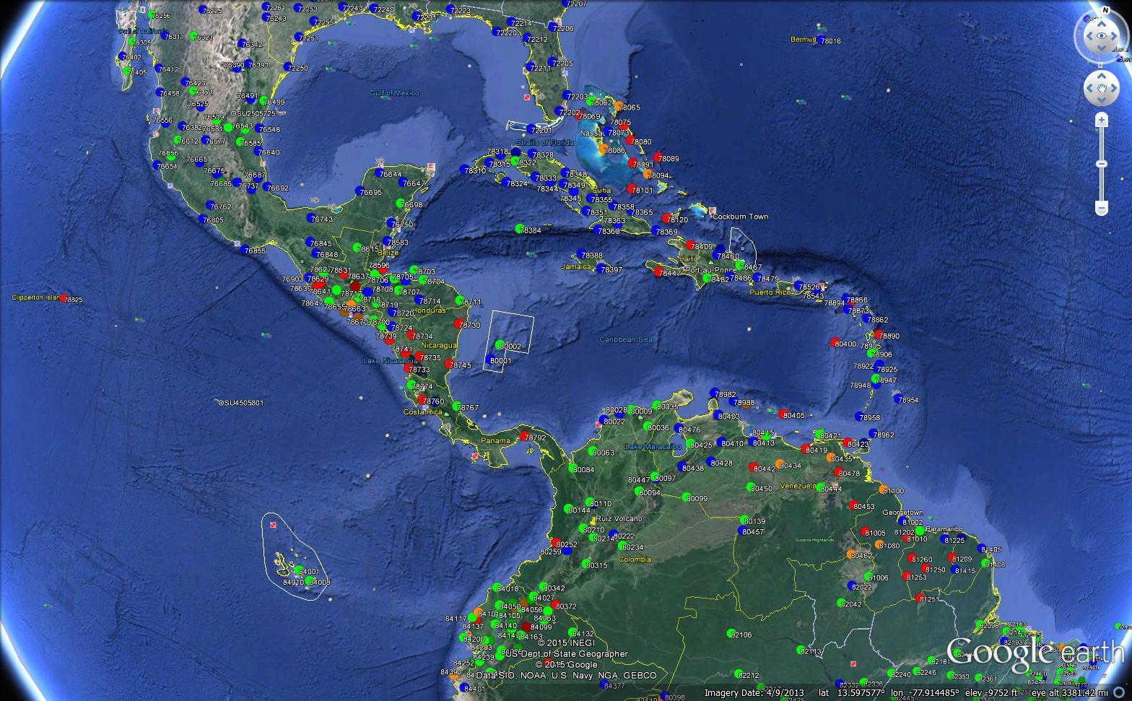

Slide 11
Integrated Observing System Operation and Maintenance
Activity | Deliverables | Timeline | Responsibility
Collect and share best practices from RA IV Members with other Regions | Shared best practices on the integration of observational systems | 2013 and onwards | Members
Exploit opportunities to benefit from the sharing of experiences, expertise and the pooling of resources across RA III and RA IV | Implementation of joint activities across RA III and RA IV | 2013 and onwards | Members

Slide 12
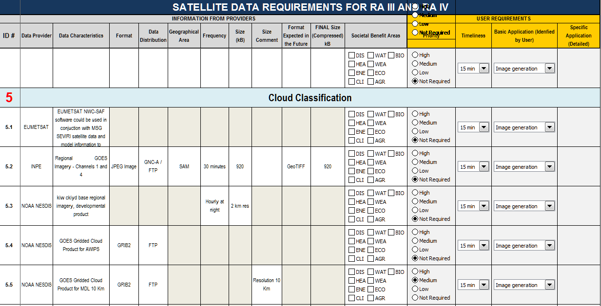

Slide 13
Integrated Quality Management
Activity | Deliverables | Timeline | Responsibility
Survey and share status on maintenance and instruments calibration for surface-based observations | Reports on status on instruments calibration for surface-based observations | 2013 and onwards | Members
Monitoring data quality to support QA and linked to 4.1 | Develop monitoring capability to support QM | 2013 and onwards | Members

Slide 14
Standardization, System Interoperability and Data Compatibility
Activity | Deliverables | Timeline | Responsibility
Implement the WMO Siting Classification Scheme in through: Provision of information and training to Member countries; and Adoption of new procedures by Member countries. | WMO Siting Classification Scheme is implemented in RA IV. | 2013 and onwards | Members
Survey and share status on QC/QA procedures and site management for the network of RBCN and RBSN stations, changes to the site after installation needs to be documented. | Reports on status on QC/QA procedures and site management in RA IV | 2013 and onwards | Members
Request the collection of metadata on all observing stations | Collection of metadata on all observing stations | 2013 and onwards | Members

Slide 15
The WIGOS Operational Information Resource
Activity | Deliverables | Timeline | Responsibility
Request, support and encourage Members to provide up-to-date data and metadata to the WIR and ensure its on-going maintenance. | Up-to-date metadata maintained at WMO. | 2013 and onwards | Members

Slide 16
Capacity development
Activity | Deliverables | Timeline | Responsibility
Creating a regional capacity development plan to include: Radar data analysis and transfer; Improving availability and utilization of AMDAR data; Improving availability and utilization of observation data including metadata; Improving availability and utilization of high resolution radiosonde data; Improving the utilization of satellite data and products; Improving the utilization of marine data and products. | A regional capacity development plan | 2013 and onwards | Members

Slide 17
Communication and outreach
Activity | Deliverables | Timeline | Responsibility
Participate in the development of a CBS Socio-economic Impact message | The development of a socio-economic impact message which can be tailored to be used at the National level | 2013 and onwards | Members
Interlink RA IV WIGOS portals and related Websites | Better access to RA IV WIGOS-related information and products | 2013 and onwards | Members

Slide 18
QUESTIONS?

