Slide 1
Observing System Capability Analysis and Review Tool (OSCAR) Detailed functions
WIGOS Project Office
WMO; Name of Department (ND)

Slide 2
Outline
OSCAR datamodel
Finding information (data?)
Station report
Users & access control
Data entry
Station Contacts
OSCAR API
Help (system & support)
OSCAR as archive & national use

Slide 3
Principles of OSCAR
Observation centric
Multipurpose station concept
Trust & traceability

Slide 4
OSCAR – data model / observation-centric
a simplified domain model of OSCAR
Program
Instrument
Observation
Schedule
Variable
Station
Geographic extent

Slide 5
OSCAR – Multipurpose Station Concept
Co-location of separate but physically close observations
Payerne station
Lidar
Radar
AWS (research)
AWS

Slide 6
OSCAR – Trust and Traceability
Station Contacts have wide-ranging rights
All changes are logged
National Focal Point oversees national changes

Slide 7
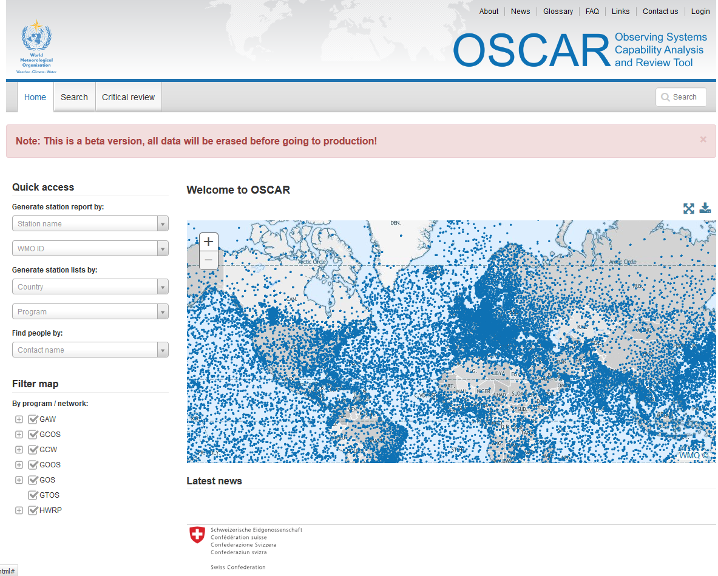
OSCAR – Finding information
Simple & Advanced Search
Site-wide search (stations, data & contacts)
Quick access
&
Map filter

Slide 8
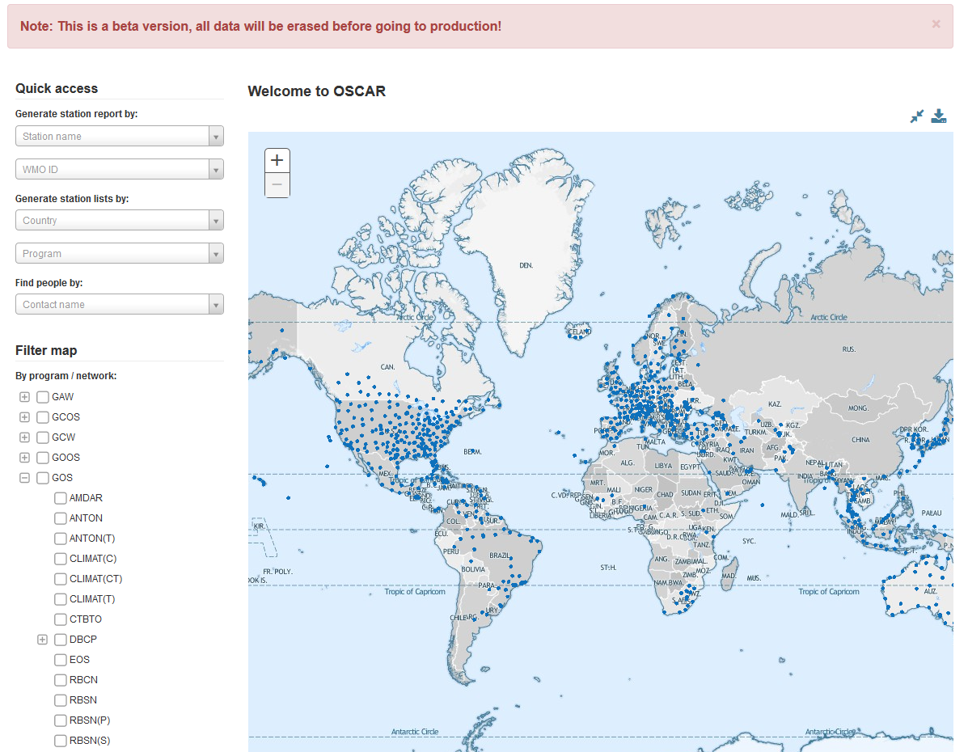
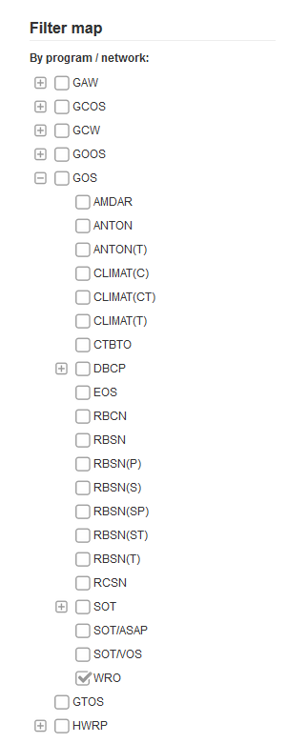
Example: Show Weather Radars

Slide 9
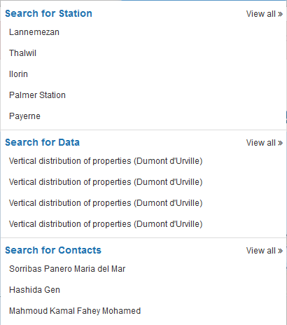
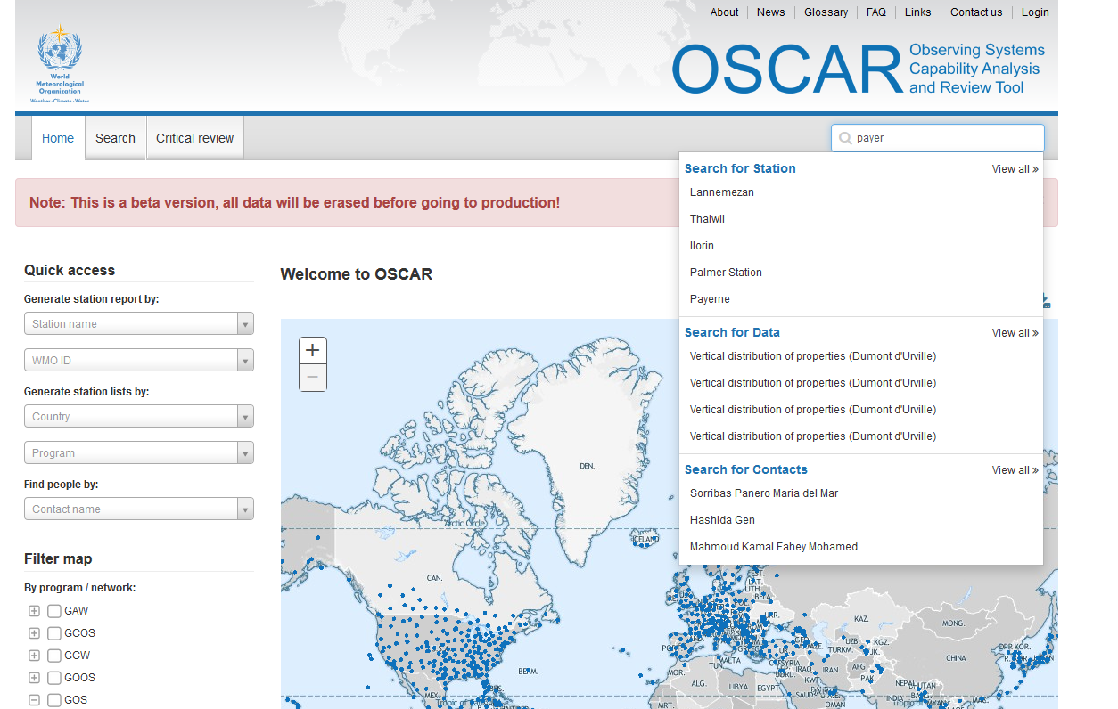
Example: Quickly Access Payerne station
What has Hashida Gen to do with Payerne?

Slide 10
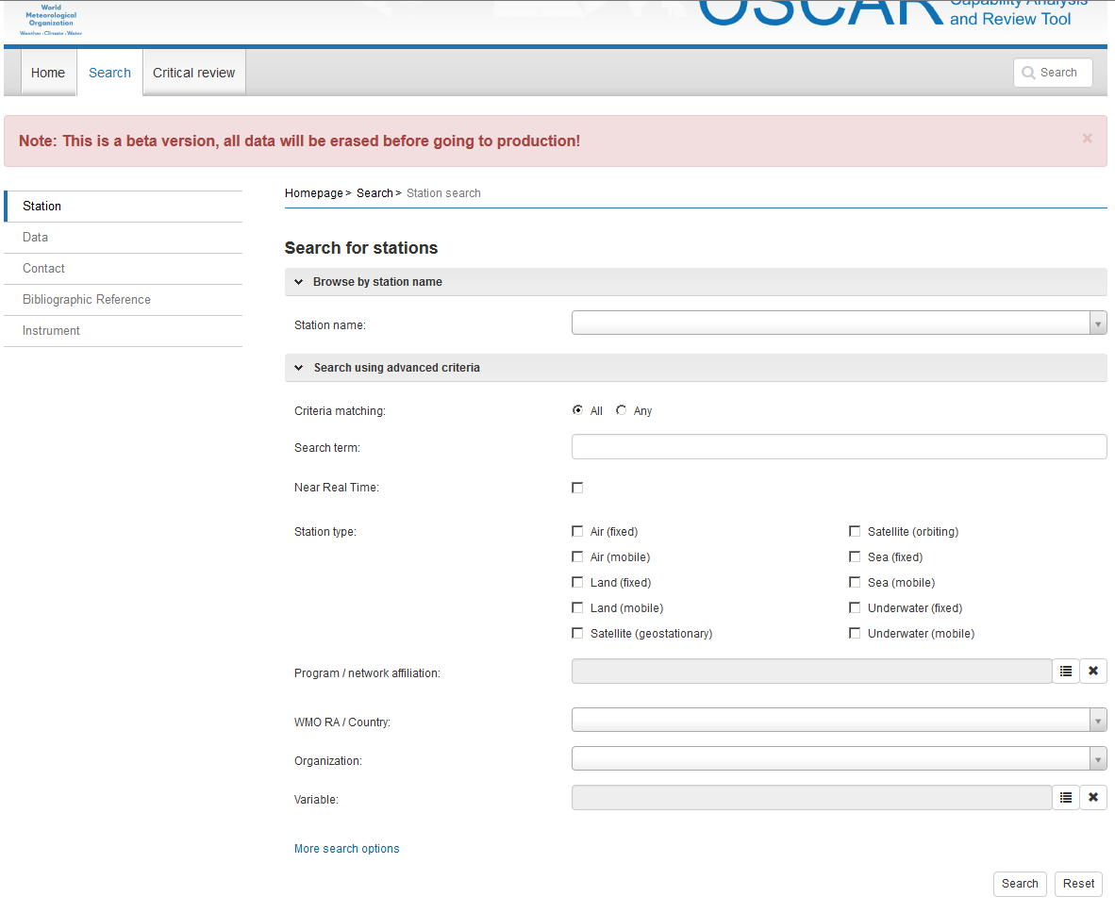
OSCAR – Simple and Advanced Search
Search by name or combined criteria
Country
Type
Program
Variable
More..

Slide 11
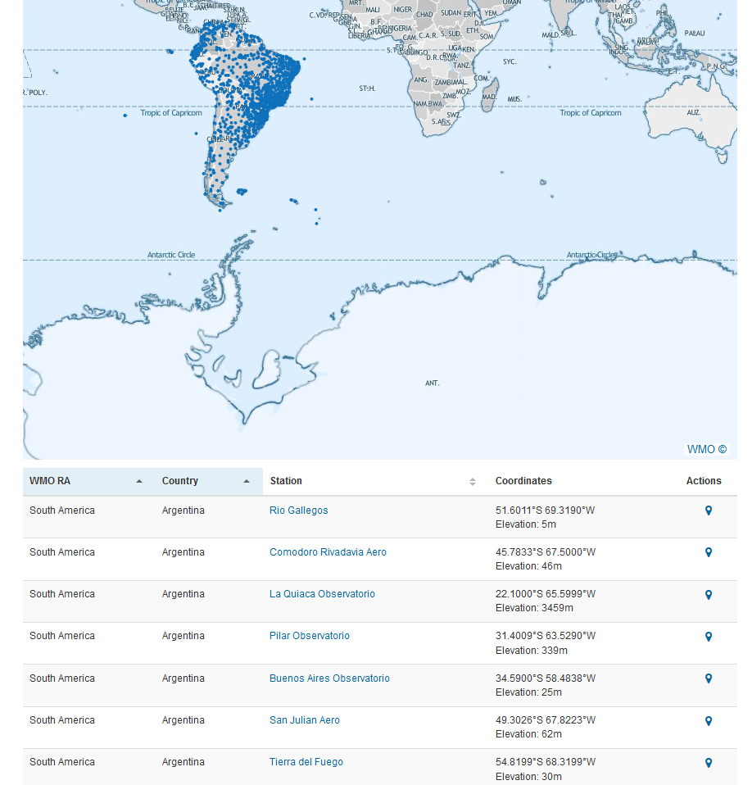
OSCAR – Search Results
Land-fixed stations measuring «pressure» in RA III
Results are shown in
Map
Paginated list
Export as
XML, KML, CSV
PNG, PDF, ..

Slide 12
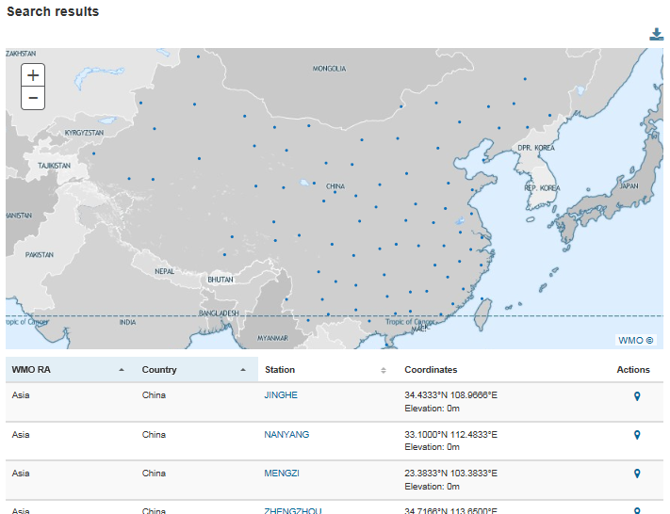
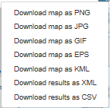
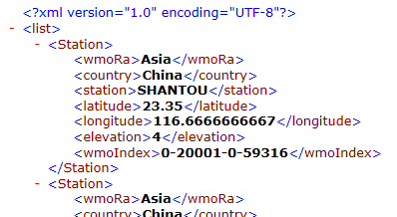
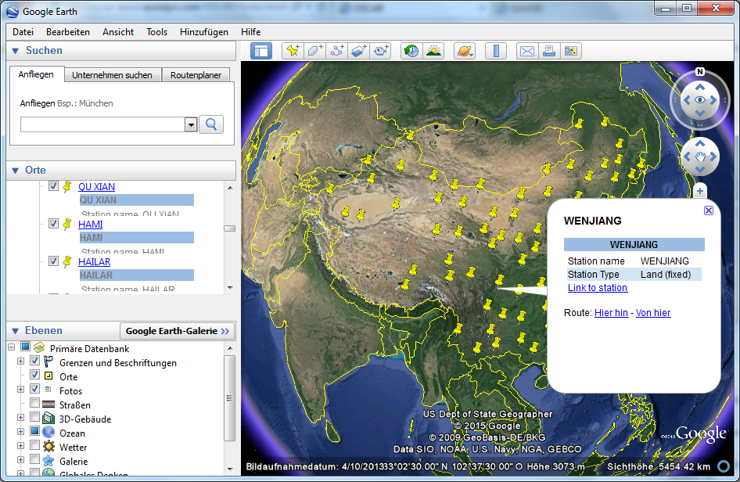
Search Results Can Be Used Elsewhere
Download for further analysis
Integration with GoogleEarth

Slide 13
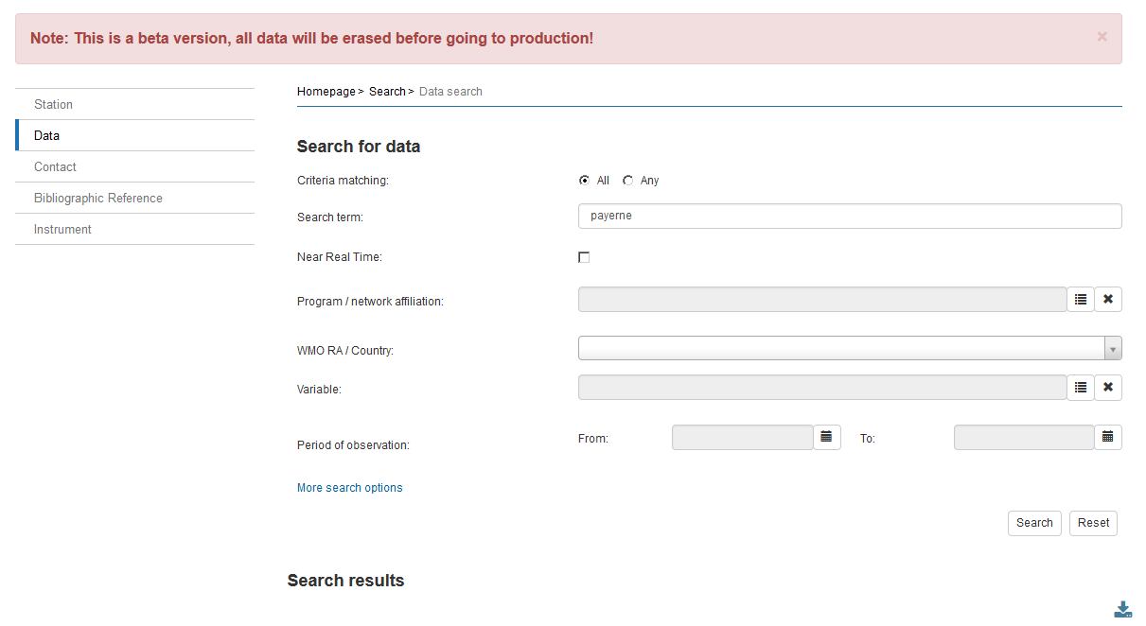
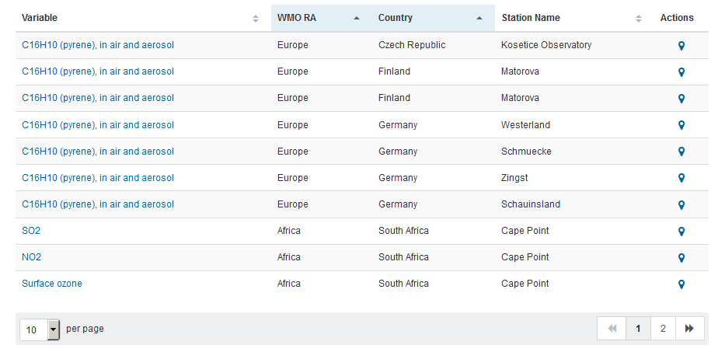
OSCAR – Data search
Data search
Searches observations
Additional options
Program
Country
Variable
Results link to
Observation section of the station report

Slide 14
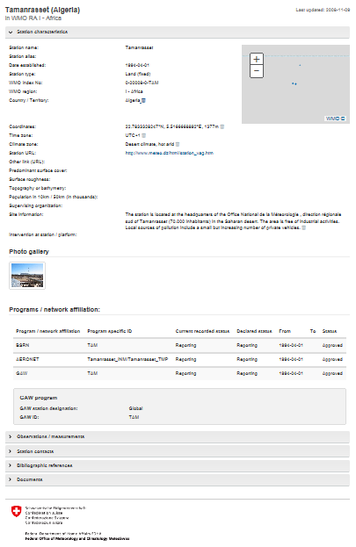
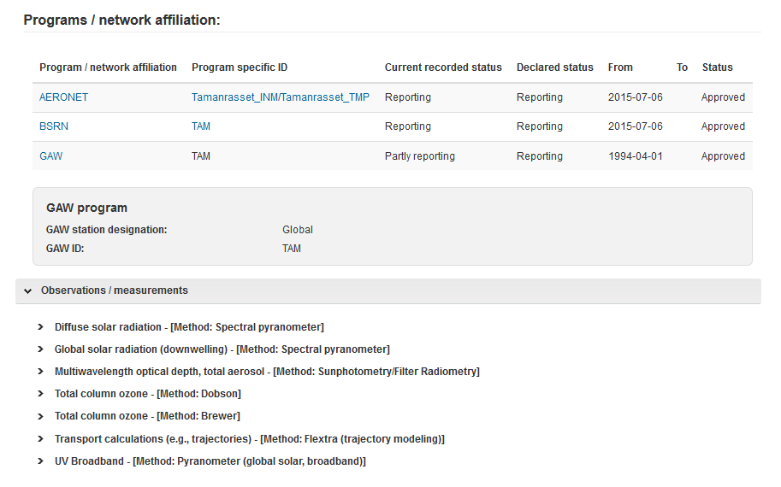
OSCAR – Station report
Detailed Station Metadata & Observations taken
Environment
Contacts
Photos
History of changes
Observations + schedule

Slide 15
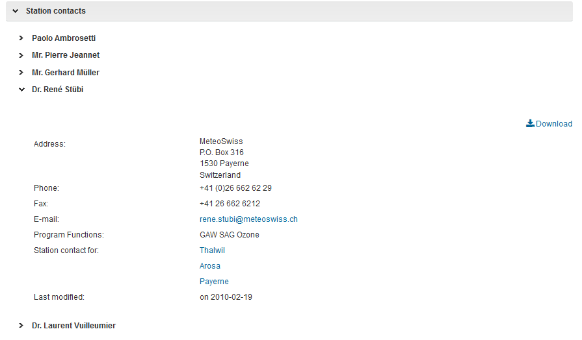
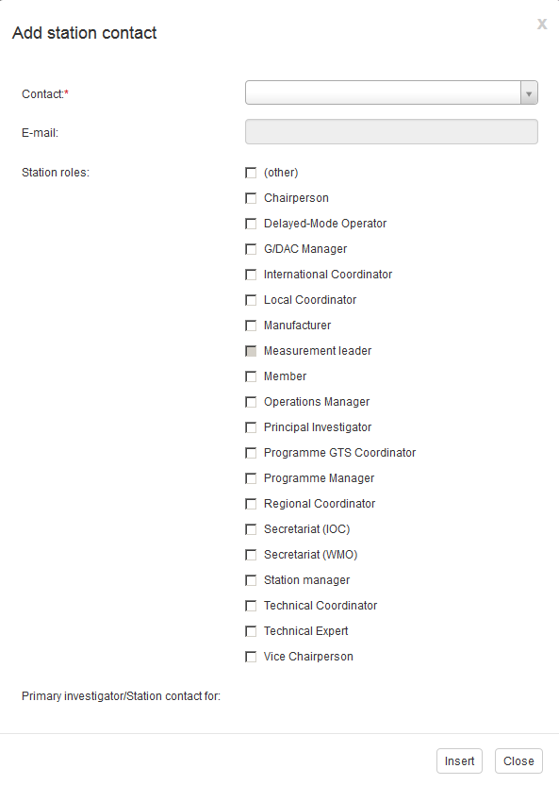
OSCAR –Contacts
Station contacts
can edit stations
Contacts have formal roles
(e.g Regional Coordinator)

Slide 16
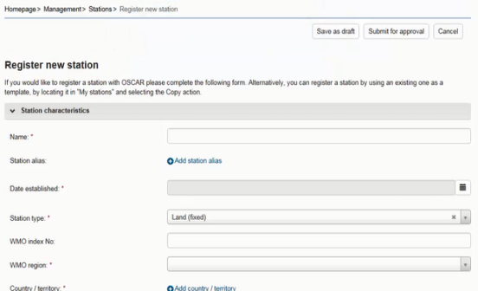
Security And User Management
Authentification by identity provider (Swiss Government)
Authorization within application based on «trust-relationships» and various «user roles»
Register
Edit all stations in country
Also: register new contact (in own country)
Admin
NFP
Edit assigned stations
Also: register new contact (in own country)
Station contact

Slide 17
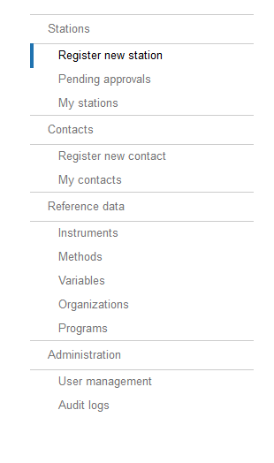
OSCAR – Data Entry / Management Console
Depending on privileges the management console provides access to
Stations
Contacts
Administrative functions
Approval
User management
«my stations» shows stations I can edit

Slide 18
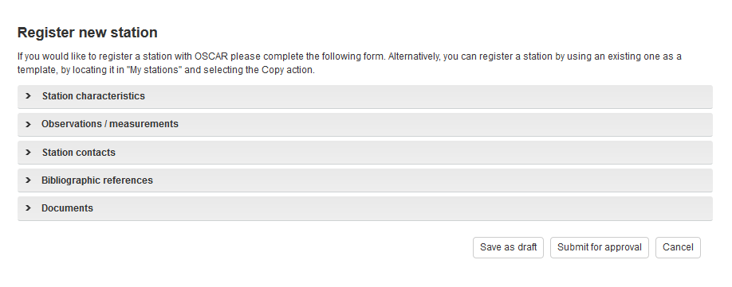
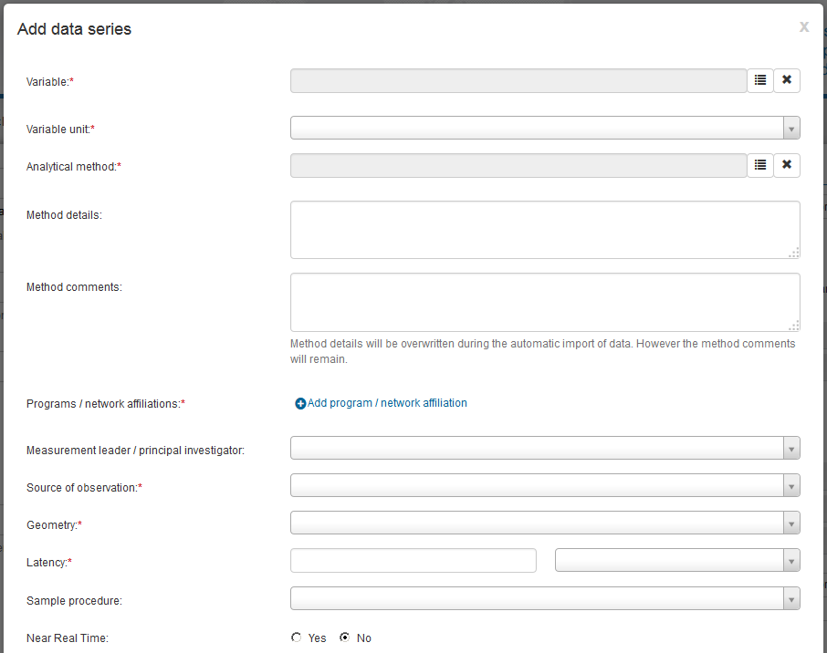
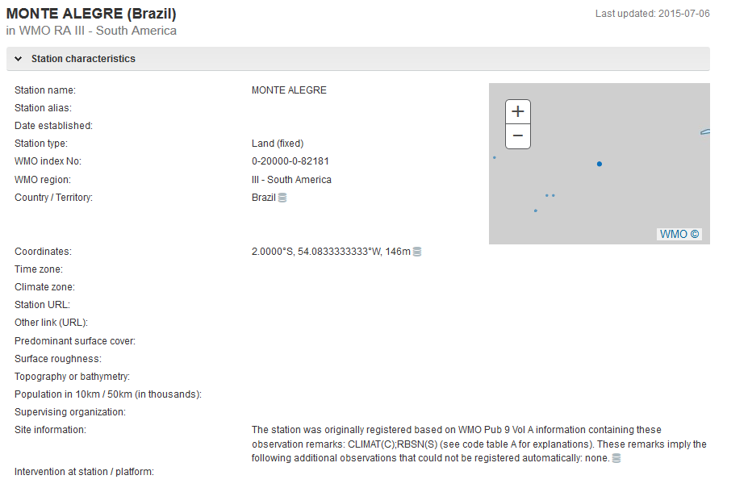
OSCAR – Register New / Edit Station
Detailed form
Various subforms
Date referenced

Slide 19
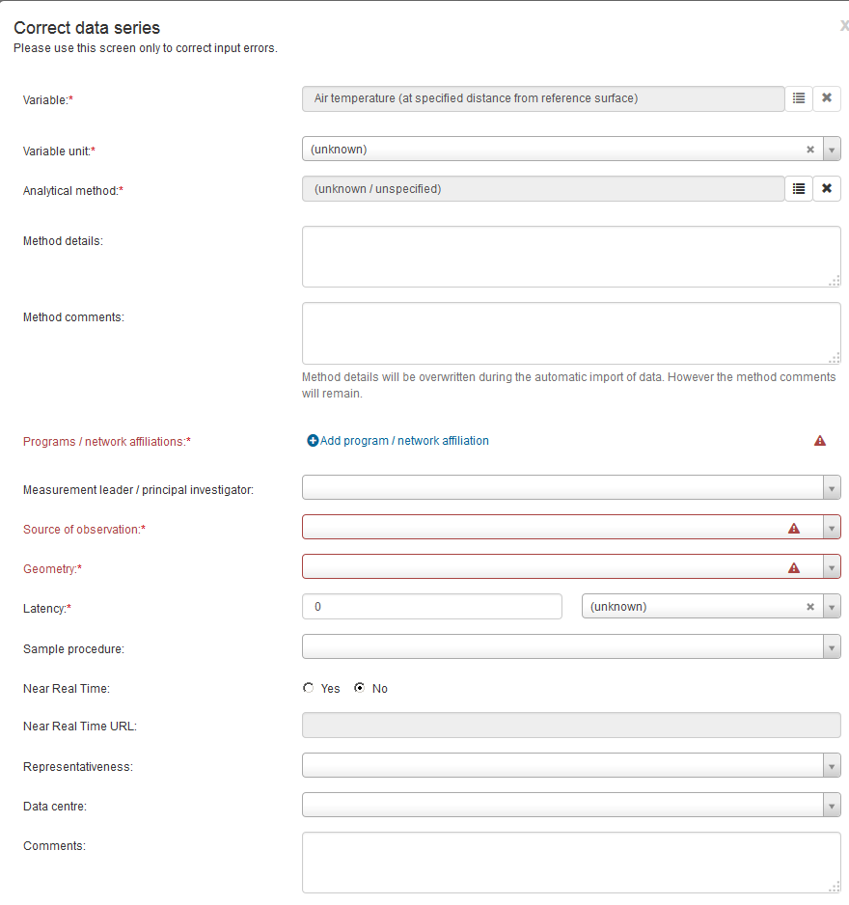
OSCAR – Form Validation
Validation error when mandatory fields not completed
Red boxes indicate incomplete fields

Slide 20
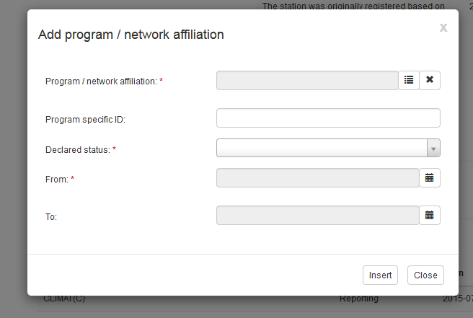
OSCAR – Program / Network Affiliation
Observations are connected to programs / networks (e.g: RBSN, GAW)
Program specific ID
May need approval

Slide 21
Machine to Machine (M2M) interface
OSCAR
Intended for batch processing / mass changes
Synchronize national / regional DBs with OSCAR
Based on WIGOS metadata standard (WMDS)
Under construction ..
How would a M2M interface be useful for you?
National DB

Slide 22
Machine to Machine (M2M) interface
OSCAR
First version currently implemented
Will be available at OSCAR/surface launch
RESTFULL API, can be used to both import and export information
Implemented as a Pilot Project together with DWD (Germany Met Service)
National DB
Notes:
API = application programming interface

Slide 23
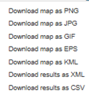
M2M Interface- Details
M2M interface is exposed as web API
Find, download and upload station information
Uses an XML encoding inspired by the OSCAR data model
Currently supports essential station/observation elements
Will also support full WMDS encoding, once it is provided by IPET-MDRD
OSCAR
National DB
Notes:
OGC means "open geospatial consortium”
IPET-MDRD .Inter-Programme Expert Team on Metadata and Data Representation Development

Slide 24
M2M Details – Upload Process
National DB
OSCAR
Periodically generate XML files, one per station
Submit files via OSCAR web API
OSCAR works out if station is new, or has been changed
Access control identical to the one used in the web interface

Slide 25
Other Ways To Export Information From OSCAR
Export information from OSCAR
Currently
Export Search results
Export Maps
Station info through M2M
Next version
Maps using OGC standards
Station info using WMDS
Deeper Geospatial integration

Slide 26
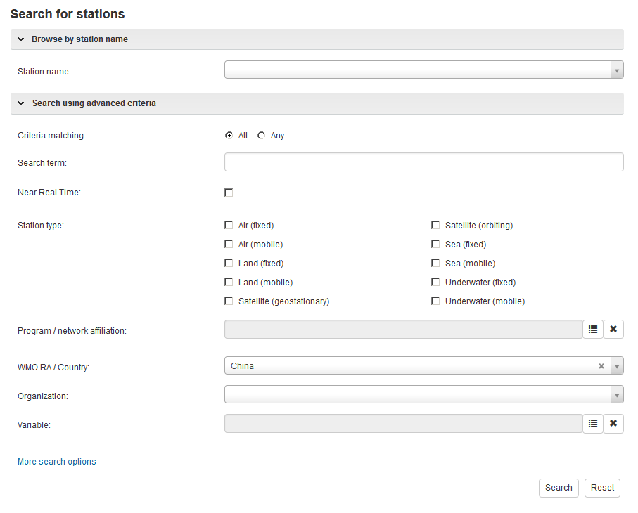
Export Information – Example: Load Stations Into Googe Earth
2. Export result
1. Search
3. Load into GIS software

Slide 27
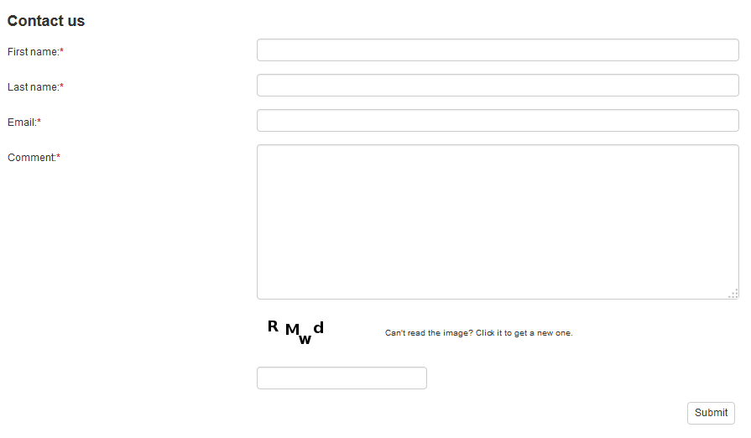
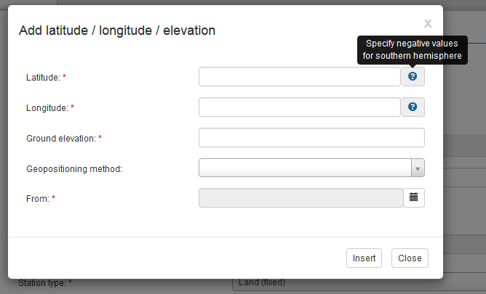
OSCAR – Help And Support
Contact form
2 level support
1 level support
Context help (tooltip)
OSCAR user manual

Slide 28
Thank you for your attention

