Slide 1
WIGOS Impacts on National Operations
Shanna Pitter
WIGOS Project Office

Slide 2
WIGOS Station Identifiers
Technical Regulation:
WMO observing stations and platforms shall be uniquely identified by a WIGOS station identifier.
Members shall issue WIGOS station identifiers for observing stations and platforms within their geographic area of responsibility that contribute to a WMO or co-sponsored programme and shall ensure that no WIGOS station identifier is issued to more than one station.
Note: Members may issue WIGOS station identifiers for observing stations and platforms within their geographic area of responsibility that do not contribute to a WMO or co-sponsored programme, provided that the operator has committed to providing and maintaining WIGOS metadata.
Before issuing a station identifier, Members should ensure that the operator of a station or platform has committed to providing and maintaining WIGOS metadata for that station or platform.
In OSCAR: automatic generation of WIGOS Station ID if not already present

Slide 3
WIGOS Station Identifiers
Component | Description | Initial Range – series 0 (Stations)
WIGOS Identifier Series | This is used to distinguish between different systems for allocating identifiers. It allows future expansion of the system so that entities do not have to be issued with new identifiers if the structure of the WIGOS identifiers proves unable to meet future requirements. Different values of the WIGOS Identifier Series may correspond to different structures of the WIGOS identifier. Initial permitted range: 0-14 | 0
Issuer of Identifier | A number that is used to distinguish between identifiers issued by different organizations. It is allocated by WMO to ensure that only one organization can create a given WIGOS station identifier. | 0-65534
Issue Number | An identifier that an organization responsible for issuing an identifier may use to ensure global uniqueness of its identifiers. For example, allocating one issue number for hydrological stations and another for voluntary climate observing stations would enable the managers of the two networks to issue Local Identifiers independently without needing to check with each other that they were not duplicating identifiers. | 0-65534
Local Identifier | This is the individual identifier issued for each entity. An organization issuing identifiers must ensure that the combination of Issue Number and Local Identifier is unique; in that way global uniqueness is guaranteed. | 16 characters
The convention for writing the WIGOS identifier (in the context of WIGOS) is:
<WIGOS Identifier series>-<Issuer of Identifier>-<Issue Number>-<Local Identifier>
Note: as an example the WIGOS Identifier would be written as 0-513-215-5678.
WIGOS Identifier series | Issuer of Identifier | Issue Number | Local Identifier
0 | 513 | 215 | 5678

Slide 4
Metadata for WIS and WIGOS Information needed to make adequate use of observations
Jörg Klausen (chair ET-WDC), B. Howe (chair TT-WMD)
ET-WDC Tony Colavecchia, Hiroshi Koide, Markus Fiebig, Anatoly Tsvetkov, Van Bowersox, Julian Meyer-Arnek, Martin Schultz
TT-WMD K. Monnik (CBS), J. Swaykos (JCOMM), Tony Boston (CHy), Manuel Bañon Garcia (CCl), S. Taylor (CAeM), J. Klausen (CAS), Zhao Licheng (China), Luis Nunes (WMO), S. Foreman (WMO), R. Atkinson (WMO)

Slide 5
Take-home messages
Data and metadata are of equal importance.
WIS metadata help you find and access observational data.
WIGOS metadata help you understand observations.
OSCAR and the RRR process help you analyze and improve observing systems.
→ It’s all mine and yours and ours!

Slide 6
Metadata – What’s in it?
TO HELP ME
FIND YOUR DATA
TO HELP ME
USE YOUR DATA
What data?
Where to find them?
How to get them?
Data policy?
→ Discovery metadata
Method of observation?
Data processing applied?
Quality control applied?
Uncertainty of data?
…
→ Interpretation metadata
Notes:
On the one side, we may ask …
Discovery data
On the other hand, we want to know about …
Interpretation metadata
Without metadata, data cannot be found!
Without metadata, data are pretty much useless, certainly in the long run, for climatological applications
Now, let’s step back and look at the ‘data value chain’

Slide 7
Rationale 1: Discovery and Access
“We cannot manage what we cannot measure”
Jim Butler, NOAA (CAS-XVI)
Numerical weather forecasting
Aeronautical meteorology
Disaster risk reduction
Agriculture
Climate applications
Air quality and health
Sand and dust storms
Glacier melting and sea level rise
…
… All need global observations, discoverable and accessible
Notes:
This rationale has been driving the development of WMO and the NHMS since the beginning.
It has led to global observing systems and the global exchange of data.

Slide 8
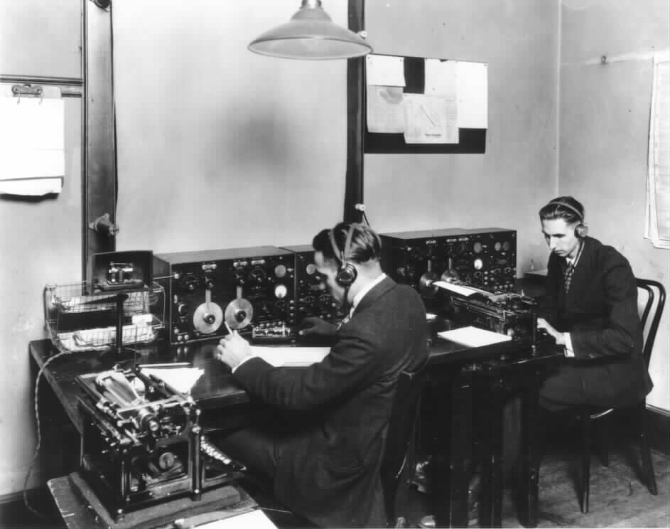
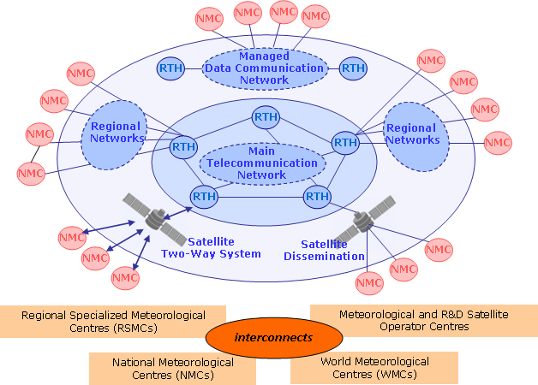
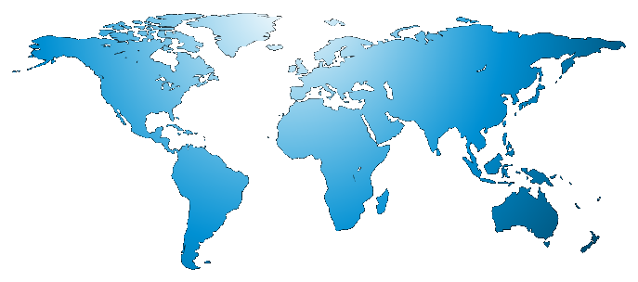
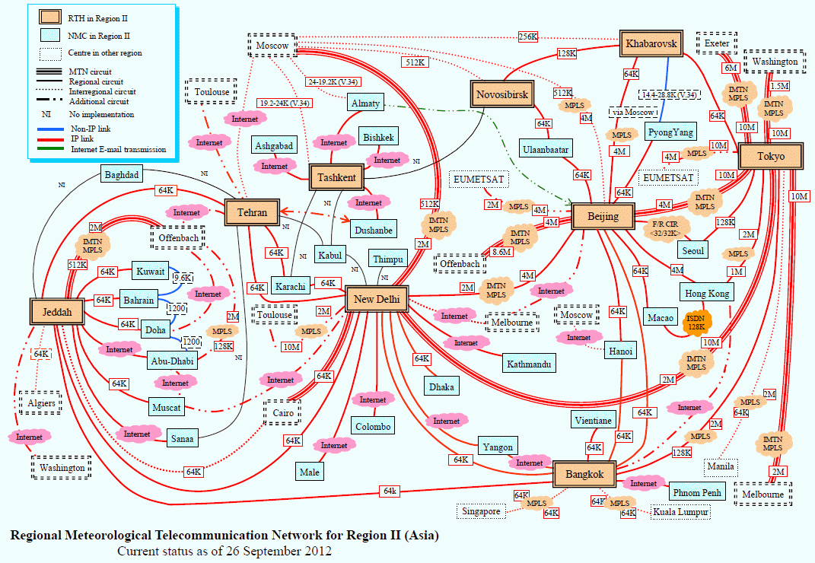
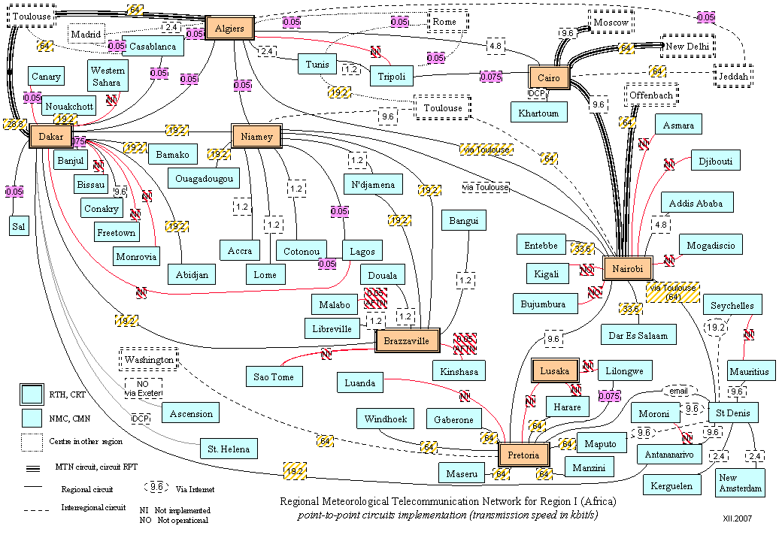
From “GTS” The 1st global, managed, private network …
24/7
robust
An impressive achievement!
Point-to-point
No cataloguing service (little metadata, limited flexibility)
→ Hard to find out what’s on it … unless you know already!

Slide 9
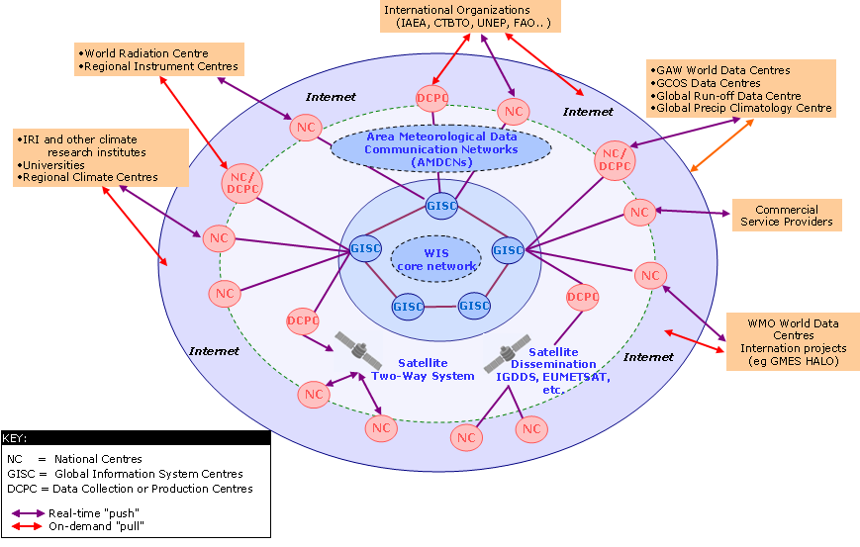
… to “WIS” The data highway for the 21st century
“push” service
24/7 real-time collection and dissemination for time-critical and operation-critical data and products
Delayed mode
“request/reply“ service
Data Discovery, Access and Retrieval → Metadata

Slide 10
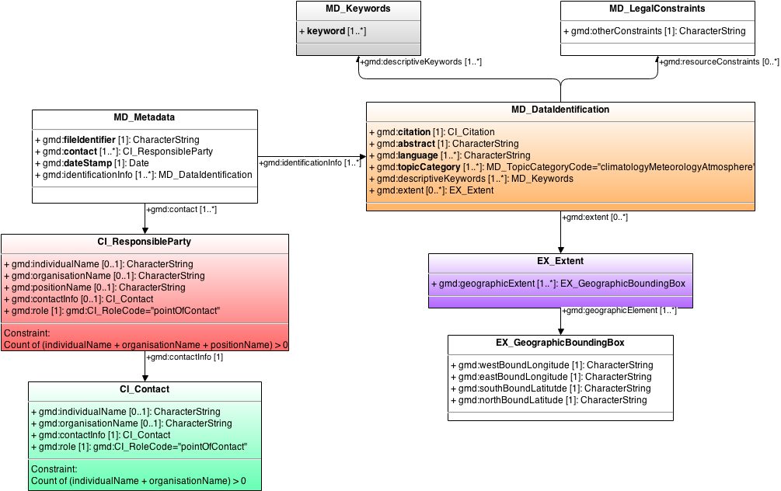
WIS Metadata The WMO Core Metadata Profile
Distribution
Keywords
Legal Constraints
Geographical Extent
Contact
MD_Metadata: Something somewhere that can be accessed under certain conditions and for which someone is responsible.

Slide 11
Rationale 2: Interpretation
“3.The details and history of local conditions, instruments, operating procedures, data processing algorithms and other factors pertinent to interpreting data (i.e., metadata) should be documented and treated with the same care as the data themselves.”
GCOS Monitoring Principles, 1999

Slide 12
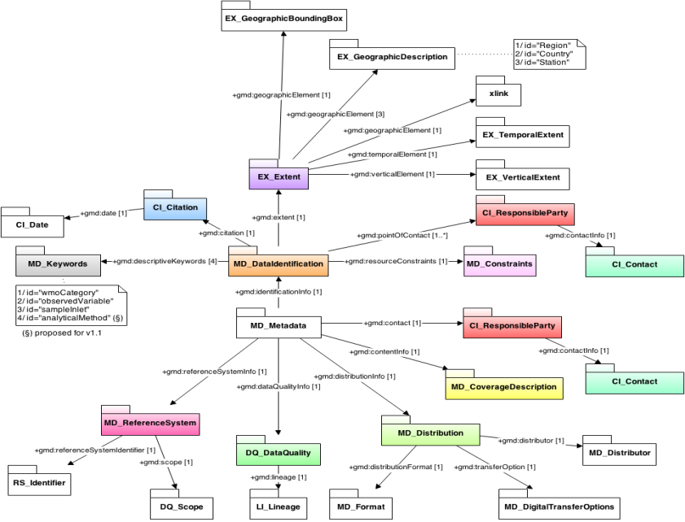
GAW Metadata Profile
Improve interoperability of GAW data centres
Includes some information about the “how” of observations
Extension of WMO Core metadata profile
Also a profile of ISO19115 (MD_Metadata) …
… and limited as such
More than WIS metadata
Not quite sufficient to enable adequate use of data

Slide 13
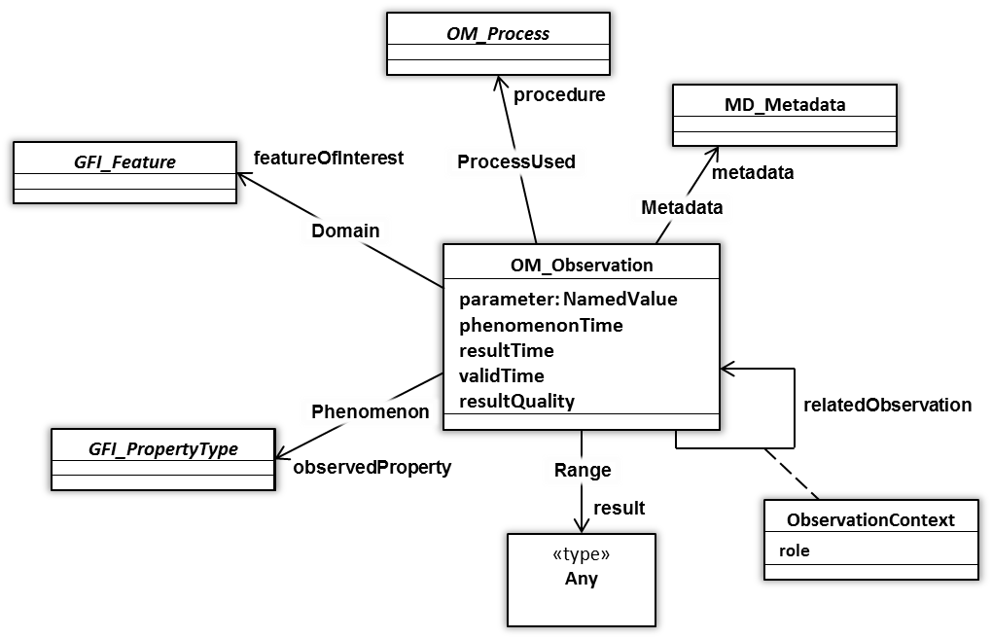
WIGOS Metadata Describe Observations
OM_Observation: an EVENT whose RESULT is an estimate of a value of some PROPERTY of some THING obtained using a specified PROCEDURE …
- 2014-07-06 13:45z
- 42.7° C
- Temperature
- Atmosphere (surface) 1.35 m above ground covered by sand
PT-100 calibrated against National Standard Stevenson screen
(courtesy of Aaron Braeckel, UKMO)
Notes:
ISO 19156 ‘Observations and measurements’ provides a conceptual schema for observations and the features involved in sampling when making observations, and specifically designed to support the exchange of information describing both the observing event and the results of the observation between different scientific and technical communities.

Slide 14
WIGOS Metadata Categories
# | Category | Description
1 | Observed variable | Specifies the basic characteristics of the observed variable and the resulting datasets.
2 | Purpose of observation | Specifies the main application area(s) of the observation and the observing programme(s) and networks the observation is affiliated to.
3 | Station/platform | Specifies the environmental monitoring facility, including fixed station, moving equipment or remote sensing platform, at which the observation is made.
4 | Environment | Describes the geographical environment within which the observation is made. It also provides an unstructured element for additional meta-information that is considered relevant for adequate use of the data and that is not captured anywhere else in this standard.
5 | Instruments and methods of observation | Specifies the method of observation and describes characteristics of the instrument(s) used to make the observation. If multiple instruments are used to generate the observation, then this category should be repeated.
6 | Sampling | Specifies how sampling and/or analysis are used to derive the reported observation or how a specimen is collected.
7 | Data processing and reporting | Specifies how raw data are transferred into the observed variable and reported to the users.
8 | Data quality | Specifies the data quality and traceability of the observation.
9 | Ownership and data policy | Specifies who is responsible for the observation and owns it.
10 | Contact | Specifies where information about the observation or dataset can be obtained.
Notes:
Question: Are we teaching them the metadata standards in the workshop?
Reliable & trusted Observations: Timely, Quality assured, Quality controlled, Well documented, Compatible

Slide 15
Principles for WIGOS Metadata
Shall enable users to make adequate use of observational data [also for climate applications]
Shall timestamp every piece of metadata
Shall make metadata available for all internationally exchanged data
Shall update metadata in a timely manner
Standard should be applicable to all disciplines
Standard should be forward-looking but also respect legacy (e.g., Vol. A)
Standard should be acceptable to all Members
Standard should be applicable for all Members

Slide 16
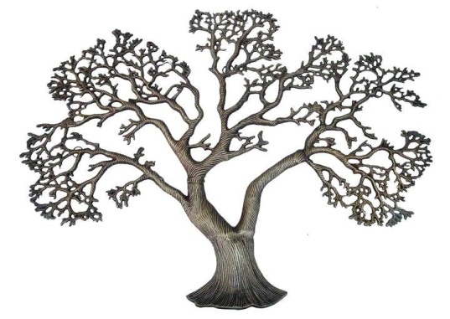
Considerations for WIGOS Metadata
Generation
Various levels of granularity
Transmission
Various intervals for (incremental) update
Access and use
By humans (researchers, managers, the public)
By machines (services)
WIGOS
WIS
Rather invariant
intermediate
Very dynamic

Slide 17
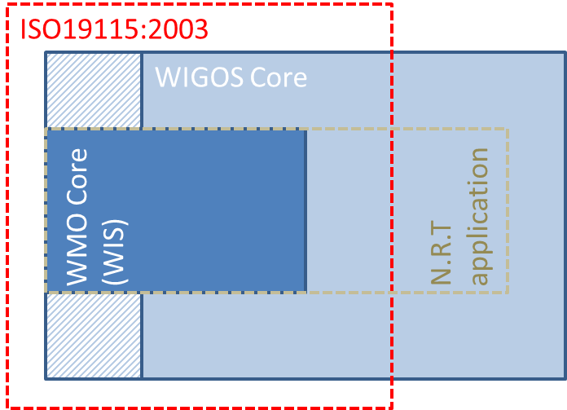
Profiling of WIGOS Metadata Standard
Specify sub-sets of standard for particular application areas, e.g.
Particular science projects
Climate
Air Traffic
NWP Assimilation
Warnings
Road Forecasts
Profiling makes standard more manageable at the risk of precluding future data use.
Profiles must not simply eliminate the “difficult elements”
Metdata demands

Slide 18
Implementation of OSCAR Implications for Members
Automated metadata import as far as possible
→ use existing metadata sources
Manual metadata input through web interface (simple work-flow, templates)
→ mitigated additional effort
Phased adoption
→ time to adjust operational processes
Caution: OSCAR will not be fully functional without your metadata!

Slide 19
Implementation of OSCAR Organization and Timing
Joint-venture between WMO and MeteoSwiss
2014 – 2015 (Cg-17)
Migrate GAWSIS (Atmospheric composition “capabilities”)
Develop OSCAR/Surface capabilities
Migrate OSCAR/Requirements from WMO
Enhance and develop OSCAR/Analysis
2016
Migrate OSCAR/Space capabilities from WMO to MeteoSwiss

Slide 20
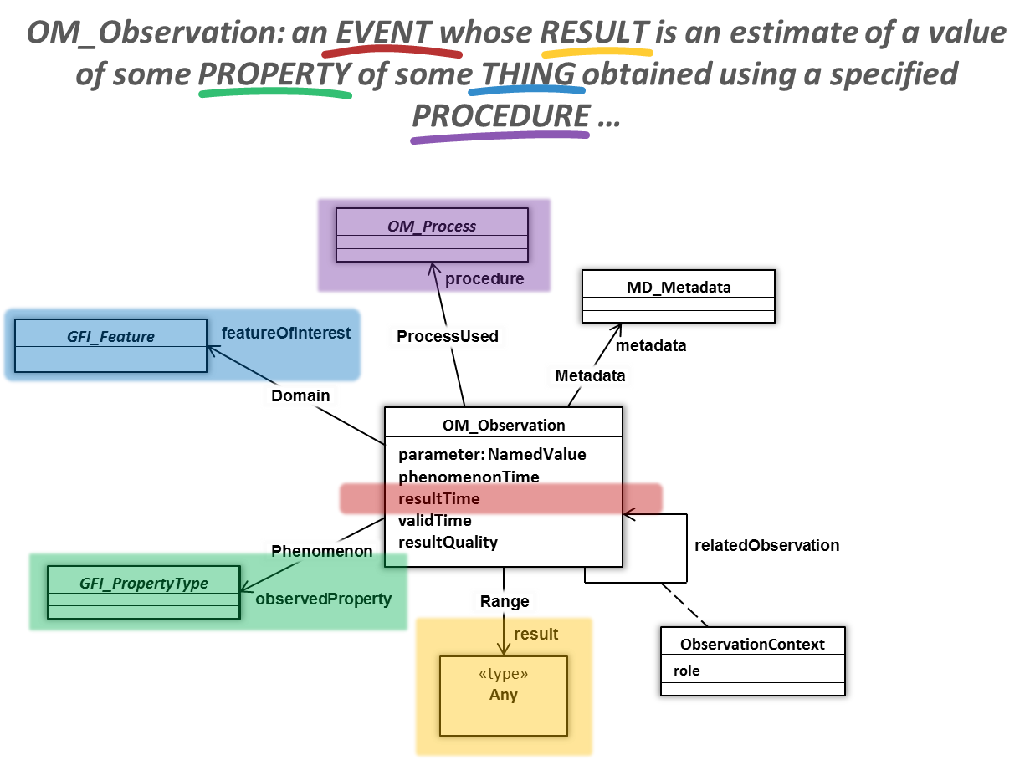
Summary
WIS
Make observations discoverable and accessible
Describe data policy
→ Operational
Geographical Extent
Keywords
MD_Metadata
Contact
Distribution
Legal Constraints
Describe observation to enable adequate use
Support rational evolution of observing systems → RRR
Semantic standard developed and under review
Formalization coming soon
Adoption by Members in phases 2016-2020
WIGOS
MD_Metadata: Something somewhere that can be accessed under certain conditions and about which someone knows more.

Slide 21
Observing System Capability Analysis and Review Tool (OSCAR) An introduction
WIGOS Project Office
WMO; Name of Department (ND)

Slide 22
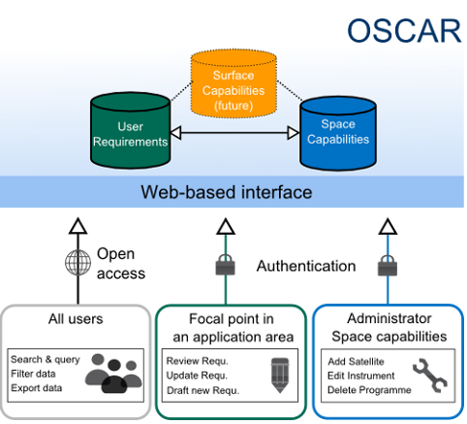
Web-based platforms for the WIGOS
Covering land, air, ocean and space
Documenting stations and observations, and their histories
Enabling comparison of requirements and capabilities (RRR)
Facilitating network planning
Applicable to all WMO Application Areas
Supporting your service to society.

Slide 23
OSCAR/Surface
Repository of metadata for all surface-based observational assets under WIGOS (WMO and co-sponsored observing systems)
Highly heterogeneous system with multiple owners and operators, including surface stations, upper-air stations, aircraft, ships, buoys, radars,…
OSCAR/Surface will replace (among other things) WMO Pub. 9, Vol. A
Complex, resource-intensive undertaking, developed in collaboration between WMO and MeteoSwiss; most of the resources provided by the latter

Slide 24
Current status of OSCAR/Surface
Successful demonstration of phase 1 prototype at Cg-17 (June 2017)
OSCAR Booth
OSCAR side Event
OSCAR Brochure
Members obligations with regard to OSCAR included in Technical Regulations and WIGOS Manual to come into force in July 2016
Operational as of March 2016

Slide 25
Current OSCAR Data Integration
# stations
1’053
13’026
11’387
762
GAWSIS
Metadata for the Global Atmosphere Watch
WMO Publication 9 Volume A
Catalogue of synoptic and upper-air stations of GOS
JCOMMOPS
Marine element of GOS / GOOS
WMO Radar Database
Worldwide radars
AMDAR
Coming soon

Slide 26
What Should Go Into OSCAR/Surface?
Long answer: All WIGOS stations (WIGOS component observing system stations), all internationally exchanged stations
Short answer: Everything
Use OSCAR even when data are not shared
Rationale
Network planning
Network evolution documentation
OSCAR can be used as national station DB

Slide 27
Plan for transition from Volume A to OSCAR/Surface
Transition period: March 2016 - December 2017.
In December 2015, National Focal Points will be given the opportunity to decide between:
providing their WIGOS metadata directly via OSCAR
continuing to provide their metadata through existing WMO procedures
Uploads will be possible through:
user editing via the web interface, and
machine to machine interfaces/web service
By March 2016, OSCAR will become the official repository of WIGOS metadata, and will serve as the source for Vol. A

Slide 28
Plans for transition from Volume A (Cont.)
OSCAR can generate reports similar to the existing Vol. A flat-files available on the WMO website. The new “Vol. A report” will maintain all current column headings but may not contain information in all columns.
Station information provided to WMO via current Vol. A procedures will be used to update WIGOS metadata in OSCAR.
Protocol and format for feeding information by batch-process into OSCAR to be completed by mid-2016
By December 2017, transition to OSCAR completed; Vol. A will officially cease to exist and related procedures used to maintain station information will be discontinued

Slide 29
Legacy Volume A Format
VolA field | Difference in OSCAR export file | Comment
RegionId | same
RegionName | almost the same | English only
CountryArea | almost the same | English only, sort order different. Textual changes possible
CountryCode | different | ISO3 instead of number code
StationId | WIGOS ID | Built according to Attachment 2.1 of the WIGOS Manual approved by WMO 17th Congress.
IndexNbr | same
IndexSubNbr | same
StationName | same
Latitude | same
Longitude | same
Hp | same
HpFlag | empty
Hha | same
HhaFlag | empty
PressureDefId | Almost the same | an entry for "mean sea level" was added
SO-1 | empty
SO-2 | empty
SO-3 | empty
SO-4 | empty
SO-5 | empty
SO-6 | empty
SO-7 | empty
SO-8 | empty
ObsHs | empty
UA-1 | empty
UA-2 | empty
UA-3 | empty
UA-4 | empty
ObsRems | empty
Differences between standard Volume A flatfile and OSCAR based «legacy» Volume A

Slide 30
What Members will need to do:
Comply with the WMO Technical Regulations; WMO-No. 49, Volume I, Part I – WIGOS and the Manual on WIGOS:
Keep records of WIGOS metadata
For those observations that are exchanged internationally:
Exchange also the associated WIGOS metadata
Review the information in OSCAR/Surface
Keep entries in OSCAR/Surface up to date
The more accurate and up-to-date the information in OSCAR/Surface is, the more useful it will be!

Slide 31
Outlook Phase I (OSCAR/Surface)
Operational processing of machine-based sources (GAW and related archives, JCOMMOPs, WMO Radar DB)
Development and implementation of WMDS exchange format for machine-to-machine import/export
OGC/ISO-compliant
XML, JSON, CSV?
“Vol A”-legacy export format
Phase-out of Vol A (by end of 2017)

Slide 32
Outlook Phase II (subject to available resources)
ABOS/AMDAR interface
Interface OSCAR/Space with OSCAR/Surface
Other data sources for OSCAR/Surface, e.g.
OSCAR/Analysis (“critical review”) component
Upper air soundings from ships (ASAP) | Road weather stations | Tide gauges (all)
Remote sensing profiling stations | Urban stations | Aerosol Optical Depth
Lightning detection systems | Research Vessels | Ground-based space weather observing stations
All hydrological Stations (WHOS) | Rigs & Platforms, Automatic Sea Stations | Partner AWS
Ground water stations | Profiling gliders | Webcams

Slide 33
OSCAR Gap analysis module
(still in design phase)
Quantitative tool that matches observational data requirements against observational capabilities
Based on selection of requirement and pertinent observational capabilities, tool can illustrate whether or not different levels of requirement is met (by area or region)

Slide 34
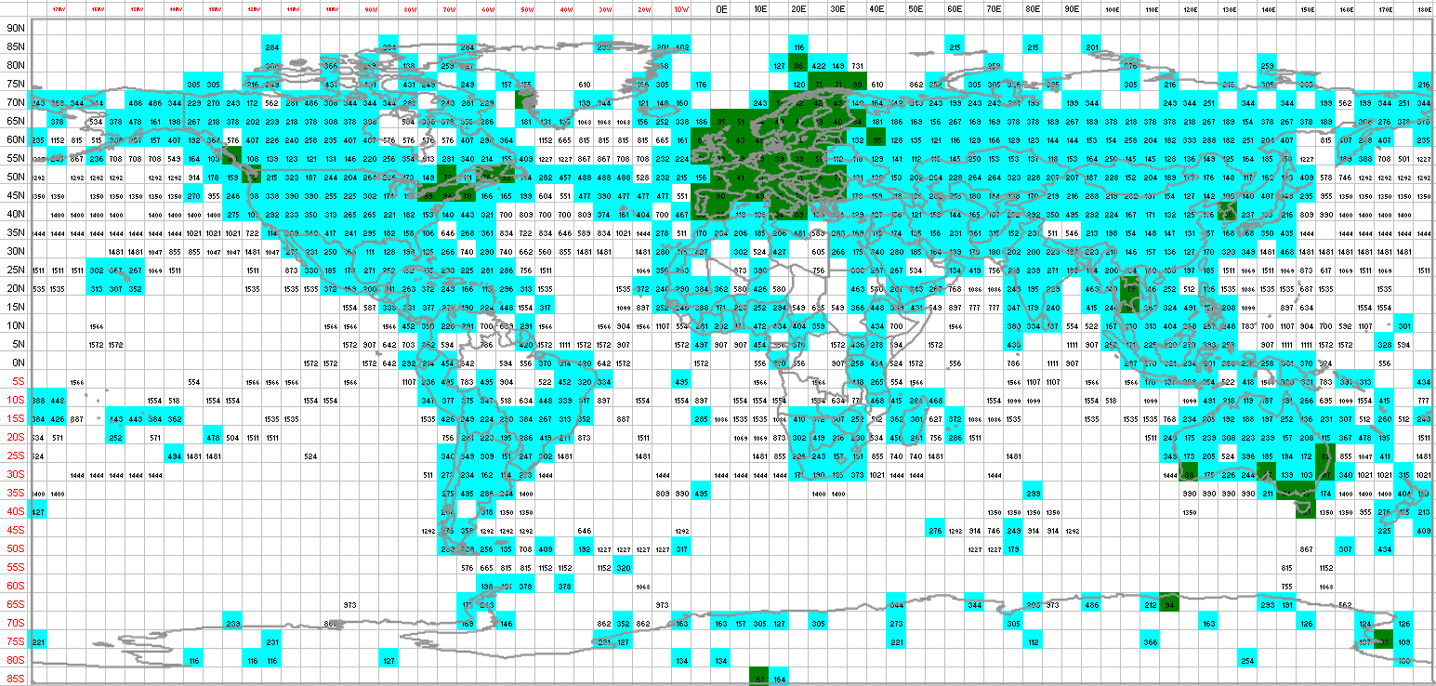
Surface pressure measurement capabilities against WMO requirements
(“capability” based on data received by ECMWF)

Slide 35
Thank you for your attention

