Slide 1
WIGOS - What are the benefits and how does impact WMO Members at the national level?
RA-IV Workshop on WIGOS
Willemstad, December 1-3 2015
Dr. Lars Peter Riishojgaard,
WIGOS Project Manager, WMO Secretariat

Slide 2
Outline
Current status of the WIGOS Framework
The next four years: The WIGOS Pre-Operational Phase
Priority areas
OSCAR/Surface and the WDQMS; what are they used for and how do they impact you?
Summary and conclusions
WMO

Slide 3
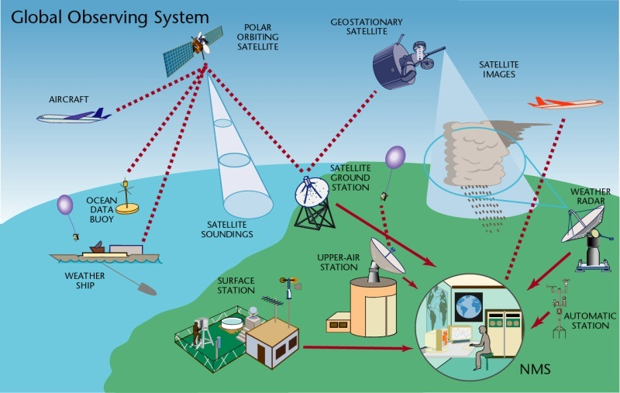
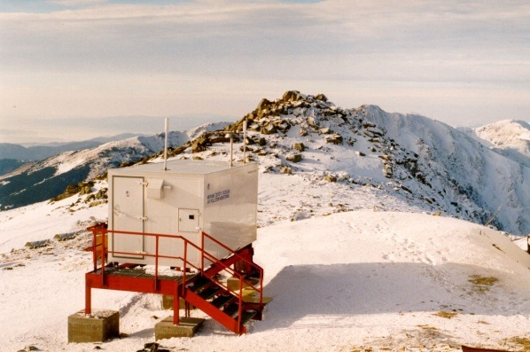
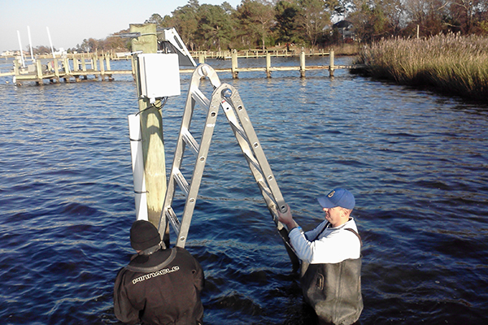
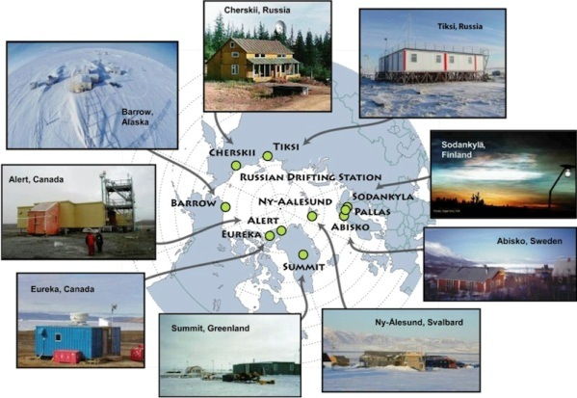
WIGOS Component Systems
Global Observing System (WWW/GOS)
Observing component of Global Atmospheric Watch (GAW)
WMO Hydrological Observations (including WHYCOS)
Observing component of Global Cryosphere Watch (GCW)

Slide 4
WIGOS Implementation Phase
WMO 16th Congress (2011): Implementation of WIGOS
Implementation work managed by ICG-WIGOS, supported by te WIGOS Project Office, driven by the WIGOS Framework Implementation Plan (WIP)
Key deliverables for the 17th Congress (2015):
Draft Technical Regulations on WIGOS; link here
Draft Manual on WIGOS; link here
WIGOS Metadata Standard; link here
Regional Implementation Plans
Proposal for the Pre-Operational Phase of WIGOS (2016-19)
All deliverables were approved

Slide 5
WIGOS Framework Implementation Plan (WIP; link here)
CONTENTS
KEY ACTIVITY AREAS
Management of WIGOS implementation
Collaboration with WMO co-sponsored observing systems & international partners
Design, planning and optimized evolution
Observing System operation and maintenance
Quality Management
Standardization, system interoperability and data compatibility
The WIGOS Operational Information Resource
Data and metadata management, delivery and archival
Capacity development
Communications and outreach
Introduction and Background
Key Activity Areas for WIGOS Implementation
Project Management
Implementation
Resources
Risk Assessment / Management
Outlook
Annexes
Rolling Review of Requirements
Primary role of OSCAR: support of KAA 3 and 4
Managing the Assets

Slide 6
The WIGOS Pre-Operational Phase (2016-2019)
Increased emphasis on regional and national activities
Five main priority areas:
WIGOS Regulatory Material, supplemented with necessary guidance material
WIGOS Information Resource, including the Observing Systems Capabilities analysis and Review tool (OSCAR), especially OSCAR/Surface
WIGOS Data Quality Monitoring System (WDQMS)
Regional Structure; Regional WIGOS Centers
National WIGOS Implementation, coordination and governance mechanisms
Priority areas II and III will enable us to:
Describe what WIGOS is, and
Measure how well it performs

Slide 7
Rolling Review of Requirements
WMO Congress: All WMO (and co-sponsored) observing systems shall use the RRR to design networks, plan evolution and assess performance.
The RRR is the process used by WMO to collect, vet and record user requirements for all WMO application areas and match them against observational capabilities
Gap analysis results in Statement of Guidance, one per application area, that provides a narrative of how well a given application area is supported by WIGOS; to be supported by a quantitative gap analysis module (in development)

Slide 8
WMO Application Areas listed in the RRR
(July 2015)
Global numerical weather prediction (GNWP)
High-resolution numerical weather prediction (HRNWP)
Nowcasting and very short range forecasting (NVSRF)
Seasonal and inter-annual forecasting (SIAF)
Aeronautical meteorology
Forecasting atmospheric composition
Monitoring atmospheric composition
Atmospheric composition for urban applications
Ocean applications
Agricultural meteorology
Hydrology
Climate monitoring (as undertaken through GCOS)
Climate applications
Space weather

Slide 9
OSCAR and the RRR
The RRR is supported by three key databases of OSCAR, the Observation Systems Capabilities and Review tool :
OSCAR/Requirements, in which “technology free” requirements are provided for each application area, expressed in units of geophysical variables (260 in total currently), not measurands; not just atmosphere, also terrestrial, ocean, cryosphere, …
OSCAR/Space, listing the capabilities of all satellite sensors, whether historical, operational or planned
OSCAR/Surface, list surface-based capabilities; developed by MeteoSwiss for WMO, in beta-testing
www.wmo.int/oscar/

Slide 10
OSCAR/Requirements
The following requirements are listed (separately for each of the 12 application areas and for all relevant variables):
Spatial (horizontal and vertical) and temporal resolution, uncertainty, data latency, required coverage area, source, and level of confidence
Each requirement is expressed in terms of three separate values:
Threshold (observations not useful unless this is met)
Break-through (optimum cost-benefit ratio)
Goal (exceeding this provides no additional benefit)
OSCAR/Requirements information content is assembled by CBS and other WMO Inter-Program Expert Teams and Task Teams and is informed by the broader scientific community
e.g. WIGOS/ GAW Workshop on Requirements for Observations of Atmospheric Composition, Geneva, Nov. 2014
However, the link to e.g. GCOS requirements is currently weak; last update from AOPC, TOPC and OOPC in 2007

Slide 12
OSCAR/Space
Repository of metadata about all satellite sensors (past, present and future) relevant to WMO Programs and Application Areas
Instrument type, measurement technique
Instrument characteristics (mass, power, data rate)
Programmatic information, e.g. agency, measurement program, operating period, heritage, etc.
Orbit, coverage, repeat frequency, resolution
Capabilities, expressed in terms of geophysical variables that can be derived from the measurements provided by the sensor, listed in order of decreasing fidelity

Slide 13
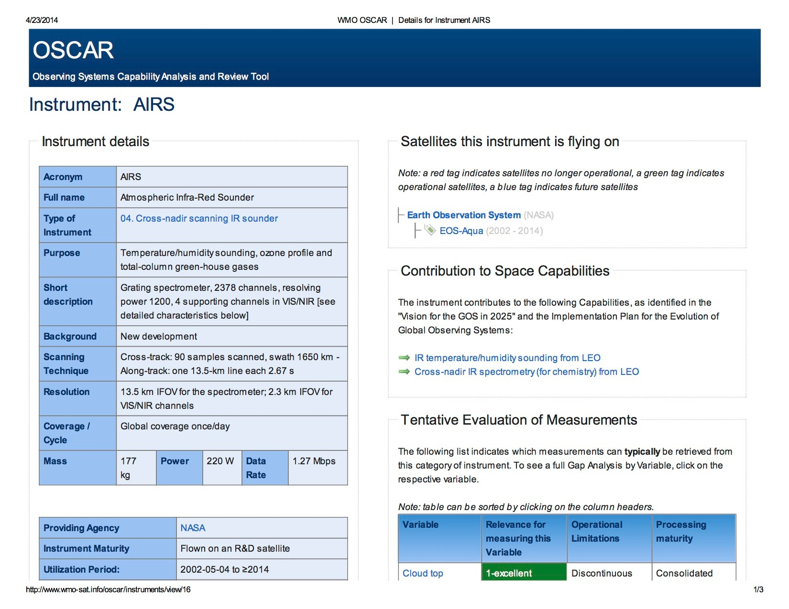

Slide 14
OSCAR/Surface
(currently in beta-testing; operational March 1 2016)
This is the implementation layer of the WIGOS Metadata Standard: a modern, electronic, searchable inventory of metadata for all observing stations/platforms under WIGOS
Together with OSCAR/Space, OSCAR/Surface provides the description of what WIGOS is
OSCAR/Surface will replace Volume A, but will also include information from similar inventories for other (non-GOS) components of WIGOS
Developed jointly by WMO and MeteoSwiss, with the Swiss government providing the major part of the funding
Education and training Members in populating, editing and using OSCAR/Surface is a major focus area for 2016-2019

Slide 15
WIGOS Metadata
(loosely defined as “ancillary information that is necessary for optimally using the observation”; more stringent definition can be found in WIGOS Metadata Standard)
10 categories,
90 elements,
All stored in OSCAR/Surface
# | Category | Description
1 | observed quantity | Specifies the basic characteristics of the observed quantity and the resulting data sets.
2 | purpose of observation | Specifies the main application area(s) of the observation and the observing program(s) the observation is affiliated to.
3 | data quality | Specifies the data quality and traceability of the observation.
4 | environment | Describes the geographical environment within which the observation is made. It also provides an unstructured element for additional meta-information that is considered relevant for adequate use of the data and that is not captured anywhere else in this standard.
5 | data processing and reporting | Specifies how raw data are transferred into the reported physical quantities and reported to the users.
6 | sampling and analysis | Specifies how sampling and/or analysis are used to derive the reported observation or how a specimen was collected
7 | station/platform | Specifies the environmental monitoring facility, including fixed station, moving equipment or remote sensing platform, at which the observation was made.
8 | method of observation | Specifies the method of observation and describes characteristics of the instrument(s) used to make the observation. If multiple instruments used to generate the observation, then this category should be repeated.
9 | ownership and data policy | Specifies who is responsible for the observation and owns it.
10 | contact | Specifies where information about the observation or dataset can be obtained.
Notes:
Reliable & trusted Observations: Timely, Quality assured, Quality controlled, Well documented, Compatible

Slide 16
Near-term impacts on NMHS operations
(due to effective date of Manual on WIGOS, including the WIGOS Metadata Standard on July 1 2016)
In order to comply with the new regulatory material, Members will need to
Keep records of WIGOS metadata
For those observations that are exchanged internationally:
Exchange also the associated WIGOS metadata
Review station information and keep it up to date
The implementation of this takes place through OSCAR/Surface!

Slide 17
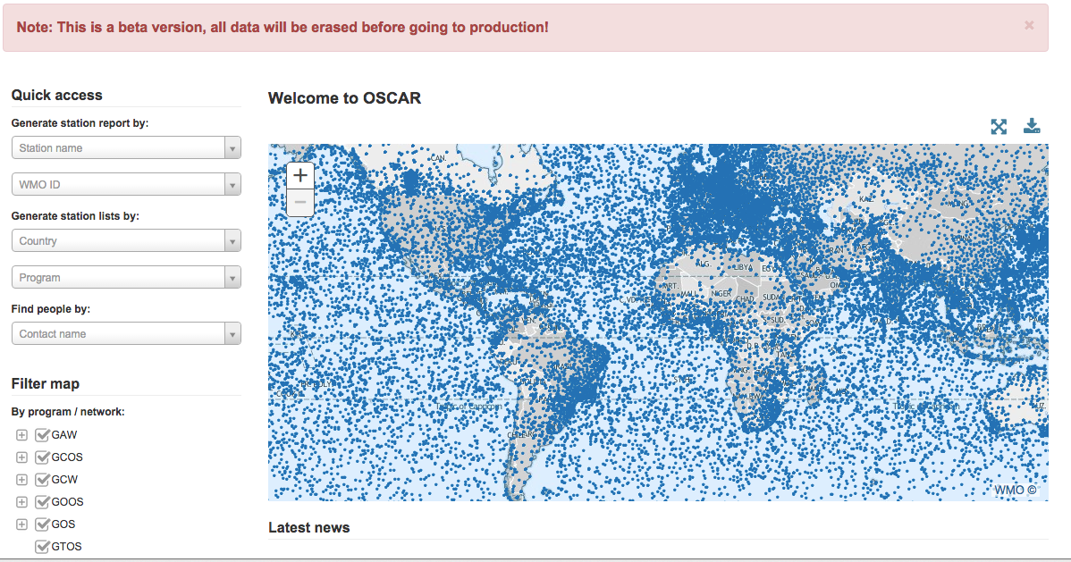
Screenshot from OSCAR/Surface beta-test version

Slide 18
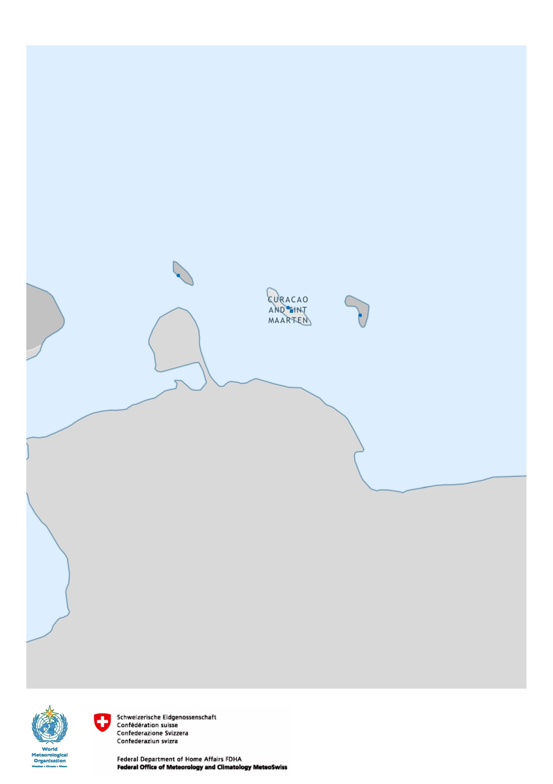
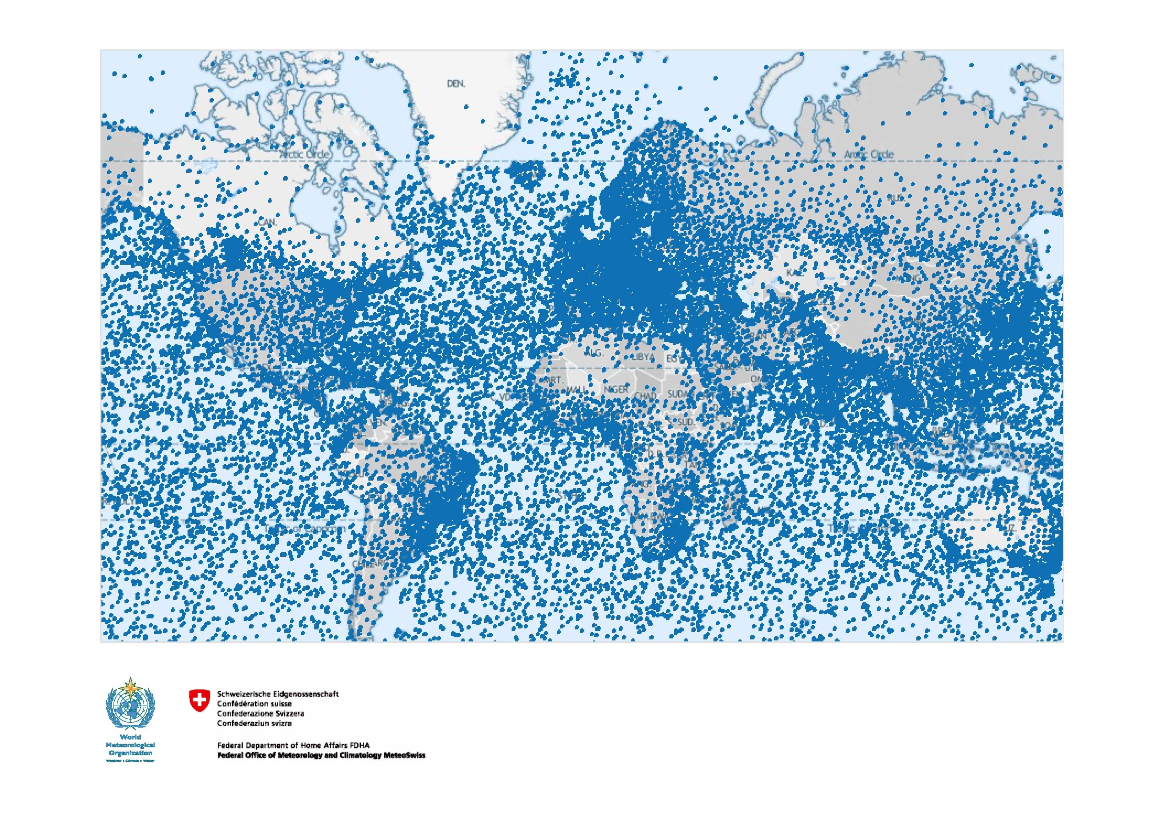
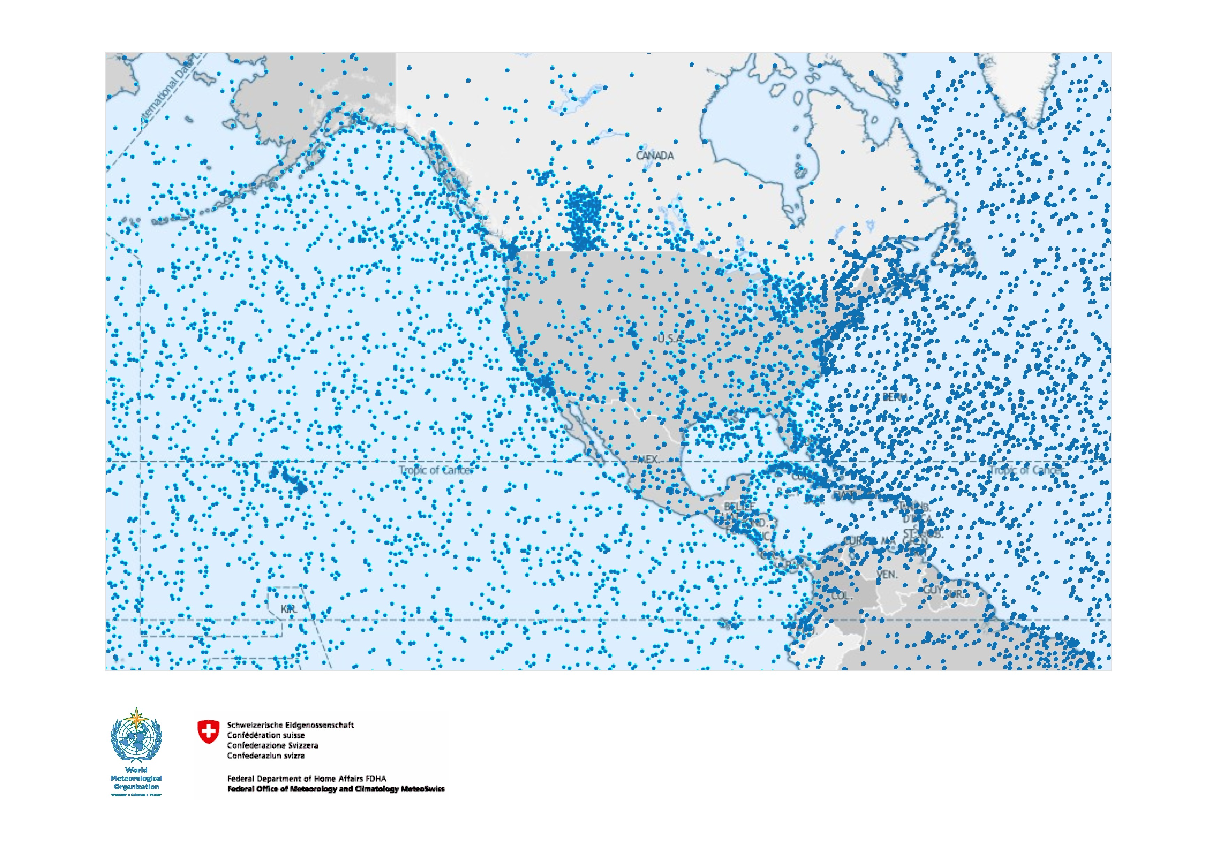
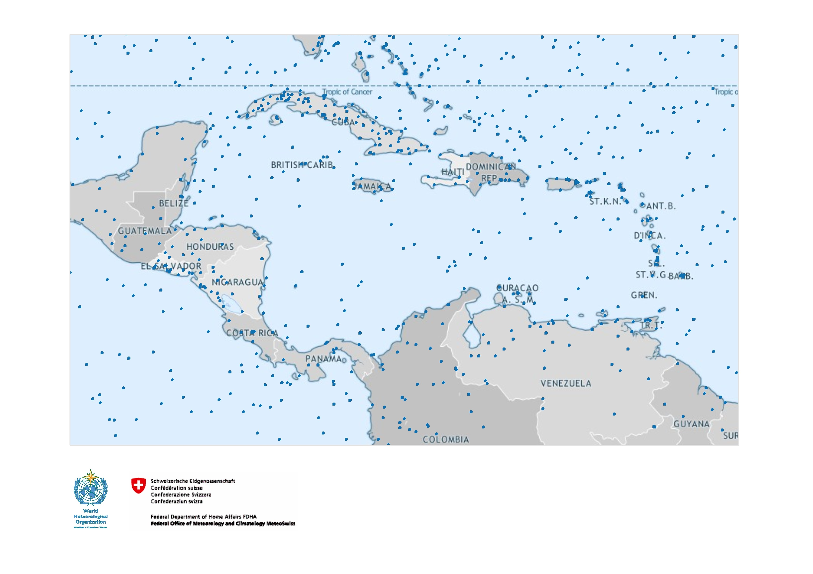

Slide 19
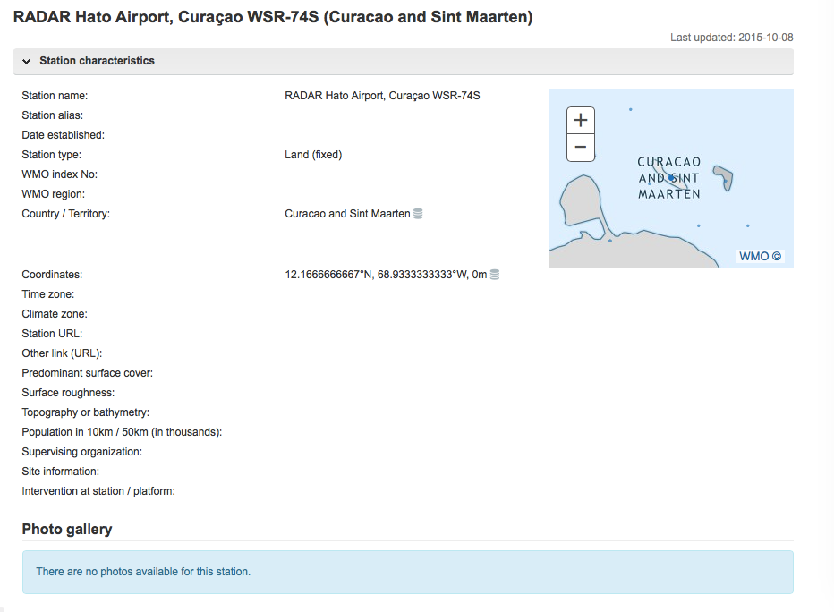

Slide 20
What does OSCAR/Surface offer?
You will be able to see comprehensive metadata for all stations/platforms under WIGOS
all over the world
all types; weather, climate, air quality, hydrology,…
This will enable you to decide which data to request, which data to use, and for which purpose(s)
Should you need it, you will be able to use OSCAR/Surface as your national database for observing systems
It is mandatory to register in OSCAR/Surface those stations for which data are exchanged internationally
Other stations may be registered in OSCAR/Surface at the discretion of the Member

Slide 21
What does OSCAR/Surface offer?
(continued)
Increased national visibility for NMHS
A chance for NMHS to position itself as a central, national resource for all information about meteorological observing systems, irrespective of ownership, by taking the lead and supporting national partners in getting all stations/platforms registered in OSCAR/Surface
Useful to support network design activities, discussion about national data policies, etc.
The Secretariat is willing to support this!

Slide 22
What are you expected to do?
Familiarize yourself with the system
Test it out and provide feedback
Assign a national focal point for OSCAR/Surface
This individual will have editing right for all stations in your territory and can assign similar rights to others, e.g. in partner organisations
Make sure that Vol. A is up to date for your country/territory
Review that your station information is correct
Add any additional metadata
Enter additional stations missing from Vol. A

Slide 23
What will the Secretariat do to help?
Provide training event(s) in all WMO Regions
Goal is to reach each Member NMHS at least once
Training activities already initiated, including one event in Barbados August 2015
Develop online learning tools for self-study and to support national training activities
Publish a user manual (“Guide to OSCAR”)
Provide help desk function (with MeteoSwiss)

Slide 24
III. WIGOS Data Quality Monitoring System (WDQMS)
Real-time monitoring of performance (data availability and data quality) of all WIGOS components, searchable by region, country, station type, period, etc.
The WDQMS will provide a complete description of how well WIGOS is functioning
Monitor regional and national performance of all WIGOS components
Pilot projects involving ECMWF, NCEP, DWD, KMS and others are underway
Delayed mode monitoring of data quality as measured against reference sources of information.
Fault management system for tracking and mitigation of performance issues.

Slide 25
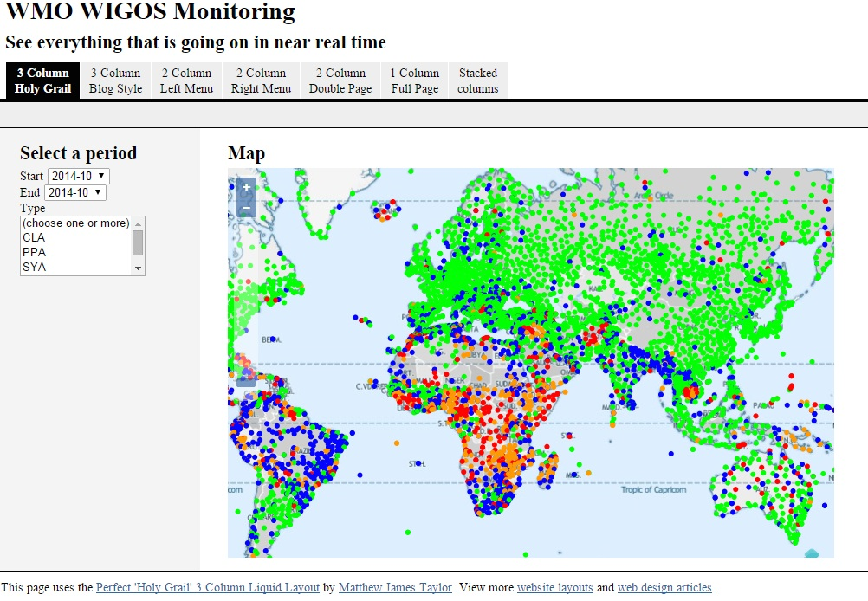

Slide 26
What does WDQMS offer?
The ability to monitor the performance of all stations/platforms all over the world
availability (timely data delivery)
data quality
Real-time monitoring of weather observations
Delayed mode monitoring of climate observations
Ability to generate statistics for any observation type, region, or period
Ability to analyze trends over time

Slide 27
What are you expected to do?
(once WDQMS is operational; system still in development)
Familiarize yourself with the system
Routinely monitor the availability reports provided for your country/territory
Alert WMO (the WIGOS Project Office in case of discrepancies)
Assign a national focal point for incident management
This individual will be responsible for contacting station operators in case of recurring data quality problems

Slide 28
What will the Secretariat do to help?
Keep Members informed as the systems develops
Develop online learning tools
Publish a user manual (“Guide to WDMQS”)

Slide 29
Summary and Conclusions
WIGOS global framework is now in place and will be further developed during the Pre-operational Phase (2016-2019)
Increased emphasis on Regional and National activities
OSCAR/Surface and the WIGOS Data Quality Monitoring System (WDQMS) are the two most important technical elements, and both are of strategic importance to WMO
OSCAR/Surface provides a quantitative, comprehensive online description of all observing platforms and stations of WIGOS
To become operational on March 1 2016
Further training events planned for all WMO Regions, supplemented by online learning tools
WDQMS is the primary WIGOS performance measuring tool
Still in development; pilot projects underway

