Slide 1
WIS’s Role in implementing WIGOS
WIS Branch
RA IV WIGOS Implementation Workshop
WMO - WIS
Notes:
David Thomas is the Chief of Information and Telecommunications System Division at WMO
He is also the Project Manager for WIS

Slide 2
Where does WIS fit in
NMHS rely on information exchange
Heads of meteorological services got together in 1873 and formed the International Meteorological Organization to enable the exchange of information they needed for operations. WMO (1951) inherited this legacy.
WMO established the Global Telecommunications System in 1963 under the World Weather Watch
Cg (2003) approved the development of the Future WMO Information Systems
  Open up the GTS to all programmes making use of latest technologies (eg Internet)
  Enable information Discovery, Access and Retrieval (DAR)
Notes:
Where does WIS fit in?
Clearly, WIS is all about information exchange, something that goes back to the initial reason why heads of national meteorological services got together and formed the International Meteorological Organization in1873. However, this basic need for information exchange is best known since 1963 as being enabled by the Global Telecommunications System (the GTS) under the world weather watch (WWW) supporting the Global Observing System (GOS) and Global data production and forecast system (GDPFS).
Congress in 2003 approved the development of the Future WMO Information System to open up the GTS to all WMO programmes, to make better use of emerging communications systems such as the Internet, and to enable the concept of information discovery, access and retrieval (DAR).

Slide 3
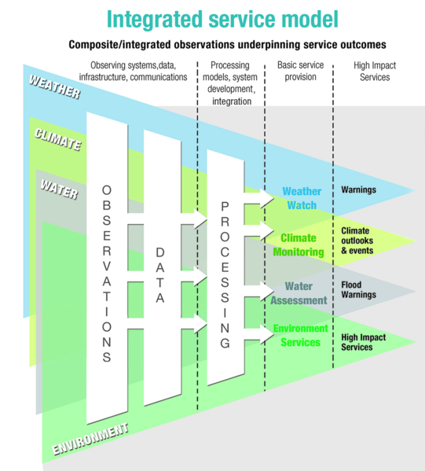
What do we mean by integration?
WIS is an inseparable component of WIGOS in the observing systems, data infrastructure and communications column
It provides the necessary interoperability to allow observing systems in a composite model to maintain their individuality but to function as virtually integrated system.
WIS is essential to interoperability in WIGOS
Notes:
Another familiar WIGOS diagram describes integration in the concept of WIGOS. From this diagram, we see WIS is an inseparable component of WIGOS in the observing systems, data infrastructure and communications column, which provides the necessary interoperability to allow observing systems in a composite model to maintain their individuality but to function as virtually integrated system. WIS is a key to interoperability in WIGOS.

Slide 4
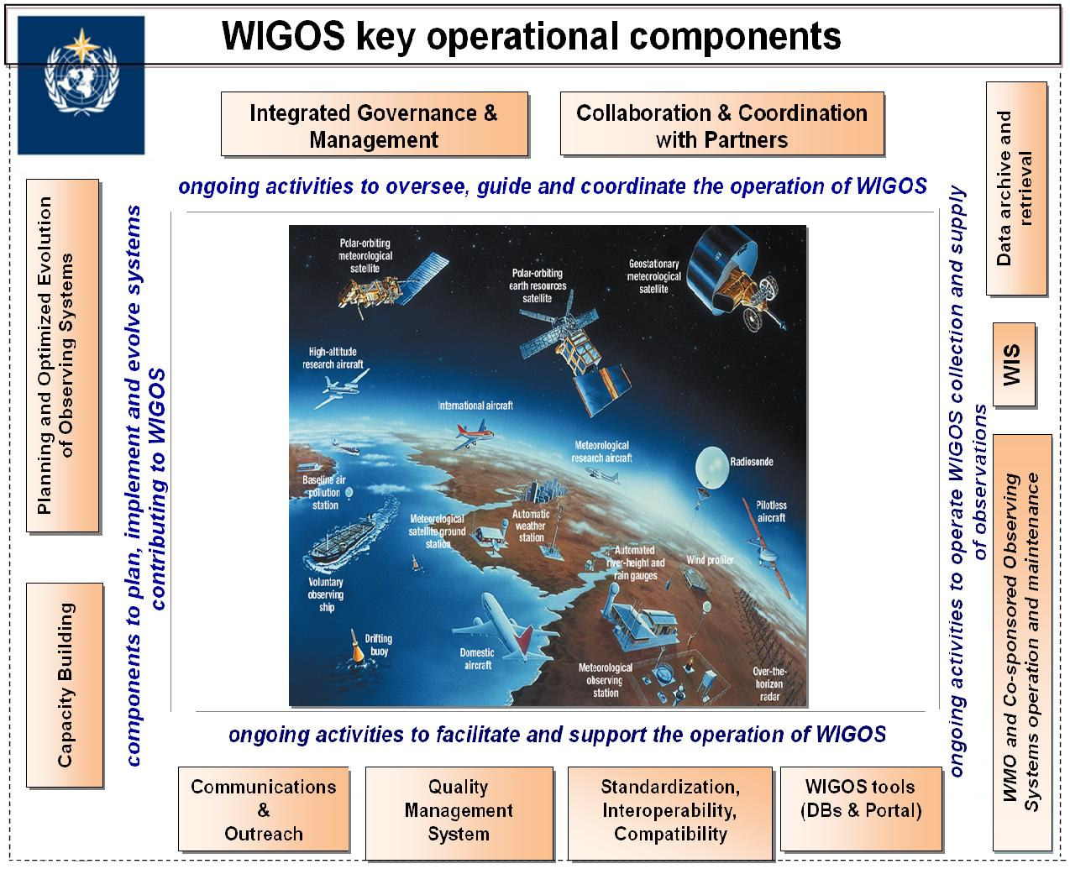

WIS in WIGOS Key areas
Management of WIGOS Implementation / operation
Collaboration with co-sponsors and partners
To oversee, guide and coordinate WIGOS
Data discovery, delivery & archival
Design, planning and optimised evolution
To ensure supply of and access to WIGOS observations
To plan, implement and evolve WIGOS component systems
Observing system operation & maintenance
Quality Management
To facilitate and support the operation of WIGOS
Communications and outreach
Capacity Development
Operational Information Resource
Standardization, interoperability & compatibility
Notes:
4
Looking at the the WIGOS key area diagrams:
The obvious place in WIGOS for WIS is in ensuring access to observations. (Highlighted in red)
In addition to expanding the traditional distribution of observations to allow data exchange with contributing partners, the new functionality of WIS allows data discovery and retrieval. WIS does not include archival of data beyond what is necessary for daily operational needs. Archival of data belongs to the programme that WIS is supporting. WIS DAR, however, allows users to discover and access these programme archives as well as to subscribe to real-time and near real-time data.
WIS is also prominent historically in the standarization, interoperability and compatibility.
Traditionally, WMO has had to develop and maintain appropriate data representation formats. Standardization as described in the Manual on GTS and Manual on Codes has allowed fast and efficient message handling and switching in order to meet the real time dissemination and access requirements of WMO programmes. It has also facilitated use of such data by NMHS and their systems. WIS is a lot more flexible and we are moving into a higher level of abstraction of data representation which will make it easier to utilise data from non WMO systems or data flows of from different communities.
Obviously, WIS has some involvement in all WIGOS key areas or has its own equivalent areas. Interestingly, the regional and national implementation of WIS shows quite a varied interdependency of WIGOS and WIS key areas.

Slide 5

What do we mean by interoperability?
Ability to access, combine or compare observations from one source or system with those from another
  To achieve this, it needs:
    Metadata
    Standards
    Regulatory material
Interoperability is key to turning observations into effective data, products and services that meet real user needs
Notes:
WIGOS defines interoperability in this slide.
There are several areas of interoperability in WIGOS, such as the WIGOS metadata, CIMO practices for describing observing practices and so on. However,
WIS is all about interoperability.
WIS defines interoperability by the phrase, “What has to be the same so everything else can be different”, which means what has to be done certain ways so that WIS works.
WIS is based on discovery metadata
It identifies what standards must be adhered to if the system is to work (ie what has to be the same so everything else can be different)
WIS is defined in Tech Reg 49, expanded on in the Manual on WIS and Guide to WIS. These combine with the Manuals on GTS and Codes.

Slide 6
Status of WIS in RA IV
WIS centres
  NCs – 35
  DCPCs – 14 (2 Endorsed)
  GISC – 1 (Washington)
  GTS plan last updated 2009 (RA IV) although we have 2012 for RA V (South East Pacific)
Notes:
So how is WIS going in RA IV
NCs – 35 (No notifications of WIS certification)
DCPCs – 14 (2 Endorsed, 4 under review, 8 not submitted to TT-CAC)
GISC – 1 (Endorsed, Operational?)
RA IV is a little unique in that it relies heavily on one nations communications infrastructure and strategy.
However, knowing what the current structure is, can be sometimes difficult as official descriptions are not always current.
For instance the latest GTS plan for RA IV is 2009, whereas, the RA V diagrams were updated in 2012.

Slide 7
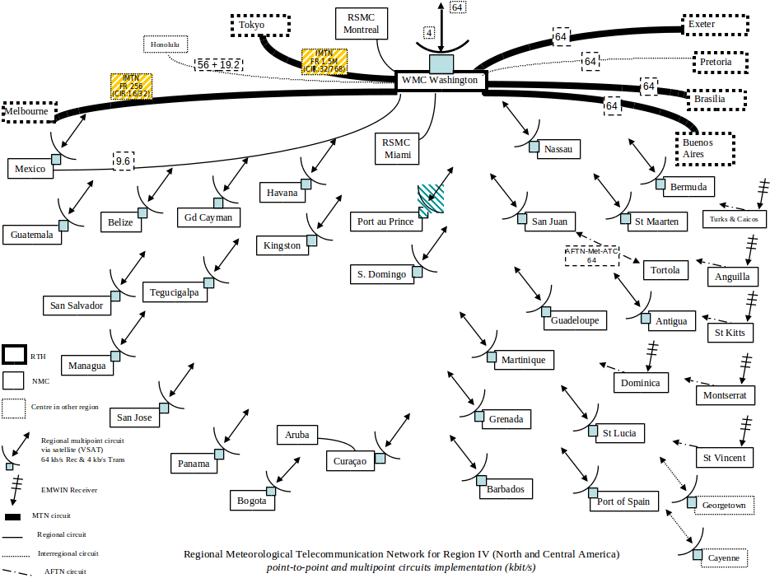
GTS in Region IV (2009)
Notes:
The 2009 plan shows the satellite distribution and collection system supported by NOAA at that time, but we know this has changed considerably since then.

Slide 8
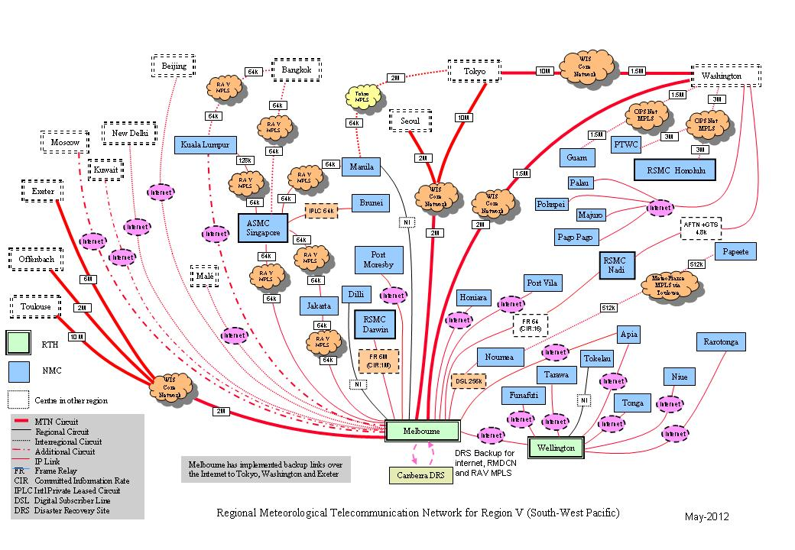
GTS in Region V (2012)
Notes:
We can perhaps get a more current feel by looking at RA V which shows the network based in the USA supporting the eastern Pacific as a combination of connections to the WIS core network, a regional MPLS network and some Internet based connectivity. Some could be by terrestrial or satellite based. The practice preferred by ET-CTS is to map the centres’ connectivity, the type and their bandwidth. Tables of these parameters should be included in the Regional WIS implementation plans.

Slide 9
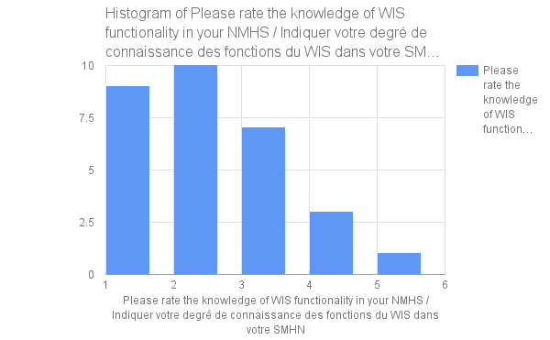
RA IV WIS implementation status
http://wis.wmo.int/page=RA4-WIS
WIS Regional Implementation Plan - None
Responses to RA IV WIS Survey (1)
  http://wis.wmo.int/page=WIS-RA-IV-Survey
National WIS Focal Points (17)
National knowledge of WIS ???
Level of implementation of WIS ???
Capacity development activities
  RA IV WIS training workshop,
  11-13 August 2015. Barbados
  http://wis.wmo.int/page=RA-IV-WIS-2015 …
Notes:
So what is the status of WIS implementation in RA IV?
We have a wiki site for each region. RA IV’s is given here wis.wmo.int/page=ra4-wis
I do not know of any RA IV WIS implementation plan, although the draft WIGOS IP has some minor WIS references
I monitor Regional WIS Implementation via a series of surveys, I was doing once a year, but regions are suggesting they prefer six monthly.
I send the request to the National WIS focal points but have had only one response from an RA IV.
We do have a significant number of WIS focal points registered (ie 17), and each of these should have received an invitation to join the National WIS Focal Point email group
As we do not have a wide spread response of surveys, I cannot tell the level of WIS knowledge in each NMHS nor their level of WIS implementation.
RA IV did hold a workshop on WIS in Barbados, the link is given here.
The small diagram is a view of the Corporate knowledge of WIS in RA I. The plan is to have no NMHS reporting level 1 or 2 and to see the curve skewed to the right rather than left. A series of WIS workshops in RA I is addressing this issue.
We have similar diagrams for the level of implementation of WIS, with similar aims to skew the diagram to the right, noting that WIS implementation takes no physical infrastructure on site as you can use the GISC Web Service, but it does take a lot of training in how to create and manage WIS discovery metadata. This would have been covered at the workshop.

Slide 10
National WIS focal points
First name | FAMILY NAME | Country Name
Donald | SIMON | Antigua and Barbuda
Cairmonte | WILLIAMS | Dominica
Kerry | POWERY | Grand Cayman
Roy | THOMPSON | Belize
Alexandre | LEROUX | Canada
María Esther | SUAREZ BALTODANO | Costa Rica
Luciano | AMARO | Cuba
Fitzroy | PASCAL | Dominica
Luis | SANDOVAL CASTRO | El Salvador
Paris | RIVERA | Guatemala
Emerson | GOMEZ | Honduras
Thomas | AUGUSTE | Saint Lucia
Venantius | DESCARTES | Saint Lucia
Bryan | THOMAS | Trinidad and Tobago
Robert | BUNGE | United States of America
Edwin Santiago | ESCOBAR RIVAS | El Salvador
Dayne | TAITT | Trinidad and Tobago
Notes:
Here is a list of the National WIS focal points. We need one for each member state or territory.

Slide 11
Implementation of WIS (Cg-XV, 2007)
Reminder: WIS is evolving in two parallel parts:
Part A: GTS continued consolidation and further improvements for data and products delivery
Time-critical and operation-critical delivery based
on real-time “push” via dedicated telecommunications
Timely delivery based on delayed mode “push”
via combination dedicated + public networks
Part B: extension of services through flexible
data discovery, access and retrieval services,
as well as flexible timely delivery
All Members should have implemented WIS by end of 2015
Part C: Cg 16 approved CBS recommendation to investigate information management – This will be a new part of WIS.
Notes:
From Congress in 2007, we see that WIS is evolving in two parallel parts:
Part A: GTS continued consolidation and further improvements for data and products delivery
Time-critical and operation-critical delivery based on real-time “push” via the dedicated telecommunications network
Timely delivery based on delayed mode “push” via a combination of dedicated and public networks
Part B: extension of services through flexible data discovery, access and retrieval services, as well as flexible timely delivery
Congress 16 this year, approved a new part of WIS, and that is information management. This is an important need across all WMO programmes and should result in updates to the guide on information management and so on.

Slide 12
WIS contribution to WIGOS
WIS is a fundamental component of WIGOS especially for sharing of data, but also standards and enabling interoperability with contributing systems
Regional associations
  have identified completion of WIS as a priority in order to implement WIGOS
  have provided WIS Branch with Regional WIS implementation plans
A regional implementation plan for WIS is essential, specifying timelines, monitoring, status, key people, etc
No monitoring evident (1 response to survey) of WIS Implementation
Who is in charge or champion for WIS implementation in the Region
From WIS Branch view, RA IV looks a long way behind on WIS
How will this affect WIGOS?
Notes:
So we have seen from the WIGOS documentation that WIS is a fundamental component of WIGOS especially for sharing of data, but also standards and enabling interoperability with contributing systems
Looking at the experience in other regions we see that Regions have identified completion of WIS as a priority in order to implement WIGOS
All but RA IV have provided WIS Branch with their Regional WIS implementation plans
It is evident that a regional implementation plan for WIS is essential and that it should specify WIS Implementation timelines, monitoring, status, key people, etc
For RA IV, there is no monitoring evident of WIS Implementation other than one response to the RA IV WIS implementation survey
Who is in charge or champion for WIS implementation in the Region? Is it Glendal de Souzo?
Despite the progress in some areas, from WIS Branch view, RA IV looks a long way behind on WIS
The question you have to ask is “How will this affect WIGOS?”

Slide 13
Recommendations
Update Regional WIGOS plan to include
  Need for WIS Implementation Team
    Membership should be WIS experts (ie Focal Points)
    Develop & monitor a WIS Implementation plan
Encourage Members to
    Develop a National WIS IP
    Register with GISC Washington
    Review current Discovery Metadata
    Register national WIS Focal Point
    Use WIS to register national partners as NCs or at least arrange to register Obs. data streams in WIS through the NMHS NC
Notes:
Based on my experience with other regions, there are some things that this WIGOS implementation team can do to accalerate WIS implementation to ensure WIGOS has the infrastructure and capabilities it will need to be successful.
You could update Regional WIGOS plan to include
Establishment of a WIS Implementation Team, typically with a membership of WIS experts (ie Focal Points)
This team should develop & monitor a WIS Implementation plan
The WIS and WIGOS implementation plans should encourage Members to
Develop a National WIS IP
Register with GISC Washington
Review current Discovery Metadata
Register national WIS Focal Point
To make really sure WIGOS is successful, Members should use WIS to register national partners as NCs or at least arrange to register Obs. data streams in WIS through the NMHS NC

Slide 14
Summary
WIGOS clearly identifies WIS as an essential component
RA IV looks good with
  An operational GISC, 14 DCPCs and 35 NCs
    But only the GISC and two DCPCs endorsed as WIS compliant
  RA IV has held one WIS training workshop
    Perhaps too recent to see impact
17 Members have identified WIS focal points
  What about the rest?
Need more information if WIS Branch is to help
  Need to work with the Region on their WIS IP
  Need Focal Points to complete survey when asked
Notes:
Summarising, we see that WIGOS clearly identifies WIS as an essential component
At a glance, the status of WIS in RA IV looks good with
An operational GISC, 14 DCPCs and 35 NCs
But only the GISC and two DCPCs are endorsed as WIS compliant
Centres need to work with the GISC to complete their compliance
RA IV has held one WIS training workshop
Perhaps it is too recent to see impact from this training, but it did cover the key issues of how to make and manage metadata.
17 Members have identified national WIS focal points
What about the rest?
The WIS Branch is only too happy to help in all of these things.
I believe WIS in RA IV needs its own plan, a good team and a champion to lead the process.
We also need focal points to participate in WIS implementation monitoring, completing the surveys when asked, and communicating to the team what they think their needs
QUESTION TIME.

Slide 15
Thank you for your attention
wis-help@wmo.int

