Slide 1
WIGOS Data Quality Monitoring System (WDQMS)
Robert Grumbine, NWS, US
Stuart Goldstraw, Met Office, UK

Slide 2
WDQMS – Contents
Plans for WIGOS in next 4 years
Context for WDQMS
Progress to date
Linking Global, Regional and National tasks
Plans for WDQMS in next 4 years

Slide 3
WIGOS 1a – Plans for 2016 to 2019
Congress identified 5 priority areas for WIGOS during the Pre-operational Phase
National WIGOS Implementation
WIGOS Regulatory and Guidance Material
WIGOS Information Resource
WIGOS Data Quality Monitoring System
Regional WIGOS Centres

Slide 4
WIGOS 1b – Plans for 2016 to 2019
Congress identified 5 priority areas for WIGOS during the Pre-operational Phase
National WIGOS Implementation
WIGOS Regulatory and Guidance Material
WIGOS Information Resource
WIGOS Data Quality Monitoring System
Regional WIGOS Centres

Slide 5
WIGOS 1c – Plans for 2016 to 2019
Congress identified 5 priority areas for WIGOS during the Pre-operational Phase
National WIGOS Implementation
WIGOS Regulatory and Guidance Material
WIGOS Information Resource
WIGOS Data Quality Monitoring System
Regional WIGOS Centres
There are very close links between WIGOS Data Quality Monitoring System and the Regional WIGOS Centres

Slide 6
WIGOS 1d – Plans for 2016 to 2019
Congress identified 5 priority areas for WIGOS during the Pre-operational Phase
National WIGOS Implementation
WIGOS Regulatory and Guidance Material
WIGOS Information Resource
WIGOS Data Quality Monitoring System
Regional WIGOS Centres
Actually there are very close links between all the priority areas – WIGOS is ‘integrated’ in both senses – integrated observations and integrated activities

Slide 7
WDQMS 2a – Context
Throughout the new WIGOS Regulatory Material there are references to the observational data quality expectations placed on members:
Technical Regulations Vol.1
2.4.3 Performance
2.4.3.1 Members shall continuously monitor the performance of their observing systems.
2.4.4 Quality Control
2.4.4.1 Members shall implement quality control for all observations for which they are responsible.
Manual on WIGOS
2.4.3 Quality Control
2.4.3.1 Members shall ensure observations provided through their WIGOS component observing systems are quality controlled.
2.4.3.2 Members shall implement real-time quality control prior to exchange of observations via the WMO Information System.

Slide 8
WDQMS 2b – Existing GOS Monitoring
Monthly Monitoring Centres:
ECMWF; RSMC Exeter; WMC Melbourne; RSMC Montreal; RSMC Offenbach; RSMC Tokyo & RSMC Toulouse
Lead Centre Monitoring:
WMC Washington (aircraft and satellite); ECMWF (upper air); RSMC Exeter (surface marine); RSMC Nairobi (RAI); RSMC Tokyo (RAII); RSMC Buenos Aires (RAIII); RSMC Montreal (RAIV); WMO Melbourne (RAV) & RSMC Offenbach (RAVI)
Regular reports produced by many Monitoring Centres but follow up actions are variable
A number of effective monitoring functions are in place for other observational programmes, for example the CBS Lead Centres for GCOS monitoring; GAW monitoring etc
Important to learn from the experiences of these groups

Slide 9
WDQMS 2c – the purpose and scope
Improved performance monitoring and reporting system for data availability and data quality – this includes latency
Provision of online real/near-real/non-real time monitoring of the performance of WIGOS observing systems / stations / platforms registered under OSCAR
Includes the development and implementation of incident management procedures to build the links between issue identification and resolution
Looking forward this will be increasingly important as more 3rd party observations are exchanged

Slide 10
WDQMS 2d – expected results
WDQMS will allow Members to:
rapidly detect problems with the observational data being exchanged and
quickly identify actions that can solve any issues highlighted.
This in turn will lead to increased availability and improved quality of observational data being made available to users

Slide 11
WDQMS – Progress to date
WIGOS Workshop on Quality Monitoring and Incident Management was held in December 2014 with the goal of reviewing the current international quality monitoring systems of the Global Observing System (GOS) and actions required to enable its modernization and the establishment of practices associated with incident management.
The workshop focused on the land surface component of the GOS and suggested that the Incident Management System (IMS) should be integrated or associated with the Data Quality Monitoring System and its outputs
The workshop drafted a Roadmap and timeline for agreed actions, which was presented to and considered by ICG-WIGOS

Slide 12
WDQMS – Progress to date
Substantial progress has been made by the NWP centres and the WIGOS Project Office in developing the global monitoring function.
Following those initial steps, WebEx meetings and ad hoc discussions have taken place with representatives from ECMWF and NCEP and some other participants from the workshop.
These discussions are ongoing and are highlighting the interesting challenges of integrating products from different NWP Centres into common formats.
The detailed planning of Incident Management Pilot Project has not yet been completed but the first pilot will be based in RSMC Nairobi.

Slide 13
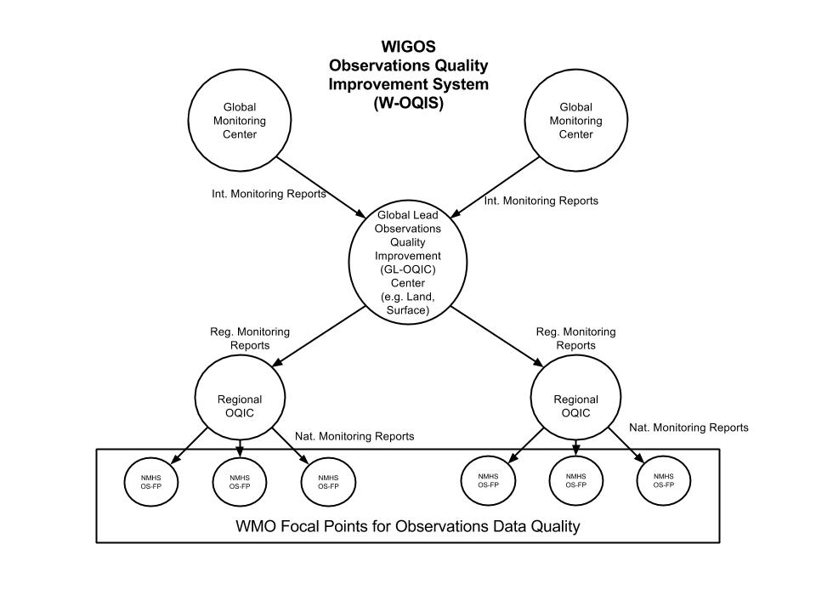
WDQMS – A schematic of the structure
Text to be added here …..
Terminology already out of date – work in progress!

Slide 14
WDQMS – A different view
Overall success will be achieved through close co-operation and collaboration at the national, regional and global levels.
National Ownership & Delivery
Global Monitoring
Regional Coordination & Incident Monitoring

Slide 15
WDQMS – Global Aspects
Global NWP Centres – more than one to ensure the observation issue is real and not an artifact of a single NWP system
Global Monitoring Centre – main co-ordination point
Global Reporting function – how are we performing collectively

Slide 16
WDQMS – Regional Aspects
Close engagement between global monitoring functions and national observing managers ensuring two way communication
Develop regionally focused tools and mechanisms to solve reoccurring incidents
Act as advocates for WIGOS DQMS issues
A clear function for the Regional WIGOS Centres

Slide 17
WDQMS – National Aspects
National Focal Point(s) – ideally Observing Network Managers – good technical understanding
Develop (in many cases already existing) national monitoring capability
Identify synergies across multiple agencies
Single point of entry in order to respect national responsibilities

Slide 18
WDQMS - Milestones
Very late 2015 – 2nd workshop on WDQMS
Early 2016 – prototype land surface monitoring system available / specification for the incident management system developed
Mid 2016 – RAI field pilot begun
Late 2016 – prototype system demonstrated
Early 2017 – 2nd RAI field pilot begun
Mid 2017: Initial monitoring capability for all WIGOS components;
2018: Fully operational monitoring for GOS surface-based components and Incident Management functionality

Slide 19
WDQMS - Incident Management Pilot
RSMC Nairobi – the lead centre for the land surface observation monitoring in RA I;
Countries to be engaged in first pilot: Kenya (lead), Uganda, Tanzania, Ethiopia, Sudan, South Sudan, Djibouti, Eritrea, Somalia, Rwanda, Burundi & Egypt
210 RBSN registrations with observations available from ~100 locations
Collaboration with CBS ET in development of the IM specification
The pilot will test the principles of the operation of a Regional WIGOS Centre (RWC) focusing on lesson learnt in order to refine the definition of a RWC in the context of WDQMS.

Slide 20
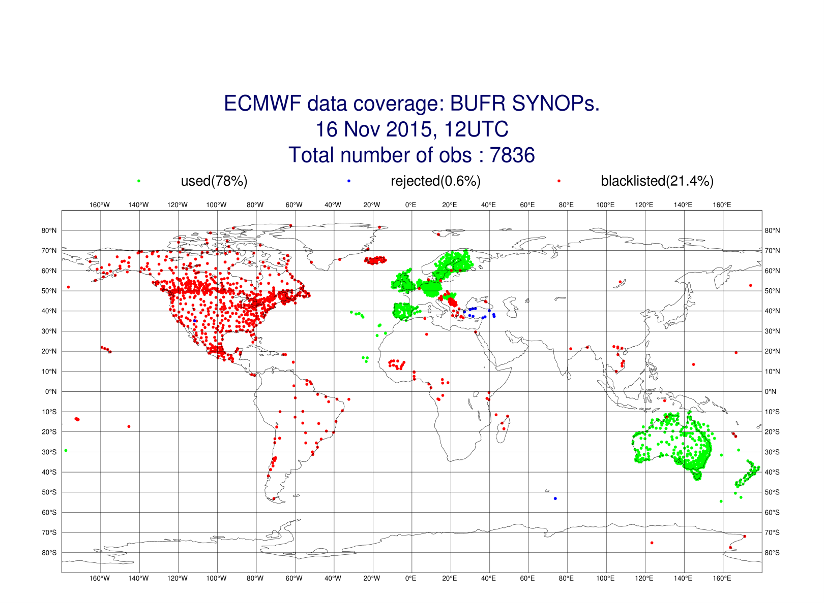
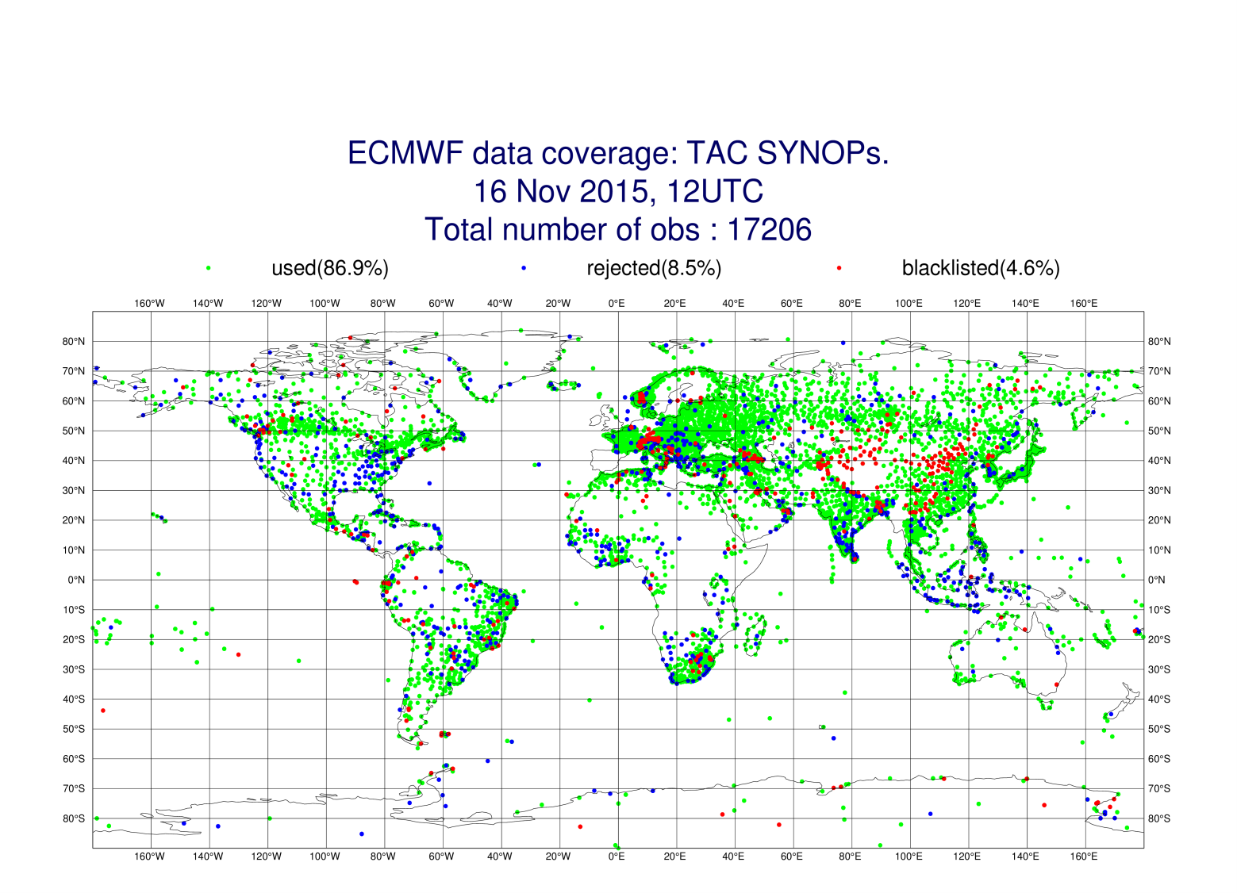
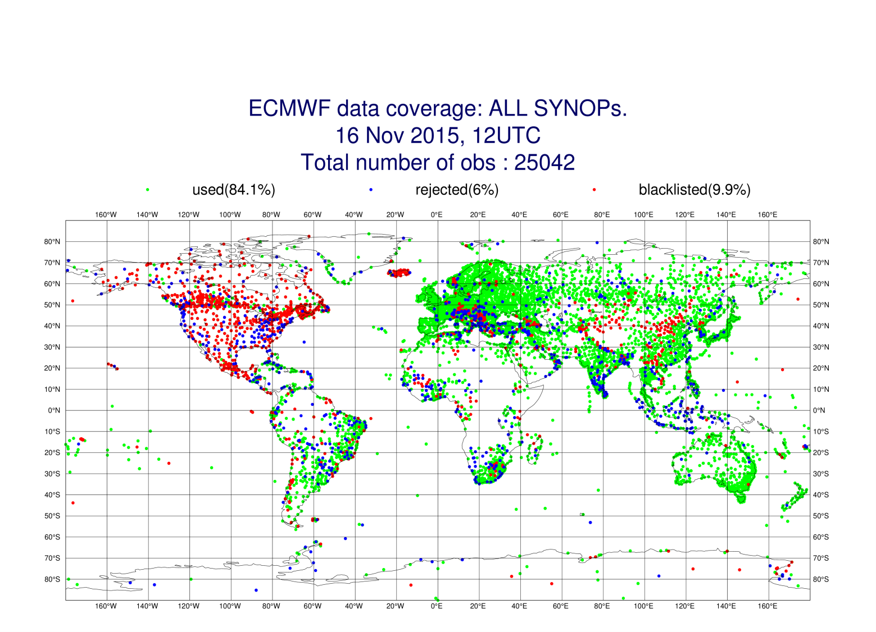
WDQMS – ECMWF Images - snapshot
Text to be added here …..

Slide 21
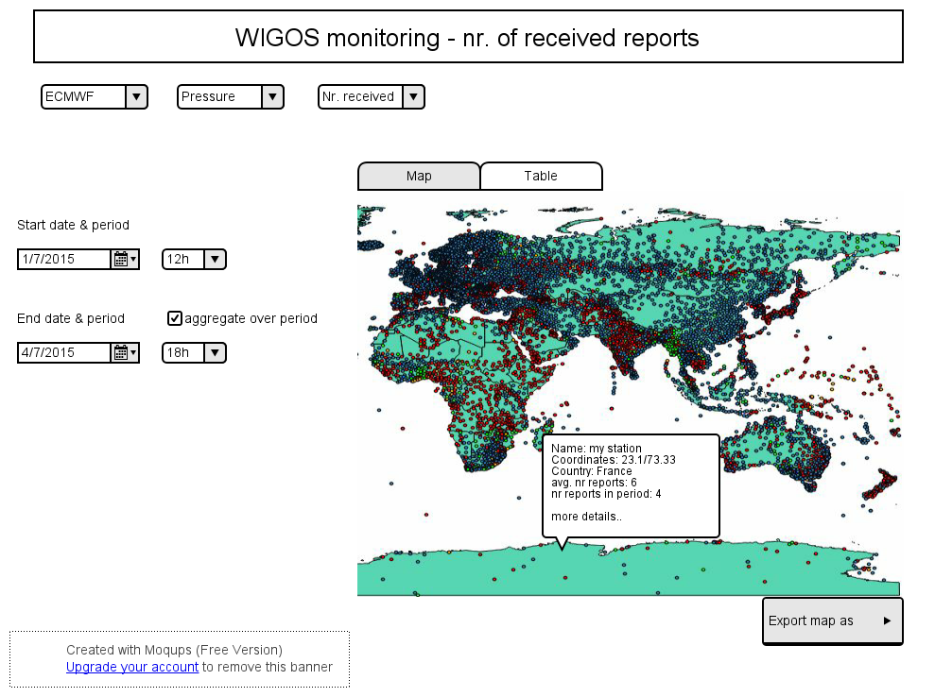
WDQMS – WIGOS PO Toolkits

Slide 22
WDQMS – Summary
The WIGOS Data Quality Monitoring System will be developed in a step wise manner, land surface GOS components first then other networks added in a progressive manner
Improved interactions between users & suppliers will improve the capability of the observing network owners and so enhance the usefulness of the observations exchanged
Improved co-ordination of the monitoring function will help WIGOS Succeed.

Slide 23
WDQMS – Contacts
WIGOS Project Office – Luis Nunes & Timo Pröscholdt
Obs Department Lead – Dean Lockett
ET-SBO Leads – Stuart Goldstraw & Henry Karanja
ECMWF Lead – Cristina Prates
NCEP Lead – Bob Grumbine
EUCOS Lead – Stefan Klink
Others to be added as activity evolves

Slide 24
Thank you for your attention
www.wmo.int/wigos

