Slide 1
WIGOS - Regional and National Implementation Planning
Guidance from Cg-17, EC-67 and TT-PWPP
RA-IV Workshop on WIGOS
Willemstad, Dec 1-3 2015
Dr. Lars Peter Riishojgaard,
WIGOS Project Manager, WMO Secretariat

Slide 2
Outline
Introduction to WIGOS
Status of the WIGOS Framework
The next four years: The WIGOS Pre-Operational Phase
Regional and National Implementation
Summary and conclusions
WMO

Slide 3
What is WIGOS?
WMO foundational activity addressing the observing needs of the weather, climate, water and environmental services of its Members
A framework for integrating all WMO observing systems and WMO contributions to co-sponsored observing systems under a common regulatory and management framework
Together with the WMO Information System (WIS), WIGOS is a WMO contribution to GEOSS.
WIGOS is not:
Replacing or taking over existing observing systems, which will continue to be owned and operated by a diverse array of organizations and programmes, national as well as international.

Slide 4
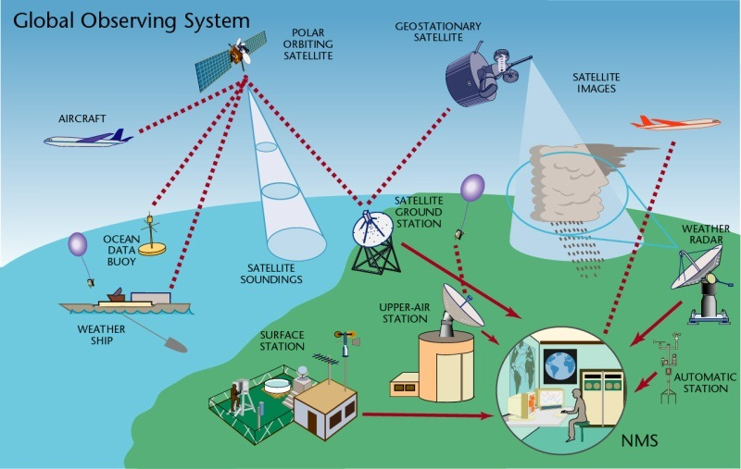
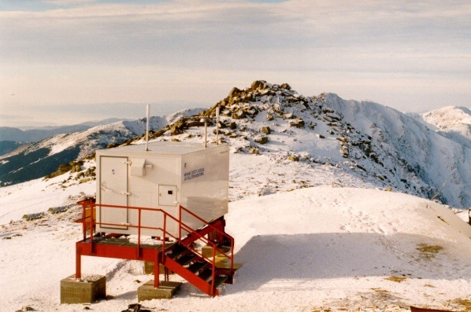
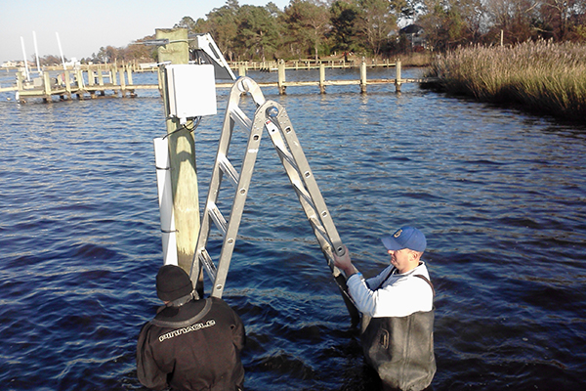
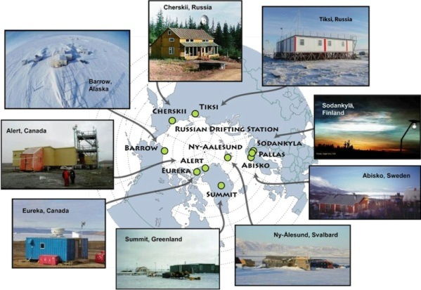
WIGOS Component Systems
Global Observing System (WWW/GOS)
Observing component of Global Atmospheric Watch (GAW)
WMO Hydrological Observations (including WHYCOS)
Observing component of Global Cryosphere Watch (GCW)

Slide 5
Why do we need WIGOS?
I. NMHS mandate typically broader now than when the World Weather Watch and the GOS were created, including e.g.
Climate monitoring, climate change, mitigation
Air quality, atmospheric composition from urban to planetary scales
Oceans
Cryosphere
Water resources
II. Technical and scientific advances:
Observing technology
Telecommunications
Numerical modeling and data assimilation
Increased user demand to access and use observations in decision making

Slide 6
Why do we need WIGOS?
III. Economic realities
Budgetary pressure on many NMHS, in spite of growing mandate and increasing demand for services
Efficiency by exploiting synergies
Integration of observing networks across disciplines (e.g. weather and climate)
Integration across organizational boundaries, e.g. between different national ministries/departments operating observing systems
Integration across technological boundaries, e.g. between surface- and space-based systems
Basic principle: One observation, many applications, many users

Slide 7
WIGOS Implementation Phase
WMO 16th Congress (2011): Implementation of WIGOS
Key deliverables for the 17th Congress (2015): Draft Technical Regulations on WIGOS; link here
Draft Manual on WIGOS; link here
WIGOS Metadata Standard; link here
Regional Implementation Plans
Proposal for the Pre-Operational Phase of WIGOS (2016-19)
All deliverables were approved by Cg-17

Slide 8
Regional WIGOS Implementation Plans
(R-WIPs)
R-WIPs developed for all WMO Regions by Regional WIGOS Task Teams or Working Groups, typically helped along by dedicated WIGOS Workshops
All WMO Regional Associations have approved their R-WIPs
Important now to align national priorities, VCP request and donor-funded projects with the respective R-WIP to the extent possible
Regional Working Structures to oversee and coordinate the WIGOS implementation are still developing, and differ from region to region
In Region IV, the RA-IV Task Team on WIGOS is responsible

Slide 9
RA-IV WIGOS Implementation Plan
(R-WIP-IV)
This will be reviewed on Day 3 of this Workshop, more details in presentation by Glendell de Souza
Lists regional activities with deliverables, many still generic
Specific RA-IV activities (from R-WIP-IV, Table 2):
(3.1) Compile the regional observational requirements including from:
The Hurricane Committee’s Technical Plan;
Marine Programmes including buoys and offshore platforms;
Expanded space based observations including NESDIS activities;
Expanded agro-met observations including USDA activities;
Strategy for the architecture for climate monitoring from space
(3.8) The evolution of the Island component of CARIB-HYCOS through database management and maintenance of the networks.

Slide 10
R-WIP-IV
(continued)
More specific RA-IV activities (from R-WIP-IV, Table 2):
(4.4) Exploit opportunities to benefit from the sharing of experiences, expertise and the pooling of resources across RA III and RA IV
(6.6) Radar data integration
Develop specific data collection requirements in support of hurricane analysis and prediction using Caribbean radars;
Assess data collection costs for integration of regional radars into near real-time central collection and distribution database
(6.7) Regional Radar Mosaics
Plans for development of regional or sub-regional mosaics;
Implementation of mosaics.

Slide 11
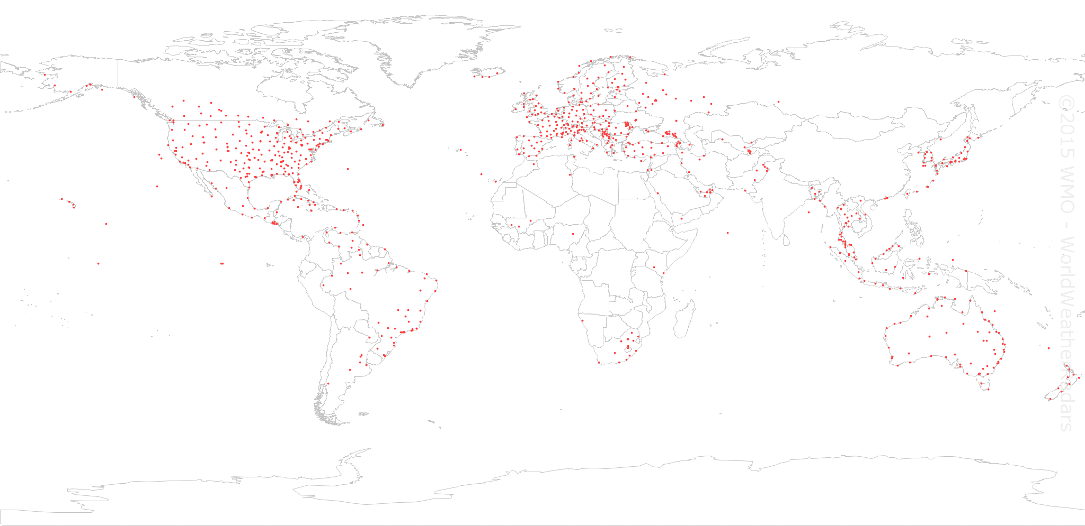
Many radars available
over Region IV: Opportunity
to develop Regional products!

Slide 12
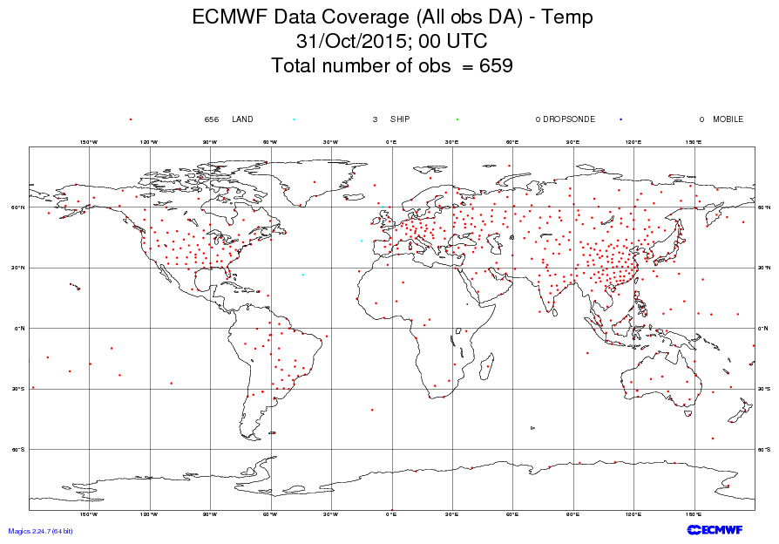
RAOB network;
(more observations in
the Pacific and the
Arctic would be better)

Slide 13
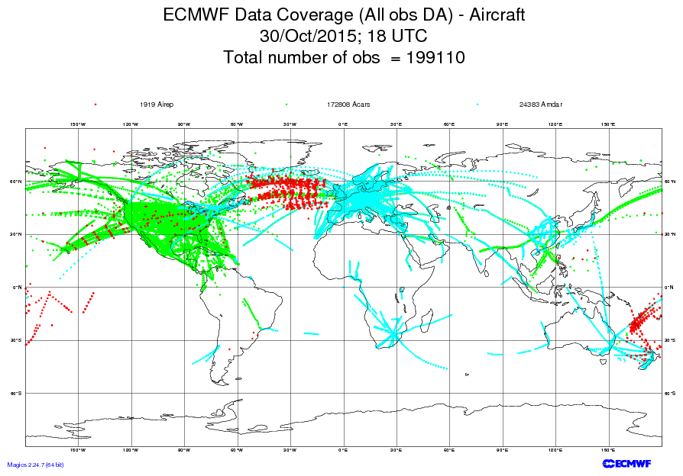
AMDAR and similar programs
provides opportunity for additional
upper air observations; limited to
commercial flight routes

Slide 14
The WIGOS Pre-Operational Phase (2016-2019)
Approved by WMO Congress-17
Increased emphasis on regional and national activities
Five main priority areas:
WIGOS Regulatory Material, supplemented with necessary guidance material
WIGOS Information Resource, including the Observing Systems Capabilities analysis and Review tool (OSCAR), especially OSCAR/Surface
WIGOS Data Quality Monitoring System (WDQMS)
Regional Structure; Regional WIGOS Centers
National WIGOS Implementation, coordination and governance mechanisms

Slide 15
1. Regulatory Material
The ”Manual on WIGOS” will be updated in 2019, with two main new elements:
Full integration of the Manual on the Global Observing System, which will be retired at that point
New material on Regional Basic Observing Networks (RBON), which will integrate the existing RBSN and RBCNs and include additional observing systems, such as radars, wind profilers ….

Slide 16
1. Guidance Material
Guidance material is most urgently needed in the following areas:
OSCAR, Metadata, Station IDs and Quality monitoring;
Regional WIGOS Centers, AWS, National partnerships;
National observing strategy, RBON, and integration of space-based observations
The areas listed under item 1. should be covered in the initial version of the “Guide to WIGOS”, to be made available before July 1 2016

Slide 17
4. Regional WIGOS Centers
Members already now requesting guidance and support from the WIGOS PO; some of this could be provided more efficiently and effectively by a regional entity, e.g. Regional WIGOS Centers
General role of RWC would be to monitor, coordinate and support the implementation activities in the Region (or sub-Region)
Specific areas of responsibility:
Regional support for OSCAR/Surface.
Regional support for WIGOS Data Quality Monitoring System, including
Data availability.
Data quality
Fault management, i.e. follow-up with data providers in case of data availability or data quality problems.
Regional network design.
Regional coordination of WIGOS implementation activities and projects.
…
The RWC concept will be developed further during the next two years

Slide 18
4. Regional WIGOS Centers Concept Development
(continued)
ICG-WIGOS (TT-PWPP), Sep 2015:
Propose list of functionalities to RAs; let the Regions take the lead in defining how to implement this
RA-I Workshop on WIGOS (English), Nov 2015:
Come back to us when you have more details on how this is supposed to be implemented
RA-VI Workshop on WIGOS, Nov 2015:
This will have to be implemented as virtual or distributed (sub-Regional) Centers, with individual Members taking responsibility for certain functions under the guidance of an overall coordinator
RA-IV Workshop on WIGOS, Dec 2015
??

Slide 19
5. National Implementation, Coordination and Governance Mechanisms
Members requesting guidance on
OSCAR/Surface
Monitoring (WDQMS)
Design, deployment, management of AWS (and other) networks
Development of National Partnership agreements
Quality Management approaches
Data policy issues
Calibration support
…
ICG-WIGOS: It will be essential for Members to develop national plans to prioritize and resource these activities

Slide 20
5. National Implementation
(continued)
Steps in national implementations
Implementation of WIGOS Metadata Standard
OSCAR/Surface
Implementation of WDQMS
Establishment of national inventory of observations, including those operated by other entities
Development of a national observing strategy, with consolidated requirements
Establish partnership agreements on exchange of observational data, where possible
The Secretariat will support these activities with both guidance material (templates) and events, within available resources

Slide 21
Summary and Conclusions
WIGOS global framework is now in place and will be further developed during the Pre-operational Phase (2016-2019)
Increased emphasis on Regional and National activities
Some WIGOS priorities for Region IV already identified; would be good to now translate them into implementation projects
Further development and ongoing support is needed; not all Members in Region are active and engaged in the projects
Regional WIGOS Centers expected to play important role
The WIGOS Project Office is ready to help regional and national implementation efforts succeed in any way it can

