Slide 1
WMO RA IV WIGOS Implementation Workshop
AVAILABILITY OF RADAR DATA
IN RA IV
Curaçao
2 December 2015

Slide 2
Regional Projects – RA IV WIP
Regional Flood Forecasting Project;
Improving availability and utilization of AWS data not already commonly shared, both existing and silent;
Regional Radar Mosaic Implementation Project;
Capacity Development focused on Quality Management Practices.

Slide 3
Radar is RA IV
The are approximately 280 radars within RA IV and more are being added;
Cayman Islands installed a radar in 2013, Curaçao recently installed a radar;
Sint Maartens has plans to install a radar

Slide 4
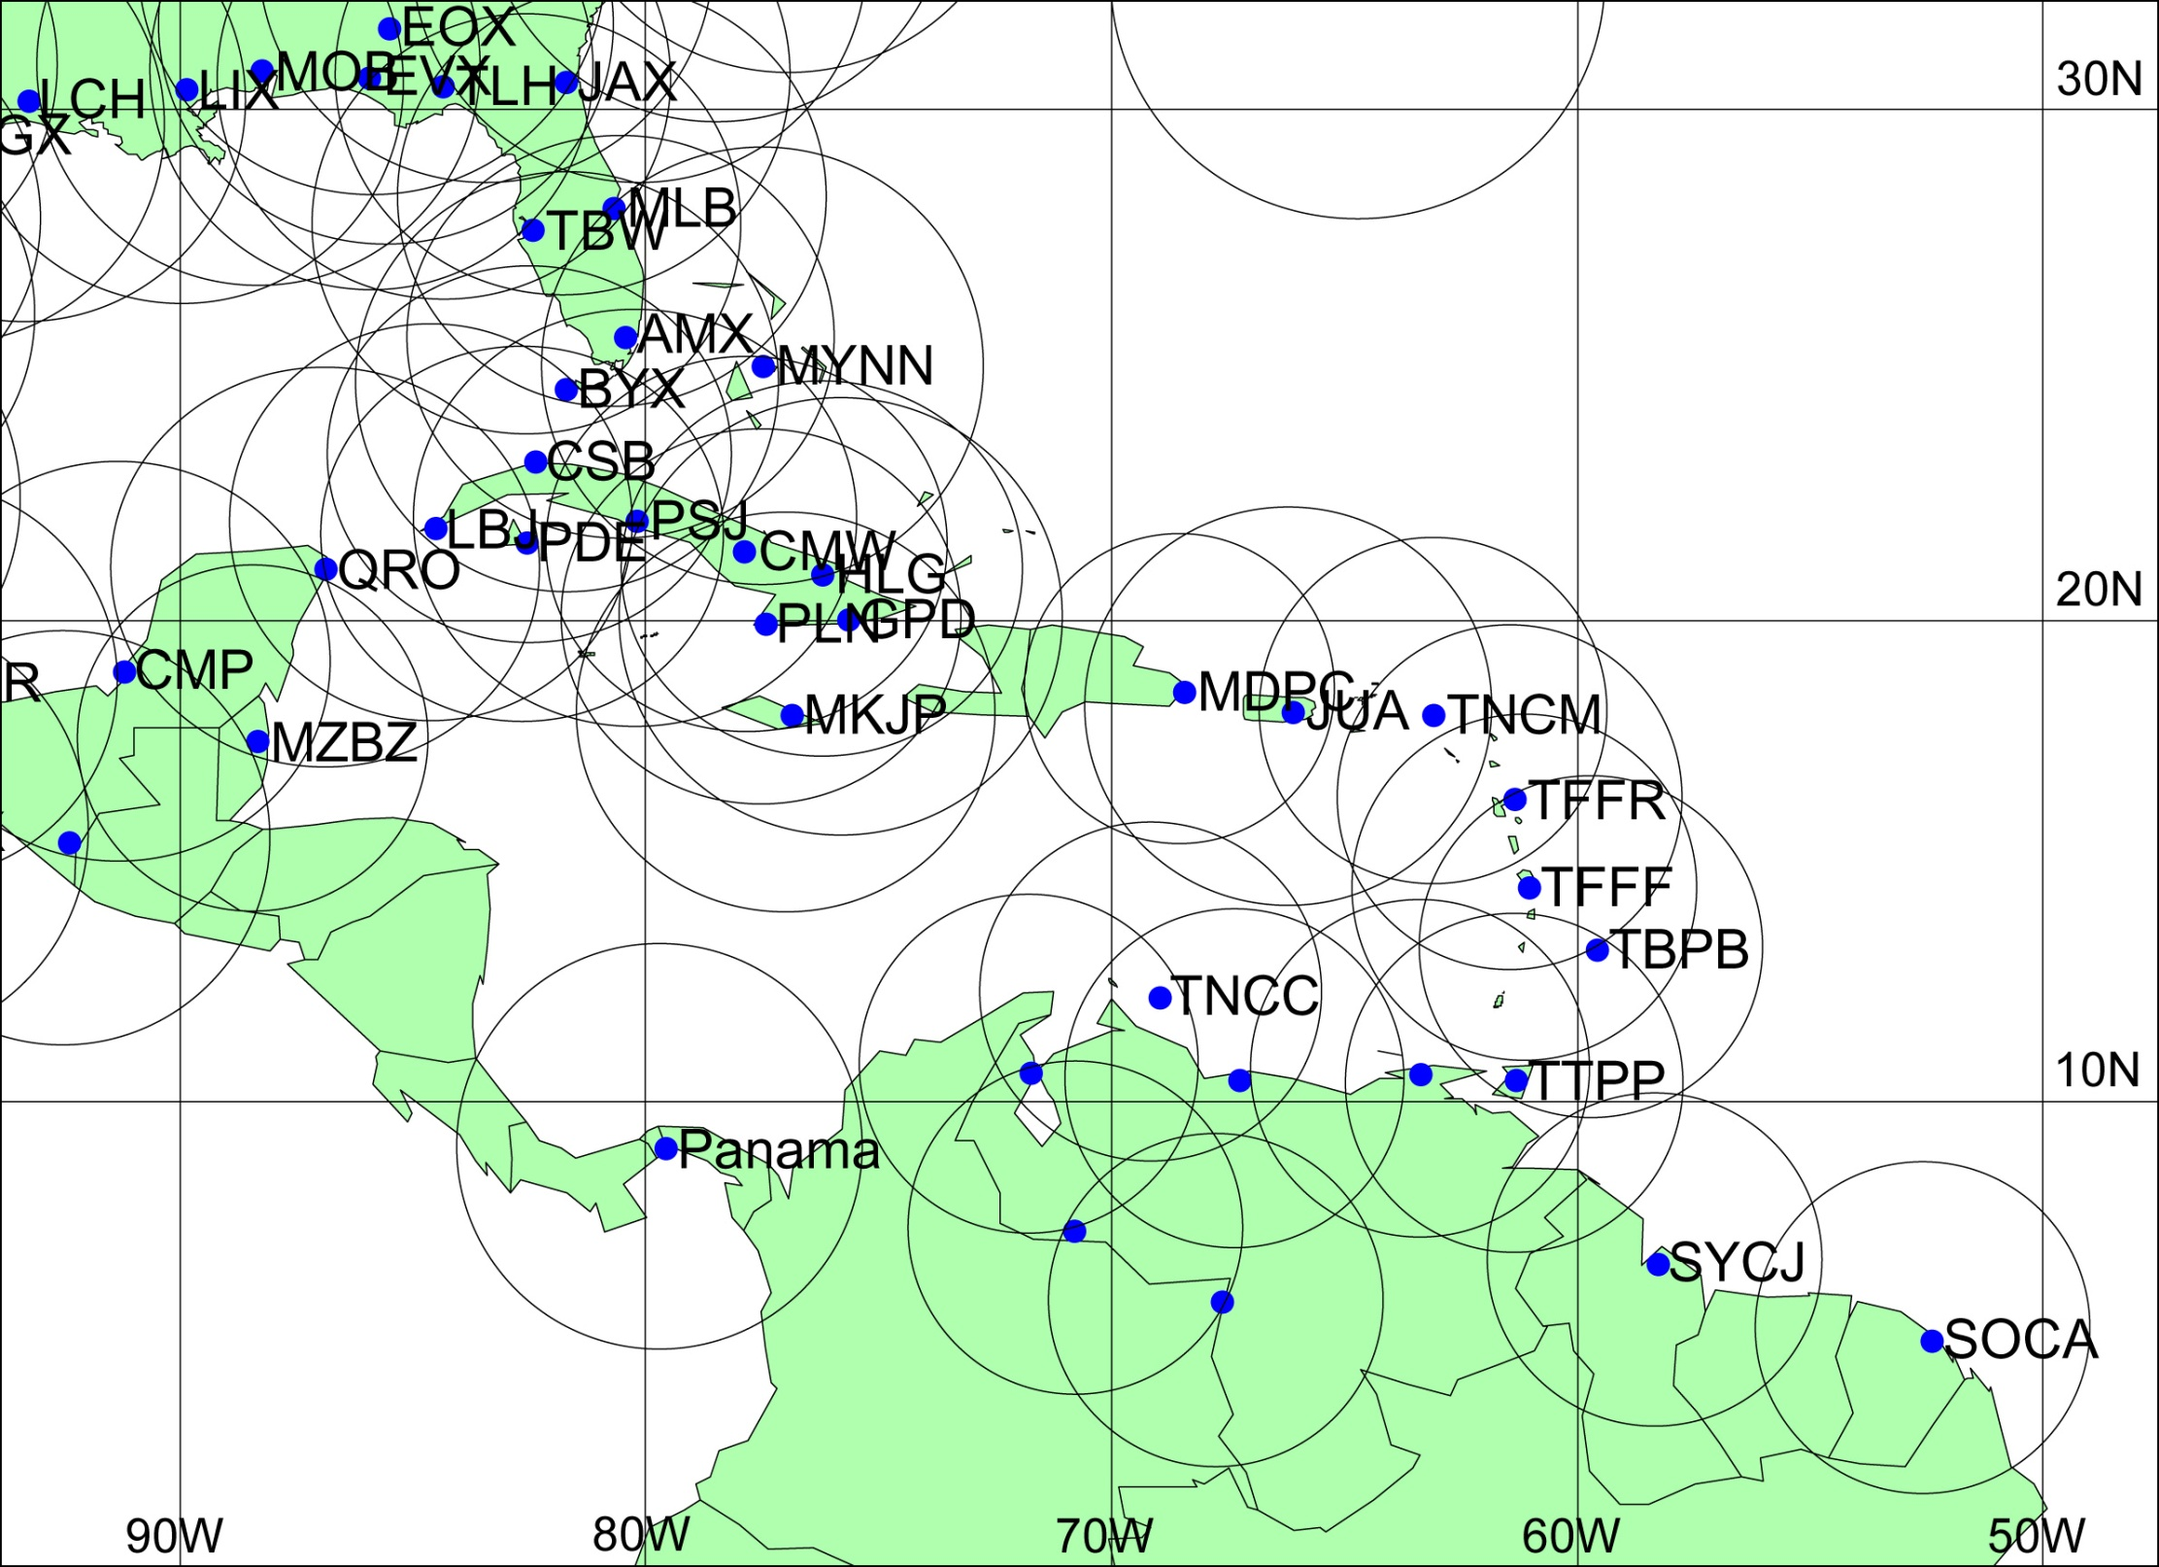

Slide 5
Radar Metadata
The WMO Radar Database is hosted and managed by the Turkish Meteorological Service ;
http://wrd.mgm.gov.tr/Default.aspx?l=en
The Focal Points for Weather Radar Metadata are responsible for:
Obtaining a login to the WRD by sending an email request to the WMO Weather Radar Metadata Focal Points email list or directly to the Secretariat.
Ensuring that metadata contained within the WMO Radar Database and for which the Focal Point (FP) is responsible, is current and accurate; and
Entering and maintaining the WRD with weather radar metadata by following the procedures available from the WRD once FPs have logged in.

Slide 6
Regional Priorities
Regional Flood Forecasting Project;
Improving availability and utilization of AWS data not already commonly shared, both existing and silent;
Regional Radar Mosaic Implementation Project;
Capacity Development focused on Quality Management Practices.

Slide 7
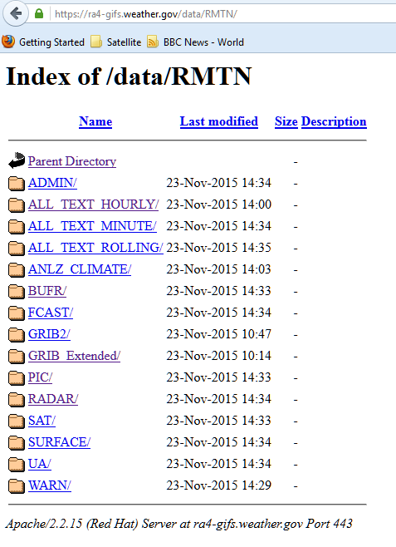
GIFS Server

Slide 8
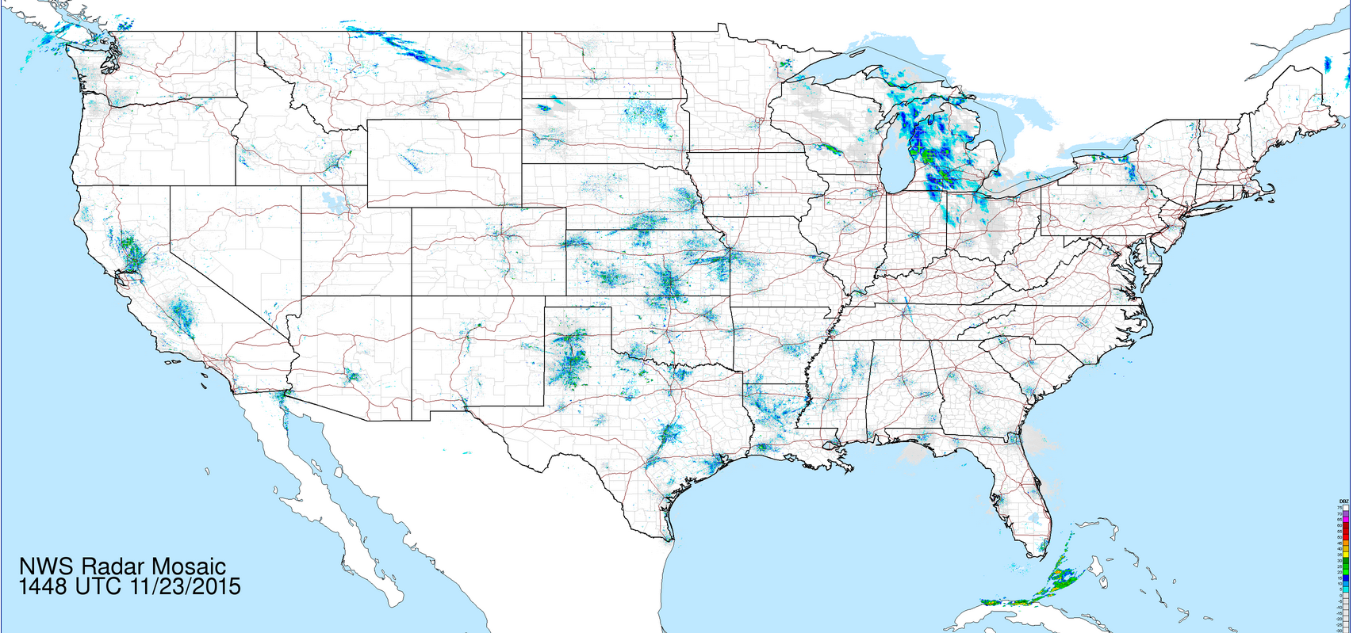
RA IV Radar Mosaics-US

Slide 9
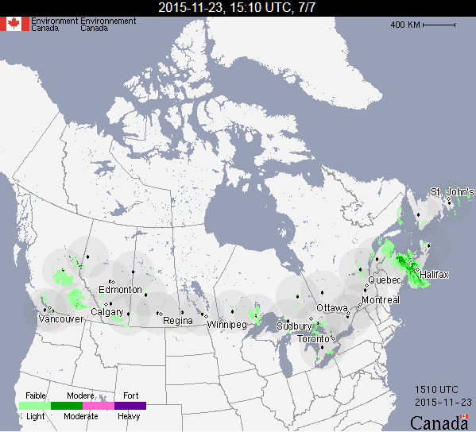
RA IV Radar Mosaics- Canada

Slide 10
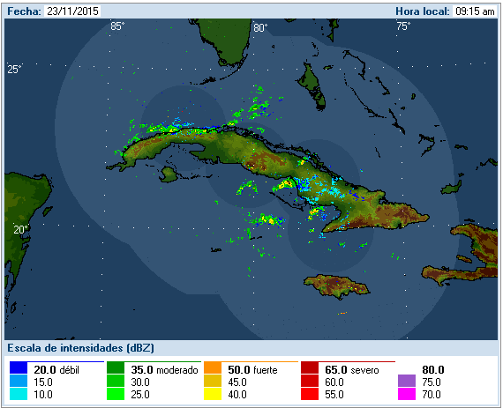
RA IV Radar Mosaics- Cuba

Slide 11
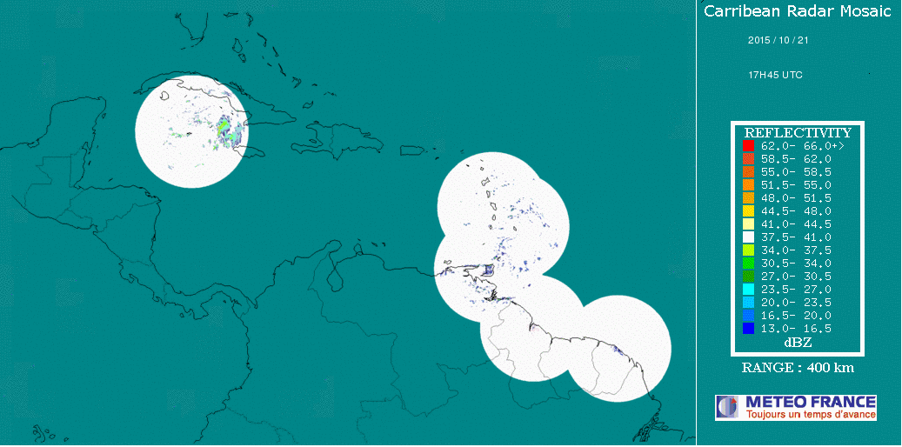
RA IV Radar Mosaics- Météo-France

Slide 12
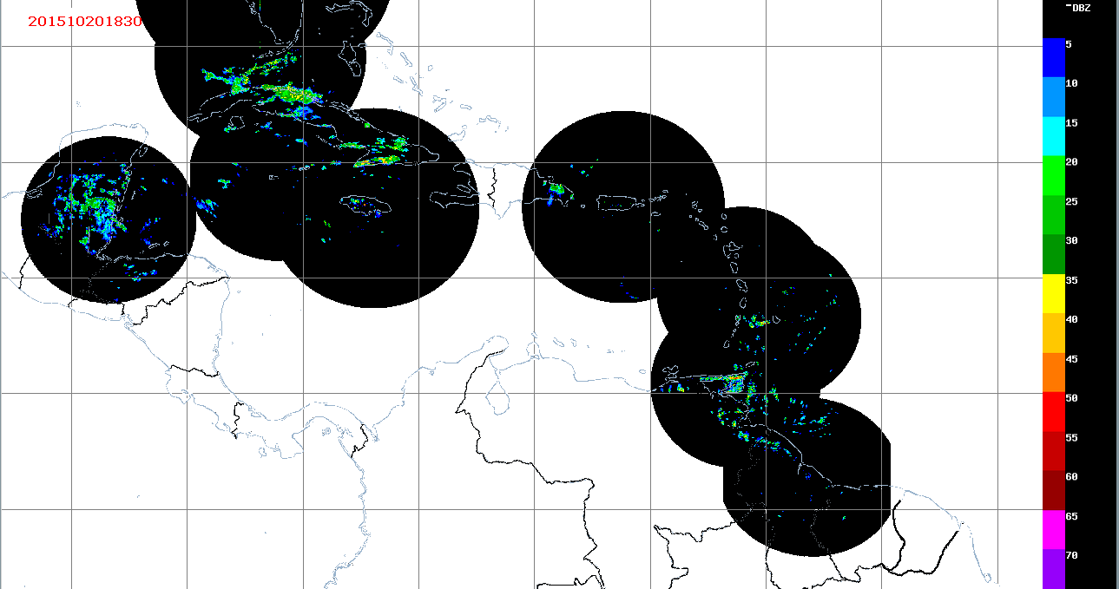
RA IV Radar Mosaics- Barbados

Slide 13
QUESTIONS?

